Slide 1
Chapter 5
General Linear Lists
Objectives
Upon completion you will be able to:
Explain the design, use, and operation of a linear list
Implement a linear list using a linked list structure
Understand the operation of the linear list ADT
Write application programs using the linear list ADT
Design and implement different link-list structures
Data Structures: A Pseudocode Approach with C

Slide 2
5-1 Basic Operations
We begin with a discussion of the basic list operations. Each operation is developed using before and after figures to show the changes.
Insertion
Deletion
Retrieval
Traversal
Data Structures: A Pseudocode Approach with C

Slide 3
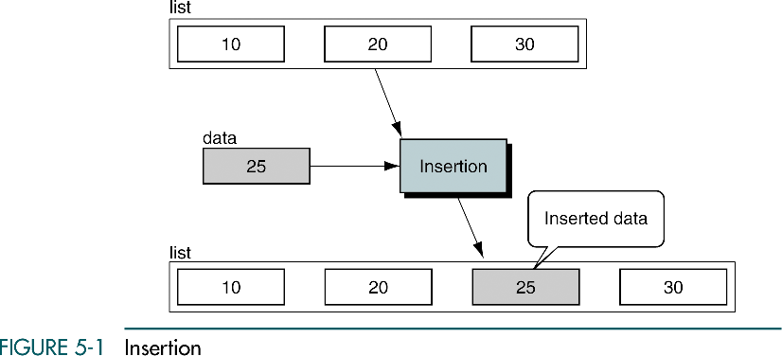
Insertion
Data Structures: A Pseudocode Approach with C

Slide 4
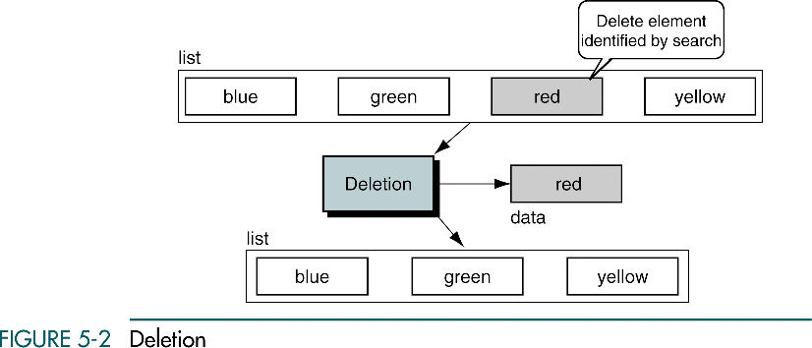
Deletion
Data Structures: A Pseudocode Approach with C

Slide 5
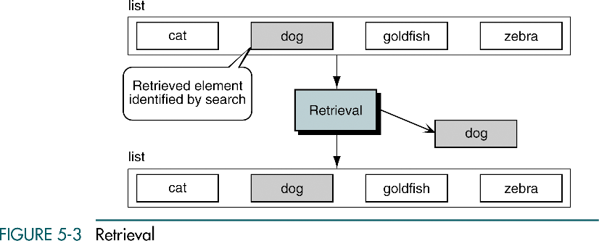
Retrieval
Data Structures: A Pseudocode Approach with C

Slide 6
5-2 Implementation
We begin with a discussion of the data structure required to support a list. We then develop the 10 basic algorithms required to build and use a list. In developing the insertion and deletion algorithms, we use extensive examples to demonstrate the analytical steps used in developing algorithms.
Data Structure
Algorithms
Data Structures: A Pseudocode Approach with C

Slide 7
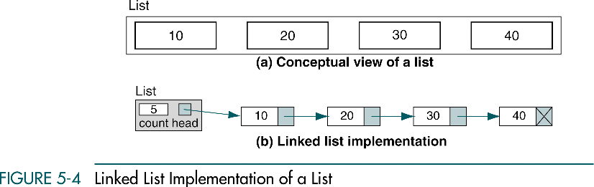
Linked List Implementation of List
Data Structures: A Pseudocode Approach with C

Slide 8
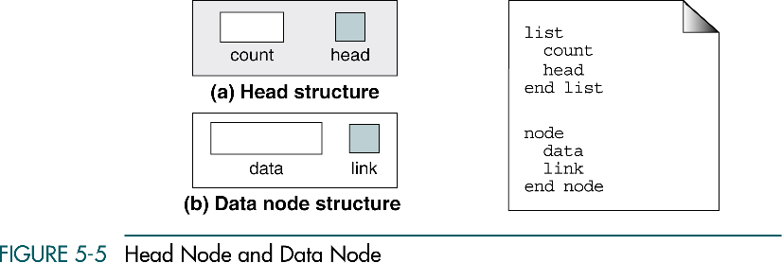
Head Node and Data Node
Data Structures: A Pseudocode Approach with C

Slide 9

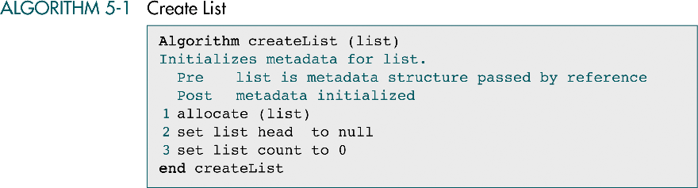
Create List
Data Structures: A Pseudocode Approach with C

Slide 10
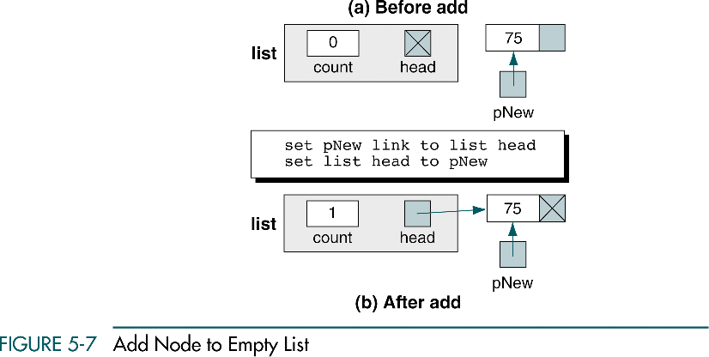
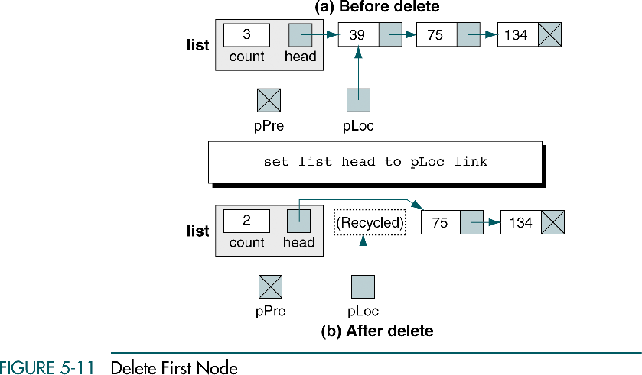
Add Node to Empty List
Data Structures: A Pseudocode Approach with C

Slide 11
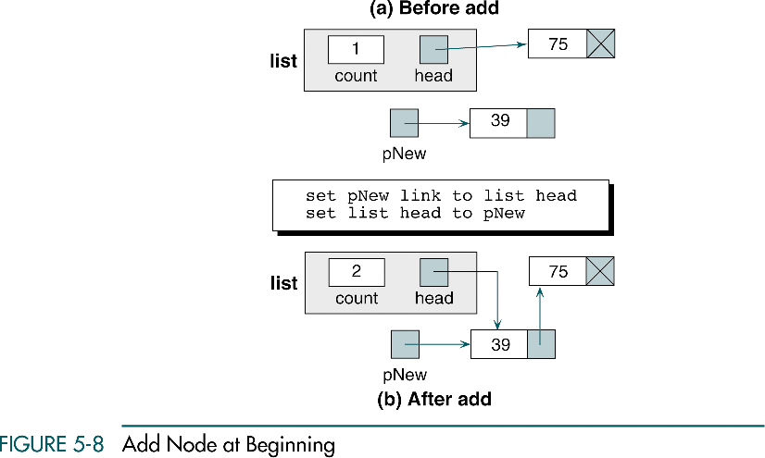
Add Node at Beginning
Same as add node
to empty list
Data Structures: A Pseudocode Approach with C

Slide 12
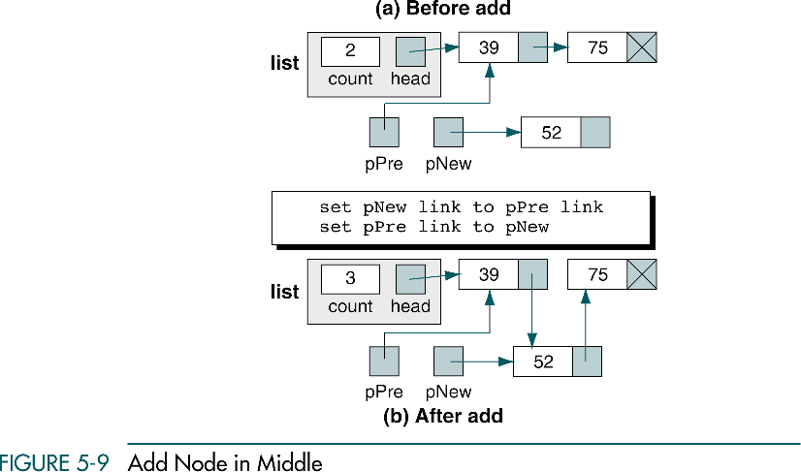
Add Node in Middle
Data Structures: A Pseudocode Approach with C

Slide 13
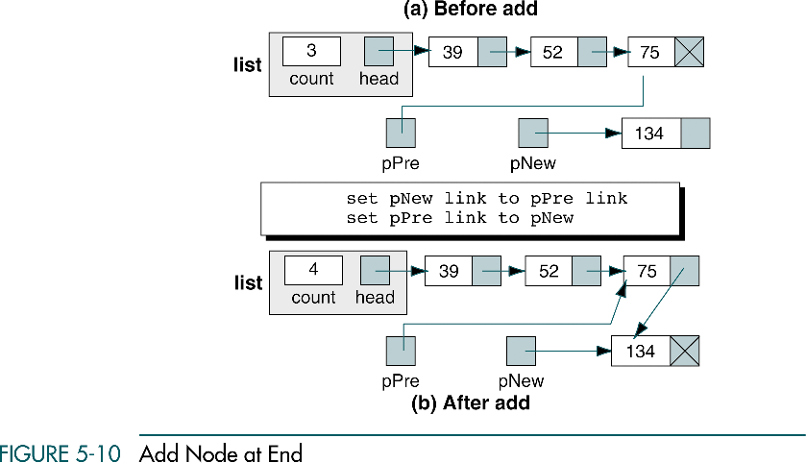
Add Node at End
Same as add node
in middle
Data Structures: A Pseudocode Approach with C

Slide 14
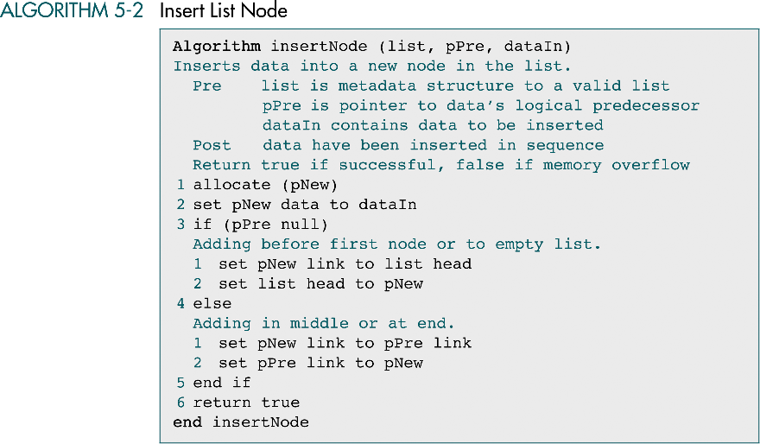
Insert List Node
Data Structures: A Pseudocode Approach with C

Slide 15
Delete First Node
Data Structures: A Pseudocode Approach with C

Slide 16
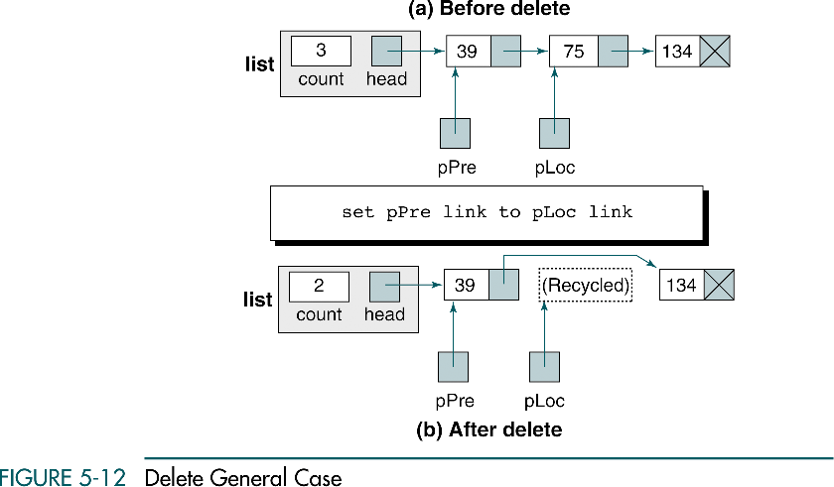
Delete General Case
Data Structures: A Pseudocode Approach with C

Slide 17
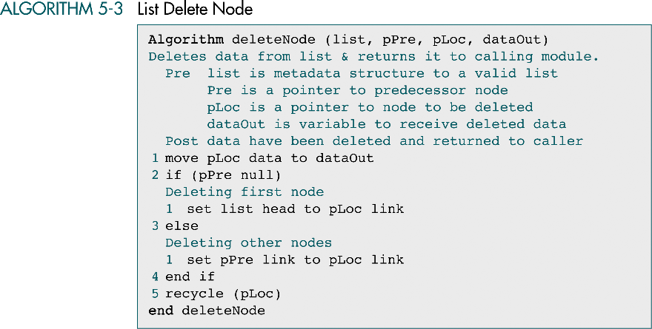
List Delete Node Algorithm
Data Structures: A Pseudocode Approach with C

Slide 18
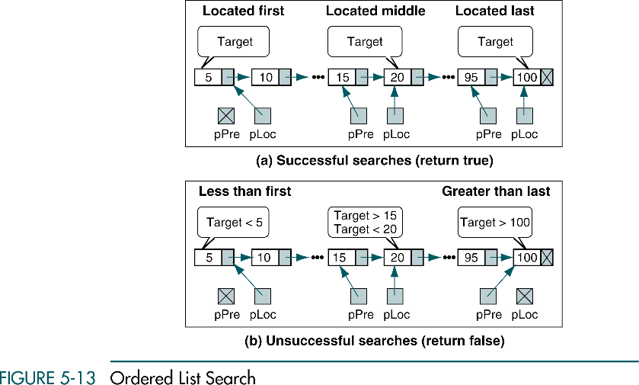
Ordered List Search
Data Structures: A Pseudocode Approach with C

Slide 19
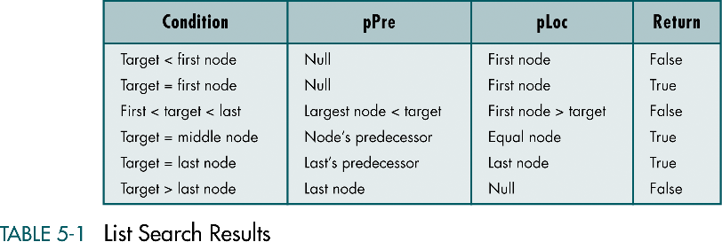
List Search Results
Data Structures: A Pseudocode Approach with C

Slide 20
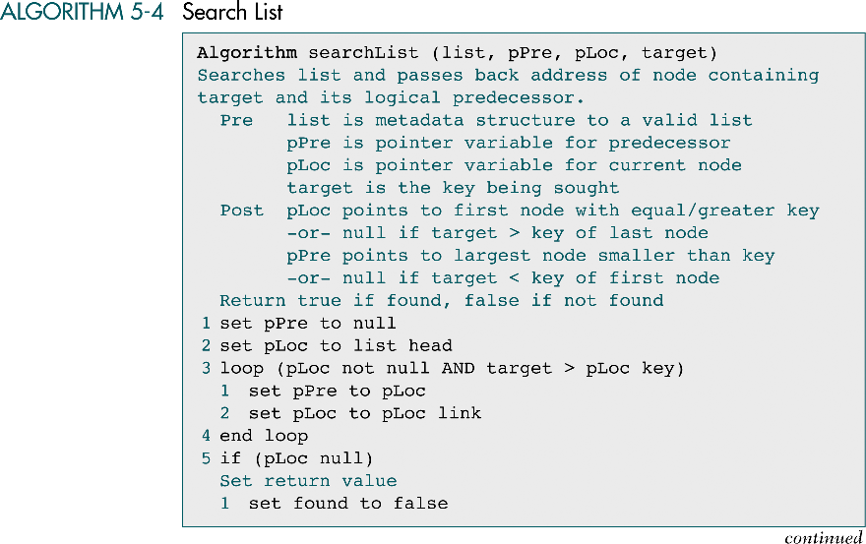
Search List Algorithm
…
5
10
15
…
15
pPre
pLoc
Data Structures: A Pseudocode Approach with C
target

Slide 21
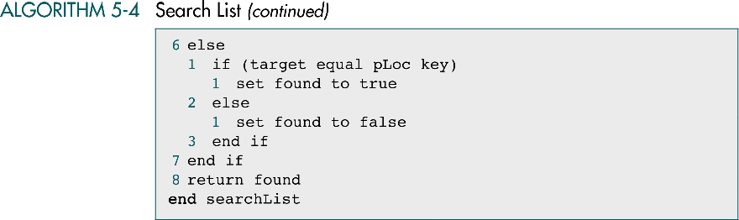
Search List Algorithm (cont.)
Data Structures: A Pseudocode Approach with C

Slide 22
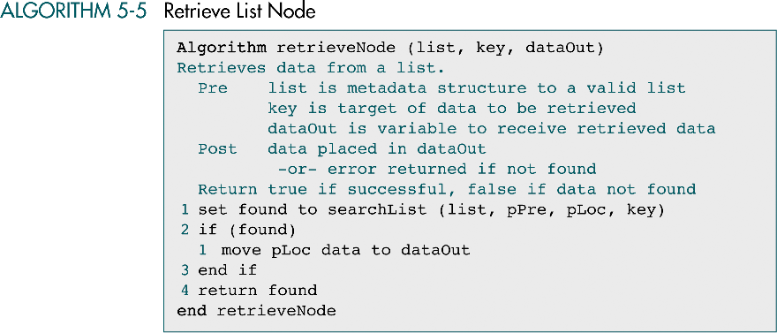
Retrieve List Node Algorithm
Data Structures: A Pseudocode Approach with C

Slide 23
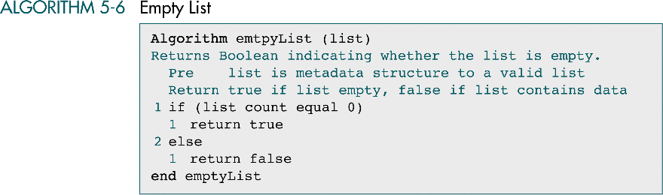
Empty List Algorithm
Data Structures: A Pseudocode Approach with C

Slide 24
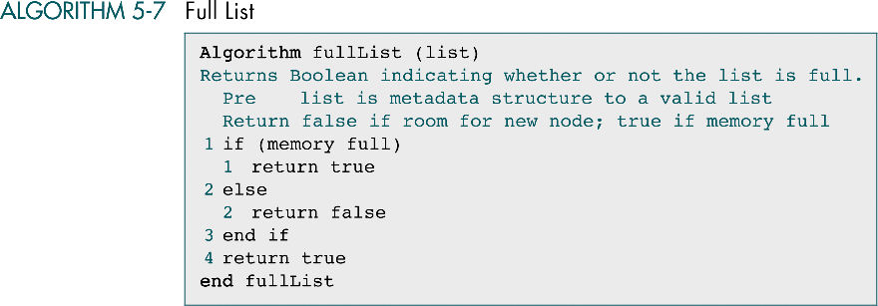
Full List Algorithm
Data Structures: A Pseudocode Approach with C

Slide 25

List Count Algorithm
Data Structures: A Pseudocode Approach with C

Slide 26
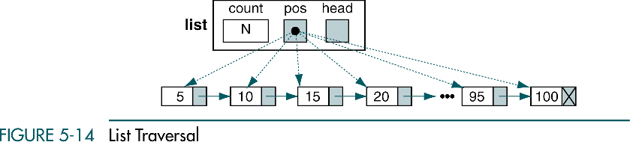
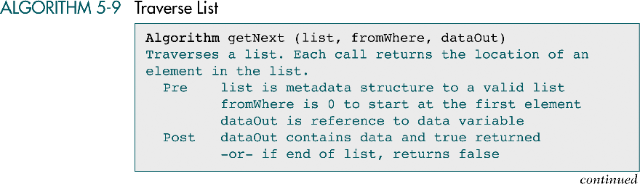
Traverse List
Data Structures: A Pseudocode Approach with C

Slide 27
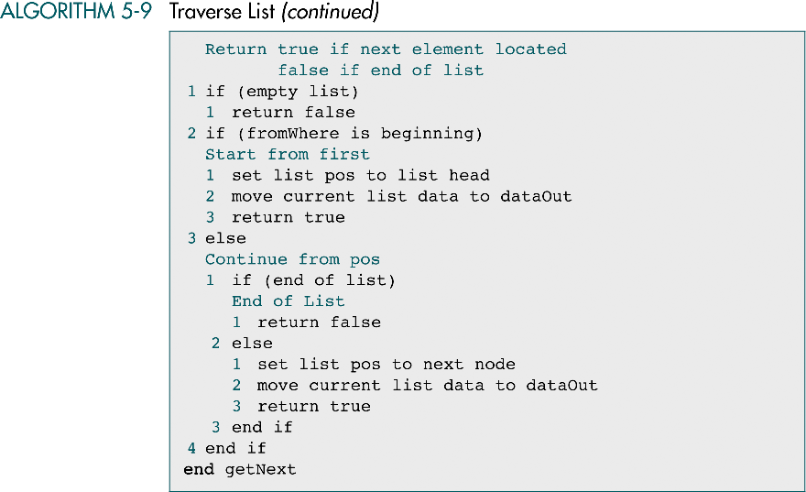
Traverse List (cont.)
Data Structures: A Pseudocode Approach with C

Slide 28

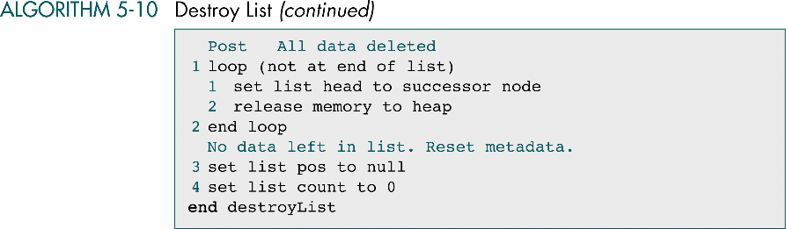
Destroy List
Data Structures: A Pseudocode Approach with C

Slide 29
5-3 List ADT
We begin with an extensive discussion of the list data structure and the compare function that is required to maintain the list in sequence. We then develop the C functions required to implement the ADT.
Data Structures: A Pseudocode Approach with C

Slide 30
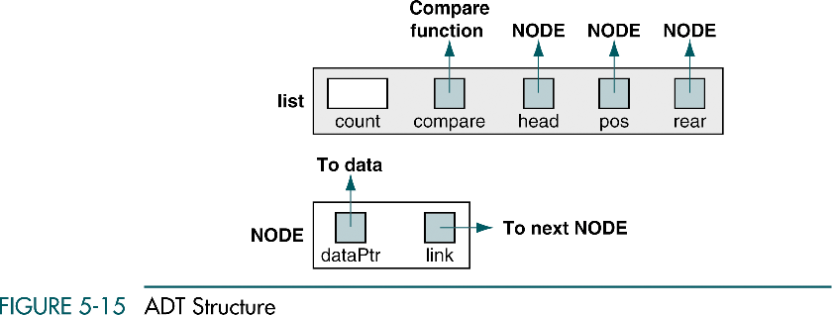
ADT Structure
Data Structures: A Pseudocode Approach with C

Slide 31
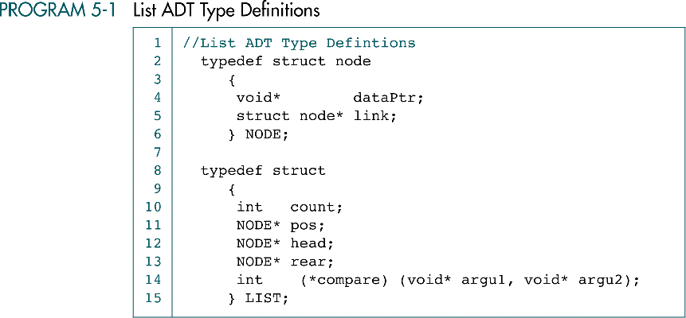
List ADT Type Definitions
Data Structures: A Pseudocode Approach with C

Slide 32
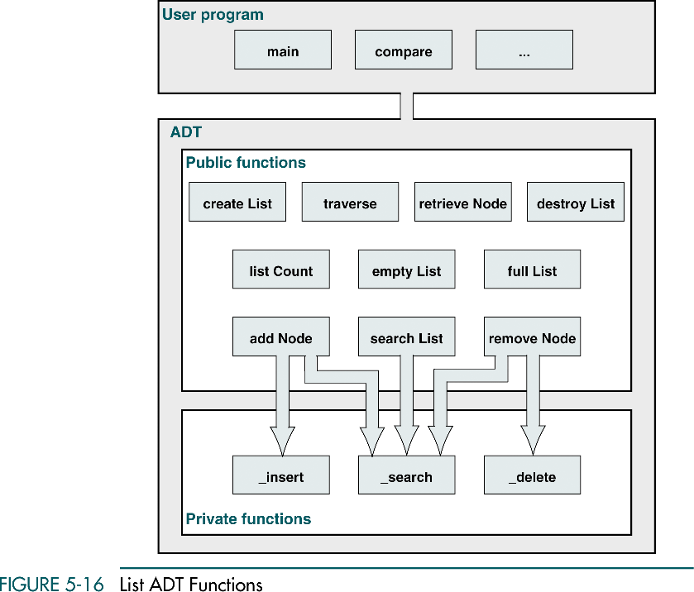
List ADT Functions
Data Structures: A Pseudocode Approach with C

Slide 33
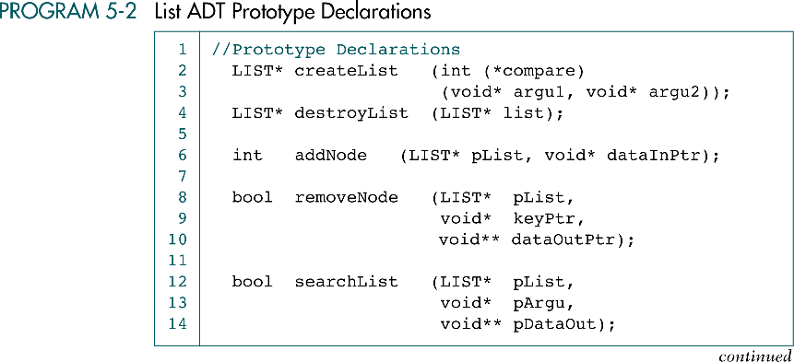
List ADT Prototype Declarations
Data Structures: A Pseudocode Approach with C

Slide 34
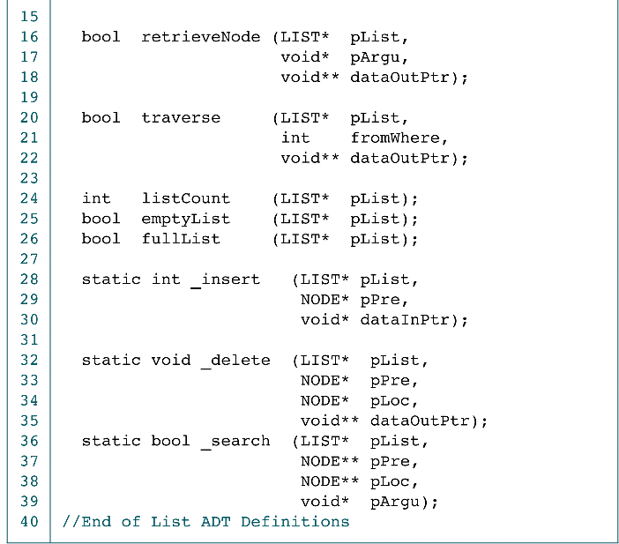
List ADT Prototype Declarations (cont.)
Data Structures: A Pseudocode Approach with C

Slide 35
Data Structures: A Pseudocode Approach with C

Slide 36
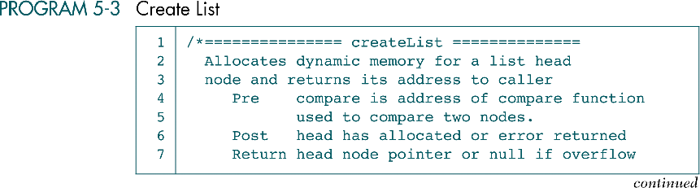
Create List in C
Data Structures: A Pseudocode Approach with C

Slide 37
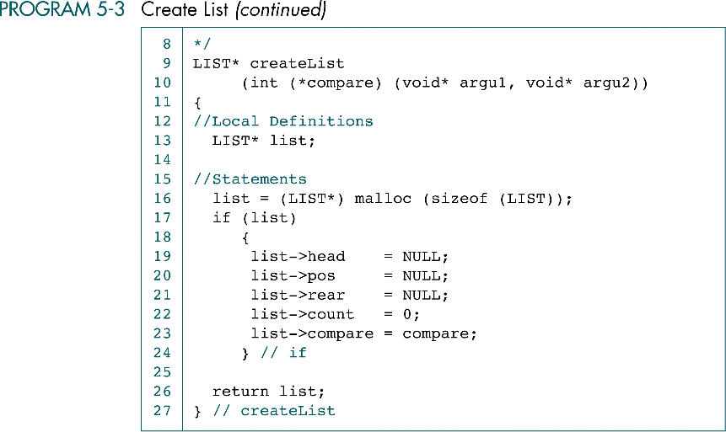
Create List in C (cont.)
Data Structures: A Pseudocode Approach with C

Slide 38
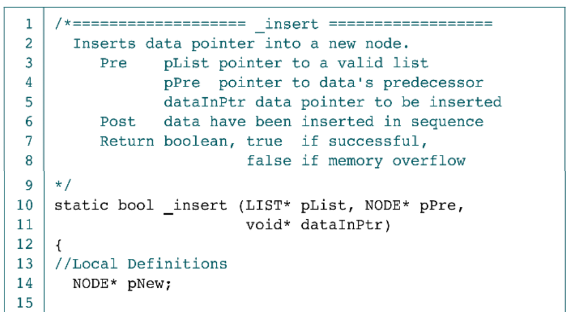
Internal Insert Function in C
Data Structures: A Pseudocode Approach with C

Slide 39
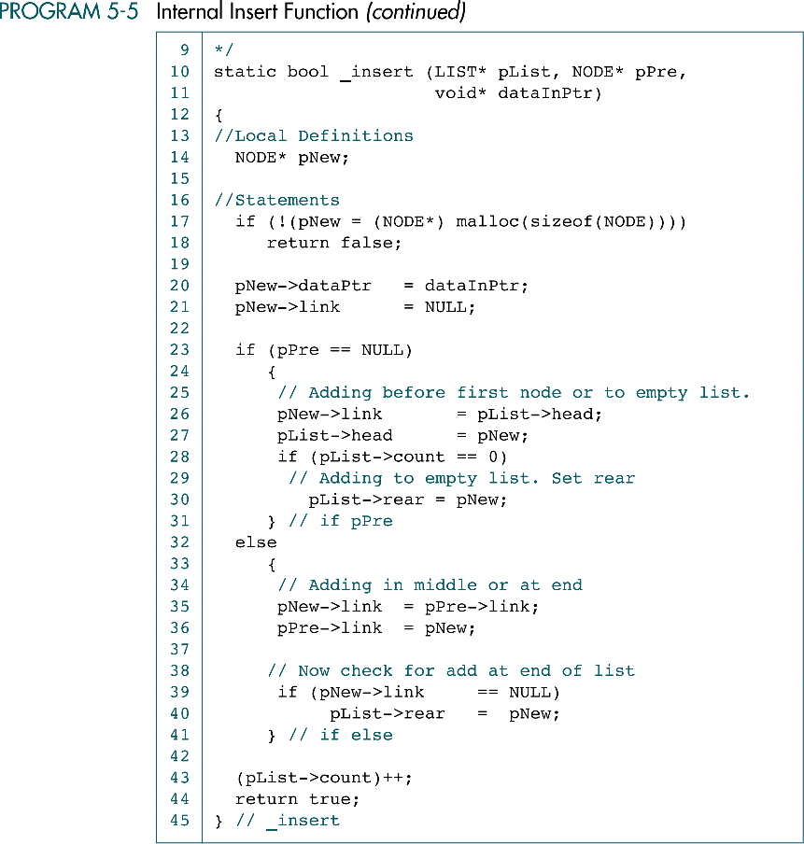
Internal Insert Function in C (cont.)
count
head
rear
pPre
1
0
pNew
dataPtr
dataInPtr
10
count
head
rear
pPre
2
1
pNew
dataPtr
dataPtr
dataInPtr
10
5
Data Structures: A Pseudocode Approach with C

Slide 40
Internal Insert Function (cont.)
count
head
rear
3
2
pPre
dataPtr
dataPtr
5
15
pNew
dataPtr
dataInPtr
10
Data Structures: A Pseudocode Approach with C

Slide 41
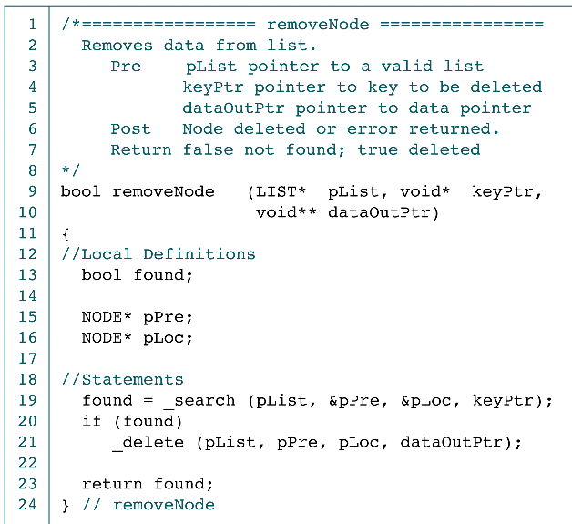
Remove Node in C
DataOutPtr
5
10
15
…
delete
…
pPre
15
pLoc
&pPre
&pLoc
keyPtr
Data Structures: A Pseudocode Approach with C

Slide 42
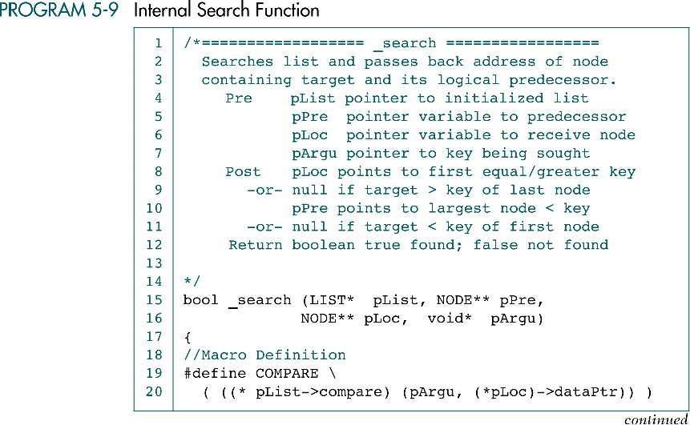
Internal Search Function in C
Data Structures: A Pseudocode Approach with C

Slide 43
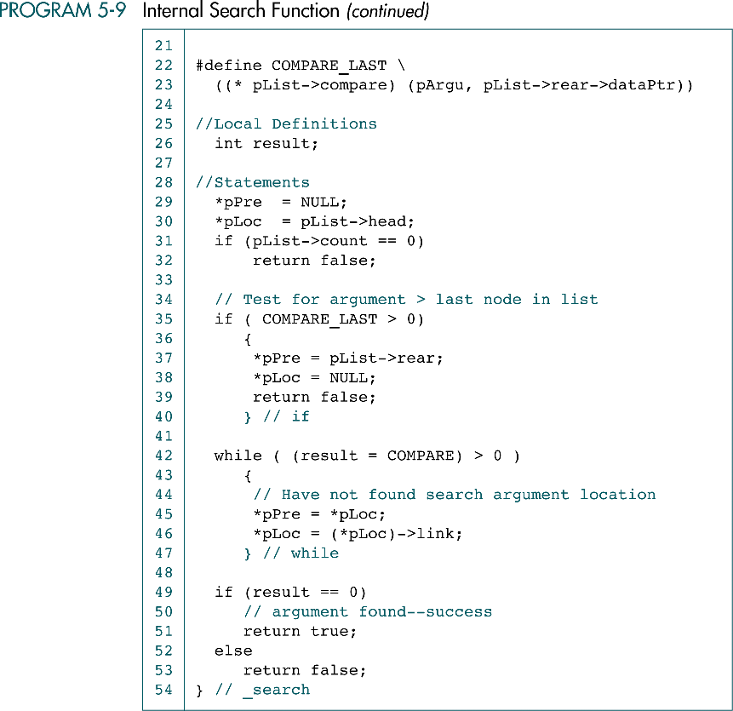
Internal Search Function in C (cont.)
5
10
13
*pPre
15
*pLoc
pArgu
pPre
pLoc
pPre
keyPtr
pLoc
Data Structures: A Pseudocode Approach with C

Slide 44
Internal Search Function in C (cont.)
Note:
5
15
20
*pPre
15
*pLoc
pArgu
pPre
pLoc
pPre
keyPtr
pLoc
Data Structures: A Pseudocode Approach with C

Slide 45
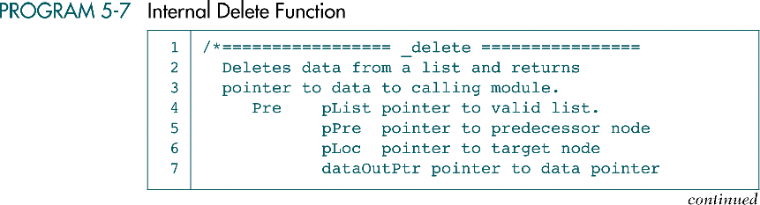
Internal Delete Function in C
Data Structures: A Pseudocode Approach with C

Slide 46
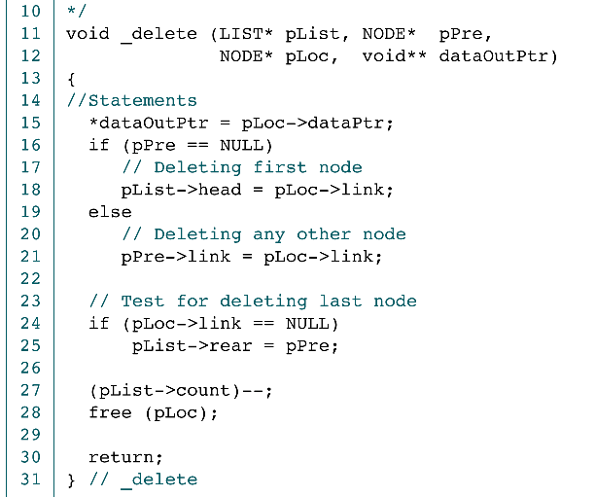
Internal Delete Function in C (cont.)
dataOutPtr
dataOutPtr
count
head
rear
*dataOutPtr
*dataOutPtr
1
2
0
rear
count
head
15
25
2
10
15
25
3
0
free
free
pPre
pLoc
pPre
pLoc
dataOutPtr
count
head
rear
*dataOutPtr
2
0
1
15
25
free
pPre
pLoc
Data Structures: A Pseudocode Approach with C

Slide 47
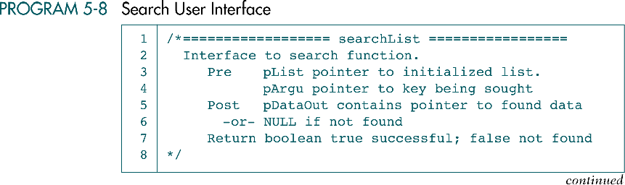
Search User Interface in C
Data Structures: A Pseudocode Approach with C

Slide 48
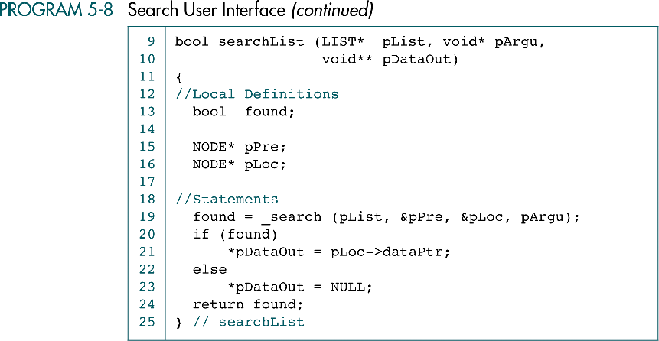
Search User Interface in C (cont.)
Data Structures: A Pseudocode Approach with C

Slide 49
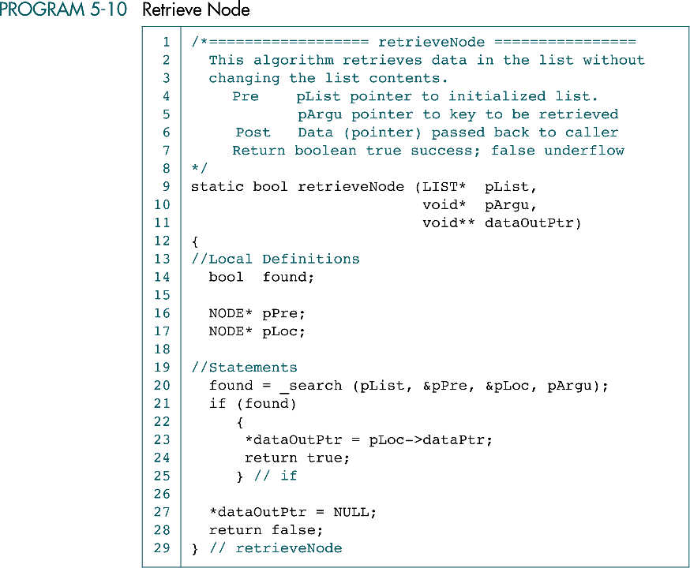
Retrieve Node in C
Data Structures: A Pseudocode Approach with C

Slide 50
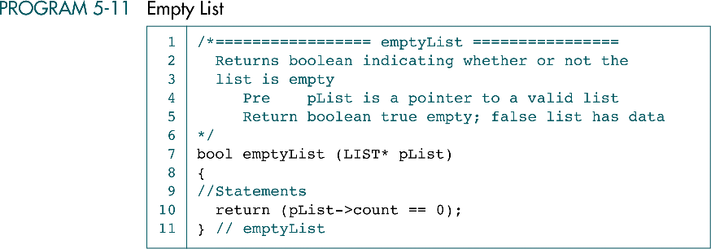
Empty List in C
Data Structures: A Pseudocode Approach with C

Slide 51
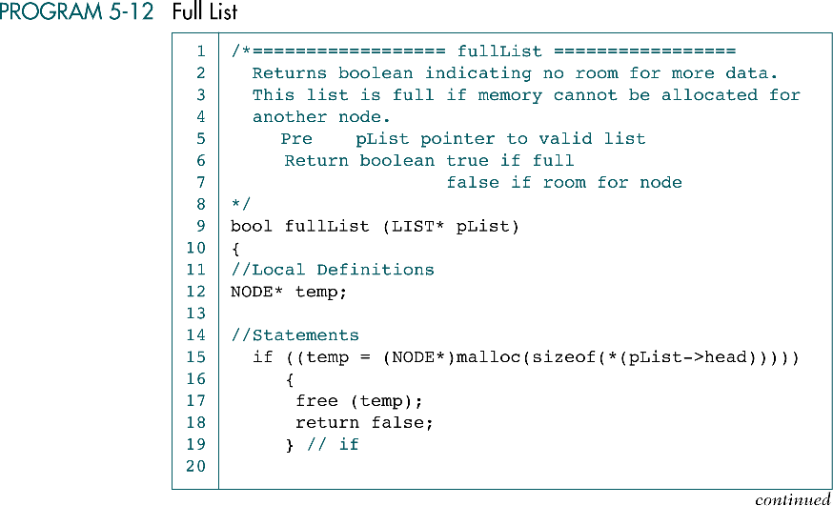

Full List in C
Data Structures: A Pseudocode Approach with C

Slide 52
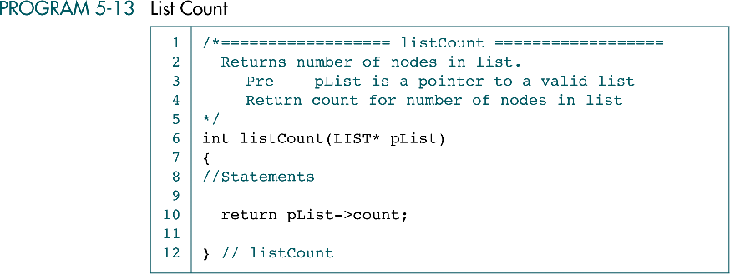
List Count in C
Data Structures: A Pseudocode Approach with C

Slide 53
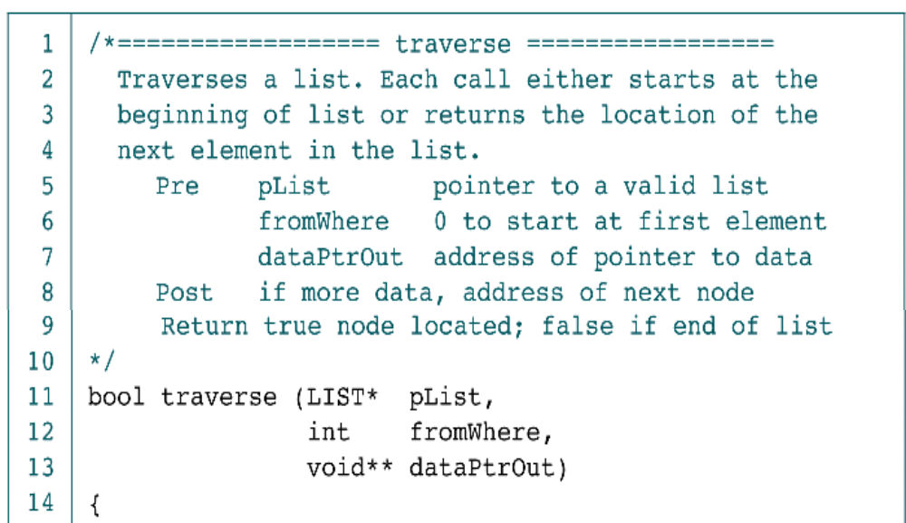
Traverse List in C
Data Structures: A Pseudocode Approach with C

Slide 54
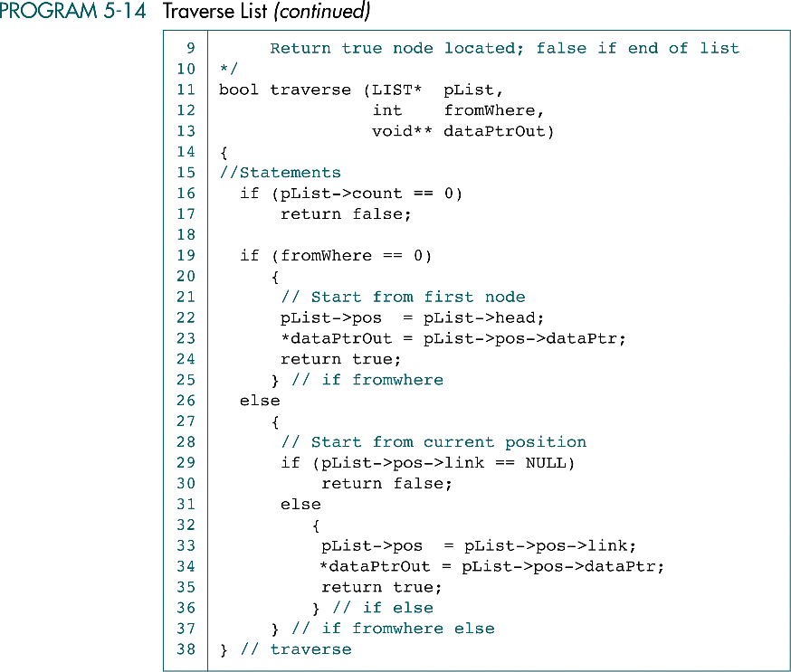
Traverse List in C (cont.)
Data Structures: A Pseudocode Approach with C

Slide 55
Traverse List in C (cont.)
Data Structures: A Pseudocode Approach with C

Slide 56
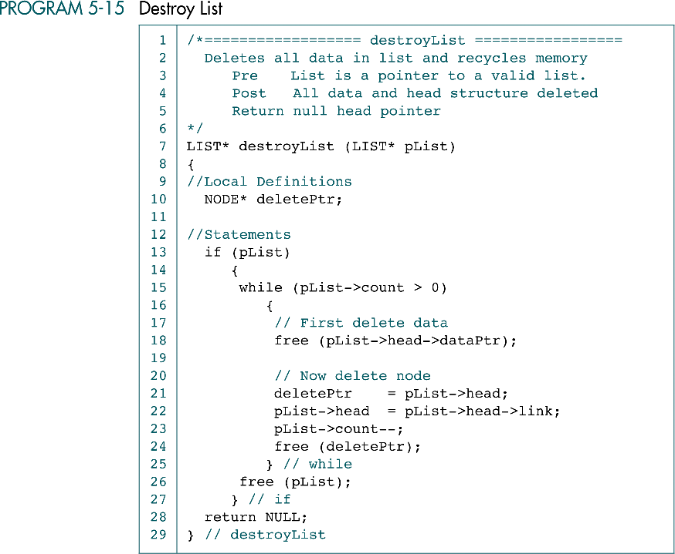
Destroy List in C
Data Structures: A Pseudocode Approach with C

Slide 57
Destroy List in C (cont.)
Data Structures: A Pseudocode Approach with C

Slide 58
5-4 Application
To demonstrate how easily we can implement a list once we have an abstract data type, we implement a list of award-winning pictures and their directors. We then develop eight functions to implement the application. We conclude with a discussion of the basic steps required to test a list implementation.
Data Structure
Application Functions
Testing Insert and Delete Logic
Data Structures: A Pseudocode Approach with C

Slide 59
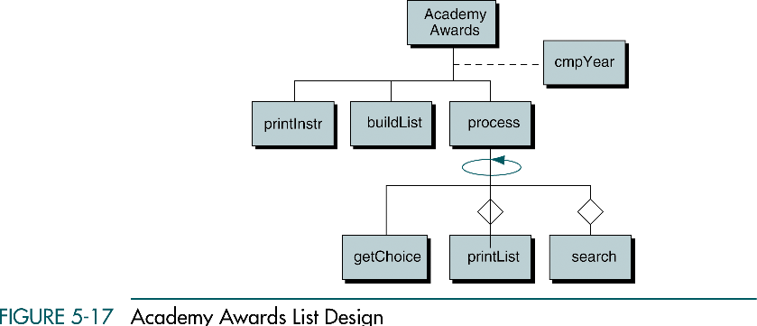
Academy Awards List Design
Data Structures: A Pseudocode Approach with C

Slide 60
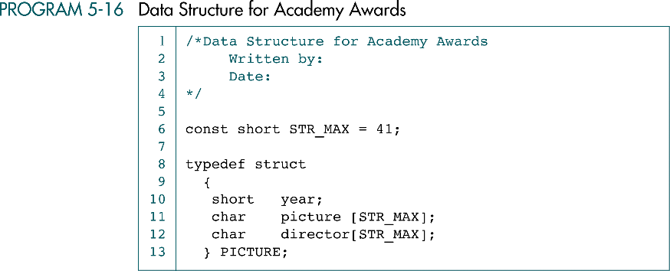
Data Structure for Academy Awards
Data Structures: A Pseudocode Approach with C

Slide 61

Machine for Academy Awards
Data Structures: A Pseudocode Approach with C

Slide 62
Machine for Academy Awards (cont.)
Data Structures: A Pseudocode Approach with C

Slide 63


Print Instructions for User

Slide 64

Build List Status after 2nd Insert
Data Structures: A Pseudocode Approach with C

Slide 65

Build List
Data Structures: A Pseudocode Approach with C

Slide 66

Build List (cont.)
Data Structures: A Pseudocode Approach with C

Slide 67
Build List (cont.)
Data Structures: A Pseudocode Approach with C

Slide 68

Process user Choices
Data Structures: A Pseudocode Approach with C

Slide 69

Get User’s Choice
Data Structures: A Pseudocode Approach with C

Slide 70

Get user’s Choice (cont.)
Data Structures: A Pseudocode Approach with C

Slide 71

Print List
Data Structures: A Pseudocode Approach with C

Slide 72

Print List (cont.)
Data Structures: A Pseudocode Approach with C

Slide 73


Search List
Data Structures: A Pseudocode Approach with C

Slide 74

Compare Year Function
Data Structures: A Pseudocode Approach with C

Slide 75

Compare Year Function (cont.)
Data Structures: A Pseudocode Approach with C

Slide 76
5-4 Complex Implementations
The implementation we have used to this point is known as a single linked list. In this section we introduce three other useful implementation. They are not fully developed. To be included in the list ADT, they would need additional structures, such as a pointer to a compare function and a position pointer as well as functions
Circularly Linked list
Double Linked List
Multilinked List
Data Structures: A Pseudocode Approach with C

Slide 77

Circularly Linked List
Circularly linked list are used to allow access to nodes in the middle of the list without starting at the beginning
If the search target lies before the current node
  Single linked list: search completes as end of the list is reached
  Circular list: search continues from the beginning of the list
If the target does not exist
  Single linked list: stop search as end of the list is reached
  Circular list: save the starting node’s address and stop search when we have circles around to it
Data Structures: A Pseudocode Approach with C

Slide 78

Double Linked List
Data Structures: A Pseudocode Approach with C

Slide 79

Double Linked List Insertion
Data Structures: A Pseudocode Approach with C

Slide 80

Double Linked List Insert Algorithm
Data Structures: A Pseudocode Approach with C

Slide 81
Double Linked List Insert (cont.)
Data Structures: A Pseudocode Approach with C

Slide 82

Double Linked List Delete
Data Structures: A Pseudocode Approach with C

Slide 83

Double Linked List Delete Algorithm
Data Structures: A Pseudocode Approach with C

Slide 84

Multilinked List Implementation of
Presidents List
Data Structures: A Pseudocode Approach with C

Slide 85

Multilinked List Implementation of
Presidents List (cont.)
In multilinked list the same set of data can be processed in multiple sequence, while the data are not replicated
In the following example, two logical lists in the one physical list: one for president and one for the spouse
Data Structures: A Pseudocode Approach with C

Slide 86

Multilinked List Add Node
Data Structures: A Pseudocode Approach with C

