Slide 1
Unit 1: Introduction and basic concepts (Chap. 1, 2)
Unit 2: Linear lists (Stack, Queues, General linear lists )
Unit 3: Non-Linear Lists
Tree (Chap. 6: Intro. to trees)
Two-way Tree
  Chap. 7: Binary search trees
  Chap. 8: AVL trees
  Chap. 9: Heap
Multiway Trees (Chap.10)
Graph (Chap. 11)
Unit 4: Sorting (Chap. 12)
Unit 5: Searching (Chap. 13)
Data Structures: A Pseudocode Approach with C, Second Edition

Slide 2
Chapter 6
Introduction to Trees
Objectives
Upon completion you will be able to:
Understand and use basic tree terminology and concepts
Recognize and define the basic attributes of a binary tree
Process trees using depth-first and breadth-first traversals
Parse expressions using a binary tree
Design and implement Huffman trees
Understand the basic use and processing of general trees
Data Structures: A Pseudocode Approach with C, Second Edition

Slide 3
6-1 Basic Tree Concepts
We begin the Chapter with a discussion of the terminology used with trees. Once the terminology is understood, we discuss three user-oriented tree representations: general trees, indented parts lists, and parenthetical trees.
Terminology
User Representation
Data Structures: A Pseudocode Approach with C, Second Edition

Slide 4
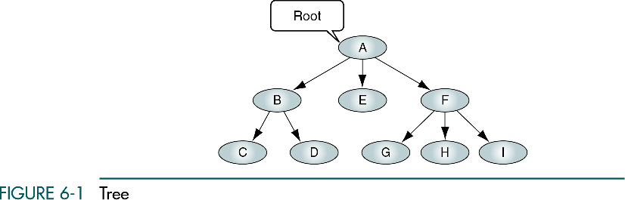
Tree
Data Structures: A Pseudocode Approach with C, Second Edition

Slide 5
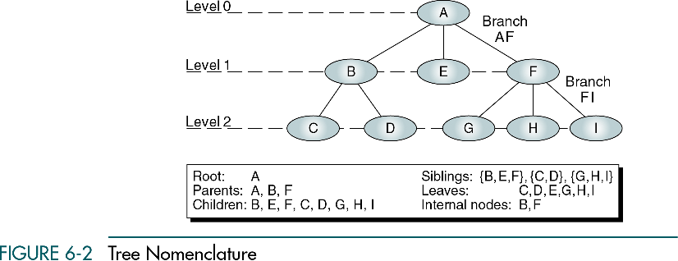
Tree Nomenclature
Height (depth) = 3
Data Structures: A Pseudocode Approach with C, Second Edition

Slide 6
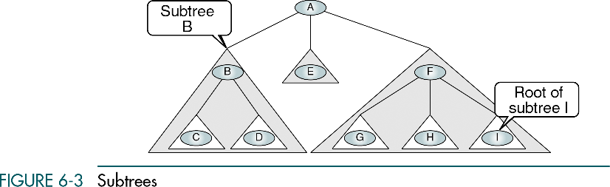
Subtrees
Data Structures: A Pseudocode Approach with C, Second Edition

Slide 7
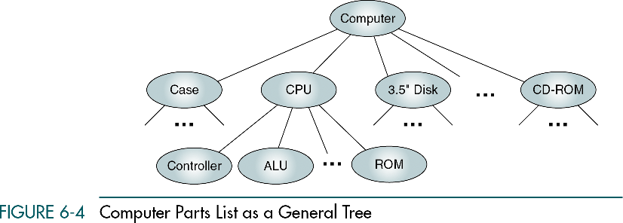
Computer Parts List as a General Tree
Data Structures: A Pseudocode Approach with C, Second Edition

Slide 8
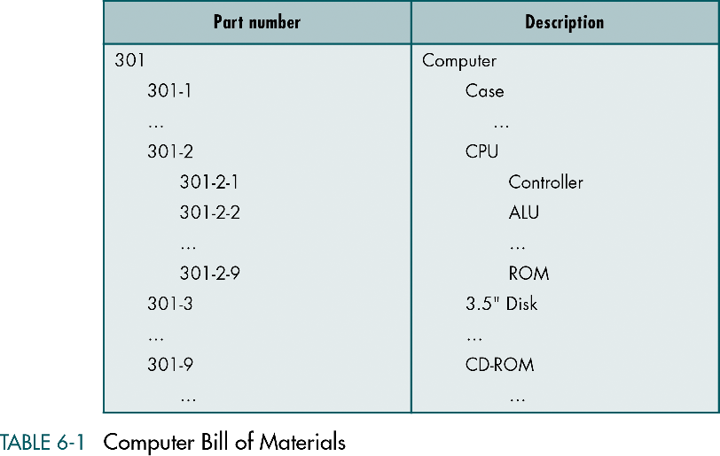
Computer Bill of Materials
Data Structures: A Pseudocode Approach with C, Second Edition

Slide 9
Convert General Tree to Parenthetical Notation
Open parenthesis indicates the start of of a new level
Closeing parenthesis completes the current level and move up one level in the tree
A (B (C D) E F (G H I))
Data Structures: A Pseudocode Approach with C, Second Edition

Slide 10
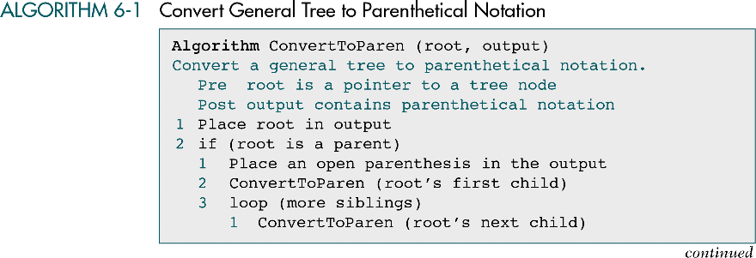
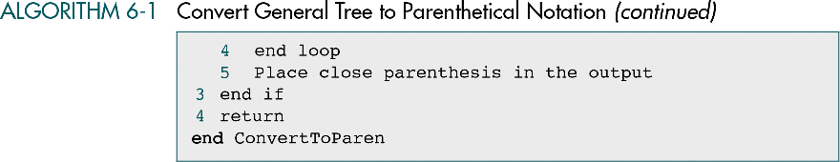
Convert General Tree to Parenthetical Notation
Data Structures: A Pseudocode Approach with C, Second Edition

Slide 11
6-2 Binary Trees
A binary tree can have no more than two descendents. In this section we discuss the properties of binary trees, four different binary tree traversals, and two applications, expression trees and Huffman Code.
Properties
Binary Tree Traversals
Expression Trees
Huffman Code
Data Structures: A Pseudocode Approach with C, Second Edition

Slide 12
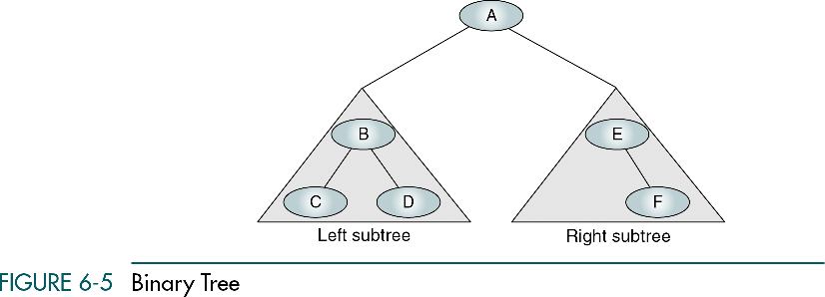
Binary Tree
A node in a binary tree can have no more than two subtree
Data Structures: A Pseudocode Approach with C, Second Edition

Slide 13
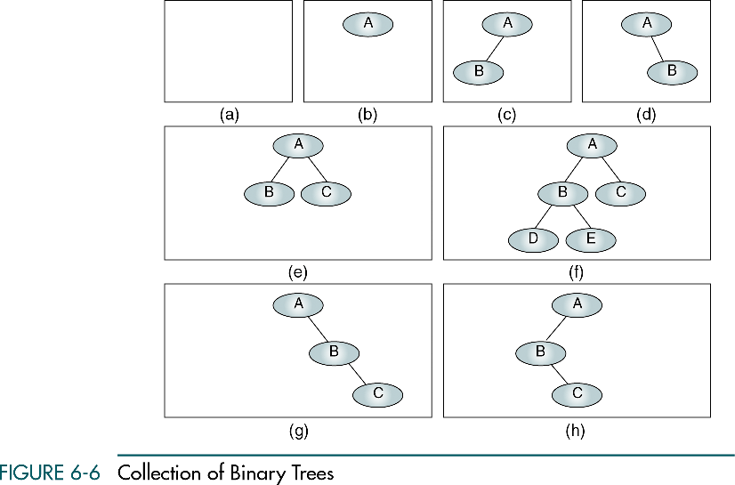
Collection of Binary Trees
Data Structures: A Pseudocode Approach with C, Second Edition

Slide 14

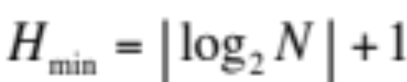



Properties of Binary Tree
Given N nodes in a binary tree
Maximum height of binary tree:
Minimum height of binary tree:
Given height of the binary tree H
Minimum number of nodes in the tree:
Maximum number of nodes in the tree:
Given height of the left subtree HL and right subtree HR
Balance factor:
Note: Balanced binary tree B = -1, 0, or +1
e.g., AVL tree
Data Structures: A Pseudocode Approach with C, Second Edition

Slide 15
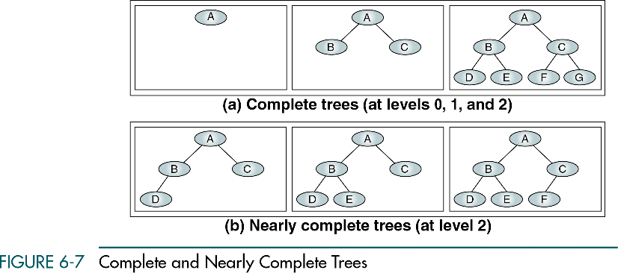
Complete and Nearly Complete Trees
Data Structures: A Pseudocode Approach with C, Second Edition

Slide 16
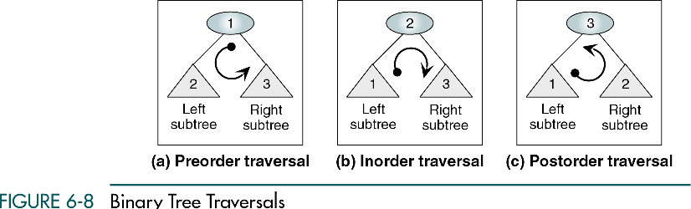
Binary Tree Traversals- Depth-first Traversals
Data Structures: A Pseudocode Approach with C, Second Edition

Slide 17
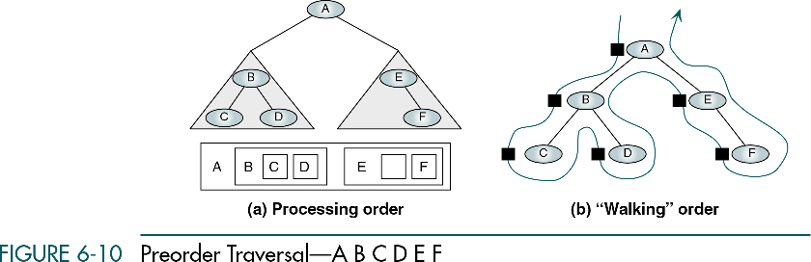
Preorder Traversal -- ABCDEF
Data Structures: A Pseudocode Approach with C, Second Edition

Slide 18
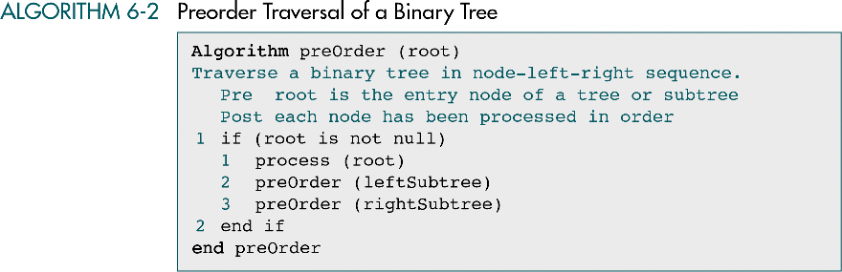
Preorder Traversal of a Binary Tree
Data Structures: A Pseudocode Approach with C, Second Edition

Slide 19
Data Structures: A Pseudocode Approach with C, Second Edition

Slide 20
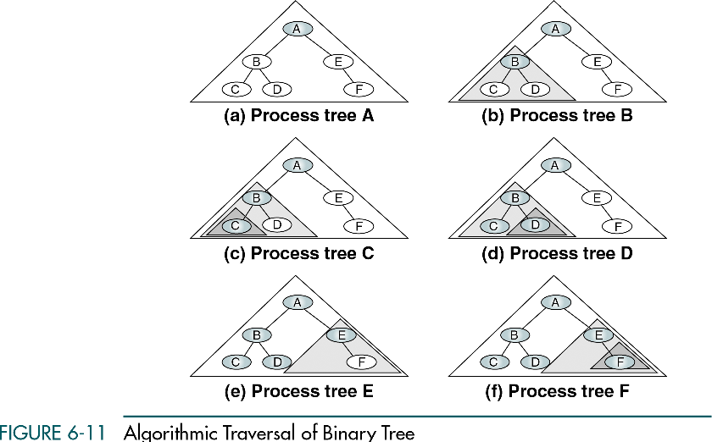
Algorithmic Traversal of Binary Tree
Data Structures: A Pseudocode Approach with C, Second Edition

Slide 21
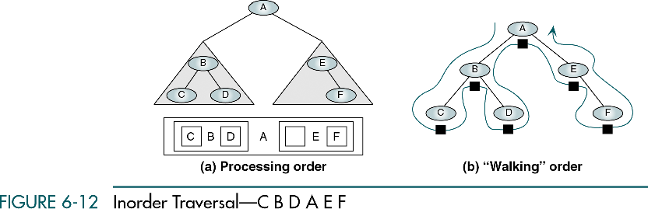
Inorder Traversal -- CBDAEF
Data Structures: A Pseudocode Approach with C, Second Edition

Slide 22
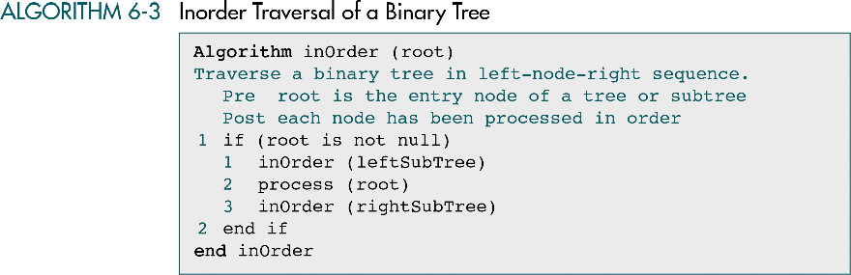
Inorder Traversal of Binary Tree
Data Structures: A Pseudocode Approach with C, Second Edition

Slide 23
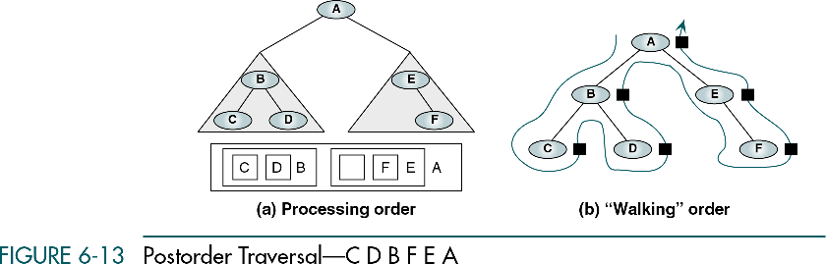
Postorder Traversal -- CDBFEA
Data Structures: A Pseudocode Approach with C, Second Edition

Slide 24
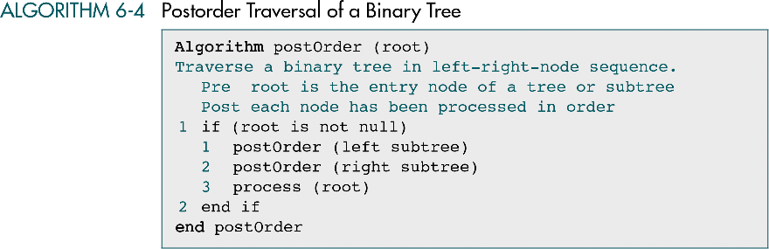
Postorder Traversal of Binary Tree
Data Structures: A Pseudocode Approach with C, Second Edition

Slide 25
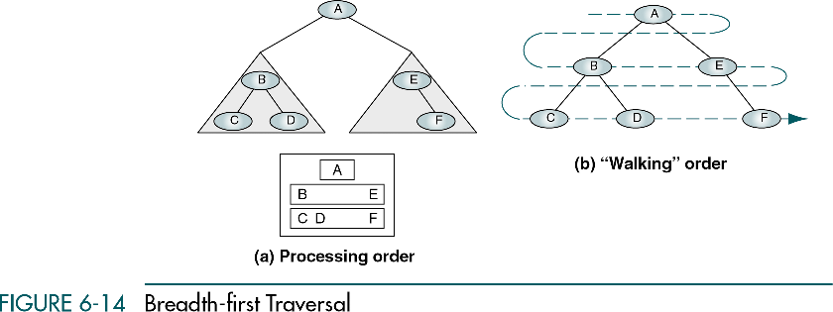
Breadth-first Traversal
A queue is used to traverse a tree in breadth-first order
A stack is used to trverse a tree in depth-first order (why ?)
Data Structures: A Pseudocode Approach with C, Second Edition

Slide 26
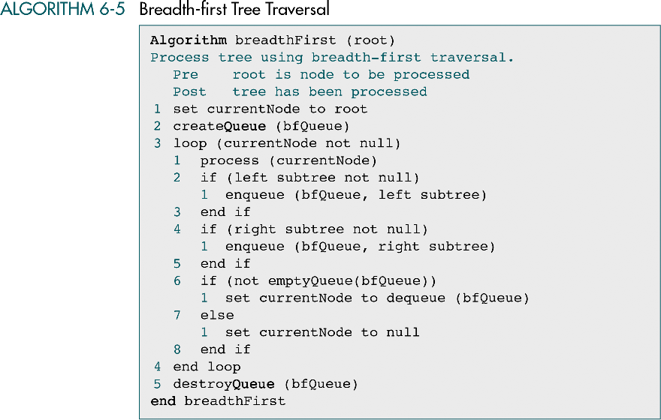
Breadth-first Tree Traversal
Data Structures: A Pseudocode Approach with C, Second Edition

Slide 27
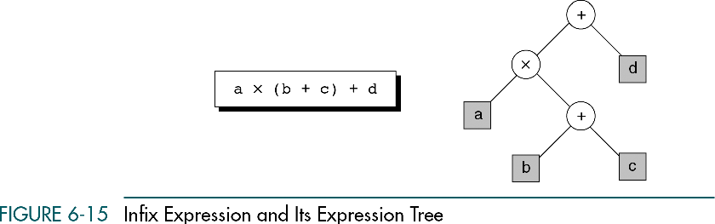
Infix Expression and Expression Tree
Each leaf is an operand
The root and internal nodes are operators
Subtrees are subexpressions, with the root being an operator
Data Structures: A Pseudocode Approach with C, Second Edition

Slide 28
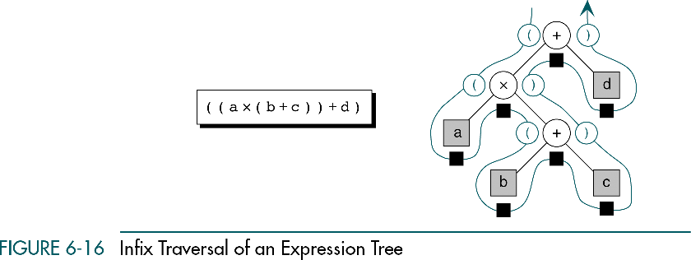
Infix Traversal of Expression Tree
Data Structures: A Pseudocode Approach with C, Second Edition

Slide 29
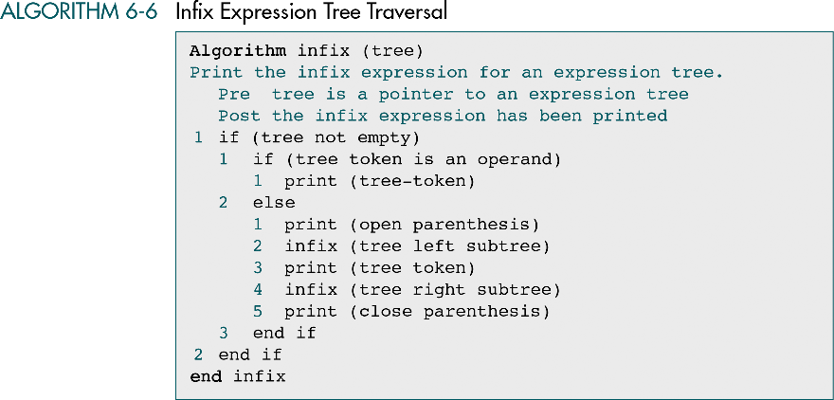
Infix Expression Tree Traversal
Data Structures: A Pseudocode Approach with C, Second Edition

Slide 30
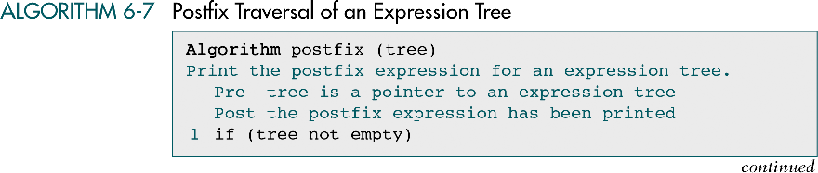

Postfix Traversal of Expression Tree
Data Structures: A Pseudocode Approach with C, Second Edition

Slide 31
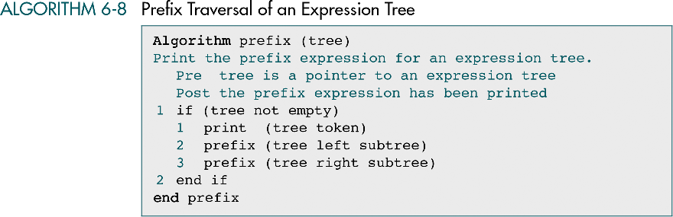
Prefix Traversal of Expression Tree
Data Structures: A Pseudocode Approach with C, Second Edition

Slide 32
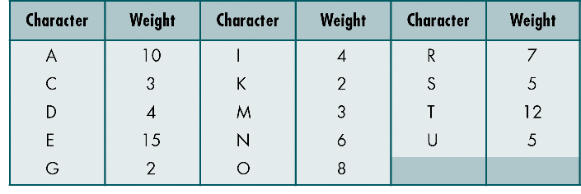
Huffman Coding
Hufman code assign shorter codes to characters that accur more frequently and longer codes to those that occur less frequently
Huffman code is a populer data compression algorithm
Data Structures: A Pseudocode Approach with C, Second Edition

Slide 33
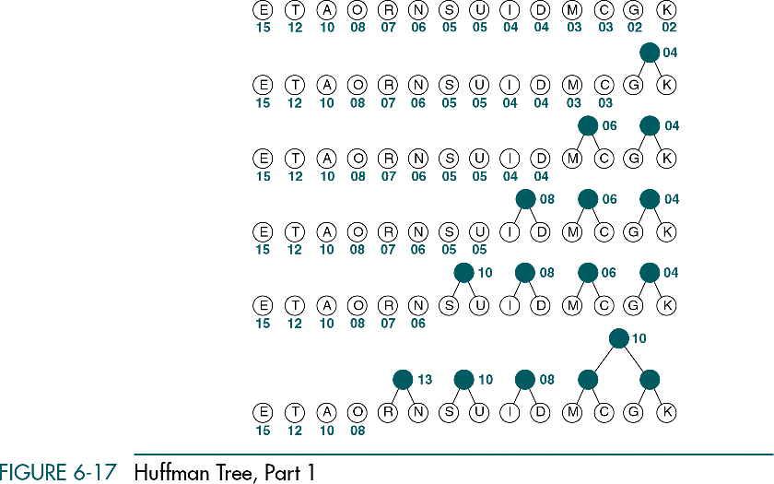
Huffman Tree – Part I
Data Structures: A Pseudocode Approach with C, Second Edition

Slide 34
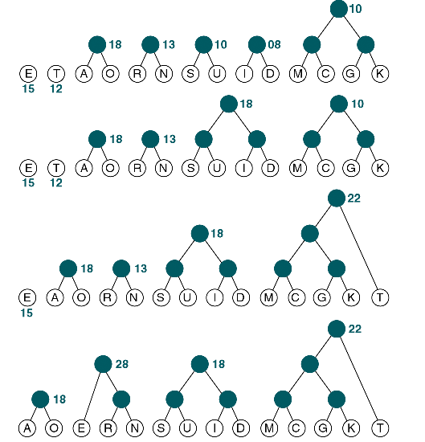
Huffman Tree – Part II
Data Structures: A Pseudocode Approach with C, Second Edition

Slide 35
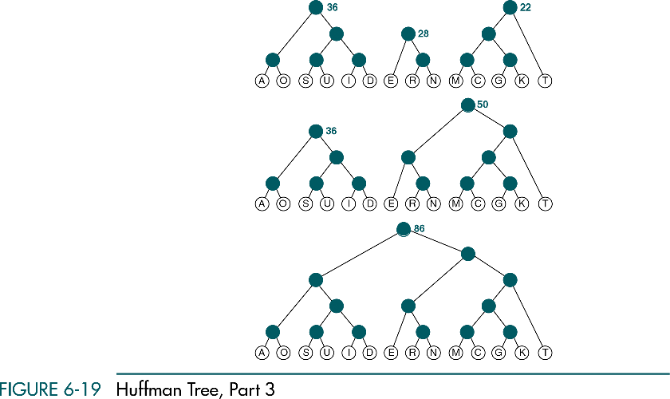
Huffman Tree – Part III
Data Structures: A Pseudocode Approach with C, Second Edition

Slide 36
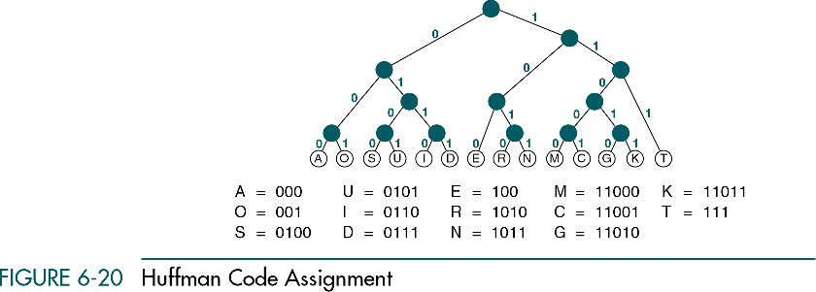
Huffman Code Assignment
Data Structures: A Pseudocode Approach with C, Second Edition

Slide 37
Decoding of Huffman Code
Sender:
00011010001001011111000000101011011100111
Receiver:
A G O O D M A R K E T
Data Structures: A Pseudocode Approach with C, Second Edition

Slide 38
6-3 General Trees
A general tree can have an unlimited number of descendents. We discuss three topics in this section: general tree insertions, deletions, and converting a general tree to a binary tree.
Insertions into General Trees
General Tree Deletions
Changing a General Tree to a Binary Tree
Data Structures: A Pseudocode Approach with C, Second Edition

Slide 39
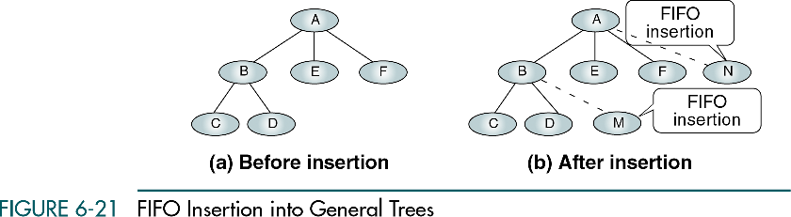
FIFO Insertion into General Trees
To insert a node into a general tree, the user must supply the parent of the node
Data Structures: A Pseudocode Approach with C, Second Edition

Slide 40
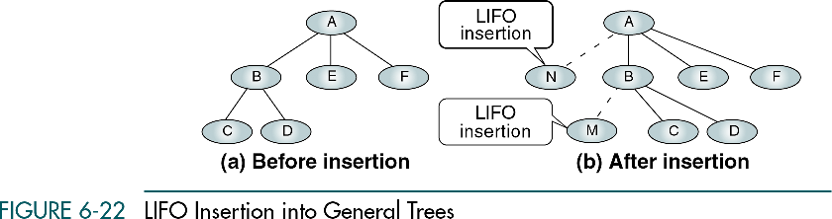
LIFO Insertion into General Trees
Data Structures: A Pseudocode Approach with C, Second Edition

Slide 41
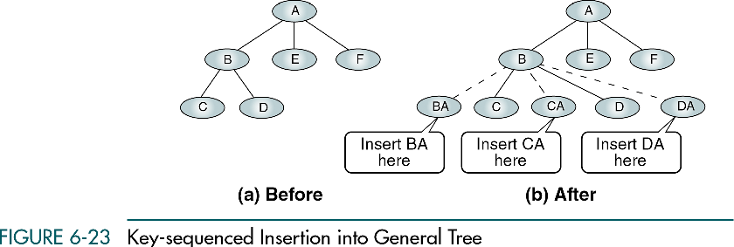
Key-sequenced insertion into General Tree
Data Structures: A Pseudocode Approach with C, Second Edition

Slide 42
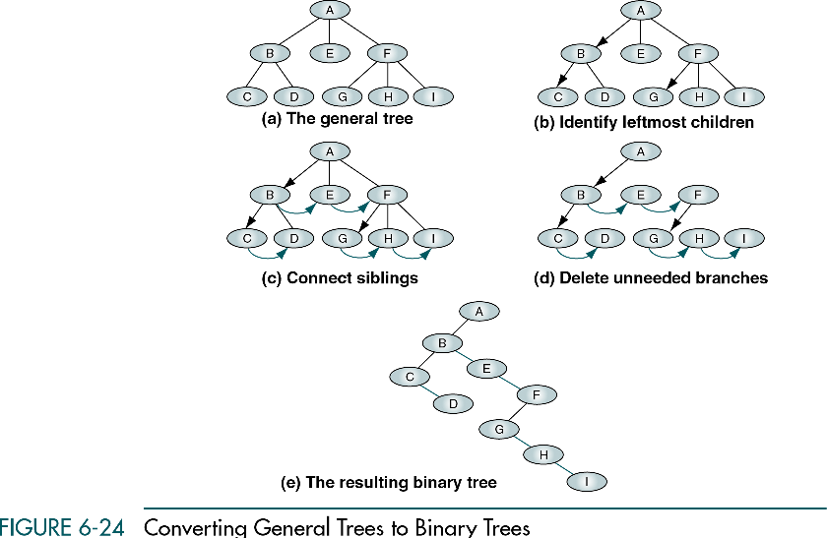
Converting General Trees to Binary Trees
Data Structures: A Pseudocode Approach with C, Second Edition

