Slide 1
Chapter 7
Binary Search Trees
Objectives
Upon completion you will be able to:
Create and implement binary search trees
Understand the operation of the binary search tree ADT
Write application programs using the binary search tree ADT
Design and implement a list using a BST
Design and implement threaded trees

Slide 2
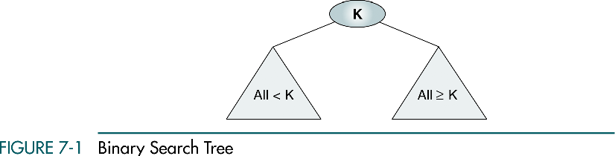
7-1 Basic Concepts
Binary search trees provide an excellent structure for searching a list and at the same time for inserting and deleting data into the list.

Slide 3
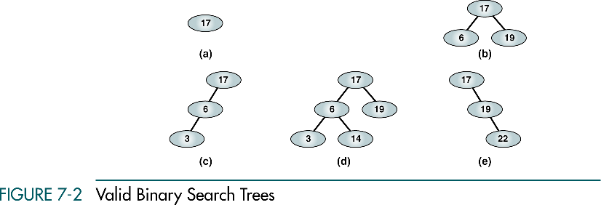
Valid Binary Search Tree

Slide 4
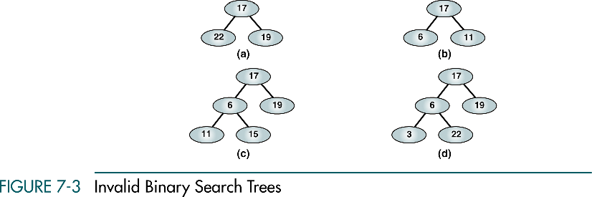
Invalid Binary Search Tree

Slide 5
7-2 BST Operations
We discuss four basic BST operations: traversal, search, insert, and delete; and develop algorithms for searches, insertion, and deletion.
Traversals
Searches
Insertion
Deletion

Slide 6
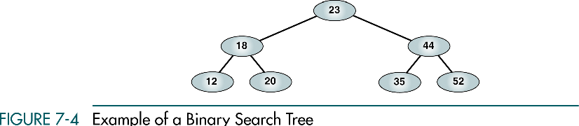
Example of Binary Search Tree
Preorder: 23 18 12 20 44 35 52
Postorder: 12 20 18 35 52 44 23
Inorder: 12 18 20 23 35 44 52

Slide 7
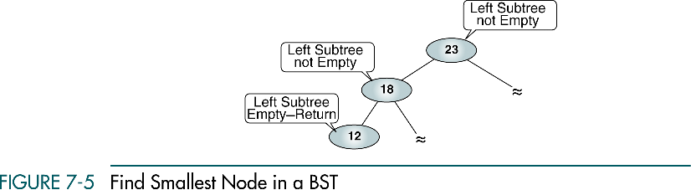
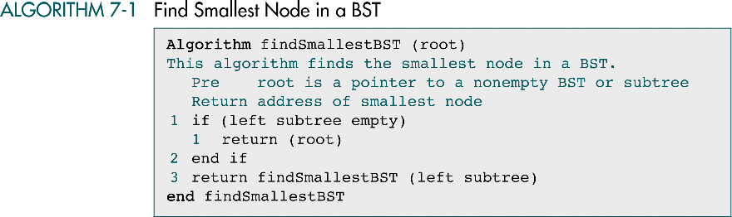
Find Smallest Node in a BST

Slide 8
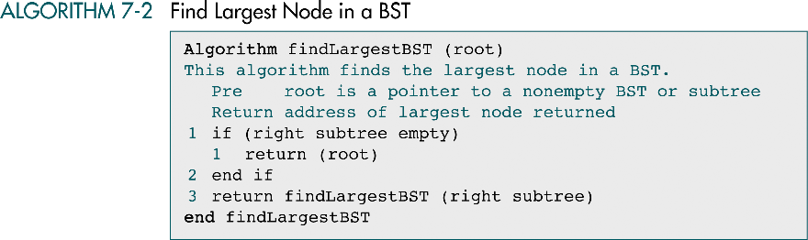
Find Largest Node in a BST

Slide 9
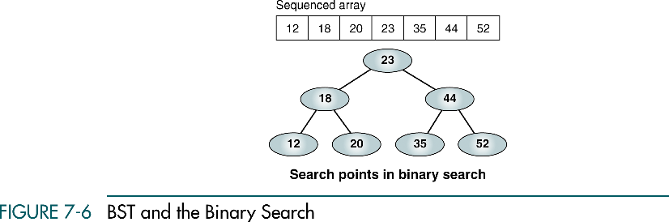
BST and Binary Search

Slide 10
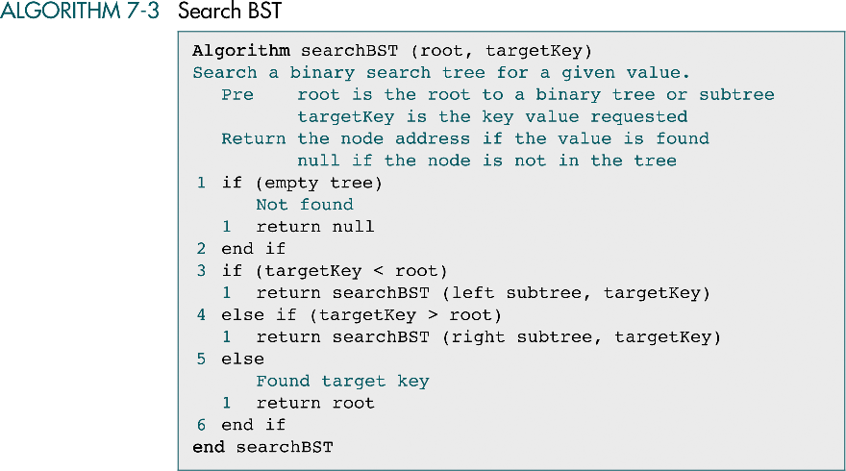
Search BST

Slide 11
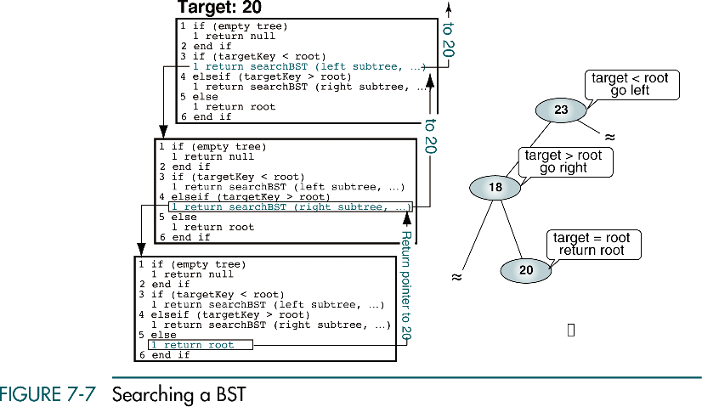
Searching a BST

Slide 12
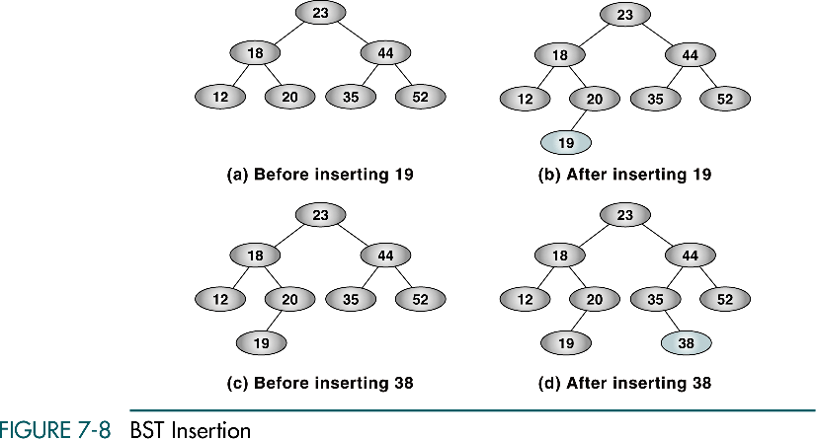
BST Insertion

Slide 13
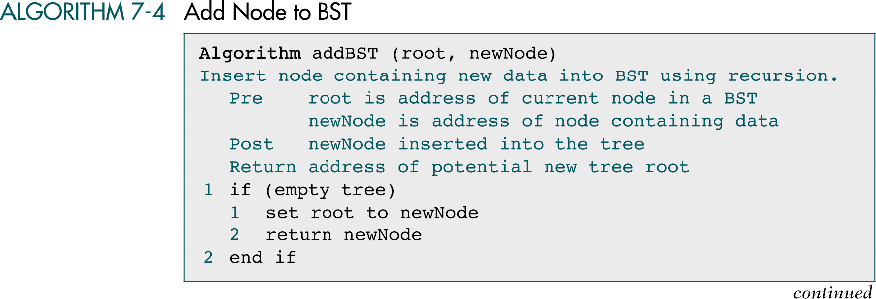
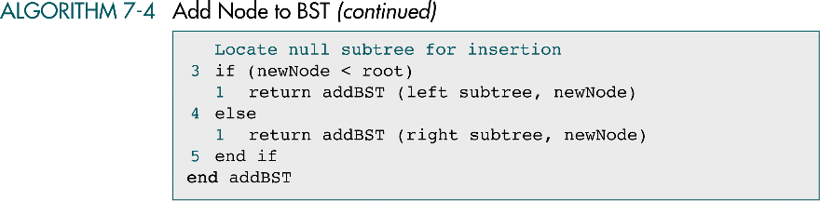
Add Node to BST

Slide 15
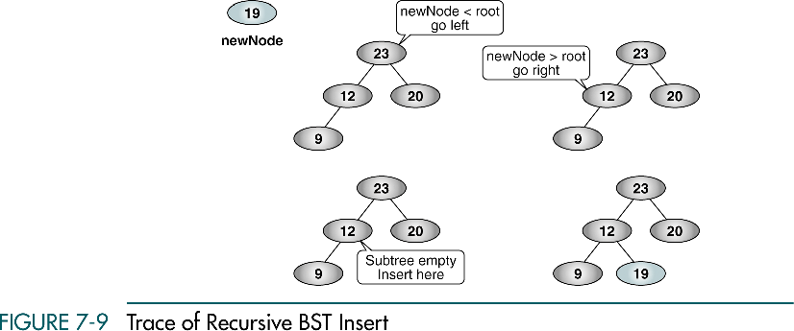
Trace of Recursive BST Insert
25
25
25
25

Slide 16
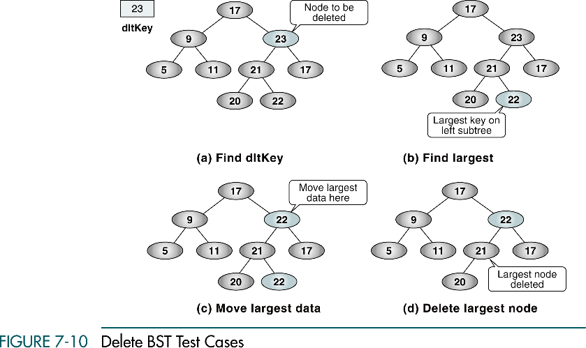
Delete BST Test Cases
26
26
22
22
22
22
26
26
22

Slide 17
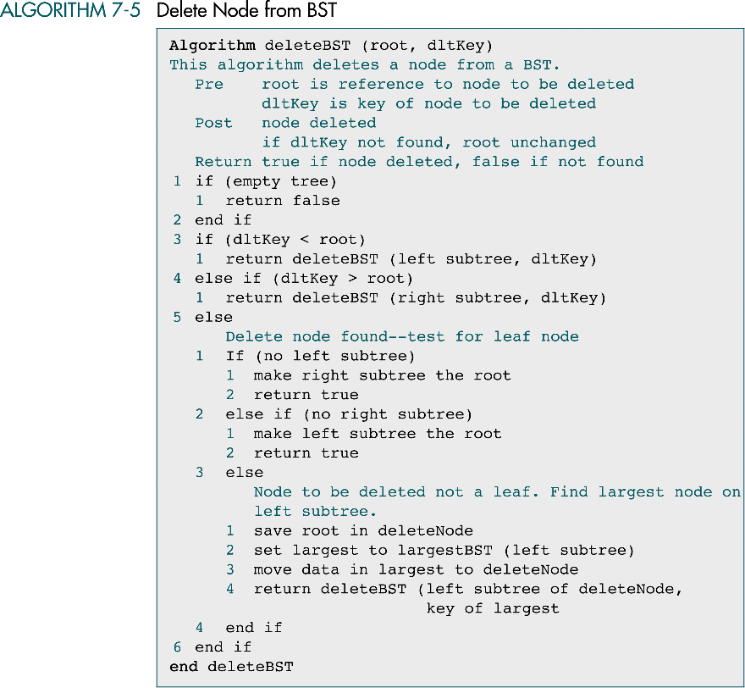
Delete Node From BST

Slide 18
Delete Node From BST (cont.)

Slide 19
7-3 Binary Search Tree ADT
We begin this section with a discussion of the BST data structure and write the header file for the ADT. We then develop 14 programs that we include in the ADT.
Data Structure
Algorithms

Slide 20
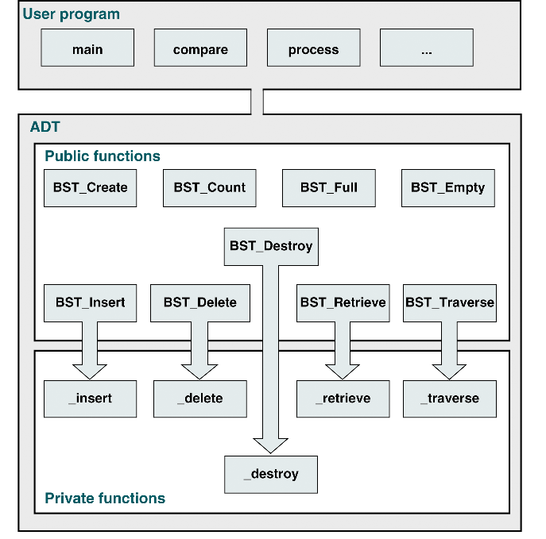
BST ADT Design

Slide 21
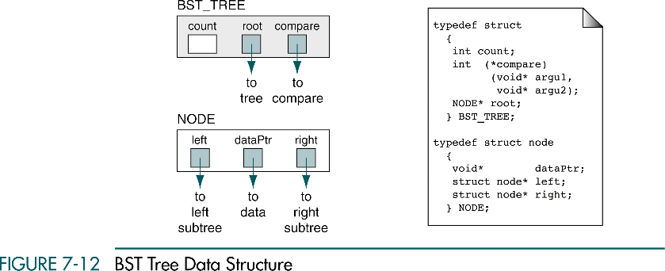
BST Tree Data Structure

Slide 22
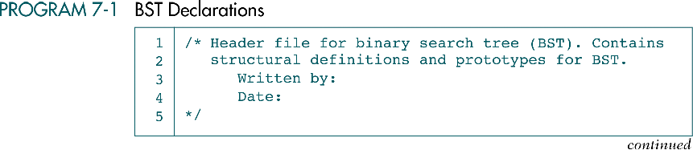
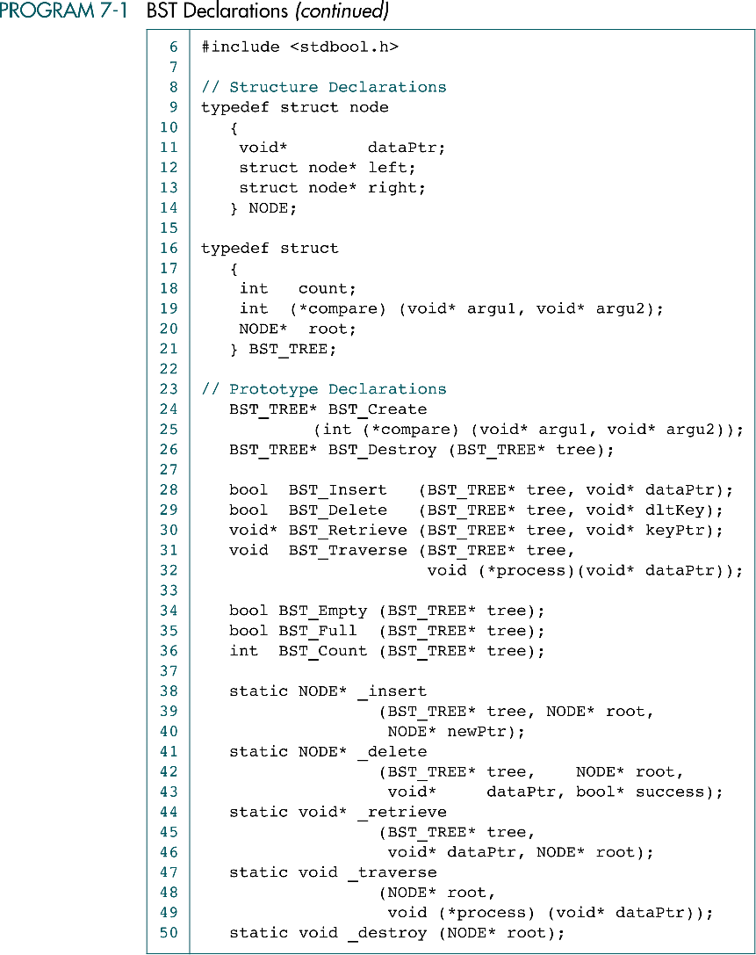
BST Declarations

Slide 23
BST Declarations (cont.)

Slide 24
BST Declarations (cont.)

Slide 25
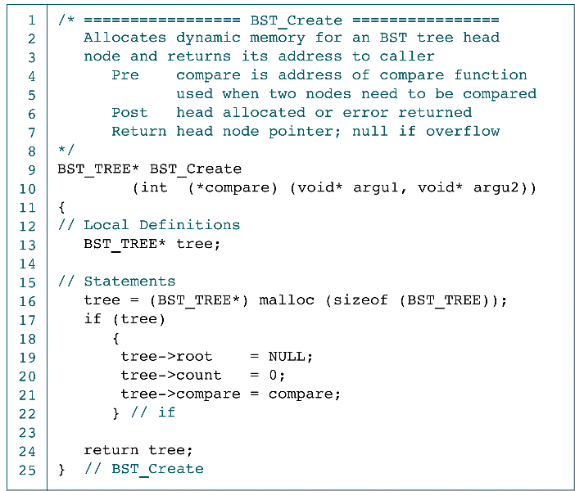
Create BST Application interface

Slide 26
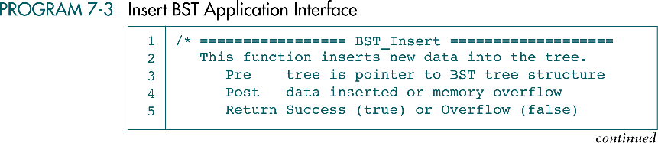
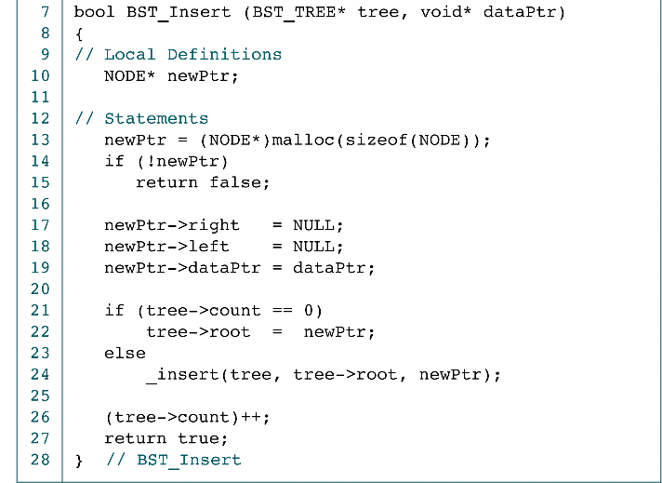
Insert BST Application Interface

Slide 27
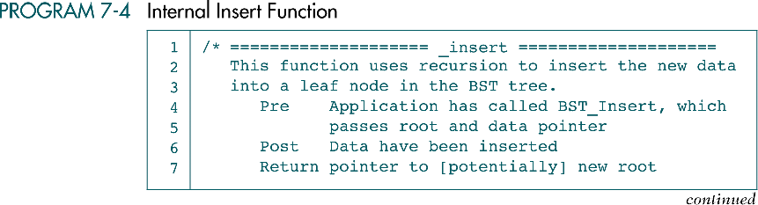
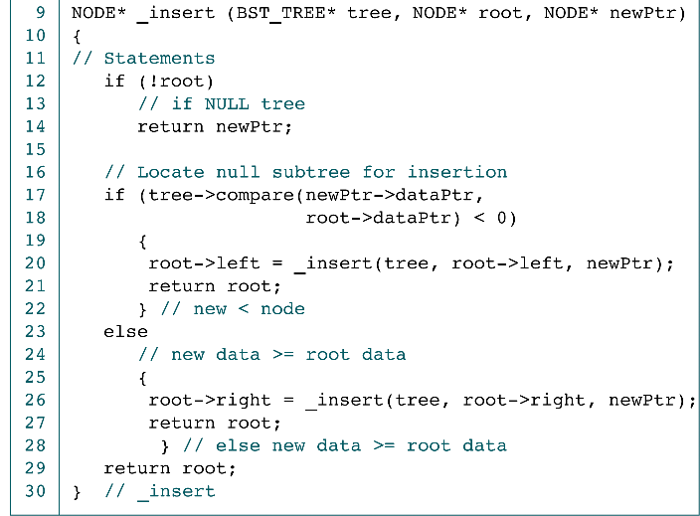
Internal Insert Function
newPtr
tree
root
5
return
root
10
root
8
15
root
4
9
root
newPtr
5

Slide 28
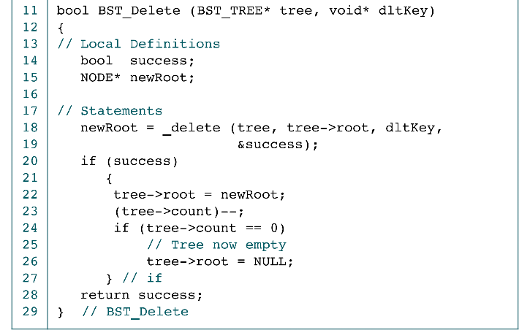
Delete BST Application Interface

Slide 29
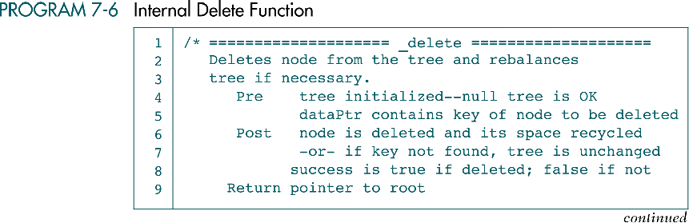
Internal Delete Function

Slide 30
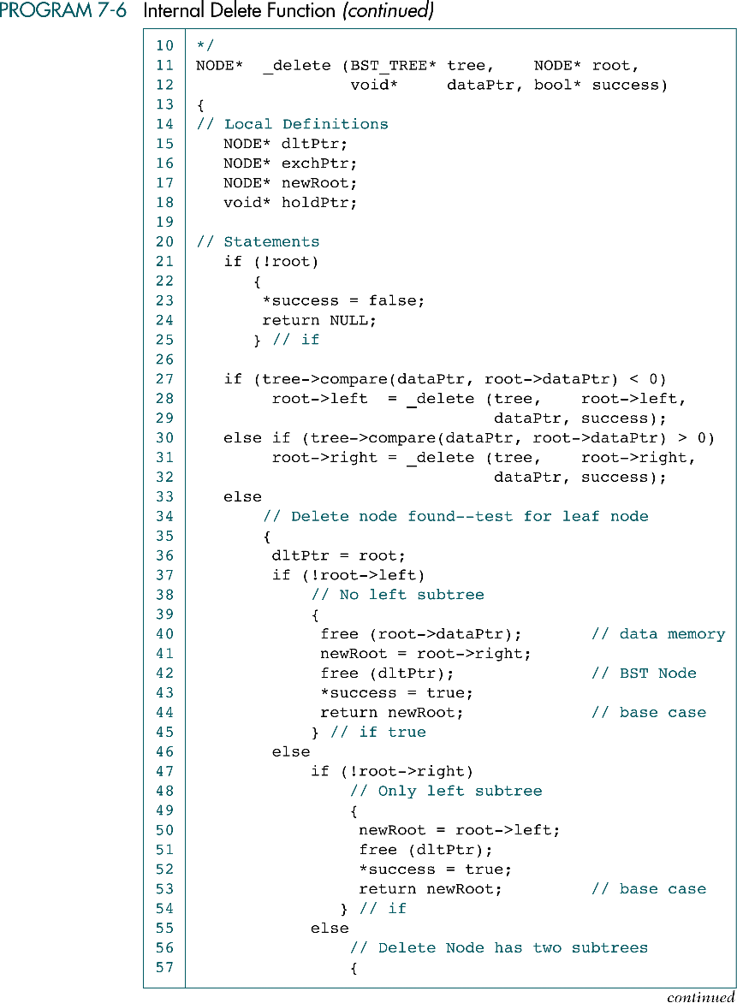
Internal Delete Function (cont.)
dataPtr
tree
root
8
root
10
root
8
15
9

Slide 31
Internal Delete Function (cont.)
dataPtr
tree
root
8
10
root
8
15
Free
dltPtr
newRoot
9

Slide 32
Internal Delete Function (cont.)
dataPtr
tree
root
8
root
10
Free
15
newRoot
9

Slide 33
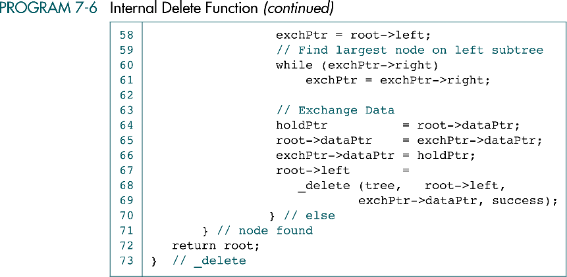
Internal Delete Function (cont.)
Redundant !

Slide 34
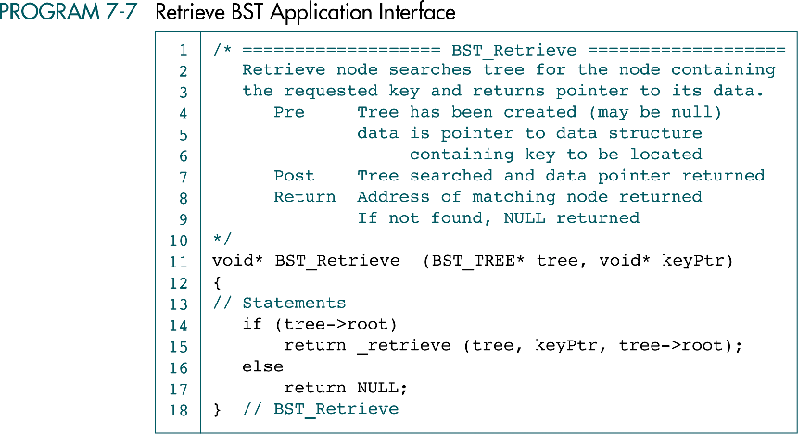
Retrieve BST Application Interface

Slide 35
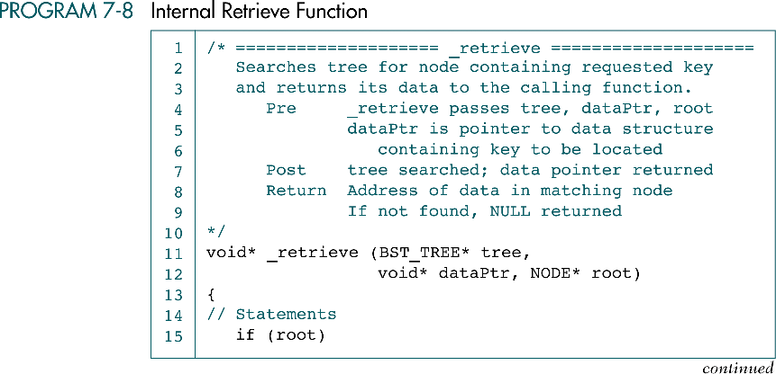
Internal Retrieve Function

Slide 36
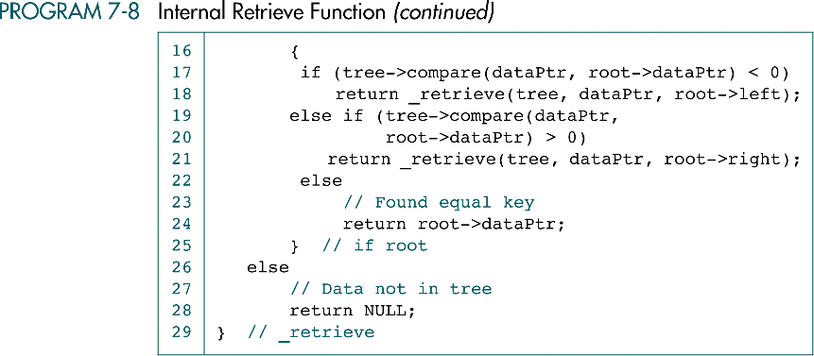
Internal Retrieve Function

Slide 37
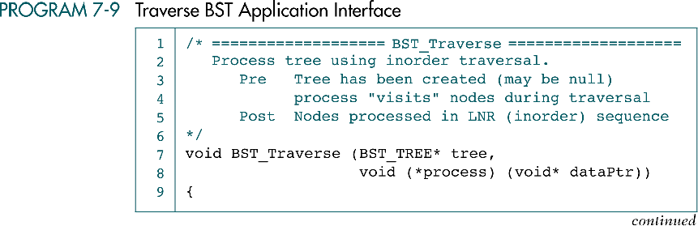

Traverse BST Application Interface

Slide 38
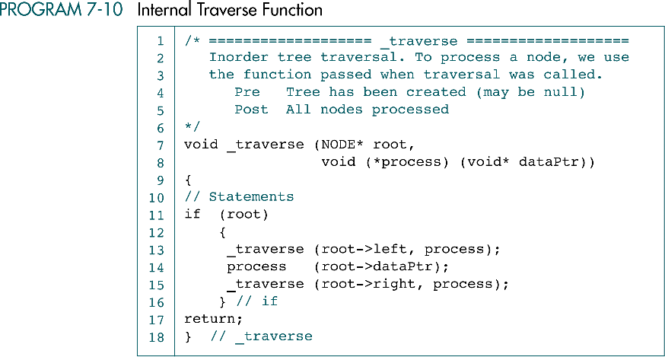
Internal Traverse Function

Slide 39
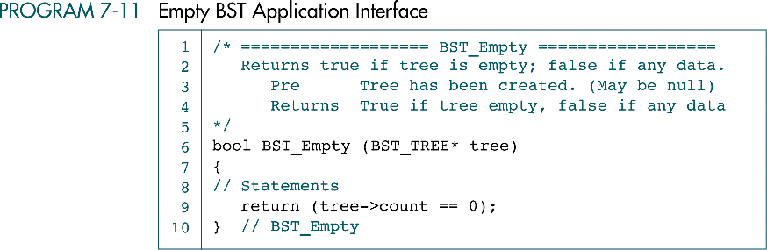
Empty BST Application Interface

Slide 40
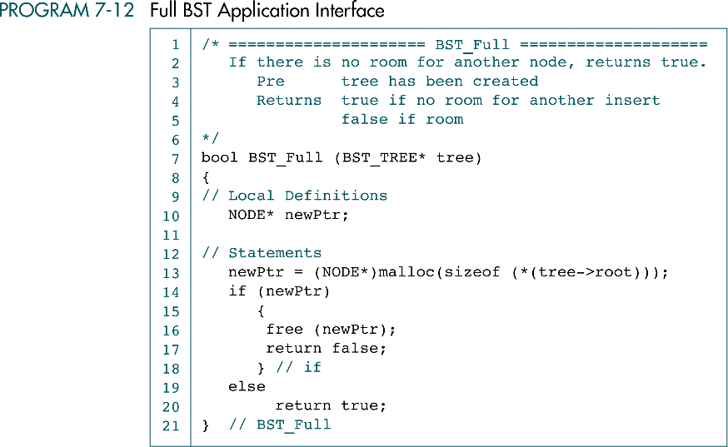
Full BST Application Interface

Slide 41
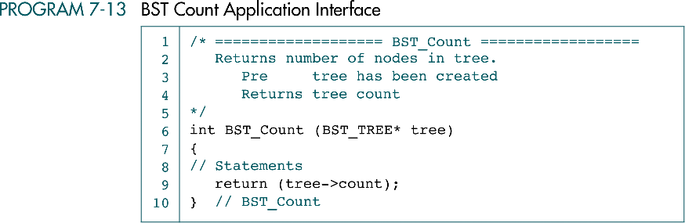
BST Count Application Interface

Slide 42
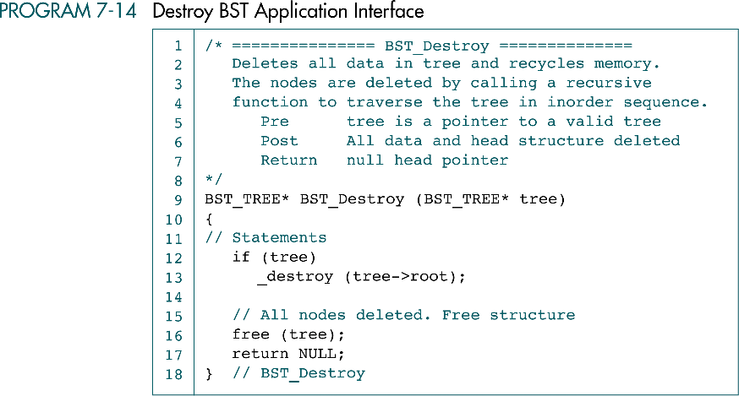
Destroy BST Application Interface

Slide 43
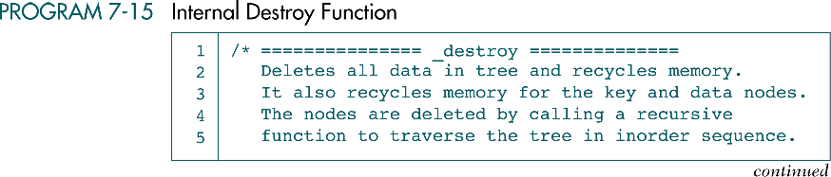
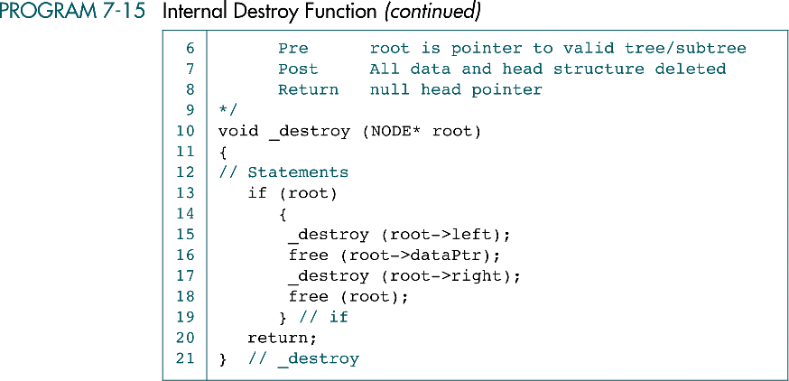
Internal Destroy Function

Slide 44
7-4 BST Applications
This section develops two applications that use the BST ADT. We begin the discussion of BST Applications with a simple application that manipulates integers. The second application, student list, requires a structure to hold the student's data.
Integer Application
Student List Application

Slide 45
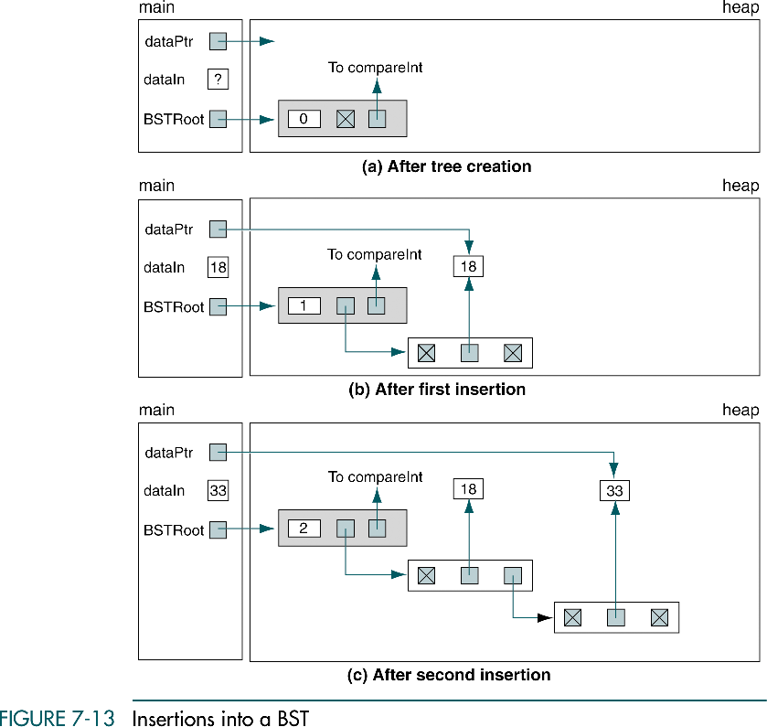
Insertions into a BST

Slide 46
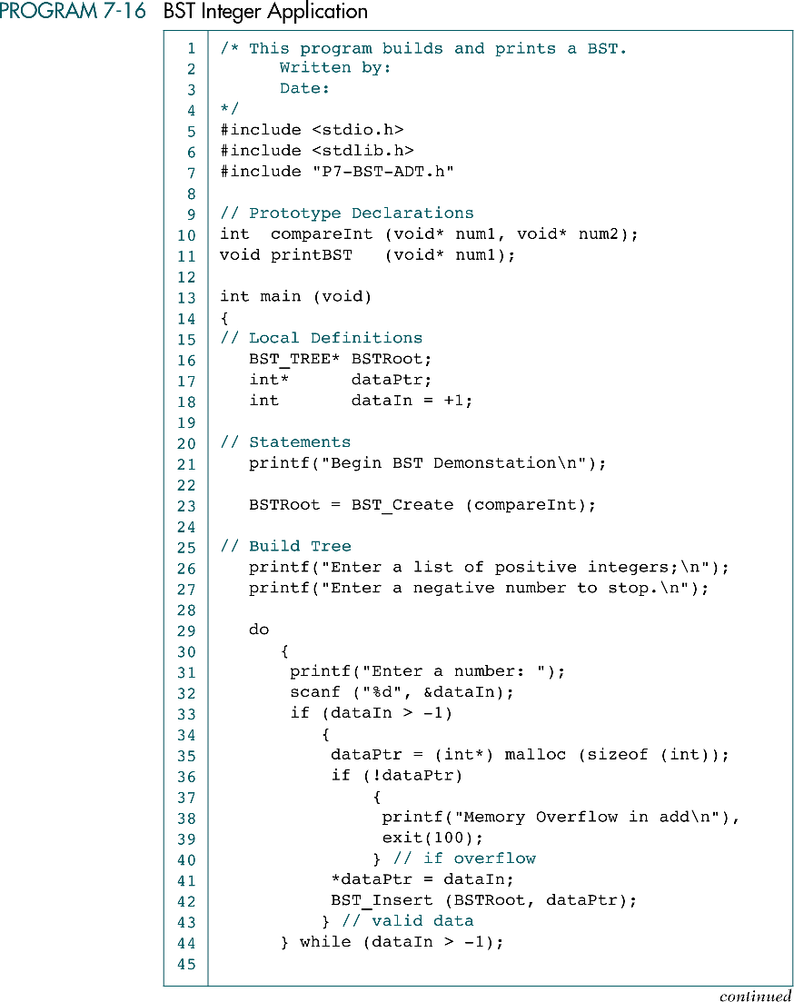
BST Integer Application

Slide 47
BST Integer Application (cont.)

Slide 48
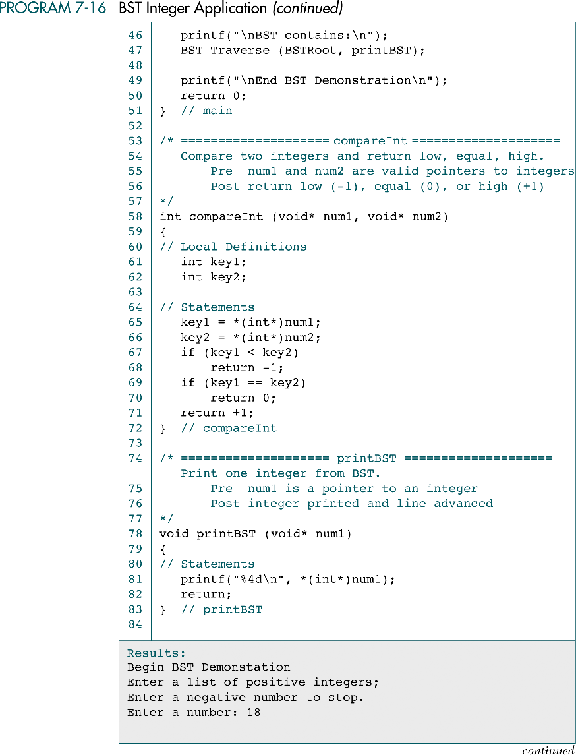
BST Integer Application (cont.)

Slide 49
BST Integer Application (cont.)

Slide 50
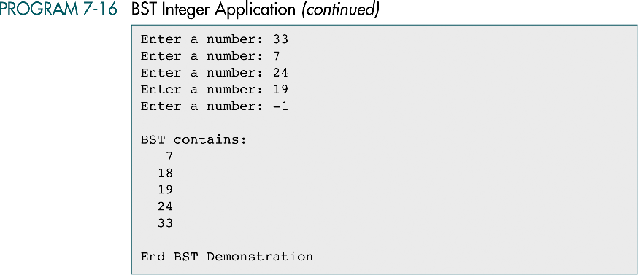
BST Integer Application (cont.)

Slide 51
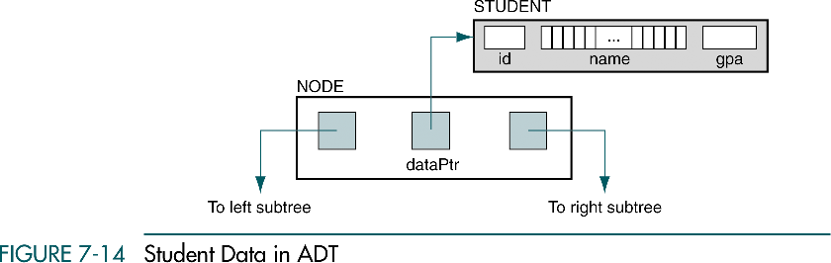
Student Data in ADT

Slide 52
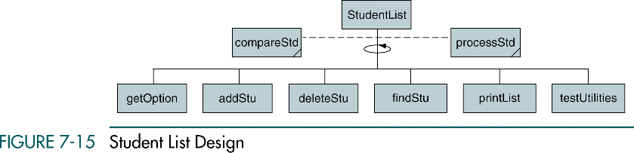
Student List Design

Slide 53
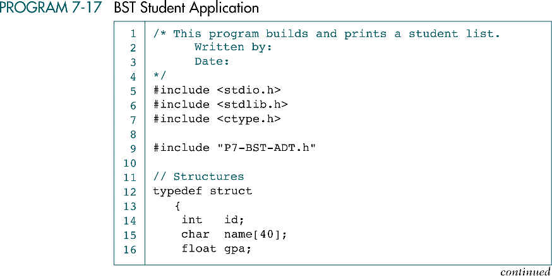
BST Student Application

Slide 54
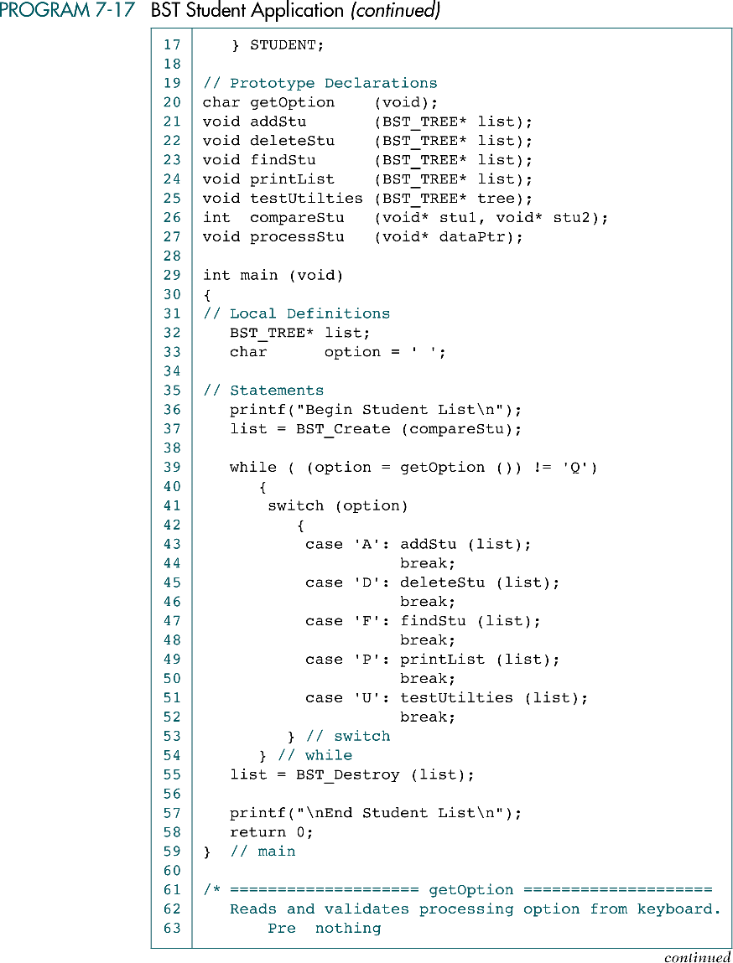
BST Student Application (cont.)

Slide 55
BST Student Application (cont.)

Slide 56
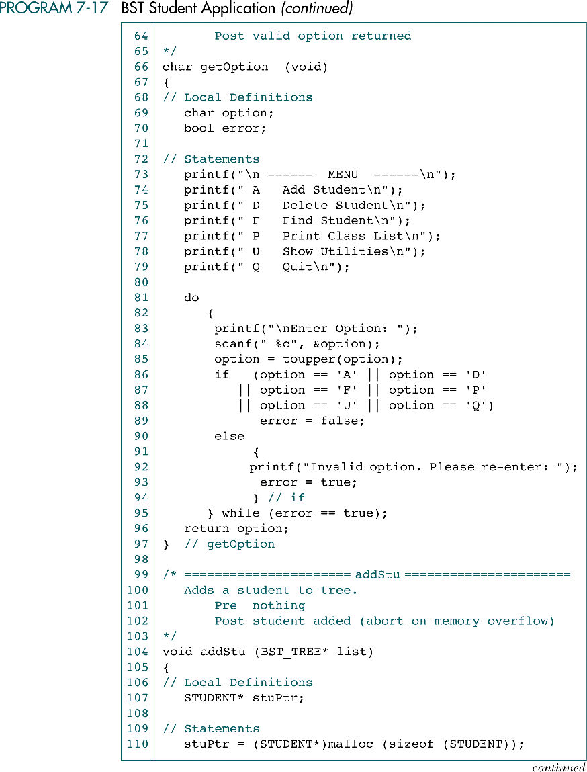
BST Student Application (cont.)

Slide 57
BST Student Application (cont.)

Slide 58
BST Student Application (cont.)

Slide 59
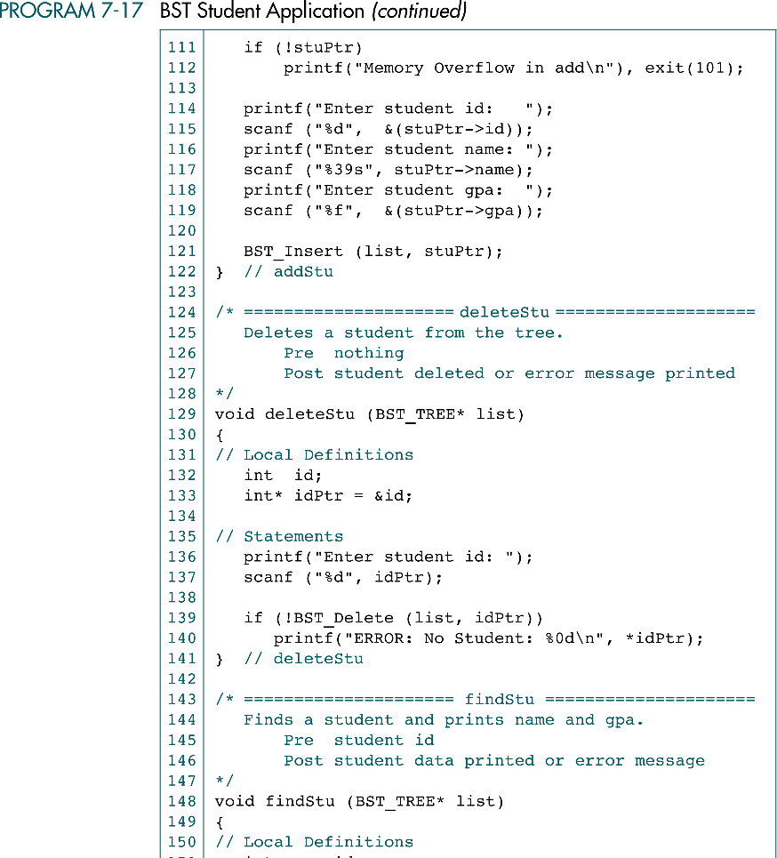
BST Student Application (cont.)

Slide 60
BST Student Application (cont.)
redundant

Slide 61

BST Student Application (cont.)

Slide 62

BST Student Application (cont.)

Slide 63
BST Student Application (cont.)

Slide 64
BST Student Application (cont.)

Slide 65

BST Student Application (cont.)

Slide 66
BST Student Application (cont.)

Slide 67

7-5 Threaded Trees
Recursion or stack are inefficient if the tree must be traversed frequently
In a threaded tree, null pointers are replaced with pointers to their successor nodes
The traversal is more efficient if the tree is a threaded tree
(inorder)

