Slide 1
Chapter 9
Heap
Objectives
Upon completion you will be able to:
Define and implement heap structures
Understand the operation and use of the heap ADT
Design and implement selection applications using a heap
Design and implement priority queues using a heap

Slide 2
9-1 Basic Concepts
A heap is a binary tree whose left and right subtrees have values less than their parents. We begin with a discussion of the basic heap structure and its two primary operations, reheap up and reheap down.
Definition
Maintenance Operations

Slide 3
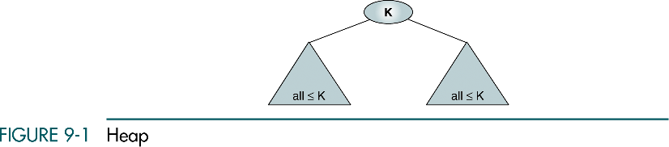
Heap
Rule 1: the binary tree is complete or nearly complete
Rule 2: the key value of each node is greater than or equal to the key value in each of its descendents
A heap tree is often implemented in an array rather than a linked list which makes for very efficient processing
It’s meaningless to traverse the heap tree
Max-heap

Slide 4
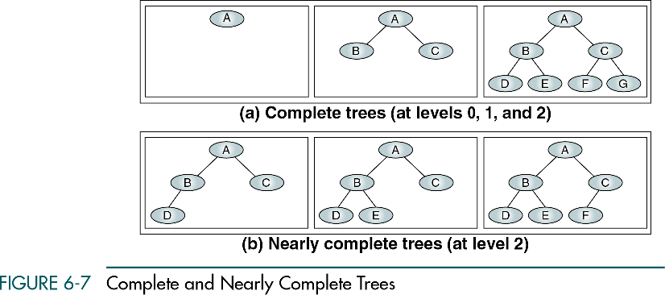
Complete and Nearly Complete Trees

Slide 5
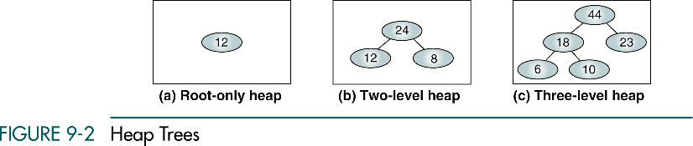
Heap Trees

Slide 6
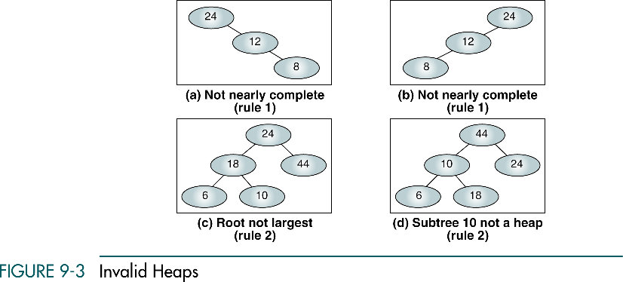
Invalid Heaps

Slide 7
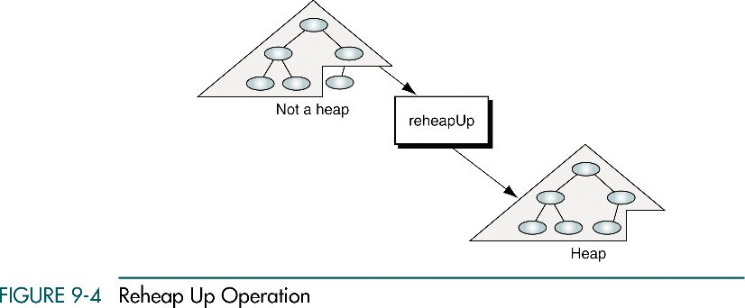
Rehaep Up Operation
After inserting a node into a heap, the reheap up operation may be needed

Slide 8
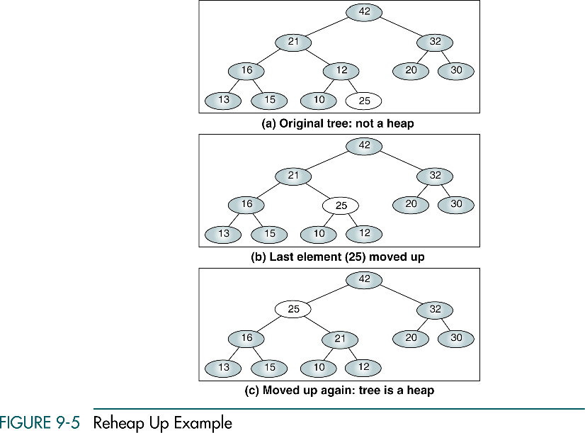
Reheap up Example

Slide 9
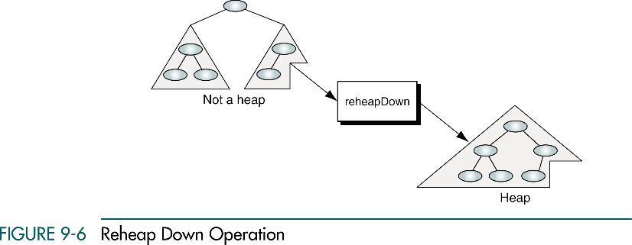
Reheap Down Operation
After deleting a node (root), the reheap down is needed

Slide 10
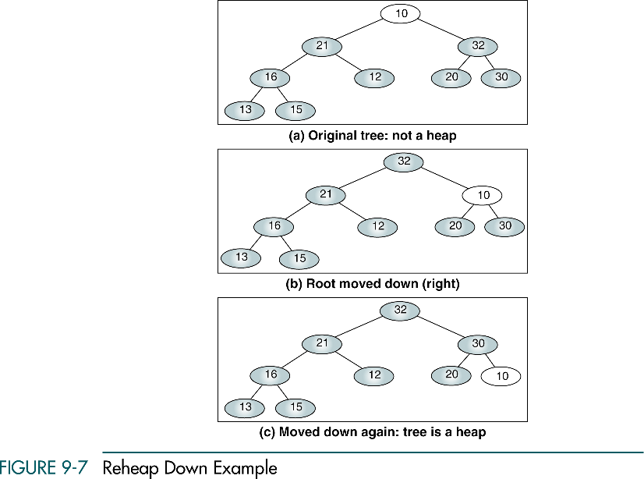
Reheap Down Example

Slide 11
9-2 Heap Implementation
Heaps are usually implemented in an array structure. In this section we discuss and develop five heap algorithms.
Reheap Up
Reheap Down
Build a Heap
Insert a Node into a Heap
Delete a Node from a Heap

Slide 12

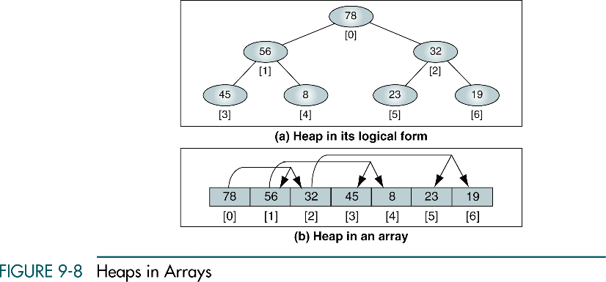
Heaps in Arrays
For a node located at index i, its children are found at
  Left child: 2 i + 1; right child: 2 i + 2; parent:
A heap can be implemented in an array because it must be a complete or nearly complete binary tree, which allows a fixed relationship between each node and its children

Slide 13
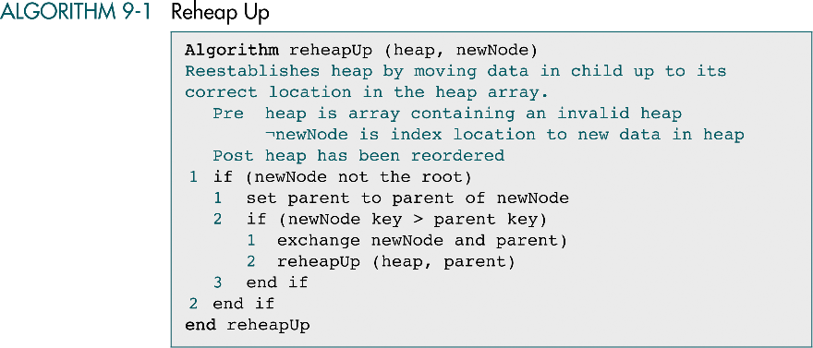
Reheap Up

Slide 14
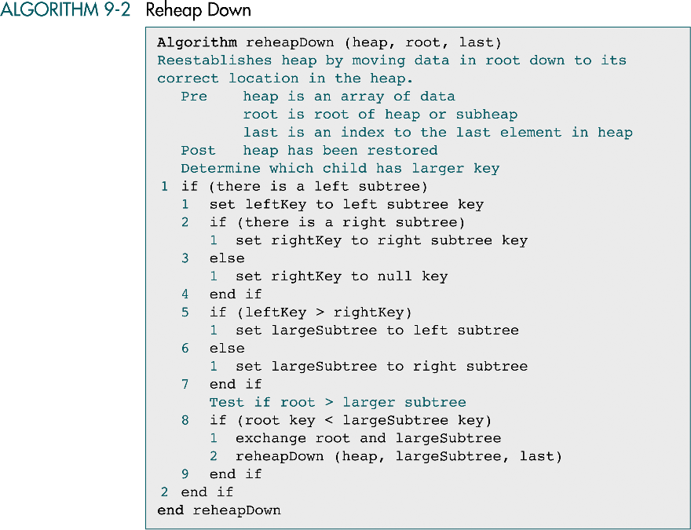
Reheap Down

Slide 15
Reheap Down (cont.)

Slide 16
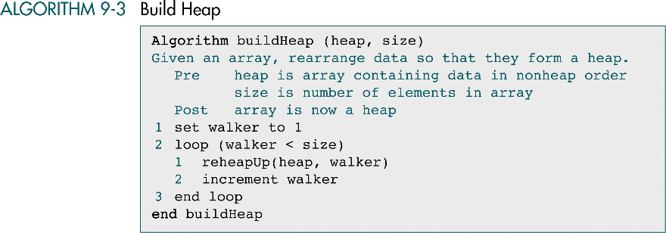
Build Heap

Slide 17
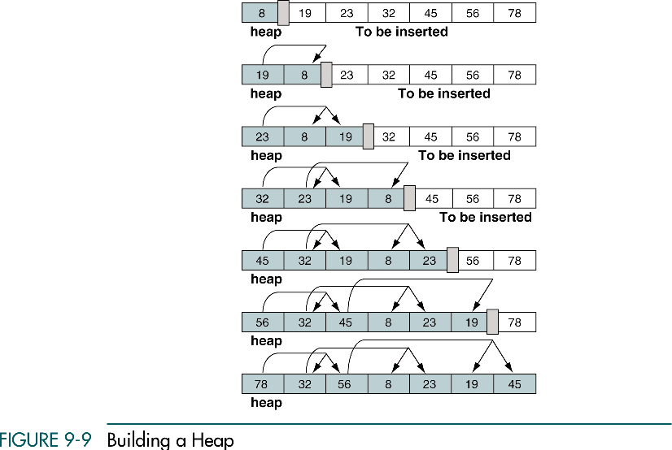
Building a Heap
8
19
8
23
8
19
32
23
19
45
8
32
19
56
8
23
32
45
23
19
78
8
32
56
8
23
19
45

Slide 18
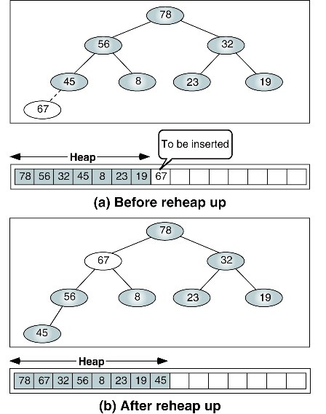
Insert Node

Slide 19
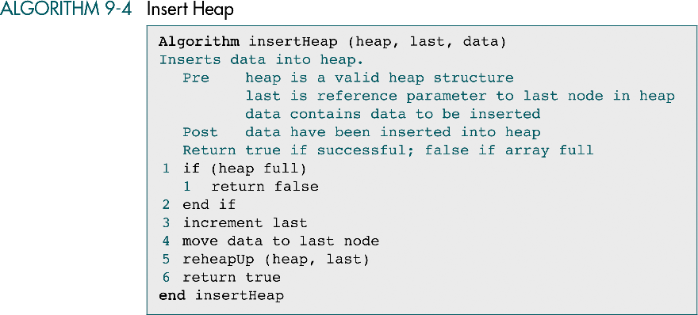
Insert Heap

Slide 20
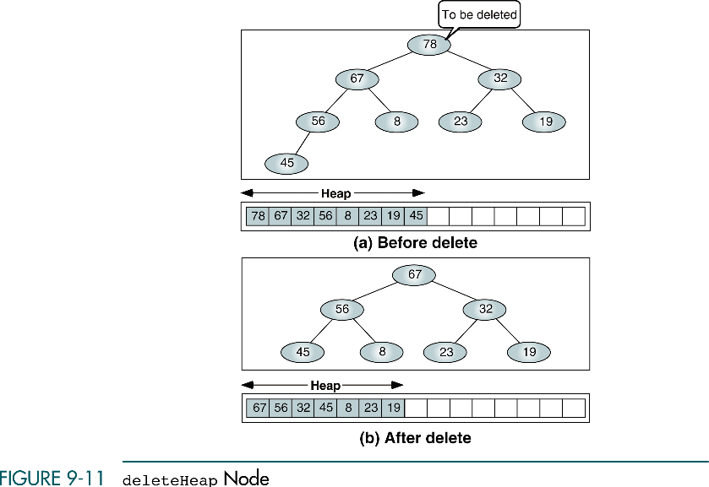
Delete Heap Node
The most common and meaningful logic is to delete the root

Slide 22
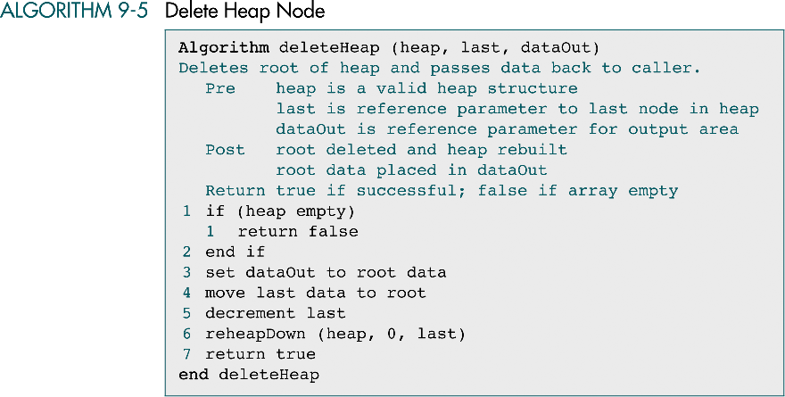
Delete Heap Node

Slide 23
9-3 Heap ADT
We begin with a discussion of the heap ADT design and then develop the C code for the five major functions developed in Section 9.2. Basic functions, such as heap full, are not provided.
Heap Structure
Heap Algorithms

Slide 24
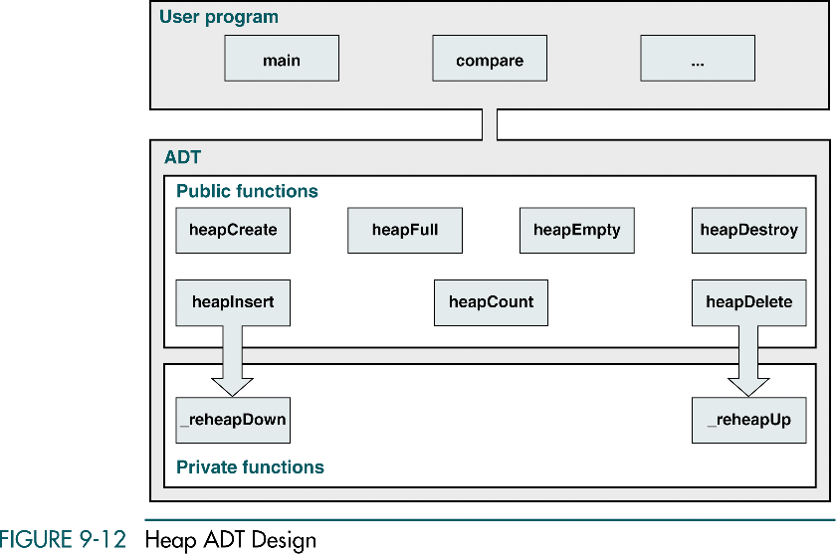
Heap ADT Design

Slide 25
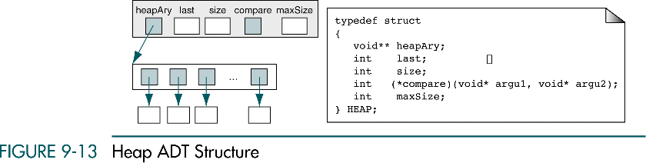
Heap ADT Structure

Slide 26
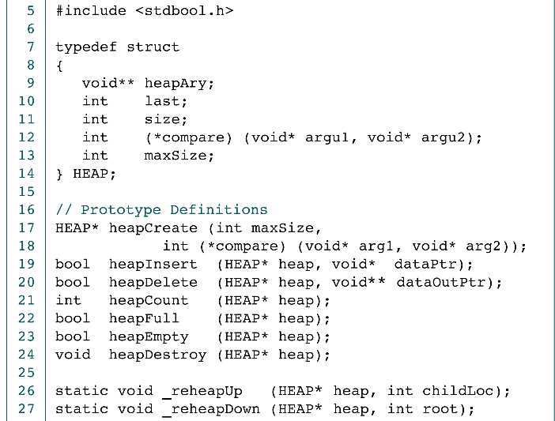
Heap Declaration

Slide 27
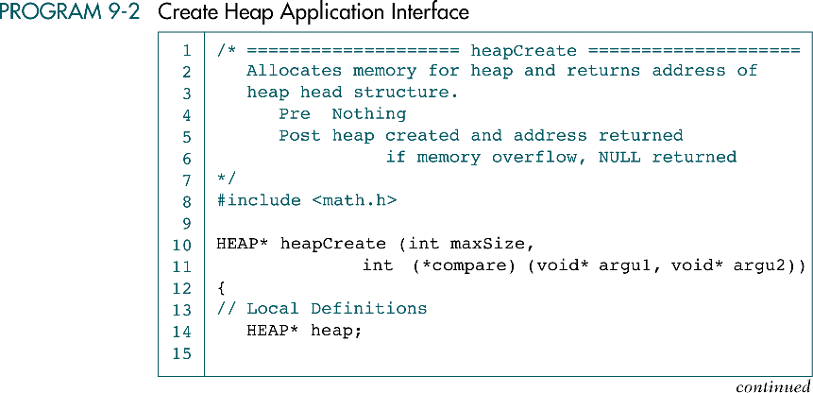
Create Heap Application interface

Slide 28
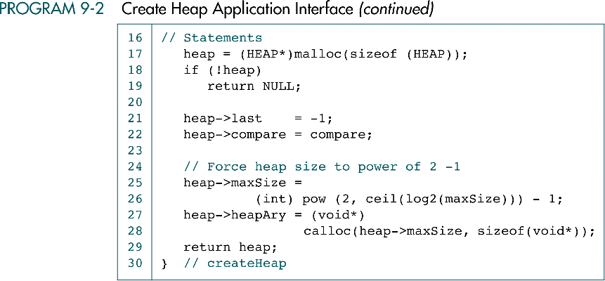
Create Heap Application interface (cont.)

Slide 29
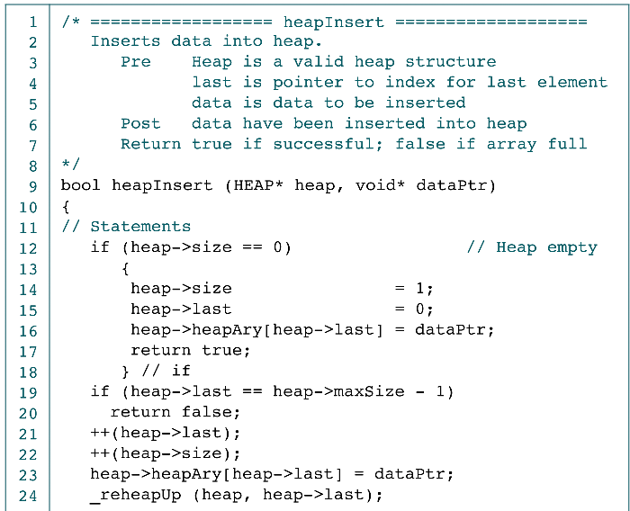

Insert Heap Application interface

Slide 30
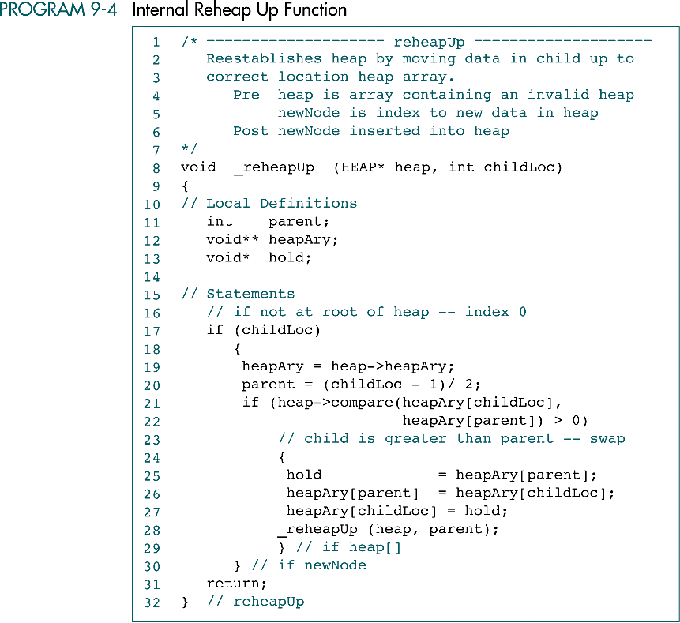
Insert ReHeap Up Function

Slide 31
Insert ReHeap Up Function (cont.)

Slide 32
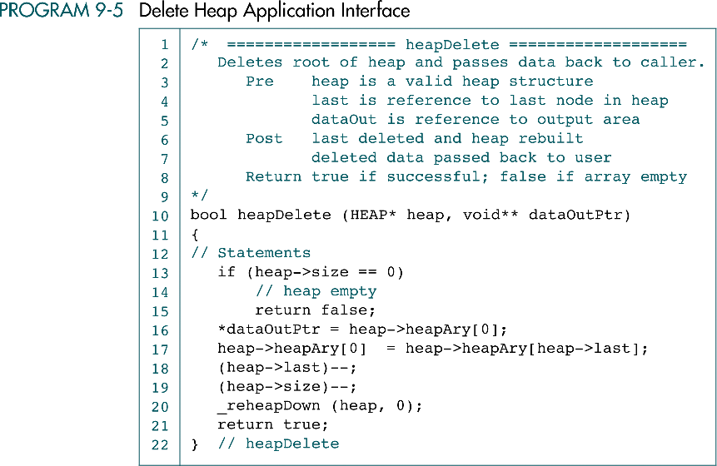
Delete Heap Application Interface

Slide 33
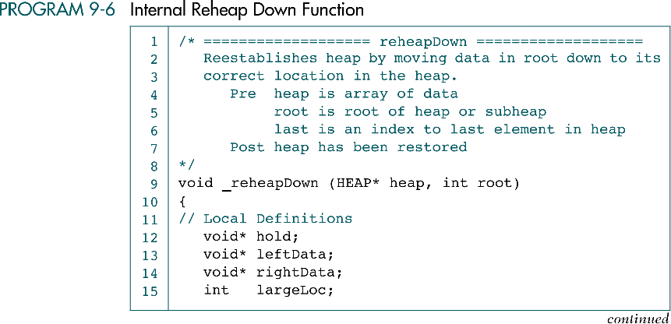
Internal Reheap Down Function

Slide 34
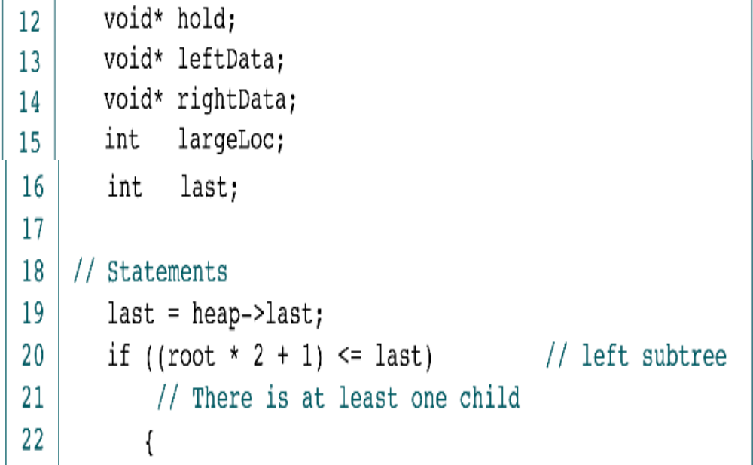
Internal Reheap Down Function (cont.)

Slide 35
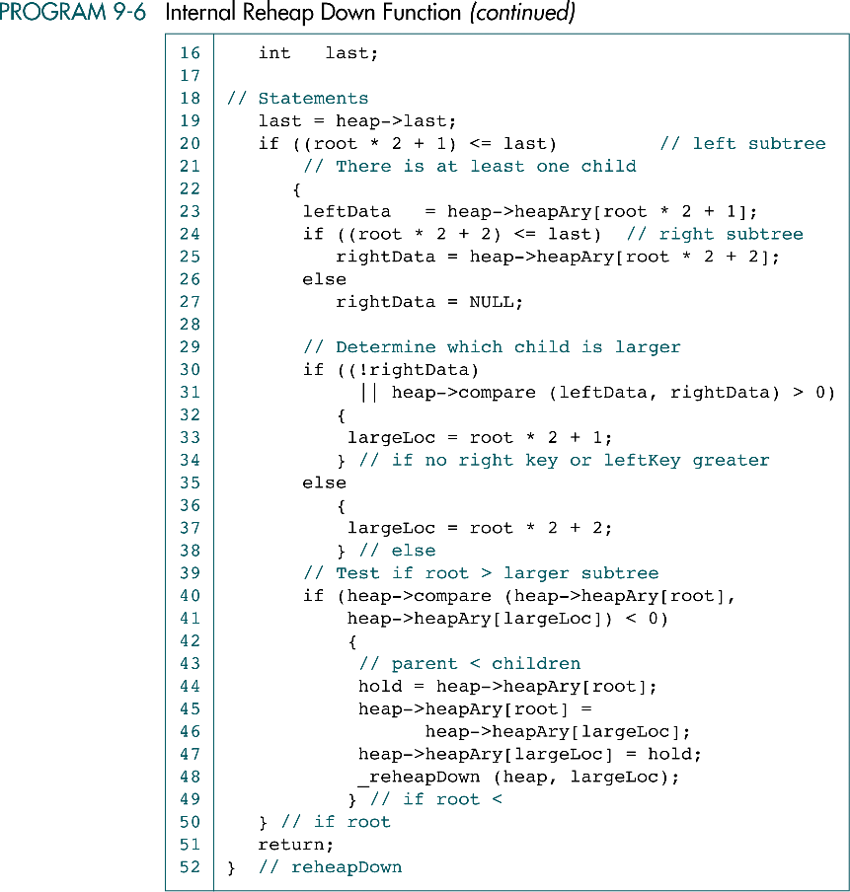
Internal Reheap Down Function (cont.)

Slide 36
9-4 Heap Applications
We discuss two of the three common heap applications-selection and priority queues. For selection applications, we develop a high-level algorithm. For priority queues, we develop the C code.
Selection Algorithms
Priority Queues
Sorting (Chapter 12)

Slide 37
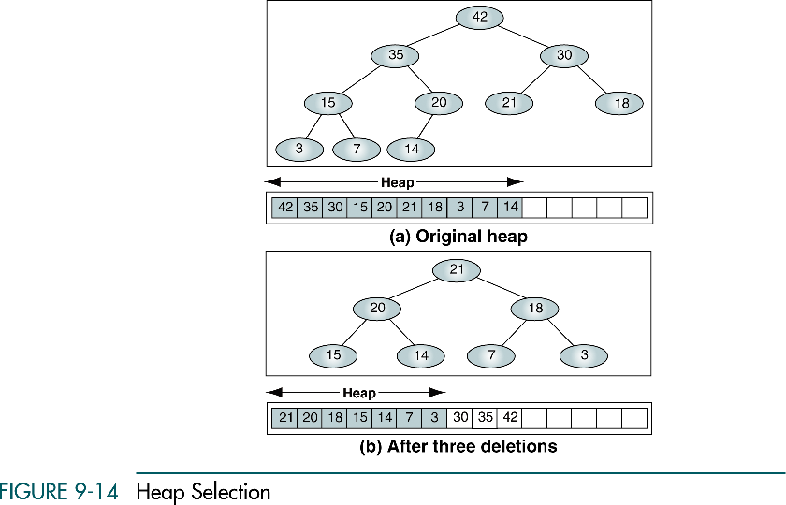
Heap Selection

Slide 38
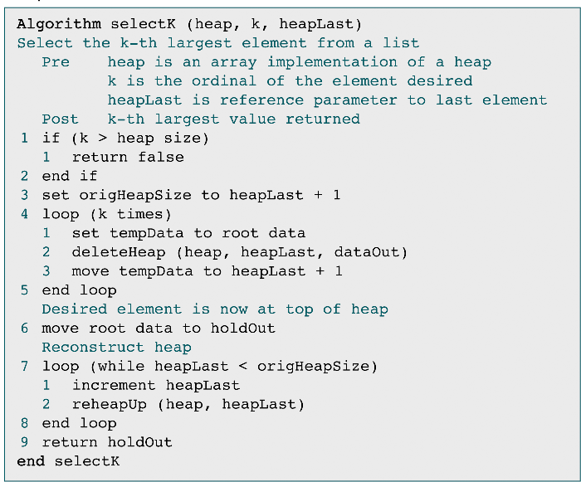
Heap Selection

Slide 39
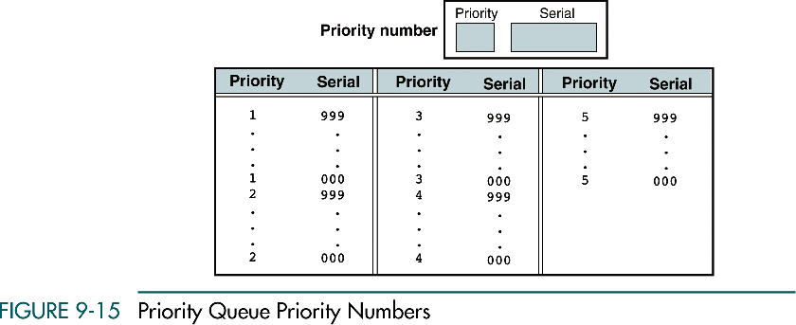
Priority Queue Priority Numbers

Slide 40
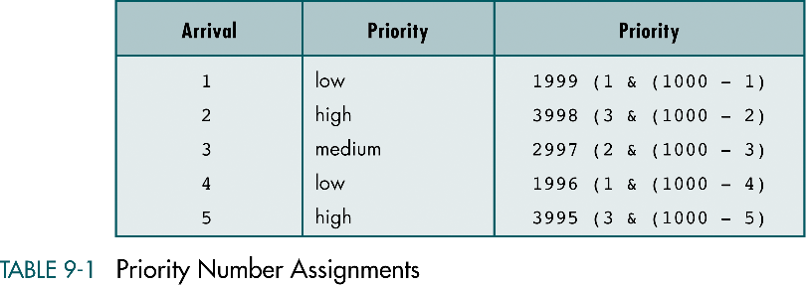
Priority Number Assignments

Slide 41
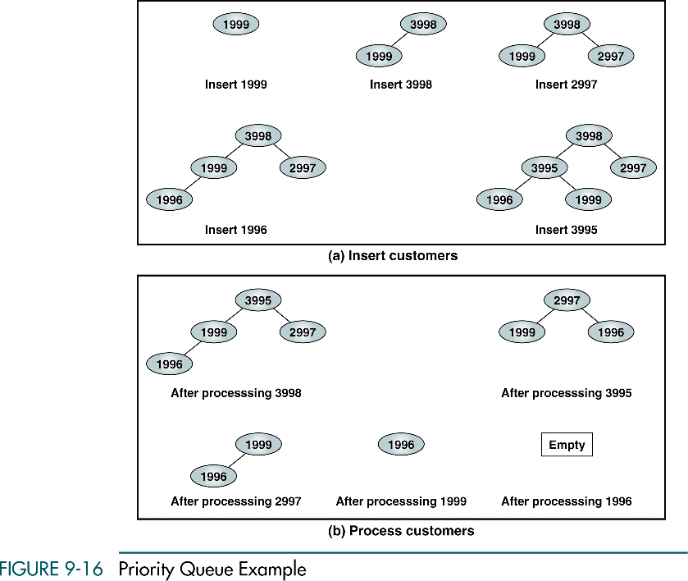
Priority Queue Example

Slide 42
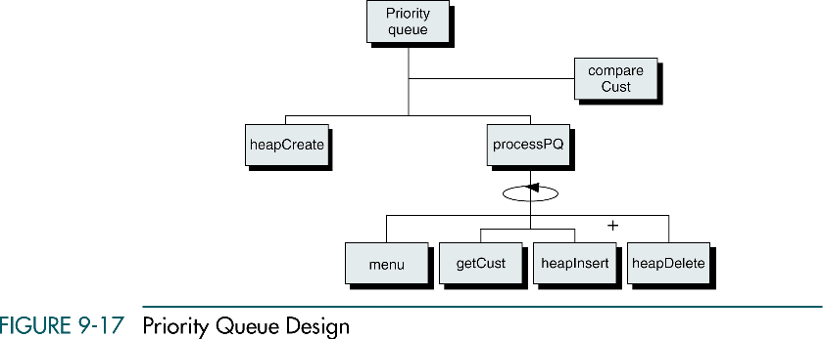
Priority Queue Design

Slide 43
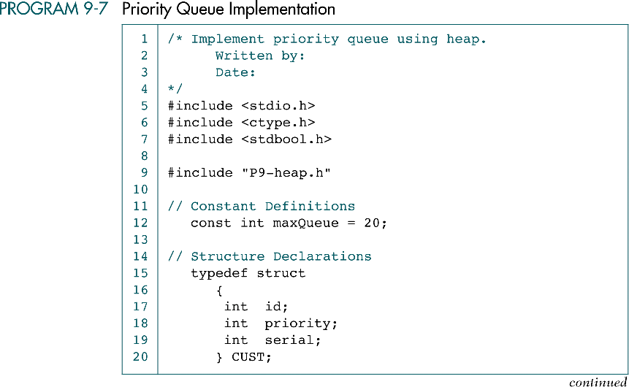
Priority Queue Implementation

Slide 44
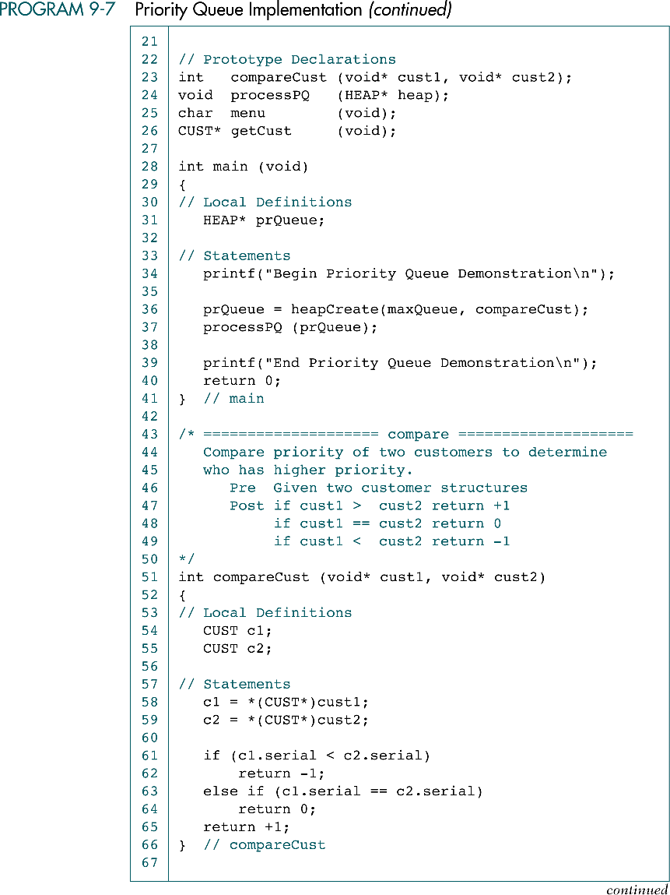
Priority Queue Implementation (cont.)

Slide 45
Priority Queue Implementation (cont.)

Slide 46
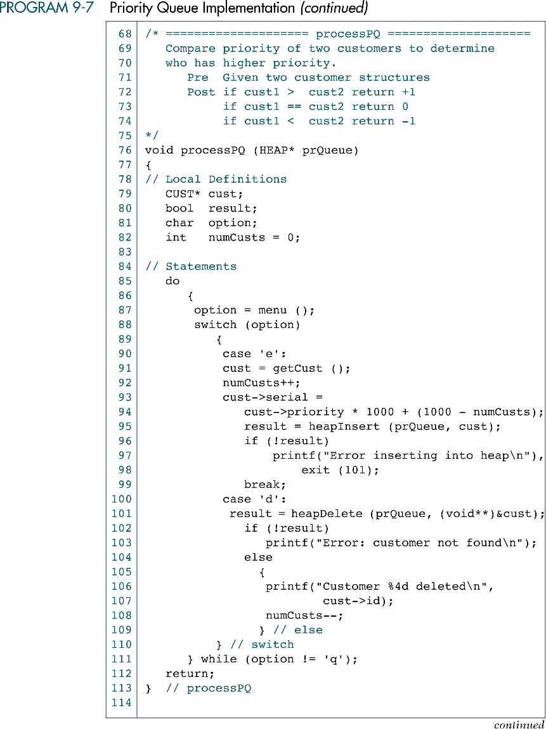
Priority Queue Implementation (cont.)

Slide 47
Priority Queue Implementation (cont.)

Slide 48
Priority Queue Implementation (cont.)

Slide 49
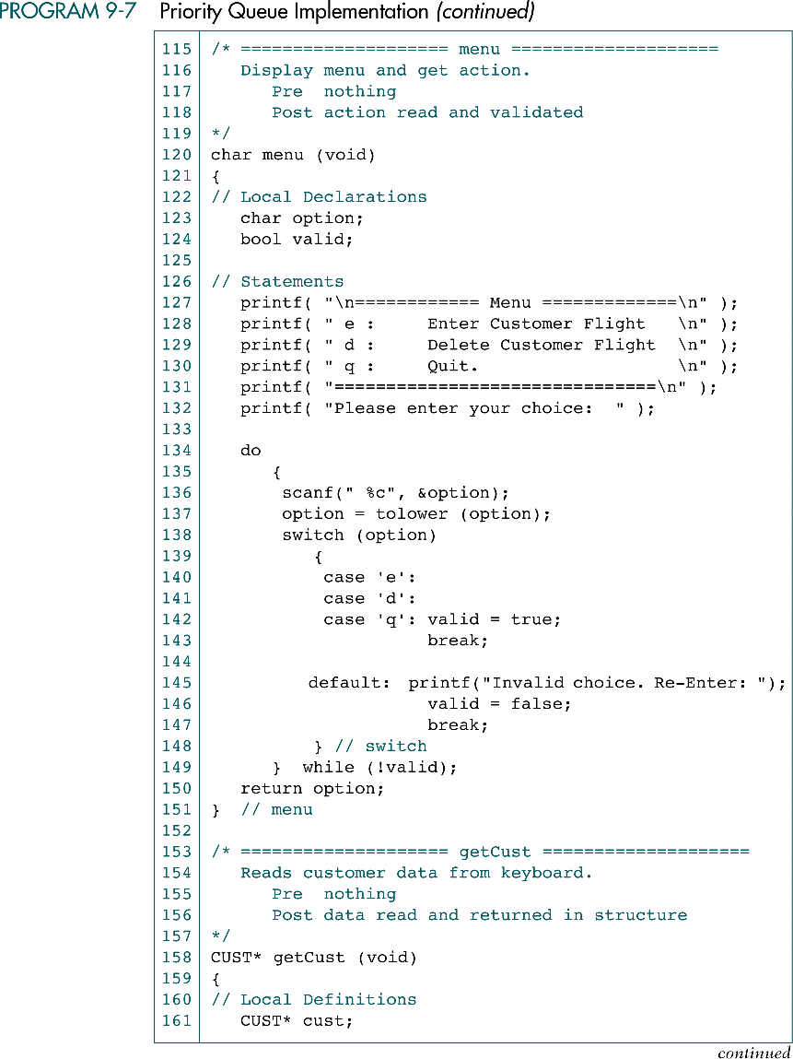
Priority Queue Implementation (cont.)

Slide 50
Priority Queue Implementation (cont.)

Slide 51
Priority Queue Implementation (cont.)

Slide 52
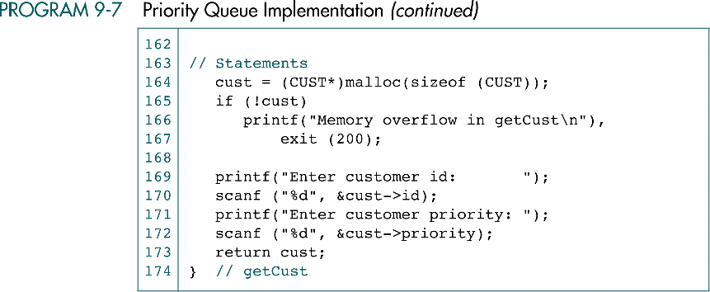
Priority Queue Implementation (cont.)

