Slide 1
Chapter 10
Multiway Trees
Objectives
Upon completion you will be able to:
Define and discuss multiway tree structures
Understand the operation and use of the B-tree ADT
Discuss the use and implementation of simplified B-trees
Compare and contrast B-trees, B*trees, and T+trees
Discuss the design and use a lexical search trees (Tries)

Slide 2
10-1 M-way Search Tree
This section explore trees whose outdegree is not restricted to 2 but that retain the general properties of binary search trees; Multiway trees have multiway entries in each node and thus may have multiple subtrees.
M-way tree
B-trees
B*trees
T+trees

Slide 3
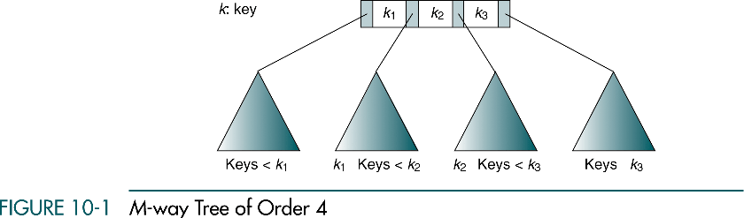
M-way Tree
≤
≤
≤

Slide 4
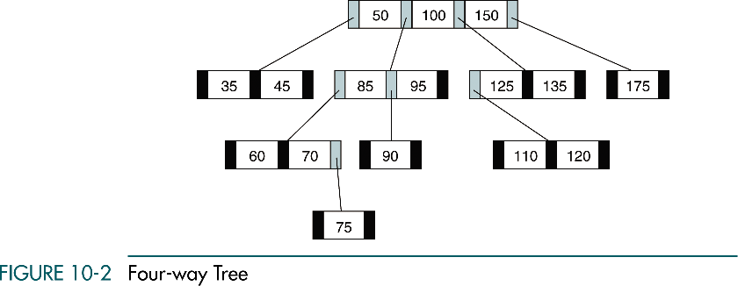
4-way Tree

Slide 5
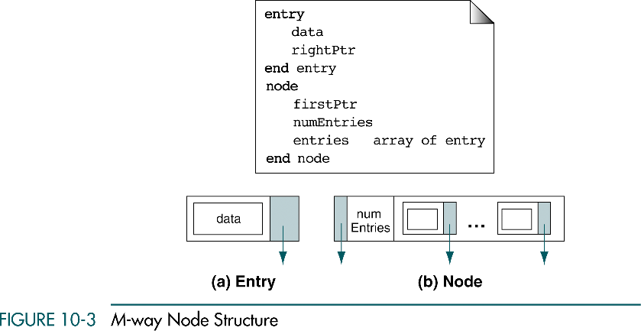
M-way Node Structure

Slide 6
10-2 B-trees
This section discusses the B-tree structure which is a balanced version of m-way tree.
Insertion
Deletion
Traversal
Search

Slide 7

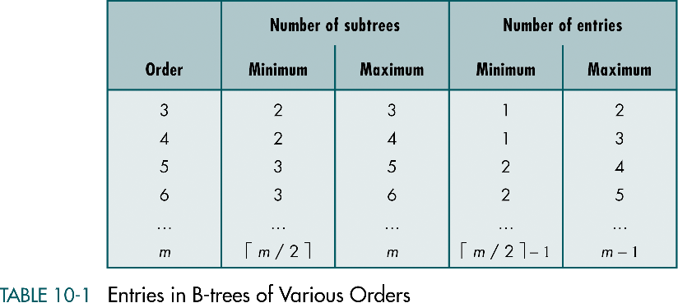
Entries in B-trees of Various Orders
Root: a leaf or it has 2…m subtrees
Internal node: … m subtrees ( -1 … m-1 entries)
Leaf node: -1 … m-1 entries
All leaf nodes are at the same level (perfectly balanced)

Slide 8
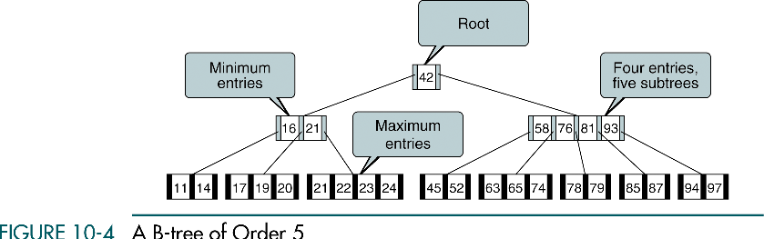
A B-tree of Order 5

Slide 9
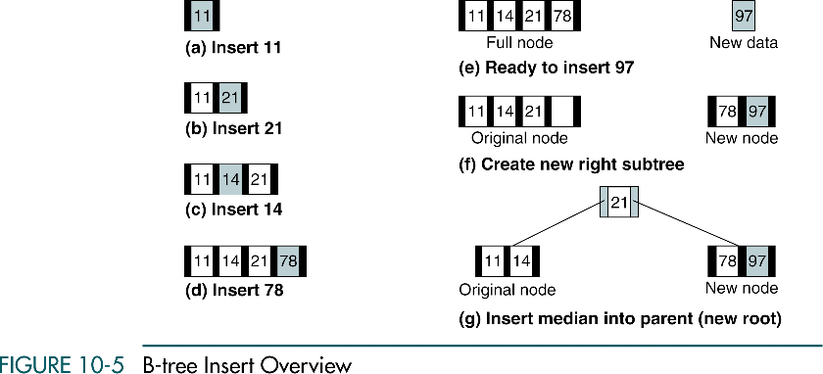
B-tree Insert Overview

Slide 10
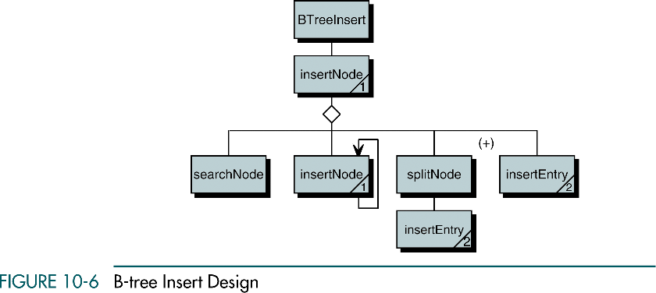
B-tree Insert Design

Slide 11
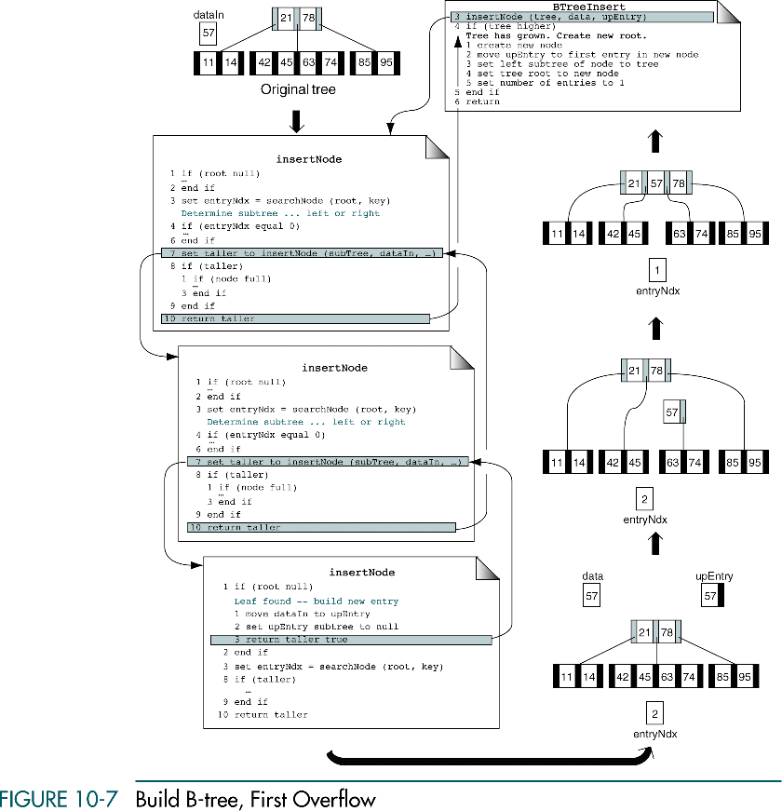
Build B-tree with Overflow

Slide 12
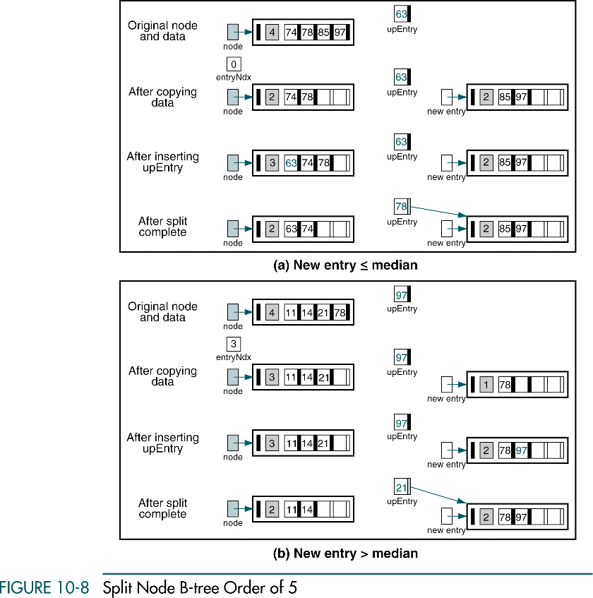
Split Node B-tree Order of 5

Slide 13
Split Node B-tree Order of 5 (cont.)

Slide 14
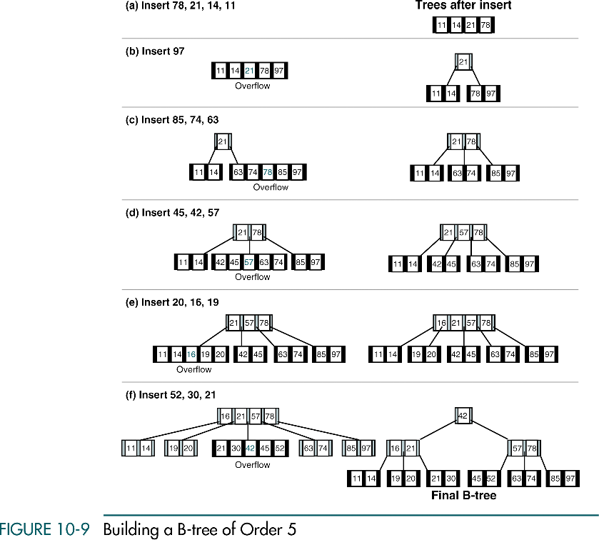
Building a B-tree of Order 5

Slide 15
Building a B-tree of Order 5 (cont.)

Slide 16
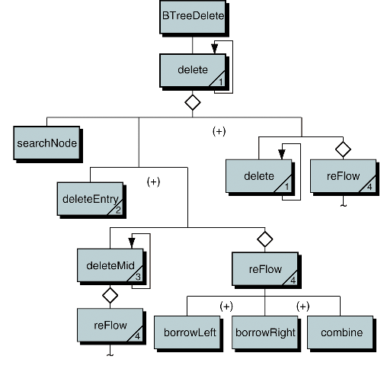
B-tree Delete Design

Slide 17
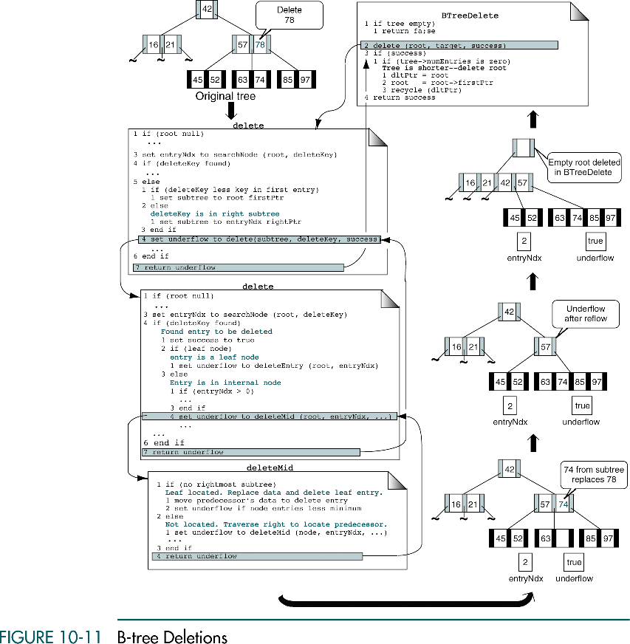
B-tree Deletions
Combine
Borrow ?
Underflow
Combine
Borrow ?
Underflow

Slide 18
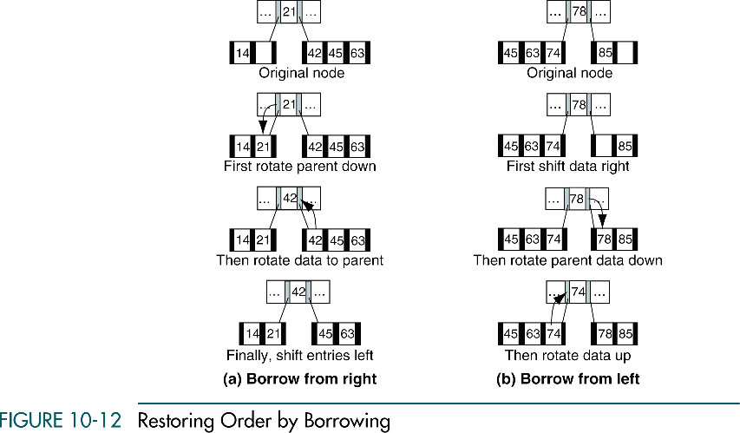
Restoring Order by Borrowing

Slide 19
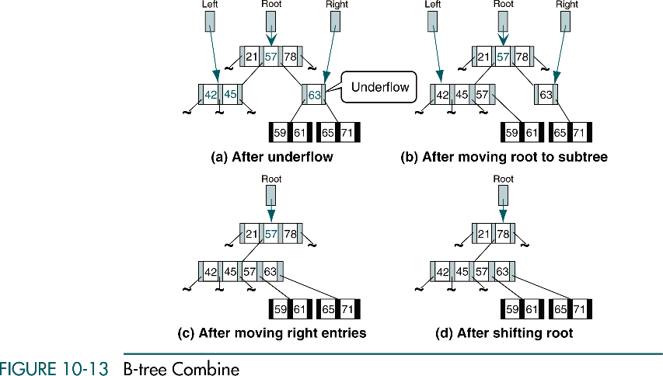
B-tree Combine

Slide 20
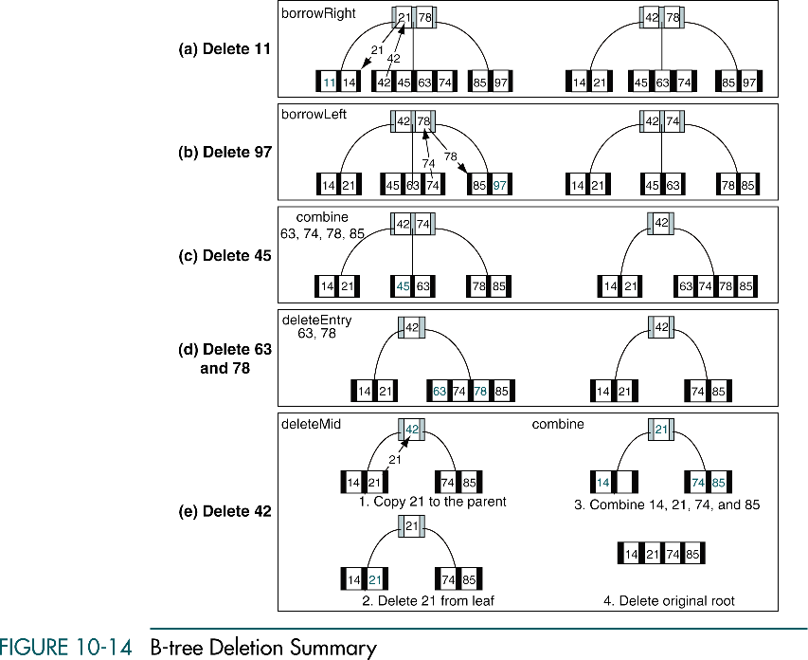
B-tree Deletion Summary

Slide 21
B-tree Deletion Summary (cont.)

Slide 22
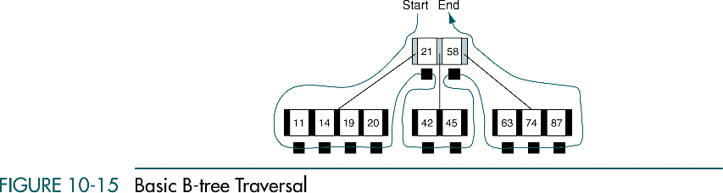
Basic B-tree Traversal

Slide 23
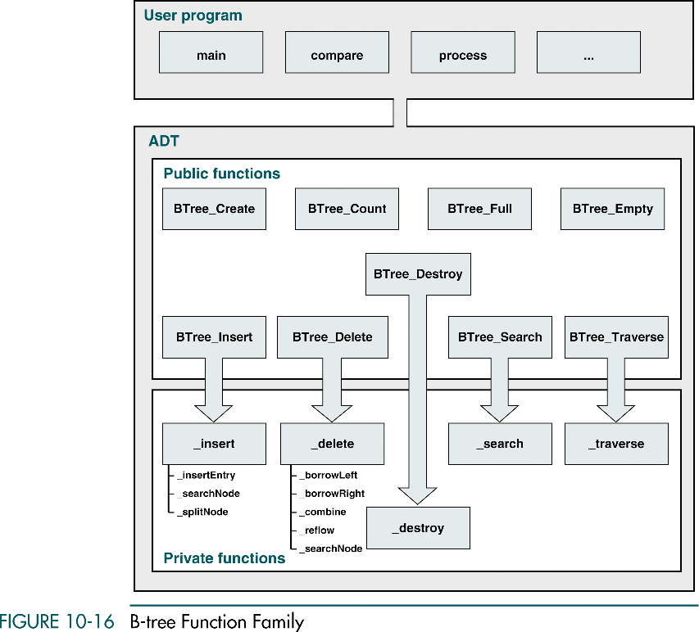
10-3 B-tree ADT

Slide 24
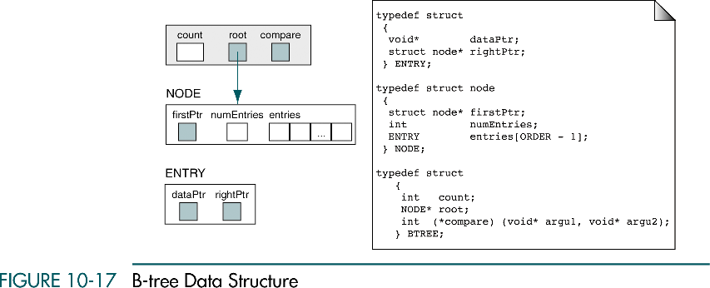
B-tree Data Structure

Slide 25
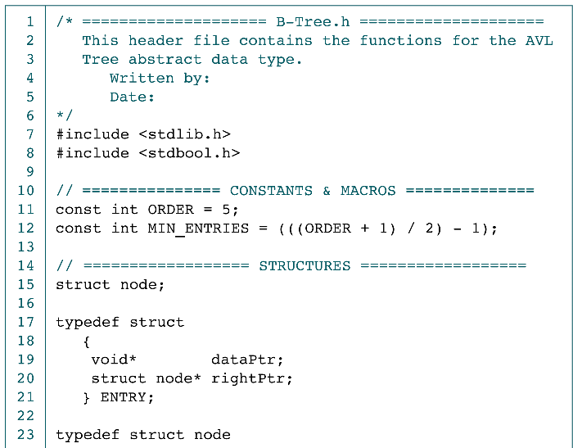
B-tree Declaration

Slide 26
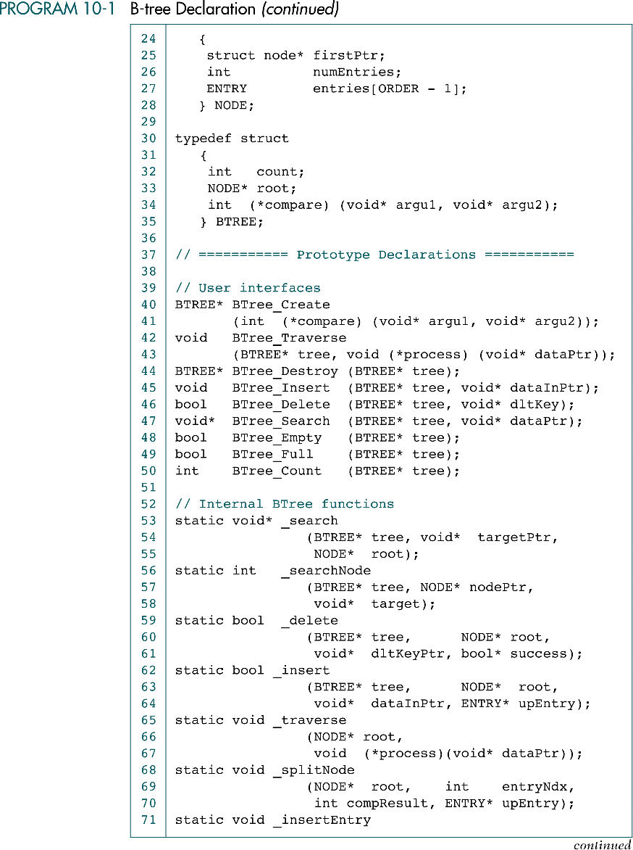
B-tree Declaration (cont.)

Slide 27
B-tree Declaration (cont.)

Slide 28
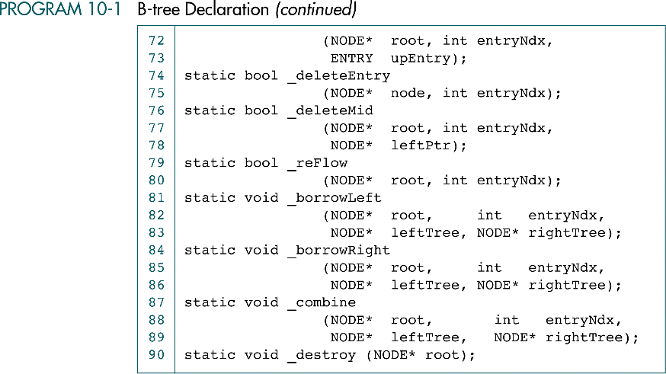
B-tree Declaration (cont.)

Slide 29
10-4 Simplified B-tree
This section discusses 2 specialized B-tree which have been assigned unique names by computer scientists
2-3 tree
2-3-4 tree

Slide 30
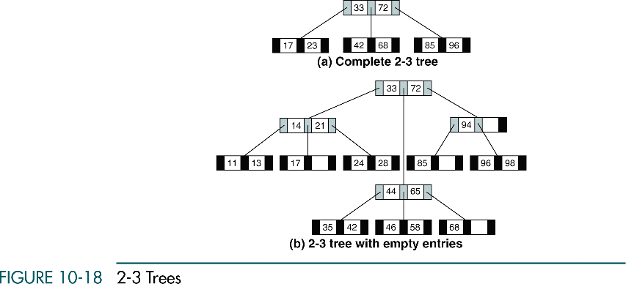
2-3 Trees

Slide 31
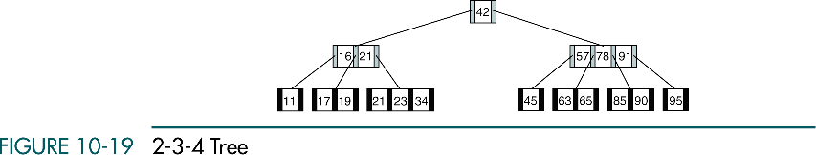
2-3-4 Tree

Slide 32
10-5 B-tree Variations
This section discusses two popular variations on the B-tree
B* tree
B+ tree

Slide 33
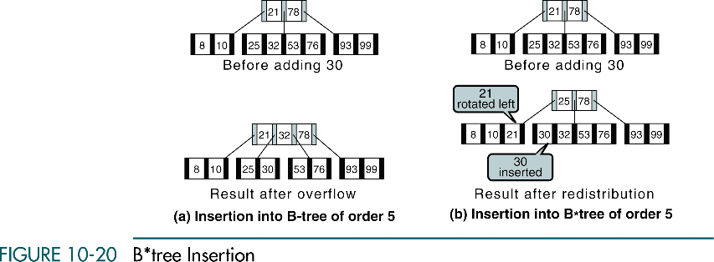
B* tree Insertion

Slide 34
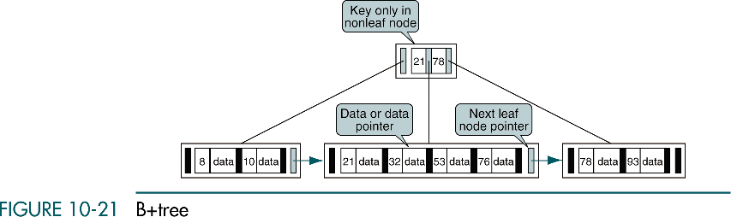
B+ tree

Slide 35
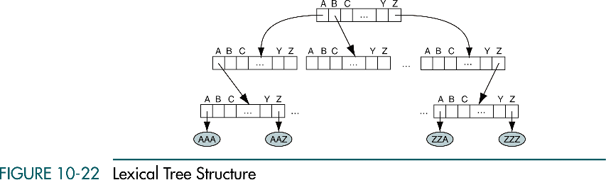
10-6 Lexical Search Tree

Slide 36
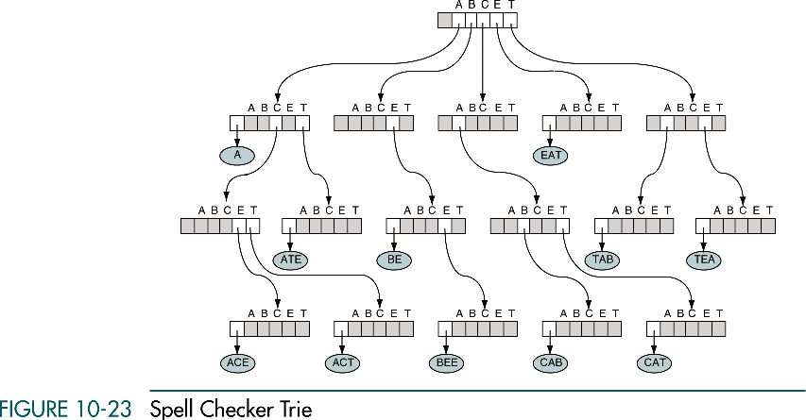
Spell Checker Trie

Slide 37
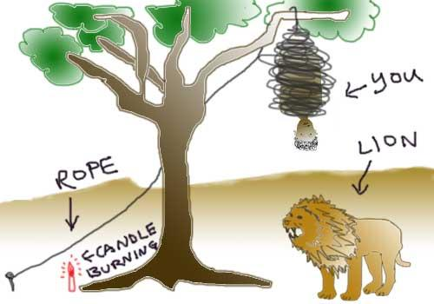

Slide 38
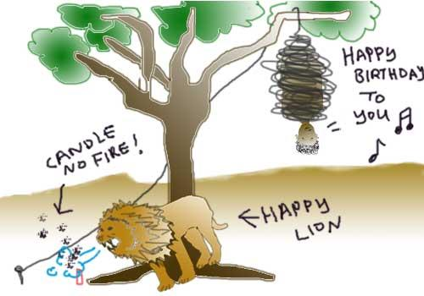

Slide 39


Slide 40
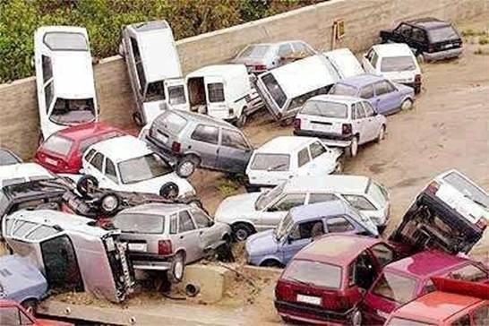
With the high rate of attacks on women in secluded
parking lots, especially during evening hours, the
Minneapolis City Council has established a "Women Only"
parking lot at the Mall of America. Even the parking lot
attendants are exclusively female so that a comfortable
and safe environment is created for patrons.
Below is the first picture available of this world-first women-only
parking lot in Minnesota.

Slide 41


