Slide 1
Chapter 11
Graphs
Objectives
Upon completion you will be able to:
Understand and use basic graph terminology and concepts
Define and discuss basic graph and network structures
Design and implement graph and network applications
Design and implement applications using the graph ADT
Define and discuss Dijkstra's shortest path algorithm

Slide 2
11-1 Basic Concepts
A graph is a collection of nodes, called vertices, and a collection of segments, called lines, connecting pairs of vertices. In Basic Concepts we develop the terminology and structure for graphs. In addition to the graph definitions, discussion points include:
Directed and Undirected Graphs
Cycles and Loops
Connected and Disjoint Graphs

Slide 3
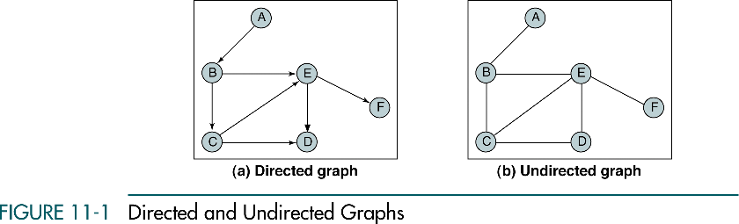
Directed and Undirected Graphs

Slide 4

Cycles and Loops

Slide 5
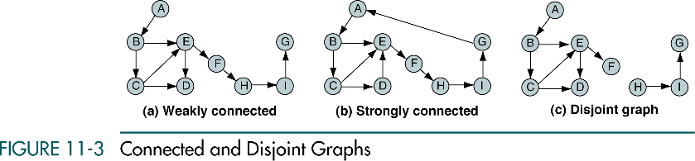
Connected and Disjoint Graphs

Slide 6
11-2 Operations
We define and discuss the six primitive graph operations required to maintain a graph.
Insert Vertex
Delete Vertex
Add Edge
Delete Edge
Find Vertex
Traverse Graph

Slide 7
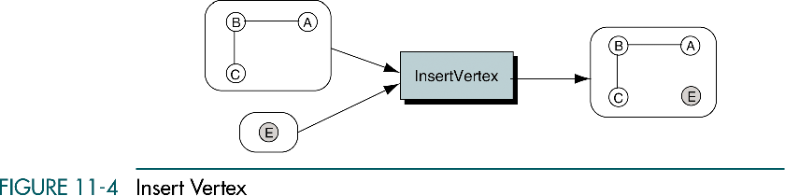
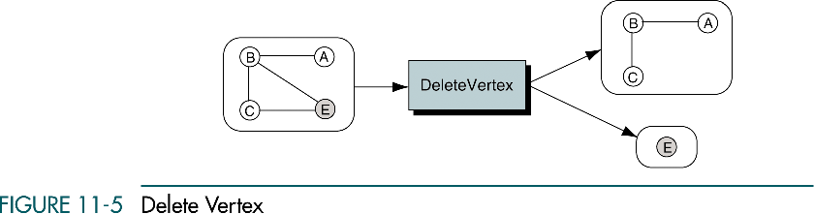
Insert and Delete Vertex

Slide 8
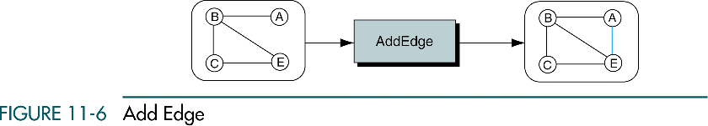
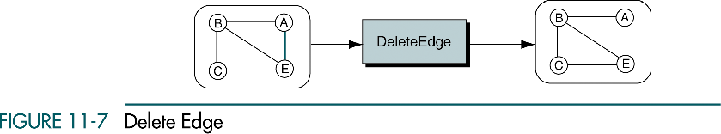
Add and Delete Edge

Slide 9
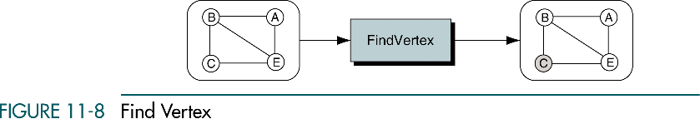
Find Vertex

Slide 10
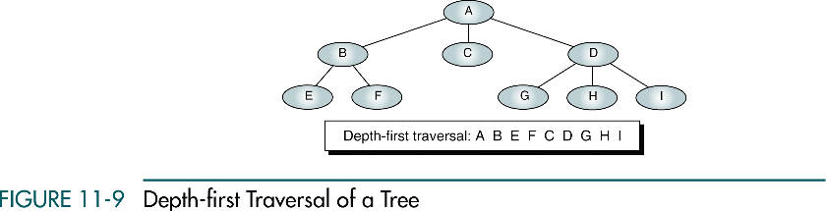
Depth-first Traversal of Tree

Slide 11
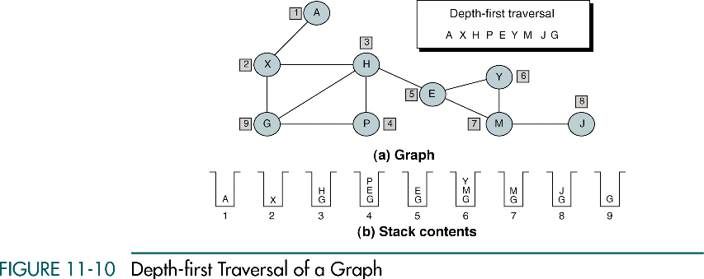
Depth-first Traversal of a Graph

Slide 12
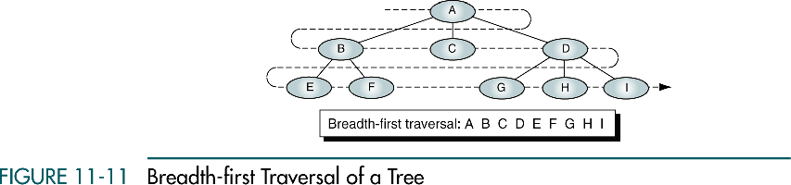
Breadth-first Traversal of a Tree

Slide 13
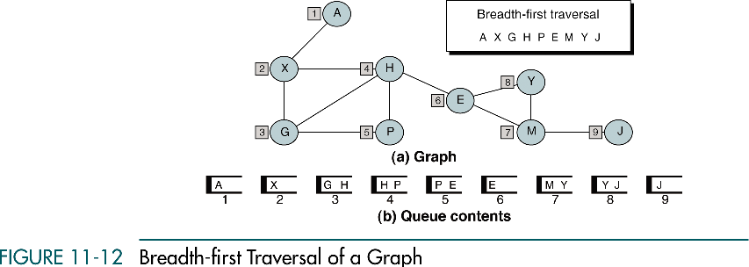
Breadth-first Traversal of a Graph

Slide 14
11-3 Graph Storage Structures
To represent a graph, we need to store two sets. The first set represents the vertices of the graph, and the second set represents the edges or arcs. The two most common structures used to store these sets are arrays and linked lists.
Adjacency Matrix
Adjacency List

Slide 15
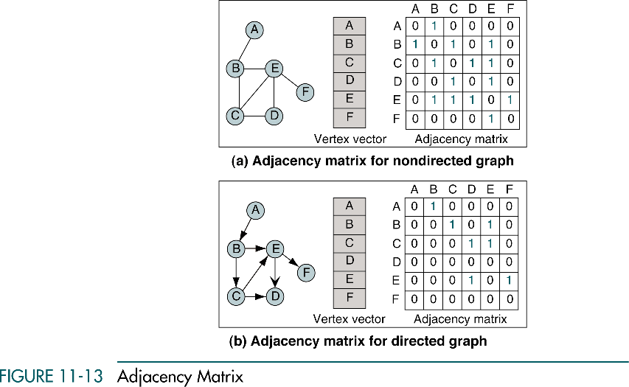
Adjacency Matrix

Slide 16
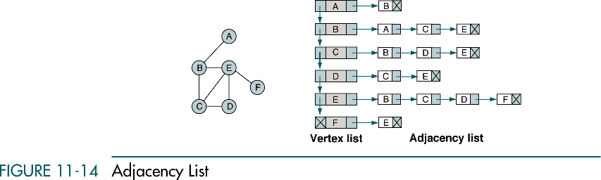
Adjacency List

Slide 17
11-4 Graph Algorithms
In this section we develop a minimum set of algorithms that are needed to create and maintain a directed graph.
Create Graph
Insert Vertex
Delete Vertex
Insert Arc
Delete Arc
Retrieve Vertex
Depth-first Traversal
Breadth-first Traversal
Destroy Graph

Slide 18
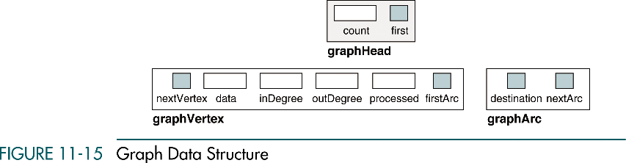
Graph Data Structure

Slide 19
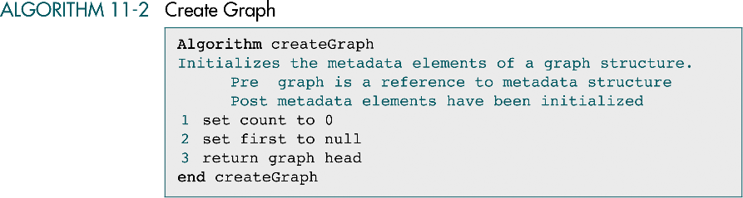
Create Graph

Slide 20
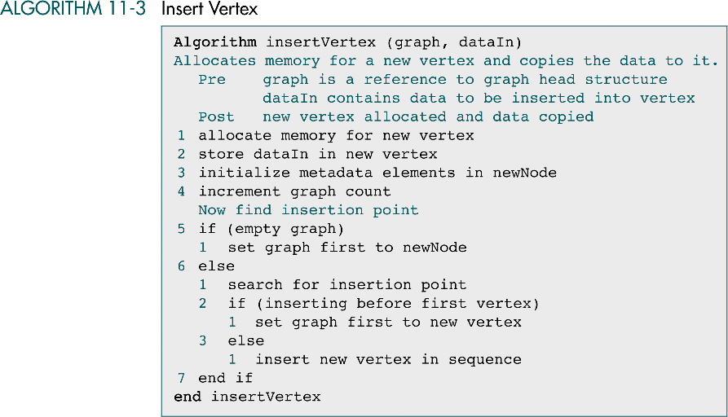
Insert Vertex

Slide 21
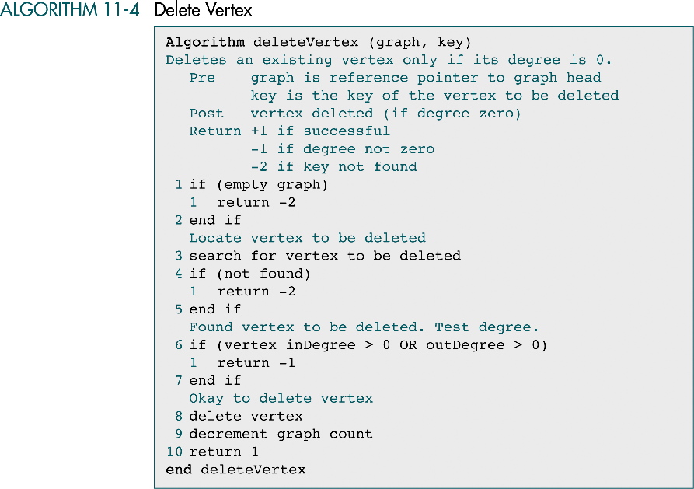
Delete Vertex

Slide 22
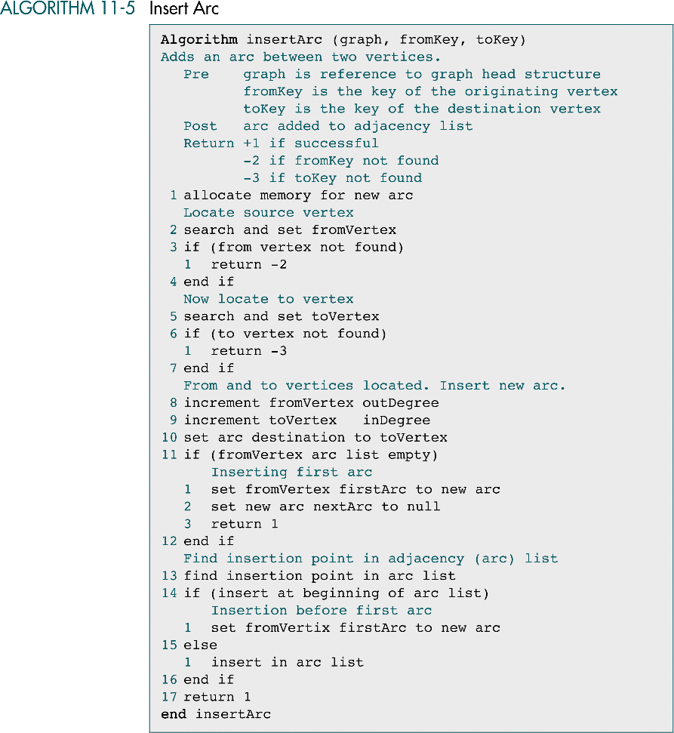
Insert Arc

Slide 23
Insert Arc (cont.)

Slide 24
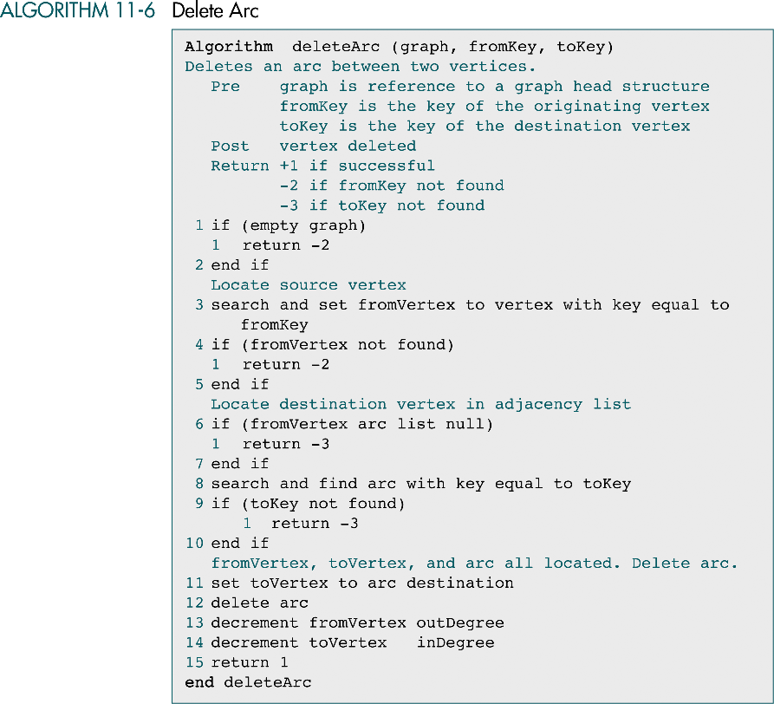
Delete Arc

Slide 25
Delete Arc (cont.)

Slide 26
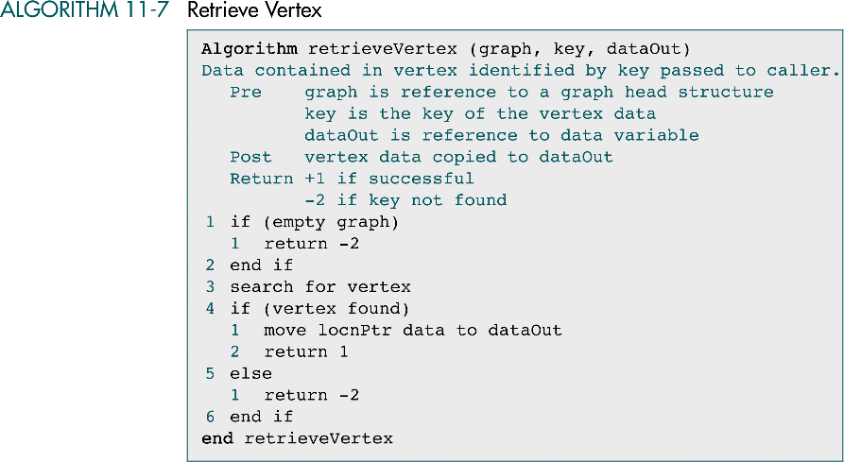
Retrieve Vertex

Slide 27
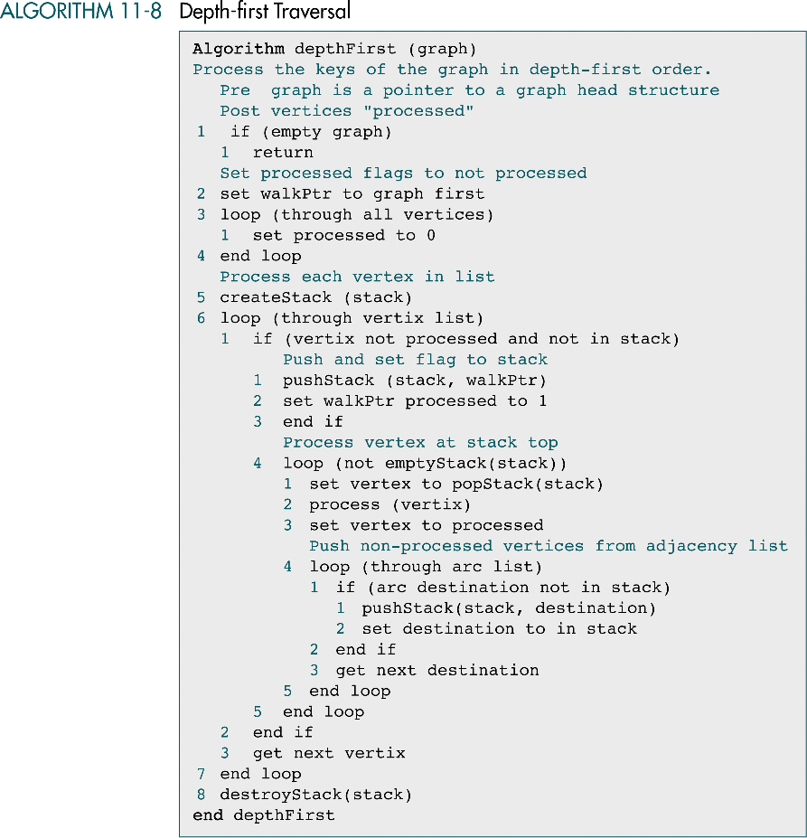
Depth-first Traversal

Slide 28
Depth-first Traversal (cont.)
?

Slide 29
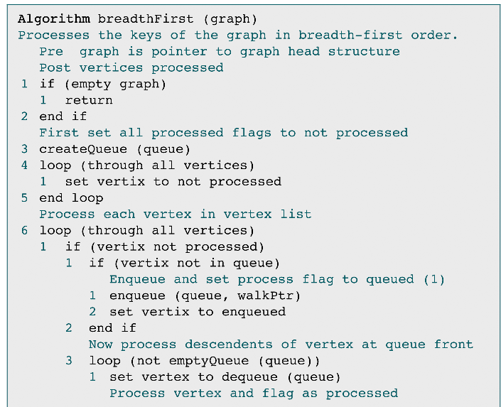
Breadth-first Traversal

Slide 30
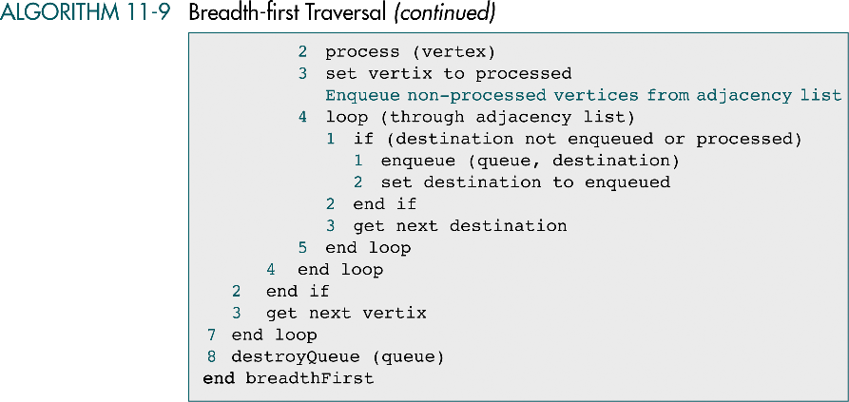
Breadth-first Traversal (cont.)

Slide 31
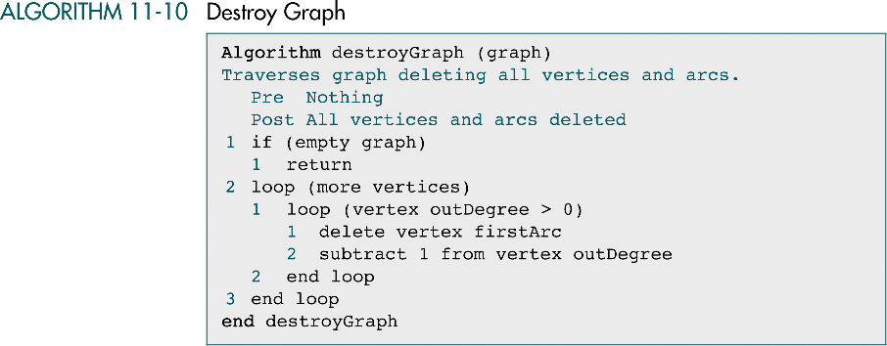
Destroy Graph

Slide 32
11-5 Graph ADT
We begin by developing the code for the three graph structures. We then develop the code for the ADT functions.
Data Structure
Functions

Slide 33
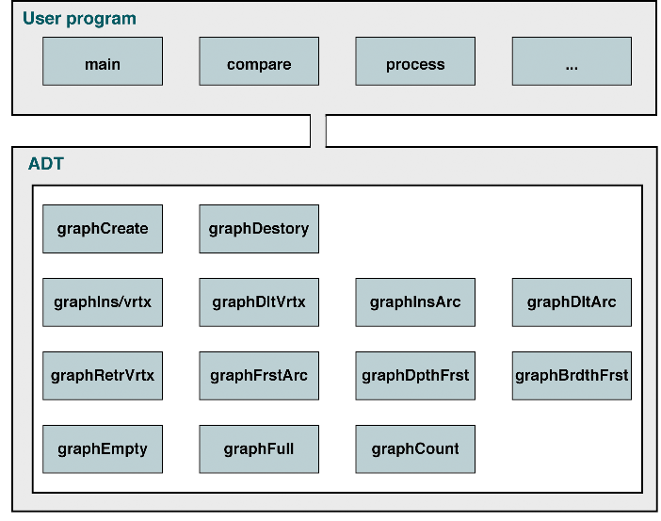
Graph ADT Design

Slide 34
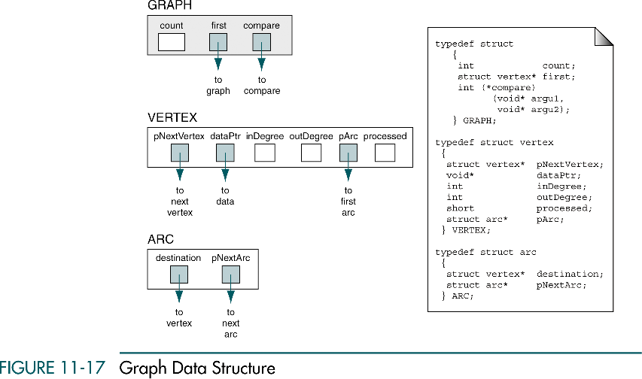
Graph Data Structure

Slide 35
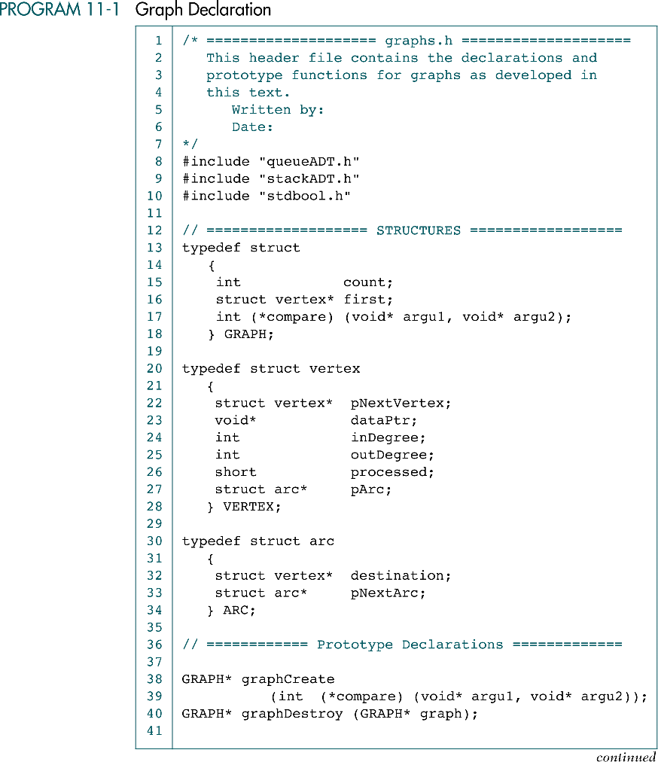
Graph Declarations

Slide 36
Graph Declarations (cont.)

Slide 37
Graph Declarations (cont.)

Slide 38
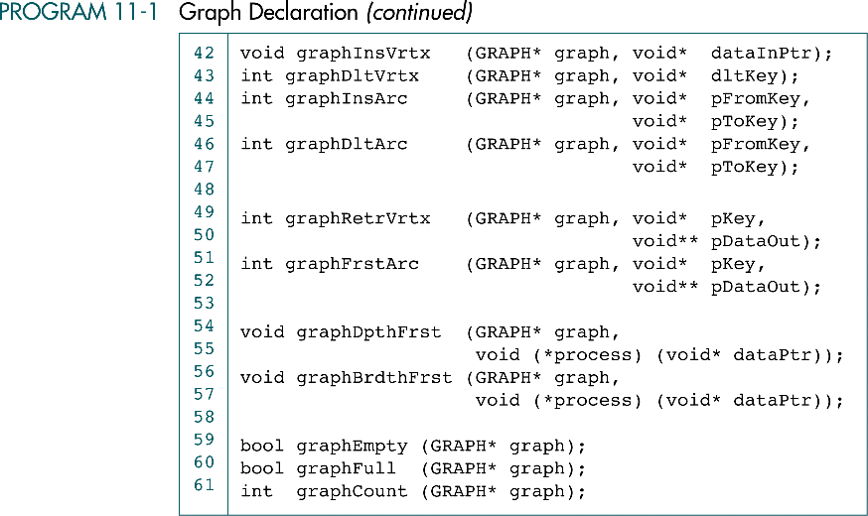
Graph Declarations (cont.)

Slide 39
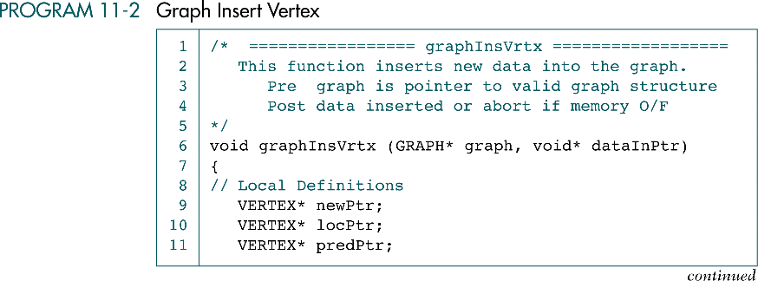
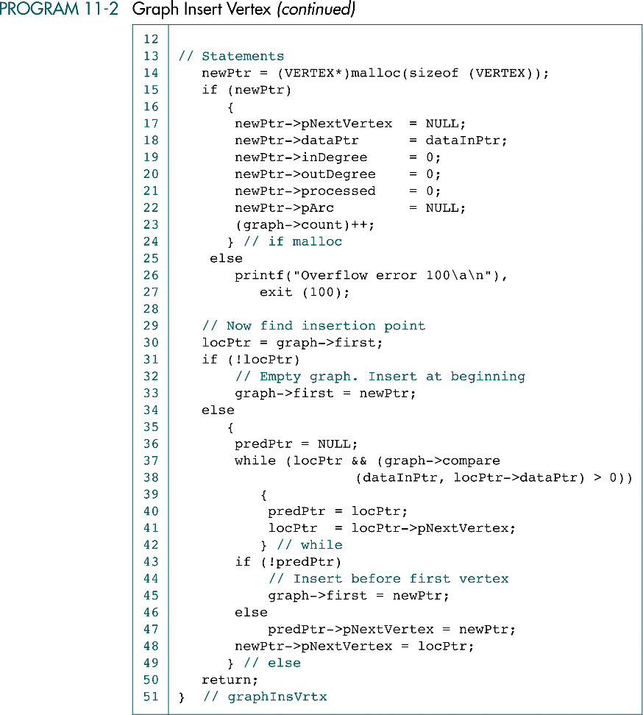
Graph Insert Vertex

Slide 40
Graph Insert Vertex (cont.)

Slide 41
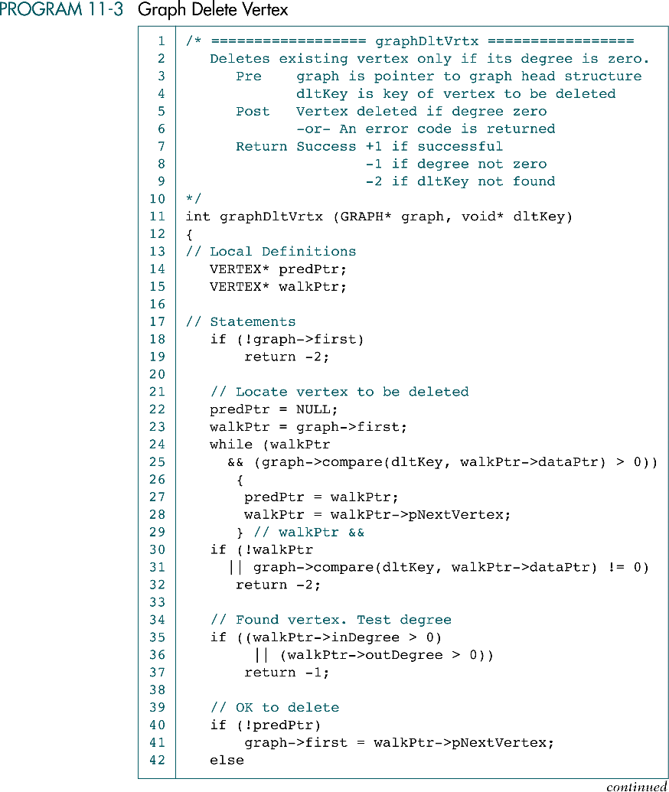
Graph Delete Vertex

Slide 42
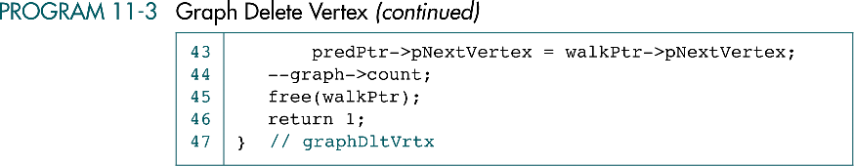
Graph Delete Vertex (cont.)

Slide 43
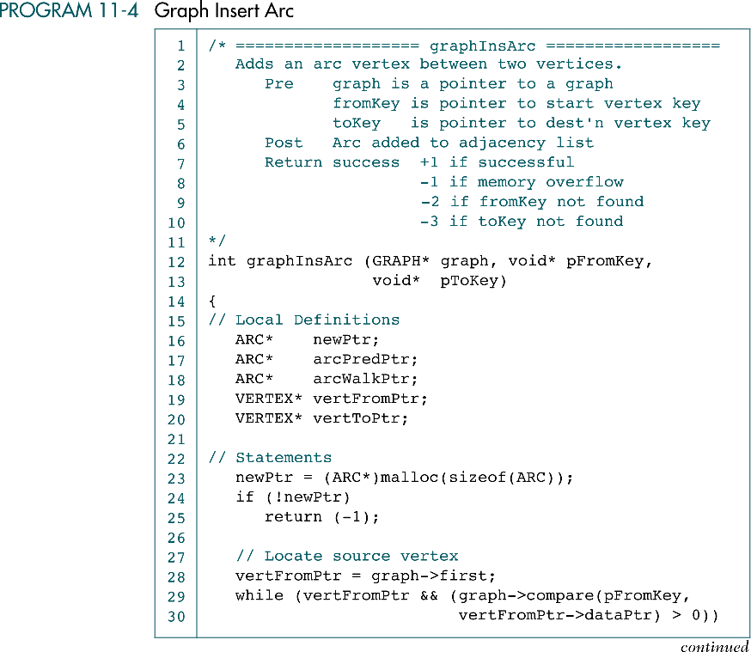
Graph Insert Arc

Slide 44
Graph Insert Arc (cont.)

Slide 45
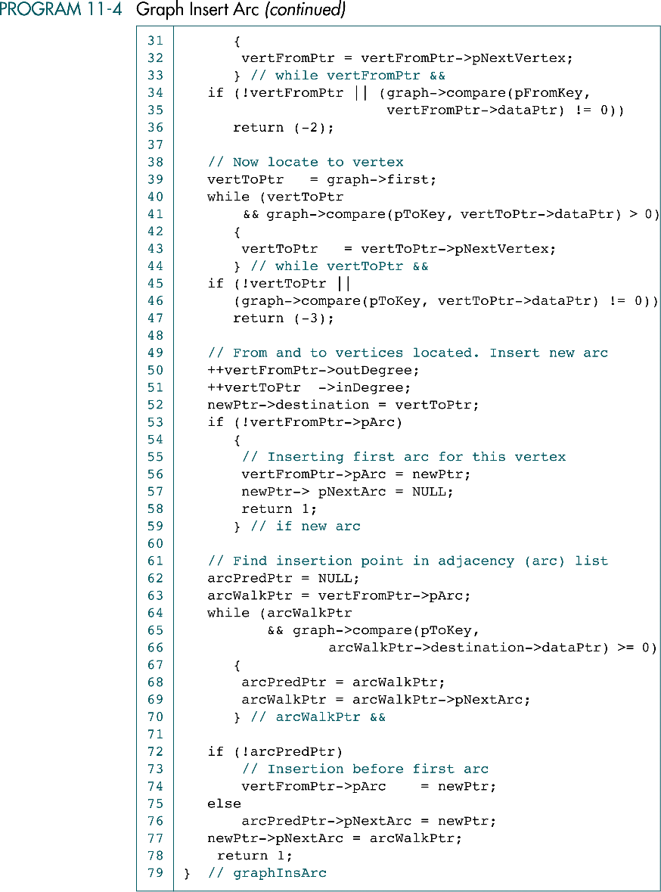
Graph Insert Arc (cont.)

Slide 46
Graph Insert Arc (cont.)

Slide 47
Graph Insert Arc (cont.)

Slide 48
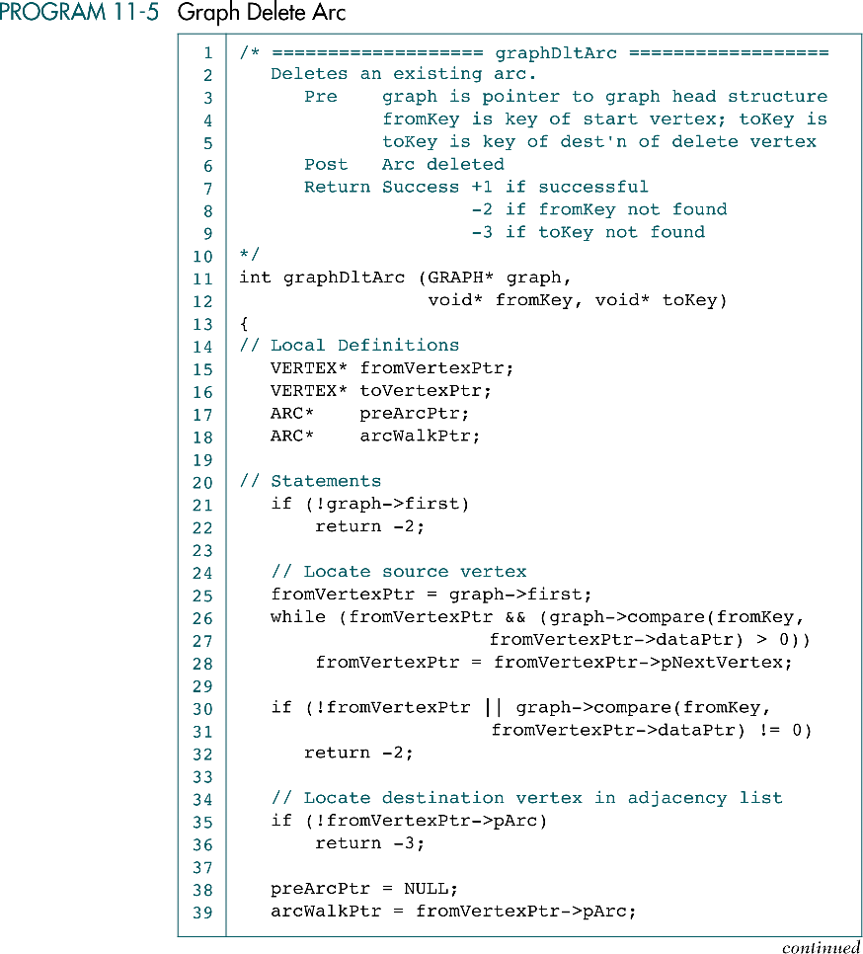
Graph Delete Arc

Slide 49
Graph Delete Arc (cont.)

Slide 50
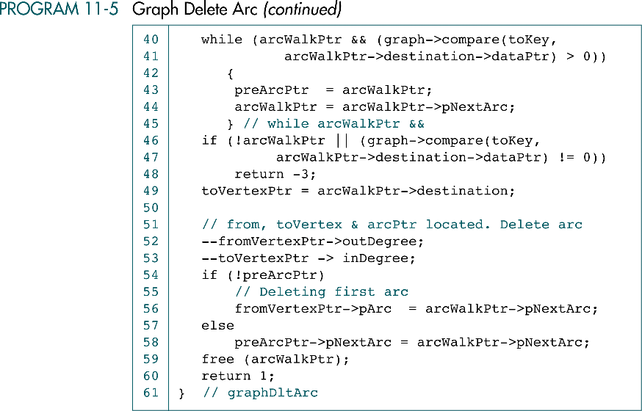
Graph Delete Arc (cont.)

Slide 51
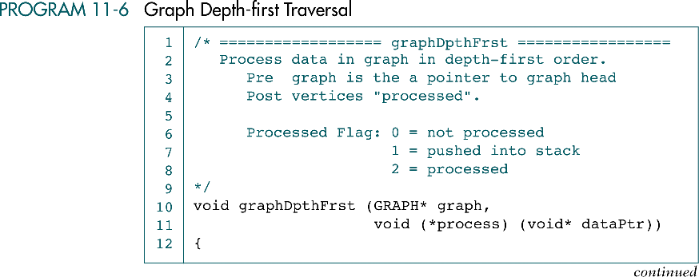
Graph Depth-first Traversal

Slide 52
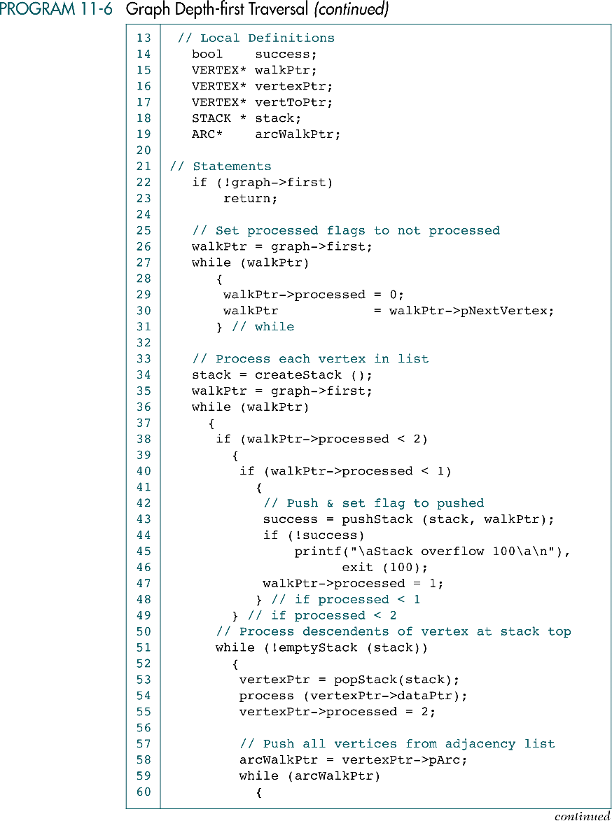
Graph Depth-first Traversal (cont.)

Slide 53
Graph Depth-first Traversal (cont.)
?

Slide 54
Graph Depth-first Traversal (cont.)

Slide 55
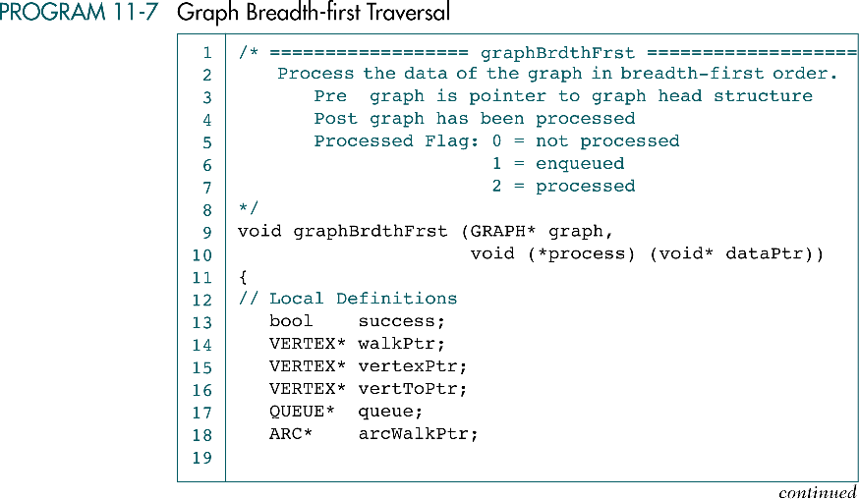
Graph Breadth-first Traversal

Slide 56
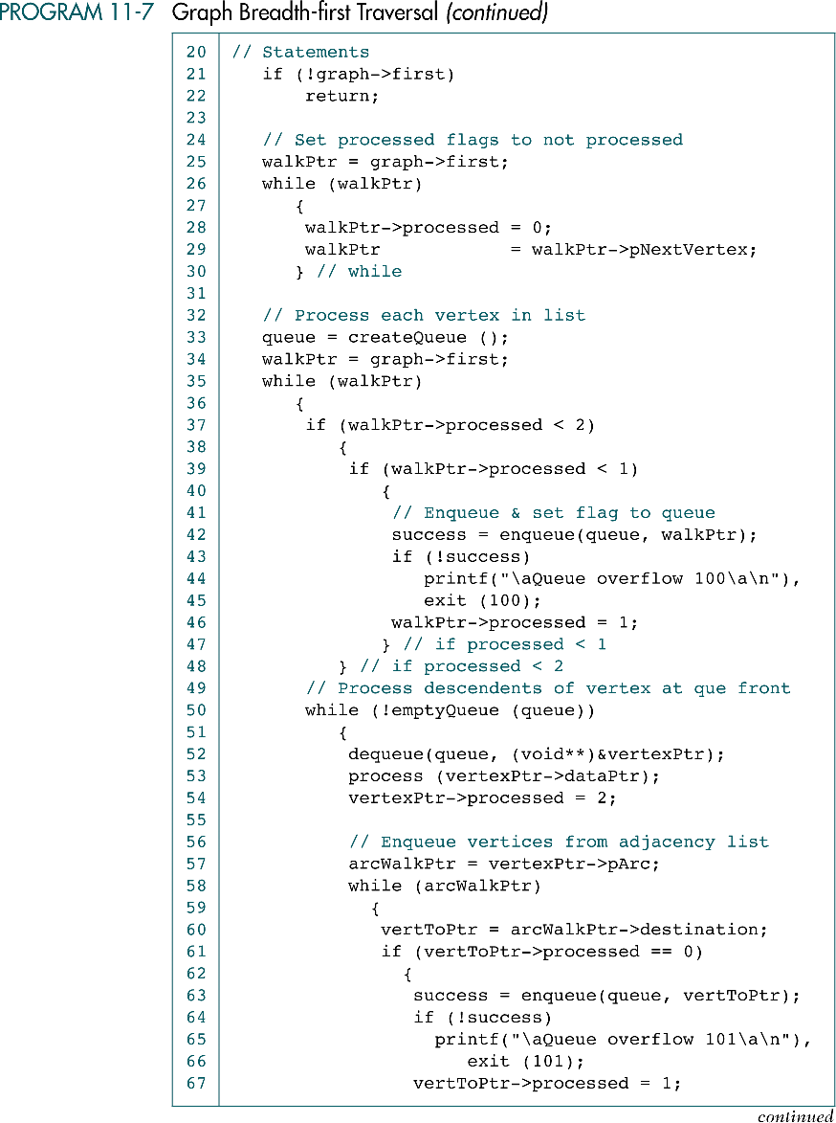
Graph Breadth-first Traversal (cont.)

Slide 57
Graph Breadth-first Traversal (cont.)

Slide 58
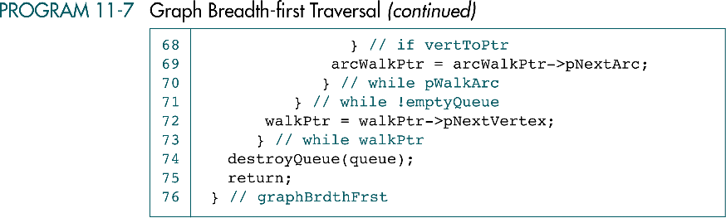
Graph Breadth-first Traversal (cont.)

Slide 59
11-6 Networks
A network is a graph whose lines are weighted. It is also known as a weighted graph. Included in this section are two graph applications that process networks.
Minimum Spanning Tree
Shortest Path Algorithm

Slide 61
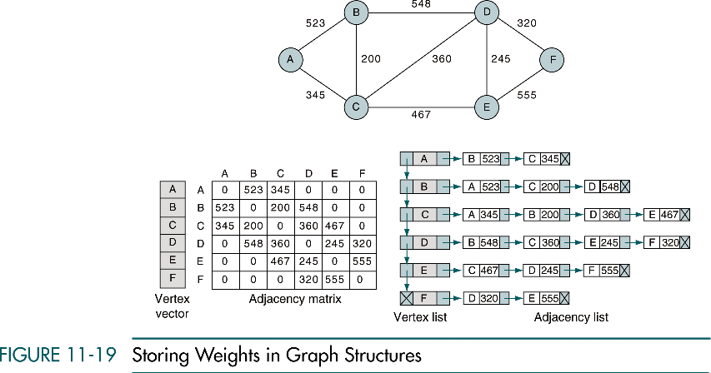
Storing Weights in Graph Structures
City Network

Slide 62
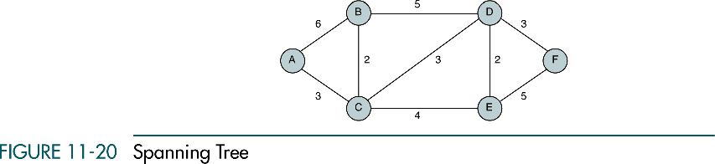
Spanning Tree of a Graph
A spanning tree contains all of the vertices in a graph
A minimum spanning tree is a spanning tree in which the total weight of the lines is quaranteed to be the minimum of all possible trees in the graph
Total weight = 21
Total weight = 13

Slide 63
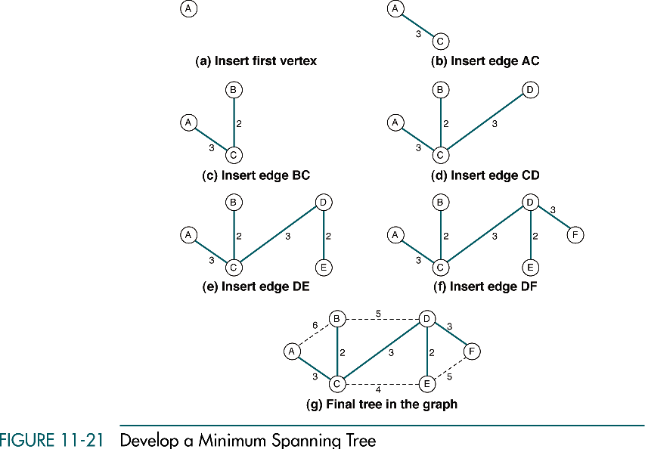
Develop Minimum Spanning Tree of Graph

Slide 64
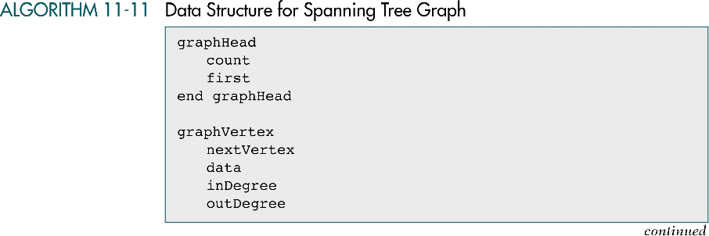
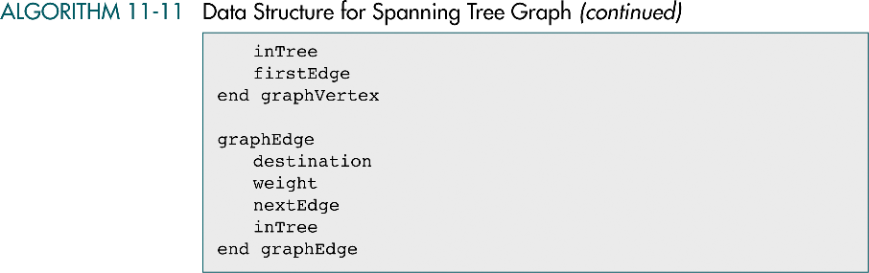
Data Structure for Spanning Tree

Slide 65
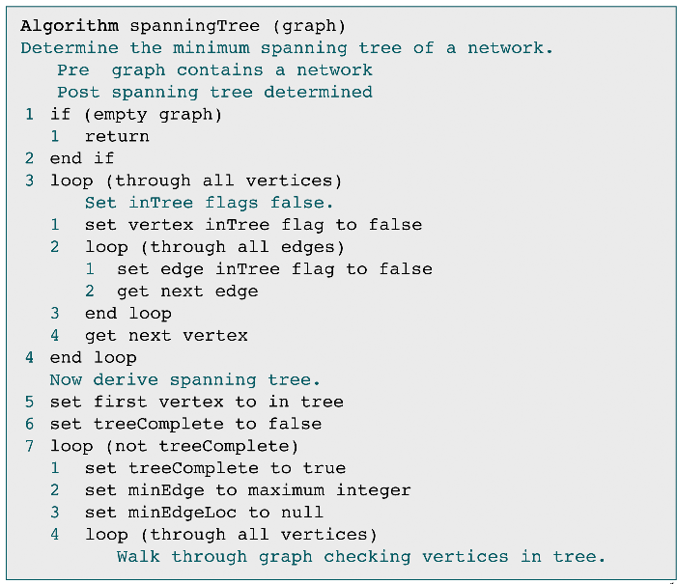
Minimum Spanning Tree of a Graph

Slide 66
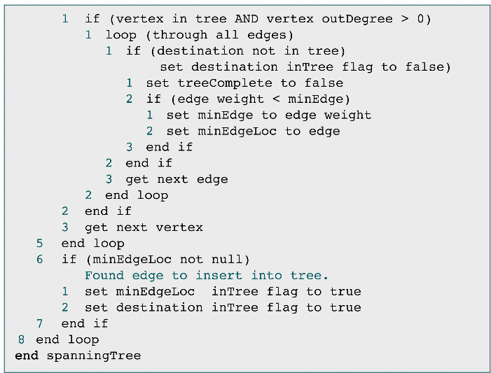
Minimum Spanning Tree of a Graph (cont.)

Slide 67
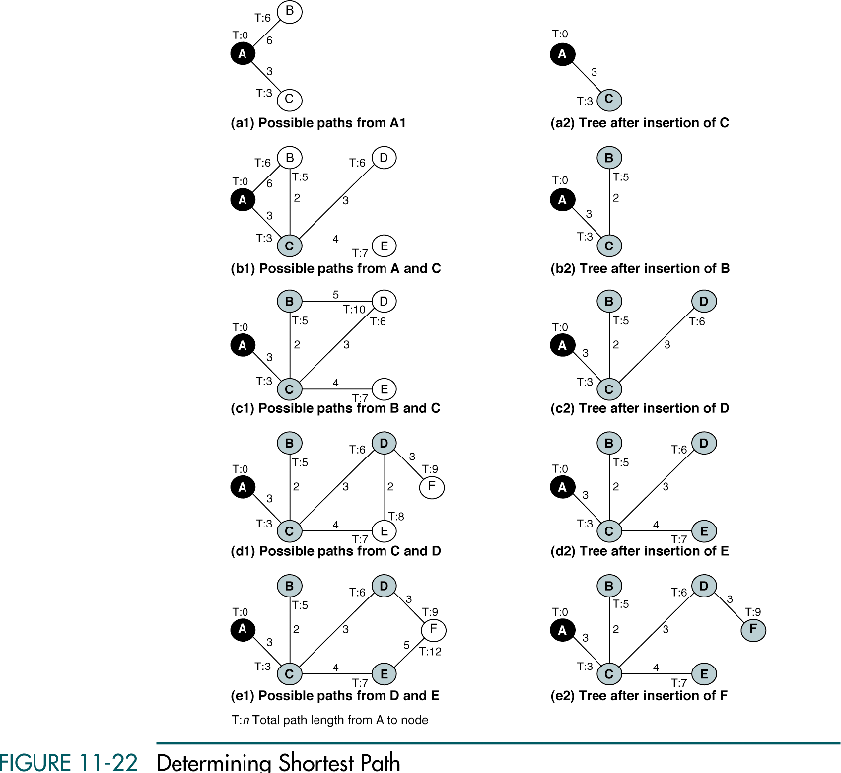
Determining Shortest Path (Dijkstra)

Slide 68
Determining Shortest Path (cont.)

Slide 69
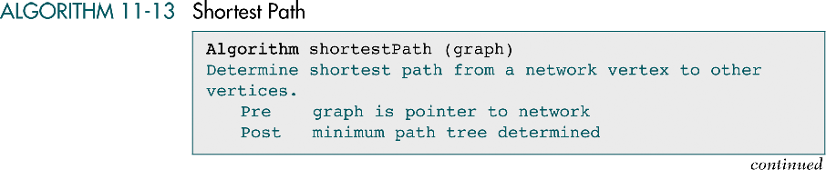

Shortest Path

Slide 70
Shortest Path (cont.)

Slide 71

Shortest Path (cont.)

