Slide 1
Chapter 13
Searching
Objectives
Upon completion you will be able to:
Design and implement sequential searches
Discuss the relative merits of different sequential searches
Design and implement binary searches
Design and implement hash-list searches
Discuss the merits of different collision resolution algorithms

Slide 2
13-1 List Searches
In this section we study searches that work with arrays. The two basic searches for arrays are the sequential search and the binary search.
Sequential Search
Variations on Sequential Searches
Binary Search
Analyzing Search Algorithms

Slide 3
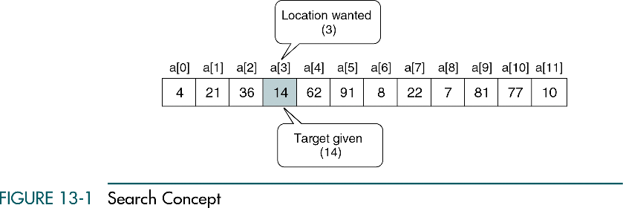
Search Concept

Slide 4
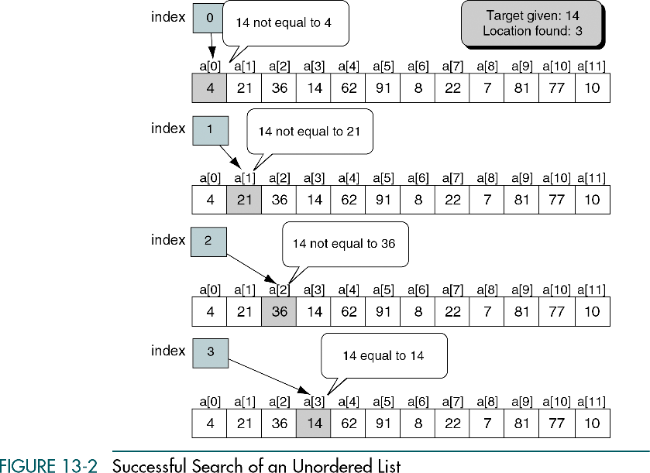
Successful Search of Unordered List

Slide 5
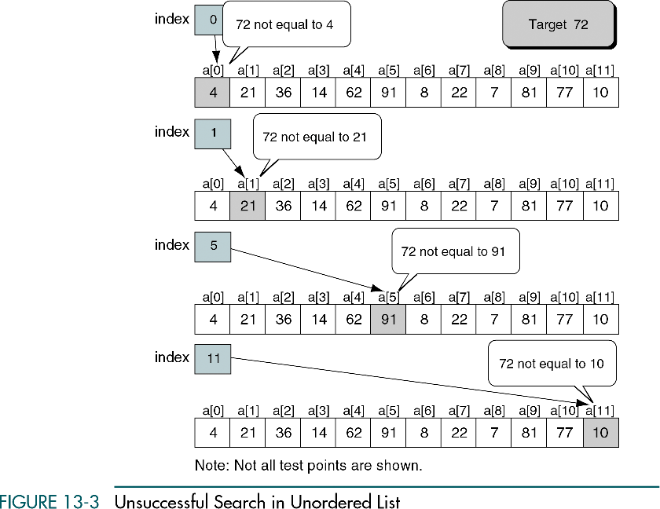
Unsuccessful Search of Unordered List

Slide 6
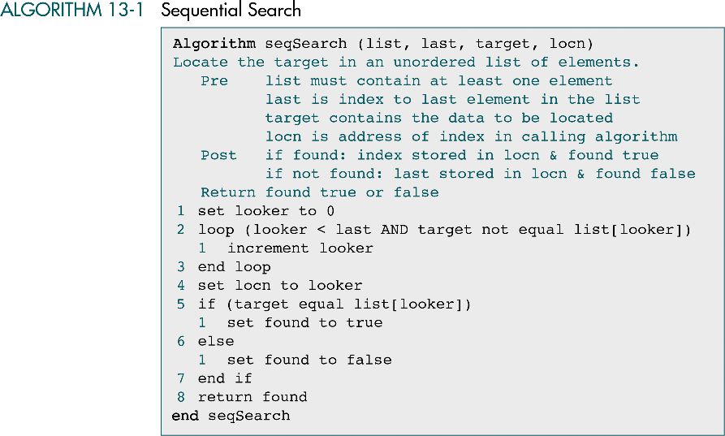
Sequential Search

Slide 7
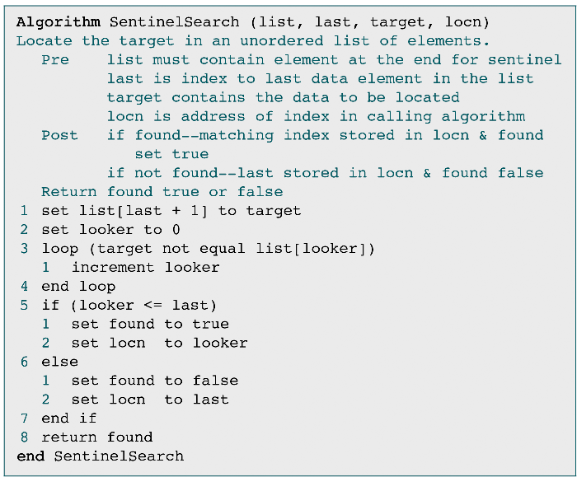
Variation 1: Sentinel Search

Slide 8
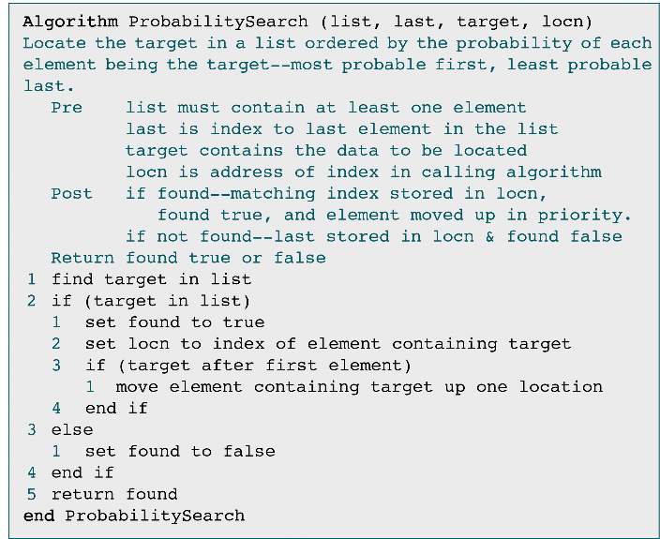
Variation 2: Probability Search

Slide 9
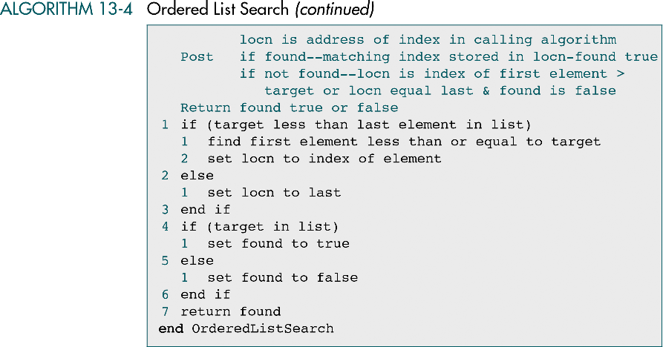
Ordered List Search
Pure sequential search: O(n) and two conditions in loop
Sentinel search: O(n) and single one condition in loop
Ordered list search
  Seq. search with target = list [loc]: O(n) with 2 tests
  Seq. search with target > or <= list[loc]: O(n/2) with 2 tests
O(n/2) with one test !

Slide 10
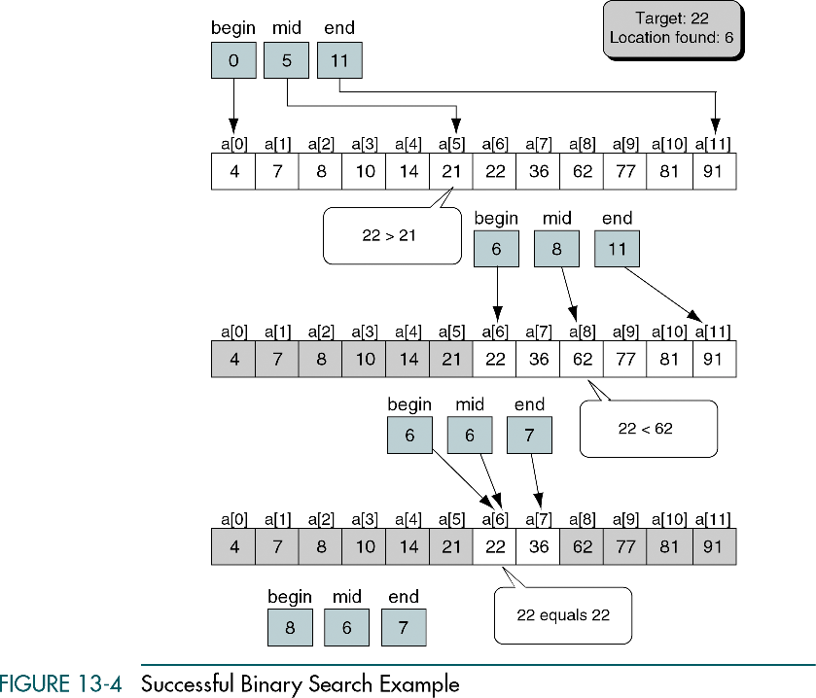
Successful Binary Search Example

Slide 11
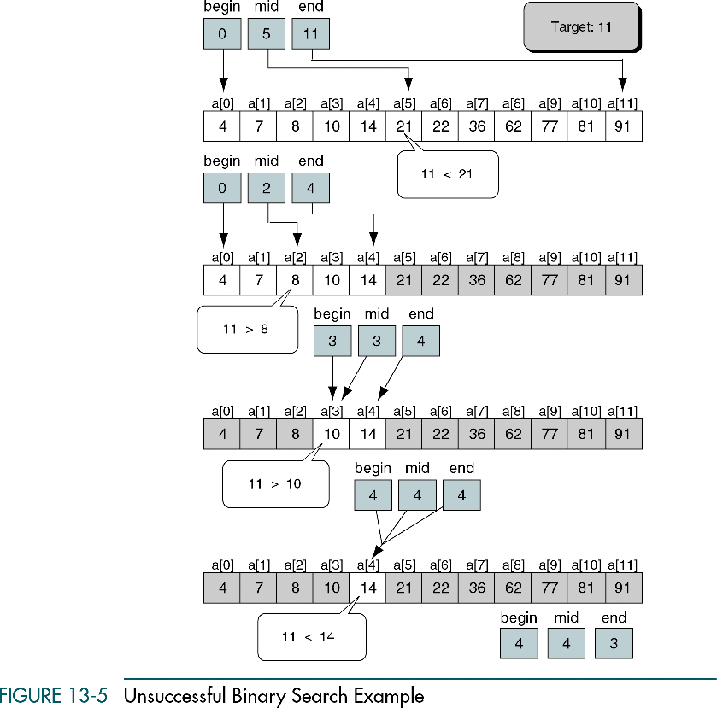
Unsuccessful Binary Search Example

Slide 12
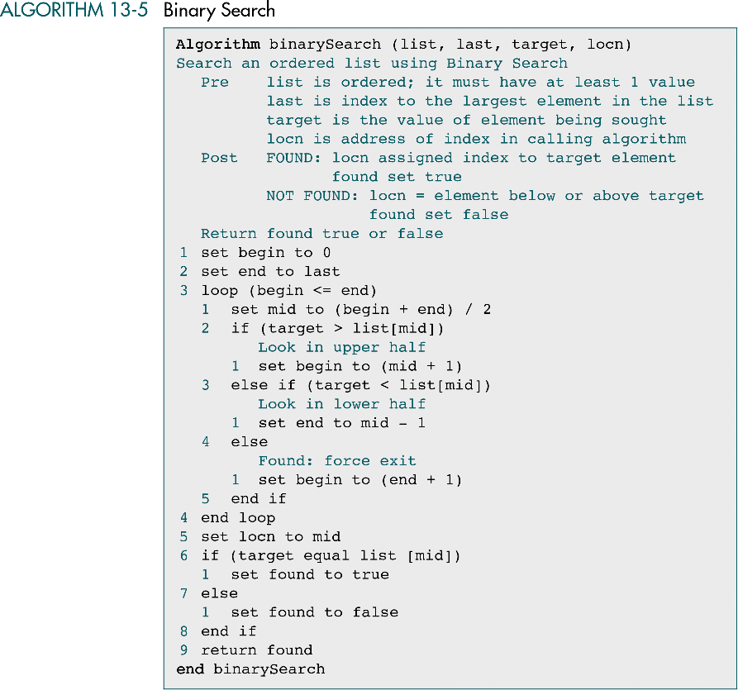
Binary Search

Slide 13
Binary Search (cont.)
Efficiency (time complexity): O(log n)

Slide 14
13-2 Search Implementations
Having discussed the basic concepts of array searches, we write C implementations of the two most common.
Sequential Search in C
Binary Search In C

Slide 15
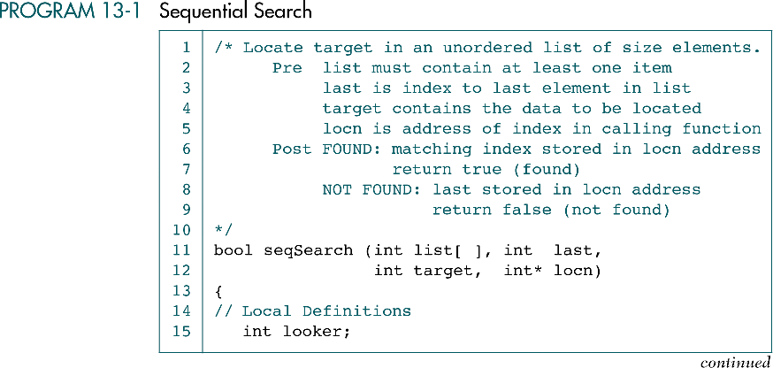
Sequential Search

Slide 16
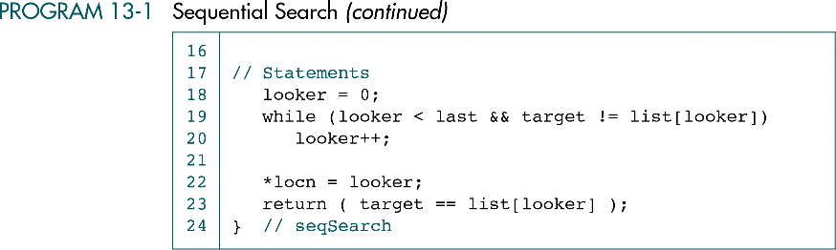
Sequential Search (cont.)

Slide 17
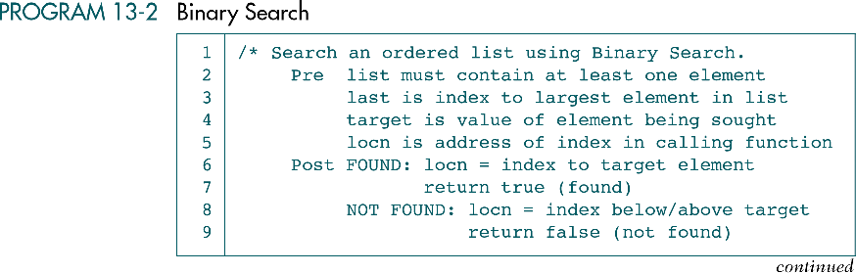
Binary Search

Slide 18
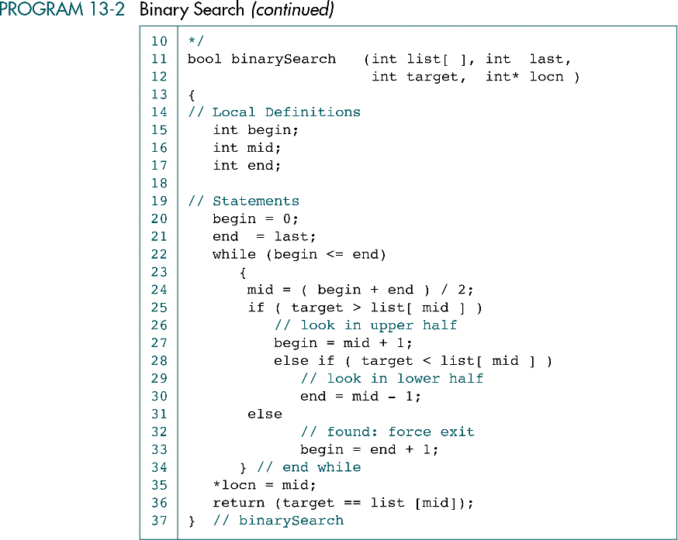
Binary Search (cont.)

Slide 19
13-3 Hashed List Searches
The goal of a hashed search is to find the target data in only one test. After discussing some basic hashed list concepts, we discuss eight hashing methods. At the end of the section, we develop a hashing algorithm that uses several of the methods discussed in the section.
Basic Concepts
Hashing Methods
One Hashing Algorithm

Slide 20
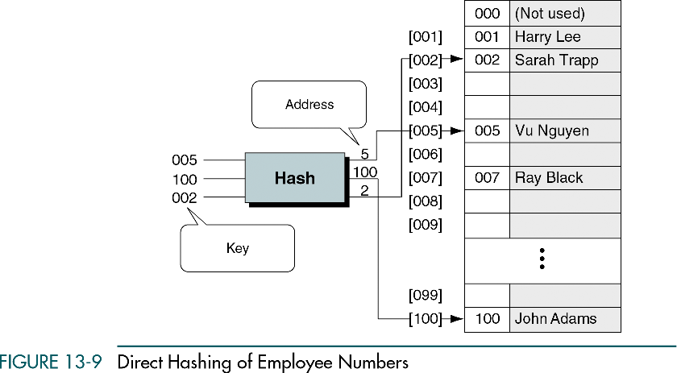
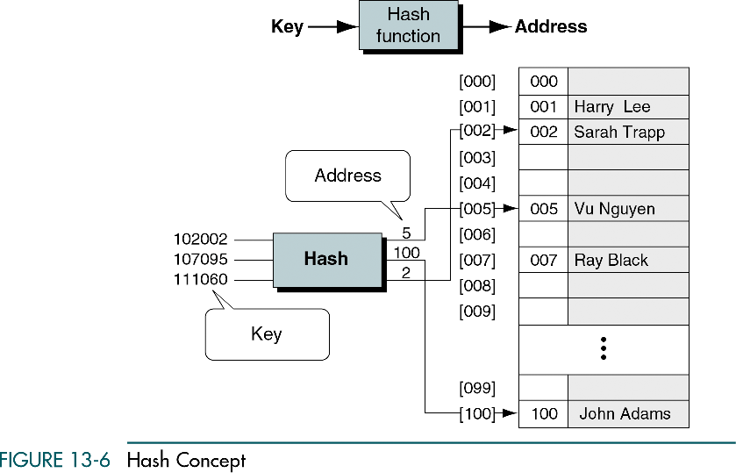
Hash Concept

Slide 21
Hash Concept (cont.)
What about number of key (e.g. employee ID) >> number of address (employee) ?
  One-to-one: waste memory space
  Many-to-one: collision

Slide 22
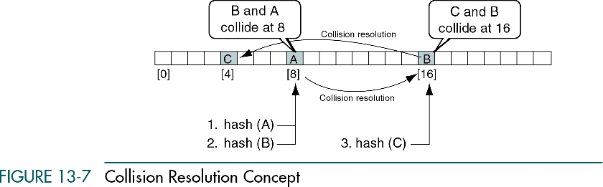
Collision Resolution Concept
Home address
Home address
Synonym

Slide 23
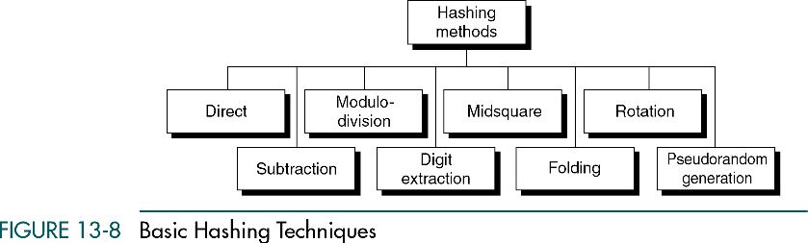
Basic Hash Techniques

Slide 24
Direct Hashing
Strength ?
Limitation ?

Slide 25
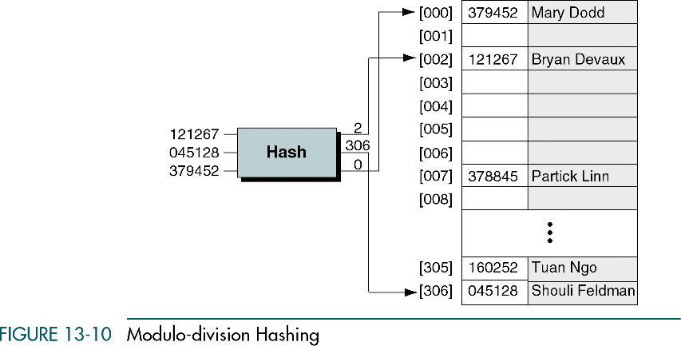
Modulo-division Hashing
Address = key mod listsize e.g., 2 = 121267 mod 307
A listsize that is prime number produces fewer collisions

Slide 26
Digit-extraction and Midsquare Hashing
Digit – extraction (address space 1 ~ 999)
  379452 → 394
  121267 → 112
  378845 → 388
Midsquare (address space 1 ~ 999)
  Sqr(9452) = 89340304 → address: 3403
  379452 → sqr(379) = 143641 → address: 364
✓
✓
✓
✓
✓
✓
✓
✓
✓

Slide 27
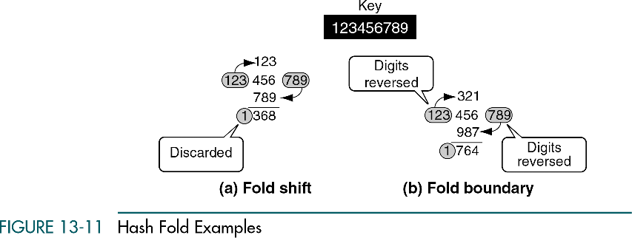
Folding Hashing

Slide 28
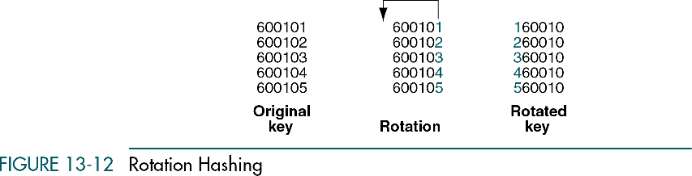
Rotation Hashing
Rotation hashing is usually incorporated in combination with other hashing methods, especially when keys are assigned serially
In the example, it does not work well with mod method
It works well with simple fold shift (two digit address)
62
63
64
65
66
26
36
46
56
66

Slide 29
Pseudorandom Hashing
In pseudorandom hashing the key is used as the seed in a pseudorandom-number generator
A common random-number generator
  y = ax + c, where x is key, a and c are predifinded constant
For example (a = 17, c = 7)
  121267 → y = ((17 x 121267) + 7) mod 307 = 41

Slide 31
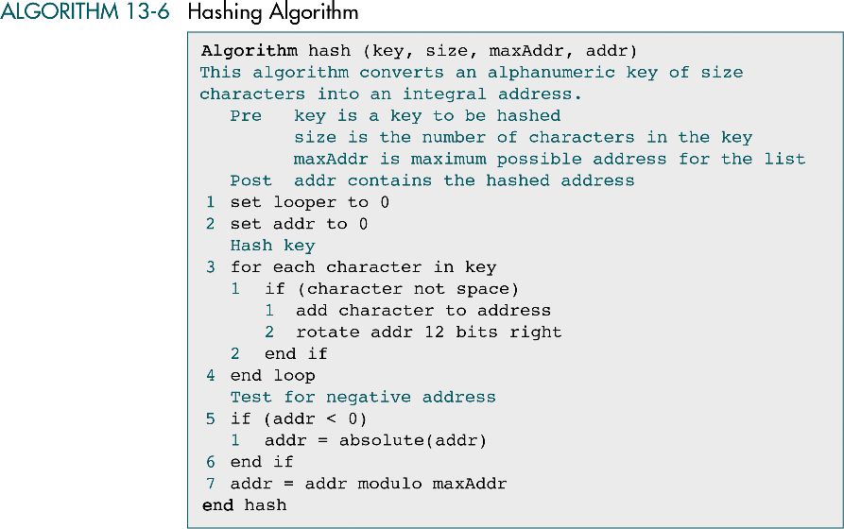
Hashing Algorithm Example
size
Key= Smart……student
0101010001101101…01110100
fold-shift
8bits
01010100
+)
01101101
Rotate-shift
11000001
11100000
…
+)
01110100
Mod
address
100011010100

Slide 32
13-4 Collision Resolution
We discuss three structural approaches and four specific collision resolution algorithms. At the end of the section, we develop a C program that builds and searches a hashed list.
Open Addressing
Linked List Collision Resolution
Bucket Hashing
Combination Approaches
Hashed List Example

Slide 33
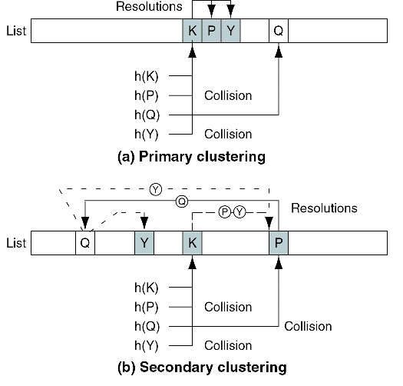
Clustering and Collisions

Slide 34
Hashing Design Principles
The load factor (# of elements divided by the # of physical elements allocated for the list) no more than 75% full
Minimize the clustering (primary and secondary clustering)
Maximize the number of elements to be inserted into a list before a collision occures
Number of elements examined in the search must be limited
Traditional limit difficulties
  Finding the ends doesn’t mean that every element has been tested
  Examining every element would be extensive time-consuming
  Some of the collision resolution techniques cannot physically examine all of the elements

Slide 35
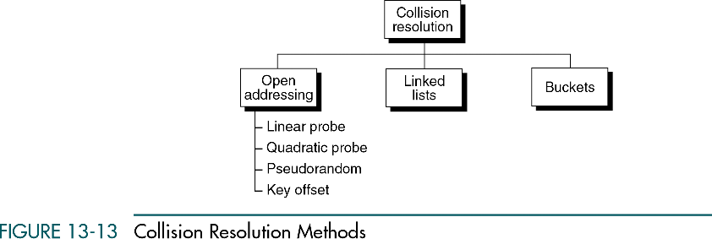
Collision Resolution Methods
Double hashing

Slide 36
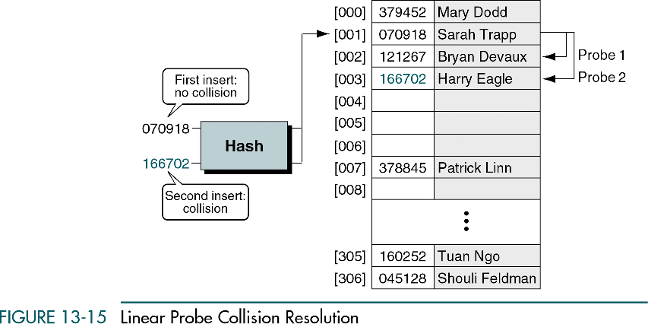
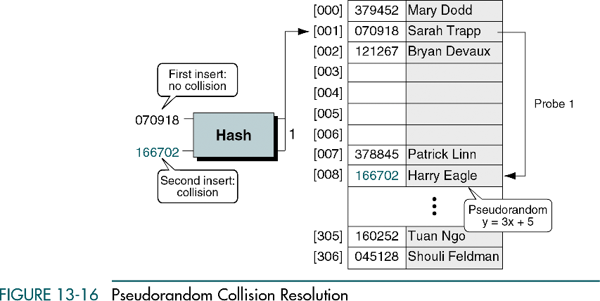
Linear Probe Collision Resolution
Disadvantages
  Not suitable for search, especially after data have been deleted
  Create primary clustering
Advantages
  Simple
  Suitable for disk address

Slide 37
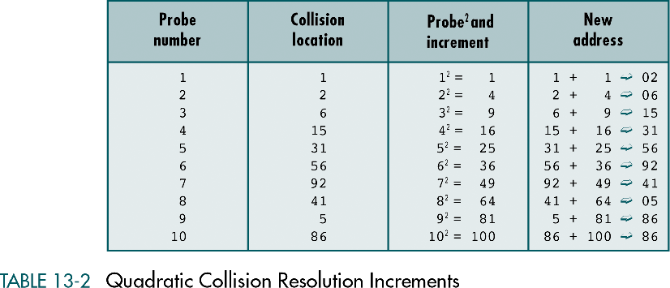
Quadratic Collision Resolution
Advantage: prevents primary clustering
Disadvantages
  Squaring the number is time-consuming → use “add”
  Impossible to generate a new address for every element → make list size prime number

Slide 38
Pseudorandom Collision Resolution
Advantages (double hashing)
  Prevent primary clustering
Disadvantages
  All keys follow one collision
  resolution path → secondary
  clustering (same as linear and
  quadratic probe)
address

Slide 39
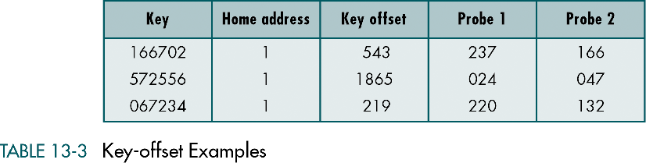
Key-offset Collision Resolution
Calculates the new address as a function of the old address and the key
Advantages
  Double hashing that produces different collision paths for different keys
offset = key/listsize, addr. = ((offset + old addr.) mod listsize
For example: key = 166702 →offset = 166702/307 = 543
addr. = ((543+001)mod 307) = 237
If 237 were collision → addr. = ((543+237) mod 307) = 166

Slide 40
Collision Resolution Methods

Slide 41
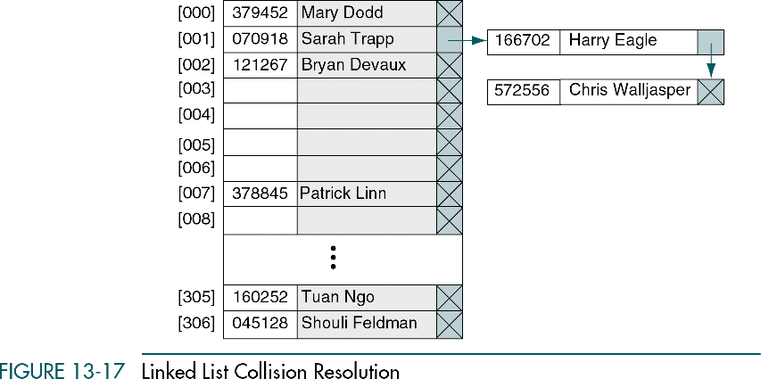
Linked List Collision Resolution
Advantage: eliminate the drawback of open addressing method in which each collision resolution increase the probability of future collisions
Overflow area
Prime area

Slide 42
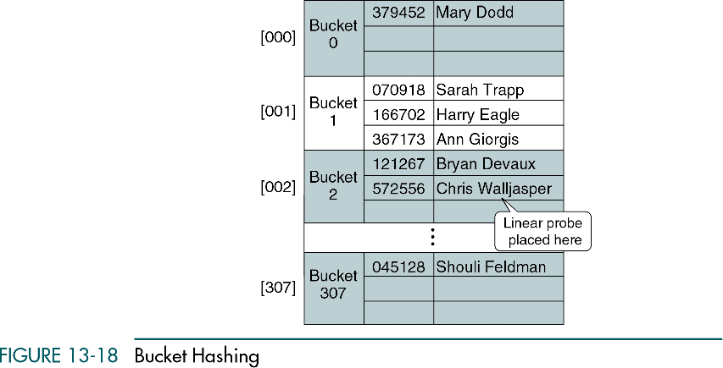
Bucket Collision Resolution
Disadvantage:
  Uses significant more space when the buckets are partially empty at given time
  Does not completely resolve the collision problem

Slide 43
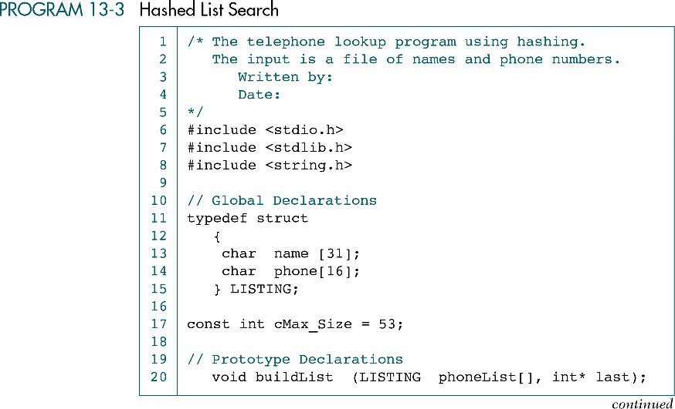
Hashed List Search Example

Slide 44
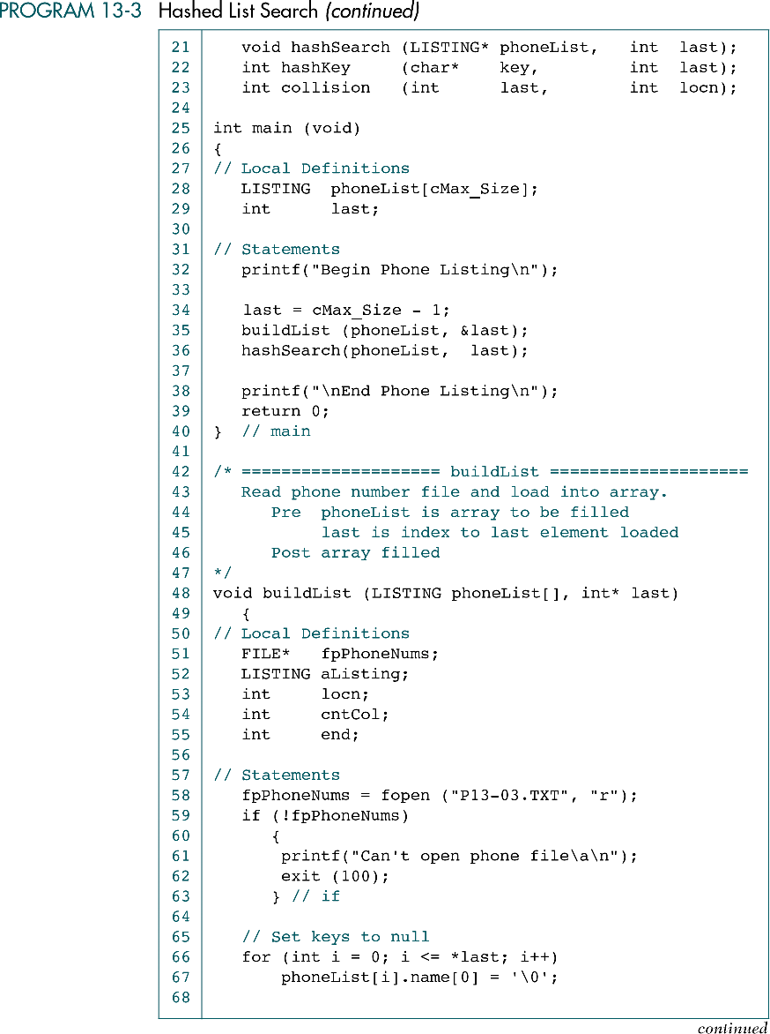
Hashed List Search Example (cont.)

Slide 45
Hashed List Search Example (cont.)

Slide 46
Hashed List Search Example (cont.)

Slide 47
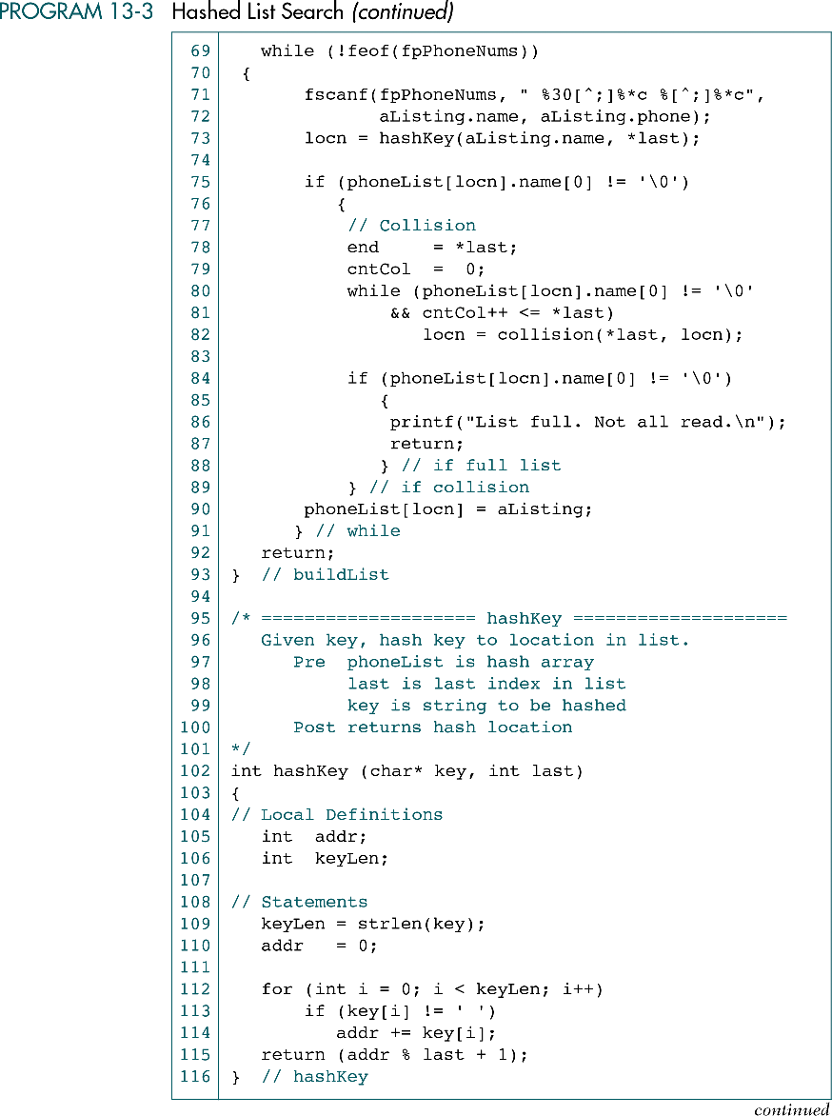
Hashed List Search Example (cont.)

Slide 48
Hashed List Search Example (cont.)

Slide 49
Hashed List Search Example (cont.)

Slide 50
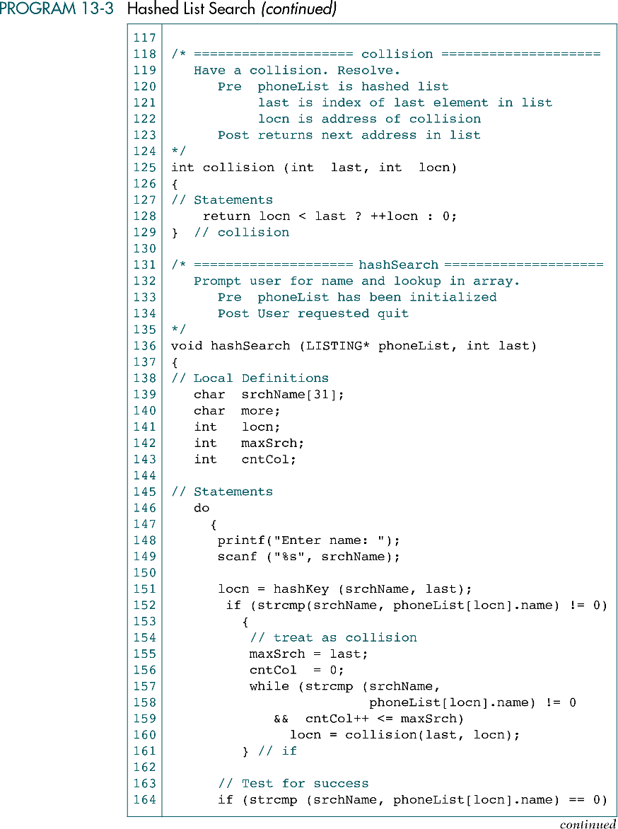
Hashed List Search Example (cont.)

Slide 51
Hashed List Search Example (cont.)

Slide 52
Hashed List Search Example (cont.)

Slide 53
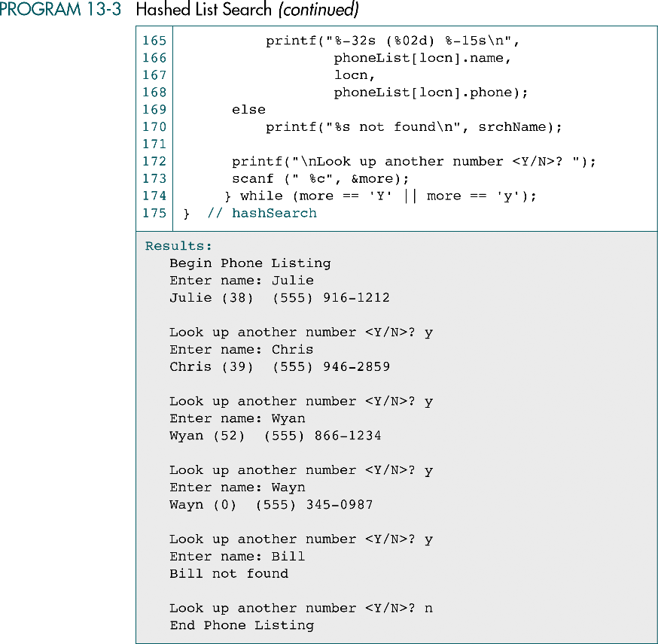
Hashed List Search Example (cont.)

Slide 54
Hashed List Search Example (cont.)

Slide 55
幾個分別了多年的同學相約去拜訪大學的老師。老師很高興，問他們生活得怎麼樣。
不料， 一句話就勾出了大家的滿腹牢騷， 大家紛紛訴說著生活的不如意:
工作壓力大呀， 生活煩惱多呀， 做生意的商戰失利呀， 當官的仕途受阻呀…
彷彿大家都成了時代的棄兒。
老師笑而不語，從廚房拿出一大堆杯子，擺在茶儿上。
這些杯子各式各樣，形態各異，有瓷器的，有玻璃的，有塑膠的，
有的杯子看起來豪華而高貴，有的則顯得普通而簡陋……
老師說:「我就不把你們當客人看了。你們要是渴了，就自己倒水喝吧。」
七嘴八舌，大家說得口乾舌燥了，便紛紛拿了自己看中的杯子倒水喝。
等我們手裏都端了一杯水時，老師又發言了。
他指著茶儿上剩下的杯子說:「你們有沒有發現，你們手裏的杯子是最好看最別緻的杯子，
而像這些塑膠杯沒有人選中它。」
當然，我們並不覺得奇怪， 誰都希望自己拿著的是一隻好看的杯子。
老師說:「這就是你們煩惱的根源」
大家需要的是水，而非杯子，但我們有意無意地會去選擇漂亮的杯子。
這就如我們的生活---如果生活是水的話， 那麼，工作、金錢、地位 這些東西就是杯子，
它們只是我們盛起生活之水的工具。
其實，杯子的好壞並不影響水的品質。
如果將心思花在杯子上，大家還有心情去品嘗水的苦甜，這不就是自尋煩惱嗎?

