Slide 1
Qiskit學習成果
0815報告
Notes:
大家好，我是朱哲毅，這禮拜要跟大家報告的是我學習量子電腦基本原理以及使用qiskit套件的心得。

Slide 2
outline
GQA
VQE
QAOA

Slide 3
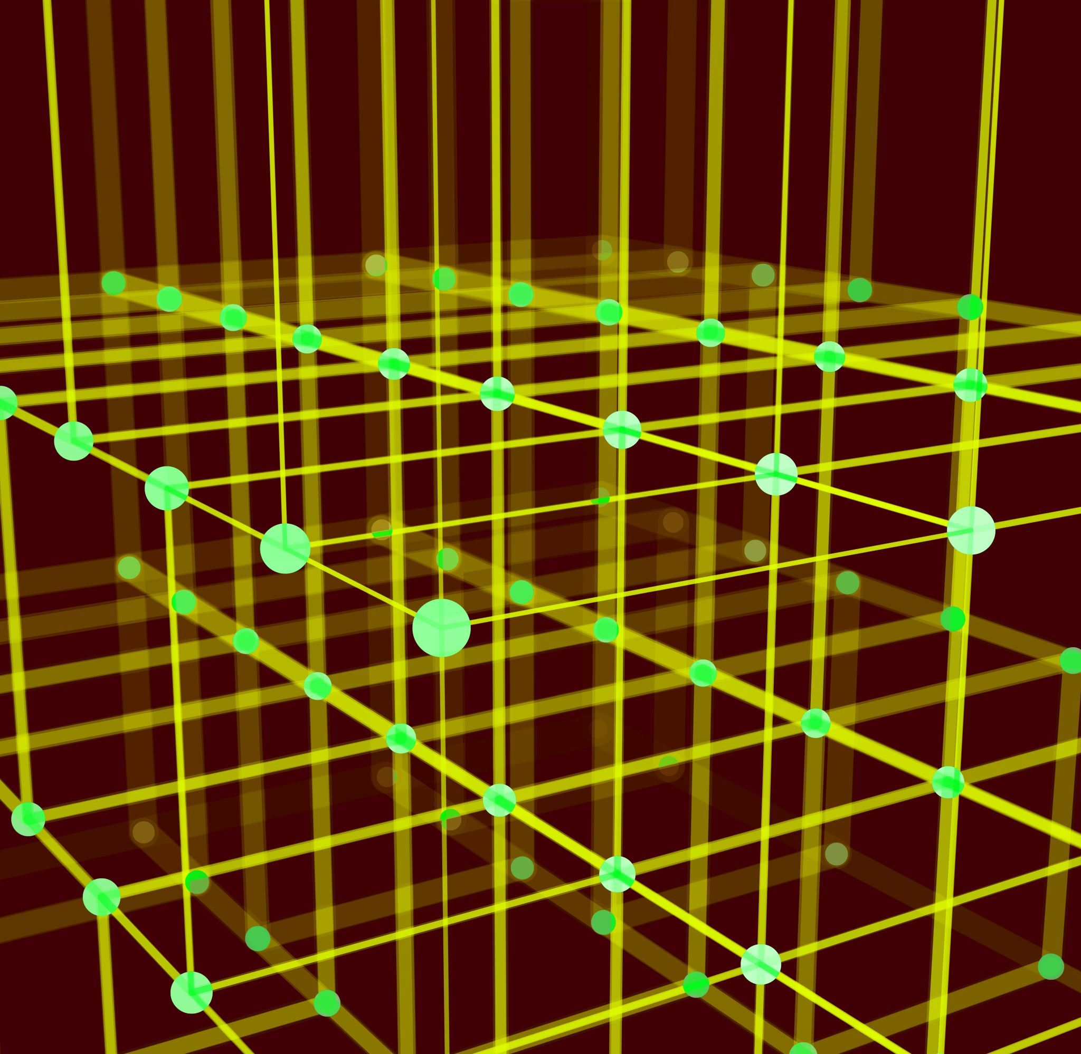
GQA
g

Slide 4
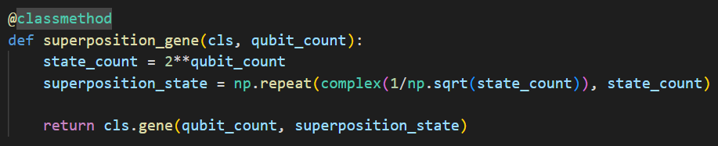
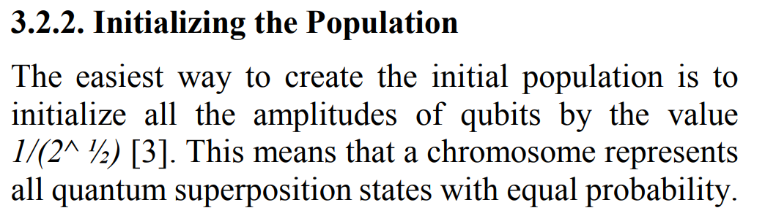
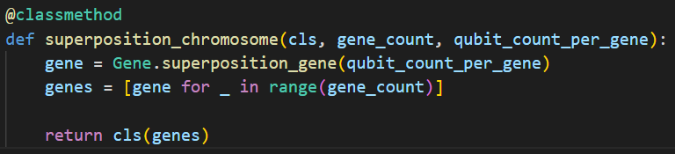
problem

Slide 5
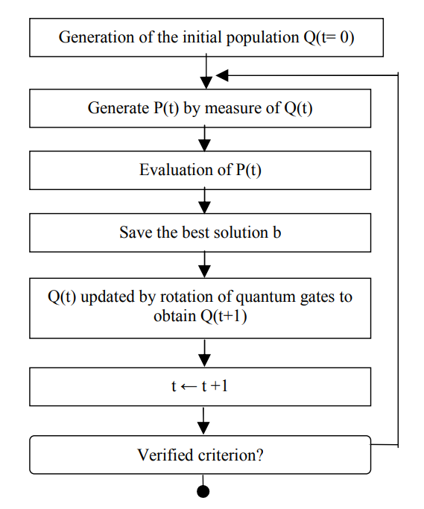
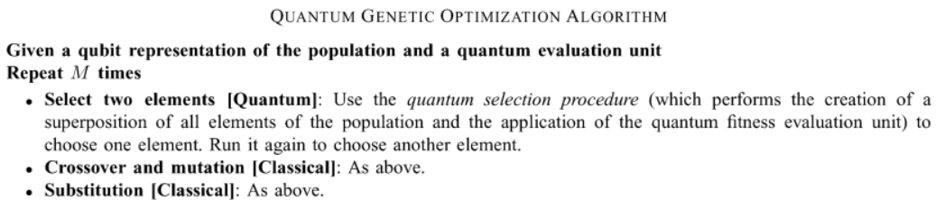
problem

Slide 6
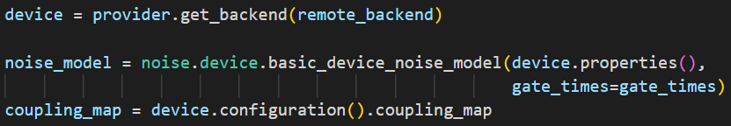
problem

Slide 7
VQE
g

Slide 8
introduction
1. Similar in structure to neural network.
2. approximate the ground state of Hamiltonian.

Slide 9
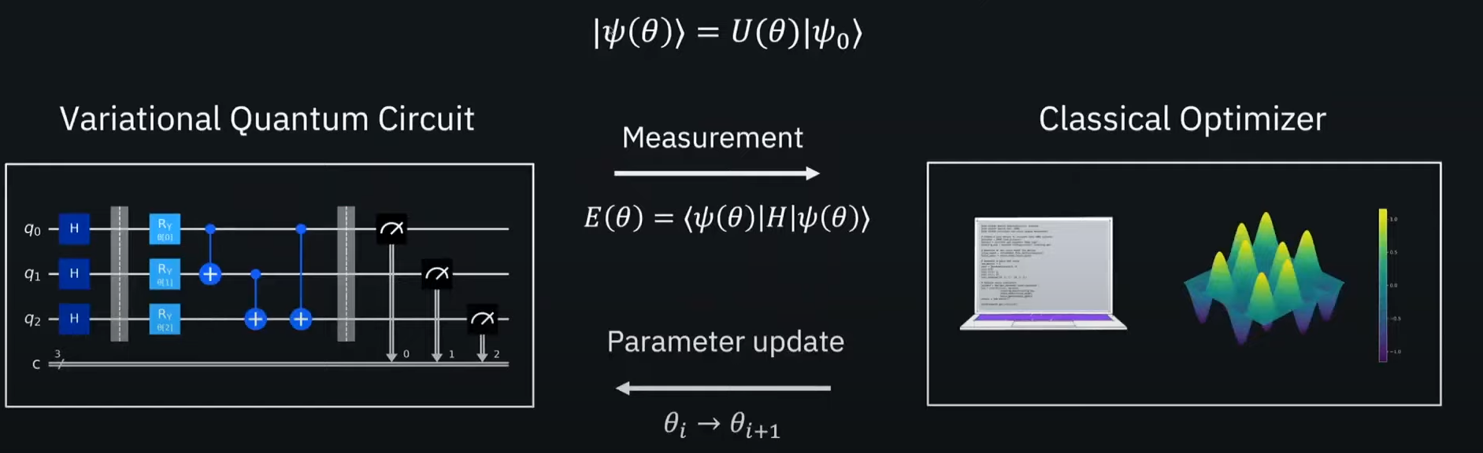
VQE

Slide 10
QAOA
g

Slide 11
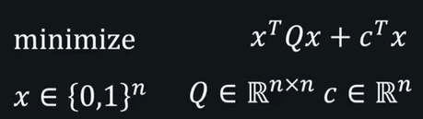
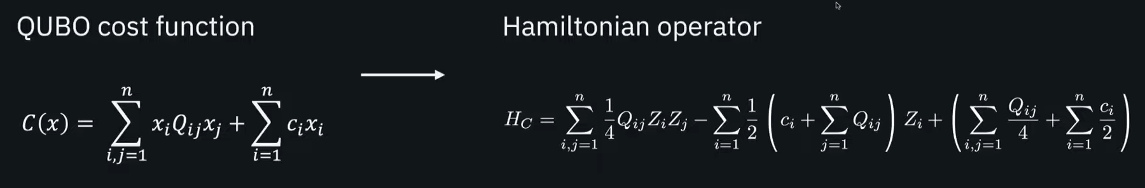
introduction
1. special case of VQE.
2. QUBO(quadratic unconstrained binary optimization)
3. layerized variational form based on adiabatic process.

Slide 12
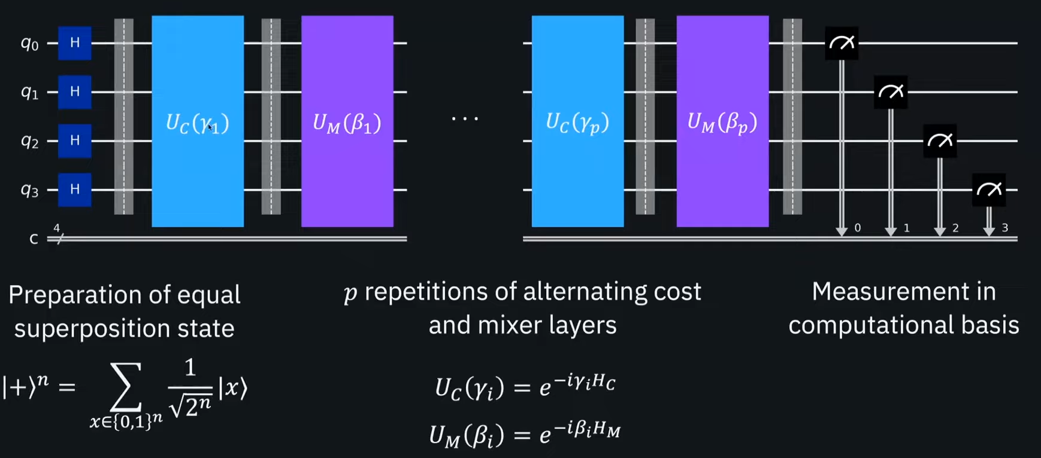
qaoa

Slide 13
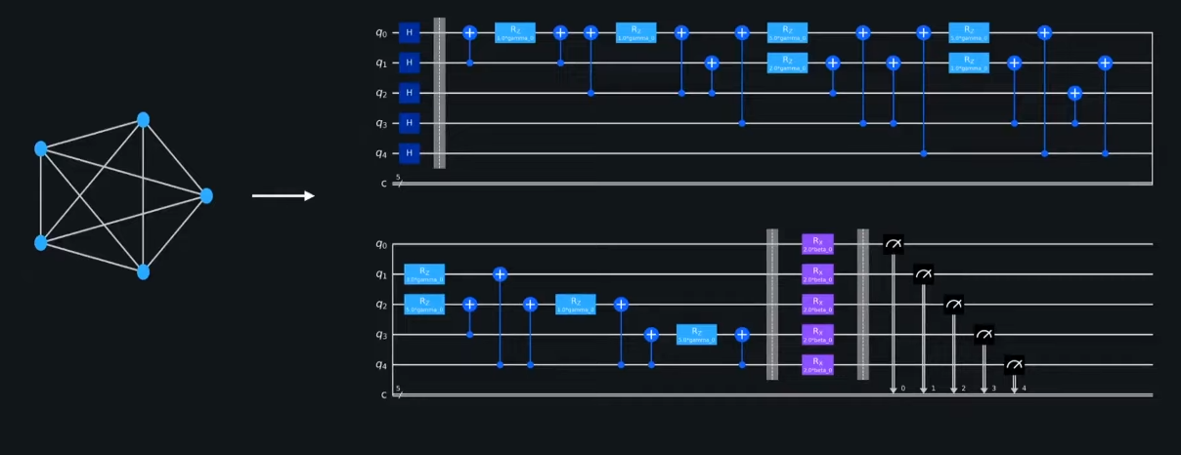
qaoa
*single layer

Slide 14
references
https://www.ccis2k.org/iajit/PDF/vol.9,no.3/2107-6.pdf
https://www.mdpi.com/2073-431X/5/4/24
https://ieeexplore.ieee.org/abstract/document/4358783

