Slide 1
Qiskit學習成果
0809報告
Notes:
大家好，我是朱哲毅，這禮拜要跟大家報告的是我學習量子電腦基本原理以及使用qiskit套件的心得。

Slide 2
outline
GQA
VQE
QAOA

Slide 3
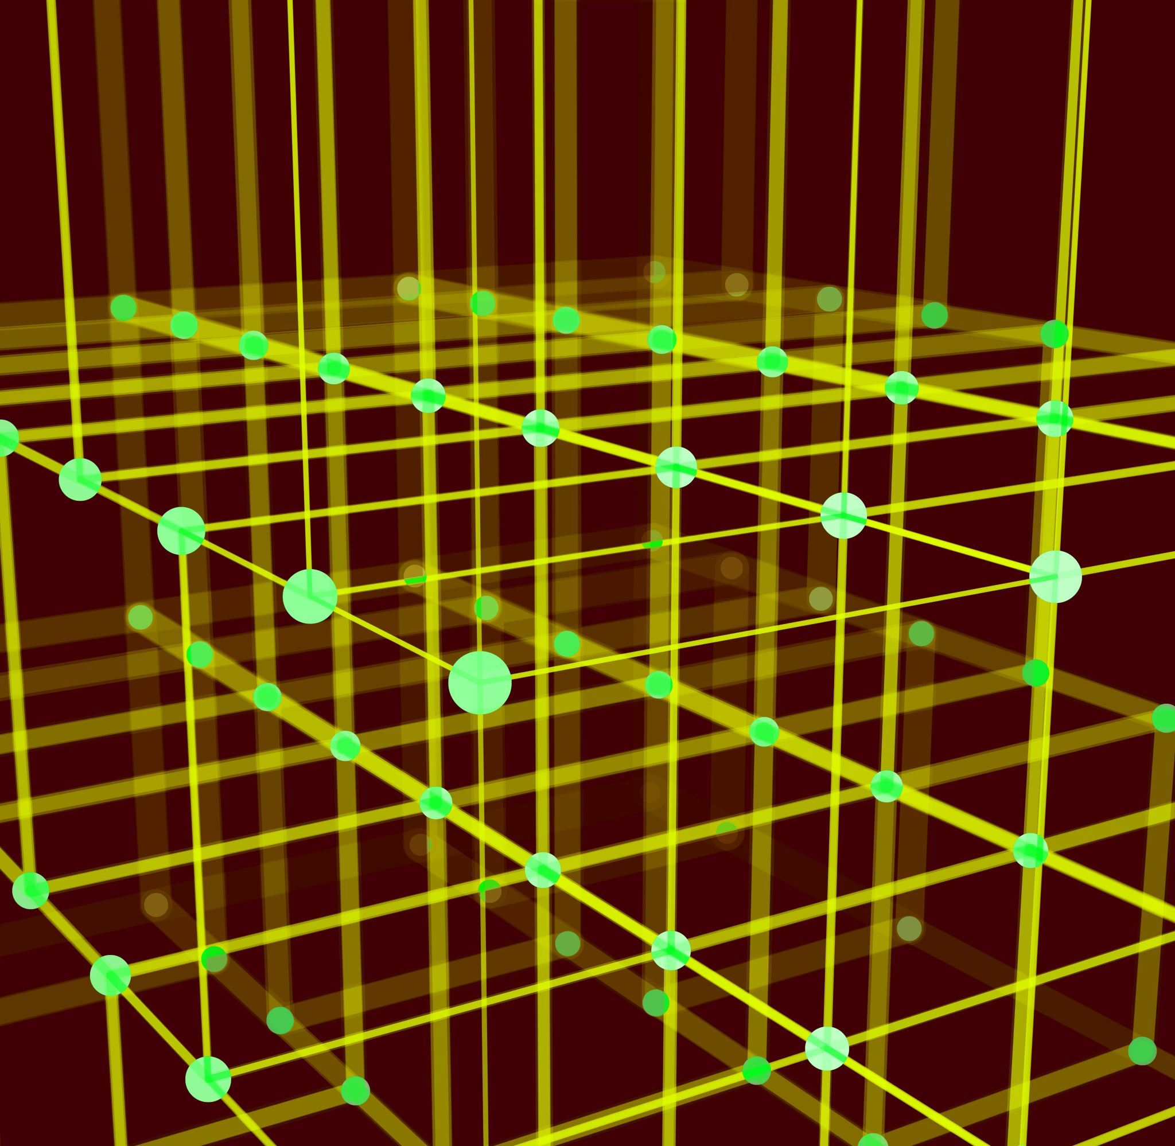
optimization
g

Slide 4
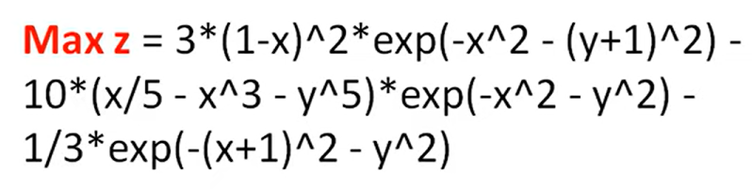
optimization
Our goal is to maximize the function with Qiskit module (qiskit_optimization).
However, qiskit only supports coverting MP(mathmetical programming) model to qiskit model while MP model can't implement non-linear constrains.

Slide 5
ga
g

Slide 6
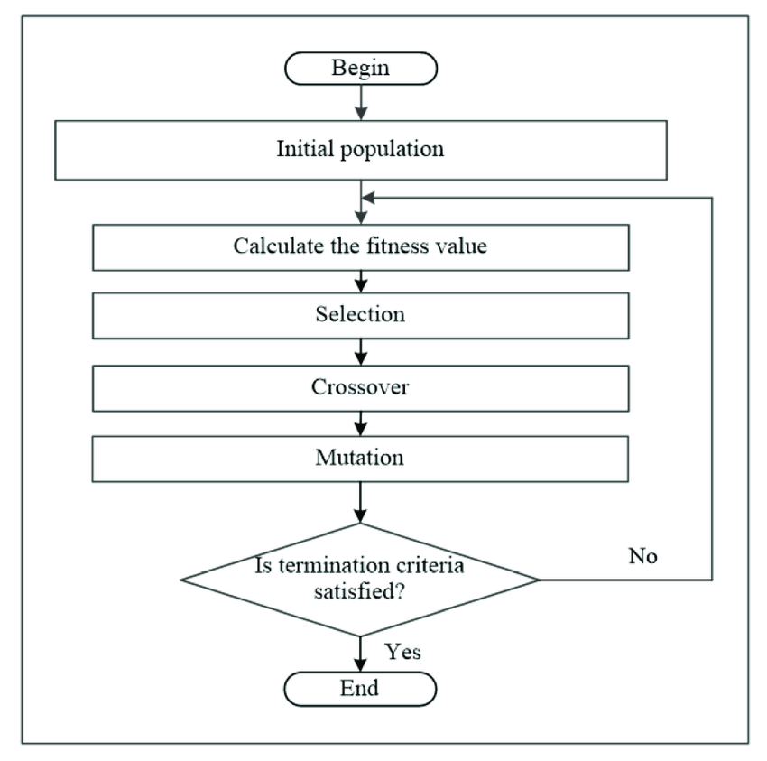
introduction
1. produce initial population
2. select a group of chromosomes randomly
3. evaluate and fit
4. crossover or mutation
5. add offspring to population
6. deciding new parents

Slide 7
Pros and cons
Pros
1.Faster
2. easier
Cons
1. consume a lot of memory
2. never have a population that represents all possible chromosomes (solution)
3. sometimes it may get stuck with local maximin/minimum.

Slide 8
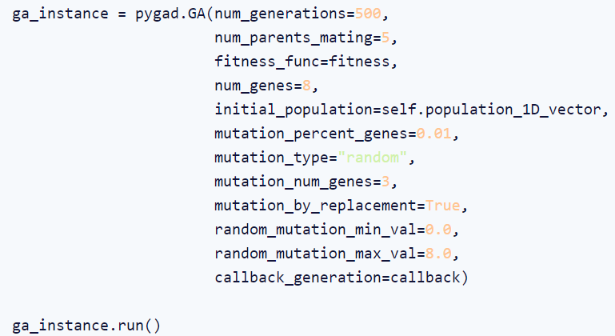
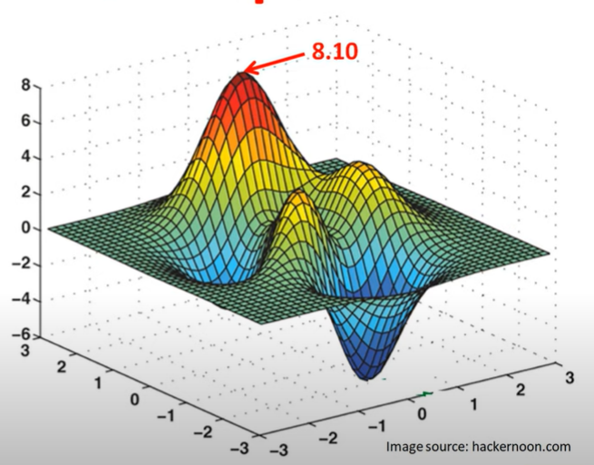

pygad

Slide 9
Quantum ga

Slide 10
introduction(AGAIN)
1. produce initial population
*use superposition to involve all candidates - (1)
2. select a group of chromosomes randomly
3. evaluate and fit
4. crossover and mutation
*we don't need crossover since (1) and Mutation could be done with quantum noisy.
5. add offspring to population
6. deciding new parents

Slide 11
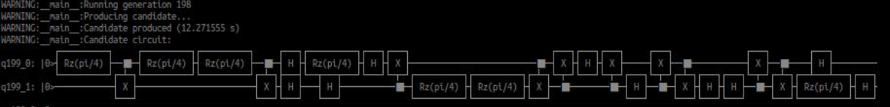
implementation
With 2 qubits

Slide 12
Future work
Figure out how did they get the result from superposition.
Study QAOA(Quantum Approximate Optimization Algorithm)

Slide 13
reference
https://becominghuman.ai/understanding-genetic-algorithms-a-use-case-in-organizational-field-2087c30fb61e
https://www.youtube.com/watch?v=MLPHLm56inQ&ab_channel=SolvingOptimizationProblems
https://github.com/quantumgenetics/quantumgenetics
Notes:
參考資料

