Slide 1
Qiskit學習成果
0823報告
Notes:
大家好，我是朱哲毅，這禮拜要跟大家報告的是我學習量子電腦基本原理以及使用qiskit套件的心得。

Slide 2
outline
GQA
Sum up

Slide 3
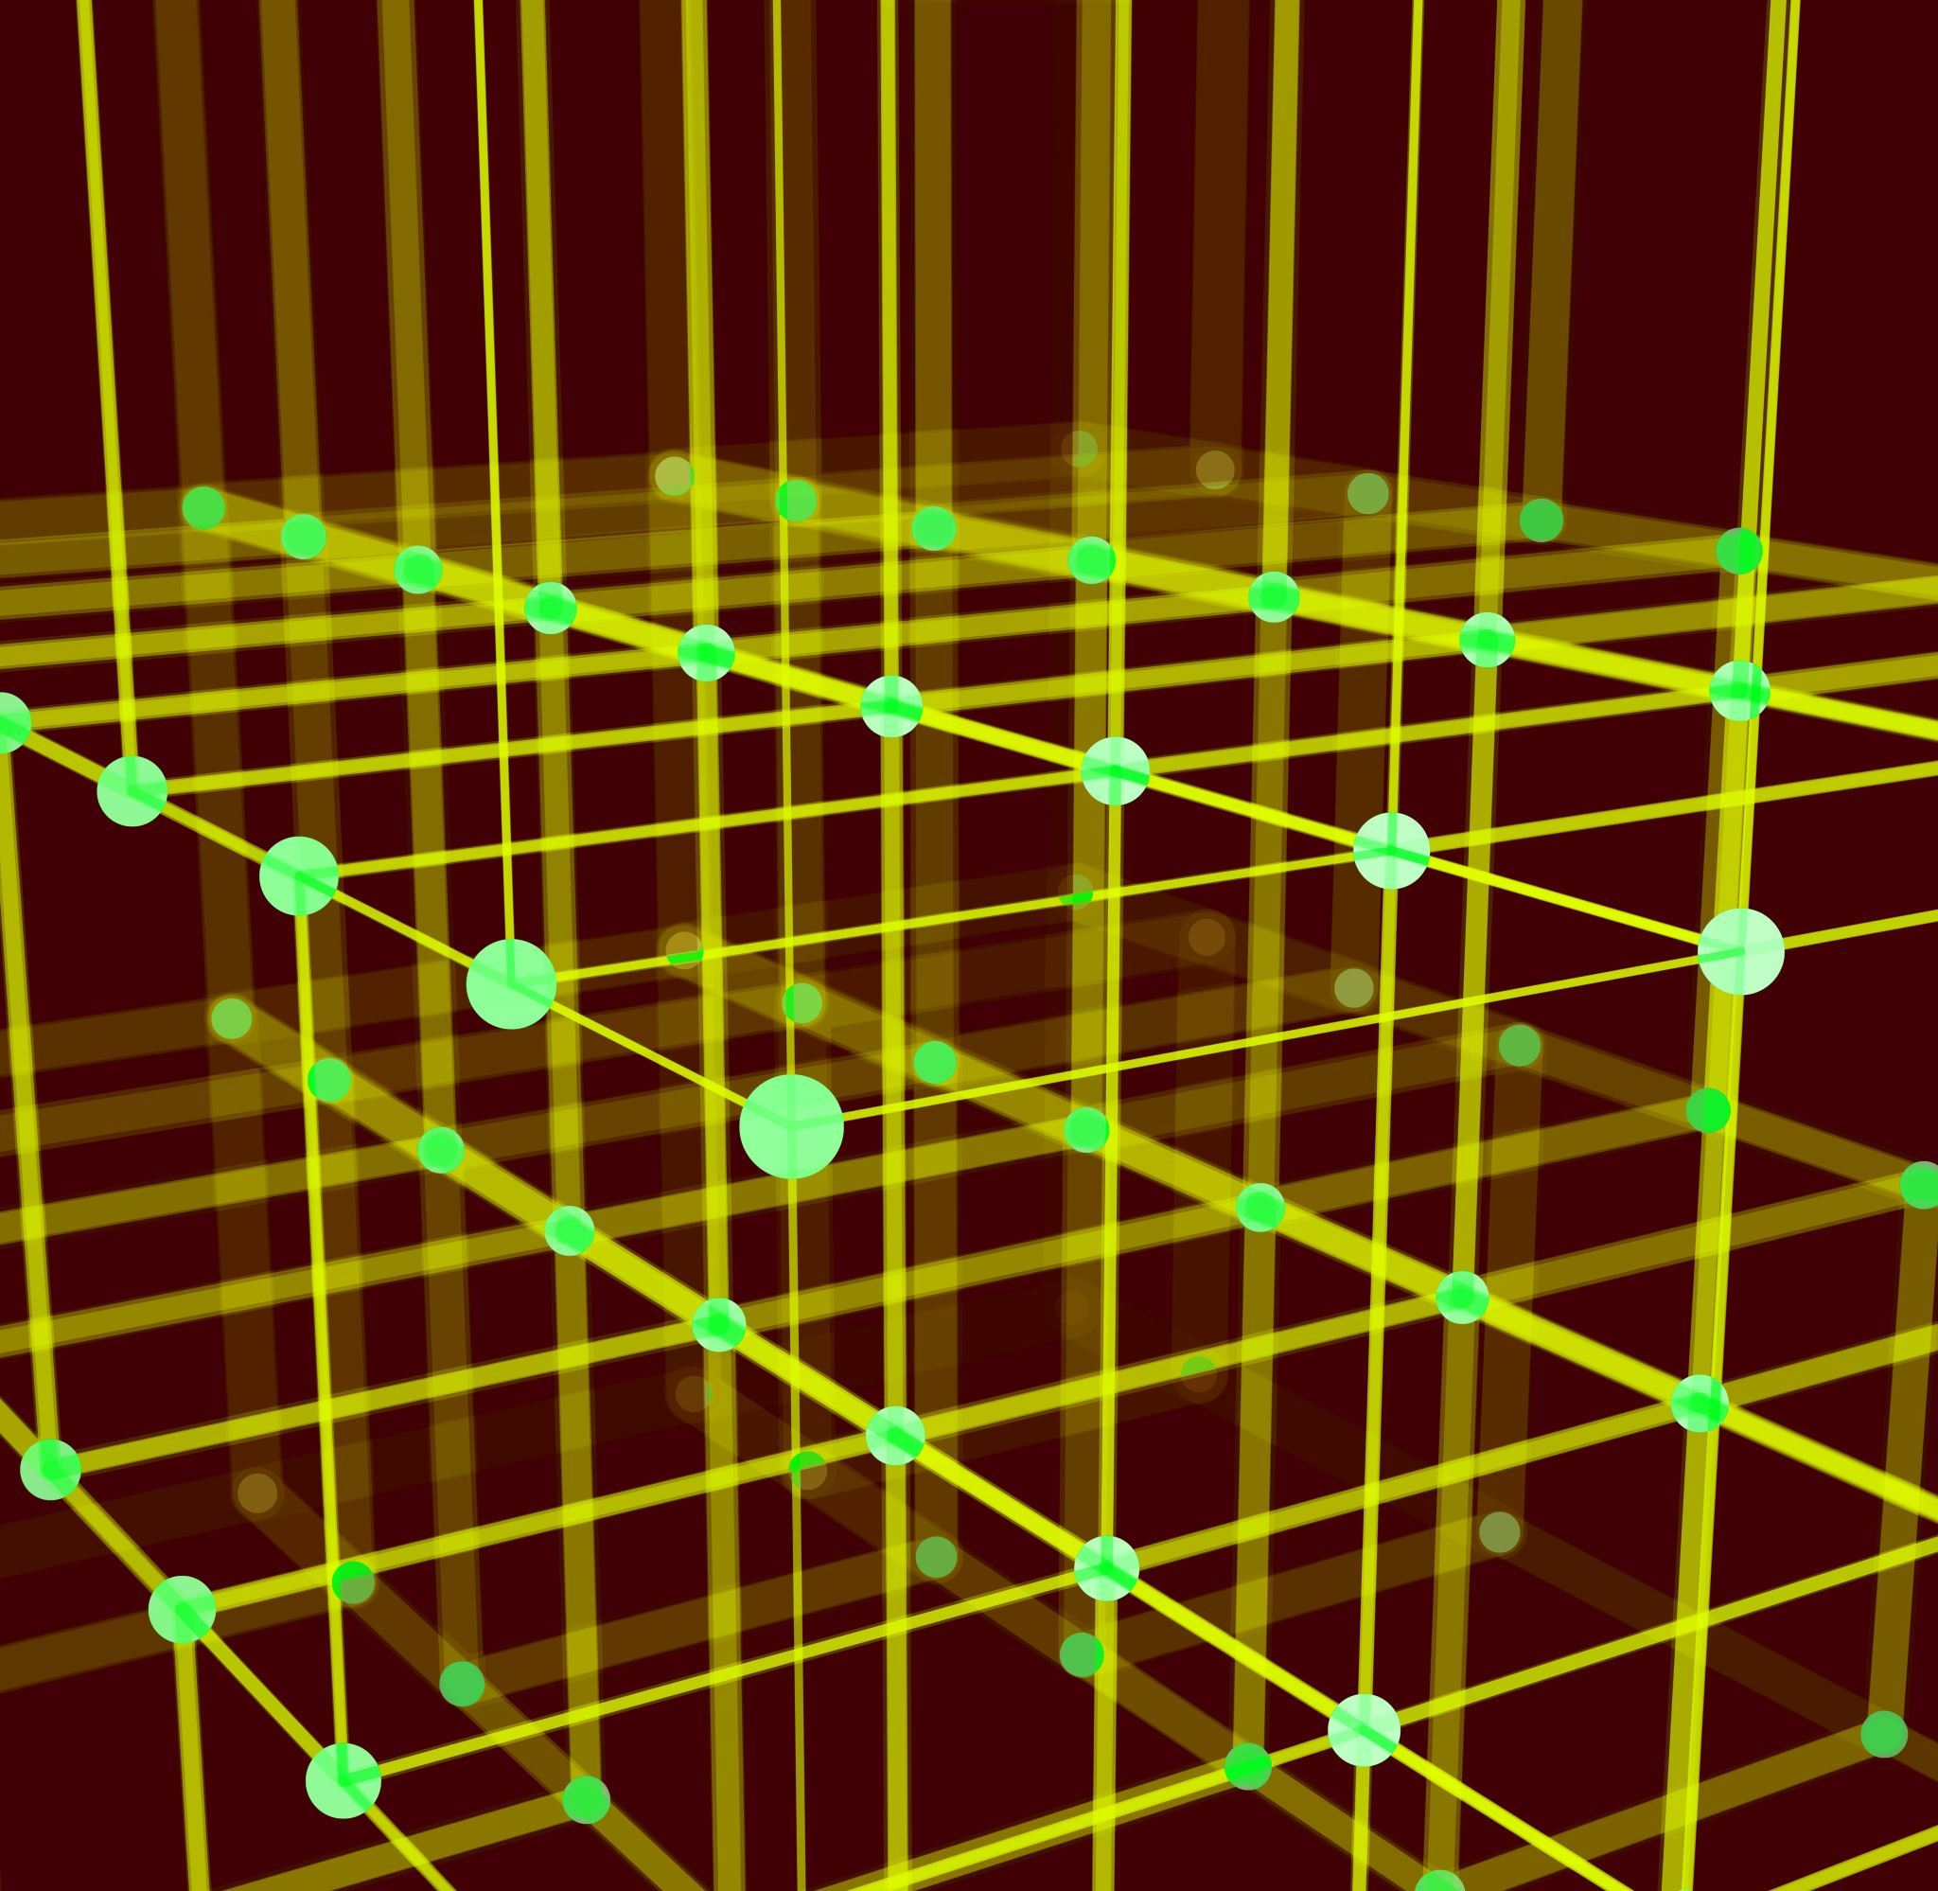
GQA
g

Slide 4
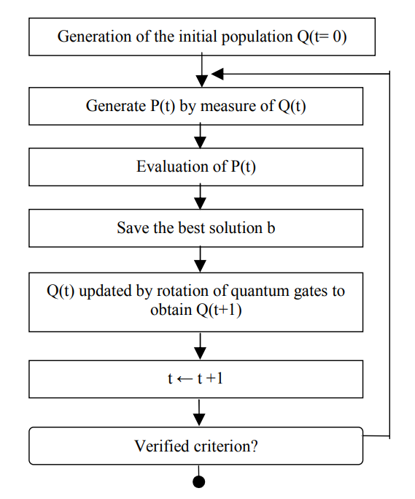
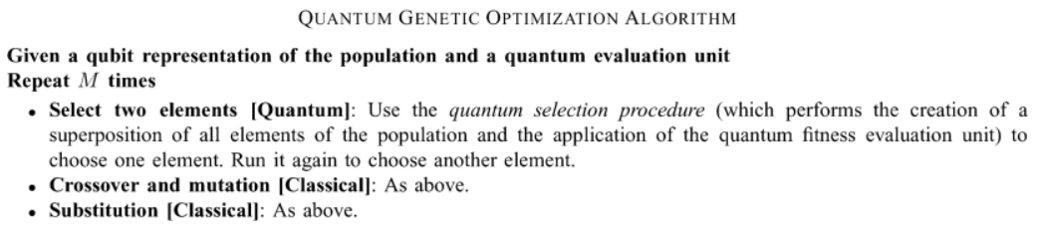
problem

Slide 5
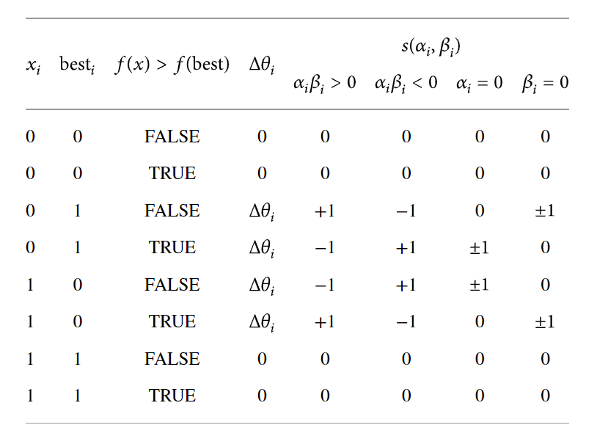
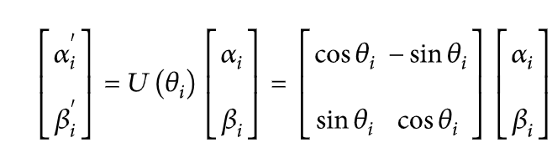
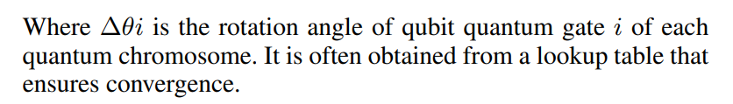
problem

Slide 6
DIFFICULTIES
1. Constrained fitness functions
2. Can not copy a superposition(crossover, mutation)

Slide 7
advantage
(1) QGA searches a group of points rather than a single point in the solution space at the same time. QGA samples in different areas of space simultaneously [22].
(2) In QGA, the knowledge of the searching space or other ancillary information is not needed. Only the fitness function is used to evaluate the individuals [23].
References: https://www.hindawi.com/journals/mpe/2013/730749/

Slide 8
conclusion
g

Slide 9
What I have learned
1. basic qunatum computation
2. quantum fourier transform
3. Shor's algorithms
4. qnnMNIST
5. optimization (QAOA,VQE)
6. QGA

Slide 10
Future work
Pack up all codes and slides
Write READMEs with HackMD

