Slide 1
MovieFlix SQL Data Analysis Project
Uncovering Business Insights from Rental Data
By AMADI JERRY GODSPOWER

Slide 2
Business Introduction – What is MovieFlix?
MovieFlix is a DVD rental service with a vast library of movies.
Tracks customer, rental, and payment data.
Allows online booking and local delivery.
Objective: Data-driven insights to improve operations.

Slide 3
Project Overview
• Understand MovieFlix’s business through its database
• Extract key metrics using SQL
• Identify patterns in customer spending and rentals
• Guide business decisions with data insights

Slide 4
Core Tables in the Database
• film – Movie catalog
• customer – Customer records
• rental – Rental activity
• payment – Revenue data
• inventory – Stock info
• staff – Employees handling transactions

Slide 5
SQL Query Objectives
• List movies and rental durations
• Analyze revenue by staff and store
• Identify top rented movies
• Categorize customer spending tiers
• Detect anomalies (payments with no rentals)

Slide 6
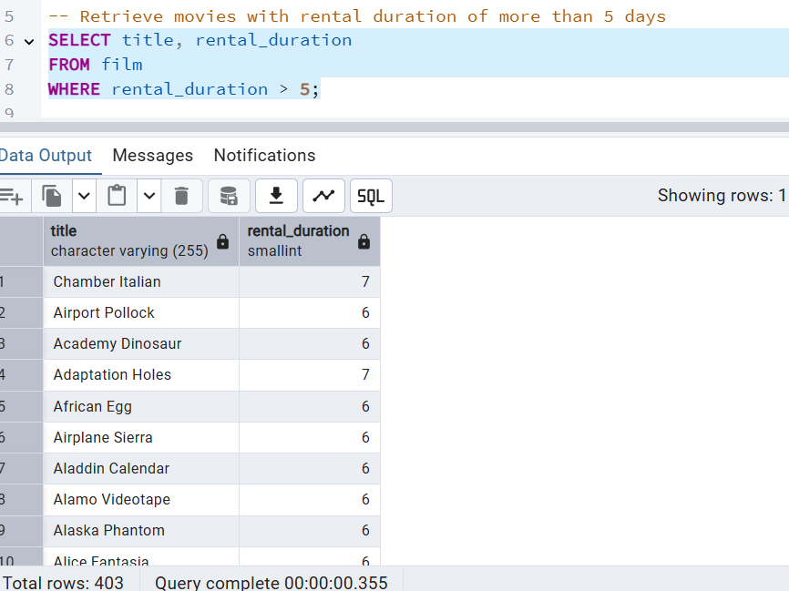

Slide 7
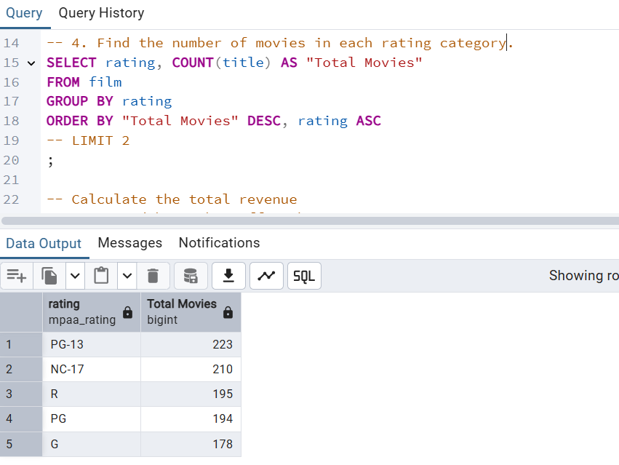

Slide 8
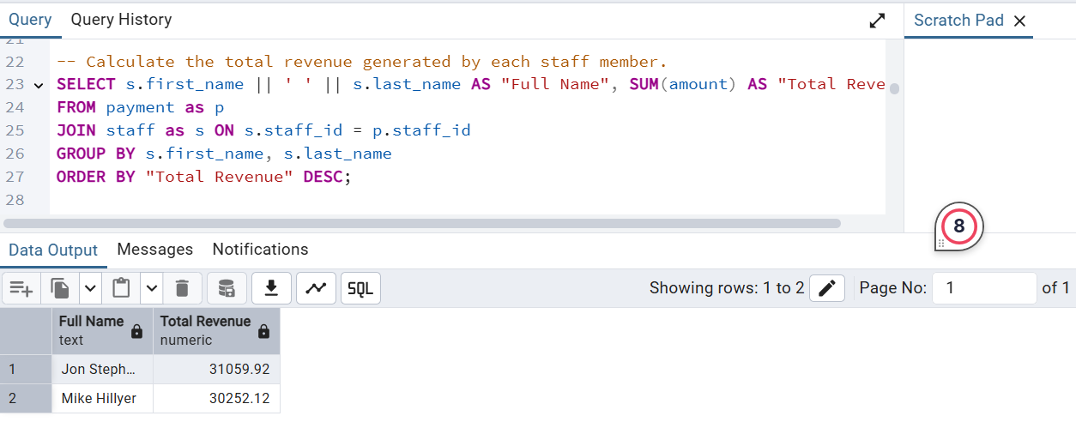

Slide 9
Customer Spending Classification
• Low Spender: < $70
• Middle Spender: $70–$100
• High Spender: > $100
Used CASE statements to classify customers
Helps identify premium customers and upsell potential

Slide 10
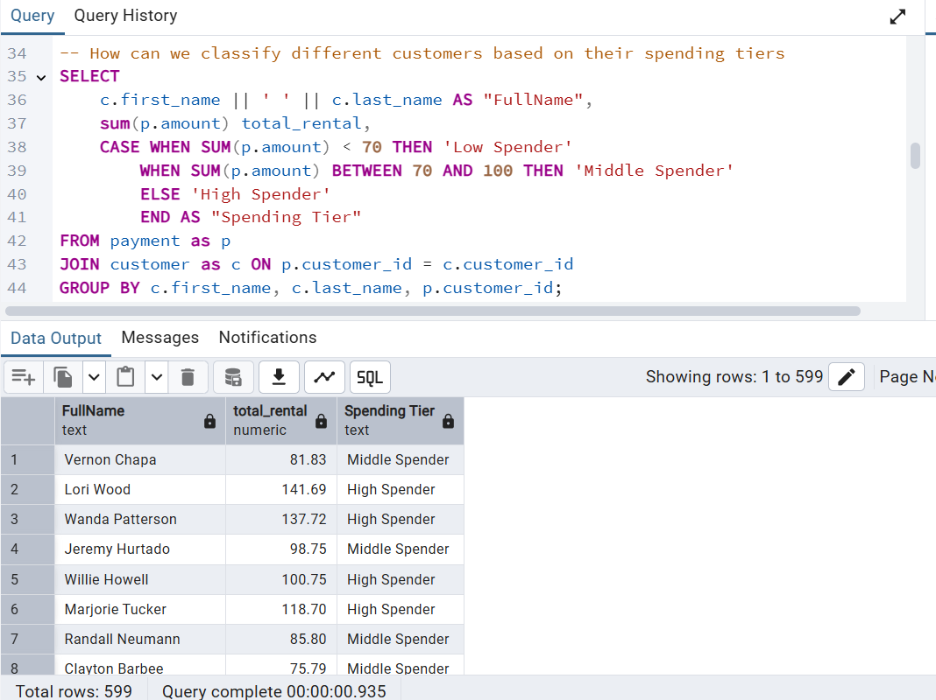

Slide 11
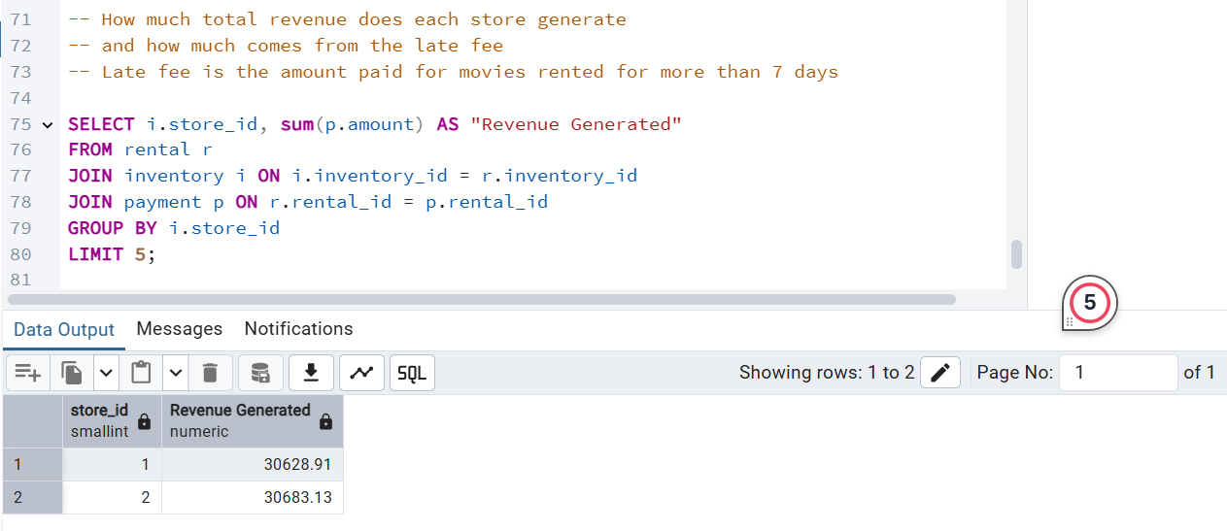

Slide 12
Recommendations
• Promote best-selling movies to similar demographics
• Train underperforming staff using top staff as benchmark
• Investigate non-rental payments
• Use customer tiering for targeted offers

Slide 13
Conclusion & Future Steps
• SQL enables powerful business insights
• MovieFlix can optimize operations with data
• Future: integrate with BI tools (Power BI/Tableau)
• Automate regular reports for stakeholders

