Slide 1


GUI - Tkinter

Slide 2
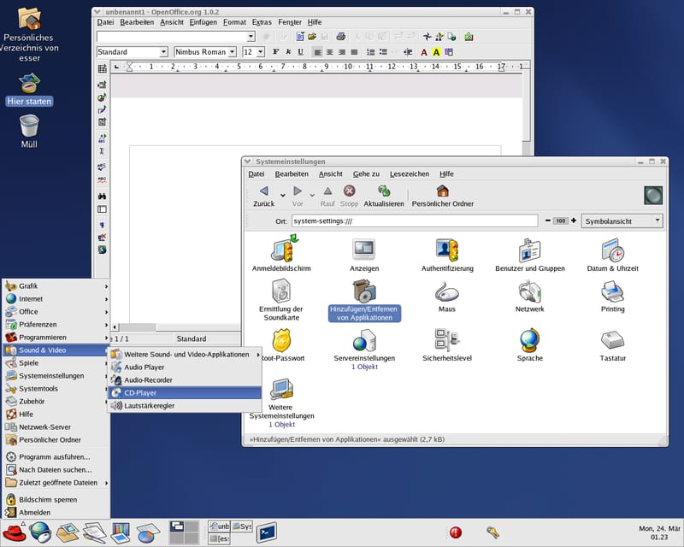
GUI
A GUI (graphical user interface) is a system of interactive visual components for computer software. A GUI displays objects that convey information, and represent actions that can be taken by the user.
Example: Text Editor, Calendar, Chrome, Calculator, Games etc.,

Slide 3
GUI in Python
Python provides various options for developing graphical user interfaces(GUIs).
Most important are listed below:
Tkinter
PyQt
wxPython
Jpython
Kivy
PySide

Slide 4
Tkinter Programming
Tkinter is the standard GUI library for python. Python when combined with Tkinter provides a fast and easy way to create GUI applications.
Tkinter provides a powerful object-oriented interface to the Tk GUI toolkit.
Creating a GUI application using Tkinter is an easy task.
Import the tkinter module.
Create the GUI application main window.
Add one or more widgets to the GUI application.
Main event loop

Slide 5
Creating Tk window
import tkinter
top=tkinter.Tk()
#code to add widgets will go here…
top.mainloop()

Slide 6
Tkinter Widgets
Tkinter provides various controls, labels and text boxes used in a GUI application. These controls are commonly called widgets.
There are currently 15 types of widgets in Tkinter.
Operator | Description
Button | The button widget is used to display buttons in your application.
Canvas | The canvas widget is used to draw shapes, such as lines, ovals, polygons and rectangles, in your application.
Check Button | The Check Button widget is used to display a number of option as checkboxes. The user can select multiple options at a time.

Slide 7
Entry | The entry widget is used to display a single-line text field for accepting values from a user.
Frame | The frame widget is used as a container widget to organize other widgets.
Label | The label widgets is used to provide a single-line caption for other widgets. It can also contain images.
Listbox | The listbox widget is used to provide a list of option to a user.
Menubutton | The Menubutton widget is used to display menus in your application.
Menu | The menu widget is used to provide various commands to a user. These commands are contained inside menubutton.
Message | The message widget is used to display multiline text fields for accepting values from a user.
Radiobutton | The Radiobutton widget is used to display a number of options as radio buttons. The user can select only one option at a time.

Slide 8

Scale | The scale widget is used to provide a slider widget.
Scrollbar | The Scrollbar widget is used to add scrolling capability to various widgets, such as list boxes.
Text | The Text widget is used to display text in multiple lines.
Spinbox | The spinbox widget is a variant of the standard Tkinter Entry widget, which can be used to select from a fixed number of values.
LabelFrame | A LabelFrame is a simple container widget. Its primary purpose is to act as a spacer or container for complex window layouts.
messagebox | This module is used to display message boxes in your applications.

Slide 9
Geometry Manager classes:
Pack() Method:
It organizes the widgets in blocks before placing in the parent widget.
Grid() Method:
It organizes the widgets in the grid (table like structure) before placing in the parent widget.
Place() Method:
It organizes the widgets by placing them on specific positions directed by the programmer.

Slide 10
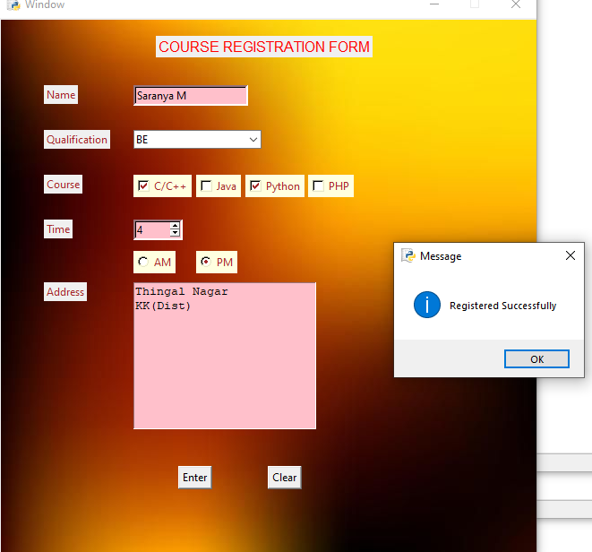
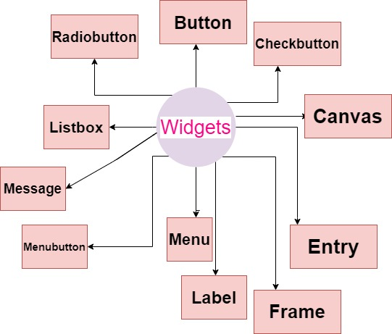

Slide 11
Button
Syntax:
w=Button(master,option=value,…)
Parameters
master: This represent the parent window.
options: Here is the list of most commonly used options for this widget. These options can be used as key-value pairs separated by commas.

Slide 12
Some options
activebackground: to set the background color when button is under the cursor.
activeforeground: to set the foreground color when button is under the cursor.
bg: to set he normal background color.
command: to call a function.
font: to set the font on the button label.
image: to set the image on the button.
width: to set the width of the button.
height: to set the height of the button.

Slide 13
Button and Message Box
from tkinter import *
from tkinter import messagebox
top = Tk()
top.title(‘Networkz Systems')
top.geometry("400x300")
def click():
messagebox.showinfo("Message","Welcome to Networkz Systems.....!!!")
b=Button(top,text='Click Me..!',font=('Times',20),bg='pink',command=click)
b.place(x=100,y=50)
top.mainloop()

Slide 14
Label
This widget implements a display box where you can place text or images. The text displayed by this widget can be updated at any time you want.
It is also possible to underline part of the text (like to identify a keyboard shortcut) and span the text across multiple lines.
Syntax
w = Label ( master, option=value, ... )
Parameters
master − This represents the parent window.
options -options can be used as key-value pairs separated by commas.

Slide 15
Options
bg: to set he normal background color.
font: to set the font on the button label.
image: to set the image on the button.
width: to set the width of the button.
height” to set the height of the button.
padx:This option is used to add extra spaces between left and right of the text within the label.The default value for this option is 1.
pady:This option is used to add extra spaces between top and bottom of the text within the label.The default value for this option is 1.

Slide 16
Entry
The Entry widget is used to accept single-line text strings from a user.
If you want to display multiple lines of text that can be edited, then you should use the Text widget.
If you want to display one or more lines of text that cannot be modified by the user, then you should use the Label widget.
Syntax
w = Entry( master, option=value, ... )
Parameters
master − This represents the parent window.
options − options can be used as key-value pairs separated by commas.

Slide 17
Options
bd: to set the border width in pixels.
bg: to set the normal background color.
cursor: to set the cursor used.
width: to set the width of the button.
height: to set the height of the button.

Slide 18
Example-Label and Entry Widgets
from tkinter import*
top=Tk()
top.geometry('300x200')
L1=Label(top,text="User Name")
L1.place(x=20,y=20)
E1=Entry(top,bd=5)
E1.place(x=100,y=20)
top.mainloop()

Slide 19
Checkbutton
The Checkbutton widget is used to display a number of options to a user as toggle buttons. The user can then select one or more options by clicking the button corresponding to each option.
You can also display images in place of text.
Syntax:
w = Checkbutton ( master, option, ... )
Parameters:
master − This represents the parent window.
options − Here is the list of most commonly used options for this widget. These options can be used as key-value pairs separated by commas.

Slide 20
Options
Title: To set the title of the widget.
activebackground: to set the background color when widget is under the cursor.
activeforeground: to set the foreground color when widget is under the cursor.
bg: to set he normal background
font: to set the font on the button label.

Slide 21
Example
from tkinter import*
w=Tk()
w.title('Check button example')
w.geometry('300x300')
l=Label(w,text='Select the course',font=('Times',18),bg='lightblue')
l.place(x=80,y=20)
ck1=IntVar()
ck2=IntVar()
b1=Checkbutton(w,text='C/C++',variable=ck1,onvalue=1,offvalue=0,height=2,width=4)
b1.place(x=125,y=100)
b2=Checkbutton(w,text='Java',variable=ck2,onvalue=1,offvalue=0,height=2,width=4)
b2.place(x=120,y=150)
w.mainloop()

Slide 22
Radiobutton:
This widget implements a multiple-choice button, which is a way to offer many possible selections to the user and lets user choose only one of them.
In order to implement this functionality, each group of radiobuttons must be associated to the same variable and each one of the buttons must symbolize a single value. You can use the Tab key to switch from one radionbutton to another.
Syntax:
w = Radiobutton ( master, option, ... )
Parameters:
master − This represents the parent window.
options − Here is the list of most commonly used options for this widget. These options can be used as key-value pairs separated by commas.

Slide 23
Options
activebackground: to set the background color when widget is under the cursor.
activeforeground: to set the foreground color when widget is under the cursor.
bg: to set he normal background color.
font: to set the font on the button label.
width: to set the width of the label in characters.
height: to set the height of the label in characters.

Slide 24
Example:
l=Label(w,text='Gender',font=('Time',14))
l.place(x=90,y=50)
v1=IntVar()
m=Radiobutton(w,text='Male',value=1,variable=v1)
f=Radiobutton(w,text='Female',value=2,variable=v1)
m.place(x=100,y=100)
f.place(x=200,y=100)

Slide 25
Listbox
The Listbox widget is used to display a list of items from which a user can select a number of items.
Syntax:
w = Listbox ( master, option, ... )
Parameters:
master − This represents the parent window.
options − Here is the list of most commonly used options for this widget. These options can be used as key-value pairs separated by commas.

Slide 26
Options
highlightcolor: To set the color of the focus highlight when widget has to be focused.
bg: to set he normal background color.
bd: to set the border width in pixels.
font: to set the font on the button label.
width: to set the width of the widget.
height: to set the height of the widget.

Slide 27
Example
from tkinter import * top = Tk() Lb1 = Listbox(top) Lb1.insert(1, "Python") Lb1.insert(2, "Perl") Lb1.insert(3, "C") Lb1.insert(4, "PHP") Lb1.insert(5, "JSP") Lb1.insert(6, "Ruby") Lb1.pack() top.mainloop()

Slide 28
ComboBox
from tkinter import*
from tkinter.ttk import Combobox
w=Tk()
w.title('Networkz Systems')
w.geometry('350x300')
pl=Label(w,text='Place',font=('Times',15))
pl.place(x=50,y=100)
cb=Combobox(w,width=14,font=('Times',12))
cb['values']=('Nagercoil','Marthandam','Mylacode','Alencode','Vattam')
cb.current(0)
cb.place(x=150,y=100)
w.mainloop()

Slide 29
Menubutton
A menubutton is the part of a drop-down menu that stays on the screen all the time. Every menubutton is associated with a Menu widget that can display the choices for that menubutton when the user clicks on it.
Syntax:
w = Menubutton ( master, option, ... )
Parameters:
master − This represents the parent window.
options − Here is the list of most commonly used options for this widget. These options can be used as key-value pairs separated by commas.

Slide 30
Options
activebackground: To set the background when mouse is over the widget.
activeforeground: To set the foreground when mouse is over the widget.
bg: to set he normal background color.
bd: to set the size of border around the indicator.
cursor: To appear the cursor when the mouse over the menubutton.
width: to set the width of the widget.
height: to set the height of the widget.
highlightcolor: To set the color of the focus highlight when widget has to be focused.

Slide 31
Example:
from tkinter import * top = Tk() mb= Menubutton ( top, text=“Languages", relief=RAISED ) mb.menu = Menu ( mb, tearoff = 0 ) mb["menu"] = mb.menu v1 = IntVar() v2= IntVar() mb.menu.add_checkbutton (label=“Tamil",variable=v1 ) mb.menu.add_checkbutton ( label=“English",variable=v2) mb.pack() top.mainloop()

Slide 32
Menu
The goal of this widget is to allow us to create all kinds of menus that can be used by our applications. The core functionality provides ways to create three menu types: pop-up, toplevel and pull-down.
It is also possible to use other extended widgets to implement new types of menus, such as the OptionMenu widget, which implements a special type that generates a pop-up list of items within a selection.
Syntax
w = Menu ( master, option, ... )
Parameters
master − This represents the parent window.
options − Here is the list of most commonly used options for this widget. These options can be used as key-value pairs separated by commas.

Slide 33
Options
title: To set the title of the widget.
activebackground: to set the background color when widget is under the cursor.
activeforeground: to set the foreground color when widget is under the cursor.
bg: to set he normal background color.
command: to call a function.
font: to set the font on the button label.
image: to set the image on the widget.

Slide 34
Example
from tkinter import*
w=Tk()
w.title('Networkz Systems')
w.geometry('300x300')
w.resizable(0,0)
w.configure(bg='lightblue')
menubar=Menu(w)
file=Menu(menubar,tearoff=0)
file.add_command(label='New')
file.add_command(label='Open')
file.add_separator()
file.add_command(label='Save')
file.add_command(label='Save As')
file.add_separator()
file.add_command(label='Exit',command=w.destroy)
menubar.add_cascade(label='File',menu=file)
w.config(menu=menubar)
w.mainloop()

Slide 35
scale
The Scale widget provides a graphical slider object that allows you to select values from a specific scale.
Syntax
w = Scale ( master, option, ... )
Parameters
master − This represents the parent window.
options − Here is the list of most commonly used options for this widget. These options can be used as key-value pairs separated by commas.

Slide 36
Options
cursor: To change the cursor pattern when the mouse is over the widget.
activebackground: To set the background of the widget when mouse is over the widget.
bg: to set he normal background color.
orient: Set it to HORIZONTAL or VERTICAL according to the requirement.
from_: To set the value of one end of the scale range.
to: To set the value of the other end of the scale range.
width: to set the width of the widget.

Slide 37
Example
from tkinter import*
w=Tk()
w.geometry('200x250')
v=DoubleVar()
scale=Scale(w,from_=1,to=100,var=v,orient=VERTICAL)
scale.pack(anchor=CENTER)
def select():
result='value='+str(v.get())
l1.config(text=result)
b=Button(w,text='value',command=select)
b.pack(anchor=CENTER,pady=20)
l1=Label(w,text='')
l1.pack()
w.mainloop()

Slide 38
scrollbar
This widget provides a slide controller that is used to implement vertical scrolled widgets, such as Listbox, Text and Canvas. Note that you can also create horizontal scrollbars on Entry widgets.
Syntax
w = Scrollbar ( master, option, ... )
Parameters
master − This represents the parent window.
options − Here is the list of most commonly used options for this widget. These options can be used as key-value pairs separated by commas.

Slide 39
Options
width: to set the width of the widget.
activebackground: To set the background when mouse is over the widget.
bg: to set he normal background color.
bd: to set the size of border around the indicator.
cursor: To appear the cursor when the mouse over the menubutton.

Slide 40
Example:
from tkinter import *
root = Tk()
scrollbar = Scrollbar(root)
scrollbar.pack( side = RIGHT, fill = Y )
mylist = Listbox(root, yscrollcommand = scrollbar.set )
for line in range(100):
mylist.insert(END, "This is line number " + str(line))
mylist.pack( side = LEFT, fill = BOTH )
scrollbar.config( command = mylist.yview )
mainloop()

Slide 41
Text
Text widgets provide advanced capabilities that allow you to edit a multiline text and format the way it has to be displayed, such as changing its color and font.
You can also use elegant structures like tabs and marks to locate specific sections of the text, and apply changes to those areas. Moreover, you can embed windows and images in the text because this widget was designed to handle both plain and formatted text.
Syntax
w = Text ( master, option, ... )
Parameters
master − This represents the parent window.
options − Here is the list of most commonly used options for this widget. These options can be used as key-value pairs separated by commas.

Slide 42
Options
highlightcolor: To set the color of the focus highlight when widget has to be focused.
bg: to set he normal background color.
font: to set the font on the button label.
width: to set the width of the widget.
height: to set the height of the widget.

Slide 43
Example-Scrollbar and Text Widget
#scrollbar
y=Scrollbar(w,orient=VERTICAL)
y.pack(side=RIGHT,fill=Y)
x=Scrollbar(w,orient=HORIZONTAL)
x.pack(side=BOTTOM,fill=X)
#text
t=Text(w,height=500,width=500,yscrollcommand=y.set,
xscrollcommand=x.set,wrap='none')
for i in range(50):
t.insert(END,'\n Graphical User Interface
Tkinter python Programming')
y.config(command=t.yview)
x.config(command=t.xview)
t.pack()

Slide 44
spinbox
The Spinbox widget is a variant of the standard Tkinter Entry widget, which can be used to select from a fixed number of values.
Syntax
w = Spinbox( master, option, ... )
Parameters
master − This represents the parent window.
options − Here is the list of most commonly used options for this widget. These options can be used as key-value pairs separated by commas.

Slide 45
Options
bg: to set he normal background color.
bd: to set the size of border around the indicator.
cursor: To appear the cursor when the mouse over the menubutton.
width: to set the width of the widget.
activebackground: To set the background when mouse is over the widget.
disabledbackground: To disable the background when mouse is over the widget.
from_: To set the value of one end of the range.
to: To set the value of the other end of the range.

Slide 46
Example
from tkinter import *
root = Tk()
var = StringVar()
label = Message( root, textvariable=var, relief=RAISED )
var.set("Hey!? How are you doing?")
label.pack()
root.mainloop()

Slide 47
Message:
This widget provides a multiline and non editable object that displays texts, automatically breaking lines and justifying their contents.
Its functionality is very similar to the one provided by the Label widget, except that it can also automatically wrap the text, maintaining a given width or aspect ratio.
Syntax
w = Message ( master, option, ... )
Parameters
master − This represents the parent window.
options − Here is the list of most commonly used options for this widget. These options can be used as key-value pairs separated by commas.

Slide 48
Options
bd: to set the border around the indicator.
bg: to set he normal background color.
font: to set the font on the button label.
width: to set the width of the widget.
height: to set the height of the widget.
relief: Specifies the appearance of a decorative border around the label. The default is FLAT; for other values.
padx: Extra space added to the left and right of the text within the widget. Default is 1.
pady:Extra space added above and below the text within the widget. Default is 1.

Slide 49
Example:
from tkinter import *
root = Tk()
var = StringVar()
label = Message( root, textvariable=var, relief=RAISED )
var.set("Hey!? How are you doing?")
label.pack()
root.mainloop()

Slide 50
Canvas
It is used to draw pictures and other complex layout like graphics, text and widgets.
Syntax:
w = Canvas(master, option=value)
Options
bd: to set the border width in pixels.
bg: to set the normal background color.
cursor: to set the cursor used in the canvas.
highlightcolor: to set the color shown in the focus highlight.
width: to set the width of the widget.
height: to set the height of the widget.

Slide 51
Example:
c=Canvas(w,bg='lightgreen',height=500,width=400)
cord=10,50,230,200
arc=c.create_arc(cord,start=0,extent=150,fill='green')
line=c.create_line(10,20,200,250,fill='green',width=5)
oval=c.create_oval(50,200,200,450,fill='pink',width=5)
rect=c.create_rectangle(250,20,350,250,fill='pink')
points=[150,300,200,120,240,180]
c.create_polygon(points,outline='blue',fill='pink',width=2)

Slide 52
Frame
The Frame widget is very important for the process of grouping and organizing other widgets in a somehow friendly way. It works like a container, which is responsible for arranging the position of other widgets.
It uses rectangular areas in the screen to organize the layout and to provide padding of these widgets. A frame can also be used as a foundation class to implement complex widgets.

Slide 53
Syntax:
w = Frame ( master, option, ... )
Parameters:
master − This represents the parent window.
options − Here is the list of most commonly used options for this widget. These options can be used as key-value pairs separated by commas.

Slide 54
Options
highlightcolor: To set the color of the focus highlight when widget has to be focused.
bd: to set the border width in pixels.
bg: to set the normal background color.
cursor: to set the cursor used.
width: to set the width of the widget.
height: to set the height of the widget.

Slide 55
Example:
from Tkinter import *
root = Tk()
frame = Frame(root)
frame.pack()
bottomframe = Frame(root)
bottomframe.pack( side = BOTTOM )
redbutton = Button(frame, text="Red", fg="red")
redbutton.pack( side = LEFT)
greenbutton = Button(frame, text="Brown", fg="brown")
greenbutton.pack( side = LEFT )
bluebutton = Button(frame, text="Blue", fg="blue")
bluebutton.pack( side = LEFT )
blackbutton = Button(bottomframe, text="Black", fg="black")
blackbutton.pack( side = BOTTOM)
root.mainloop()

Slide 56
TopLevel:
This widget is directly controlled by the window manager. It don’t need any parent window to work on.
Syntax:
w = TopLevel(master, option=value)
Options
bg: to set he normal background color.
bd: to set the size of border around the indicator.
cursor: To appear the cursor when the mouse over the menubutton.
width: to set the width of the widget.
height: to set the height of the widget.

Slide 57
Example
from tkinter import *
root = Tk()
root.title(‘Networkz Systems')
top = Toplevel()
top.title('Python')
top.mainloop()

Slide 58
Image:
from tkinter import*
from PIL import Image,ImageTk
top=Tk()
top.title("Adding Image")
top.geometry("500x500")
img=Image.open("night.jpg")
name=ImageTk.PhotoImage(img)
lb=Label(top,image=name)
lb.place(x=0,y=0)
##photo=PhotoImage(file="button.png")
##Button(top,image=photo).pack(side=BOTTOM,pady=20)
top.mainloop()

Slide 59
exercise
1.Create a calculator using GUI programming?

Slide 60
thankyou
PRESENTED BY,
SARANYA M

