Slide 1
AWT

Slide 2
CUI: CUI stands for Character User Interface. This is a type of user interface where user interacts with computer using only keyboard.
A graphical user interface (GUI) is an interface through which a user interacts with electronic devices such as computers and smartphones ...
UI User Interface
GUI graphical User interface
CUI character User Interface
Windows Application
Web Application
Mobile Application
AWT-Abstract window Tool Kit
Swings
JAVA FX

Slide 3
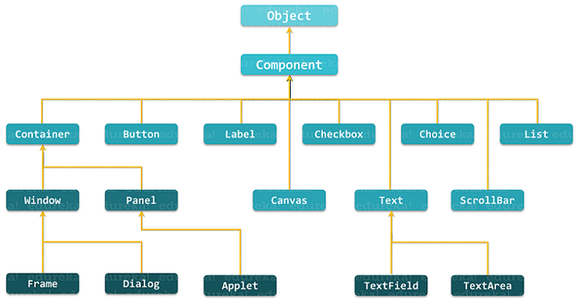

Slide 4
Frame in Java AWT
The class Frame is a top level window with border and title. It uses BorderLayout as default layout manager.
The size of the frame includes any area designated for the border. The dimensions of the border area may be obtained using the getInsets method,

Slide 5
Source Code
01_method.java
package awtDemo;
import java.awt.*;
public class app {
public static void main(String[] args) {
Frame frm =new Frame(“First app");
frm.setSize(1000,600);//w,h
frm.setLayout(null);
Button btn=new Button("Click Me");
btn.setBounds(75,75,200,50);//X,Y,W,H
frm.add(btn);
frm.setVisible(true);
}
}

Slide 6
02_method.java
package awtDemo;
import java.awt.*;
public class app extends Frame
{
Button btn;
public app()
{
super(“First app");
setLayout(null);
btn=new Button("Click Me");
btn.setBounds(75,75,200,50);//X,Y,W,H
add(btn);
setSize(1000,600);
setVisible(true);
}
public static void main(String args[])
{
app frm =new app();
}
}

Slide 7
03_method.java
package awtDemo;
import java.awt.*;
class MyApp extends Frame
{
Button btn;
public MyApp()
{
super(“first app");
setLayout(null);
btn=new Button("Click Me");
btn.setBounds(75,75,200,50);
add(btn);
setSize(1000,600);
setVisible(true);
}
}
public class app
{
public static void main(String args[])
{
MyApp frm =new MyApp();
}

Slide 8
Button and ActionListener in Java AWT
The Java ActionListener is notified whenever you click on the button or menu item. It is notified against ActionEvent.
Example

Slide 9
CheckBox in Java AWT
Checkbox control is used to turn an option on(true) or off(false). There is label for each checkbox representing what the checkbox does.
Constructor | Used for
Checkbox() | checkbox with no string as the label.
Checkbox(String label) | checkbox with the given label.
Checkbox(String label, boolean state) | checkbox with the given label and sets the given state.
Checkbox(String label, boolean state, CheckboxGroup group) | checkbox with the given label, set the given state in the specified checkbox group.
Checkbox(String label, CheckboxGroup group, boolean state) | checkbox with the given label, in the given checkbox group and set to the specified state.

Slide 10
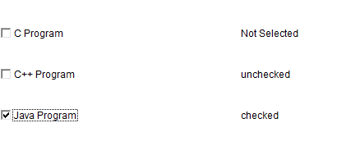
Example
Output

Slide 11
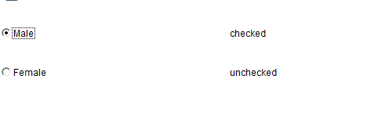
RadioButton in Java AWT
Radio buttons provide a more user friendly environment for selecting only one option among many. It is a special kind of checkbox that is used to select only one option.
Example
output

Slide 12
TextField in Java AWT
The textField component allows the user to edit single line of text.When the user types a key in the text field the event is sent to the TextField.
Constructor | Used for
TextField() | new text field component.
TextField(String text) | new text field initialized with the given string text to be displayed.
TextField(int columns) | new textfield (empty) with given number of columns.
TextField(String text, int columns) | new text field with the given text and given number of columns (width).

Slide 13
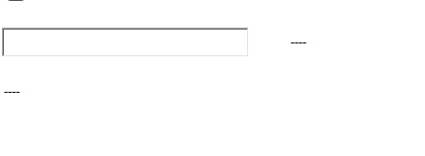
Example
output

Slide 14
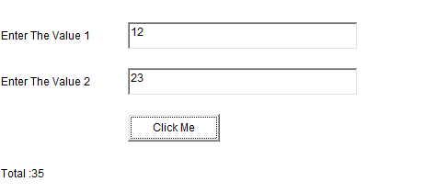
Basic Addition Program in Java AWT
In this program, You will learn how to add two numbers using awt in Java.
Example
output

Slide 15
TextArea in Java AWT
The TextArea control in AWT provide us multiline editor area. The user can type here as much as they wants. When the text in the text area become larger than the viewable area the scroll bar is automatically appears which help us to scroll the text up & down and right & left.
Constructor | Used for
TextArea() | new and empty text area with no text in it.
TextArea (int row, int column) | new text area with specified number of rows and columns and empty string as text.
TextArea (String text) | new text area and displays the specified text
TextArea (String text, int row, int column) | new text area with the specified text in the text area and specified number of rows and columns.
TextArea (String text, int row, int column, int scrollbars) | new text area with specified text in text area and specified number of rows and columns and visibility.

Slide 16
Example
output

Slide 17
Count Words and Characters in Java AWT
We can develop Word Character Counter in java with the help of string, AWT/Swing with event handling.
Source code

Slide 18
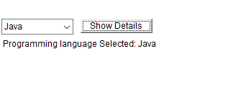
Choice in Java AWT
Choice class is part of Java Abstract Window Toolkit(AWT). The Choice class presents a pop- up menu for the user, the user may select an item from the popup menu.
Source code
output

Slide 19
List in Java AWT
The List represents a list of text items. The list can be configured that user can choose either one item or multiple items.
Constructor | Used for
List() | new scrolling list.
List(int row_num) | new scrolling list initialized with the given number of rows visible.
List(int row_num, Boolean multipleMode) | new scrolling list initialized which displays the given number of rows.

Slide 20
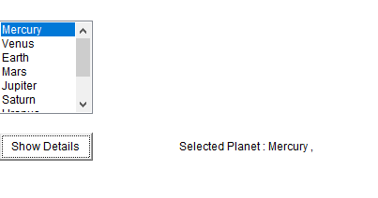
Source code
OUTPUT

Slide 21
Canvas in Java AWT
The Canvas class controls and represents a blank rectangular area where the application can draw or trap input events from the user. It inherits the Component class.
Constructor | Used for
Canvas() | Creates a new blank canvas.
Canvas(GraphicsConfiguration c) | Creates a new canvas with a specified graphics configuration.

Slide 22

Source Code
Output

Slide 23
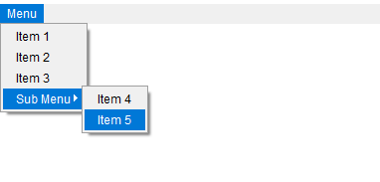
MenuBar,Menu,MenuItem in Java AWT
The object of MenuItem class adds a simple labeled menu item on menu. The items used in a menu must belong to the MenuItem or any of its subclass.
Source Code
output

Slide 24
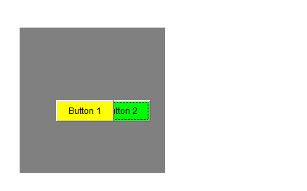
Panel in Java AWT
The class Panel is the simplest container class. It provides space in which an application can attach any other component, including other panels. It uses FlowLayout as default layout manager.
Source Code
output

Slide 25
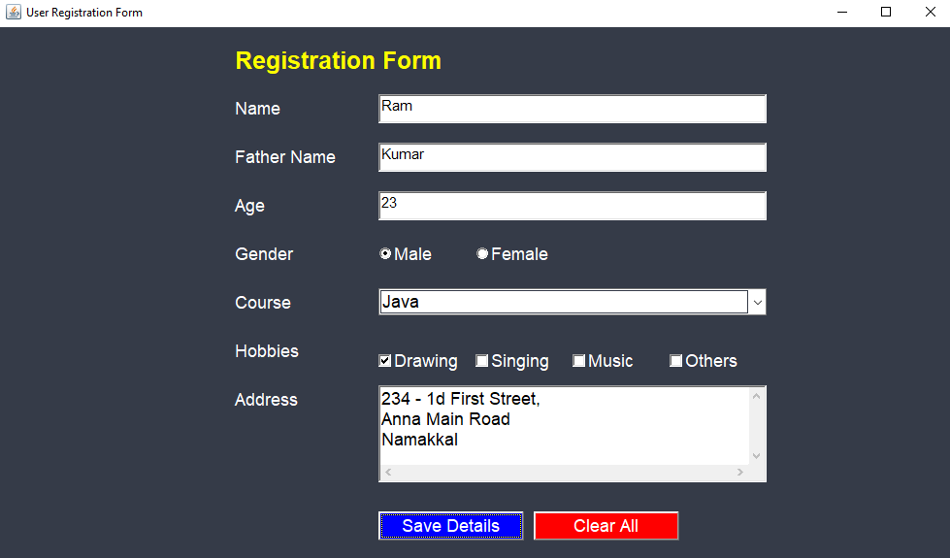
Form Design Using Java AWT
We'll see how to make a Registration form which includes all the buttons and field in one Form.
Source Code
Output

