Slide 1
fn_ITSBNImageSegm
The features Y will be imported and standardized
Y is a NxD feature matrix where
  N: number of superpixels at the bottom most level
  D: dimensionality of each feature vector
Then use GMM to fit Y

Slide 2
fn_SuperpixelMori1
[] = fn_SuperpixelMori1(imagename, N_ev, N_sp3, N_sp2, N_sp1)
  Imagename
  N_ev: second to top H(L-2)
  N_sp3
  N_sp2
  N_sp1: the label level H1
Output: imagename_img_label_hier.mat
  img_label_hier is 4x3 cell array. 4 is # of levels and 3 is the followings:
    img_label_hier{l,1} = # of superpixels on level l determined by the user
    img_label_hier{l,2} = # of actual superpixels on level l
    img_label_hier{l,3} = resulting label for each pixel in the whole image, this has the same dimension as the original image

Slide 3
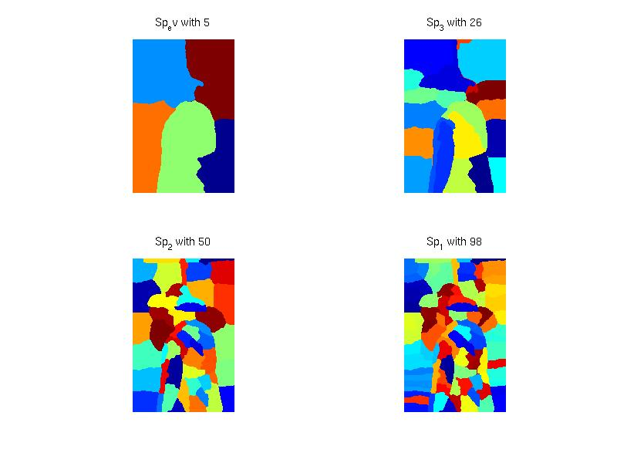
fn_SuperpixelMori1
This is how img_label_hier{l,3} looks like in each level l from 1 to 4.
H5
H1
H0

Slide 4
[] = makeTreeFromLabel(imagename)
Input: imagename_img_label_hier.mat
Output: imagename_package
  Y: feature vector for each superpixel
  Y_index: node label of each superpixel in H0 in the ascend order
  Z: adjacency matrix of the size (#child x #parent) and #parent = #child+1
  evidence_label: a matrix with the same size as the original image.Each element is the corresponding node index for level H(0)
  n_level: # of levels from H(L-2) to H(1)
  H: cell array of size (n_level+2+1) x 2
    H{level+1,1} = H(level)
    H{level+1,2} = list of the node index in the level H(level)

