Slide 1
Memory Optimized Table Investment
In-Memory Technologies
Enhanced
High Availability
New Hybrid
Scenarios
Other investments
In-Memory OLTP
5-25x performance gain for OLTP integrated into SQL Server
In-Memory DW
5-25x performance gain and high data compression
Updatable and clustered
SSD Bufferpool Extension
4-10X of RAM and up to 3X performance gain transparently for apps
Always On Enhancements
Increased availability and improved manageability of active secondaries
Online Database Operations
Increased availability for index/partition maintenance
Backup to Azure
Easy to implement and cost effective Disaster Recovery solution to Azure Storage
HA to Azure VM
Easy to implement and cost effective high availability solution with Windows Azure VM
Deploy to Azure
Deployment wizard to migrate database
Better together with Windows Server
WS2012 ReFS support
Online resizing VHDx
Hyper-V replica
Windows “Blue” support
Extending Power View
Enable Power View on existing analytic models and support new multi-dimensional models.

Slide 2
In-Memory Technology
In-Memory Technologies
Applicable to
Transactional workloads:
Concurrent data entry, processing and retrieval
In-Memory OLTP
5-20X performance gain for OLTP integrated into SQL Server
In-Memory DW
5-25X performance gain and high data compression
Updatable and clustered
SSD Bufferpool Extension
4-10X of RAM and up to 3X performance gain transparently for apps
Applicable to
Decision support workloads:
Large scans and aggregates
Applicable to
Disk-based transactional workloads:
Large working (data)set

Slide 3
Outline
Motivating trends – hardware, software, apps
In-memory OLTP architecture & integration into SQL Server
Performance and customer results
Review and References

Slide 4

Why In-memory OLTP (aka Hekaton)
Customer demand for ever higher throughput and predictable lower latency OLTP at a lower cost
Hardware trends demand architectural changes on RDBMS to meet those demands
In-memory OLTP is:
High performance,
Memory-optimized OLTP engine,
Integrated into SQL Server and
Architected for modern hardware

Slide 5
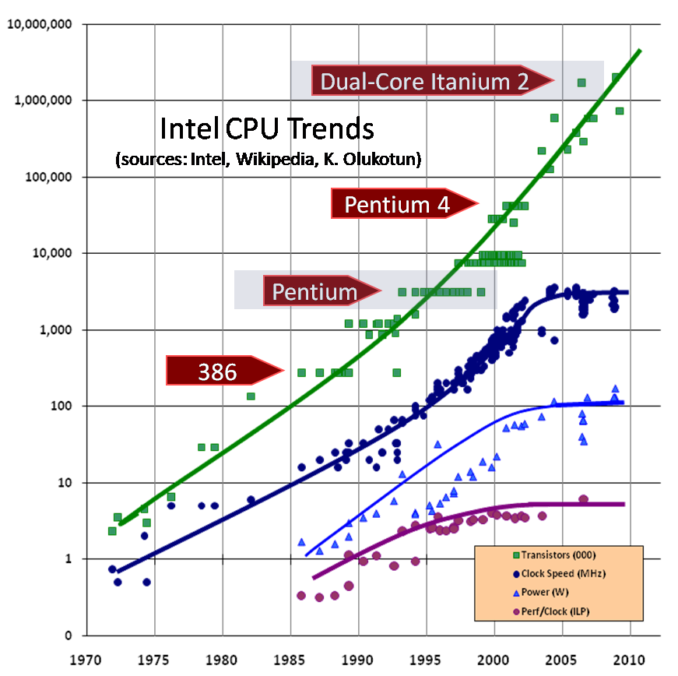
Hardware Trends
Moore’s Law on total CPU processing power holds but in parallel processing…
New CPU won’t run a short transaction much faster
CPU clock rate stalled…
Because processors would melt…
Meanwhile RAM cost continues to drop

Slide 6
Outline
Motivating trends – hardware, software, apps
In-memory OLTP architecture & integration into SQL Server
Performance and customer results
Review and References

Slide 7
In-Memory OLTP Architectural Pillars
Principles
Performance-critical data fits in memory
Push decisions to compilation time
Conflicts are Rare
Built-In
Architectural Pillars
Main-Memory Optimized
T-SQL Compiled to Native Machine Code
Non-Blocking Execution
SQL Server Integration
Direct pointers to rows
Indexes exist only in memory
No buffer pool
No write-ahead logging
Stream-based storage
T-SQL compiled to machine code leveraging VC compiler
Procedure and its queries, becomes a C function
Aggressive compile-time optimizations
Multi-version optimistic concurrency control, full ACID support
Lock-free data structures
No locks, latches or spinlocks,
No I/O in transaction
Same manageability, administration & development experience
Integrated queries & transactions
Integrated HA and backup/restore
Results
In-memory cache speed with capabilities of a database
Queries & business logic run at native-code speed
Transactions execute to completion without blocking
Hybrid engine and integrated experience

Slide 8
In-Memory OLTP: Integration and Application Migration
Application
Few improvements in comm layers
TDS Handler and Session Management
Key
SQL Server.exe
Existing SQL Component
Parser, Catalog, Optimizer
Execution Plan cache for ad-hoc T-SQL and SPs
Native-Compiled SPs and Schema
Hekaton Compiler
20-40x more efficient
Real Apps see 2-30x
T-SQL Interpreter
Hekaton Component
Access Methods
Hekaton Engine: Memory_optimized Tables & Indexes
Generated .dll
Non-durable Table option
Query Interop
Buffer Pool
T1
T2
T3
Tables
Reduced log contention; Low latency still critical for performance
T1
T2
T3
Indexes
Memory-optimized Table Filegroup
Transaction Log
Data Filegroup
T1
T2
T3
T1
T2
T3
T1
T2
T3
T1
T2
T3

Slide 9
Memory-Optimized Tables
Timestamps
Chain ptrs
Name
City
Row format
BW-tree index on Name
Hash index on City
B
200, ∞
John
Beijing
P
J
100, 200
John
Paris
90,150
Susan
Bogota
S
50, ∞
Jane
Prague
70, 90
Susan
Brussels
Rows are multi-versioned, each has a valid time range indicated by two timestamps
A version is visible if transaction read time falls within the version’s valid time
Row can be part of multiple indexes, but there is only a single copy of the row
Hash indexes accelerate point-lookup
BW-tree is a lock-free b-tree (range index) invented by MSR
Indexes are not stored on disk

Slide 10
Create Table DDL
Hash Index
BUCKET_COUNT
Use 2x # of unique index key values
CREATE TABLE [Customer](
[CustomerID] INT NOT NULL
PRIMARY KEY NONCLUSTERED HASH WITH (BUCKET_COUNT = 1000000),
[Name] NVARCHAR(250) NOT NULL,
[CustomerSince] DATETIME NULL
INDEX [ICustomerSince] NONCLUSTERED
INDEX [ICustomerID-Since] NONCLUSTERED (CustomerID, CustomerSince)
)
WITH (MEMORY_OPTIMIZED = ON,
DURABILITY = SCHEMA_AND_DATA);
Indexes may be specified inline
NONCLUSTERED indexes are supported
Multi-Column indexes are supported
This table is memory optimized
This table is durable.
Non-durable tables:
DURABILITY=SCHEMA_ONLY

Slide 11
Limitations on Memory Optimized Tables
Optimized for high-throughput OLTP
No XML, CLR data types and sqlvariant
Optimized for in-memory
Rows are at most 8060 bytes – no off row data
No Large Object (LOB) types like varchar(max)
Other limitations
No FOREIGN KEY and no CHECK constraints
No schema changes (ALTER TABLE, add/drop index) – need to drop/recreate table
No DML triggers(Native Trigger is allowed)

Slide 12
Create Procedure DDL
CREATE PROCEDURE [dbo].[InsertOrder] @id INT, @date DATETIME
WITH
NATIVE_COMPILATION,
SCHEMABINDING,
EXECUTE AS OWNER
AS
BEGIN ATOMIC
WITH
(TRANSACTION
ISOLATION LEVEL = SNAPSHOT,
LANGUAGE = 'us_english')
-- insert T-SQL here
END
This proc is natively compiled
Native procs must be schema-bound
Execution context is required
Atomic blocks
Create a transaction if there is none
Otherwise, create a savepoint
Session settings are fixed at create time

Slide 13
Durability and Availability
One of the hardest parts of a high-performance in-memory system
Performance goals require in-memory format to diverge from storage format
Storage format must be very efficient for checkpoint and recovery
Contention on the transaction log grows
High-availability remains very critical

Slide 14
Outline
Motivating trends – hardware, software, apps
In-memory OLTP architecture & integration into SQL Server
Performance and customer results
Review and References

Slide 15
Customer Experiences
Customer | Workload | Results
Edgenet – SaaS provider for retailers and product delivery for end consumers | Provide real-time insight into product price/availability for retailers and end-consumers. Used by retailers in-stores and to end-consumers via search engines. | 8x-11x in performance gains for ingestion of data Consolidated from multi-tenant, multi-server to single database/server. Removed application caching layer (additional latency) from client tier. Case Study
BWin.party - Largest regulated online gaming site | Running ASP.NET session state using SQL Server for repository Critical to end-user performance and interaction with the site | Increase 15,000 batch requests/sec per to over 250,000 in case study Lab testing achieved over 450,000 batch requests/sec Consolidate 18 SQL Servers -> 1. Case Study
SBI Liquidity Market - Japanese foreign currency exchange trading platform. | Includes high volume and low latency trading. Expecting 10x volume increase | 2x throughput (get over 3x in testing) with goal to reduce latency from 4 seconds to 1 per business transaction. Case study

Slide 16
Early Customer Performance Gains
Apps that take full advantage: e.g. web app session state
Apps with periodic bulk updates & heavy random reads
Existing apps typically see 4-7x improvement
Despite 20 years of optimizing for OLTP benchmarks – we still get 2x on a workload derived from TPC-C

Slide 17
Micro-benchmark: lookups
Transaction size in #lookups | CPU cycles (in millions) |  | Speedup
 | Regular | Memory-Opt
1 | 0.73 | 0.040 | 10.8x
10 | 0.93 | 0.051 | 18.4x
100 | 2.72 | 0.150 | 18.1x
1,000 | 20.10 | 1.063 | 18.9x
10,000 | 201.00 | 9.850 | 20.4x
Random lookups in a table with 10M rows
All data in memory for “regular” and “memory optimized”
Intel Xeon W3520 2.67 GHz
Performance: 2.7M lookups/sec/core

Slide 18
Micro-benchmark: updates
Transaction size in #updates | CPU cycles (in millions) |  | Speedup
 | Regular | Memory-Opt
1 | 0.91 | 0.045 | 20.2x
10 | 1.38 | 0.059 | 23.4x
100 | 8.17 | 0.260 | 31.4x
1,000 | 41.90 | 1.500 | 27.9x
10,000 | 439.00 | 14.400 | 30.5x
Random updates, 10M rows, one index, snapshot isolation
Log IO disabled (disk became bottleneck)
Intel Xeon W3520 2.67 GHz
Performance: 1.9M updates/sec/core

Slide 19
Outline
Motivating trends – hardware, software, apps
In-memory OLTP architecture & integration into SQL Server
Performance and customer results
Review and References

Slide 20
Towards Seamless Integration in SQL 2014
SQL Server RDBMS
Column-Store Engine for DW
Disk-optimized, row-store engine
Memory-optimized OLTP engine
Available only in one engine
Batch Query Operators
Blobs
Native-Compiled Procedures
Work across two engines with limitations
Range + Column secondary indexes
Readable Secondaries
Work across all engines but with limitations
Transactions, Queries, Stored Procedures
AlwaysOn, Backup/Restore, Security, Admin, Deployment
Nearly seamless across all engines
Not comprehensive - only representative examples.

Slide 21
Characteristics of In-Memory Architectures
Optimized for efficient CPU processing
Instead of being optimized for efficient buffering of storage
Goal: keep CPUs well fed with data
Storage and memory formats differ
At least until NVRAM becomes commonplace
Immutable in-memory data and on-disk structures
Instead of highly mutable complex on-disk structures
I/O done in bulk (streaming)
Instead of random I/O
Optimistic concurrency control
Logical conflicts rare
Physical conflicts rare, but contention magnified with higher throughput enabled by in-memory efficiency
Apply to
In-Memory BI
(PowerPivot,
PowerView)
In-Memory DW (columnstore)
In-Memory OLTP

Slide 22
Key Take Aways
Database systems need deep architectural changes
To meet latency & throughput expectations
To take advantage of hardware trends
SQL 2014’s in-memory OLTP architecture is aligned with these trends
As is In-memory data warehouse (columnstores)
Applications can incrementally take advantage of in-memory OLTP capabilities
AMR tool guides adoption
Memory-optimized tables
Native-compiled stored procedures
Typical performance gains range from 2-25x

Slide 23
More Information
SIGMOD 2013 paper
Kalen Delaney Whitepaper
David DeWitt’s SQL PASS 2013 keynote:
Video (starts 26 minutes from beginning),
Slides
Microsoft Virtual Academy talks
MSDN
Blog series
Other Presentations

Slide 24
Questions?

Slide 25
Related content at TechEd
Breakout Sessions (in logical order)
DBI-B287 - Microsoft SQL Server 2014: In-Memory OLTP Overview
DBI-B386 - Microsoft SQL Server 2014: In-Memory OLTP for Database Developers
DBI-B385 - Microsoft SQL Server 2014: In-Memory OLTP for Database Administrators
DBI-B384 - Microsoft SQL Server 2014: In-Memory OLTP End-to-End: Preparing for Migration
DBI-B315 - Microsoft SQL Server 2014: In-Memory OLTP: Memory/Storage Monitoring and Troubleshooting
DBI-B488 - Microsoft SQL Server 2014: In-Memory OLTP Performance Troubleshooting
DBI-B313 - Microsoft SQL Server 2014: In-Memory OLTP Customer Deployments and Lessons Learned

Slide 26
Related Content Online
SIGMOD 2013 paper
David DeWitt’s SQL PASS 2013 keynote:
Video (starts 26 minutes from beginning),
Slides
Microsoft Virtual Academy talks
In-Memory OLTP Common Workloads and Migration Considerations
In-Memory OLTP Internals Overview
In-Memory OLTP Sample Database and Workload (based on AdventureWorks) http://msdn.microsoft.com/en-us/library/dn511655(v=sql.120).aspx
In-Memory OLTP Blog Series
Books Online: In-Memory OLTP

Slide 27

Track resources
Download Microsoft SQL Server 2014
http://www.trySQLSever.com
Try out Power BI for Office 365!
http://www.powerbi.com
Sign up for Microsoft HDInsight today!
http://microsoft.com/bigdata

Slide 28

Resources
Learning
Sessions on Demand
Microsoft Certification & Training Resources
http://channel9.msdn.com/Events/TechEd
www.microsoft.com/learning
TechNet
msdn
Resources for IT Professionals
Resources for Developers
http://microsoft.com/technet
http://microsoft.com/msdn

Slide 29
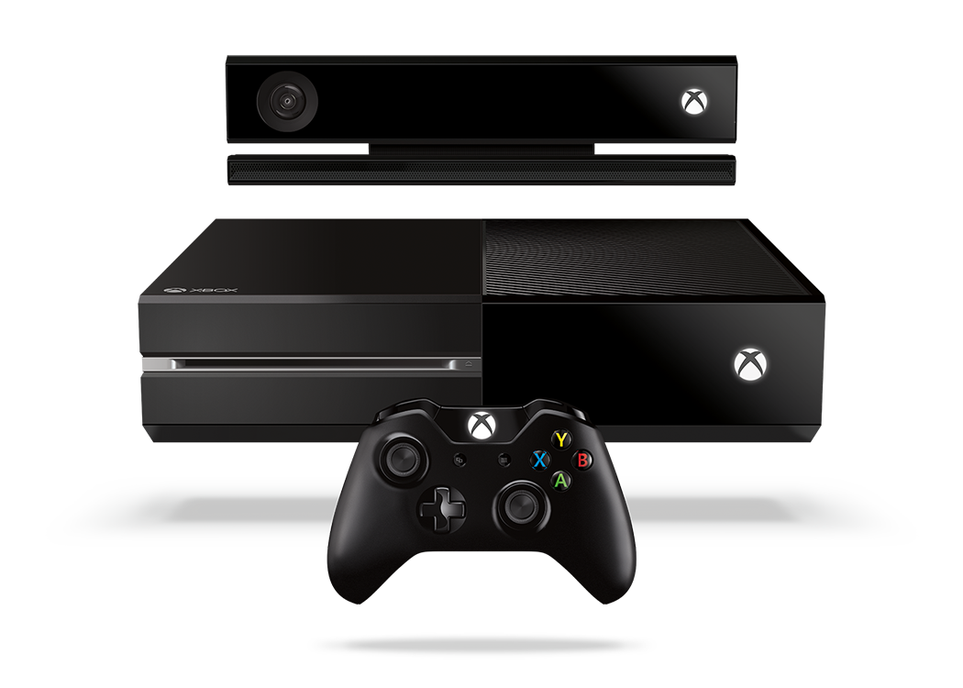


Complete an evaluation and enter to win!

Slide 30

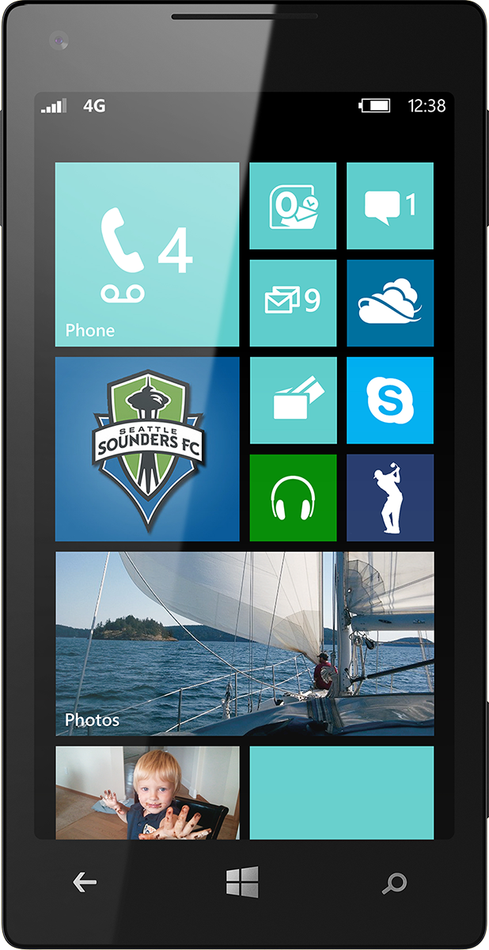
Evaluate this session
Scan this QR code to evaluate this session.

Slide 31


© 2014 Microsoft Corporation. All rights reserved. Microsoft, Windows, and other product names are or may be registered trademarks and/or trademarks in the U.S. and/or other countries.
The information herein is for informational purposes only and represents the current view of Microsoft Corporation as of the date of this presentation. Because Microsoft must respond to changing market conditions, it should not be interpreted to be a commitment on the part of Microsoft, and Microsoft cannot guarantee the accuracy of any information provided after the date of this presentation. MICROSOFT MAKES NO WARRANTIES, EXPRESS, IMPLIED OR STATUTORY, AS TO THE INFORMATION IN THIS PRESENTATION.

