Slide 1
What are we trying to solve?

Slide 2
Spinners’ need . . .
Spinners, realizing its expertise encompasses all things round, has, naturally, decided to open a pizza delivery service! You will blend streaming and static data with a third party source to feed the data warehouse to power a business performance reporting tool. The analytics team would like to reports based upon orders and the associated customer information. This report will allow for a dropdown for the user to select a single US state, and it will display the top 3 best-selling pizza combinations for that state along with:
Total number of pizzas sold over the last 12 months for each type
Gross sales (USD) over the last 12 months for each type
Gross sales (USD) per capita over the last 12 months for each type
Number of unique customers who ordered the item at least once over the last 12 months for each type

Slide 3
What the executives are saying. . . .
“We at Spinners Pizza have, naturally, decided to open a pizza delivery service! You will blend streaming, static internal data and third party to power a business performance reporting tool. Work with the analytics team on details. . . ”

Slide 4
What the analytics team says . . .
“We (Analytics team) need to build reports based upon orders and the associated customer information. This report will allow for a dropdown for the user to select a single US state, and it will display the top 3 best-selling pizza combinations for that state along with:
Total number of pizzas sold over the last 12 months for each type
Gross sales (USD) over the last 12 months for each type
Gross sales (USD) per capita over the last 12 months for each type
Number of unique customers who ordered the item at least once over the last 12 months for each type
Can you build us a data warehouse to power our decisions?”

Slide 5
What the business analysts are saying . . .
“Orders are already placed on our website in real time via API. We have no desire to duplicate this system so you need to leverage this in your data pipeline with little to no modification.”
“We have an existing customers database and a loyal yet slowly growing customer base. You should use this to cross-reference your reports”
“We want to leverage the cloud as much as possible to save on costs and continue our move away from on-prem implementations”
“To meet the analytics team needs you will need to take each transactional API request, join it with our customer data and output to a data warehouse”
“We need to keep our orders data forever. In the future we want to re-analyze the data with AI/ML in order to uncover additional opportunities.”
“We must be able to analyze the data quickly therefore the reports and warehouse should have data within 15 minutes of order placement (SLO)”.
“We need to keep the size of data warehouse as small as possible to meet our reporting needs (12 months) to cut down on OpEx costs.”

Slide 6
Pizza on the Go by Spinners

Slide 7
Tired of your regular pizza delivery?
Why not give us a spin . . . .

Slide 8
How are we going to solve this?
Transactional Ingestion System:
Utilize existing API servers.
Potentially “bursty” traffic that could cause issues for a traditional n-tier solution.
Must maintain transactional data permanently in a cost- effective manner.
Scale as needed based orders to maintain 15 minute SLO.
Customer Database:
Utilize traditional RDBMS system.
Customer list will remain constant over time.
Adult Population Dataset:
Curate a dataset that provides adult population by state.
Create a reporting datamart:
End user should be able to query by state several key dimensions to reflect sales effectiveness.
Data must be refreshed at least once a day (more often is better).
Keep the data in the datamart as small as possible to speed performance and reduce cost.

Slide 9
My approach and why GCP?
Spinners currently utilizes GCP so a focus on GCP will limit staff retraining and allow the teams to hit the ground running.
Google builds managed solutions based on open source technologies. This allows for easy “lift and shift” to equivalent open source technologies regardless of provider. Examples include BigQuery to Hive, Pub/Sub to Kafka and GKE to Kubernetes. This reduces rework and tech debt.
Deploy managed services where possible to leverage built-in monitoring, HA and backups. This reduces support/maintenance costs and increase reliability.

Slide 10
Transactional Ingestion System
Utilize existing API servers.
(NEW) Potentially “bursty” traffic that could cause issues for a traditional n-tier solution.
Must maintain transactional data permanently in a cost- effective manner.
Scale as needed based orders to maintain 15 minute SLO.

Slide 11
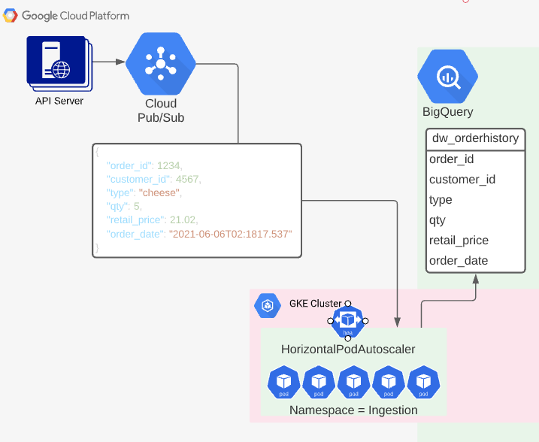
Transactional Ingestion System explained
API server produces data to Pub/Sub. Ingestion microservices consume Pub/Sub topics and produce to a BigQuery table (dw_orderhistory).
Key Benefits:
Bursty traffic is handled by lightning-fast Pub/Sub staging queues (topics).
Containerized microservices orchestrated by Kubernetes can scale based on the workload utilizing Horizontal Pod Autoscaler.
BigQuery can store streaming data very inexpensively ($0.02/GB).
NOTE partition on order date. This will speed queries AND reduce retrieval fees.

Slide 12
Customer Database
Utilize traditional RDBMS system.
Customer list will remain constant over time.

Slide 13
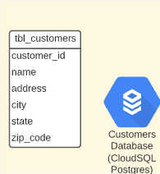
Customer Database explained
Static customer data will be held in a CloudSQL (Postgres) database.
Key Benefits:
Maintain industry standard query languages based on ANSI 1999.
HA and backups provided by the managed service.
Security can be handled by IAM roles instead of maintaining database users directly

Slide 14
Adult Population Dataset
Curate a dataset that provides adult population by state.

Slide 15
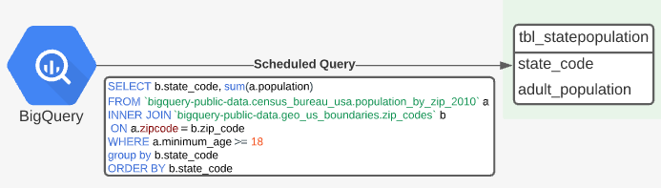
Adult Population Dataset explained
Utilize publicly available BigQuery US Census dataset harvesting state and population
Details:
Scheduled Queries lower cost because Big Query uses a storage-based consumption cost model. Cached queries are no cost.
To speed performance and reduce costs even more utilize a Scheduled Query to create a static table refreshed periodically. This will reduce the “data fetch” frequency and thus cost. Additionally, the Scheduled Query to cache data will fetch less data saving cost as well.

Slide 16
Create a reporting datamart
End user should be able to query by state several key dimensions to reflect sales effectiveness.
Data must be refreshed at least once a day (more often is better).
Keep the data in the datamart as small as possible to speed performance and reduce cost.

Slide 17
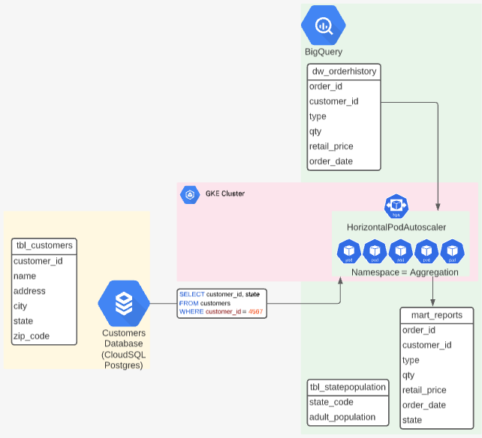
Create a reporting datamart explained
Aggregation microservices consume data from the orderhistory data warehouse and the Customers Database and insert it into the reporting mart.
Details:
Containerized microservices orchestrated by Kubernetes can scale based on the workload utilizing Horizontal Pod Autoscaler allowing for 15 minute or less SLO.
Create a monthly partition on the mart_reports table and remove month 14+ on a regular basis via automation.
BigQuery can store streaming data very inexpensively ($0.02/GB).
Consider a GCP memorystore between the mart_reports table and the UI if querying BigQuery data fetch becomes costly.

Slide 18
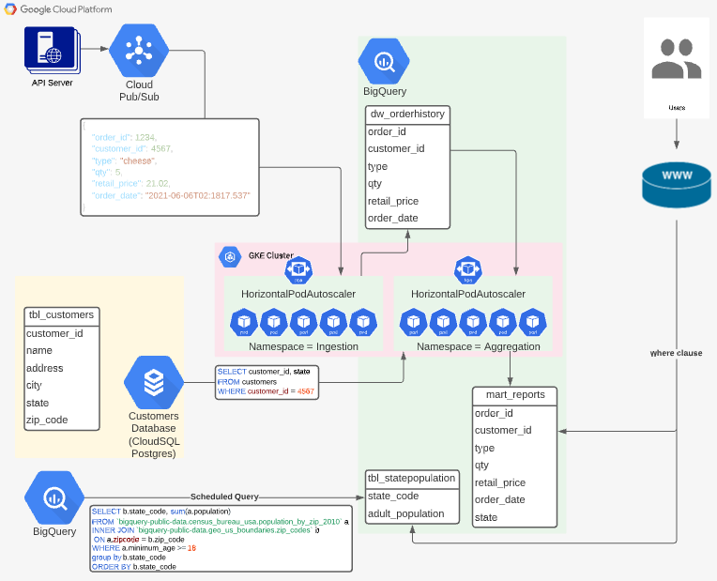
The whole solution
This solution will allow Spinners to realize their goal of taking over the pizza delivery world. The solutions ability to handle multiple data sets (streaming and static) in a scalable, cloud based microservices solution will aid in future growth.

Slide 19
Considerations for AWS only implementation. . .
Generally, the architecture can be implemented on AWS with the same design goals and expectations. Things to consider:
Replace Google Pub/Sub message queuing with AWS Managed Streaming for Apache Kafka (AWS MSK). No additional considerations required as MSK is based on opensource Kafka like Pub/Sub.
Replace Google Kubernetes Engine (GKE) with AWS Elastic Kubernetes Service (EKS). Additional considerations:
EKS requires teams to source a 3rd party Kubernetes UI or use kubectl commands. This may be a barrier to entry for teams not already familiar with Kubernetes. Full cluster workload visibility tooling doesn’t exist in AWS EKS like it does in GKE.
Some vetting should be done to determine if the added cost of EKS (fargate) outweighs the operational burden/cost of EKS (standard).
Being fully open source Kubernetes compliant EKS will require only small YAML/Helm deployment adjustments (ex. persistent volume addressing). Otherwise, no additional changes will be required.
Replace Big Query with a combination AWS services:
No direct equivalent to BigQuery exists in the AWS portfolio.
AWS Kinesis + AWS Redshift
Pull from AWS MSK with Kinesis and land data in AWS Redshift.
Queries for AWS Redshift and Google BigQuery are both ANSI compliant so neither should require any significant alteration.
AWS Redshift is NOT serverless. Some consideration should be made for operational teams overhead to support additional IaaS.
AWS Kinesis + AWS S3 + AWS Athena
Pull from AWS MSK with Kinesis and land data in AWS S3 (flat files) to be queried directly via AWS Athena.
Queries for AWS Athena and Google BigQuery are both ANSI compliant so neither should require any significant re-tooling.
AWS Athena is based on Hive much like Google BigQuery so it’s a technically more similar solution with the same challenges, performance expectations, etc.
AWS Athena IS serverless but requires an AWS S3 intermediary. Some consideration should be made for operational teams overhead to support additional managed services.

Slide 20
Planning
How do we pull this off . . . .

Slide 21
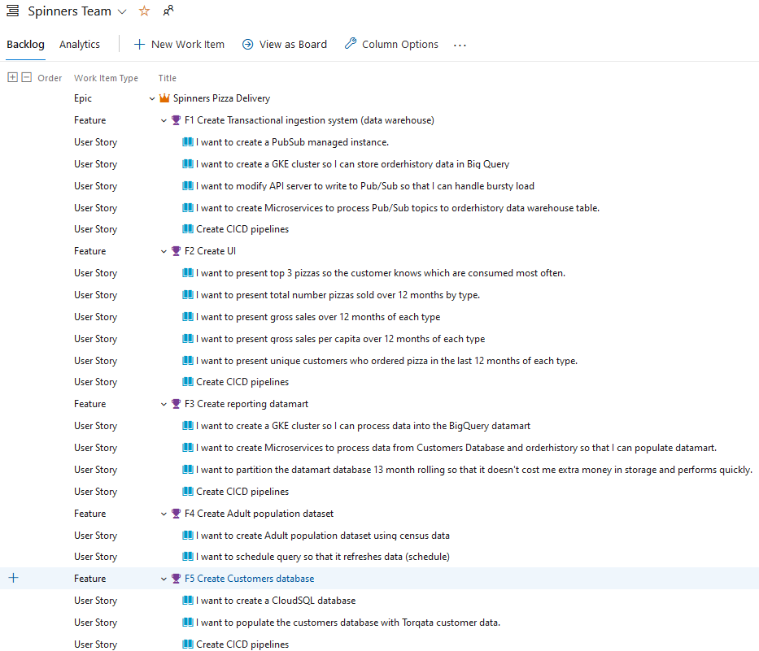
The Backlog (Epics, Features and User Stories)
Feel free to access this list yourself at: https://dev.azure.com/jerrycutshaw

Slide 22
Timeline and execution
To complete this Epic it will require the following personnel:
Software Engineer’s (5)
Data Engineer (2)
QA Engineer (1)
Product Manager/SCRUM master (1)
All 5 Features could be worked simultaneously in the same sprints. If handled in this manner 1 Software Engineer per feature with Data and QA Engineer’s “floating” between features.
Based on estimates the project could be completed in 3 weeks or 2 sprints.
Hourly estimate is simply a guess. This is very team/individual dependent. I did my best to SWAG a number. Better numbers should be provided by existing Product Managers.

Slide 23
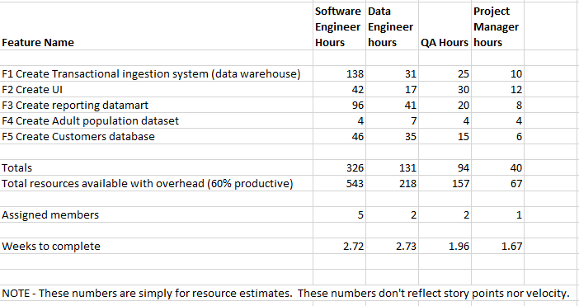
Resource Planning detail

Slide 24
Conclusion

Slide 25
Additional things to consider . . . .
Add additional datasets to drive further insights. Such as a social media feed that includes Natural Language Processing to uncover sentiment on how our service and pizza’s are performing.
Global/Regional Disaster Recovery component to the solution.
Utilize Cloud Dataflow instead of Kubernetes pods. As a serverless technology it could be far less costly.
Proper build out of a true SDLC strategy including Dev, test, uat and prod.
Deliver changes via CICD and IaC technologies such as build/release pipelines and Terraform for managing and deploying infrastructure.
Deep dive on Kubernetes services and deployment YAML snippets could be provided if needed.
Go into detail level with tasks associated with User Stories to better define roles for Software Engineers vs. Data Engineers vs. QA Engineers.

