Slide 1
Spectral Methods for Time Series Foundation Models
Universal Sequence Preconditioning & Spectral Transform Units for Zero-Shot Forecasting
Jerry Han · Alex Kawaja · Benjamin Cole
Princeton University · Prof. Elad Hazan's Group · February 2026

Slide 2
Platform: MOIRAI Foundation Model
Can spectral methods improve zero-shot time series foundation models?
• Pre-trained on LOTSA: 27B observations, 9 domains
• Zero-shot forecasting on unseen datasets
• MOIRAI 1.0: masked encoder, 14M params
• MOIRAI 2.0: causal decoder, 11.4M params
Evaluation: GIFT-Eval Benchmark
• 97 dataset configs × 3 horizons
• Energy, weather, transport, health, sales, cloud
• Metric: MASE normalized by seasonal naive
• Normalized MASE < 1.0 = beats naive baseline
Approach 1: Replace Attention with STU
Approach 2: Polynomial Preconditioning (USP)
FFT-based spectral mixing: O(n log n) vs O(n²) Alternate STU + Attention layers
Chebyshev FIR filter on input series + Learned 64-tap inverse for reversal

Slide 3
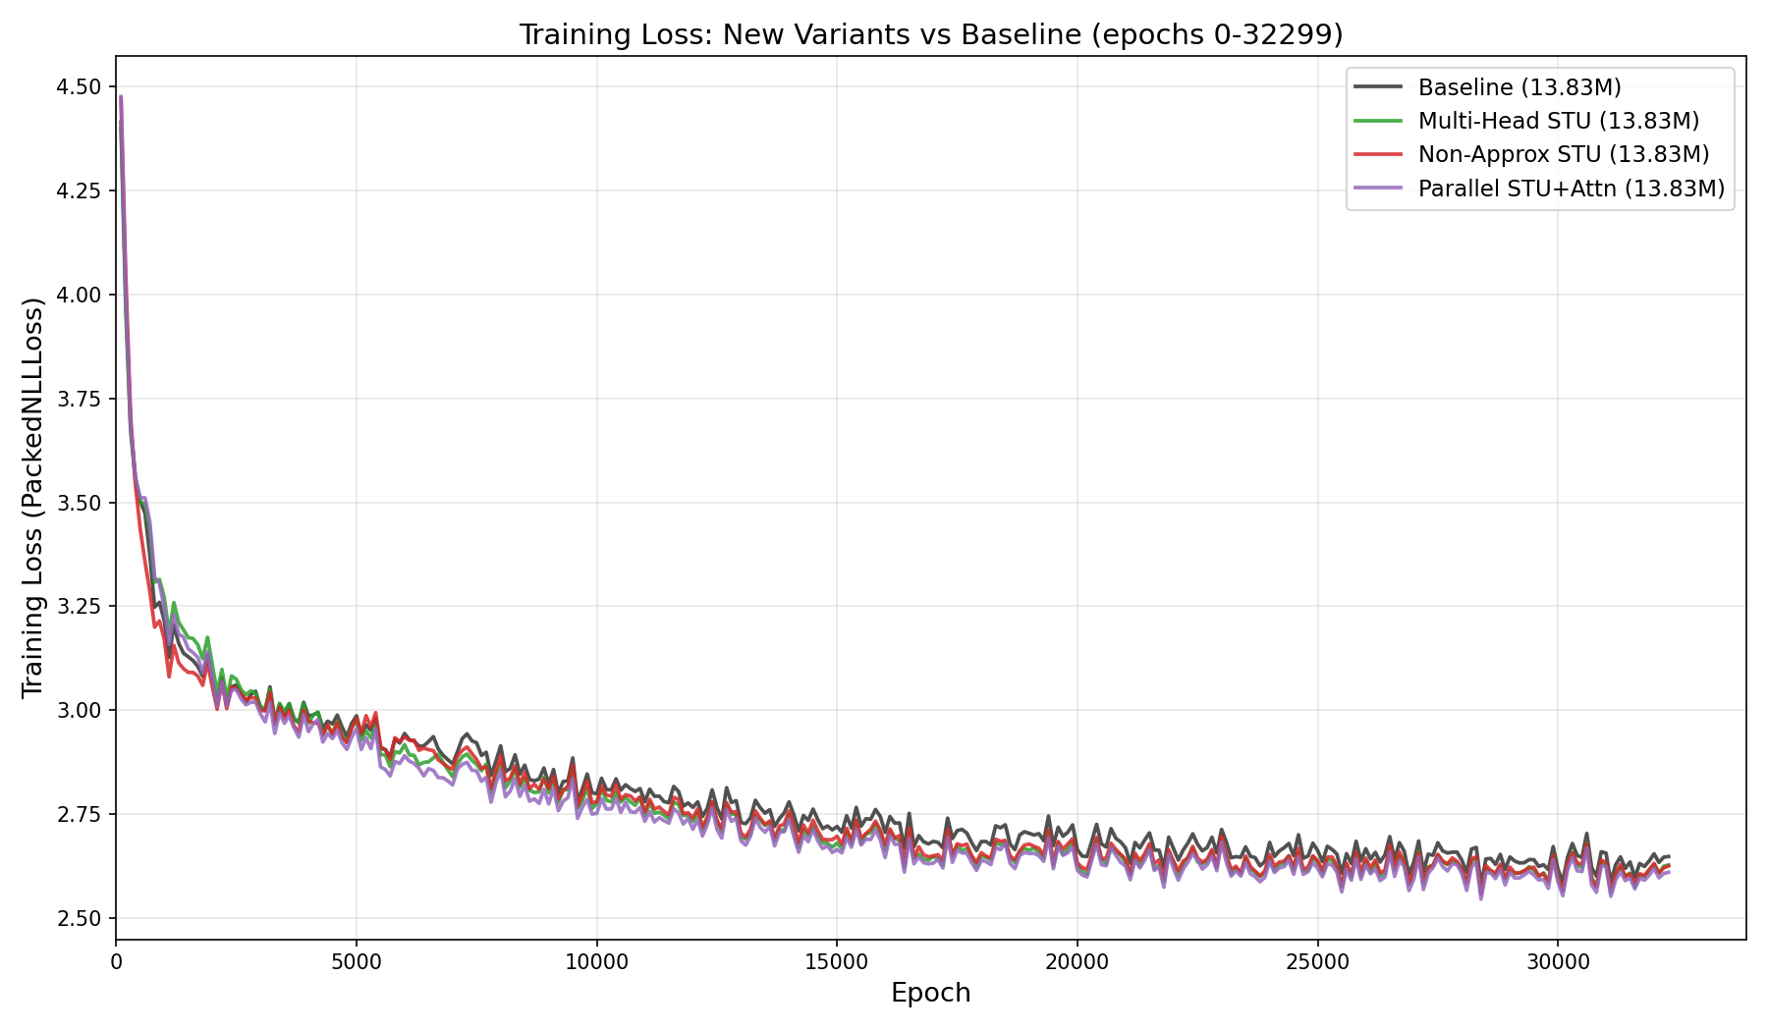
Approach 1: STU-MOIRAI Hybrid
Spectral Transform Units as drop-in attention replacement
Baseline: Input → Patch Embed → [Attn + FFN] × 6 → Output Head
Hybrid: Input → Patch Embed → [STU] [Attn] [STU] [Attn] [STU] [Attn] → Output Head
Variant | Architecture | Params | Train Loss | Status
Baseline | 6 attention layers | 13.83M | 2.380 | Evaluated
Approx STU | 3 STU + 3 Attn (alternating) | 12.53M | 2.361 | Evaluated
Sandwich STU | 3 STU(+MLP) + 3 Attn | 15.65M | 2.350 | Evaluated
Multi-Head STU | 3 MH-STU(H=6) + 3 Attn | 13.83M | 2.534 | Training (74%)
Non-Approx STU | 3 full-STU(K=2) + 3 Attn | 13.83M | 2.372 | Eval running
Parallel STU+Attn | 6 layers: gate*attn+(1-g)*stu | 13.83M | 2.488 | Training (84%)

Slide 4
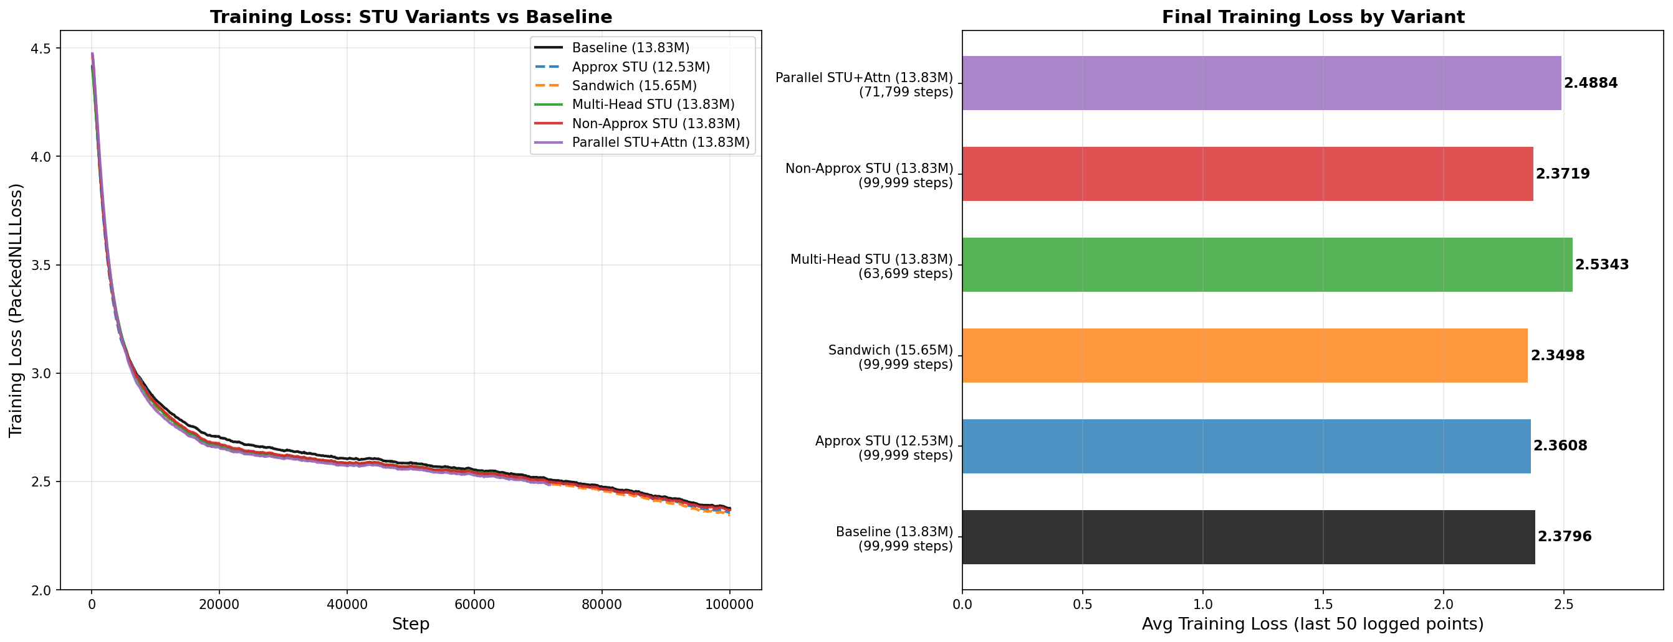
STU Results: Matches Baseline, Doesn't Beat It
GIFT-Eval, 97 configurations, 95% bootstrap CIs (10K resamples)
Model | Params | Geo MASE | Norm. MASE | 95% CI | Beats Naive
Approx STU | 12.53M | 1.317 | 0.920 | [0.850, 0.991] | 37/58
Sandwich STU | 15.65M | 1.313 | 0.927 | [0.854, 1.001] | 37/58
Baseline | 13.83M | 1.315 | 0.933 | [0.864, 1.004] | 37/58
Model vs Baseline | Mean ΔMASE | 95% CI | Wins / Losses
Approx STU | +0.009 | [-0.087, +0.088] | 55W / 42L
Sandwich STU | -0.002 | [-0.037, +0.034] | 45W / 52L
Takeaway: STU achieves comparable quality with 10% fewer params. CIs overlap completely — not significant. Spectral mixing alone isn't the bottleneck at ~30-token sequences (ctx=1000, patch=32).

Slide 5
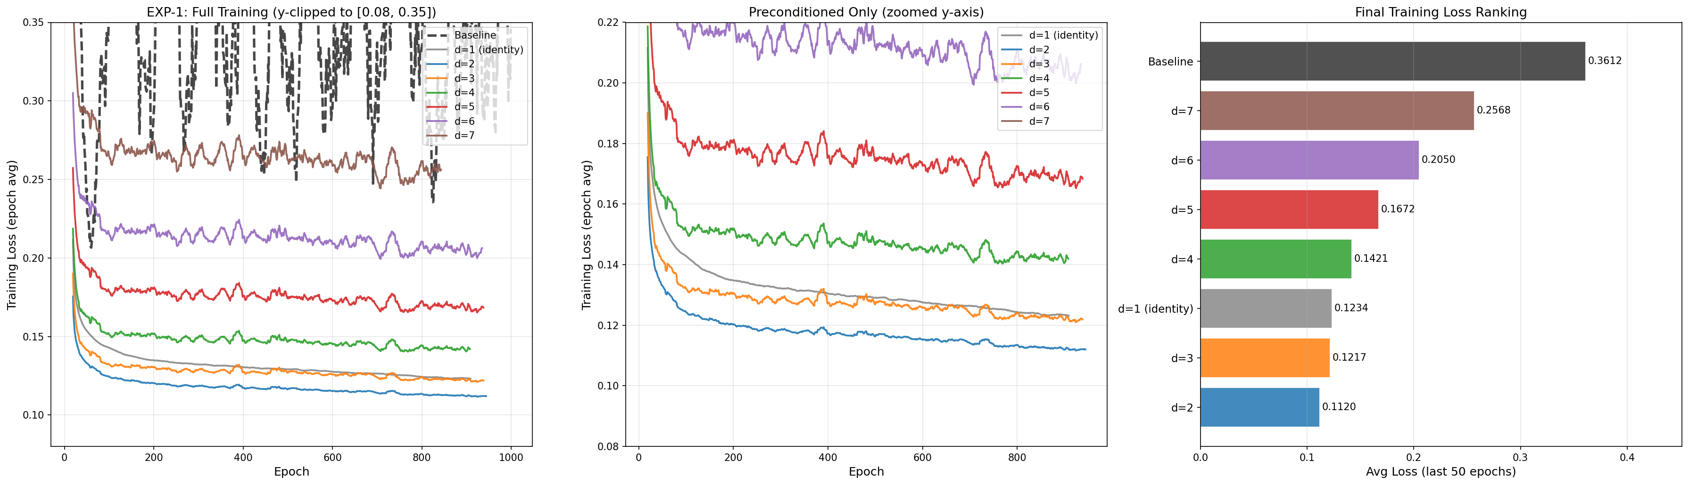
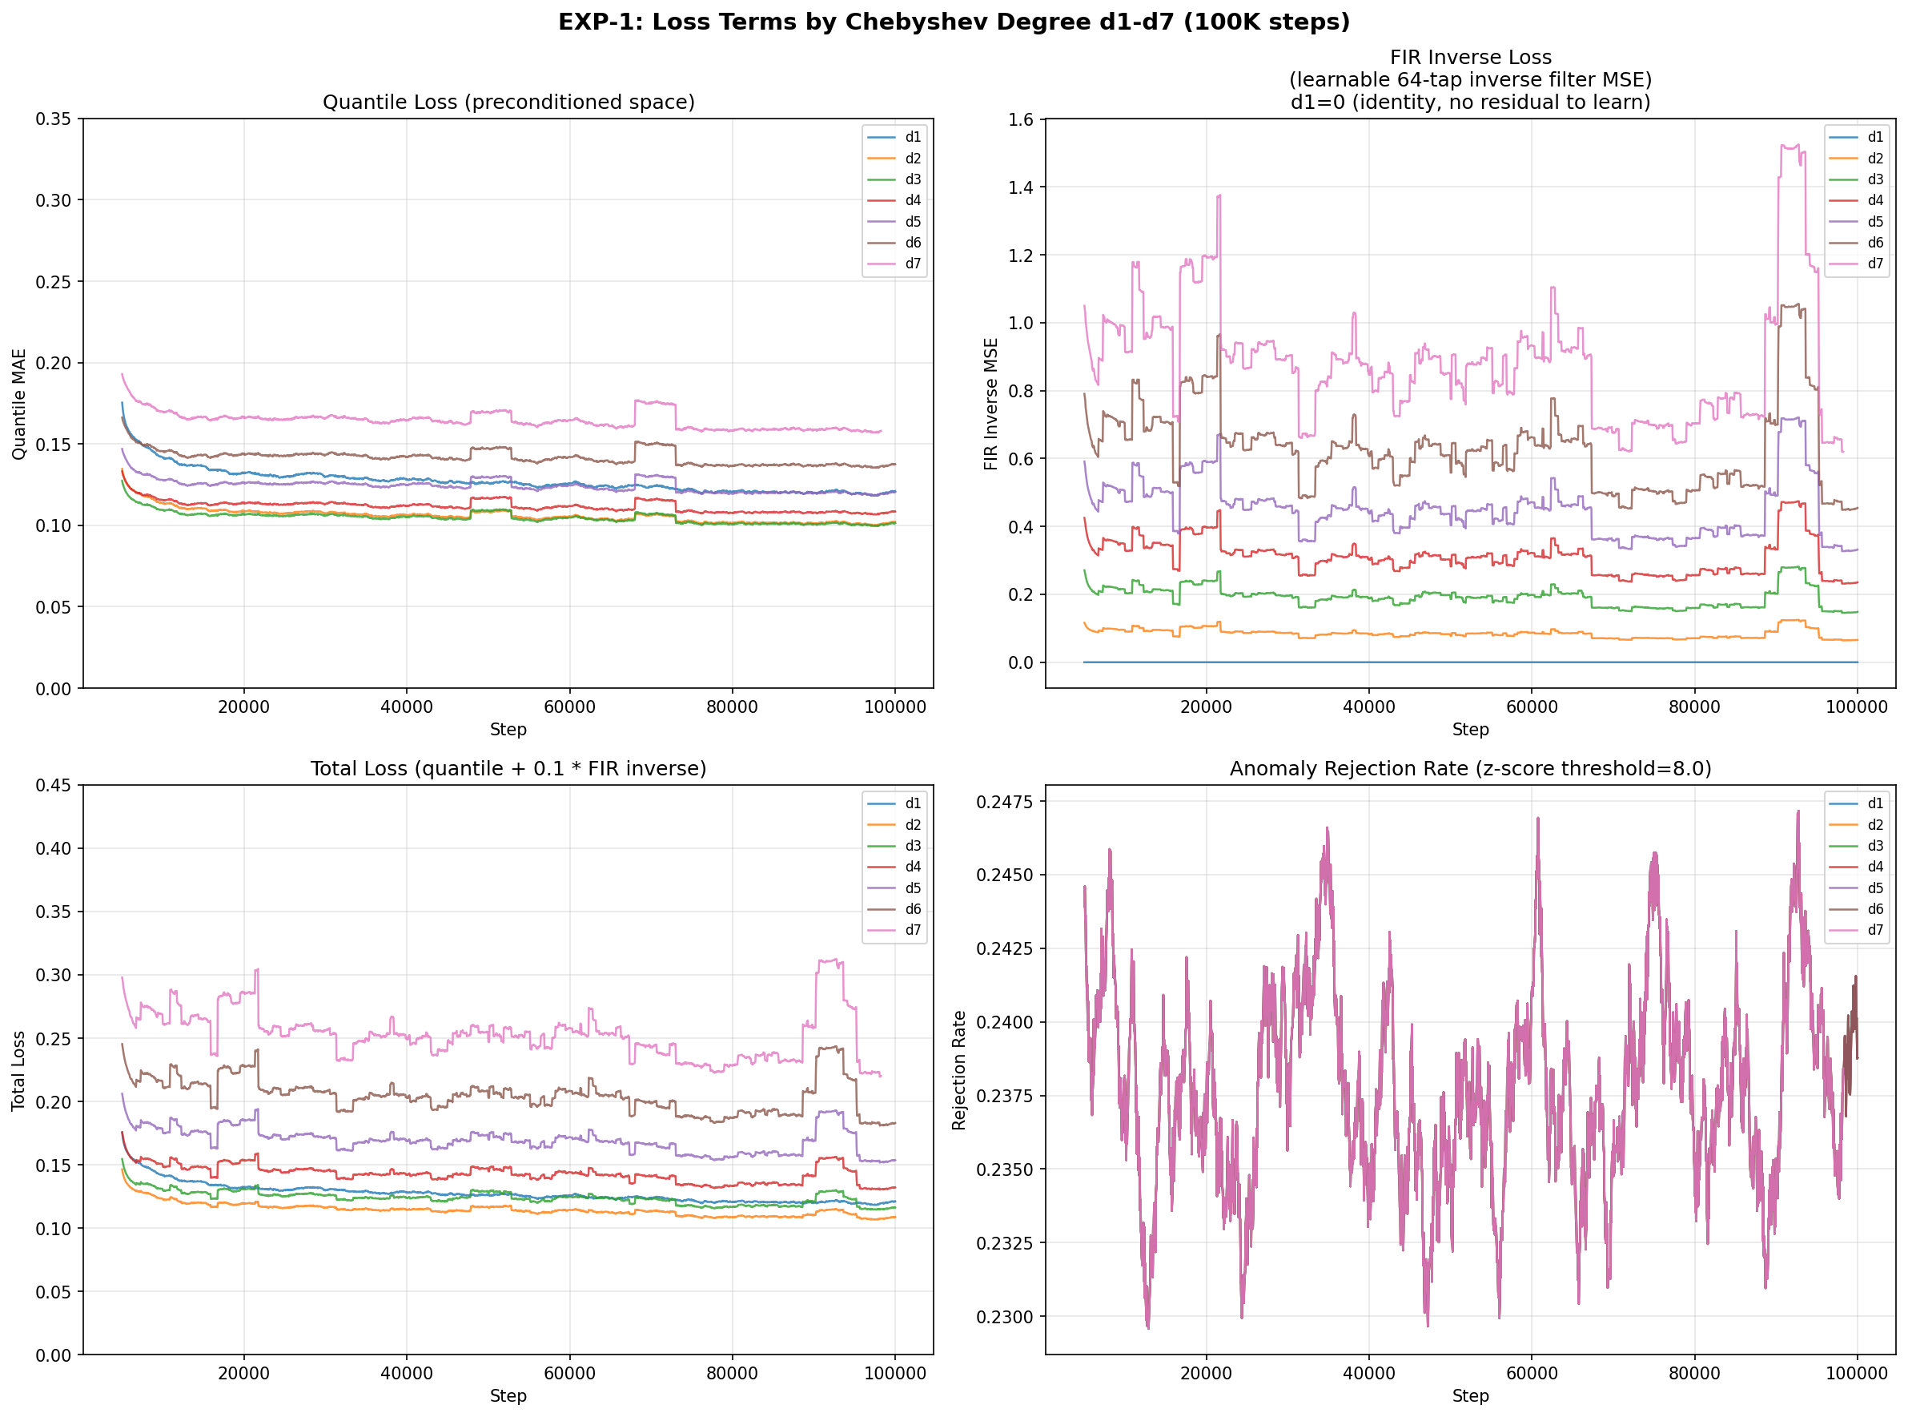
Approach 2: Universal Sequence Preconditioning
Convolve time series with Chebyshev polynomial coefficients before transformer
z(t) = y(t) + c₁·y(t-1) + c₂·y(t-2) + ... + c_d·y(t-d)
• Flattens spectral profile → easier to predict
• Chebyshev: minimax-optimal on [-1, 1]
• Higher degree = more aggressive filtering
• At inference: must reverse to recover original space
Moirai 2.0 Pipeline:
Series → Z-score → FIR(fixed) → Transformer
Loss = Quantile + 0.1×||FIR_inv(z) - y||²

Slide 6
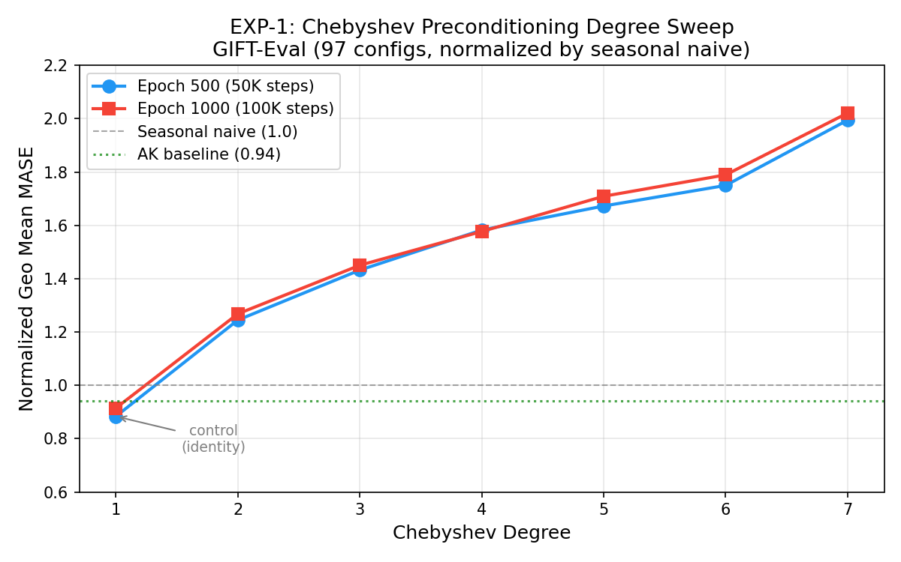
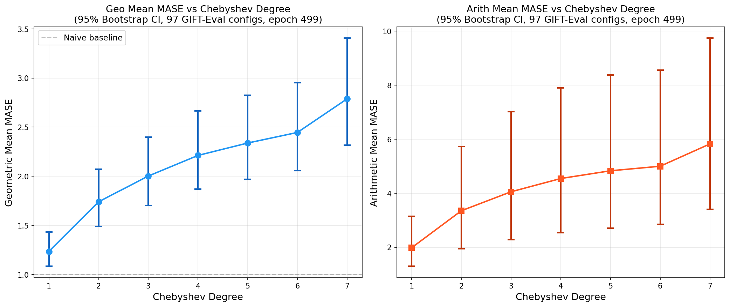
The Reversal Problem: Exponential Error Accumulation
Moirai 1.0 on Monash Benchmark (29 datasets)
Method | Geo Mean MAE Ratio | Interpretation
Baseline (no precond) | 1.00 | Reference
d=5, ground-truth reversal | 0.71 | 29% better (oracle -- needs future)
d=2, model-forecast reversal | 1.22 | 22% WORSE
d=5, model-forecast reversal | 2.02 | 2× WORSE
Error Dynamics (LDS formulation):
e_{h+1} = M·x_h + B·ε_{h+1} M = companion matrix, λ_i = roots of p(x)
Method | Max |p(z)| | Noise Gain | ρ (Spectral Radius)
Chebyshev | 0.063 | 11.9 | 0.951
Lyapunov Reg | 0.293 | 1.6 | 0.902
L2 Reg | 0.291 | 1.7 | 0.882
Key: Chebyshev is optimal for spectral flatness but has near-unit-circle roots → 12× noise amplification. Regularization trades flatness for stability: noise gain 12 → 1.6 at the cost of 5× larger max|p(z)|.

Slide 7
Moirai 2.0: Chebyshev Degree Sweep (100K steps)
GIFT-Eval 97 configs | Normalized Geo Mean MASE | Lower is better | With learned 64-tap FIR inverse
Degree | Coefficients | Train Loss | FIR Inv Loss | Norm MASE @50K | Norm MASE @100K | Beats Naive
d=1 (control) | [0.0] (identity) | 0.120 | 0.000 | 0.884 | 0.915 | 36/97
d=2 | [0, -0.5] | 0.101 | 0.082 | 1.245 | 1.268 | 22/97
d=3 | [0, -0.75, 0] | 0.101 | 0.186 | 1.432 | 1.450 | 14/97
d=4 | [0, -1.0, 0, +0.125] | 0.108 | 0.304 | — | 1.577 | 12/97
d=5 | [0, -1.25, 0, +0.3125, 0] | 0.120 | 0.444 | 1.673 | 1.709 | 11/97
d=6 | [0, -1.5, 0, +0.5625, 0, -0.03] | 0.137 | 0.629 | 1.750 | 1.789 | 10/97
d=7 | [0, -1.75, 0, +0.875, 0, -0.11, 0] | 0.159 | 1.065 | 1.994 | — | 8/97
• Monotonic degradation: d=1 < d=2 < d=3 < ... < d=7. Even with learned inverse, Chebyshev hurts.
• Lower training loss ≠ better inference. FIR inverse loss grows with degree — the inverse can't keep up.
• d=1 (identity) is best — advantage over orig. baseline was anomaly rejection (zscore=8.0), not filtering.
• Models slightly degrade from 50K→60K steps. Possible overfitting, or 50K already near-optimal.

Slide 8
The Path Forward: Regularized USP + Learned Inverse
Keep coefficients small enough that reversal errors stay bounded
Optimization:
Normalized MASE across training:
min_c ( max_{|z|≤1} |p(z)| + λ·||c||² )
Step | Baseline | Reg. USP | Δ
20K | 0.96 | 0.86 | -10.4%
40K | 0.94 | 0.83 | -11.7%
60K | 0.93 | 0.86 | -7.5%
80K | 0.94 | 0.85 | -9.6%
100K | 0.94 | 0.86 | -8.5%
• Term 1: spectral flatness (learnability)
• Term 2: coefficient energy (stability)
• λ=0 → Chebyshev (noise gain=12)
• λ→∞ → identity (no preconditioning)
~8-10% improvement in normalized MASE, sustained throughout training
Coefficients: [0, -0.118, 0, -0.136] | max|c| = 0.14 | Noise gain ≈ 1.5 (vs Chebyshev's 12)
Regularization sweep (7 λ values) running now → finishing overnight. Will map the full tradeoff curve.

Slide 9
Active Experiments (Finishing Tonight)
Regularization sweep: mapping the learnability–stability tradeoff
λ | Coefficients | max|c| | Noise Gain (est.) | Progress | ETA
0 (Cheb) | [0, -1.0, 0, +0.125] | 1.000 | ~12 | Done | —
0.25 | [0, -0.706, 0, -0.085] | 0.706 | ~5 | 36% | ~2:30 AM
0.5 | [0, -0.507, 0, -0.214] | 0.507 | ~3 | 35% | ~3:00 AM
1.0 | [0, -0.377, 0, -0.294] | 0.377 | ~2.5 | 35% | ~2:45 AM
2.0 | [0, -0.250, 0, -0.250] | 0.250 | ~2 | 35% | ~2:55 AM
3.0 | [0, -0.167, 0, -0.167] | 0.167 | ~1.7 | 35% | ~3:05 AM
10.0 | [0, -0.050, 0, -0.050] | 0.050 | ~1.1 | 36% | ~2:25 AM
Custom | [0, -0.118, 0, -0.136] | 0.136 | ~1.5 | 38% | ~1:45 AM
Also running: Non-Approx STU eval (job 4620192), Multi-Head STU (74%), Parallel STU (84%)
Hypothesis: moderate λ (0.5–2.0) will outperform both extremes — enough filtering to help, small enough to reverse.

Slide 10
Key Takeaways
1. STU ≈ Attention for Time Series
2. Preconditioning: Learnability vs Reversibility
Matches attention with 10% fewer params but doesn't beat it. At ~30 tokens, O(n log n) advantage is negligible. May matter at longer contexts or larger scale.
Chebyshev improves training, destroys inference. Errors compound exponentially through polynomial reversal. Formalized via LDS/Lyapunov. Fundamental tension.
3. Regularized USP Is Promising
4. Anomaly Rejection > Spectral Methods
Small coefficients (max|c| < 0.2) + learned 64-tap inverse: 8-10% improvement. Noise gain 12× → 1.5×. Sweep running to find optimal λ.
Z-score thresholding at 8.0 on training data was the single largest gain. Was a confound in early experiments. Simple data quality beats fancy architecture.

Slide 11
Next Steps
• Complete regularization sweep → find optimal λ for the learnability–stability tradeoff
• Learnable coefficients: make filter taps nn.Parameter, train end-to-end (code implemented)
• Scale to MOIRAI-base (91M params, 12 layers) — differences often emerge at scale
• Longer context (4000+ tokens) where STU's O(n log n) advantage becomes meaningful
• Finite-horizon coefficient engineering — Lyapunov assumes ∞ horizon; real forecasts are bounded
• Connect theoretical quantities (max|p(z)|, noise gain, ρ) directly to forecasting loss

Slide 12
Appendix Technical Details
Hidden slides with full implementation and result details

Slide 13
[Appendix] MOIRAI 1.0 vs 2.0 Architecture
Aspect | Moirai 1.0 | Moirai 2.0
Architecture | Masked encoder | Decoder-only autoregressive
Patch size | Multi-patch (8, 16, 32, 64, 128) | Single patch (16)
Output head | Mixture dist. (Student-t, NB, LogNorm) | Quantile prediction (9 quantiles)
Loss function | Negative log-likelihood | Quantile MAE loss
Prediction | Single-token, direct | Multi-token, autoregressive
Model sizes | 14M / 91M / 311M | 11.4M (single variant)
Training data | LOTSA (~27B obs) | New corpus (~295B obs, 36M series)
Attention | Any-variate with binary biases | Causal self-attention
Normalization | Instance norm (non-learnable) | RMS Norm
Positional encoding | RoPE | RoPE

Slide 14
[Appendix] STU Integration: Technical Details
Flash STU (arXiv:2409.10489)
Per-Layer Parameter Budget
• Sequence mixing via FFT convolution with learned spectral filters
• num_eigh=24 top eigenvalues of Hankel matrix
• Approx mode: M_inputs[d,d] × M_filters[K,d] (~156K params)
• Non-approx: M_phi[K,d,d] (~590K params per branch)
• use_flash_fft=False (flash-fft-conv not installed on cluster)
• use_attn=True (hybrid mode with flash-attn installed)
Component | Params
Self-Attention (H=6, d=384) | 589,964
FFN (d_ff=1536) | 1,179,648
Layer Norms | 768
Total per layer | 1,770,380
--- | ---
Approx STU mixing | 156,672
Multi-Head STU (H=6) | 181,248
Non-Approx STU (K=2) | 589,824
Budget Matching Strategy:
• Approx STU uses 3.8× fewer mixing params than attention → compensate with wider FFN (d_ff=1536)
• Multi-Head STU (H=6): 181K mixing + d_ff=1379 to match layer budget exactly at 13.83M total
• Non-Approx STU (K=2): 590K mixing params, matches attention budget exactly
• Parallel: both STU+Attn per layer, d_ff=888, learned sigmoid gate α: out = α*attn(x) + (1-α)*stu(x)

Slide 15
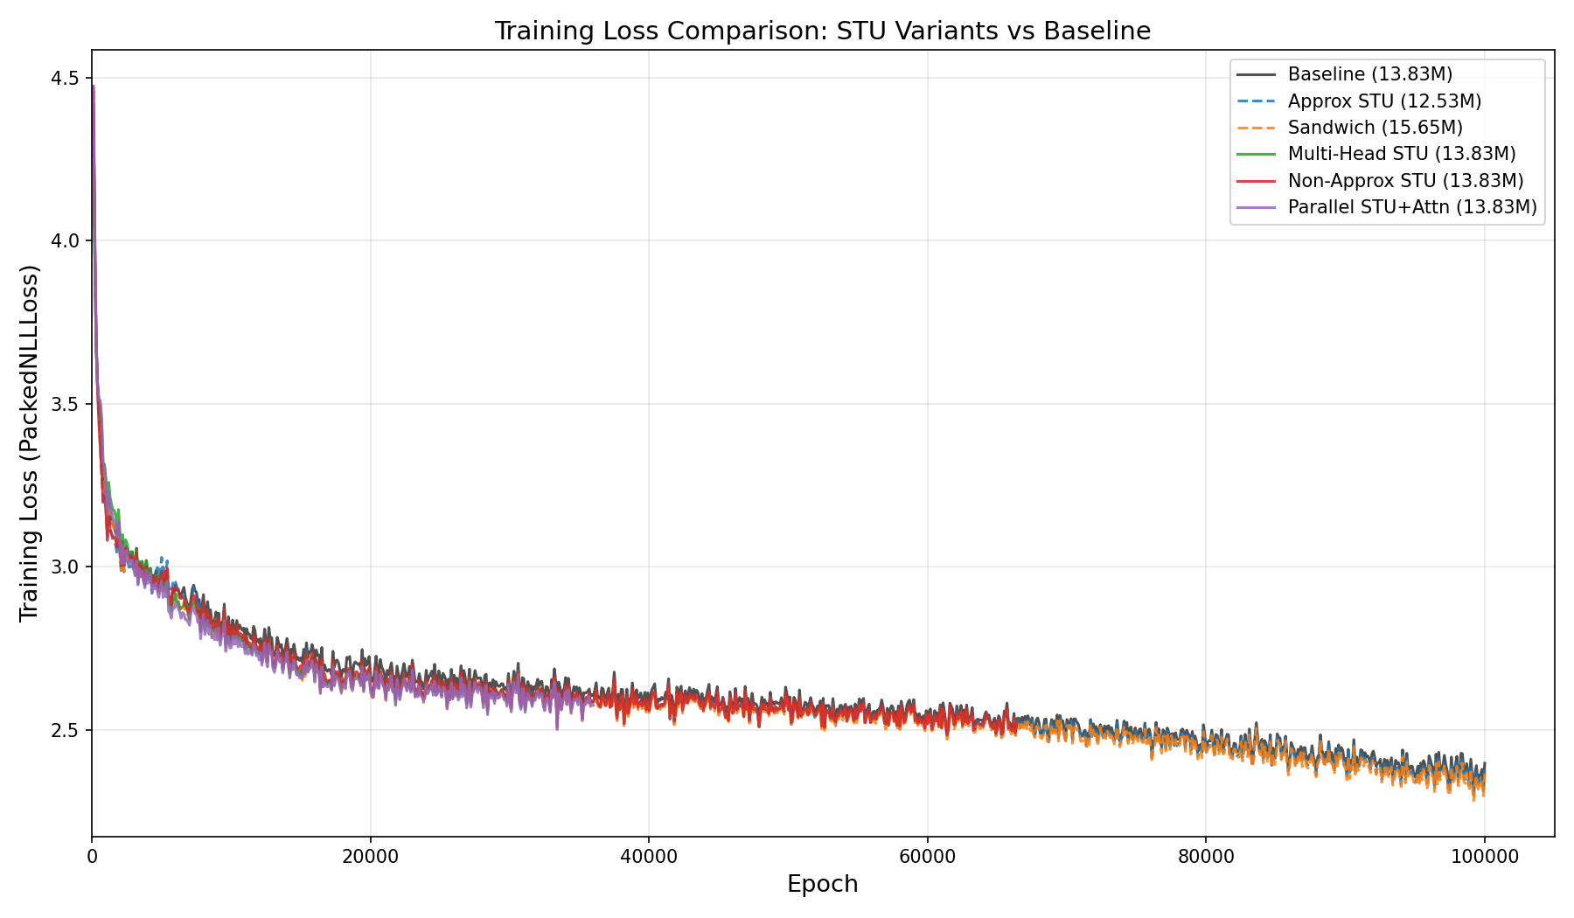
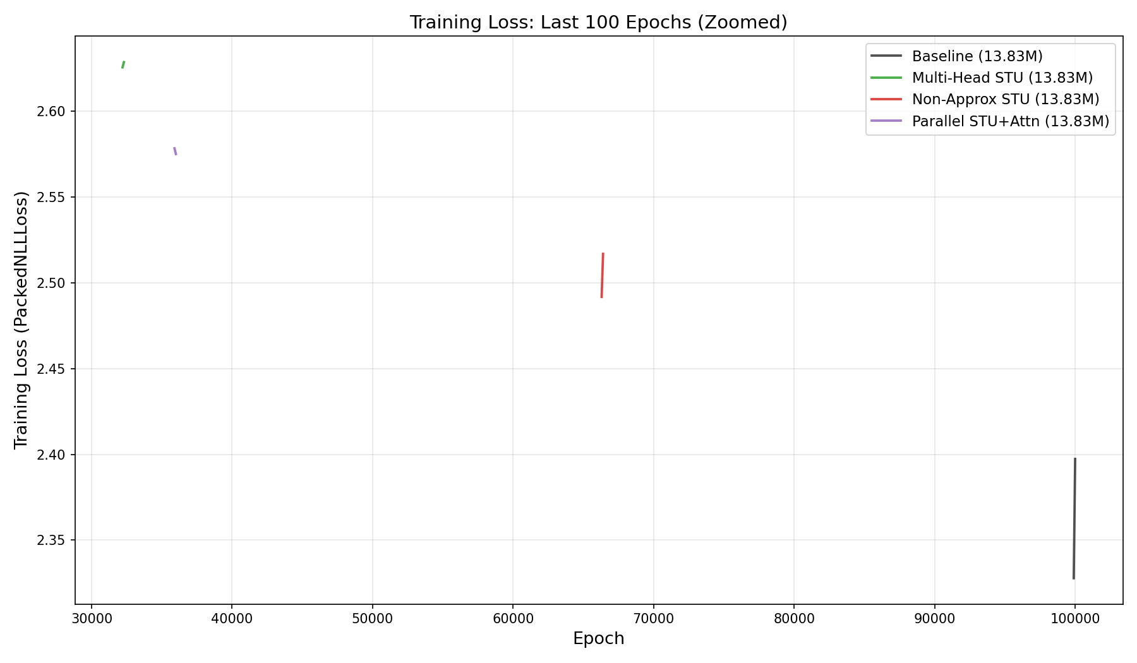
[Appendix] STU Pretraining: All Runs
Model | Params | Final Loss | Speed (it/s) | Epochs | Ckpt Size
Baseline MOIRAI | 13.83M | 2.400 / 2.380 | 2.16 | 1000 | 159M
Approx STU Hybrid | 12.53M | 2.380 / 2.361 | 0.59 / 0.96* | ~600 | 144M
STU-Only Sandwich | 14.29M | 2.650 | 0.51 | 1000 | 164M
Hybrid Sandwich | 15.65M | 2.370 / 2.350 | 0.86 | 1000 | 180M
Multi-Head STU (H=6) | 13.83M | 2.534 (ep 744) | ~0.55 | 744/1000 | TBD
Non-Approx STU (K=2) | 13.83M | 2.372 | ~0.50 | 1000 ✓ | TBD
Parallel STU+Attn | 13.83M | 2.488 (ep 842) | ~0.45 | 842/1000 | TBD
* STU Fast = batched forward implementation, 1.6× speedup over original

Slide 16
[Appendix] Preconditioning: Mathematical Details
Time-Domain FIR Filter (Causal)
z(t) = y(t) + c₁·y(t-s) + c₂·y(t-2s) + ... + c_d·y(t-ds) where c_i = monic polynomial coefficients, s = stride, d = degree
Chebyshev Coefficients (monic):
FIR Inverse Filter (Learned):
Degree | Coefficients | # Non-zero taps
1 | [0.0] | 0 (identity)
2 | [0, -0.5] | 1
3 | [0, -0.75, 0] | 1
4 | [0, -1.0, 0, +0.125] | 2
5 | [0, -1.25, 0, +0.3125, 0] | 2
6 | [0, -1.5, 0, +0.5625, 0, -0.031] | 3
7 | [0, -1.75, 0, +0.875, 0, -0.109, 0] | 3
• 64-tap learnable filter (nn.Parameter)
• Trained via auxiliary MSE loss:
L_inv = ||sum(alpha_i * z(t-i)) - sum(c_i * y(t-i))||²
• Weight: lambda_inv = 0.1 (total = L_quant + 0.1 * L_inv)
• Applied per-timepoint before patch formation
• d=1 control: zero FIR inverse loss (nothing to invert)
Loss Reversal (alternative, not used in main exps):
• Analytically undo precond on predictions before loss
• Mutually exclusive with FIR inverse

Slide 17
[Appendix] Error Dynamics & Lyapunov Theory
Prediction reversal: y_hat(t+h) = -sum(c_i * y_hat(t+h-i)) + z_hat(t+h)
Ground truth: y(t+h) = -sum(c_i * y(t+h-i)) + z(t+h)
Error evolution: e_{h+1} = -sum(c_i * e_{h+1-i}) + ε_{h+1}
Companion matrix M = [[-c1, -c2, ..., -cn], [1, 0, ..., 0], ..., [0, ..., 1, 0]]
State vector x_h = [e_h, e_{h-1}, ..., e_{h-n+1}]^T
x_{h+1} = M * x_h + B * ε_{h+1} where B = [1, 0, ..., 0]^T
For horizon H: x_H = M^H * x_0 + sum_{i=0}^{H} M^{H-i} * B * ε_i
Var(e_H) = sigma^2 * sum_{i=0}^{H} beta_{H-i}^2 where beta_i = B^T * M^i * B
Infinite horizon: minimize sum beta_i^2 = B^T * P * B where P solves M^T*P*M - P = -Q
(Discrete Lyapunov equation. Converges iff spectral radius rho(M) < 1.)
Regularized optimization: min_c ( max_{|z|<=1} |p(z)| + lambda * P_{0,0} )
First term: spectral flatness (Chebyshev criterion). Second term: noise gain (stability).

Slide 18
[Appendix] Moirai 1.0: Full Preconditioning Results
Monash Benchmark, 29 datasets. MAE[0.5] ratio vs baseline (< 1.0 = better).
 | d=2 GT rev. | d=2 model rev. | d=5 GT rev. | d=5 model rev.
M1 Monthly | 0.78 | 1.02 | 0.95 | 1.22
M3 Monthly | 0.83 | 1.14 | 0.91 | 1.82
M3 Other | 0.79 | 2.23 | 0.62 | 7.38
M4 Monthly | 0.77 | 1.16 | 0.77 | 2.00
M4 Weekly | 0.75 | 1.39 | 0.77 | 3.53
M4 Daily | 0.65 | 2.08 | 0.46 | 6.34
M4 Hourly | 0.52 | 1.15 | 0.28 | 2.09
Tourism Qtr | 0.82 | 1.22 | 0.98 | 2.26
FRED-MD | 0.38 | 1.43 | 0.49 | 4.63
Saugeen River | 0.58 | 1.05 | 0.56 | 1.06
COVID Deaths | 0.76 | 1.44 | 0.16 | 2.45
GEO MEAN | 0.75 | 1.22 | 0.71 | 2.02
GT reversal shows huge gains (0.71× MAE). Model-forecast reversal: catastrophic for d>=2. Error ∝ degree.

Slide 19
[Appendix] Patch (Embedding) Preconditioning Results
Pipeline: Raw series → in_proj → Chebyshev filter → Transformer → out_proj
• Train loss improves with degree up to d=5
• Eval loss improves up to d=4, but still worse than baseline
• Root cause: transformer + out_proj must learn both
time series mechanics AND filter reversal
• Too much burden on same parameters
Eval GeoMean MAE Ratio (vs d=1 baseline):
Degree | d=2 | d=3 | d=4 | d=5
Ratio | 1.13 | 1.10 | 1.05 | 1.14
Training vs Eval Divergence:
Training (LOTSA): precond_context_LOTSA → attention_patterns_LOTSA → param_proj → good predictions Eval (Monash): precond_context_Monash → attention_patterns_??? → param_proj → bad predictions param_proj learns LOTSA-specific preconditioned mapping that doesn't transfer to new domains.

Slide 20
[Appendix] EXP-1 Training Configuration & Loss Decomposition
Common Configuration:
Final Loss Decomposition (avg last 200 steps):
Parameter | Value
Training steps | 100K (1000 ep × 100 batches)
Batch size | 256
Learning rate | 1e-3 (cosine annealing)
Warmup steps | 10K
Precision | bf16-mixed
Dataset | LOTSA v1 (27 datasets)
FIR inverse length | 64 taps
FIR inverse λ | 0.1
Anomaly z-score | 8.0
GPU | NVIDIA H200, 30h limit
Seed | 42
Run | Quantile Loss | FIR Inv Loss | Total Loss
baseline | 0.841 | — | 0.841
d=1 | 0.120 | 0.000 | 0.120
d=2 | 0.101 | 0.082 | 0.110
d=3 | 0.101 | 0.186 | 0.119
d=4 | 0.108 | 0.304 | 0.138
d=5 | 0.120 | 0.444 | 0.164
d=6 | 0.137 | 0.629 | 0.200
d=7 | 0.159 | 1.065 | 0.265
Key: Baseline quantile loss (0.841) is not comparable to precond runs (0.101–0.159) because they operate in different spaces. Anomaly rejection (zscore=8.0) explains most of the gap.

Slide 21
[Appendix] Confound: Anomaly Rejection Threshold
Original baseline (job 4583433) used anomaly_zscore_threshold=0.0 (disabled). All precond runs used anomaly_zscore_threshold=8.0 (rejects samples with |z| > 8).
• Anomaly rejection rate: ~23-24% of training samples rejected (outlier LOTSA datasets)
• Without rejection: massive loss spikes from extreme values (e.g., financial data with 1000× outliers)
• d=1 (identity filter + zscore=8.0) vs baseline (no filter + no rejection): the entire gap is anomaly rejection
• This was discovered when d=1 (which applies no filtering!) outperformed the baseline
Fix: resubmitted baseline with zscore=8.0 (job 4611086, running now).
RULE: All future runs MUST include model.anomaly_zscore_threshold=8.0

Slide 22
[Appendix] EXP-1b: Regularization Sweep Design
CVXPY optimization: min_c ( max_{|z|≤1} |p(z)| + λ * ||c||² ) where p(x) = x⁴ + c₁x³ + c₂x² + c₃x + c₄ (monic degree 4)
λ | c1 | c2 | c3 | c4 | max|c| | ||c||_2 | max|p(z)| | Noise Gain (est.)
0 (Cheb) | 0 | -1.000 | 0 | +0.125 | 1.000 | 1.008 | 0.063 | ~12
0.25 | 0 | -0.706 | 0 | -0.085 | 0.706 | 0.711 | ~0.15 | ~5
0.5 | 0 | -0.507 | 0 | -0.214 | 0.507 | 0.551 | ~0.20 | ~3
1.0 | 0 | -0.377 | 0 | -0.294 | 0.377 | 0.478 | ~0.25 | ~2.5
2.0 | 0 | -0.250 | 0 | -0.250 | 0.250 | 0.354 | ~0.28 | ~2
3.0 | 0 | -0.167 | 0 | -0.167 | 0.167 | 0.236 | ~0.30 | ~1.7
10.0 | 0 | -0.050 | 0 | -0.050 | 0.050 | 0.071 | ~0.35 | ~1.1
• λ=0–0.1: No effect (Chebyshev already near-optimal for combined objective)
• λ=0.25: First meaningful shift — c4 flips sign from +0.125 to -0.085
• λ=2.0: Both non-zero coefficients become equal (-0.25, -0.25)
• λ=10.0: Near-identity filter (coefficients ~0.05)
• Custom 4-tap [0, -0.118, 0, -0.136] is closest to λ≈3 regime

Slide 23
[Appendix] Planned: Learnable Coefficients (EXP-6)
Code implemented. Awaiting EXP-1/1b results to determine best degree d* before launching.
Implementation:
• time_precondition_learnable=True: registers coefficients as nn.Parameter (not buffer)
• L2 regularization via time_precondition_coeffs_lambda
• Logged metrics: train/precond_coeffs_norm, train/precond_coeffs_l2
• Config: model.module_kwargs.time_precondition_learnable=true + model.time_precondition_coeffs_lambda=0.01
Planned Sub-experiments:
Exp | Runs | Question
6a: Learnable vs Fixed | 5 | Does end-to-end learning beat fixed polynomials?
6b: Init Sensitivity | 4 | Chebyshev init vs zero vs random vs simpler poly?
6c: Degree × Learnable | 4 | Can 2 learned taps beat fixed d*? Does d=16 help?
6d: Without FIR Inverse | 3 | Do learnable coeffs make FIR inverse unnecessary?
Total: ~12 new runs, ~9 GPU-days. Priority: 6a > 6d > 6b > 6c.

Slide 24
[Appendix] GIFT-Eval Benchmark Methodology
97 dataset configurations total:
• 39 unique datasets × multiple freq/horizon combos
• Cloud/Web: bitbrains, bizitobs (20 configs)
• Sales: car_parts, hierarchical, restaurant (4)
• Health: covid_deaths, hospital (2)
• Energy: electricity, ETT1/2, solar (24)
• Weather: jena, kdd_cup, temp_rain (12)
• Nature: saugeen, us_births (6)
• Transport: LOOP_SEATTLE, SZ_TAXI (11)
• M-competitions: m4_daily/hourly/monthly/qtr/wk/yr (6)
• Dense matrix: M_DENSE (4)
• Horizons: short, medium, long
Leaderboard Methodology:
1. Per-config ranking: rank models 1-N by MASE[0.5]
2. MASE_Rank = arithmetic mean of per-config ranks
3. Geo Mean MASE = geometric mean across configs
4. Normalized MASE = model_MASE / naive_MASE per config
Interpretation:
• MASE < 1.0 = beats seasonal naive baseline
• Normalized MASE < 1.0 = better than naive on that config
• Geo mean is scale-invariant (preferred for aggregation)
Eval Settings:
Setting | Value
Context length | 1000
Patch size | 32 (non-quarterly) / 8 (quarterly)
Batch size | 32
Num samples | 100 (probabilistic)
Device | NVIDIA H200

Slide 25
[Appendix] Complete Job Log
Job ID | Name | Type | Status | Key Config
4611086 | m2_baseline_fixed | Pretrain | RUNNING (ep 388) | Moirai2, zscore=8.0
4610803 | m2_custom_4tap | Pretrain | RUNNING (ep 384) | [0,-0.118,0,-0.136]
4611080-85 | m2_d4_lam* | Pretrain | RUNNING (~35%) | EXP-1b sweep
4558185 | multihead_stu | Pretrain | RUNNING (ep 744) | H=6, d_ff=1379
4558187 | parallel_stu | Pretrain | RUNNING (ep 842) | gate*attn+(1-g)*stu
4620192 | gifteval_nonapprox | Eval | RUNNING | Non-approx STU ep 999
4558186 | nonapprox_stu | Pretrain | DONE | K=2, full M_phi, ep 999
4583434-40 | m2_precond d=1-7 | Pretrain | DONE | EXP-1 degree sweep
4583433 | m2_baseline_orig | Pretrain | DONE | CONFOUNDED (no zscore)

