Slide 1
Sound attenuated training box: Acrylic plastic framework

Slide 2
a
b
35
Horizontal gap, 5 mm width and 15 cm length
25
25
25
25
Hinge door
c
d
35
6
35
punching
25
25
15
5
Circle diameter 5mm
Horizontal gap, 5 mm width and 15 cm length
Notes:
Acrylic plastic outer training box
Unit by centimeter, not including plate thickness
a) Stereo view
b) Right side view
c) Back side view
d) Upper side view

Slide 3
a
c
25
Punching
Hole diameter 5 mm
1
1
25
1
1
15
15
1
1
1
1
15
d
Horizontal gap, 5 mm width and 10 cm length
15
b
15
25
e
6
Punching
25
15
15
10
Horizontal gap, 5 mm width and 10 cm length
Notes:
Acrylic plastic inner training box
Unit by centimeter, not including plate thickness
A) Stereo view, Five –side box, no plate in front side
c) Bottom view
d) Right side view
b) Back side view
E) Upper side view

Slide 4
Punching
Hole diameter 5 mm
25
1
2
1
1
5.5
1
2
13
4
5
2
15
1
5
1
1
1
0.5
1
Punching
Rectangle size 2 cm by 1 cm
Notes:
Acrylic plastic plate, thickness is 5 mm
Unit by centimeter

Slide 5
a
b
35
切割缝, 5 mm 宽，15 cm 长
25
25
25
25
合页门
c
d
35
6
35
打孔
25
25
15
5
孔直径5mm
切割缝, 5 mm 宽，15 cm 长
Notes:
Acrylic plastic outer training box
Unit by centimeter, not including plate thickness
a) Stereo view
b) Right side view
c) Back side view
d) Upper side view

Slide 6
a
c
25
打孔
孔直径 5 mm
1
1
25
1
1
15
15
1
1
1
1
15
d
切割缝, 5 mm 宽，10 cm 长
15
b
15
25
e
6
打孔
25
15
15
10
切割缝, 5 mm 宽，10 cm 长
Notes:
Acrylic plastic inner training box
Unit by centimeter, not including plate thickness
A) Stereo view, Five –side box, no plate in front side
c) Bottom view
d) Right side view
b) Back side view
E) Upper side view

Slide 7
打孔
孔直径 5 mm
25
1
2
1
1
5.5
1
2
13
4
5
2
15
1
5
1
1
1
0.5
1
打孔
矩形尺寸2 cm x 1 cm
Notes:
Acrylic plastic plate, thickness is 5 mm
Unit by centimeter

Slide 8
Sound attenuated training box: ventilator, foam, support

Slide 9
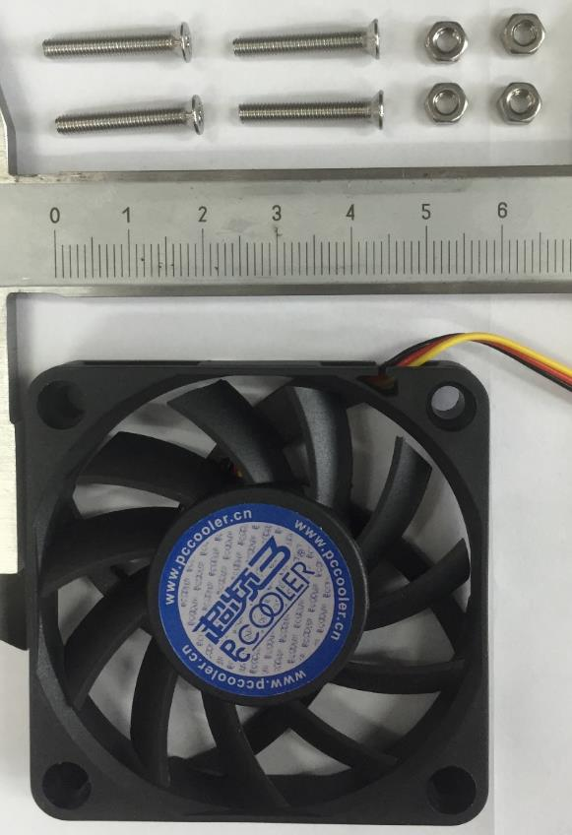
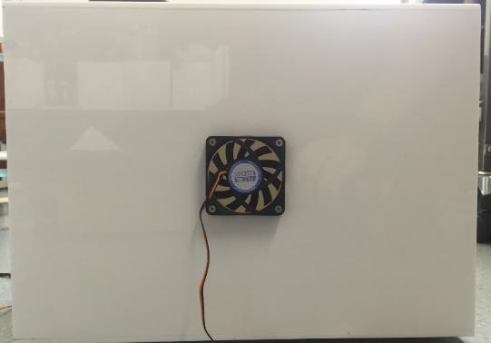
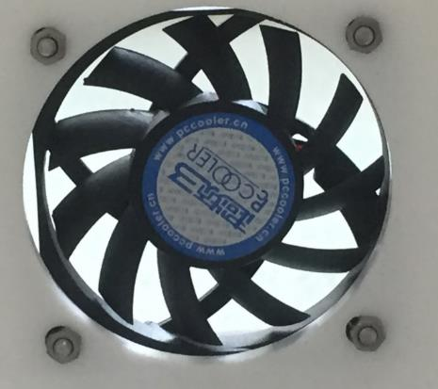
a
b
c
Notes:
Install a ventilation fan
Needed ventilation fan and four sets of screw and screw cap
back side view of outer training box after installing a ventilation fan
inside view of outer training box after installing a ventilation fan

Slide 10
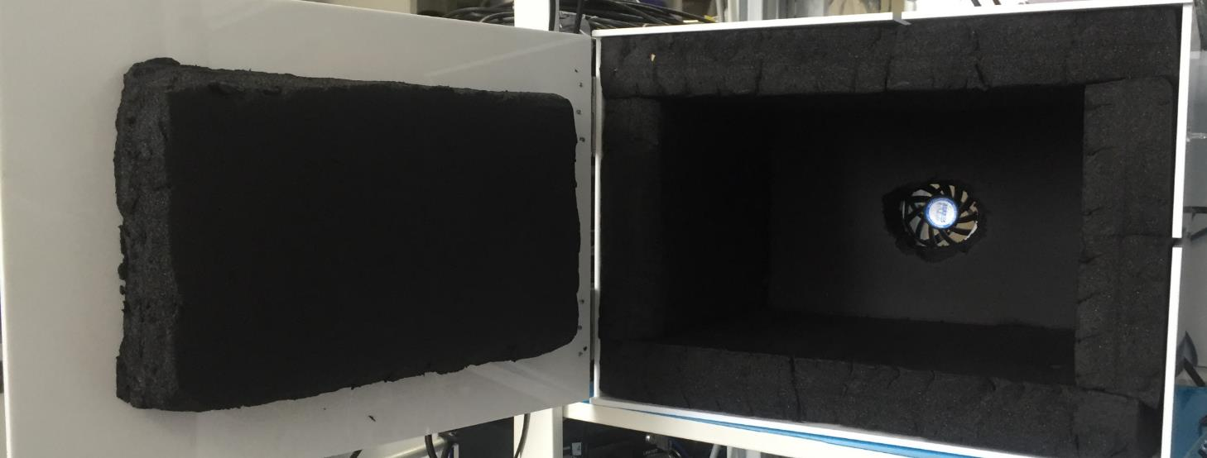
Notes:
Attach sound insulation sponge. Insulation sponge thickness is 45 mm.

Slide 11
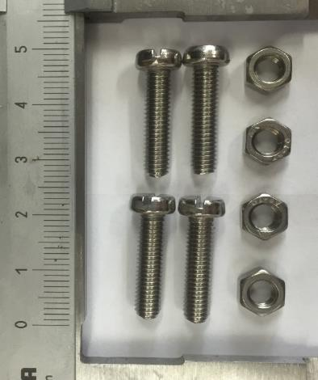
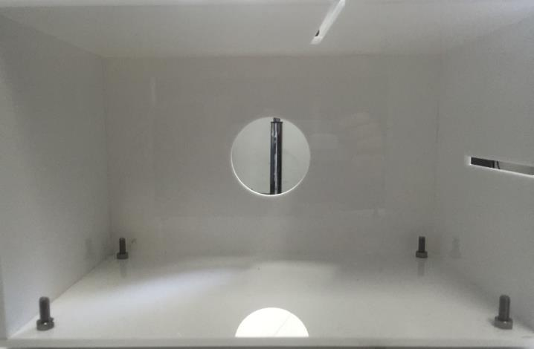
a
b
Notes:
Install screw and screw cap to acrylic plastic plate.
Needed four sets of screw and screw cap
inside view of inner training box after installing screws and screw caps

Slide 12
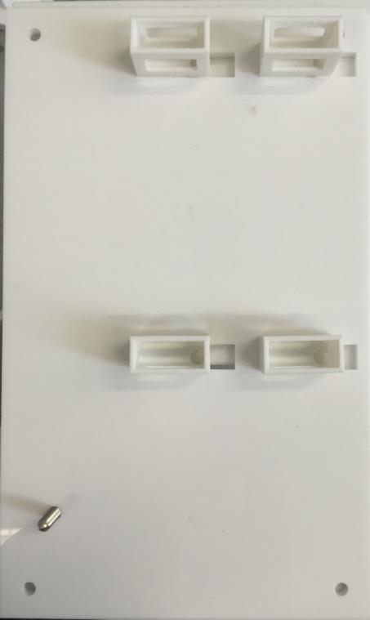
Notes:
Attach one screw and four sliding brackets to acrylic plastic plate

Slide 13
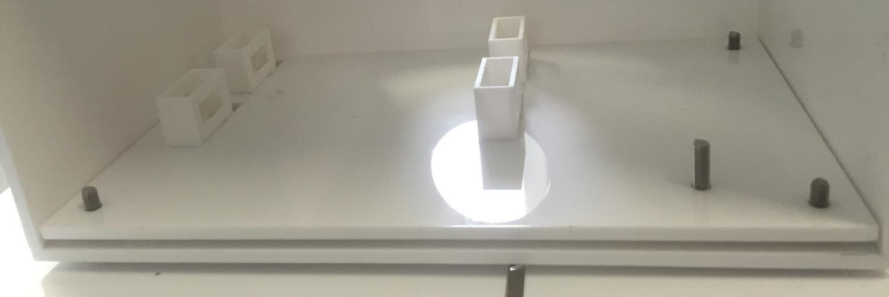
Notes:
Place acrylic plastic board to inner training box.

Slide 14
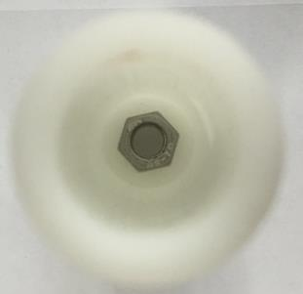
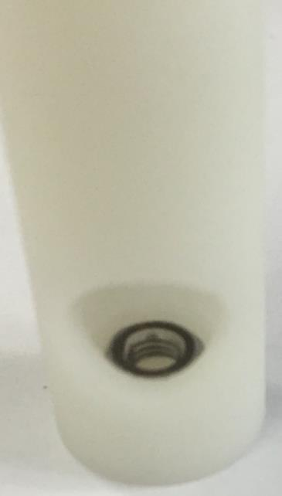
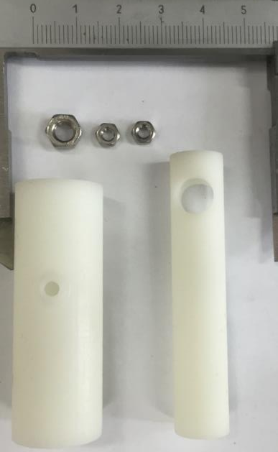
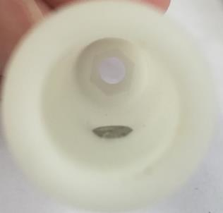
a
b
d
c
Notes:
Install a holder
Needed three screws and two parts of holder (outer and inner)
install one screw to the inside bottom of outer holder
Install one screw to the inside surface of outer holder
install one screw to the inside upper side of inner holder

Slide 15
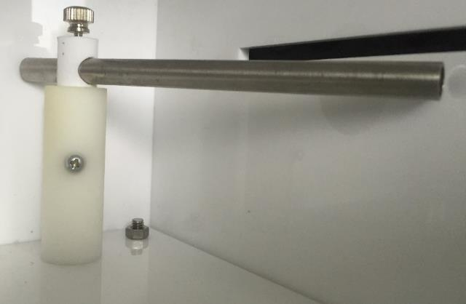
Notes:
Install holder to acrylic plastic board

Slide 16
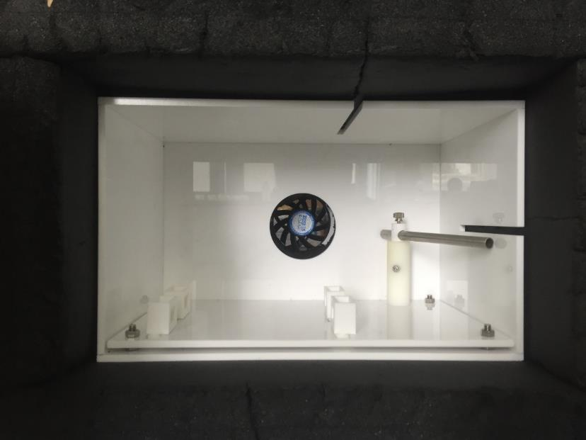
Notes:
Insert inner training box into outer training box .

Slide 17
Training tube

Slide 18
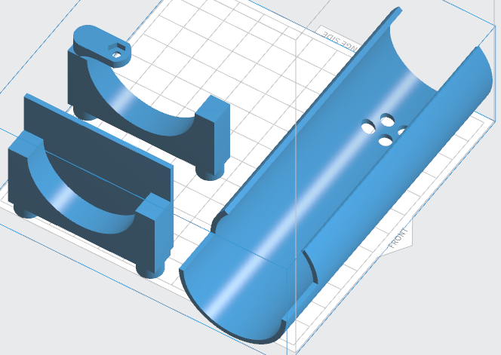
a
c
b
Notes:
Three-dimensional blue print of training tube.
Front part of training tube
Back part of training tube
Training tube

Slide 19
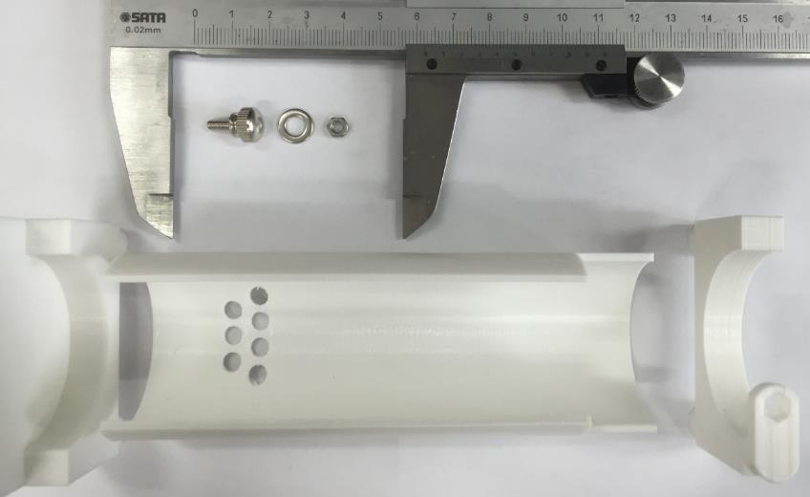
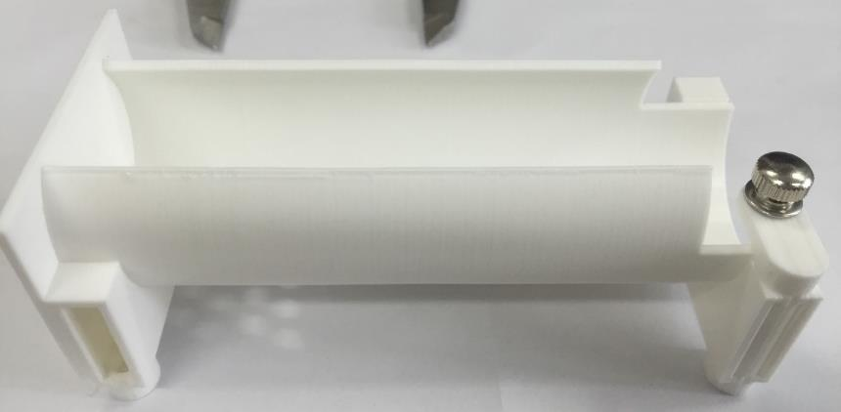
a
b
Notes:
Assemble a training tube
Needed screw, screw cap, screw plate and three parts of training tube
attach three parts of training tube, install screw, screw plate and screw cap.

Slide 20
Motorized water port, odor tube socket

Slide 21
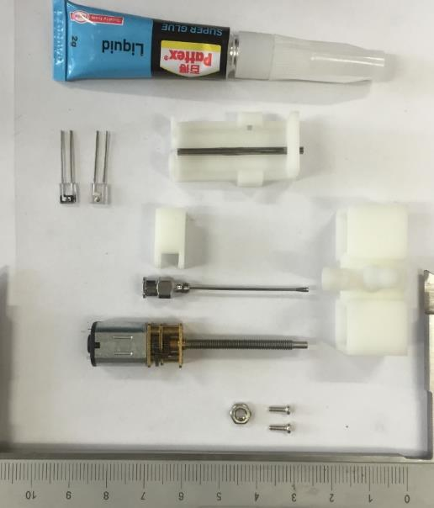
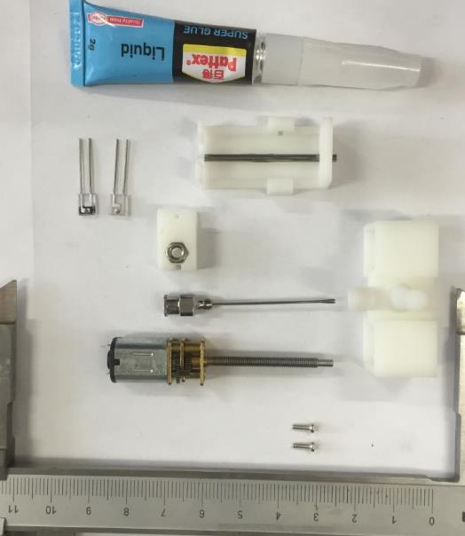
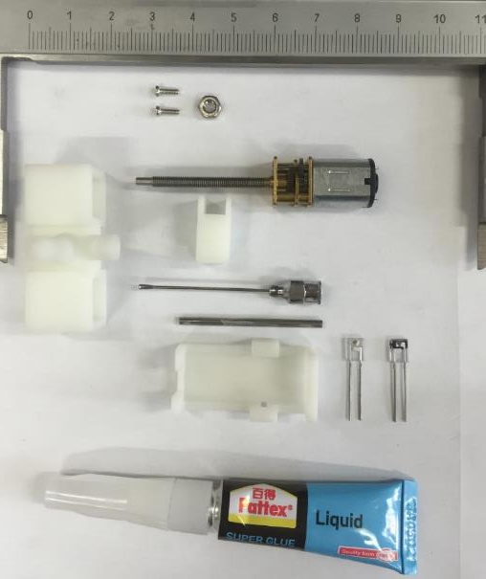
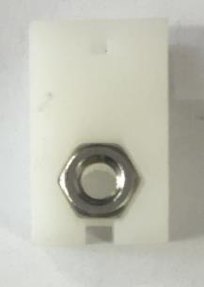
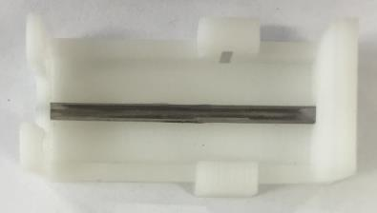
a
b
d
a
c
e
Notes:
Assemble a movable water port
Needed three printed parts of water port, DC motor. Intra gastric needle, iron bar, super glue, two screws, one screw cap and a pair of IR diode
c) insert iron bar into sliding pad
d) e)Insert screw into slide block

Slide 22
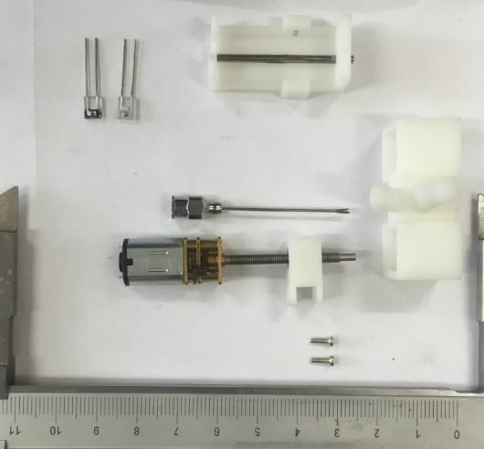
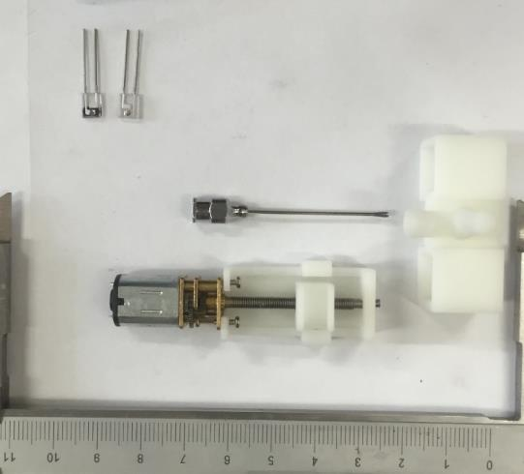
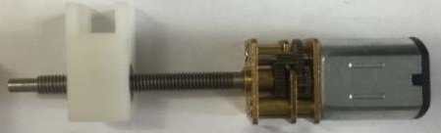
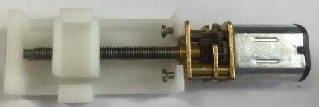
a
c
b
d
Notes:
b) Screw the DC motor into sliding block
c) d) assemble sliding pad and sliding block

Slide 23
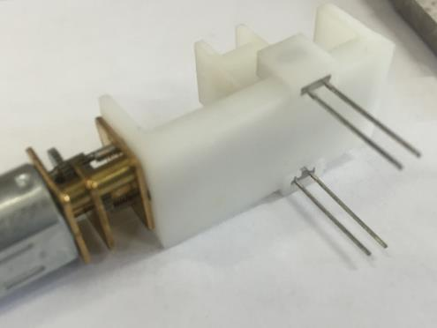
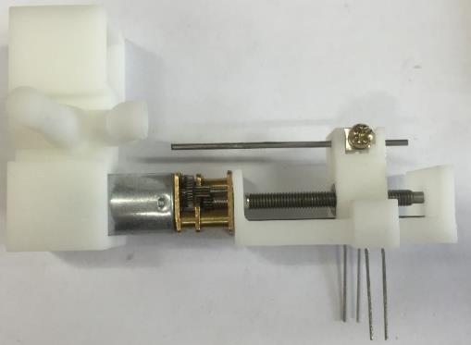
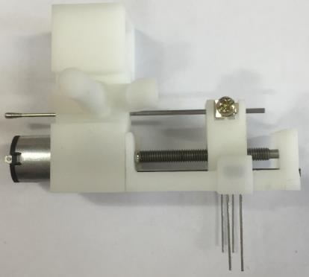
a
b
c
Notes:
Insert IR diodes into bracket of sliding pad
c) Insert intra gastric needle into holes of sliding block, and insert DC motor into motor bracket.

Slide 24
Odor delivery part

Slide 25
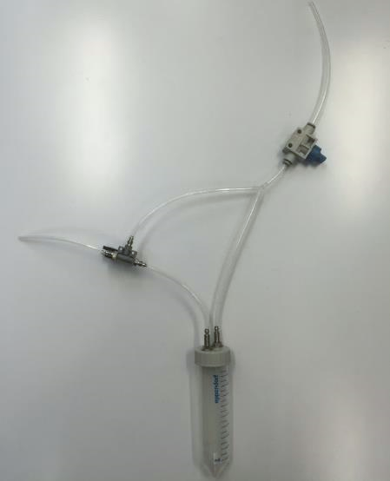
PUMP
FILTER
M
M
Manual air flow controller
M
M
V
V
FLOW METER
Two-way manual valve
V
V
V
V
Three-way solenoid valve
MOUSE
V
V
15cm
5cm
15cm
Odorant bottle
10cm
15cm
10cm

