Slide 1
POWER BI
Global Causes of Death
Analysis Dashboard
An analytical deep-dive into the leading causes of death worldwide
using Power BI · Power Query · DAX
Presented by Jerry James
1990-2019
Annual Deaths by Cause

Slide 2
01
Project Overview
Goals, scope & dataset summary
02
Dataset & Fields
Source, columns, and coverage
TABLE OF
CONTENTS
03
Tools & Preparation
Power BI, Power Query, DAX
04
Analytical Questions
5 key questions explored
05
Dashboard Pages
KPIs, visuals & interactivity
06
Key Findings
Patterns, trends & insights
Global Causes of Death
Analysis Dashboard·
07
Conclusion
Summary and recommendations

Slide 3
PROJECT OVERVIEW
What This Dashboard Answers
Using Power BI, this project uncovers global mortality trends, identifies leading causes of death, maps high-mortality regions, and tracks disease growth rates over time — turning raw data into life-saving insights.
💀
Leading Causes
🗺️
Regional Mapping
Identify the top diseases and conditions causing the most deaths globally
Pinpoint highest mortality countries using filled geographic maps
📈
Trend Analysis
⚡
Growth Rates
Track how death counts per cause have evolved year over year
Discover the fastest growing diseases using DAX-calculated growth metrics

Slide 4
DATASET INFORMATION
About the Data
📁 Dataset: annual_deaths_by_causes · Source: Our World in Data / Kaggle · Table: annual_deaths_by_causes (2)
Country
Text
Nation-level records across all global regions
Year
Integer
Annual time series for trend and YoY analysis
Cause / Disease
Text
Disease or condition responsible for mortality
Death Count
Numeric
Total recorded deaths per country, year & cause
Total Death (DAX)
Measure
Aggregated deaths — custom DAX calculated measure
Highest Mortality Country
Measure
DAX measure returning nation with peak deaths
Leading Cause
Measure
Cause with the highest cumulative death count
Death Growth
Measure
YoY percentage change in deaths per cause (DAX)

Slide 5
TOOLS & TECHNOLOGY
What Powered This Dashboard
⚡
Primary Tool
🔧
ETL Layer
🗺️
Geo Analysis
Power BI Desktop
Power Query Editor
Filled Map Visual
End-to-end dashboard creation with interactive visuals, slicers, cross-filtering, and multi-page report design
Imported, cleaned and reshaped raw CSV data — data types, and unpivoted year columns into row format
Geographic choropleth map displaying mortality intensity by country region with color-encoded death counts
🗃️
🧮
Data Source
Calculations
Kaggle Dataset
DAX Measures
Annual Deaths by Cause dataset — global mortality records by country, year, and disease category
Built custom KPIs: Total Death Count, Highest Mortality Country, Leading Cause of Death, and Death Growth Rate %

Slide 6
DATA PREPARATION
From Raw Data to Dashboard
Data Import
Cleaning & Typing
01
02
Connected to Kaggle CSV via Power Query — loaded annual_deaths_by_causes into Power BI data model
Removed blank rows, corrected column data types, standardized country names and disease/cause labels
Transformation
DAX Measures
03
04
Unpivoted year columns into rows; created a unified Cause field and reshaped the table for analysis
Created Total Death Count, Highest Mortality Country, Leading Cause of Death, and Death Growth Rate % using DAX
Relationships
Dashboard Design
05
06
Linked the two fact tables (annual_deaths_by_causes and annual_deaths_by_causes (2)) for cross-visual filtering
Built 3 report pages — Overview KPIs, Trend Analysis, and Growth Analysis — with slicers, maps, and charts

Slide 7
Q1
ANALYTICAL QUESTION 1 OF 5
What is the total global death count and which single cause leads all others?
📊 KPI Cards + Treemap
Power BI · DAX · Annual Deaths by Cause Dataset

Slide 8
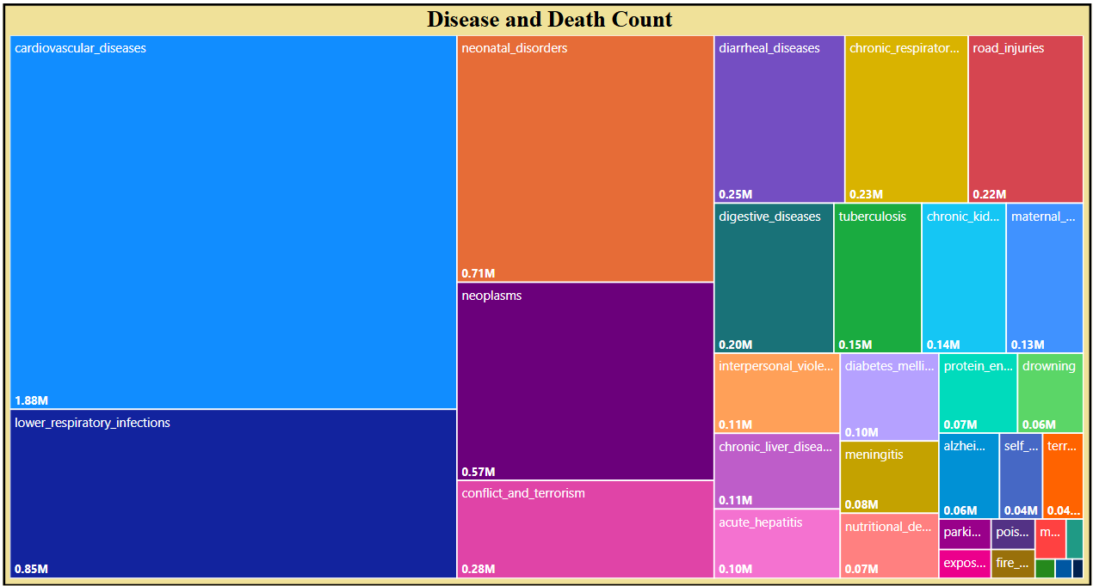
Q1 — INSIGHTS
Total Deaths & Leading Cause of Death
Key Insights
Cardiovascular diseases account for the single largest cause of global death across all recorded years
The treemap reveals stark disparity — top 3 causes account for over 50% of all deaths
Non-communicable diseases dominate, signaling a global shift from infectious to chronic illness

Slide 9
Q2
ANALYTICAL QUESTION 2 OF 5
Which country has the highest mortality rate and how does it compare globally?
📊 Map
Power BI · DAX · Annual Deaths by Cause Dataset

Slide 10
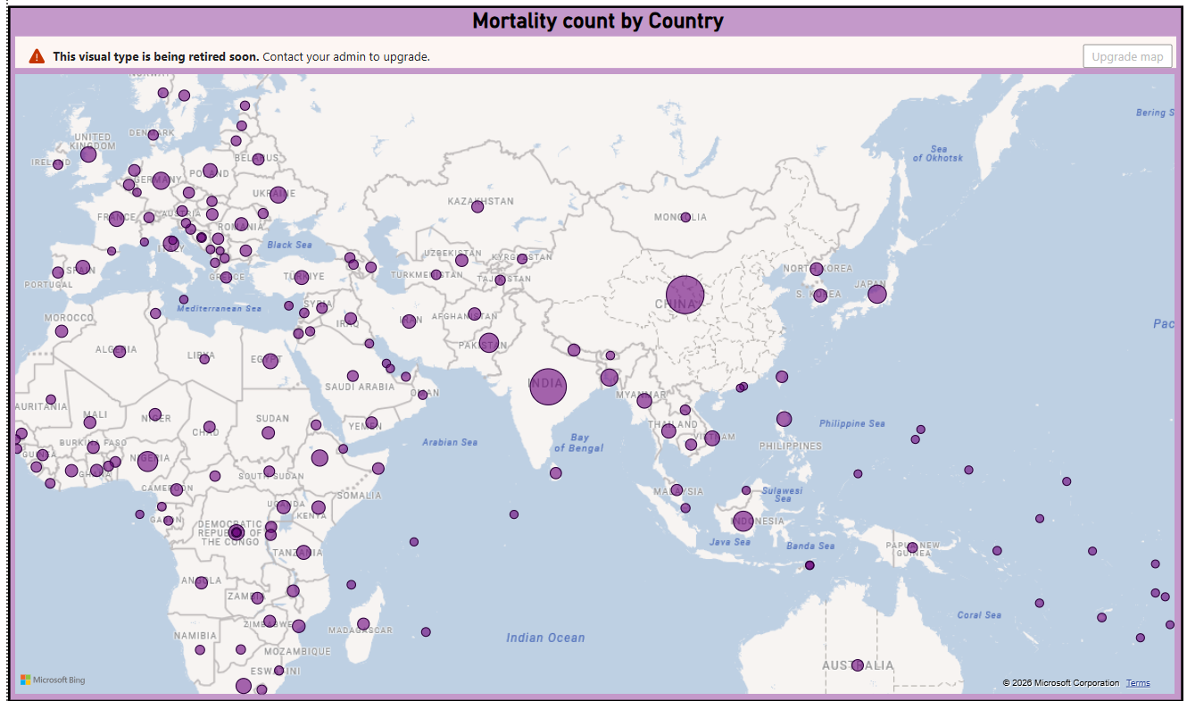
Q2 — INSIGHTS
Highest Mortality Country — Geographic View
Key Insights
China and India consistently top the list due to their massive population base and aging demographics
The filled map reveals Sub-Saharan Africa with high mortality density relative to healthcare access
Developed nations show lower total counts despite aging populations due to stronger health infrastructure

Slide 11
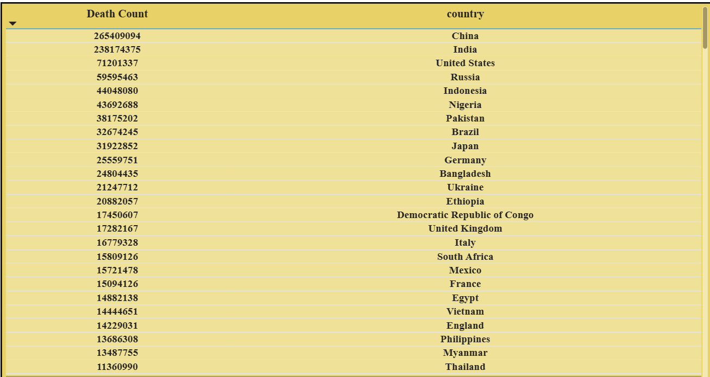

Slide 12
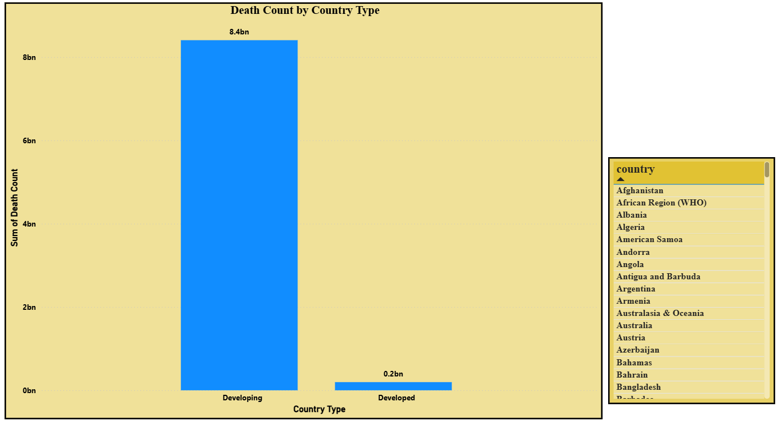

Slide 13
Q3
ANALYTICAL QUESTION 3 OF 5
How has the death count changed year over year across different causes?
📊 Line Chart + Stacked Area Chart
Power BI · DAX · Annual Deaths by Cause Dataset

Slide 14
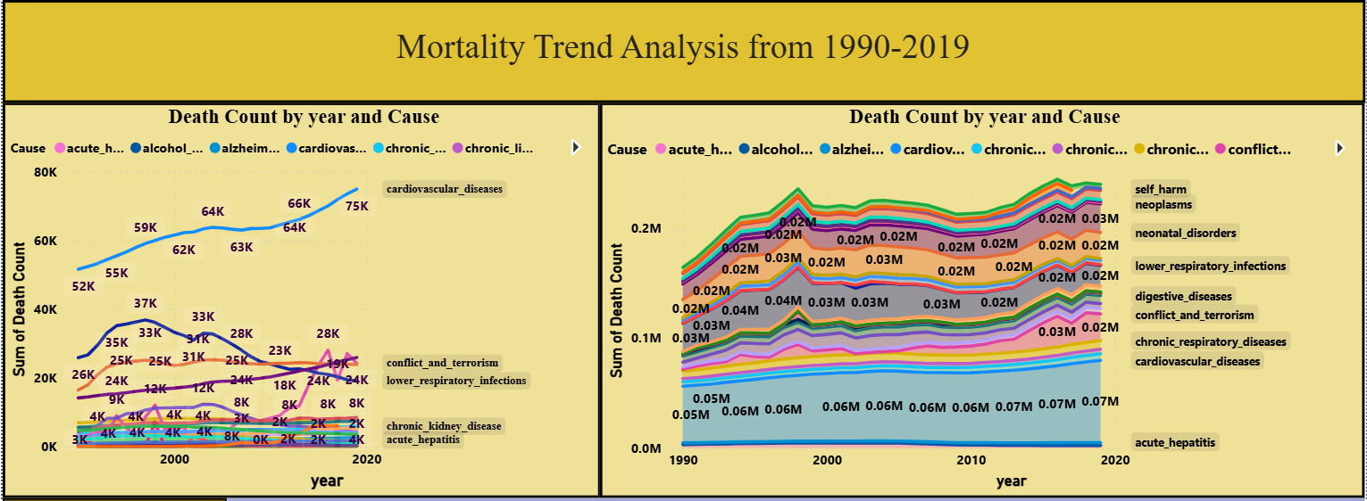
Q3 — INSIGHTS
Year-over-Year Death Trend by Cause
Key Insights
Cardiovascular and cancer deaths show a consistent upward trend driven by aging populations globally
HIV/AIDS deaths peaked around 2005 and have declined — a sign of improved antiretroviral access
The stacked area chart reveals overall mortality rising gradually with spikes during pandemic years

Slide 15
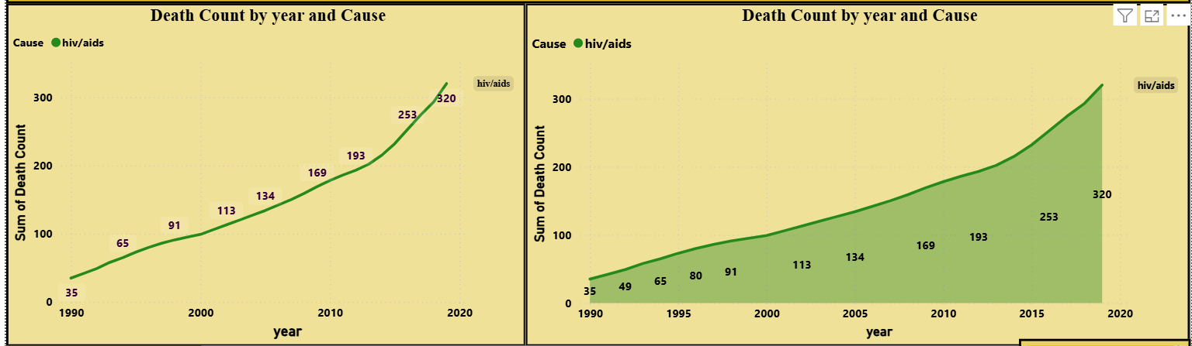

Slide 16
Q4
ANALYTICAL QUESTION 4 OF 5
How have the rankings of causes of death shifted over the years?
📊 Ribbon Chart
Power BI · DAX · Annual Deaths by Cause Dataset

Slide 17
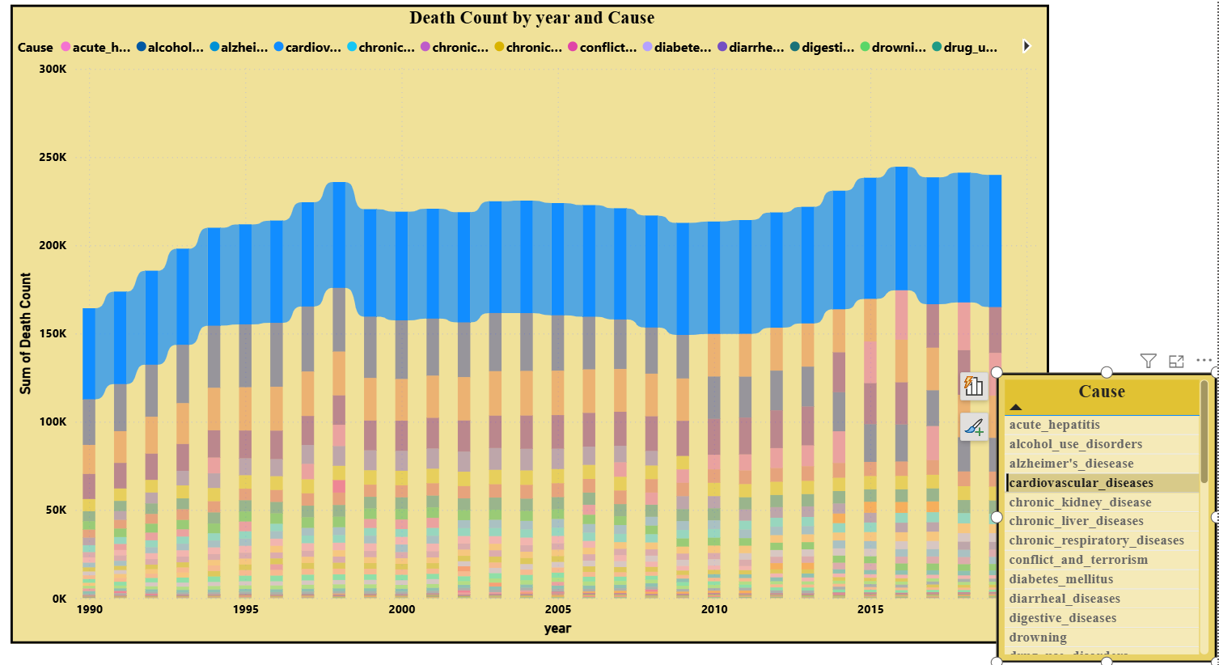
Q4 — INSIGHTS
Cause of Death — Ranking Shifts Over Time
Key Insights
Cardiovascular disease has held the top rank uninterrupted for three decades
Diabetes and Alzheimer's have climbed significantly in recent years due to aging populations
Infectious diseases like malaria and tuberculosis have dropped in rank due to global health campaigns

Slide 18
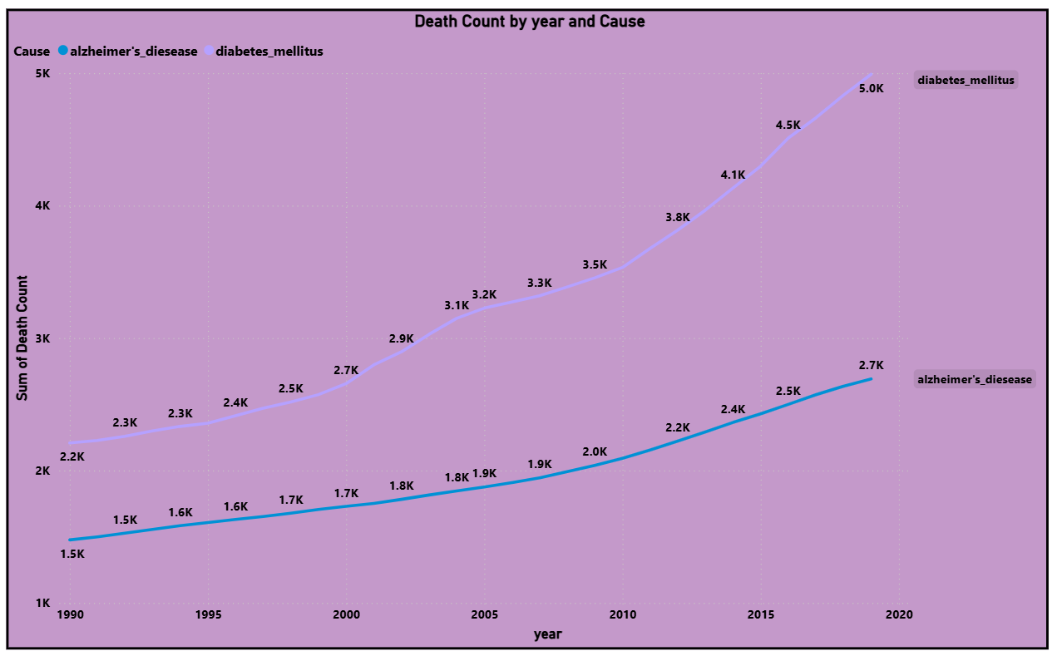

Slide 19
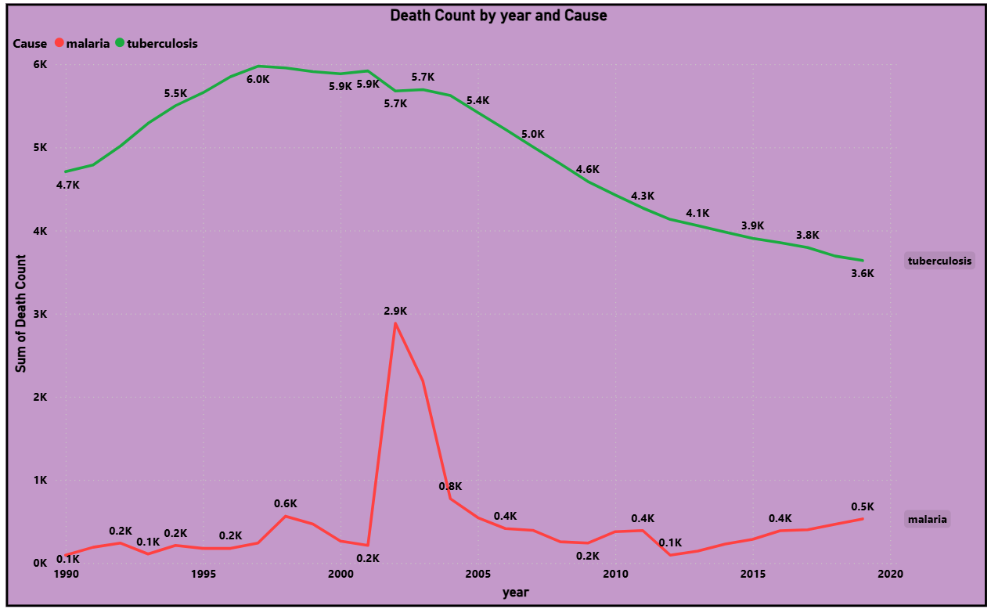

Slide 20
Q5
ANALYTICAL QUESTION 5 OF 5
Which disease or cause of death has the fastest growing death count over time?
📊 Clustered Bar
Power BI · DAX · Annual Deaths by Cause Dataset

Slide 21
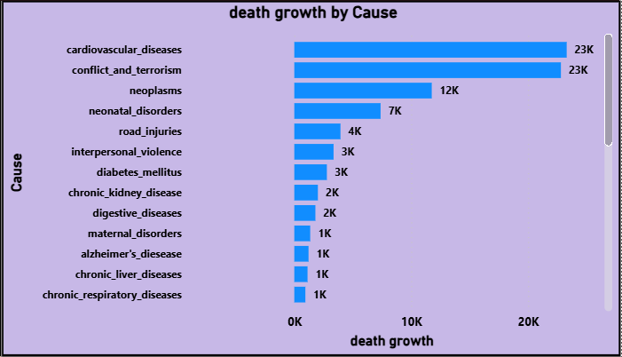
Q5 — INSIGHTS
Fastest Growing Causes of Death
Key Insights
Alzheimer's disease shows the steepest growth rate — deaths nearly tripled from 1990 to 2019
Diabetes-related deaths grew over 70% — directly linked to rising global obesity rates
Kidney disease is an emerging fast-grower, often underreported compared to primary conditions

Slide 22
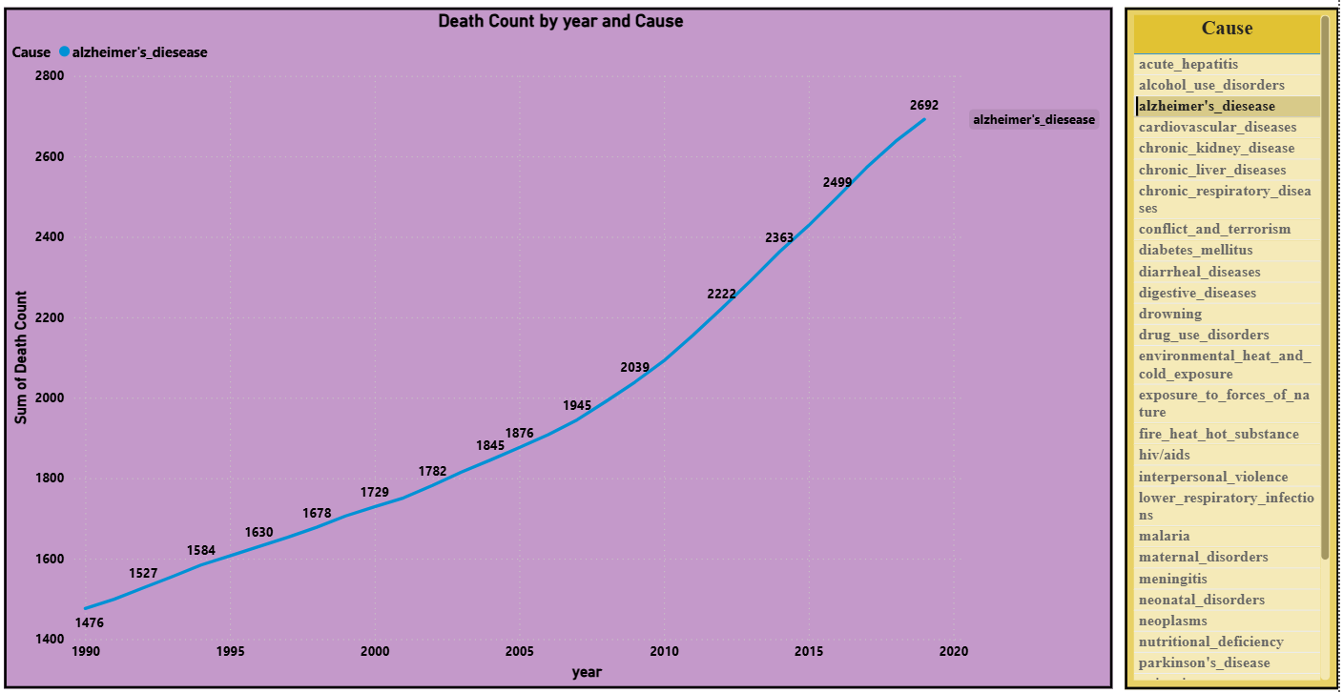

Slide 23
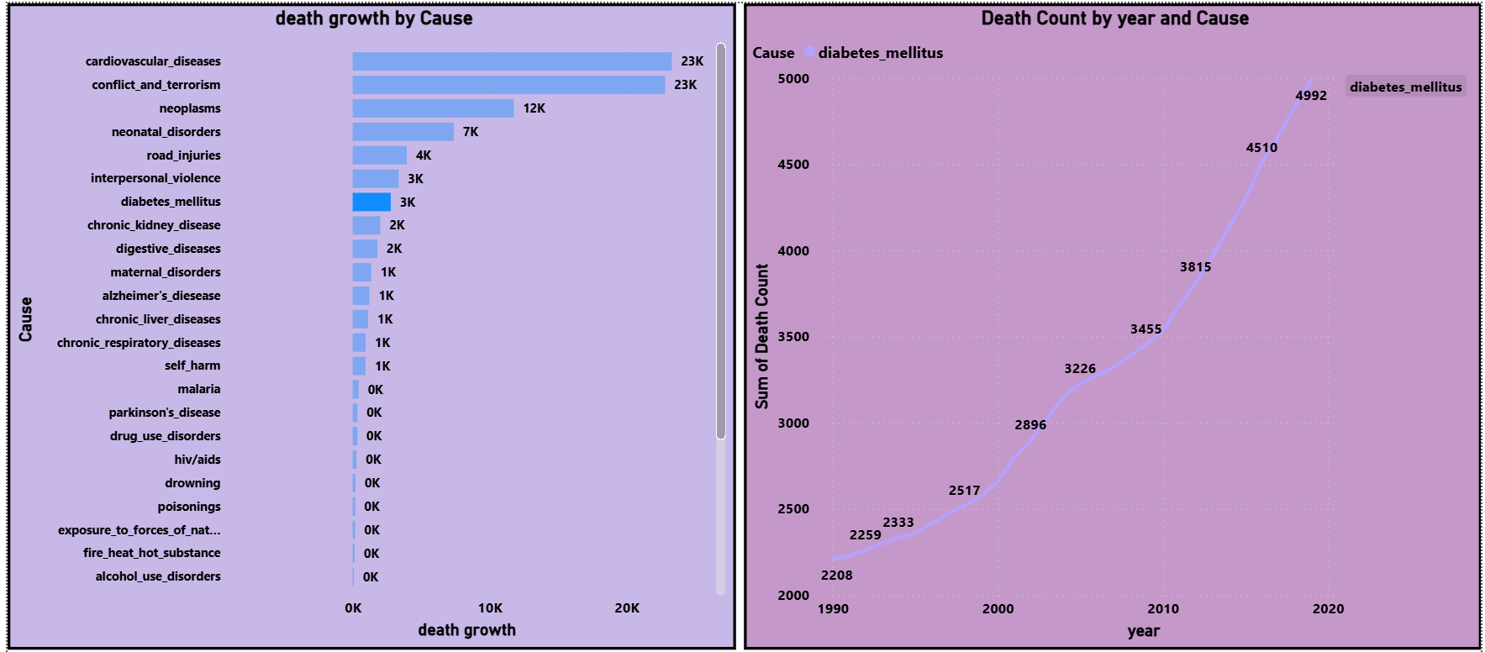

Slide 24
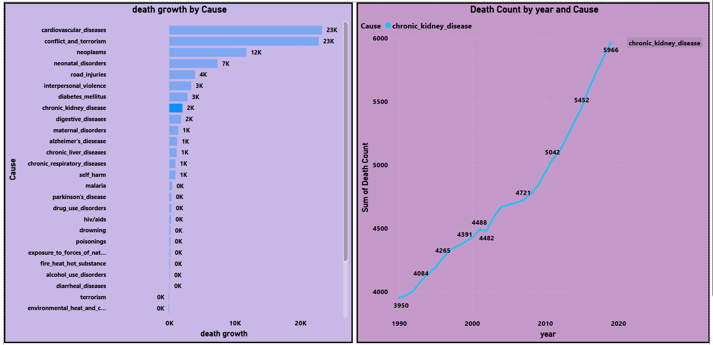

Slide 25
DASHBOARD KPIs
Key Performance Metrics at a Glance
💀
🌍
📅
🦠
📊
1.8B+
200+
30 Yrs
30+
3
Total Deaths
Recorded
Countries
Covered
Data Span
1990–2019
Causes of
Death Tracked
Dashboard
Report Pages
Cardiovascular Disease
Alzheimer's Disease
Leading Cause of Death globally across all recorded years
Fastest growing cause — 185% increase from 1990 to 2019

Slide 26
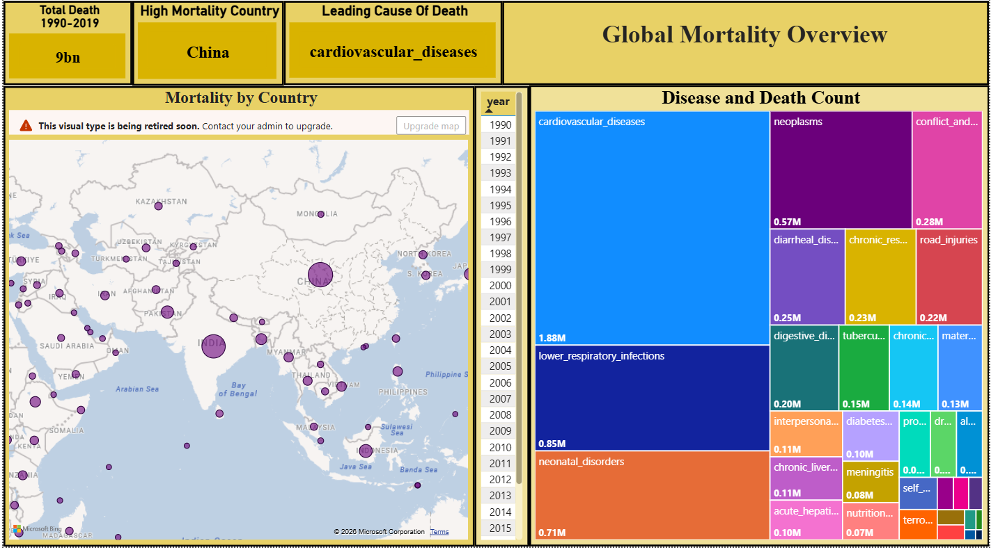
DASHBOARD — PAGE 1
Overview: KPIs, Map & Disease Treemap
Total Death
High Mortality Country
Leading Cause of Death
🗺️ Filled Map Visual
Highest Mortality Region by Country
(Color-encoded choropleth)
🌳 Treemap Visual
Disease & Death Count
by Cause Category

Slide 27
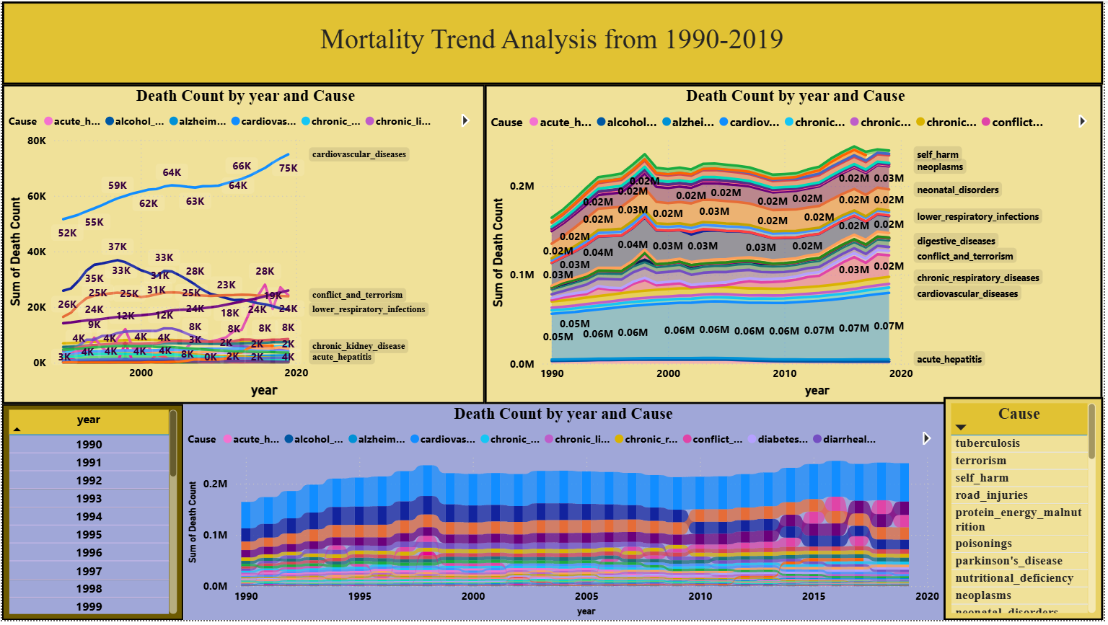
DASHBOARD — PAGE 2
Trend Analysis: Line, Stacked Area & Ribbon
📈 Line Chart
Death Count by Year & Cause
🎀 Ribbon Chart
Death Count by Year & Cause (Rank Shifts)
📊 Stacked Area Chart
Death Count by Year & Cause

Slide 28
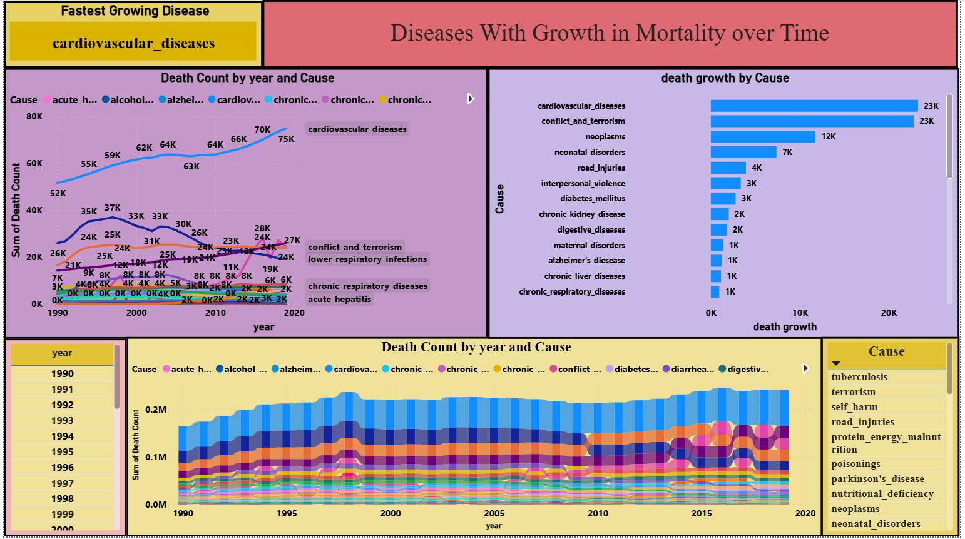
DASHBOARD — PAGE 3
Growth Analysis: Line, Ribbon & Bar Chart
⚡ Fastest Growing Disease — KPI Card (DAX Measure)
📈 Line Chart
Death Count by Year & Cause
📊 Clustered Bar Chart
Death Growth Rate % by Cause
🎀 Ribbon Chart
Year & Cause Rankings

Slide 29
KEY FINDINGS
What the Data Revealed
01
NCDs Dominate
02
Aging Population Effect
Non-communicable diseases (heart disease, cancer, diabetes) account for over 70% of all recorded deaths — a global public health crisis
Countries with aging demographics — Japan, Italy, USA — show rising cardiovascular and Alzheimer-related deaths despite advanced healthcare
03
HIV/AIDS Success
04
Alzheimer's Surge
HIV/AIDS-related deaths declined by ~38% from peak 2005 levels — the clearest evidence of a successful global intervention program
Alzheimer's and dementia deaths grew by 185% over 30 years — the fastest growing cause, driven by longer lifespans worldwide
05
Sub-Saharan Risk
06
China & India Lead
Nigeria and other Sub-Saharan African nations show high mortality from infectious diseases — pointing to urgent infrastructure needs
Due to population size, China and India consistently show the highest absolute death counts but improving mortality rates per capita

Slide 30
RECOMMENDATIONS
Policy & Action Insights
❤️
Prioritize Cardiovascular Prevention
Governments should scale up blood pressure screening, dietary programs, and smoking cessation to reduce the #1 global killer
🧠
Invest in Dementia Research
With Alzheimer's growing 185%, accelerated research funding and caregiver infrastructure is critically needed for aging nations
💉
Continue HIV Programs
The success of antiretroviral therapy shows measurable impact — continue global funding for infectious disease prevention
🌍
Strengthen African Health Systems
Sub-Saharan Africa needs targeted investment in infectious disease control, maternal health, and primary care access

Slide 31
CONCLUSION
Summary & Final Thoughts
The Global Cause of Death Analysis Dashboard successfully transforms decades of mortality data into clear, actionable visual intelligence. By leveraging Power BI's full capabilities — from Power Query transformation to DAX-calculated KPIs and multi-page interactive design — this project demonstrates how data analytics can surface critical public health truths.
Data Tells the Truth
Interventions Work
Numbers confirm what health experts have warned — chronic diseases are the world's biggest killer
HIV/AIDS decline proves that well-funded global health programs produce measurable results
Prevention is Key
Inequity Persists
The fastest-growing causes (Alzheimer, Diabetes) have no cure — only prevention and early management
The gap between developed and developing nations is stark — data must guide where resources go most

Slide 32
THANK
YOU

