Slide 1

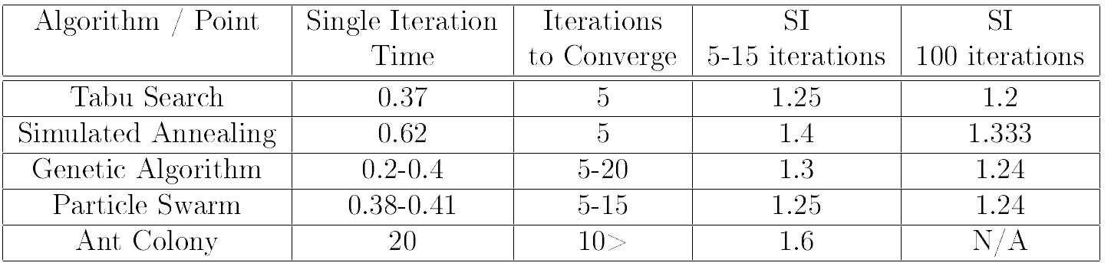
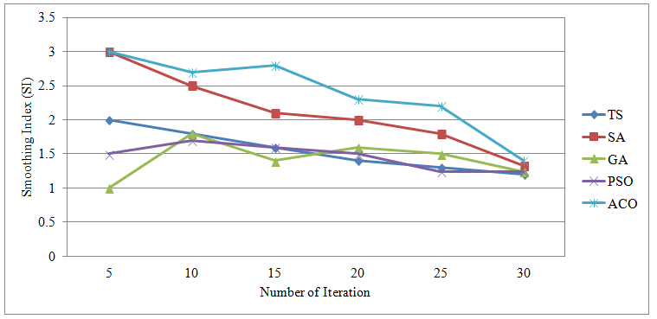
Winter 2018 – ECE457B Computational Intelligence
ECE Dept, University of Waterloo
Instructor: Fakhri Karray
NLU as Applied to Financial Markets
Group 5: Zipei Jerry Shi, Zhenyu Liu, Samuel Yigzaw, Daniel Lin Chen
Abstract and Overview:
With billions of dollars flowing through the stock market each day, being able to understand and predict the trends of stocks can give us a huge advantage in stock trading. The focus is to use NLU techniques to analyze textual reports and articles concerning specific stocks and cryptocurrencies, and to use that data to predict their future values and potential approaches towards future investments and market capitalization.
Text Size: 32
Tools, Algorithms:
Problem Formulation:
Experiments, Analysis:
The financial world is one of the biggest and most volatile industries, the problem in hand is that financial stocks and markets could be divided into equity, risk management, and potential sustainability of the stock or cryptocurrency. When it comes to the value of a stock, NLU is expected to be able to extract knowledge from bodies of text and articles, providing with an programmatic way to parse through a large amount of data regarding a specific company.
Experiment Setup
Evaluation Metrics
Analysis
Text Size: 32
Proposed Solution:
Conclusion:

