Slide 1
Front-End Automation with Grunt
Grunt as a build tool for JS
Thi NguyenDinh

Slide 2
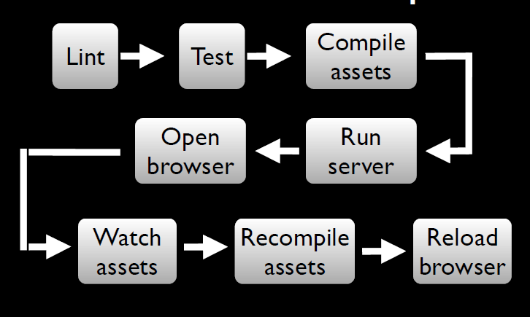
A Frontend workflow Dev

Slide 3
What is Grunt?
JavaScript task runner
Cross-platform , built on top of NodeJS
Works by executing tasks
Can be used for Develop-Build-Deploy
Enables team to write consistent code
Maintain coding standards within teams
Automate your build process
Automate testing and deployment and release process

Slide 4
Grunt can be useful in
Development
clean
htmlhint
jshint
istanbul-code-coverage for Unit tests and code coverage
minify
Deployment and Release
copy
versioning(bump)
release (Create git tag and push)
Deploy – upload artifacts using grunt-shell commands
Build Phase
htmlhint
Watch
Unit test
Validate code

Slide 5
Grunt as JS task runner
Development phase – scaffolding, htmlhint, jshint
Build – compile, test runner, code coverage, css minification, js minificaiton, concatination
Deploy – versioning, git tags, copy

Slide 6
Who is using Grunt ?
Jquery: https://github.com/jquery/jquery
AngularJS: https://github.com/angular/angular.js
Reactjs: https://github.com/facebook/react
KnockoutJs: https://github.com/knockout/knockout
Visual Studio 2015 now support Nodejs and grunt:
https://www.visualstudio.com/en-us/features/node-js-vs.aspx
More: http://gruntjs.com/who-uses-grunt (Twitter, Wall mart, Victoria Secret…)

Slide 7
JS Project setup
Install NodeJS
Install grunt
npm install –g grunt-cli
cd <project_dir>
Create package.json at root level or use npm init
Add grunt as dev dependency
npm install grunt --save-dev
Create Gruntfile.js(root level)
module.exports = function(grunt){
grunt.initConfig(
{
pkg: grunt.file.readJSON('package.json')
});
grunt.registerTask('default', []);
};
Notes:
1. npm install –g grunt-cli will install Grunt command line module globally
2. npm install grunt will install Grunt locally in the <project_dir>
3. --save-dev adds Grunt dependencies as a development dependencies in your package.json

Slide 8
Adding a plugin to Gruntfile.js
Install locally using command line and add it as dependency to package.json
npm install <plugin> --save-dependency
Or manually add dependency to package.json
Sample:
"devDependencies": {
"grunt": "~0.4.2",
"grunt-htmlhint": "*",
"matchdep": "*",
"grunt-contrib-watch": "*",
"grunt-contrib-clean": "~0.5.0",
"grunt-contrib-jshint": "~0.8.0",
"grunt-bump": "0.0.13",
"grunt-contrib-cssmin": "~0.7.0"
}

Slide 9
Grunt plugins http://gruntjs.com/plugins
grunt-contrib-jshint: validator for javascript
grunt-contrib-uglify: minify javascript
grunt-contrib-watch: run tasks when file pattern change or delete
grunt-contrib-concat: concatenate files
grunt-contrib-cssmin: minify css
grunt-mocha-test: A grunt task for running server side mocha tests
Notes:
grunt.loadNpmTasks('grunt-htmlhint');
Defines a wrapper function with “grunt” is taken as an argument
~1.2.3 := >=1.2.3-0 <1.3.0-0 "Reasonably close to 1.2.3". When using tilde operators, prerelease versions are supported as well, but a prerelease of the next significant digit will NOT be satisfactory, so 1.3.0-beta will not satisfy ~1.2.3.

Slide 10
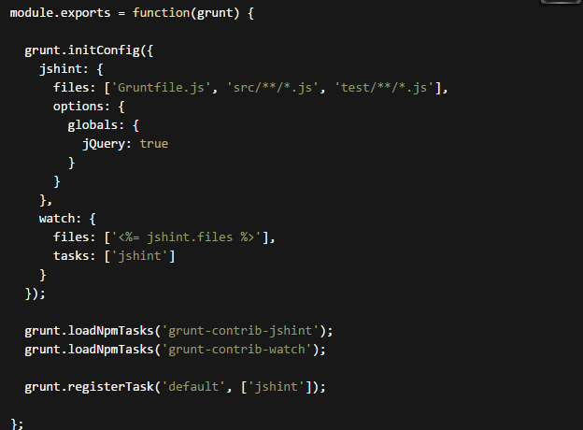
Simple GruntFile.js jshint and watch

Slide 11
Custom tasks
Custom project-specific tasks may be defined in external .js files and loaded via the grunt.loadTasks method.
Simple tasks can be added to Gruntfile.js
module.exports = function(grunt) {
// A very basic default task.
grunt.registerTask('default', 'Log some stuff.‘, function() { grunt.log.write('Logging some stuff...').ok();
});
};

Slide 12
Advantages
Good community support
Built on top on NodeJS
Readily available plugins for basic tasks
Can add custom tasks
Can be integrated with Gradle

Slide 13
Part II: Unit testing for Javascript
Mocha [ˈ mɒkə]: https://mochajs.org/
Framework for writing tests.
Install: npm install mocha –save-dev
Chai [tʃʌɪ]: http://chaijs.com/
BDD / TDD assertion library
An assertion library
Install: npm install chai – save-dev
Sinon: http://sinonjs.com
Test spies, stubs and mocks for JavaScript
Install: npm install sinon –save-dev

Slide 14
References
http://gruntjs.com/getting-started
Demo app
https://github.com/jerrykid/Automation-FrontEnd-With-Gruntjs

