Slide 1
Front-End Automation with Grunt
Grunt as a build tool for JS
Thi NguyenDinh

Slide 2
Agenda
Part I: What is grunt ?
Frontend development tasks
Configuration Common plug-in of grunt
Part II: Unit testing with grunt
Mocha: unit testing framework
Chai: assert library
Sinon: Spy, Stub, Mock library

Slide 3
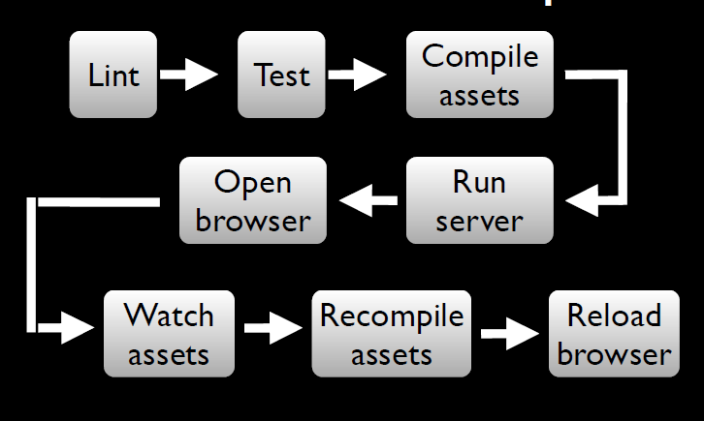
A Frontend workflow Dev

Slide 4
Part I: What is Grunt?
JavaScript task runner
Cross-platform , built on top of NodeJS
Works by executing tasks
Can be used for Develop-Build-Deploy
Enables team to write consistent code
Maintain coding standards within teams
Automate your build process
Automate testing and deployment and release process
Optimize performance by minify css, javascripts, image…

Slide 5
Grunt can be useful in
Development
clean
htmlhint
jshint
istanbul-code-coverage for Unit tests and code coverage
minify
Deployment and Release
copy
versioning(bump)
release (Create git tag and push)
Deploy – upload artifacts using grunt-shell commands
Build Phase
htmlhint
Watch
Unit test
Validate code

Slide 6
Grunt as JS task runner
Development phase – scaffolding, htmlhint, jshint
Build – compile, test runner, code coverage, css minification, js minificaiton, concatination
Deploy – versioning, git tags, copy

Slide 7
Who is using Grunt ?
Jquery: https://github.com/jquery/jquery
AngularJS: https://github.com/angular/angular.js
Reactjs: https://github.com/facebook/react
KnockoutJs: https://github.com/knockout/knockout
Visual Studio 2015 now support Nodejs and grunt:
https://www.visualstudio.com/en-us/features/node-js-vs.aspx
More: http://gruntjs.com/who-uses-grunt (Twitter, Wall mart, Victoria Secret…)

Slide 8
JS Project setup
Install grunt : npm install –g grunt-cli
Create Gruntfile.js(root level) with basic
module.exports = function(grunt){
grunt.initConfig(
{
pkg: grunt.file.readJSON('package.json')
});
grunt.registerTask('default', []);
};
To run task:
Grunt => run ‘default’ task
Grunt taskname => run taskname
Notes:
1. npm install –g grunt-cli will install Grunt command line module globally
2. npm install grunt will install Grunt locally in the <project_dir>
3. --save-dev adds Grunt dependencies as a development dependencies in your package.json

Slide 9
Grunt plugins http://gruntjs.com/plugins
grunt-contrib-jshint: validator for javascript
grunt-contrib-uglify: minify javascript
grunt-contrib-watch: run tasks when file pattern change or delete
grunt-contrib-concat: concatenate files
grunt-contrib-cssmin: minify css
grunt-mocha-test: A grunt task for running server side mocha tests
Notes:
grunt.loadNpmTasks('grunt-htmlhint');
Defines a wrapper function with “grunt” is taken as an argument
~1.2.3 := >=1.2.3-0 <1.3.0-0 "Reasonably close to 1.2.3". When using tilde operators, prerelease versions are supported as well, but a prerelease of the next significant digit will NOT be satisfactory, so 1.3.0-beta will not satisfy ~1.2.3.

Slide 10
Adding a plugin to Gruntfile.js
Install locally using command line and add it as dependency to package.json
npm install <plugin> --save-dependency
Or manually add dependency to package.json
Sample:
"devDependencies": {
"grunt": "~0.4.2",
"grunt-htmlhint": "*",
"matchdep": "*",
"grunt-contrib-watch": "*",
"grunt-contrib-clean": "~0.5.0",
"grunt-contrib-jshint": "~0.8.0",
"grunt-bump": "0.0.13",
"grunt-contrib-cssmin": "~0.7.0"
}

Slide 11
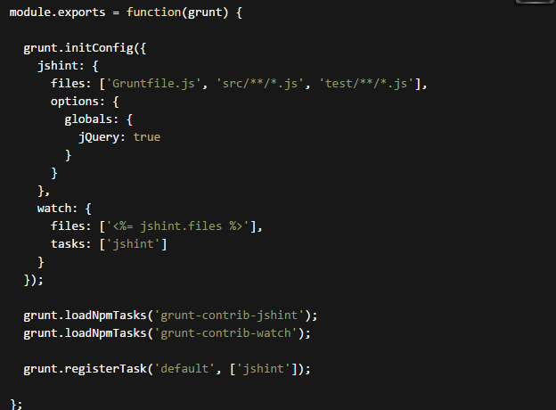
Simple GruntFile.js jshint and watch
Notes:
Sample configuration for automation call JSHint when a file change

Slide 12
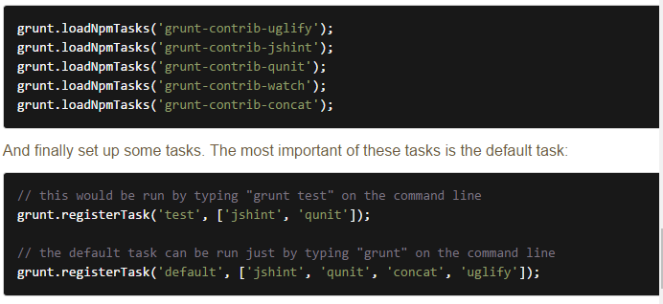
More sample configuration

Slide 13
Advantages
Good community support
Built on top on NodeJS
Readily available plugins for basic tasks
Can add custom tasks
More config at http://gruntjs.com/sample-gruntfile

Slide 14
Part II: Unit testing with Grunt
Mocha [ˈ mɒkə]: https://mochajs.org/
Framework for writing tests.
Install: npm install mocha –save-dev
Chai [tʃʌɪ]: http://chaijs.com/
BDD / TDD assertion library
An assertion library
Install: npm install chai – save-dev
Sinon: http://sinonjs.com
Test spies, stubs and mocks for JavaScript
Install: npm install sinon –save-dev

Slide 15
Mocha: Test framework
Runs on Node.js/Browser
Supports BDD/TDD
Choose any assertion library(chai, assert)
Choose any Mocking library
Async and promise support
Highlights slow tests
File watcher support
Optionally run tests that match a regexp

Slide 16
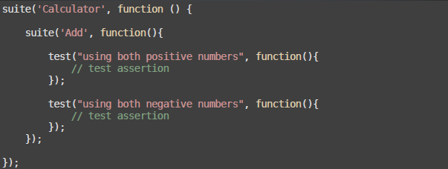
Mocha: TDD

Slide 17
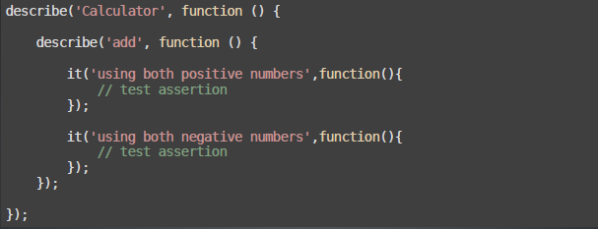
Mocha: BDD

Slide 18
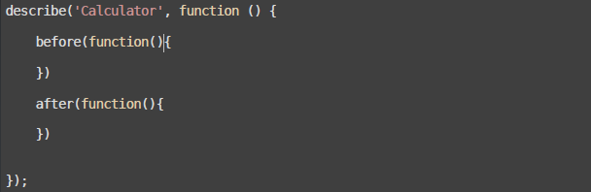
Mocha: Hook before and after

Slide 19
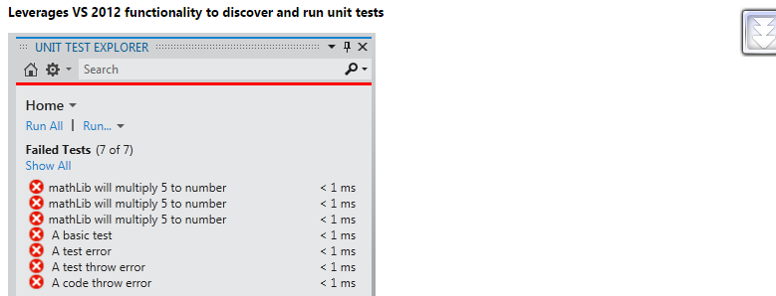
Chutzpah 3.0 support Mocha
Test adapter from Visual Studio 2012
Support discover and run unit tests
More at:
https://visualstudiogallery.msdn.microsoft.com/f8741f04-bae4-4900-81c7-7c9bfb9ed1fe

Slide 20
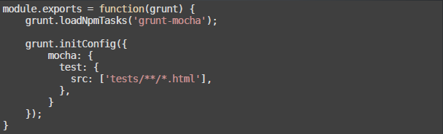
Mocha: run under Grunt
Notes:
grunt mochaTest

Slide 21
Mocha: Coverage
Blanket: seamless JavaScript code coverage
http://blanketjs.org/
Travis-cov: A coverage reporter for Mocha/Blanket that will fail a travis-ci build when the coverage threshold is too low
https://github.com/alex-seville/travis-cov
Notes:
https://github.com/alex-seville/travis-cov

Slide 22
Chai.js: Assert
chai.assert(expression, [message])
chai.assert(actual, expected, [message])

Slide 23
Chai.js: Expect
chai.expect(expected).to.not.equal(actual);
chai.expect(expected).to.be.a('string');

Slide 24
Chai.js: SHOULD
value.should.be.an('object');
value.should.equal(10);
value.should.be.a('string')
object.should.have.property('key')

Slide 25
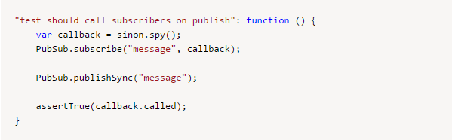
Sinon with test spies
A test spy is a function that records arguments, return value

Slide 26
Sinon with stubs

Slide 27
Sinon with Mock

Slide 28
References
http://gruntjs.com/getting-started
https://mochajs.org/
Demo app
https://github.com/jerrykid/Automation-FrontEnd-With-Gruntjs
https://github.com/jerrykid/grunt-mocha-test

