Slide 1
Front-End Automation with Grunt
Grunt as a build tool for JS
Thi NguyenDinh

Slide 2
Agenda
Part I: What is grunt ?
Frontend development tasks
Configuration Common plug-in of grunt
Part II: Unit testing with grunt
Mocha: unit testing framework
Chai: assert library
Sinon: Spy, Stub, Mock library

Slide 3
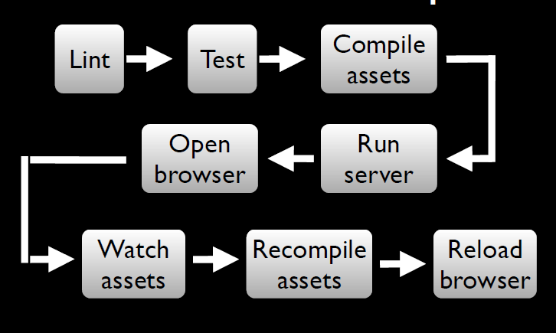
A Frontend workflow Dev

Slide 4
Part I: What is Grunt?
JavaScript task runner
Cross-platform , built on top of NodeJS
Works by executing tasks
Can be used for Develop-Build-Deploy
Enables team to write consistent code
Maintain coding standards within teams
Automate your build process
Automate testing and deployment and release process
Optimize performance by minify css, javascripts, image…

Slide 5
Grunt can be useful in
Development
clean
htmlhint
jshint
istanbul-code-coverage for Unit tests and code coverage
minify
Deployment and Release
copy
versioning(bump)
release (Create git tag and push)
Deploy – upload artifacts using grunt-shell commands
Build Phase
htmlhint
Watch
Unit test
Validate code

Slide 6
Grunt as JS task runner
Development phase – scaffolding, htmlhint, jshint
Build – compile, test runner, code coverage, css minification, js minificaiton, concatination
Deploy – versioning, git tags, copy

Slide 7
Who is using Grunt ?
Jquery: https://github.com/jquery/jquery
AngularJS: https://github.com/angular/angular.js
Reactjs: https://github.com/facebook/react
KnockoutJs: https://github.com/knockout/knockout
Visual Studio 2015 now support Nodejs and grunt:
https://www.visualstudio.com/en-us/features/node-js-vs.aspx
More: http://gruntjs.com/who-uses-grunt (Twitter, Wall mart, Victoria Secret…)

Slide 8
JS Project setup
Install grunt : npm install –g grunt-cli
Create Gruntfile.js(root level) with basic
module.exports = function(grunt){
grunt.initConfig(
{
pkg: grunt.file.readJSON('package.json')
});
grunt.registerTask('default', []);
};
To run task:
Grunt => run ‘default’ task
Grunt taskname => run taskname
Notes:
1. npm install –g grunt-cli will install Grunt command line module globally
2. npm install grunt will install Grunt locally in the <project_dir>
3. --save-dev adds Grunt dependencies as a development dependencies in your package.json

Slide 9
Grunt plugins http://gruntjs.com/plugins
grunt-contrib-jshint: validator for javascript
grunt-contrib-uglify: minify javascript
grunt-contrib-watch: run tasks when file pattern change or delete
grunt-contrib-concat: concatenate files
grunt-contrib-cssmin: minify css
grunt-mocha-test: A grunt task for running server side mocha tests
Notes:
grunt.loadNpmTasks('grunt-htmlhint');
Defines a wrapper function with “grunt” is taken as an argument
~1.2.3 := >=1.2.3-0 <1.3.0-0 "Reasonably close to 1.2.3". When using tilde operators, prerelease versions are supported as well, but a prerelease of the next significant digit will NOT be satisfactory, so 1.3.0-beta will not satisfy ~1.2.3.

Slide 10
Adding a plugin to Gruntfile.js
Install locally using command line and add it as dependency to package.json
npm install <plugin> --save-dependency
Or manually add dependency to package.json
Sample:
"devDependencies": {
"grunt": "~0.4.2",
"grunt-htmlhint": "*",
"matchdep": "*",
"grunt-contrib-watch": "*",
"grunt-contrib-clean": "~0.5.0",
"grunt-contrib-jshint": "~0.8.0",
"grunt-bump": "0.0.13",
"grunt-contrib-cssmin": "~0.7.0"
}

Slide 11
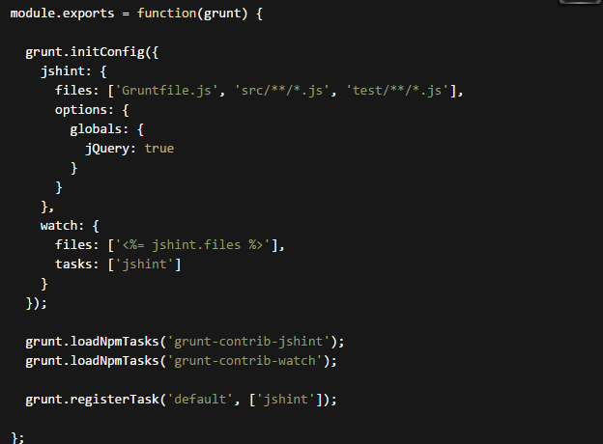
Simple GruntFile.js jshint and watch

Slide 12
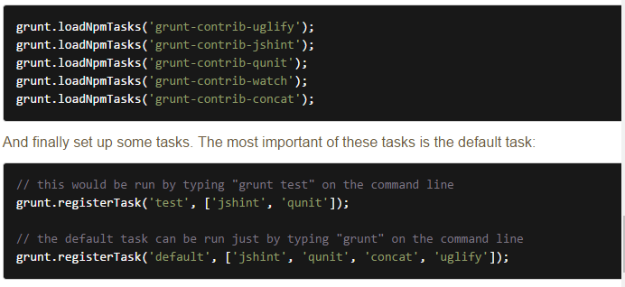
More sample configuration

Slide 13
Advantages
Good community support
Built on top on NodeJS
Readily available plugins for basic tasks
Can add custom tasks
More config at http://gruntjs.com/sample-gruntfile

Slide 14
Part II: Unit testing with Grunt
Mocha [ˈ mɒkə]: https://mochajs.org/
Framework for writing tests.
Install: npm install mocha –save-dev
Chai [tʃʌɪ]: http://chaijs.com/
BDD / TDD assertion library
An assertion library
Install: npm install chai – save-dev
Sinon: http://sinonjs.com
Test spies, stubs and mocks for JavaScript
Install: npm install sinon –save-dev

Slide 15
Mocha: Test framework
Demo run under Grunt

Slide 16
Mocha: Working with Chutzpah

Slide 17
Mocha: Run under Mocha cli

Slide 18
Mocha: run under Grunt

Slide 19
Mocha: Test coverage

Slide 20
Chai: assert library

Slide 21
Chai: Web driver

Slide 22
Sinon with test spies

Slide 23
Sinon with stubs

Slide 24
Sinon with Mock

Slide 25
References
http://gruntjs.com/getting-started
https://mochajs.org/
Demo app
https://github.com/jerrykid/Automation-FrontEnd-With-Gruntjs

