Slide 1

BME/ECE 6850 Pattern Recognition Lab
Presentation for 3.6.4 to 3.6.7
George Washington University
Department of Electrical and Computer Engineering
Zeyu Liu & Fangfang Cai

Slide 2




We use R to complete the lab
The presentation make by just three simple steps
↓
1
2
3
formula
Solution
Figure
Important Concepts
Lab code
data analysis

Slide 3
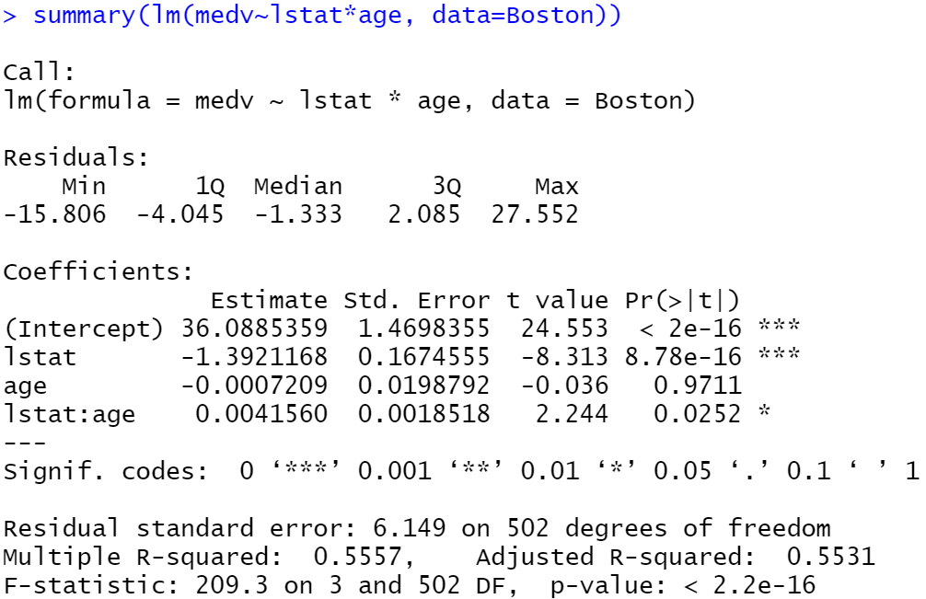
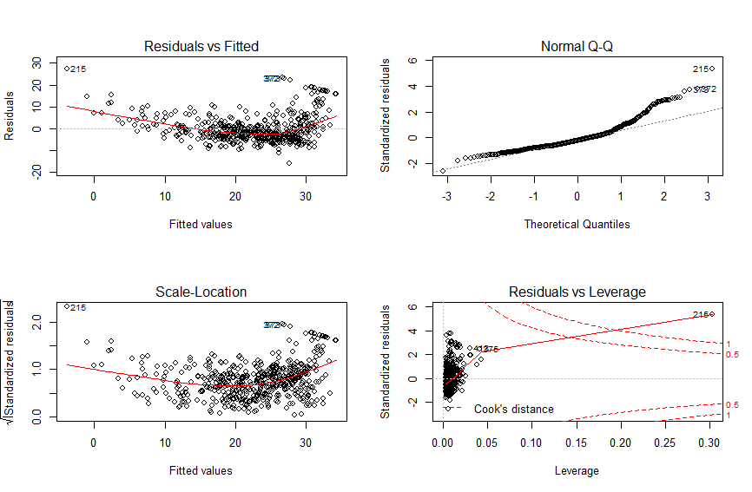
Important Concepts
01
Summary()
02
Plot(lm(y~x))
Residuals, Coefficients
Use par(mfrow=c(2,2)) first
RSE, R², t-statistic, F-statistic, p-value
Residuals vs Fitted, Normal Q-Q,
Scale-Location, Residuals vs Leverage

Slide 4

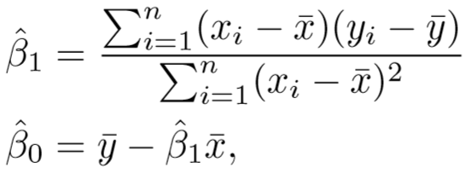
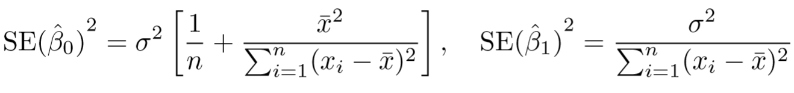
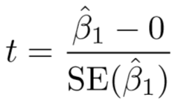
t-statistic
Using least squares approach, finally will we will get the t-statistic.
Estimate
Std. Error

Slide 5
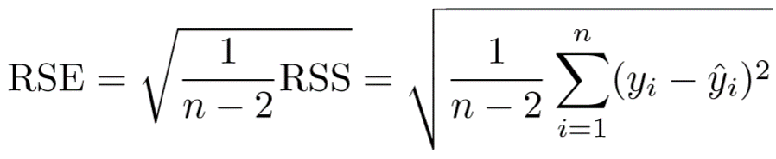
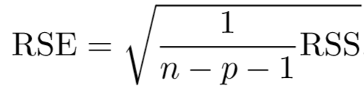
P-value
RSE
Using t-statistic, assuming β1= 0. We call this probability the p-value.
p-value indicates that it is unlikely to observe such a substantial association between the predictor and the response due to chance, in the absence of any real association between the predictor and the response. We reject the null hypothesis(H₀)
A small p-value can infer that there is an association between the predictor and the response.
The RSE is considered a measure of the lack of ﬁt of the model Y = β0 + β1X + ɛ to the data.
If the predictions obtained using the model are very close to the true outcome values—if RSE will be small, and we can conclude that the model ﬁts the data very well.
On the other hand, if yiˆ is very far from yi for one or more observations, then the RSE may be quite large, indicating that the model doesn’t ﬁt the data well.

Slide 6
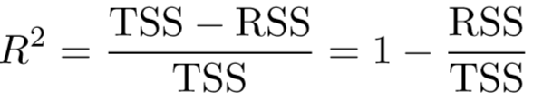
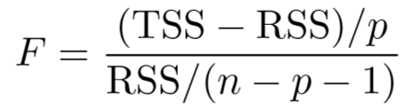

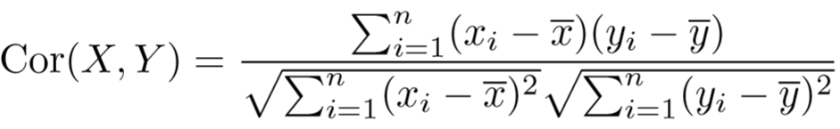


R² -statistic
F -statistic
The approach of using an F-statistic to test for any association between the predictors and the response works when p is relatively small, and certainly small compared to n
if H0 is true, there is only a 5% chance that the Fstatistic will result in a p-value below 0.05
If F is far larger than 1, it provides compelling evidence against the null hypothesis
it always lies between 0 and 1
R² measures the proportion of variability in Y that can be explained using X, R²=1 is best
The R² statistic is a measure of the linear relationship between X and Y . Recall that correlation

Slide 7
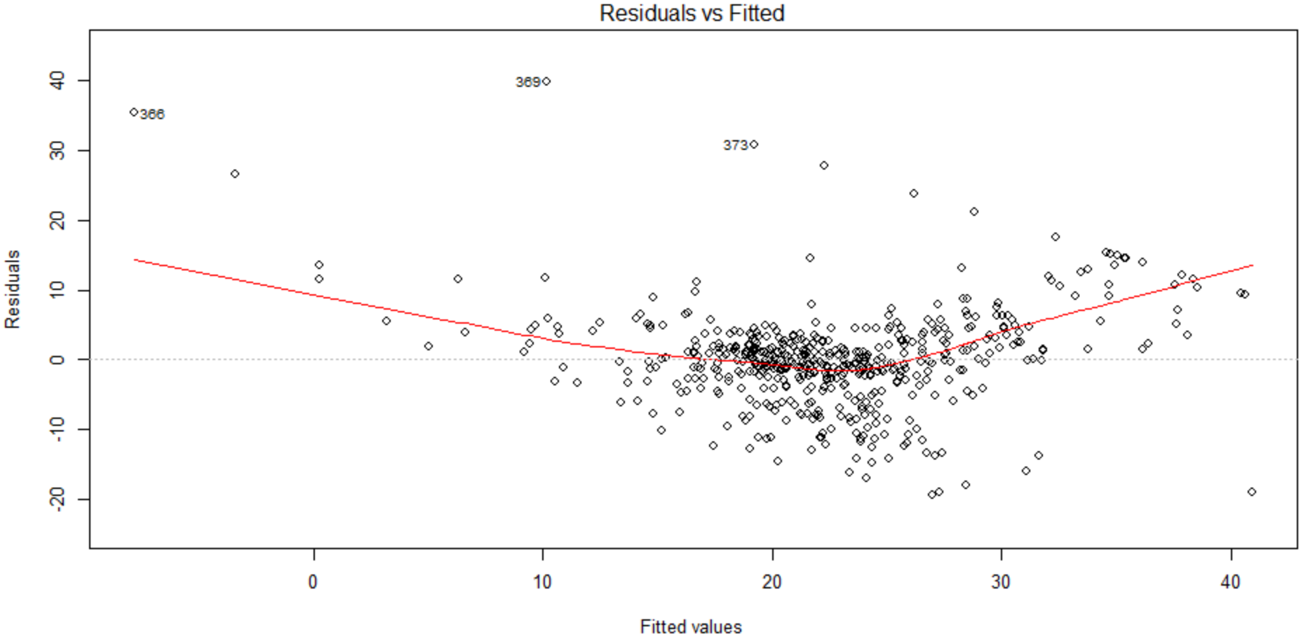
1. Residuals vs Fitted
Residuals are leftover of the outcome variable after fitting a model (predictors) to data and they could reveal unexplained patterns in the data by the fitted model.
Not only could you check if linear regression assumptions are met, but you could improve your model in an exploratory way.
If you find equally spread residuals around a horizontal line without distinct patterns, that is a good indication you don’t have non-linear relationships.

Slide 8
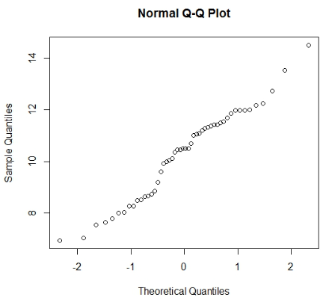
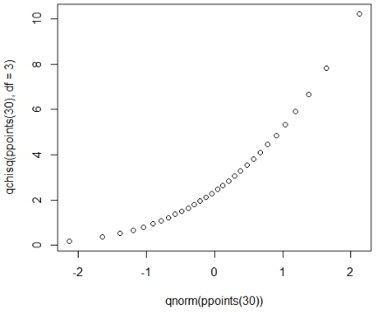
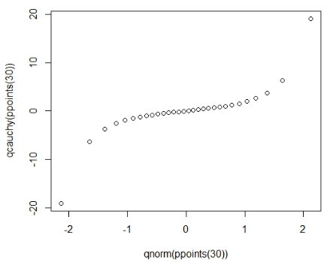
2. Normal Q-Q
This plot shows if residuals are normally distributed. Do residuals follow a straight line well or do they deviate severely? It’s good if residuals are lined well on the straight dashed line.
Notice the points form a curve instead of a straight line. Normal Q-Q plots that look like this usually mean your sample data are skewed.
Notice the points fall along a line in the middle of the graph, but curve off in the extremities. Normal Q-Q plots that exhibit this behavior usually mean your data have more extreme values than would be expected if they truly came from a Normal distribution.

Slide 9
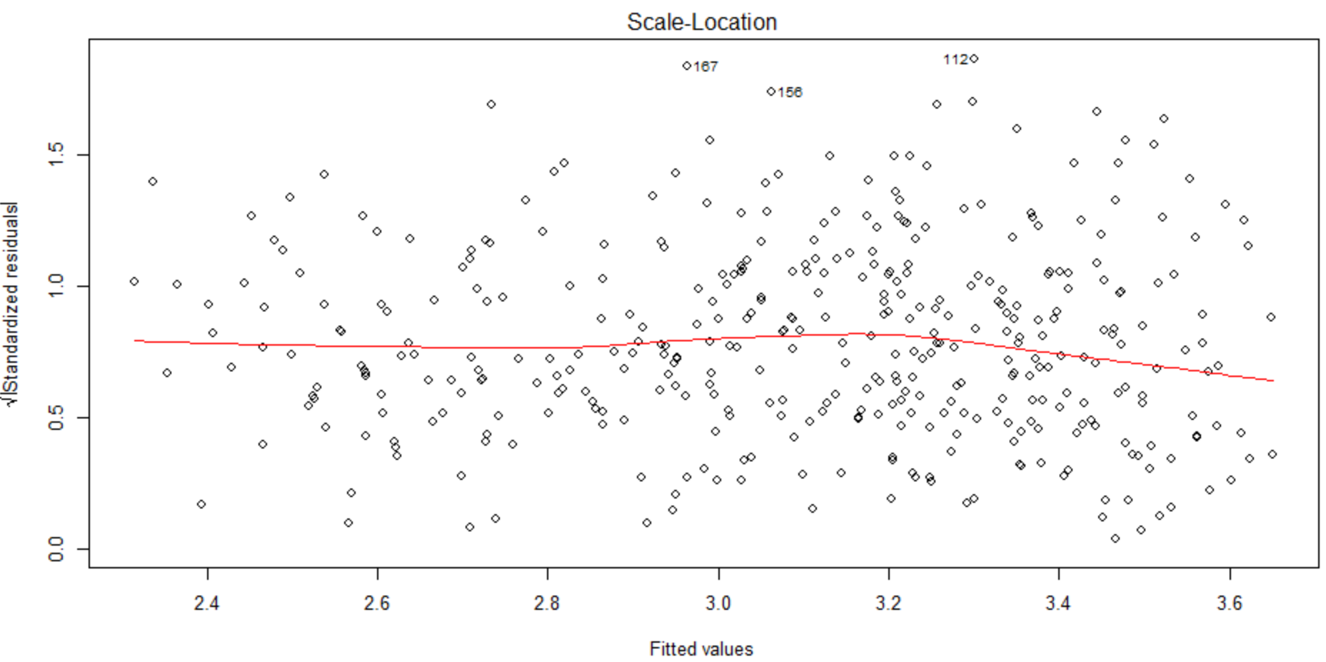
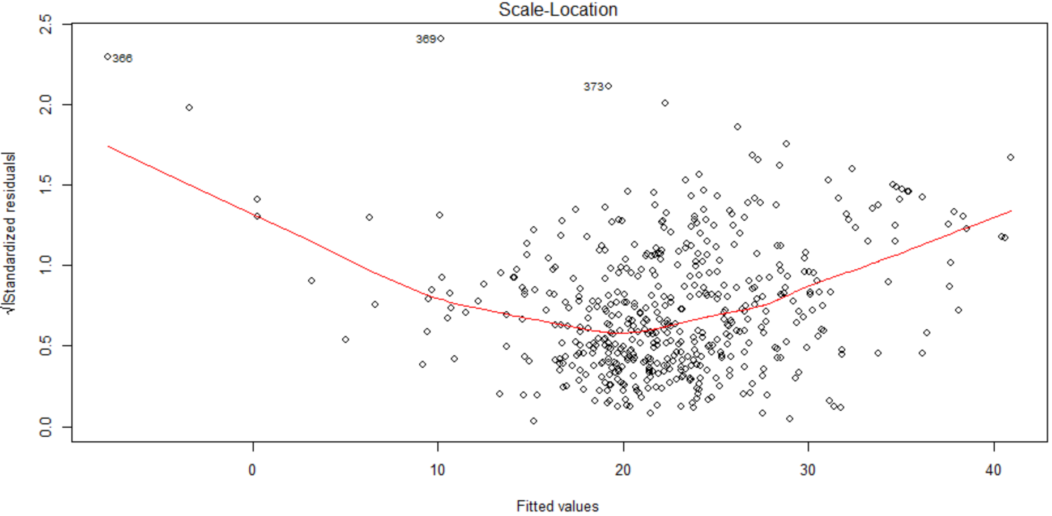
3. Scale-Location
It’s also called Spread-Location plot. This plot shows if residuals are spread equally along the ranges of predictors.
This is how you can check the assumption of equal variance (homoscedasticity).
It’s good if you see a horizontal line with equally (randomly) spread points.

Slide 10
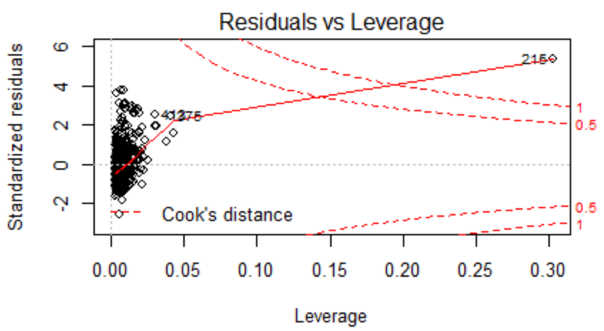
4. Residuals vs Leverage
This plot helps us identify influential data points on our model. Outliers can be influential, though they don’t necessarily have to it and some points within a normal range in your model could be very influential.
The points we’re looking for are values in the upper right or lower right corners, which are outside the red dashed Cook’s distance line. These are points that would be influential in the model and removing them would likely noticeably alter the regression results.

Slide 11
In this lab, we have used the library MASS and ISLR,
The data sets we used in the lab are Boston and Carseats.
Library(MASS)
MASS (which is a very large collection of data sets and functions)
Library(ISLR)
ISLR (which includes the data sets associated with this book).
Data: Boston
This dataset contains information collected by the U.S Census Service concerning housing in the area of Boston Mass.
Data:Carseats
The Carseats data is part of the ISLR library. We will attempt to predict Sales (child car seat sales) in 400 locations based on a number of predictors.

Slide 12
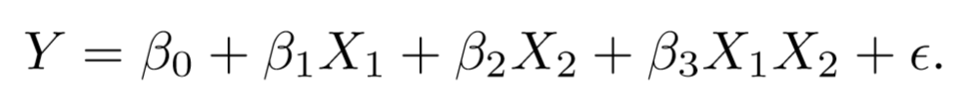
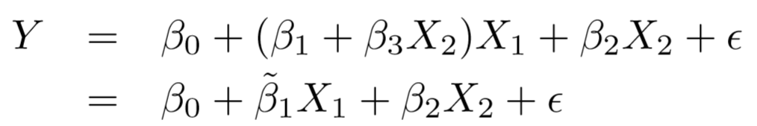
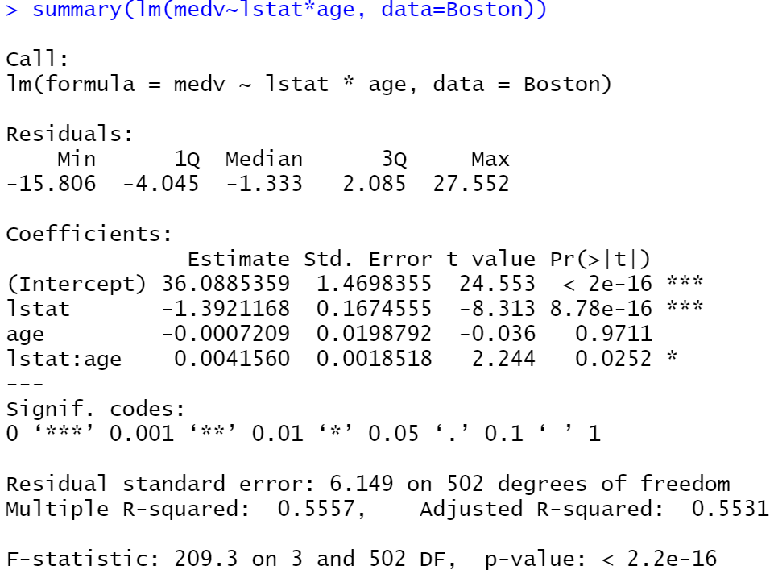
3.6.4 Interaction Terms
# lstat*age it is a shorthand for lstat+age+lstat:age.
# lstat:age tells R to include an interaction term between lstat and age
summary(lm(medv∼lstat*age,
data=Boston))

Slide 13
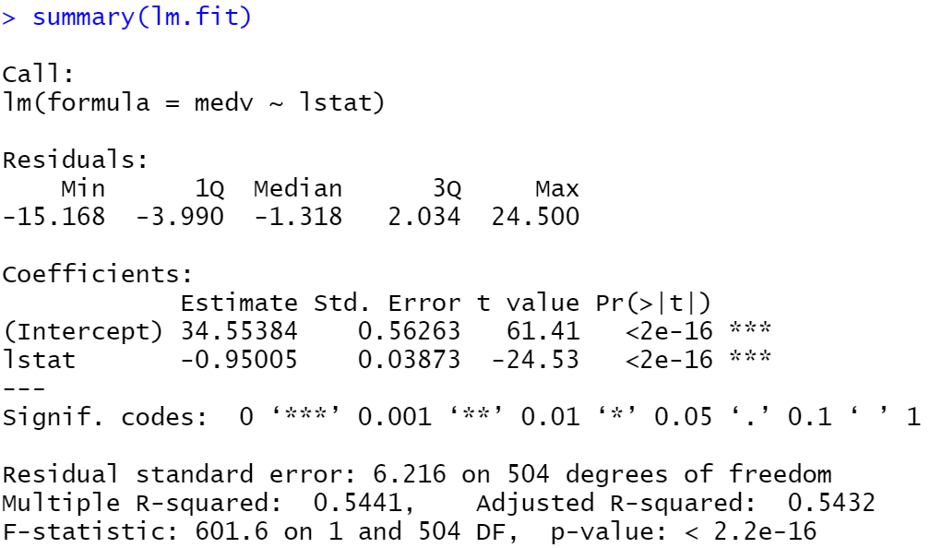
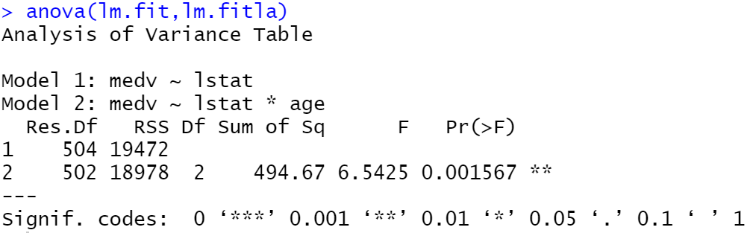
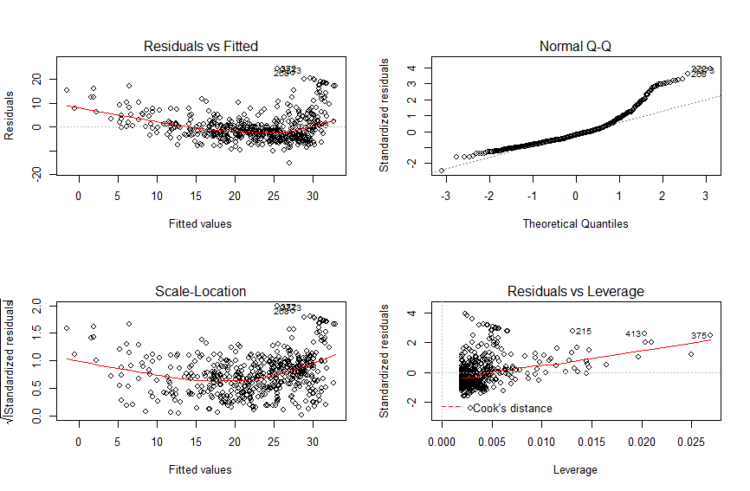
Problem 1

Slide 14
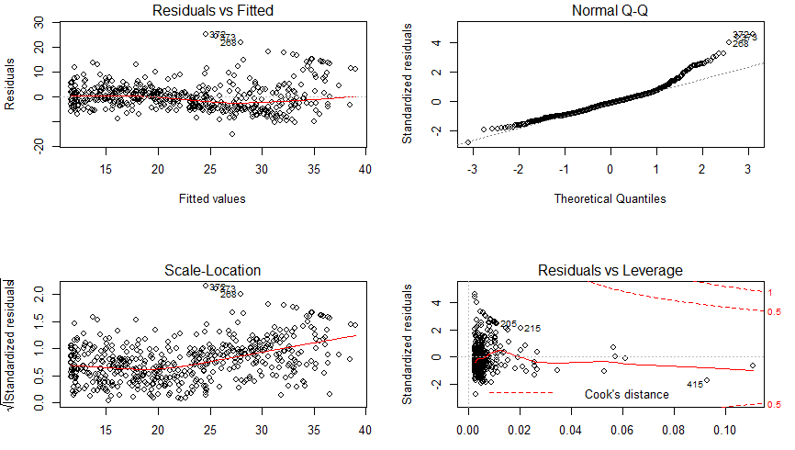
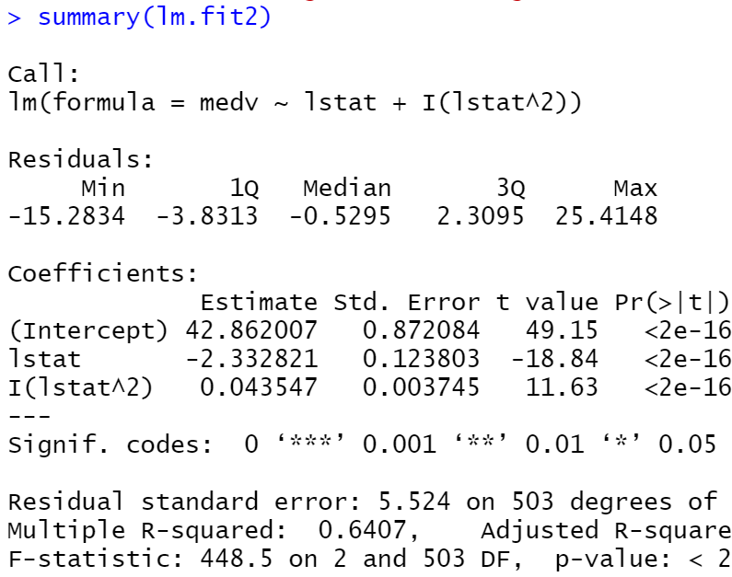
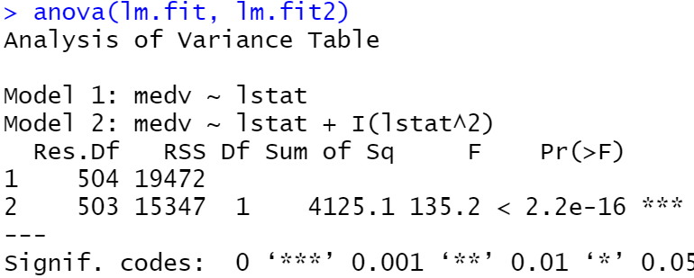
3.6.5 Non-linear Transformations of the Predictors
# We can create a predictor X² using I(X^2).
lm.fit2=lm(medv~lstat+I(lstat^2))
summary(lm.fit2)
lm.fit=lm(medv~lstat)
anova(lm.fit, lm.fit2)
par(mfrow=c(2,2))
plot(lm.fit2)

Slide 15
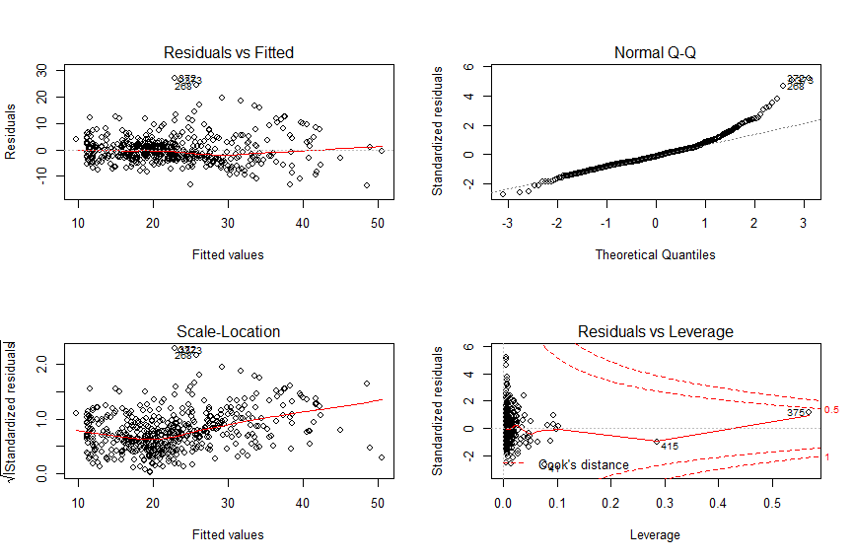
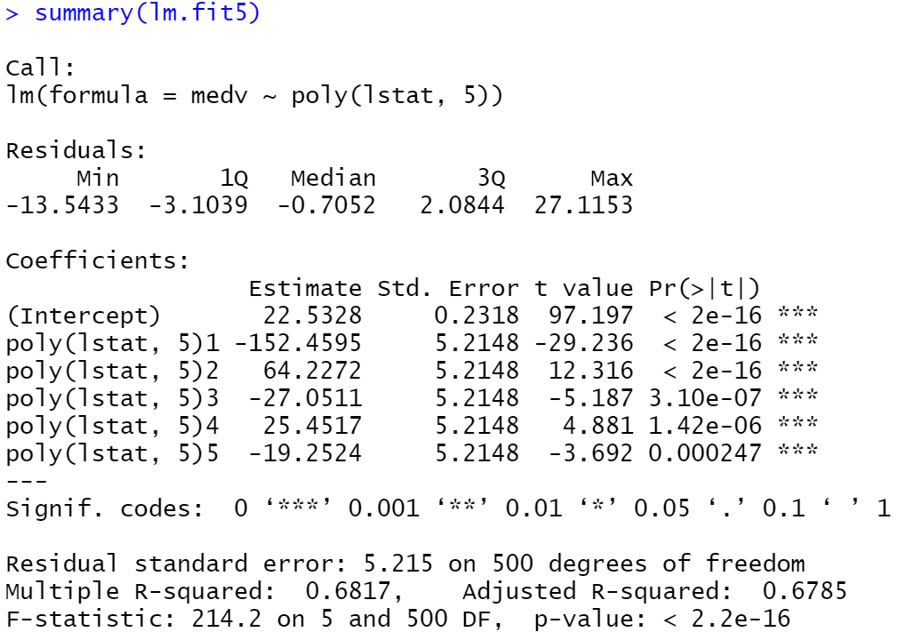
3.6.5 Non-linear Transformations of the Predictors
# Using the poly() function to create the polynomial within lm().
lm.fit5=lm(medv~poly(lstat,5))
summary(lm.fit5)
plot(lm.fit5)

Slide 16
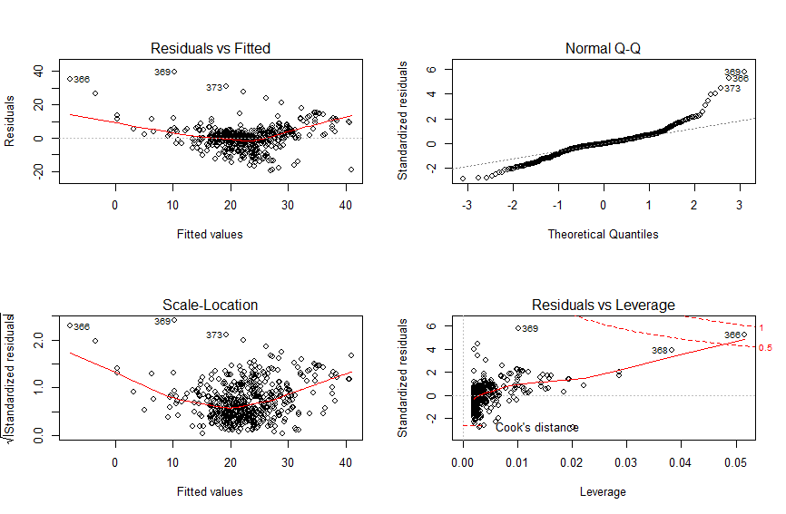
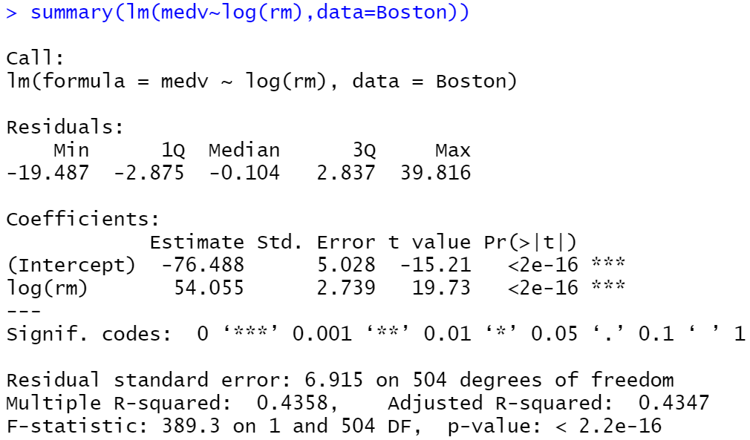
3.6.5 Non-linear Transformations of the Predictors
# Here we try a log transformation.
attach(Boston)
summary(lm(medv~log(rm)
lm.fitl= lm(medv~log(rm))
plot(lm.fitl)

Slide 17
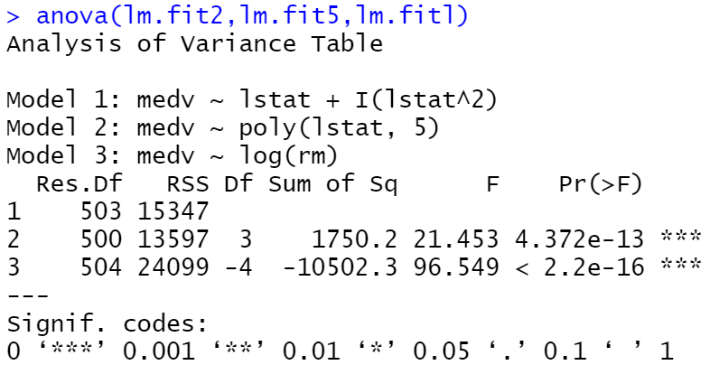
Anova()
# The anova() function performs a hypothesis test comparing the two models.
# The null hypothesis is that the two models ﬁt the data equally well, and the alternative hypothesis is that the full model is superior.
lm.fit2=lm(medv~lstat+I(lstat^2))
lm.fit5=lm(medv~poly(lstat,5))
lm.fitl =lm(medv~log(rm))

Slide 18
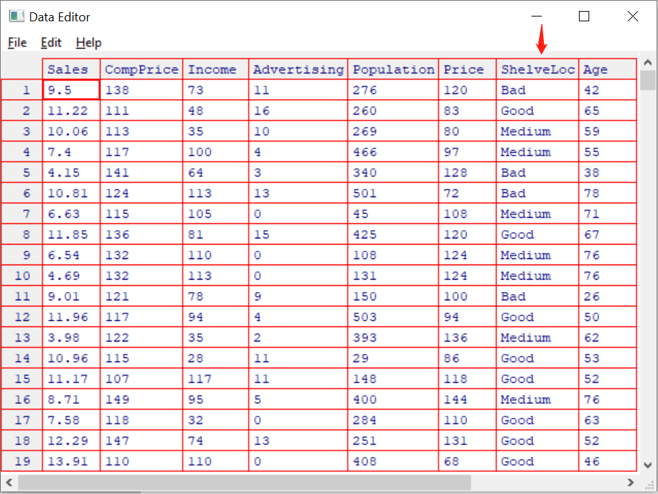
3.6.6 Qualitative Predictors

Slide 19
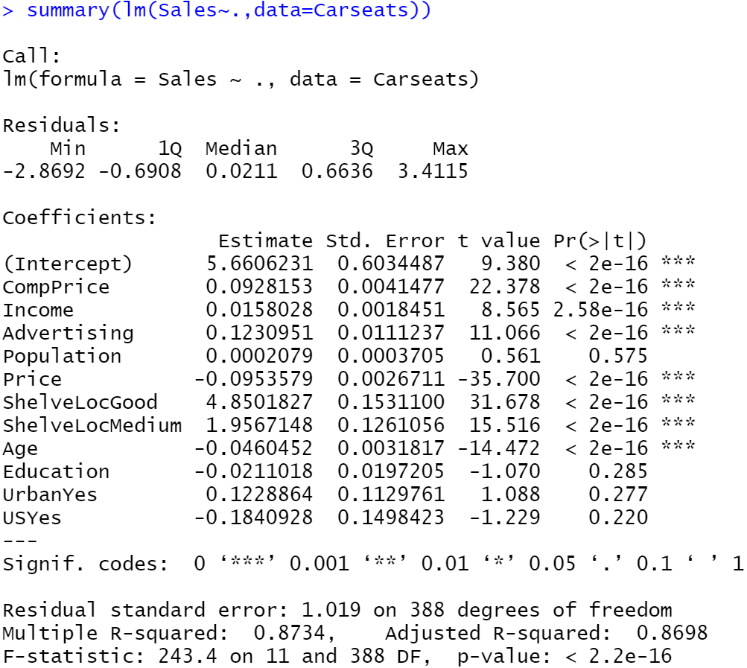
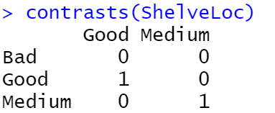
fix(Carseats)
names(Carseats)
lm.fit=lm(Sales~.+Income:Advertising+Price:Age,data=Carseats)
summary (lm.fit)
attach(Carseats )
# Contrasts() dummy variance
contrasts(ShelveLoc)

Slide 20
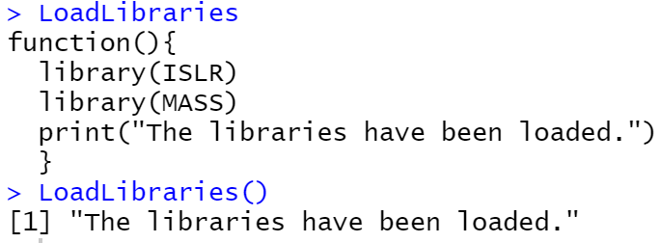
3.6.7 Writing Functions
LoadLibraries()
LoadLibraries=function(){
library(ISLR)
library(MASS)
print("The libraries have been loaded.")
}
# Display information, do not run the function
LoadLibraries
# Run the function, and return print()
LoadLibraries()

Slide 21
Dream still have to have, in case it is realized
Thank you for watching

