Slide 1
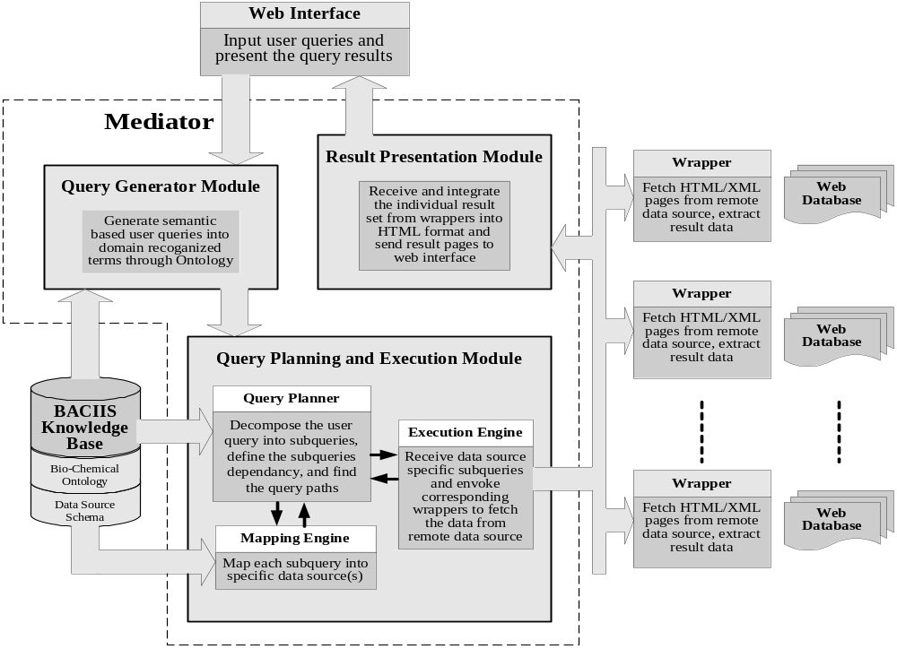
BACIIS System Architecture

