Slide 1
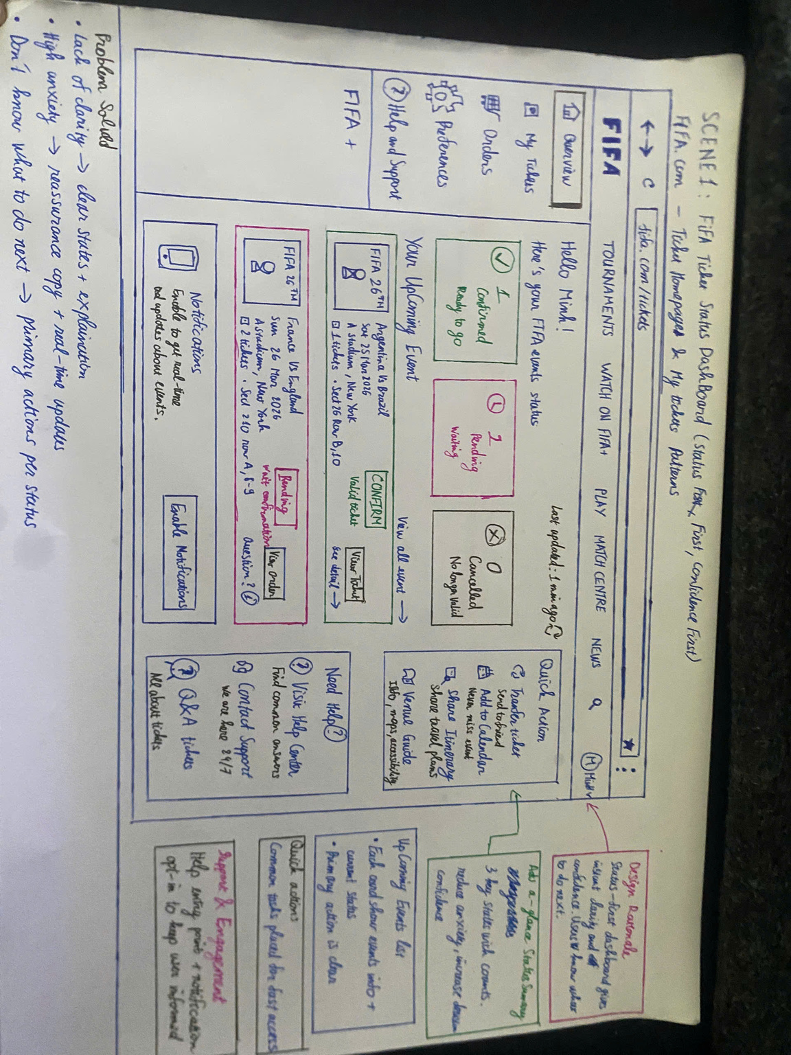
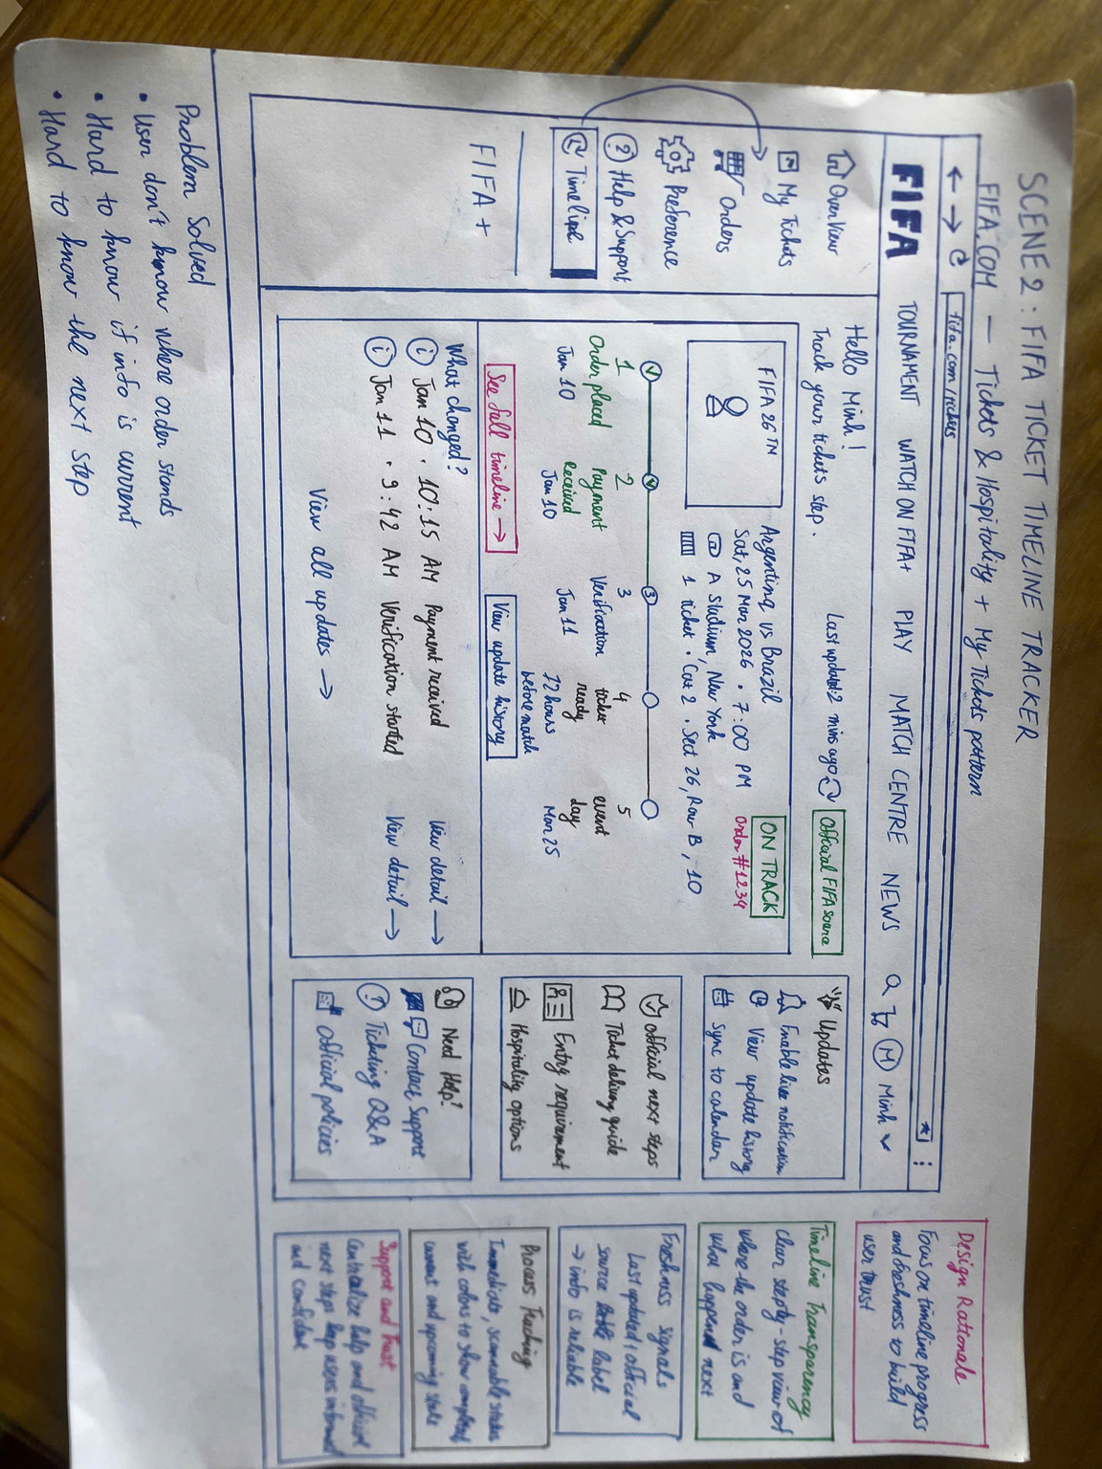
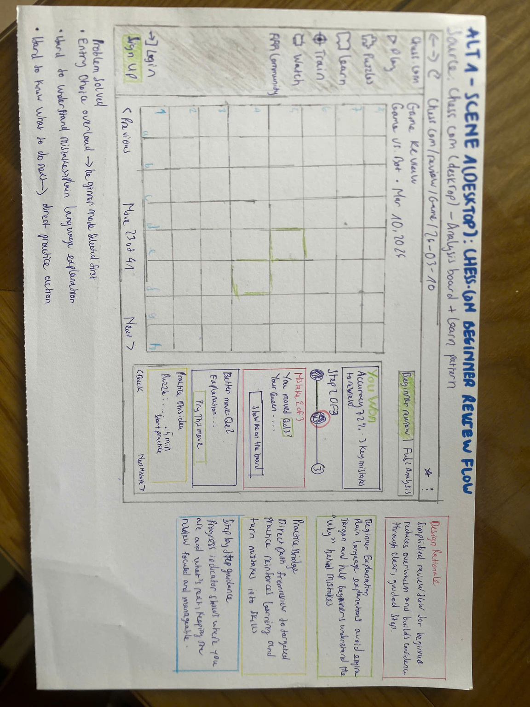
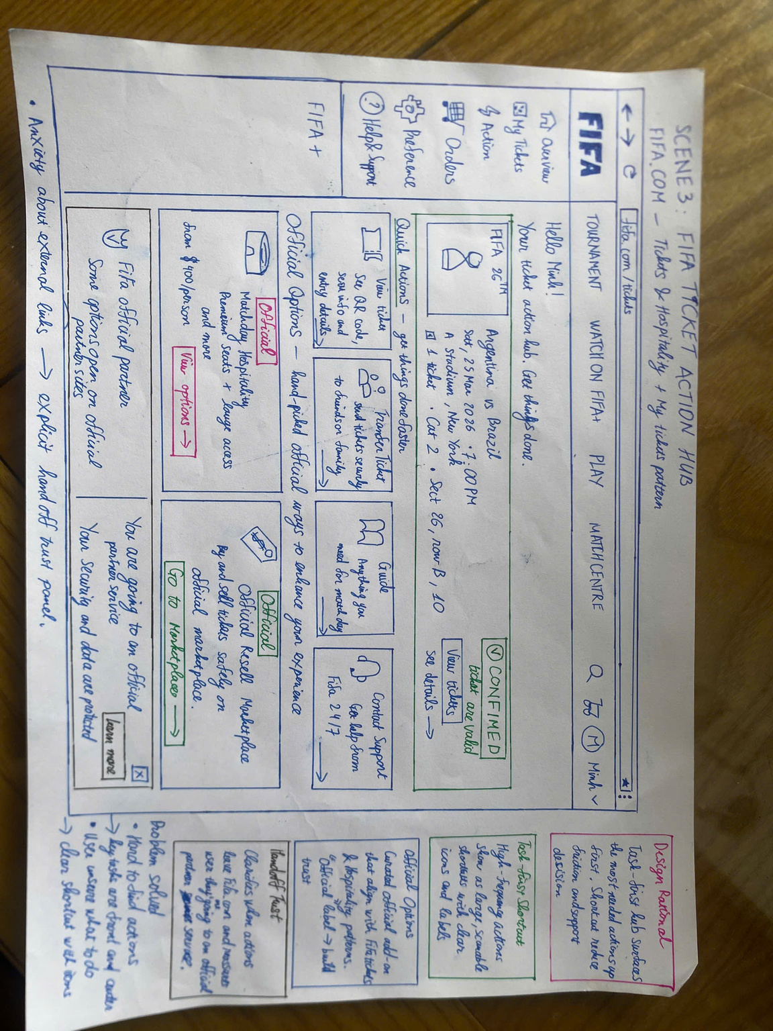
PAPER PROTOTYPE &
INFORMAL TESTING
Group 10

Slide 2
TEAM MEMBERS
Nguyễn Vũ Bách
Lê Minh
Phạm Nguyễn Gia Bảo
Trang Minh Nhựt
21127224
21127645
20127119
22127318

Slide 3
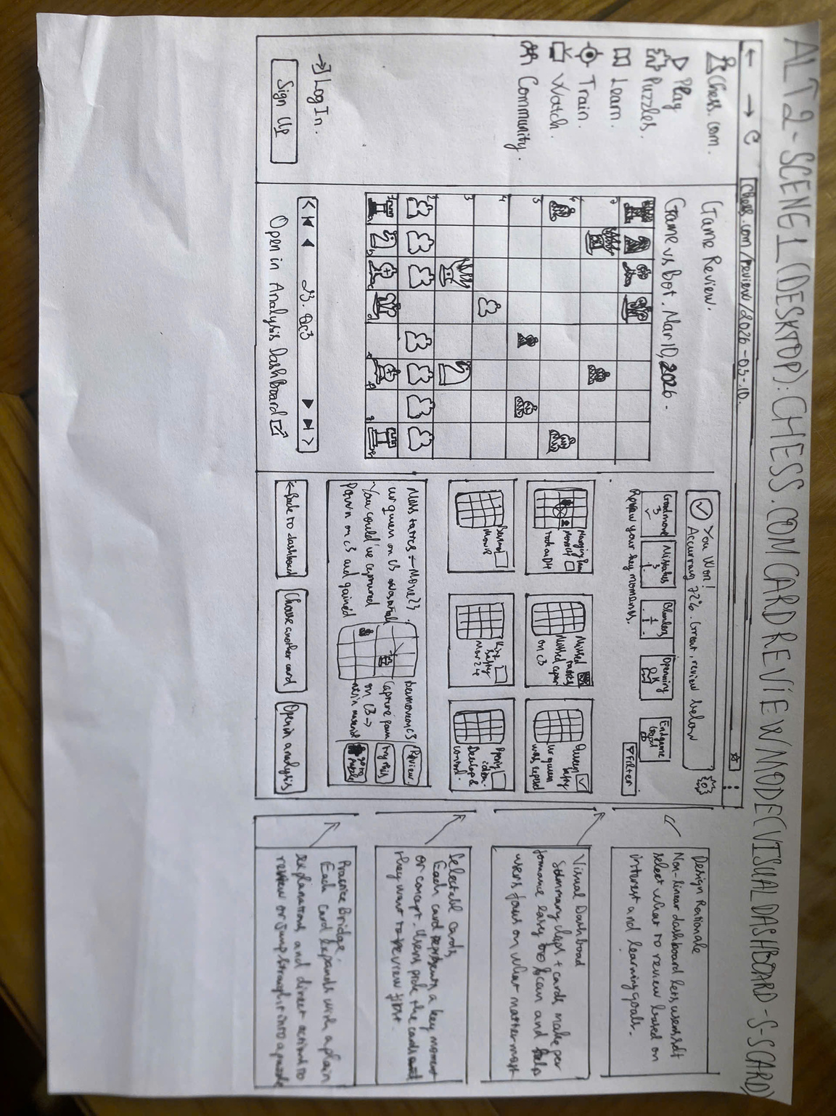
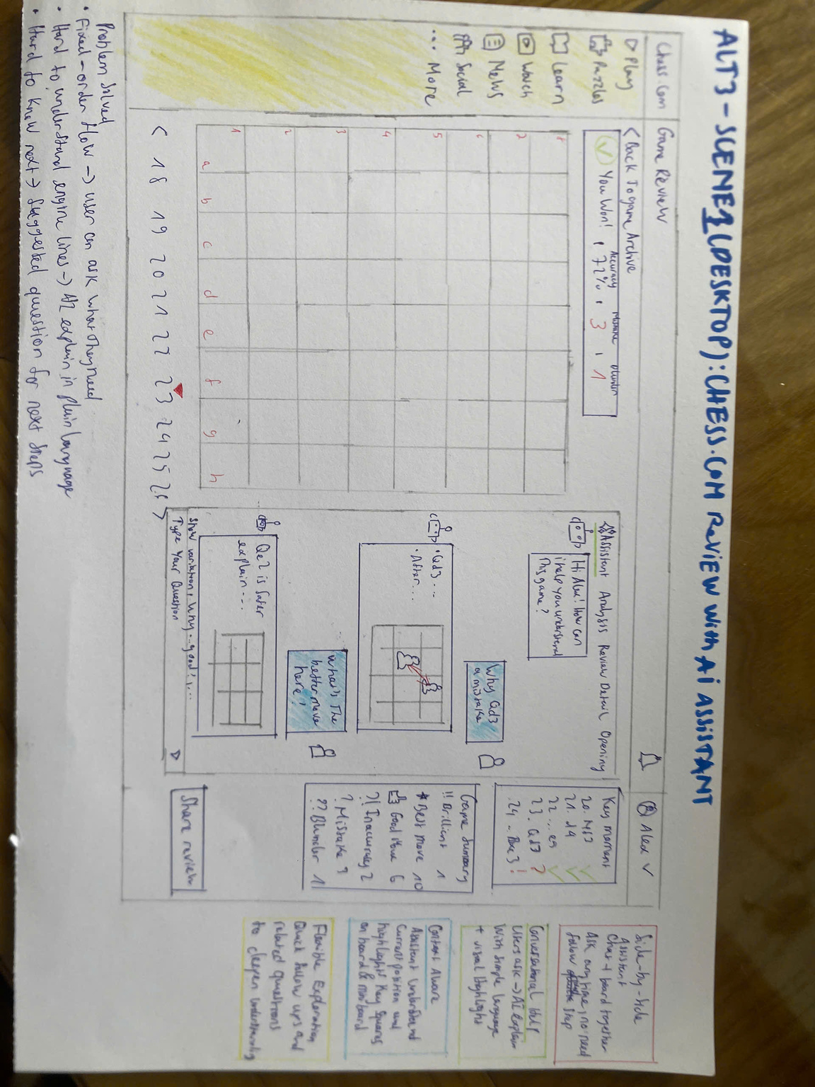
CONTENTS
Problems
What are we solving
Solutions
How are we solving
Results
Did we solve it?

Slide 4


PROBLEMS
FIFA.COM
CHESS.COM
Poor Ticket Visibility
Users have difficulty finding ticket status, progress, and next actions.
⇒ They feel uncertain and lack confidence.
Low Review Learnability
Users struggle to understand mistakes, analysis, and what to do next.
⇒ They feel overwhelmed and have difficulty turning review into practice.

Slide 5
SOLUTIONS
FIFA Ticketing Solutions
Status Dashboard
Timeline Tracker
Action Hub

Slide 6
SOLUTIONS
Chess Review Solutions
Beginner Review Flow
Card Review Mode
AI Review Assistant

Slide 7

POOR TICKET VISIBILITY
Status Dashboard
See your ticket status at a glance
Clear status cards show Confirmed, Pending, Action Needed, and Cancelled tickets, so users can quickly understand their ticket situation and decide what to do next.

Slide 8
POOR TICKET VISIBILITY
Status Dashboard
Motivation:
provide instant ticket status visibility and reduce user uncertainty.
Why:
users need a quick way to know whether their tickets are confirmed, pending, or require action.

Slide 9
POOR TICKET VISIBILITY
Status Dashboard
How:
Show key ticket statuses at a glance [1]
Display status clearly on each upcoming event [2]
Provide quick actions for fast access [3]
Keep users updated with notifications [4]
[1]
[3]
[2]
[4]

Slide 10
POOR TICKET VISIBILITY
Status Dashboard
Pros:
Clear ticket status at a glance
Reduces anxiety with reassuring information
Makes next actions easy to find
Important ticket information is centralized
Cons:
Many quick actions can make the UI feel busy
Less visibility into the full ticket process

Slide 11
POOR TICKET VISIBILITY
Timeline Tracker
Track every ticket step with confidence
Clear timelines show each stage of the ticket process, helping users understand their current progress, what happens next, and whether their information is up to date.

Slide 12
POOR TICKET VISIBILITY
Timeline tracker
Motivation:
make ticket progress transparent and keep information up to date.
Why:
users need to know where their ticket stands, what step comes next, and whether the latest information is reliable.

Slide 13
POOR TICKET VISIBILITY
Timeline tracker
How:
Show the ticket process as a step-by-step timeline [1]
Highlight completed, current, and upcoming steps [2]
Show latest updates and update history [3]
Provide official next steps and reliable information [4]
[2]
[1]
[4]
[3]

Slide 14
POOR TICKET VISIBILITY
Timeline tracker
Pros:
Makes ticket progress easy to understand
Shows what happens next
Keeps users informed with fresh updates
Builds trust with official information
Cons:
Users may need to scan the timeline to find key details
More information can make the UI feel heavier

Slide 15
POOR TICKET VISIBILITY
Action Hub
Get important ticket actions done quickly
Task-focused shortcuts bring common ticket actions into one place, helping users quickly find what they need and take action with confidence.

Slide 16
POOR TICKET VISIBILITY
Action Hub
Motivation:
make important ticket actions easy to find and complete.
Why:
users have difficulty finding common actions such as viewing, transferring, reselling, or managing their tickets.

Slide 17
POOR TICKET VISIBILITY
Action Hub
How:
Put high-frequency ticket actions front and center [1]
Use large shortcuts with clear icons and labels [2]
Group official ticketing and hospitality options [3]
Clearly explain when users leave FIFA.com [4]
[1]
[2]
[3]
[4]

Slide 18
POOR TICKET VISIBILITY
Action Hub
Pros:
Makes common ticket actions easy to find
Reduces steps for frequent tasks
Clear shortcuts make actions easy to scan
Cons:
Less visibility into ticket progress

Slide 19

LOW REVIEW LEARNABILITY
Beginner Review Flow
Review your game step by step
A guided review flow breaks the game into clear steps, explains mistakes in simple language, suggests better moves, and connects each mistake to targeted practice.

Slide 20
LOW REVIEW LEARNABILITY
Beginner Review Flow
Motivation:
simplify game review for beginners and reduce cognitive overload.
Why:
beginners may struggle to understand mistakes, engine analysis, and what to do next.

Slide 21
LOW REVIEW LEARNABILITY
Beginner Review Flow
How:
Guide users through mistakes step by step [1]
Explain mistakes in simple language & highlight [2]
Suggest a better move with a clear reason [3]
Connect each mistake to targeted practice [4]
[1]
[2]
[2]
[3]
[4]

Slide 22
LOW REVIEW LEARNABILITY
Beginner Review Flow
Pros:
Simple and easy for beginners to follow
Explains mistakes in plain language
Clear guidance on what to do next
Connects review directly to practice
Cons:
Fixed sequence gives users less control
Users may need to go through steps they already understand

Slide 23
LOW REVIEW LEARNABILITY
Card Review Mode
Choose what you want to review
A visual dashboard organizes key moments into selectable cards, allowing users to focus on the mistakes, good moves, openings, or endgames that matter most to them.

Slide 24
LOW REVIEW LEARNABILITY
Card Review Mode
Motivation:
give users more control over what they want to review.
Why:
users may want to focus on specific mistakes or game phases instead of following a fixed review sequence.

Slide 25
LOW REVIEW LEARNABILITY
Card Review Mode
How:
Show key game moments in visual categories [1]
Let users select the moments they want to review [2]
Expand a selected card with a clear explanation [3]
Link each review to actions or targeted practice [4]
[1]
[2]
[3]
[4]

Slide 26
LOW REVIEW LEARNABILITY
Card Review Mode
Pros:
Gives users more control over what to review
Easy to scan key moments visually
Flexible review order based on user interest
Connects selected moments directly to practice
Cons:
Too many cards may increase choice overload
Users may not know which card to review first
Requires more user decision-making

Slide 27
LOW REVIEW LEARNABILITY
AI Review Assistant
Ask questions and understand why
An AI assistant lets users ask questions about their game, explains mistakes in simple language, and highlights relevant positions directly on the board.

Slide 28
LOW REVIEW LEARNABILITY
AI Review Assistant
Motivation:
provide interactive, context-aware help during game review.
Why:
users may understand the move but still struggle to understand why it is a mistake or what they should do instead.

Slide 29
LOW REVIEW LEARNABILITY
AI Review Assistant
How:
Place an AI assistant beside the game board [1]
Let users ask questions in natural language [2]
Use the current position to explain and highlight key squares [3]
Suggest follow-up questions for deeper exploration [4]
[1]
[3]
[2]
[4]

Slide 30
LOW REVIEW LEARNABILITY
AI Review Assistant
Pros:
Flexible and personalized explanations
Users can ask questions in natural language
Explains the “why” behind mistakes
Context-aware visual highlights improve understanding
Cons:
AI explanations may not always be accurate
More complex to implement and maintain
Users may become dependent on AI

Slide 31
Formative Testing
5 AI reviewers · 6 prototypes · 285 coded outcomes
5
AI Reviewers
6
Prototypes
19
Task Definitions
285
Coded Outcomes
PA4
Direction
19 task definitions · 57 coded outcomes per reviewer
We tested whether each prototype helped users understand the problem, complete the task, and know the next step.
Notes:
[Sources]
Content: Group10-PA3-PaperPrototypes.pptx slides 19-42.
Verified against submission-final/source-evidence/formative-testing-results.md.
Updated ending slide 31; no external assets used.

Slide 32
What We Tested
FIFA Ticket Visibility
Chess Review Learnability
Alt 1 Status Dashboard
current state · pending/confirmed · next action
Alt 2 Timeline Tracker
progress · freshness · ownership
Alt 3 Action Hub
direct actions · partner handoff
Alt 1 Beginner Review Flow
guided mistake → practice path
Alt 2 Card Review Mode
choose a moment · puzzle bridge
Alt 3 AI Review Assistant
ask why · flexible follow-up
Two scenarios · six alternatives · one decision question: which interaction model best supports the user’s next step?
Notes:
[Sources]
Content: Group10-PA3-PaperPrototypes.pptx slides 19-42.
Verified against submission-final/source-evidence/formative-testing-results.md.
Updated ending slide 32; no external assets used.

Slide 33
Testing Plan
SET UP
TEST
SYNTHESIZE
Same protocol
Observe behavior
Choose PA4
Five novice AI reviewers used the same scenarios, prototype images, task wording, and neutral moderator rules. Orders were counterbalanced.
Two scenarios · six alternatives · 19 task definitions per reviewer. Code first action, comprehension, next step, trust, recovery, and intervention.
Code Independent Success / Hesitation / Failure, group recurring issues, rank severity and recurrence, then select a feasible direction.
Decision rule: preference supports the decision; repeated blockers, trust impact, learning impact, and revision effort drive PA4.
Notes:
[Sources]
Content: Group10-PA3-PaperPrototypes.pptx slides 19-42.
Verified against submission-final/source-evidence/formative-testing-results.md.
Updated ending slide 33; no external assets used.

Slide 34
FIFA Results: status clarity mattered
50 task outcomes per alternative · preference supports, not decides
Independent Success
Success With Hesitation
Failure
Alt 1 Status
31
11
8
3/5 preferred
Alt 2 Timeline
26
9
15
2/5 preferred
37
10
Alt 3 Actions
3
0/5 preferred
STATE
TRUST
ACTION
Alt 1: strongest current-state read. Alt 2: strongest progress/freshness view. Alt 3: action-first, but weak pending-state explanation.
Alt 2 made official source and freshness explicit. Alt 1 needed owner/timing + partner handoff. Alt 3 had trust cues, but away from actions.
Alt 3 led on direct actions (37 independent). Alt 1 kept common actions visible. Alt 2 explained progress but hid View / Transfer.
Independent success · hesitation · failure · reviewer preference
Synthesis → Status Dashboard: keep the state model; borrow Timeline provenance and Action Hub handoff cues.
Notes:
[Sources]
Content: Group10-PA3-PaperPrototypes.pptx slides 19-42.
Verified against submission-final/source-evidence/formative-testing-results.md.
Updated ending slide 34; no external assets used.

Slide 35
FIFA: what testing exposed
ISSUE
ISSUE
ISSUE
Pending status had no owner, timing, or clear wait-versus-act cue.
Timeline steps mixed system work and user work; pending ownership stayed ambiguous.
Direct actions were fast, but status context and the partner boundary were separated.
FIX
FIX
FIX
Add Current status, Next step, Owner, and Expected timing; keep status color paired with text.
Label System / Your Step / Waiting; surface the current and next step, including the 72h milestone.
Add a status strip, expected step, and handoff warning beside each outgoing action.
PA4 direction: Status Dashboard, with selected cues borrowed from Timeline and Action Hub.
Notes:
[Sources]
Content: Group10-PA3-PaperPrototypes.pptx slides 19-42.
Verified against submission-final/source-evidence/formative-testing-results.md.
Updated ending slide 35; no external assets used.

Slide 36
Chess Results: guidance beat flexibility
45 task outcomes per alternative · preference supports, not decides
Independent Success
Success With Hesitation
Failure
Alt 1 Guided
36
8
1
5/5 preferred
Alt 2 Cards
34
11
0
0/5 preferred
Alt 3 Assistant
26
14
5
0/5 preferred
STATE
TRUST
ACTION
Alt 1 and Alt 2 exposed the mistake and better move. Alt 3 enabled questions, but conflicting square references reduced confidence.
Alt 1 kept explanations bounded and practice-linked. Alt 2 added terminology load. Alt 3 needed a visible analysis basis.
Alt 1 connected Try this move → Practice → Next mistake. Alt 2 offered a puzzle route. Alt 3 lacked direct try / practice controls.
Alt 2 had zero failures; choice-load and preference evidence still favored Alt 1
Synthesis → Beginner Review Flow: keep the guided chain; borrow Card priority and bounded Assistant help.
Notes:
[Sources]
Content: Group10-PA3-PaperPrototypes.pptx slides 19-42.
Verified against submission-final/source-evidence/formative-testing-results.md.
Updated ending slide 36; no external assets used.

Slide 37
Chess: what testing exposed
ISSUE
ISSUE
ISSUE
Guided flow started at step 2 and lacked a clear recovery or help route.
Many cards and metrics made the first choice and terminology unclear.
Flexible explanations lacked a direct Try / Practice path; c3 and e2 references conflicted.
FIX
FIX
FIX
Add Start / Restart review, Explain another way, and Review Another Moment.
Add a Start Here card; explain categories and material; keep the puzzle bridge.
Add bounded prompts, a visible analysis basis, Try this move, and Practice this idea.
PA4 direction: Beginner Review Flow, with selected help, preview, and recovery cues.
Notes:
[Sources]
Content: Group10-PA3-PaperPrototypes.pptx slides 19-42.
Verified against submission-final/source-evidence/formative-testing-results.md.
Updated ending slide 37; no external assets used.

Slide 38
Final PA4 Direction
FIFA
Chess
Selected: Status Dashboard
Selected: Beginner Review Flow
Only option combining strong current-state comprehension with direct ticket actions; repair pending owner/timing and partner handoff before PA4.
36 independent, 1 failure, 5/5 preference; clearest mistake → better move → practice chain, with recovery and help cues to add.
Borrow: Timeline: freshness + ownership labels. Action Hub: direct actions + adjacent handoff warning.
Borrow: Card Review: Start Here + category cues. Assistant: bounded Explain another way help.
Carry forward the strongest core workflow; borrow only evidence-supported cues that repair a repeated blocker.
Notes:
[Sources]
Content: Group10-PA3-PaperPrototypes.pptx slides 19-42.
Verified against submission-final/source-evidence/formative-testing-results.md.
Updated ending slide 38; no external assets used.

Slide 39
THANK YOU
AI-Agent Formative Testing → PA4 direction
Notes:
[Sources]
Content: Group10-PA3-PaperPrototypes.pptx slides 19-42.
Verified against submission-final/source-evidence/formative-testing-results.md.
Updated ending slide 39; no external assets used.

