Slide 2

The Life Alerting Safety Cane
By Derek Feng and Jerry Shen

Slide 3
Defining the Problem
In 2016
~591 deaths from falls for every 100,000 people 95 and older
~42 for every 100,000 people ages 75 to 79
Deaths from falls among U.S. adults aged 75 or older rose from 8,613 in 2000 to 25,189
https://www.reuters.com/article/us-health-elderly-falls/more-elderly-americans-dying-from-falls-idUSKCN1T5213

Slide 4
Proposed Solution
IoT cane that detects and alerts when there’s a fall
If there’s a fall, send an SMS text to designated contact
To prevent false positives, user can press a button to send an SMS text saying that it’s a false alarm

Slide 5
Implementation
Arduino (slave)
Accelerometer to detect falls
Button to send the false alarm SMS
LED light to indicate when the cane detected a fall
GPS to track the latest movement of the user
Raspberry Pi (master)
Receives the info from Arduino
Connects to WiFi
Sends the GPS data to cloud service (ThingSpeak)
If fall/button press detected from Arduino, send SMS (Twilio)

Slide 6
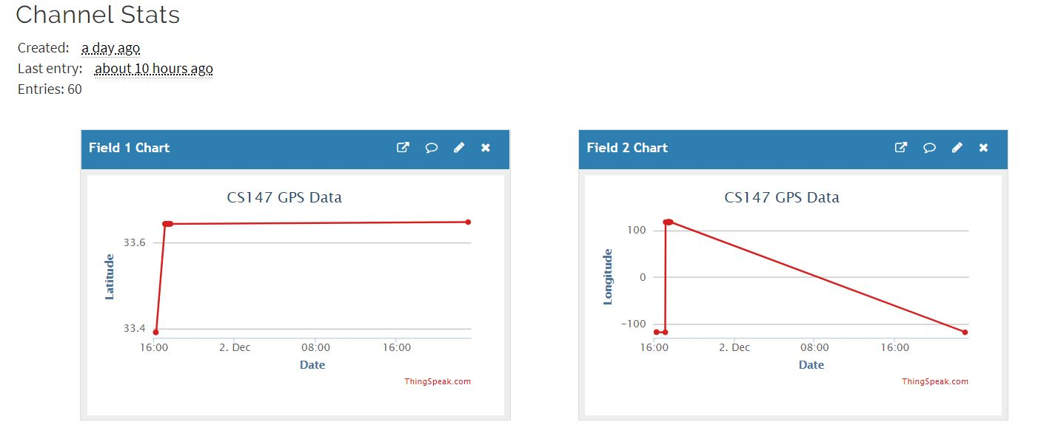
ThingSpeak Channel Data

Slide 7
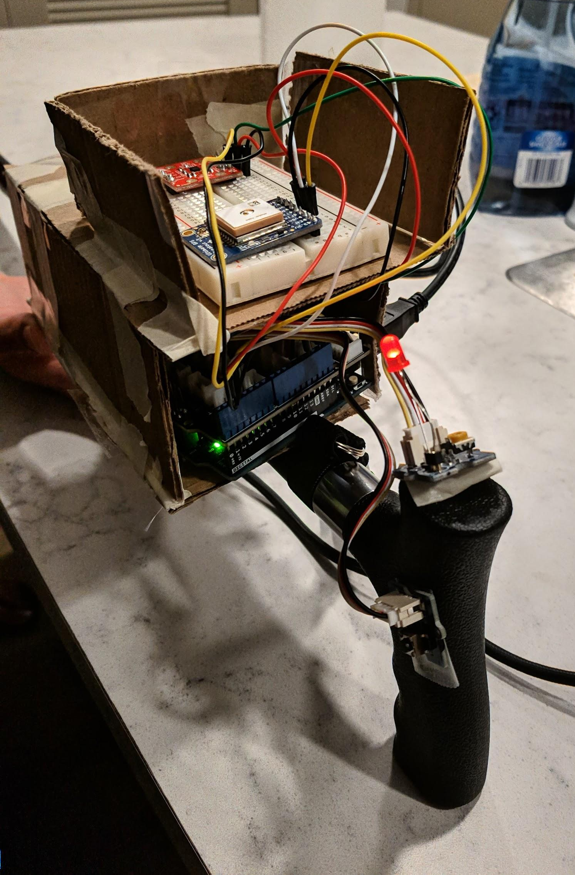
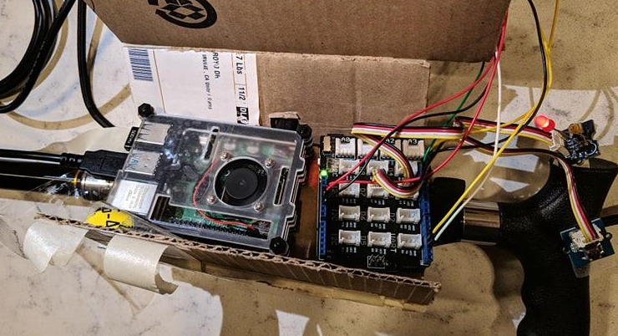

Slide 8
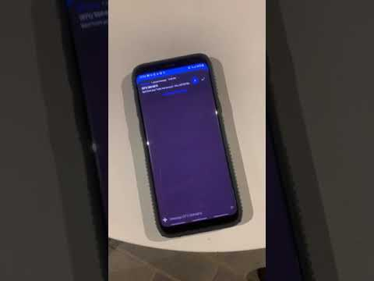
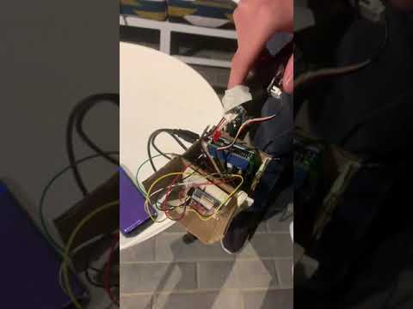
Fall Detected
False Alarm

Slide 9
Challenges and Solution
3D print a whole cane and an enclosure for the Arduino + Pi + sensors
Bought a cane and made enclosure out of cardboard
ESP8266 troubles
Managed to setup as webserver, but not sure how to go on from there
Used a Raspberry Pi to connect to Arduino
GPS requires direct line of sight to the sky
Recorded the demo

