Slide 1
Crypto-101
and some more…

Slide 2




Why?
Secure
Authenticate
Tamper-proof
Alice
Bob
X

Slide 3


Encryption
Symmetric-key encryption
Alice
Bob
Same cryptographic key used for encryption and decryption
e.g. Caesar cipher
A
X
X
A
THE QUICK BROWN FOX JUMPS OVER THE LAZY DOG
QEB NRFZH YOLTK CLU GRJMP LSBO QEB IXWV ALD
QEB NRFZH YOLTK CLU GRJMP LSBO QEB IXWV ALD
THE QUICK BROWN FOX JUMPS OVER THE LAZY DOG

Slide 4


Encryption
Symmetric-key encryption
Alice
Bob
Drawbacks
Prior knowledge of keys is required.
How to transmit the keys?
How to authenticate the sender
Difficult to change the keys
Vulnerable to brute-force attack

Slide 5

Encryption
Asymmetric-key or Public-key encryption
Alice
Bob
Cryptographic key-pair is used for encryption
Drawbacks
Computation is intensive
How can you be sure that Bob’s certificate is really Bob’s certificate?
Public-key or Certificate is shared widely
Private-key or Key kept safe

Slide 6




Certificate Authorities (CA)
Solving the Identity Crisis
Submit
Signed
Verify
Generate
CA
Alice
Bob
Country Name (2 letter code) []:IN
State or Province Name (full name) []:Karnataka
Locality Name (eg, city) []:Bangalore
Organization Name (eg, company) []:CAPIOT
Organizational Unit Name (eg, section) []:Engineering
Common Name (eg, fully qualified host name) []:odp.capiot.com
Email Address []:it@capiot.com

Slide 7

Self-signed Certs. / Org. Level CAs
Generate
Self-sign
Trust the certificate at your own risk
Alice
Bob
Submit
Verify
Organization’s CA
Generate
Sign
Everyone trusts the Organization’s CA
Alice
Bob

Slide 8
Digital Signatures
Sending tamper-proof messages
Has the message been altered?
?
?
Alice
Bob

Slide 9

Digital Signatures
Sending tamper-proof messages
Alice
Bob
encrypt( )
digest( )
decrypt( )
digest( )
Same?

Slide 10
Secure-socket Layer (SSL)
Hello!
Hello!
Here is my certificate ( ) and a set of encryption algorithms that I support
Ok. These are the set of encryption algorithms that I understand
Sure. We can use AES 256.
Alice
Bob
Here’s a large symmetric key + message encrypted with that. Do you copy?
All looks good. Send me your data.

Slide 11
2-way SSL
Hello!
Hello!
B
B
Here is my certificate ( ) and a set of encryption algorithms that I support. Please send me your identity
Ok. These are the set of encryption algorithms that I understand
Here’s my certificate ( )
A
A
Sure. We can use AES 256.
B
A
Alice
Bob
Here’s a large symmetric key + message encrypted with that. Do you copy?
All looks good. Send me your data.

Slide 12
Saving passwords
Never save passwords as clear text in the DB.
Why?
What’s the alternate approach?

Slide 13

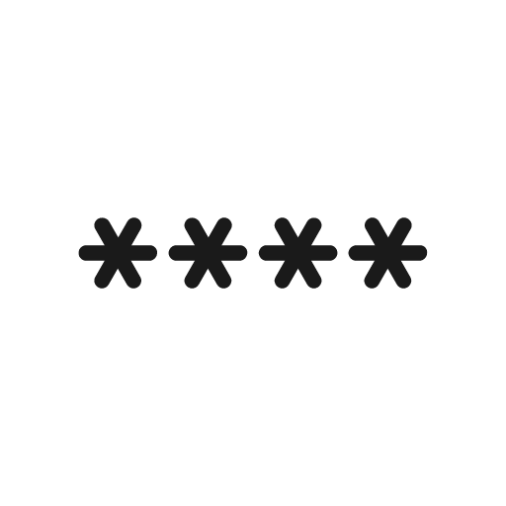

Saving passwords
Hashing!
md5
sha256
sha512
checksum( )
﻿6926f9e52fbebdcf1ef16c14fe77d2fa
Password
Salt
(saved in the db)
Same?
User authentication
checksum( )
﻿6926f9e52fbebdcf1ef16c14fe77d2fa
User entered password
Salt (from db)

Slide 14
Generating a KEY
openssl genrsa -out server_2048.key 2048
openssl genrsa -out server_4096.key 4096
openssl genrsa -out server.key 2048
openssl genrsa -out ca.key 2048

Slide 15
Generate a CSR from KEY
openssl req -out server.csr -key server.key –new
Generate CSR and KEY (single command)
openssl req -out server.csr -new -newkey rsa:2048 -nodes -keyout server.key
openssl req -out ca.csr -new -newkey rsa:2048 -nodes -keyout ca.key

Slide 16
Display information within CSR
openssl req -in server.csr -verify -noout -text
openssl req -in ca.csr -noout -text

Slide 17
Generate a CERT from CSR and self-sign it with the key
openssl x509 -signkey server.key -in server.csr -req -days 365 -out server.crt
openssl x509 -signkey ca.key -in ca.csr -req -days 365 -out ca.crt

Slide 18
Generate a CERT from CSR and CA sign it
openssl ca -config openssl.cnf -policy signing_policy -extensions signing_req -out server_ca.crt -infiles server.csr
* The openssl.cnf file can be found in the repository

Slide 19
Display information within CERT
openssl x509 -in server.crt -text -noout
openssl x509 -in server_ca.crt -text -noout

Slide 20
Encrypting a file
Generate a random key to encrypt
openssl rand -base64 32 > key.bin

Slide 21
Encrypting a file
Encrypt the file
openssl enc -aes-256-cbc -salt -in README.md -out README.md.enc -pass file:./key.bin

Slide 22
Encrypting a file
Get the public key
openssl rsa -in server.key -out server.pub.pem -outform PEM -pubout

Slide 23
Encrypting a file
Encrypt the random key with the public keyfile
openssl rsautl -encrypt -inkey server.pub.pem -pubin -in key.bin -out key.bin.enc

Slide 24
Decrypting a file
Decrypt the random key with our private key file
openssl rsautl -decrypt -inkey server.key -in key.bin.enc -out key.bin.out

Slide 25
Decrypting a file
Decrypt the large file with the random key
openssl enc -d -aes-256-cbc -in README.md.enc -out README.md.out -pass file:./key.bin.out

Slide 26
Hashing
md5sum README.md
shasum -a 256 README.md

Slide 27
Commands
https://github.com/jerrymannel/crypto101

Slide 28
Thankyou!

