Slide 1

The Battle of Neighborhoods -Real Estate in Manhattan
Ruijie Ma

Slide 2
Background:
Covid-19 drops real estate price
The low price might attract investors around the world who consider the current house price is undervalued.

Slide 3

Business Problem:
In this senerio, the ABC real estate company realized that there might be some investors who are not familiar with the real estate market in Manhattan. They are considering about what they can do to help those investors to gather more information?

Slide 4
How we solve it
We plan to cluster Manhattan's neighborhoods for recommending suitable price and venues to their investors

Slide 5
Data Selection
The data of real estate price comes from the link (https://www1.nyc.gov/site/finance/taxes/property-rolling-sales-data.page)
Foursquare API

Slide 6

Methodology
data cleaning methods from IBM data science class
Kmeans and clustering for modeling.

Slide 7
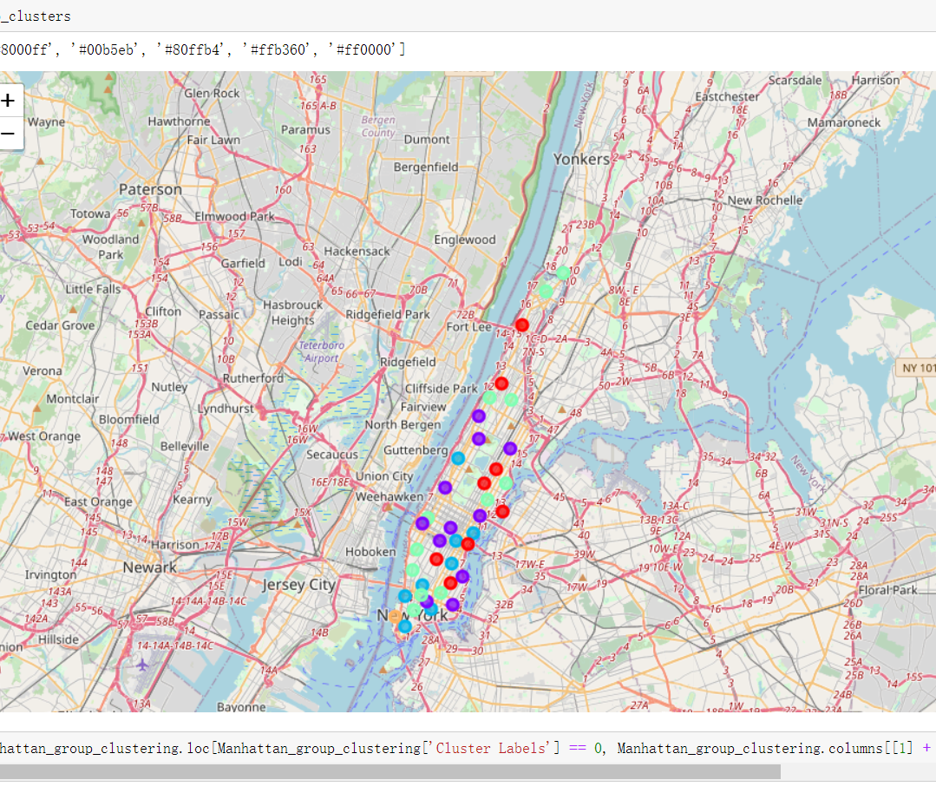
Result
Map of Clustering

Slide 8
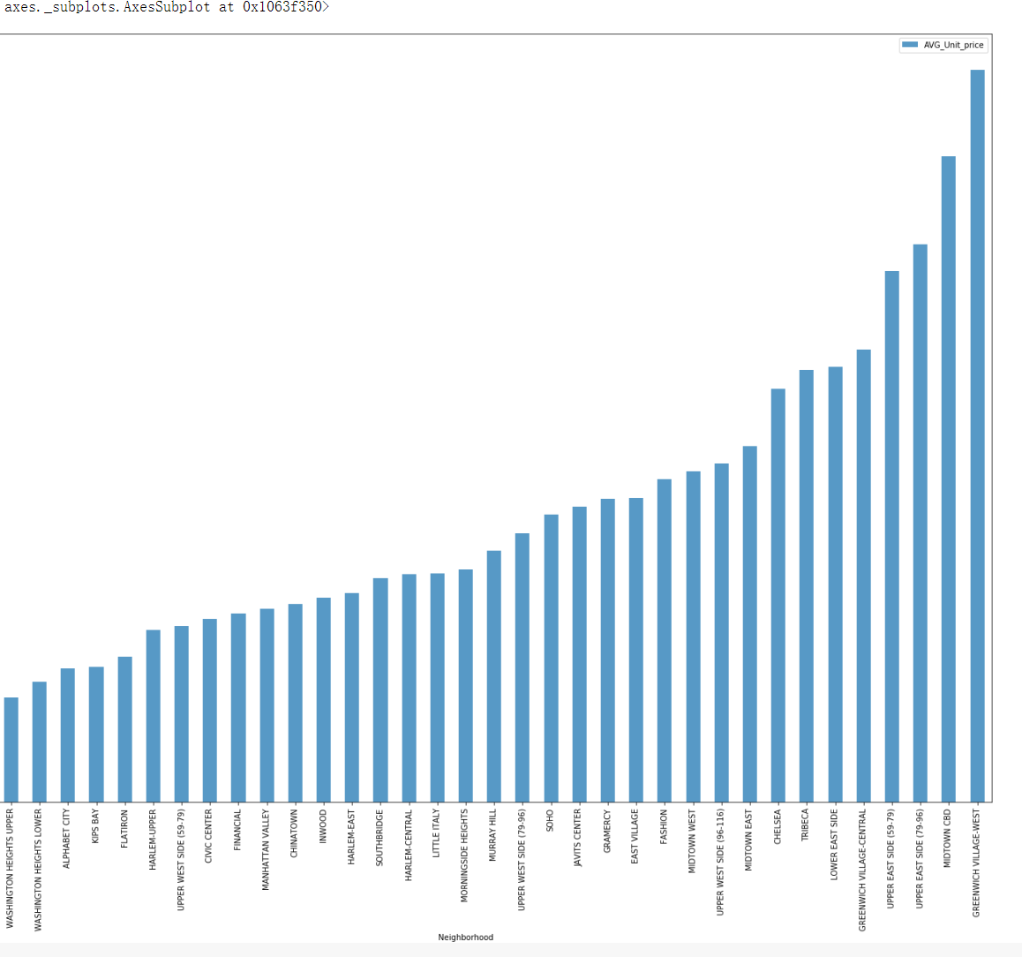
Result
Visualization of average price on Neighborhoods

Slide 9
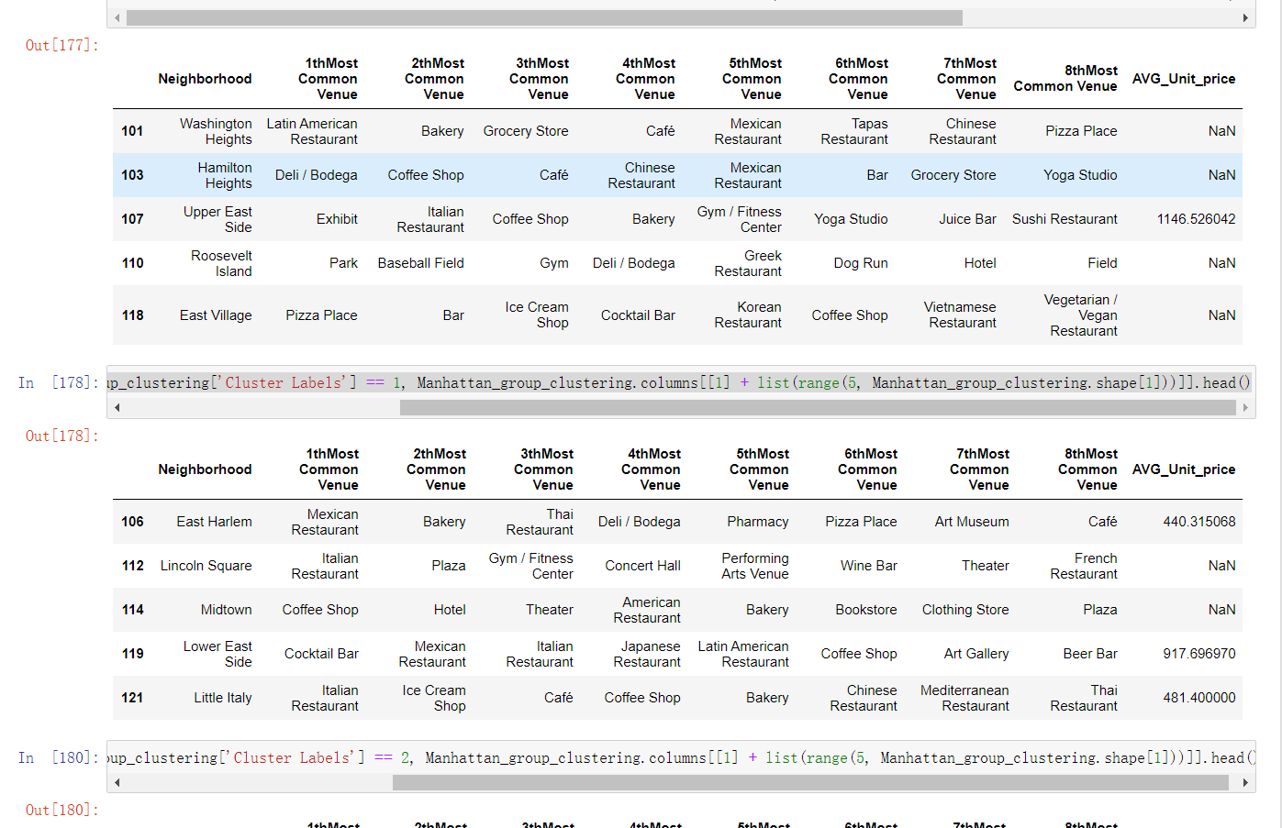
Result
Cluster 0 and 1

Slide 10
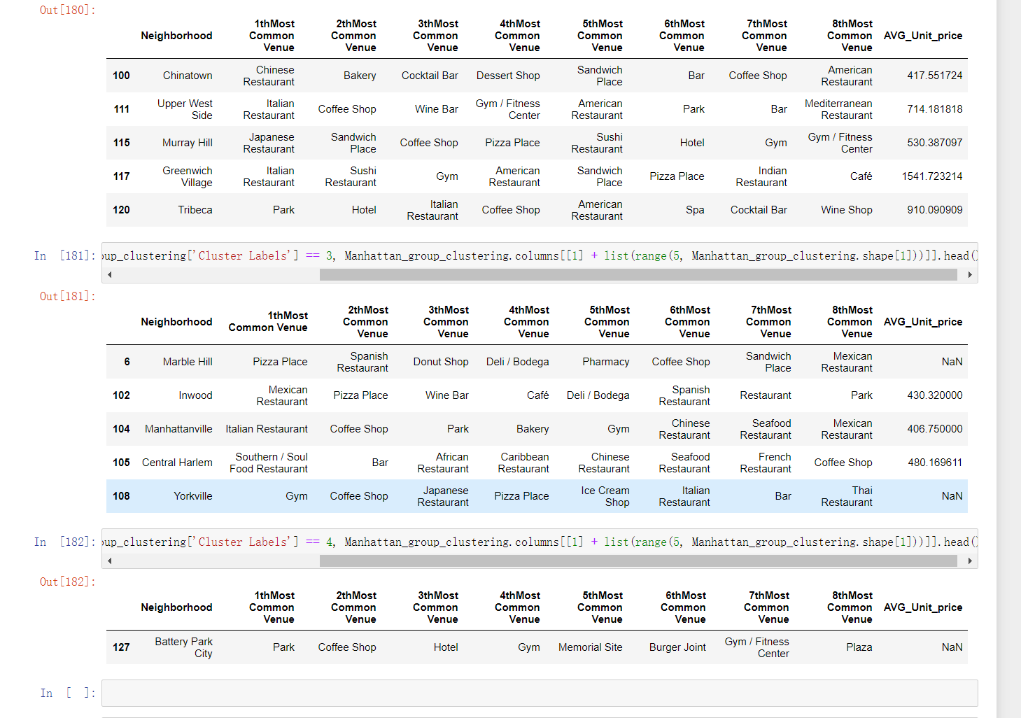
Result
Cluster 2,3,4

Slide 11
Conclusion
The major business problem in this project is to process and visulize data in order to help the investors to make their investment decision on real estate market. To achieve this goal, we successfully process the real estate price and calculate their average price of each neiborhood and sort it ascendingly. The result of housing price is shown above that is efficient for investors to make their decision. Venue is another aspect that considered by house buyer. Our project sucessfully seperate the neighborhoods based on their venues to 5 patterns and I believe it will help home buyers for their decision making. For instance, people who consider the apartment near park is more profitable would choose the apartment in cluster 4 which has park as its most common venue. Therefoer, I believe the current real estate market in Manhattan is highly diverse and it fits investors with differnet appitates.

Slide 12

Thanks

