Slide 1
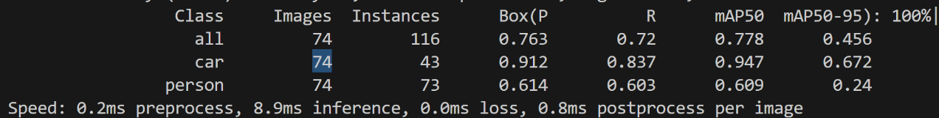
人车检测
Yolov8 map50:0.778 10ms/pic
Detr map50:0.802 0.2430s/pic

Slide 2
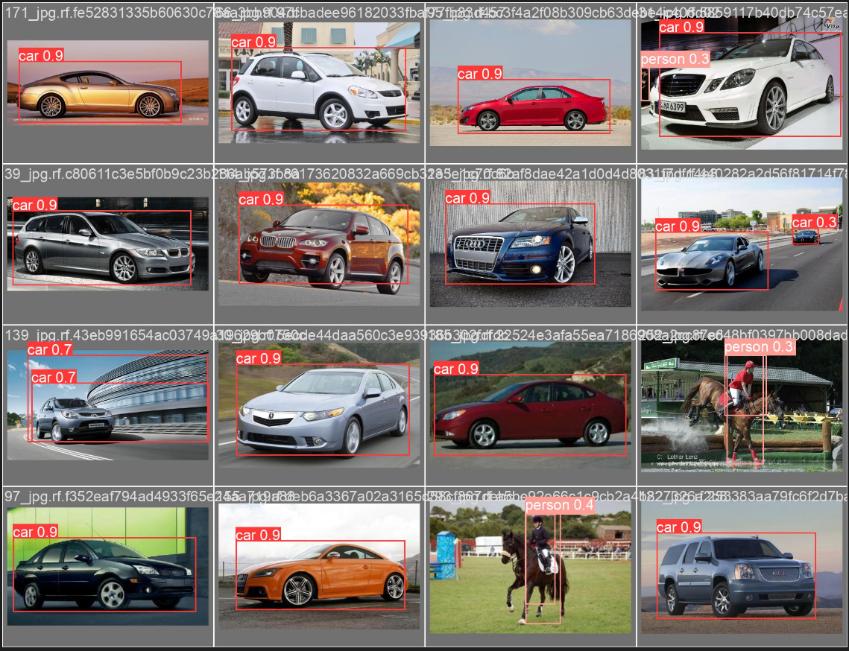
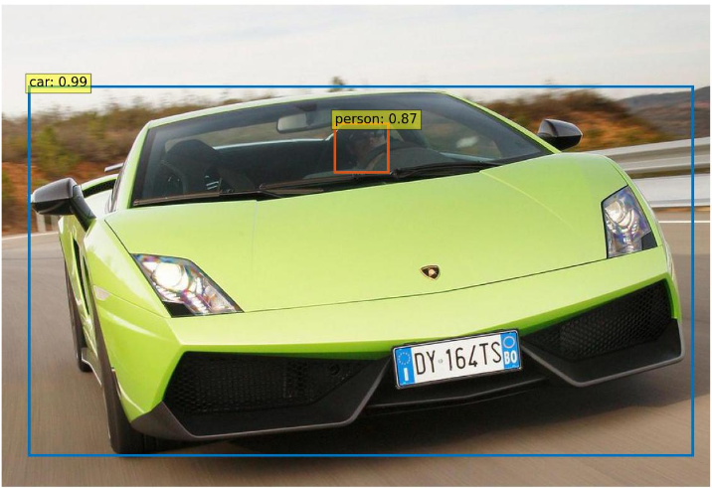
人车检测
Yolov8 map50:0.778 10ms/pic
Detr map50:0.802 0.2430s/pic

Slide 3

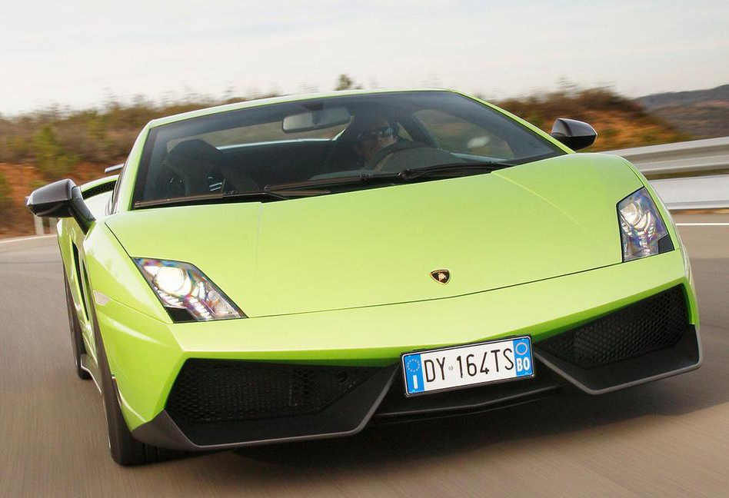
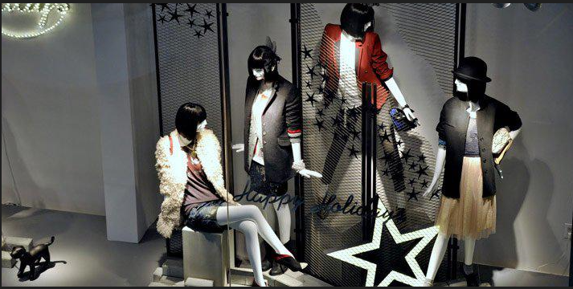
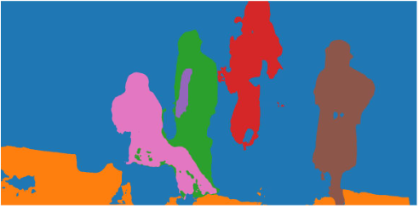
无标签物体检测DETR panoptic segmentation

