Slide 1
RACELOG: A RACE ORGANIZATION DATABASE
By: Jerry Peng, Noah Glusenkamp, and Ryan Barr

Slide 2

CURRENT SITUATION
- Currently Noah Participates in an Outrigger Canoeing club and various canoeing competitions which host race events for other clubs in the region.
- Each competition has many clubs and individual participants, filed into many divisions, classes and even different courses depending on the race.
- Participation is linked between the individual, the club they belong to and which canoe(s) they will be using for which events.
- Canoes can hold between 1 and 6 paddlers and a given canoe can be used by multiple different paddlers/groups of paddlers for a variety of different race division, class, and course combinations.

Slide 3
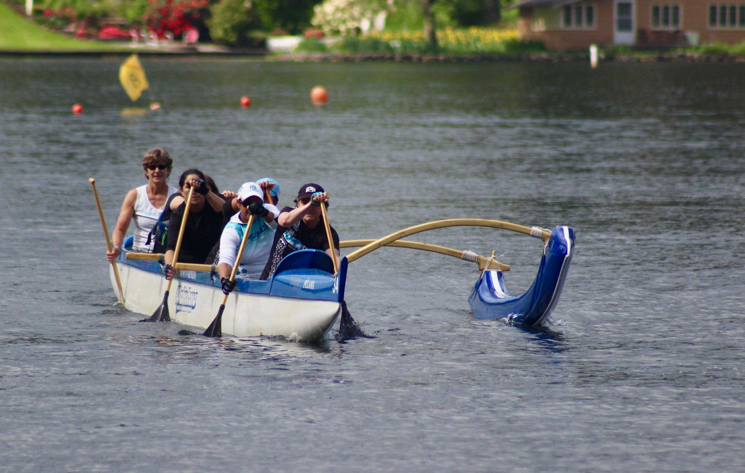

Slide 4
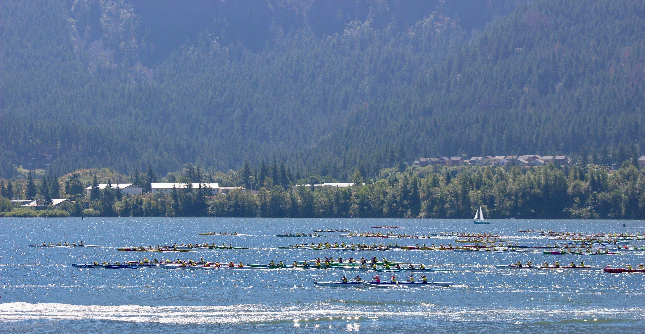

Slide 5
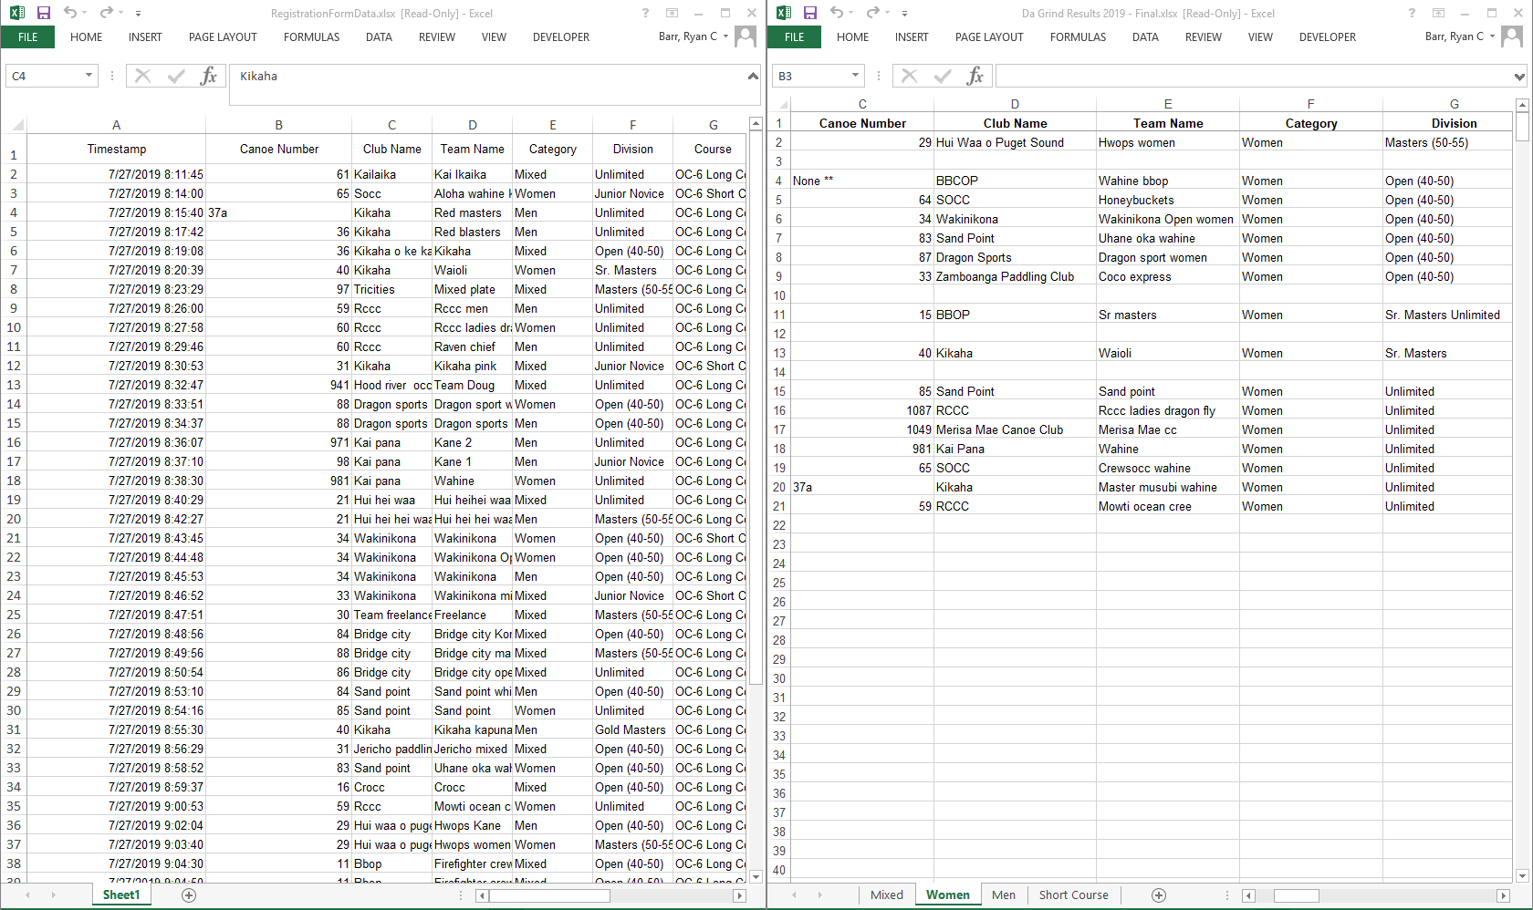
PROBLEMS WITH STATUS QUO
- Tedious manual entry spanned across multiple excel sheets and files.
- Data is duplicated many times and is often in non standard formats as it was manually entered.
- Requires many people just to maintain the records on the day of the race to associate the correct time to the correct event and participants.
- After the race, results are not immediately available as data must be collected and combined from several sheets to give final results

Slide 6
PROJECT GOALS
Create a Database that can handle the following tasks:
Participant/paddler registration and payment
Correctly register/associate paddlers to their club, canoe(s), and entered division/class.
Record race results in real time and be able to immediately produce placements.
Span multiple races so that every club can have one central data store.
Be flexible to add new events/races/divisions/paddlers at any time.
Minimal back-end maintenance. Events are run by volunteers who shouldn’t need to mess with any of the nuts and bolts.

Slide 7
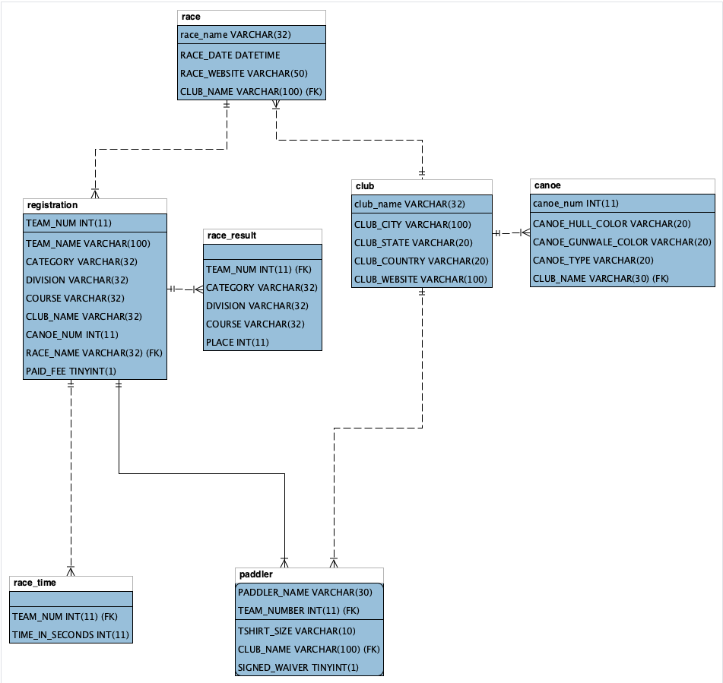
DATABASE STRUCTURE

Slide 8
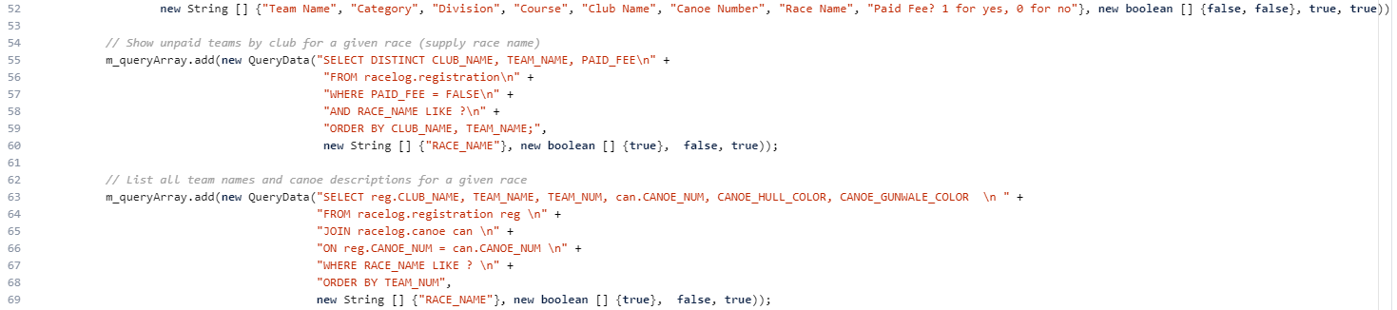
IMPLEMENTATION
GUI Option
Added queries to the query array
Non-GUI Option (with -console argument)
Execute all queries that is both parameter query and action query sequentially, skip the non-parameter query

Slide 9
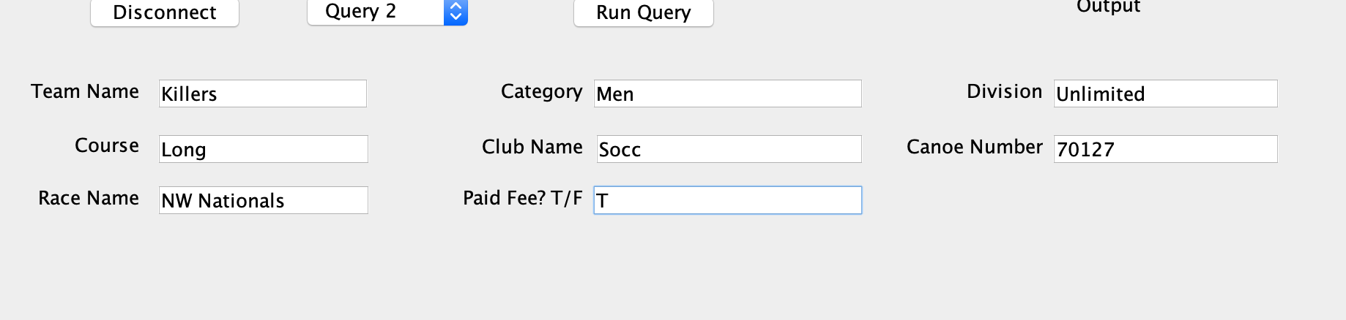
DEMONSTRATION
Here we switch to cmd line and demonstrate queries/table insert.
Setup Steps:
Run script and save it to a schema
if execute it with the GUI option, double click the .jar file
if execute it with the non GUI option, open terminal and run “java -jar <.jar file name with extension> -console

Slide 10
DEMONSTRATION
Query 1: List all race names
Query 2: Add a registration
Query 3: Show unpaid teams by club for a given race (supply race name)
Query 4: List all team names and canoe descriptions for a given race
Query 5: Add a race result by team number (team numbers are unique to a race)
Query 6: Show winning 1st place teams for a given race
Query 7: Show all results for a team (supply race and team)

Slide 11
FURTHER EXPANDABILITY
Web Interface: Allow multiple clubs to use the database without lugging around a specific dedicated piece of hardware (laptop) with the database on it.
Expand applicability: This project could be generalized to work with any racing format. With very minimal changes to the actual back end, this could be used for foot, bicycle or automotive racing. Any races with a class/division system.
Automatic input of times: Many race timing devices support digital output of times. This functionality could be hooked into the database via additional java coding to automatically record times. Combine with a homebrew vision/QR code system to handle correctly assigning times to multiple competing participants.

Slide 12
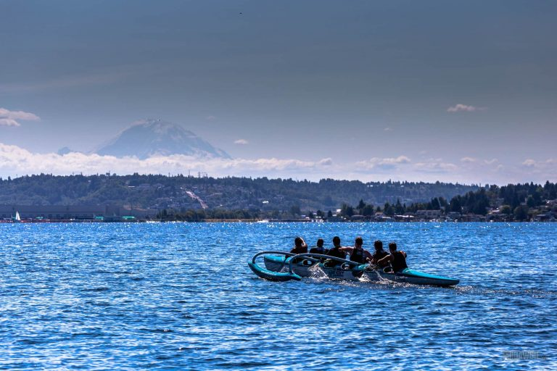
QUESTIONS/COMMENTS?

