Slide 1
PowerPoint Exercises
Complete each exercise, then save the file and upload it to the course website.

Slide 2
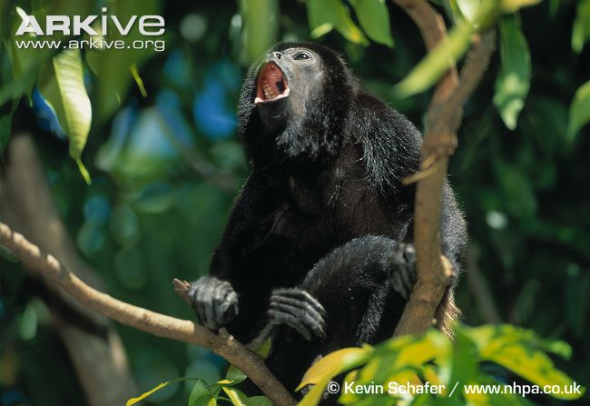
Crop this image tightly around the monkey.

Slide 3
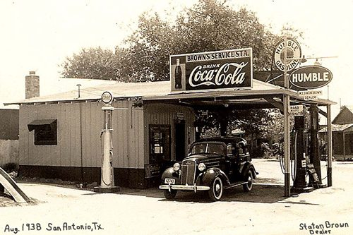
Apply a 2-point thick solid brown border and a drop shadow to this photo.

Slide 4
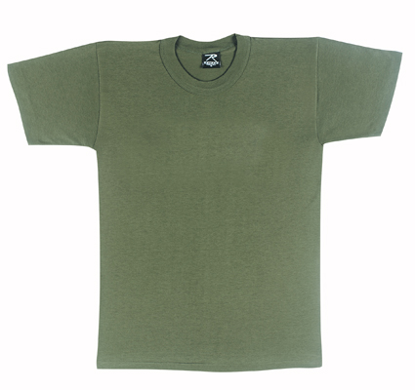

Eliminate the white background from the logo and place it on the t-shirt.

Slide 5
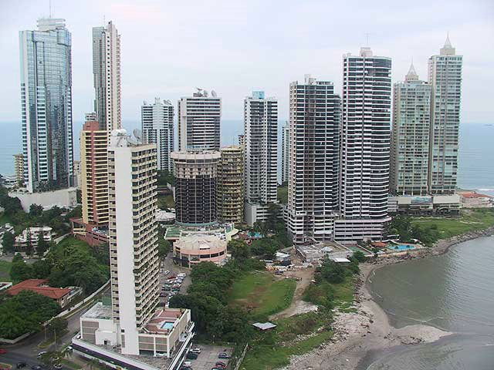
Recolor this image with a blue overtone, set the transparency to 80%, and stretch it to fit the entire slide background

Slide 6
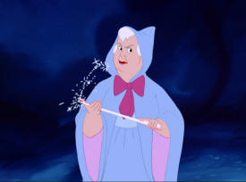
Place this image in a circular frame and apply 3D styling to it.

Slide 7
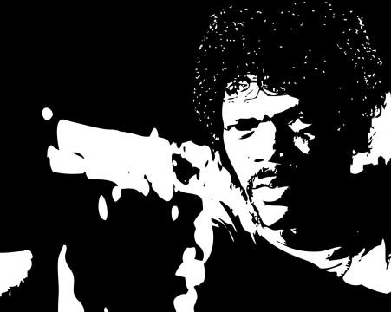
Arrange these images into three perfectly aligned and spaced columns.

Slide 8
Insert a “transition” between this slide and the previous

Slide 9
Change the background color of this slide to light blue and alter the typefaces to show hierarchy
A variety of baits can be used on the mouse trap:
Peanut butter
Use creamy, not crunchy
Cheese Wiz or Eazy-Cheese
Dry cat food

Slide 10
Apply animation to these bullet points. Each click should bring in one point.
Bullet point
Bullet point
Bullet point
Bullet point

Slide 11
Insert a SmartArt graphic and apply animation to bring in one part of the graphic at a time.

Slide 12
Find one more technical tool or trick to do on this slide. The more creative, the better.

