Slide 1
It's not that I'm so smart, it's just that I stay with problems longer.
– Albert Einstein
Lecture 4 – Fundamental Data Structures
CST370 – Design & Analysis of Algorithms
Dr. Byun
Computer Science

Slide 2
Lecture Objectives
After completion of this lecture, you will be able to
  recall the important linear data structures such as an array and a linked list.
  explain basic terminologies of a graph and represent it using two different representations.

Slide 3
Chapter 1: Introduction
1.1 What is an Algorithm?
1.2 Fundamentals of Algorithmic Problem Solving
1.3 Important Problem Types
1.4 Fundamental Data Structures

Slide 4
Fundamental Data Structures
Data structure is a particular scheme to organize related data items.
Examples
  List, stack, queue, tree, graph, etc.

Slide 5
Linear Data Structures (1 of 2)

Slide 6
Linear Data Structures (2 of 2)

Slide 7
Array vs. Linked List

Slide 8
Stack and Queue
Stack
Queue

Slide 9
Puzzle

Slide 10
Solution

Slide 11
Puzzle

Slide 12
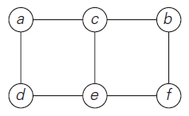
Graphs
A graph is composed of nodes (= vertices) and lines (= edges).
  They are used for modeling many real-life applications such as transportation, communication networks, project scheduling, etc.
Example

Slide 13
Graph Definition
A graph, G = <V,E>, is composed of a pair of two sets: a finite nonempty set V of items called vertices and a set E of pairs of these items called edges.
  In mathematics, a set is an unordered collection, possibly empty, of distinct items (= no duplicates).

Slide 14
Example

Slide 15
Question (1 of 2)

Slide 16
Question (2 of 2)

Slide 17
Directed Graph (or Digraph)

Slide 18
Question

Slide 19
Exercise (1 of 2)
Suppose that we have an undirected graph G <V, E> where |V| indicates the number of vertices.

Slide 20
Exercise (2 of 2)

Slide 21
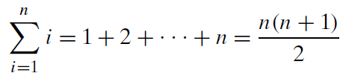
Useful Formula for the Analysis of Algorithms
We will use the following formula several times in the algorithm analysis.
Example
  1 + 2 + … + 100 = (100*101)/2 = 5050

Slide 22
Useful Formula for the Analysis of Algorithms
Memorize this formula as a CS major.
  Or you can understand this formula more easily with this video.
  https://bit.ly/2LGTej4

Slide 23
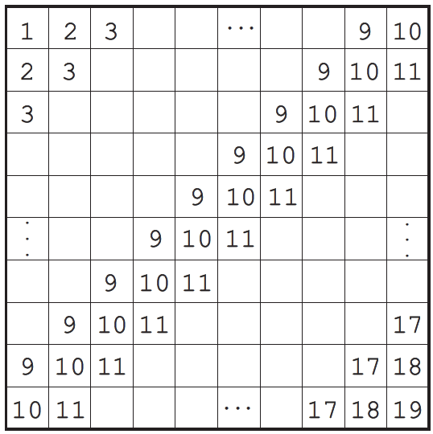
Puzzle

Slide 24
Solution

Slide 25
Complete Graph
A graph is complete if every pair of vertices in the graph is connected by an edge.

Slide 26
Dense Graph vs Sparse Graph

Slide 27
Graph Representation
There are several ways to represent a graph in a program.
Two common approaches
  Adjacency matrix and adjacency list

Slide 28
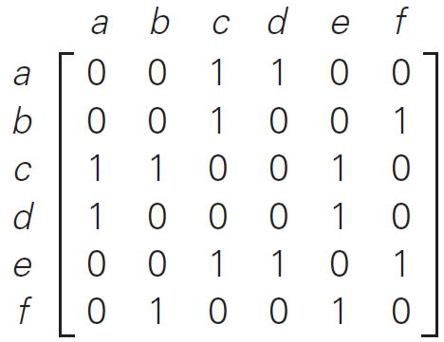
Graph Representations: Adjacency matrix
Example
Graph
Adjacency Matrix

Slide 29
Exercise

Slide 30
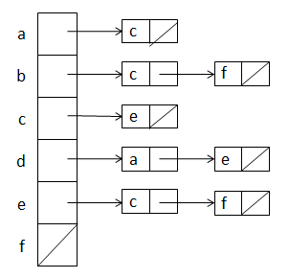
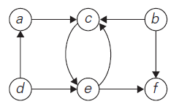
Graph Representations: Adjacency list
Example
Graph
Adjacency List

Slide 31
Exercise

Slide 32
Question

