Slide 1
Thus, the last will be first, and the first will be last.
– Matthew 20:16
Lecture 4 (2) – Fundamental Data Structures
CST370 – Design & Analysis of Algorithms
Dr. Byun
Computer Science

Slide 2
Lecture Objectives
After completion of this lecture, you will be able to
  explain basic terminologies of weighted graphs and trees.

Slide 3
Weighted Graphs
A weighted undirected graph and a weighted directed graph are graphs with numbers (or cost) assigned to their edges.
Example

Slide 4
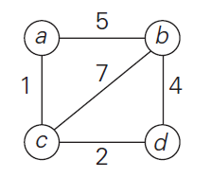
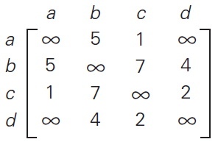
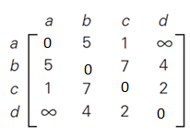
Weighted Graphs Representation (1 of 2)
Adjacency matrix
➔
Frequently, we put zeros on the diagonal as below.

Slide 5
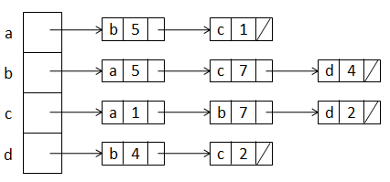
Weighted Graphs Representation (2 of 2)
Example
Representation in adjacency list

Slide 6
Exercise

Slide 7
Paths and Cycles
Read the textbook to study the following terminologies in a graph.
  Path
  Length
  Simple path
  Connected
  Connected component
  Cycle
  Acyclic graph

Slide 8
Example (1 of 2)

Slide 9
Example (2 of 2)

Slide 10
Exercise

Slide 11
Puzzle

Slide 12
Solution

Slide 13
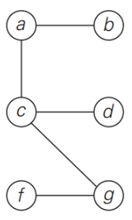
Trees
A tree is a connected acyclic graph.
Example

Slide 14
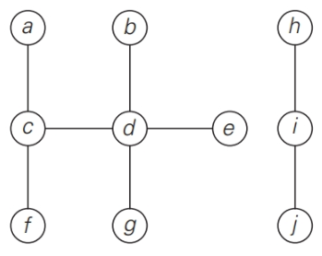
Exercise

Slide 15
Free Tree, Rooted Tree, and Ordered Tree
There are several different trees in computer science theory such as (free) trees, rooted trees, and ordered trees.
  Our main interest in the class is the binary tree and binary search tree.
  However, you should know the general terminologies of trees in the textbook.

Slide 16
Binary Tree

Slide 17
Binary Search Tree

Slide 18
Exercise

Slide 19
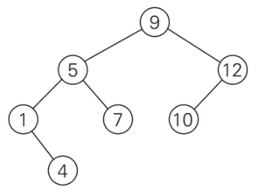
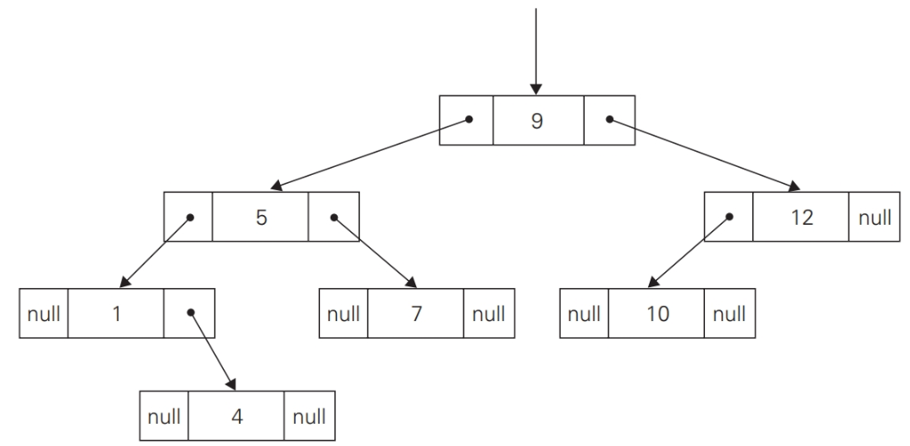
Standard Implementation of Binary Tree

Slide 20
Multi-way Search Tree

Slide 21
Sets
A set is an unordered collection of distinct items.
Example
  S = {2, 3, 5, 7}
  S = {n: n is a prime number and n < 10}
Important set operations
  Membership check
  Union and intersection
  etc.

Slide 22
Set Implementation

Slide 23
Sets vs. Lists

Slide 24
Dictionaries
A dictionary is an abstract data type that provides the following operations
  Searching an item
  Adding a new item
  Deleting an item

Slide 25
Dictionary Implementation
Array (sorted or unsorted)
Hash table
Balanced binary search tree

Slide 26
Priority Queue
Priority queue is an abstract data type that provides the following operations
  Finding the highest priority element
  Deleting the highest priority element
  Adding a new element
“Heap” is used to implement it.

Slide 27
Puzzle

Slide 28
Solution

