Slide 1


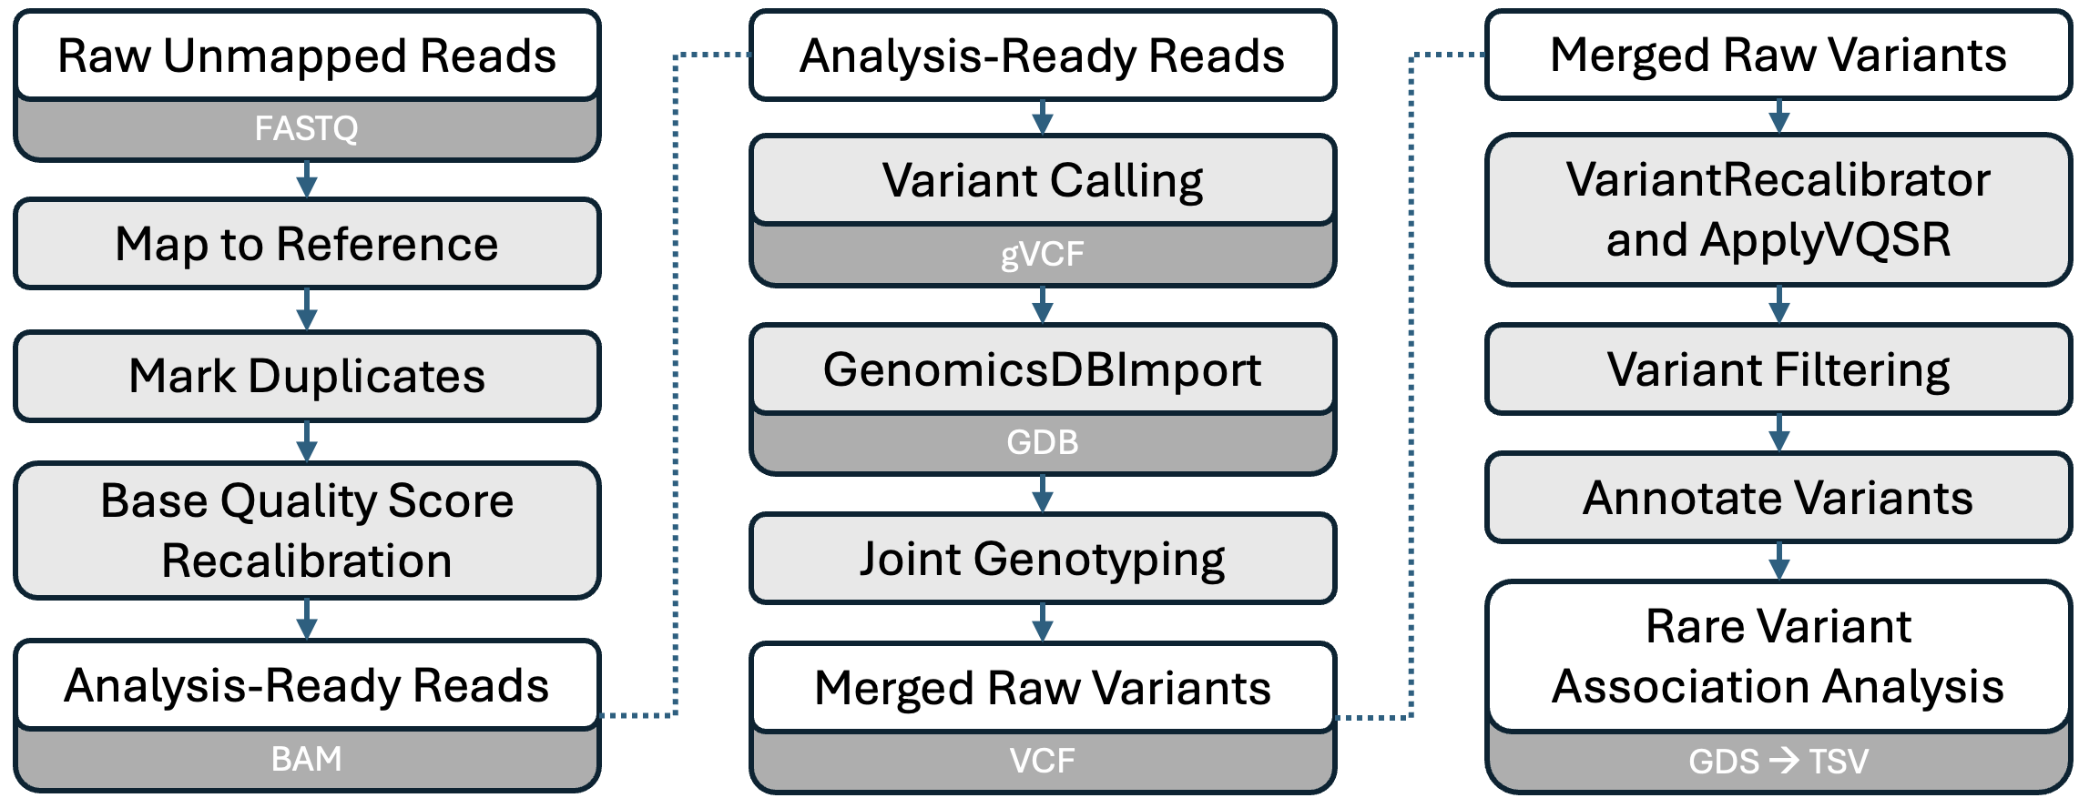
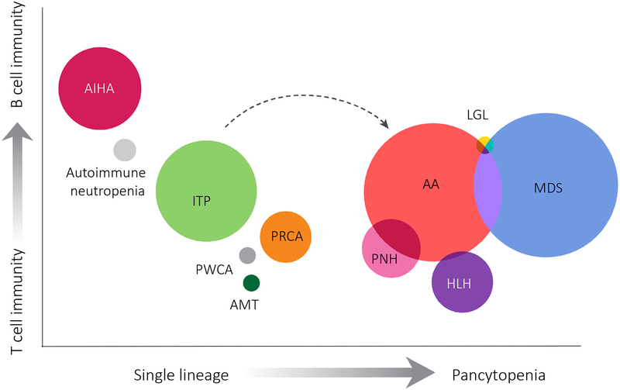
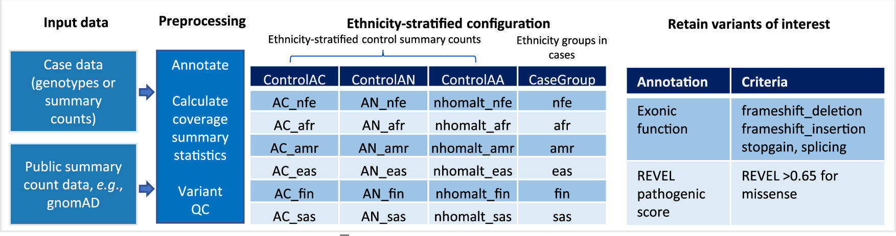
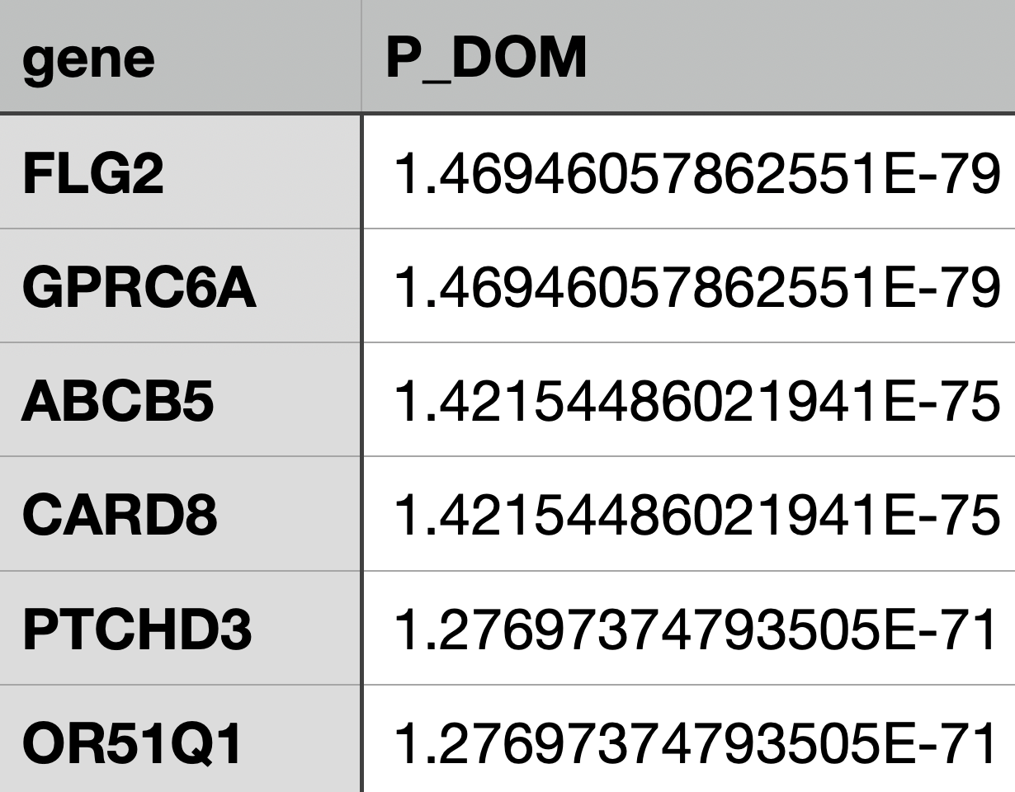
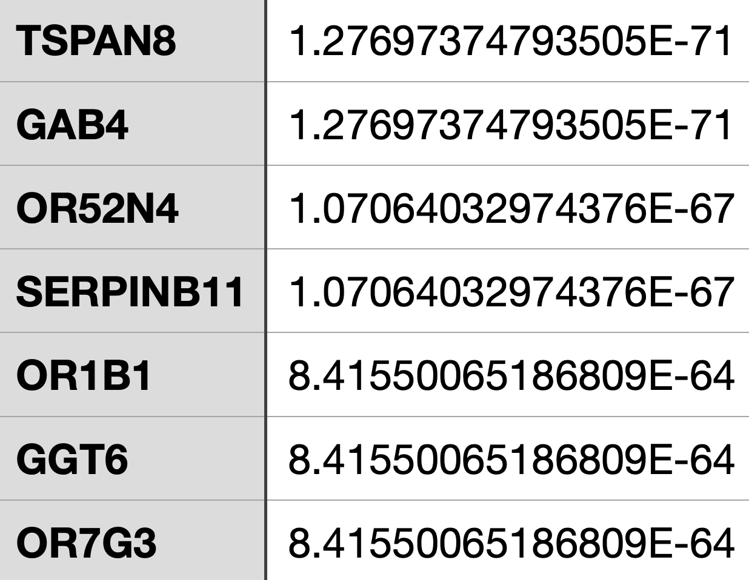

Rare-variant association analysis of acquired aplastic anemia using whole exome sequencing and public genotype controls data
Jerry Sheng, Shouguo Gao, Hiroki Mizumaki, Zhijie Wu, Neal S. Young
Background
Methods
Discussion
Acquired aplastic anemia (AA) is an autoimmune disorder characterized by the destruction of hematopoietic stem cells, resulting in bone marrow failure and pancytopenia¹. While immunosuppressive therapy can be effective for many, ~15% of patients progress to myelodysplastic syndrome (MDS) or acute myeloid leukemia (AML) during long-term follow-up. Clonal hematopoiesis, involving mutations in genes such as DNMT3A, ASXL1, and TET2, contributes to disease progression and is associated with adverse survival outcomes².
Recent studies emphasize the role of rare genetic variants in AA’s pathogenesis, which conventional genetic association studies may not fully capture. Rare-variant collapsing analyses aggregate these variants to identify genetic risk factors for AA, offering a promising approach for studying complex traits^{3,4}.
Advances in frameworks using public genotype data also aid in prioritizing disease-predisposition genes for conditions like AA⁵. Incorporating public control data is important for rare-variant analyses in AA as it provides a broad genetic reference that enhances the ability to detect disease-associated rare variants by offering a comparison against a diverse control pool.
Our project focused on developing a robust pipeline for identifying rare genetic variants associated with (AA), from raw exome sequencing data to the creation of a rare variant table and a preliminary gene list. While the pipeline was effective in processing data, the study's conclusions are limited using a relatively small dataset and did not include detailed genetic analyses.
Although we utilized publicly available genomic data to enhance statistical power, future studies should focus on enlarging sample cohorts; despite analyzing only 32 samples, resources like gnomAD and SAAWES⁶ offer hundreds of human DNA references that could augment future studies.
Additionally, conducting thorough genetic analyses on results to validate and understand the functional impact of these variants will be crucial for advancing our understanding of AA and identifying potential therapeutic targets.
Figure 2. Variant discovery and analysis pipeline with GATK Best Practices and CoCoRV.
gVCF files were generated through variant calling for each sample (n=32), then performed joint genotyping to merge these into a single VCF file. VQSR was applied for variant recalibration and filtering with additional quality. The final VCF was annotated for biological significance and converted to a GDS format for further rare variant analysis using CoCoRV.
Figure 3. Schematic representation of main input and preprocessing of variants in CoCoRV.
Figure 1. Relationship of aplastic anemia to other diseases.
Results
References
Young, N. S. Aplastic anemia. New England Journal of Medicine. 2018. 379(17), 1649-1660.
Yoshizato T, Dumitriu B, Hosokawa K, et al. Somatic Mutations and Clonal Hematopoiesis in Aplastic Anemia. N Engl J Med. 2015;373(1):35-47.
Povysil G, Petrovski S, Hostyk J, et al. Rare-variant collapsing analyses for complex traits: guidelines and applications. Nat Rev Genet. 2019;20(12):747-759.
Lee S, Abecasis GR, Boehnke M, et al. Rare-variant association analysis: study designs and statistical tests. Am J Hum Genet. 2014;95(1):5-23.
Chen, W., Wang, S., Tithi, S.S. et al. A rare variant analysis framework using public genotype summary counts to prioritize disease-predisposition genes. Nat Commun. 2022; 13(1):2592.
McReynolds LJ, Rafati M, Wang Y, et al. Whole Exome Sequencing in Severe Aplastic Anemia Identifies Unrecognized Inherited Subset with Inferior Survival after Hematopoietic Cell Transplant. Blood. 2021;138(1):605.
Figure 4 & 5. Top rare variants associated with AA and their raw P values. Pipeline can be accessed through GitHub.
The study identified FLG2, GPRC6A, and ABCB5 as three of the top rare variants in a preliminary gene list associated with AA using exome sequencing data. However, any conclusions are tempered by the small dataset used, underscoring the need for larger cohorts to validate findings.. The publicly available code repository on GitHub facilitates transparency and future collaborations in further genetic analyses of AA.
Notes:
Add public control, shorten background 2/3, change flow diagram, keep cocorv, only tested on small dataset, pipeoline design only, discussion, from raw data → rare variant table results, gene list used for further studies

