Slide 1
Dynamic Material Flow Analysis with Python for Designing Eco-civilization
Tutorial Example III: GloBus
Global Dynamic Building-sand Model
Jingyang Song, Nankai University, jerrysong0128@nankai.edu.cn
Zhi Cao*, Nankai University, zhicao@nankai.edu.cn
College of Environmental Science and Engineering, Nankai University
Date: 2024.08.26
Notes:
老师同学们大家好，我今天开题的题目是“基于综合评估模型，的中国住宅建筑物质效率提升潜力、减排效应及能源系统响应”。
以下我讲开启我的汇报。

Slide 2
ODYM Applications
ODYM
Open Dynamic Material Systems Model
Repo: https://github.com/IndEcol/ODYM
BUMA
BUilding MAterials model – 2020 Journal of Cleaner Production
Repo: https://github.com/SPDeetman/BUMA
Deetman, S., Marinova, S., Van Der Voet, E., Van Vuuren, D. P., Edelenbosch, O., & Heijungs, R. (2020). Modelling global material stocks and flows for residential and service sector buildings towards 2050. Journal of Cleaner Production, 245, 118658. https://doi.org/10.1016/j.jclepro.2019.118658
Marinova, S., Deetman, S., Van Der Voet, E., & Daioglou, V. (2020). Global construction materials database and stock analysis of residential buildings between 1970-2050. Journal of Cleaner Production, 247, 119146. https://doi.org/10.1016/j.jclepro.2019.119146
GloBUME
Global Building Material Demand and Embodied GHG emissions – 2021 Nature Communications
Repo: https://zenodo.org/records/5171943
Zhong, X., Hu, M., Deetman, S., Steubing, B., Lin, H. X., Hernandez, G. A., Harpprecht, C., Zhang, C., Tukker, A., & Behrens, P. (2021). Global greenhouse gas emissions from residential and commercial building materials and mitigation strategies to 2060. Nature Communications, 12(1), 6126. https://doi.org/10.1038/s41467-021-26212-z
GloBus
Global Dynamic Building Sand Model – 2022 Nature Sustainability
Repo: https://github.com/Zh-xy/GloBus
Zhong, X., Deetman, S., Tukker, A., & Behrens, P. (2022). Increasing material efficiencies of buildings to address the global sand crisis. Nature Sustainability, 5(5), 389–392. https://doi.org/10.1038/s41893-022-00857-0
GloBus
Tutorial
Repo: https://github.com/jerrysong0128/GloBUS_Tutorials

Slide 3
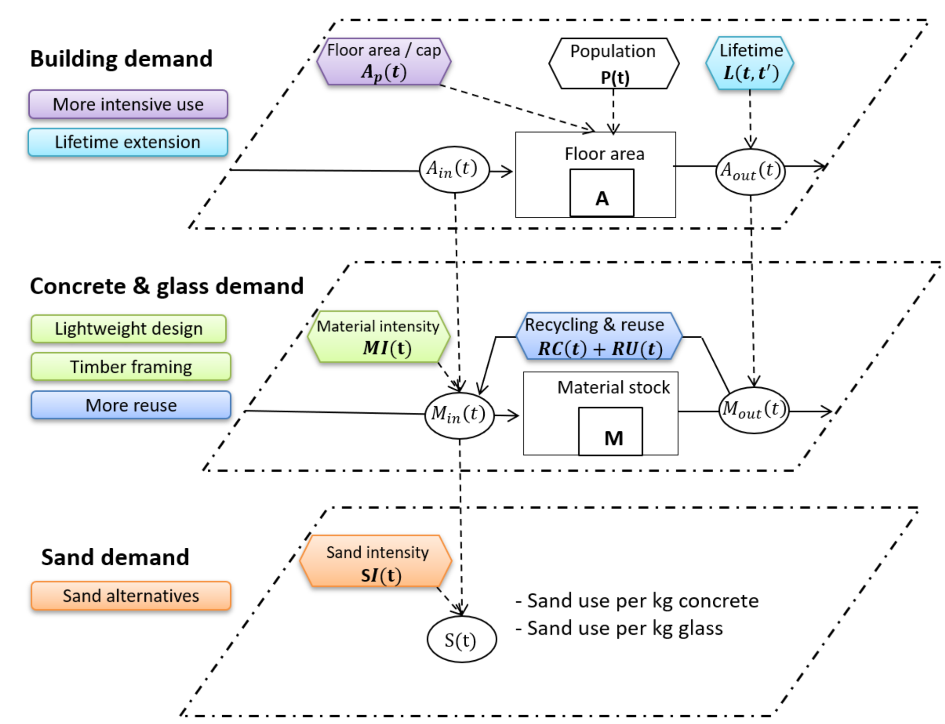
GloBus Framework

Slide 4
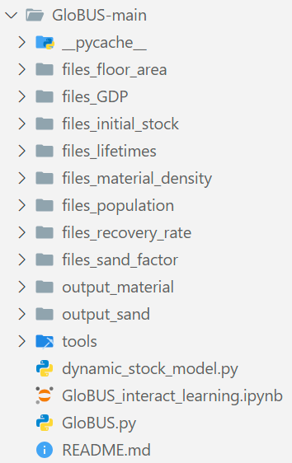
GloBUS Tutorial Folder Structure
Floor area / cap
A_{p}(t)
Used to calculate commercial building per cap floor space with Gomperz curve
Lifetime
L(t,t’)
Population
P(t)
Recycle & Reuse
RC(t) +RU(t)
Material Intensity
MI(t)
MODEL OUTPUT
ODYM
GloBUS

Slide 5
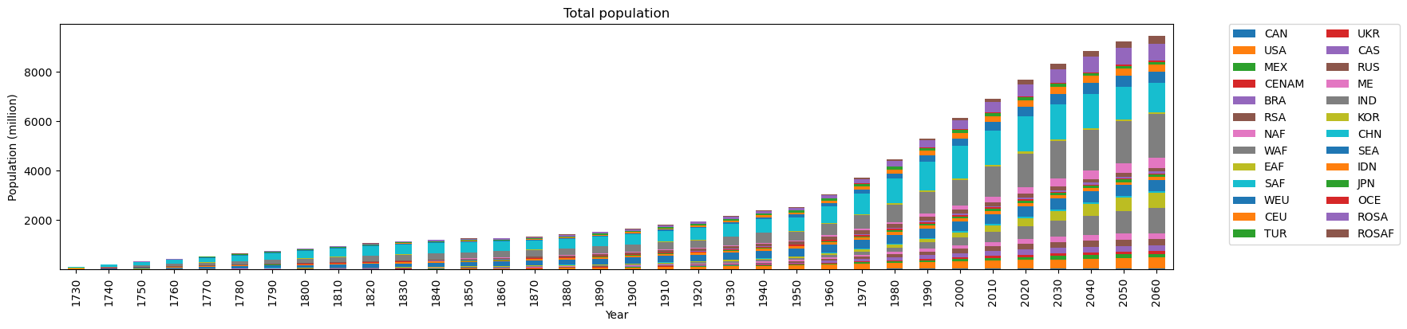
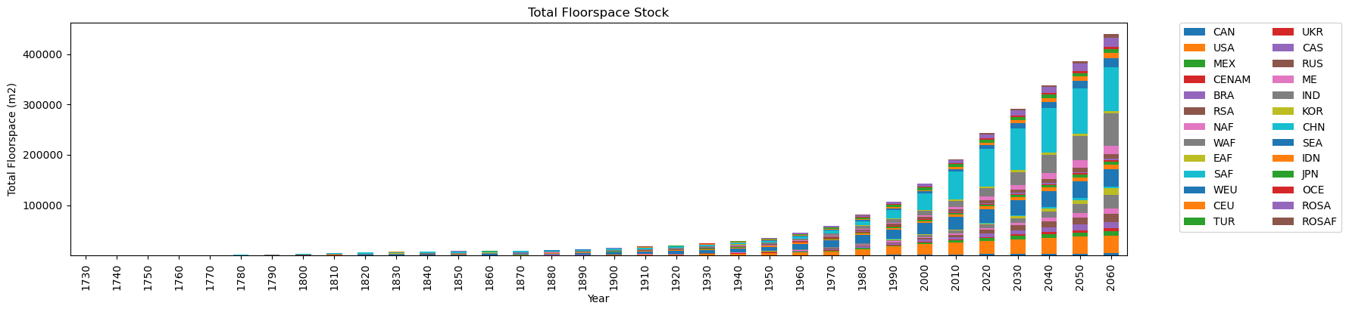

Slide 6
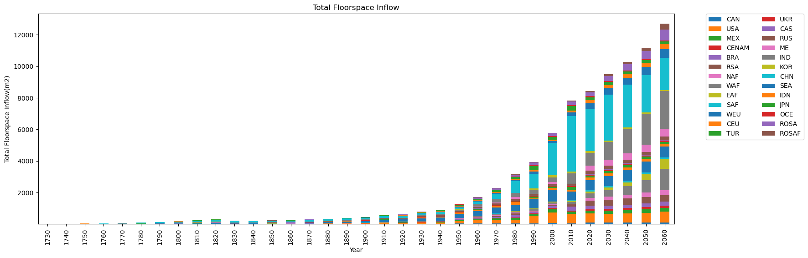

Slide 7
