Slide 1
Tracking changes in brain organoid spontaneous activity over maturation
Temperature analysis on the activity
Chuqi Wang
Notes:
Project topic is … Focus on

Slide 2
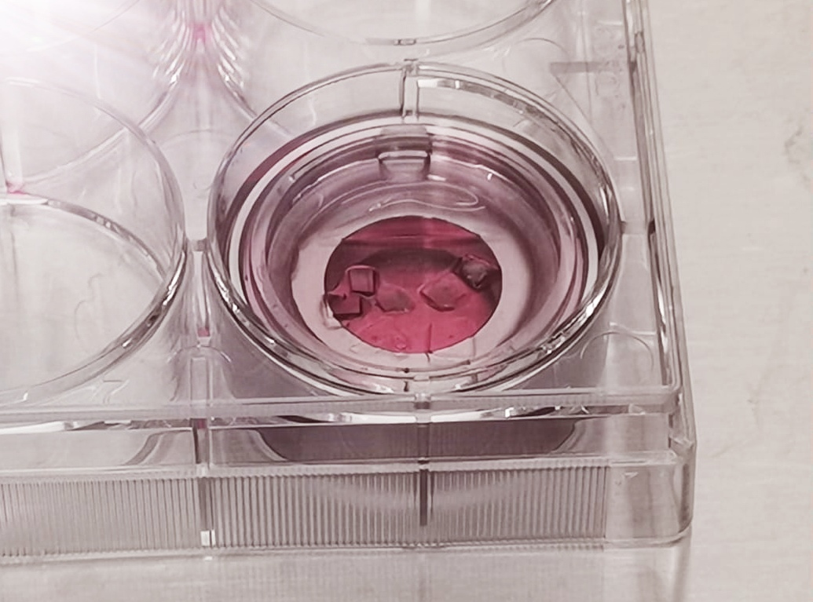
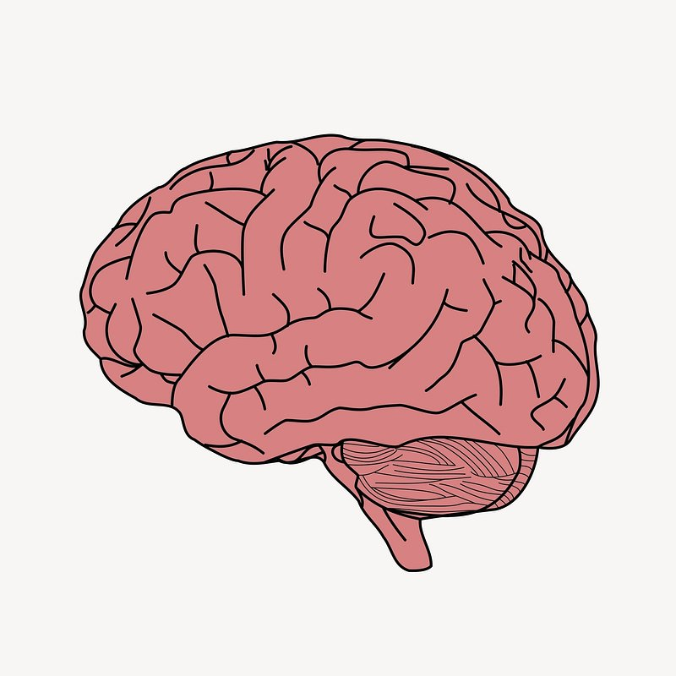
Study Model: Organoid vs. Brain
Brain
Complexity for study and understanding
Highly sensitive to temperature
Optimal temperature range
Highly
Brain Organoid
In vitro model
Long-term culture
Recapitulate early developmental stages [1]
Expectation: to observe similar temperature impact in organoid model as in the brain
Notes:
The study model of the project: cerebral organoid
the complexity of the brain model makes it challenge to investigate developmental disorders and biological mechanism.[1]
Relate to the temperature analysis topic, we know that the functioning brain is highly sensitive to temperature, and any deviation from the optimal temperature range would have severe impacts ((i.e. brain metabolism, neural activity and synaptic plasticity)
Sum up to the aim
Brain is highly temperature sensitive and deviation from the optimal temperature range (36.5 to 37.5 in the body and a bit higher in the brain, especially deeper region) would have severe impacts (i.e. energy metabolism, neural activity and synaptic plasticity)
Brain organoid is an in vitro model, which the generated and long-term cultured by replicating the growth factor and condition of brain development. It is a good model for early brain development study as the complexity of the brain model makes it challenge to investigate developmental disorders and biological mechanism.[1]
Relate to the temperature analysis topic, we know that the functioning brain is highly sensitive to temperature, and any deviation from the optimal temperature range would have severe impacts ((i.e. brain metabolism, neural activity and synaptic plasticity)
So that is also expected in organoid model, expecting temperature impacts and evidence of the significant of temperature control on the dynamics

Slide 3
Objectives
Mimic the thermoregulation (homeostasis), keep organoid under optimal temperature while imaging
Observe the variation of neural activity in organoids under temperature manipulation
Track and compare the conditions and activities in current feasible development stage. Future application preparation of the model, such as disease screening
Notes:
To mimic the thermoregulation (homeostasis) in the brain, keep organoid in optimal temperature while imaging
Observe the variation of neural activity in organoids under temperature fluctuation
Track and compare the condition and activity in current feasible development stage, to prepare for further applications, such as the study of neurodegenerative diseases

Slide 4
Fine Temperature Control
Mechanical Secure
Engineering Design
Sensor Resolution
Overshooting Prevention
Sterilization
Accurate & Reliable Reading
Long-term Tracking
Notes:
To achieve the precise temperature control like in our brain, work on …
Engineering design: resolution of sensor reading, generation capacity of power and controlling range to prevent overshooting
And the need of mechanically secure to provide an accurate and reliable reading for control, could be completely out of the mapping range with connection and other external factor
Sterilized environment for organoid sample, the system requires to measure the temperature from outer area of the chamber and map it to the inner sample area

Slide 5
Feedback Control System
Error
Pulse width modulation (PWM)
Setpoint
Input
Controller
Output
Feedback
Sensor reading
Error = setpoint – sensor reading
Output = error * gain
Notes:
Proportional control , two parameters, setpoint, mapping to the desired sample temperature, and gain, a tested constant which prop. control the output power

Slide 6
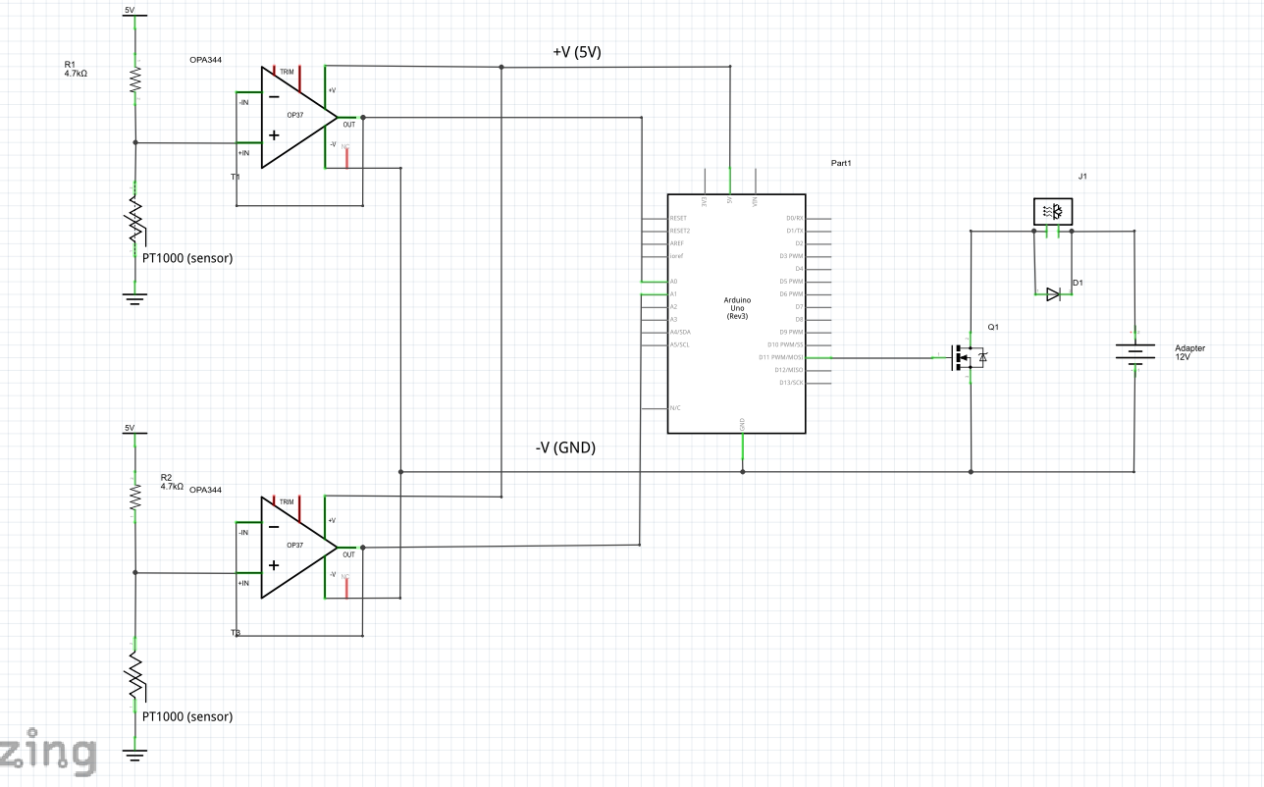
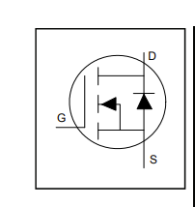
Circuit Design
Heating Circuit
Peltier plate
FET, act as a switch, which controlled by the sensor value
Monitoring Circuit
Power adapter, AC to DC 12V
Notes:
Circuit diagram with two circuit
Key elements to make the control
- PT1000 (platinum), with nearly linear relationship between temperature and its resistance, with high accuracy and long-term stability
- Thermoelectric device, peltier plate, which transfer heat from one side to another with current applying.
field effect transistor (MOSFETs),act as a switch, which vary the controlling signal/voltage to the gate terminal which control the conductivity and allow current flow between drain and source. Drive the high voltage heating circuit with the microcontroller PWM(on/off) signal
-Generation capacity of the power, decide the heating power and speed

Slide 7
Coding
Setpoint = mapped sensor value;
Gain = constant;
n = reading array size;
i=i++ ;
if i>=n{
In time window, average sensor readings}
Error = setpoint – averaged value;
Output = error * gain;
If (output <= 1*gain)
% deadband for delay in activation
PWM = 0
Else if (output>max desired capacity)
PWM = max capacity
Else
PWM=output
Zero stored array and averaged value
If (output <= 1*gain)
% deadband for delay in activation
PWM = 0
Else if (output>max desired capacity)
PWM = max capacity
Else
PWM=output
Zero stored array and averaged value
Notes:
Input
1. setpoint = value mapped desired temperature
2. gain = tested constant, decide the controlling range
Output = PWM value which communicate with the heating circuit, the proportion of On/Off time in each duty cycle
Proportional control

Slide 8
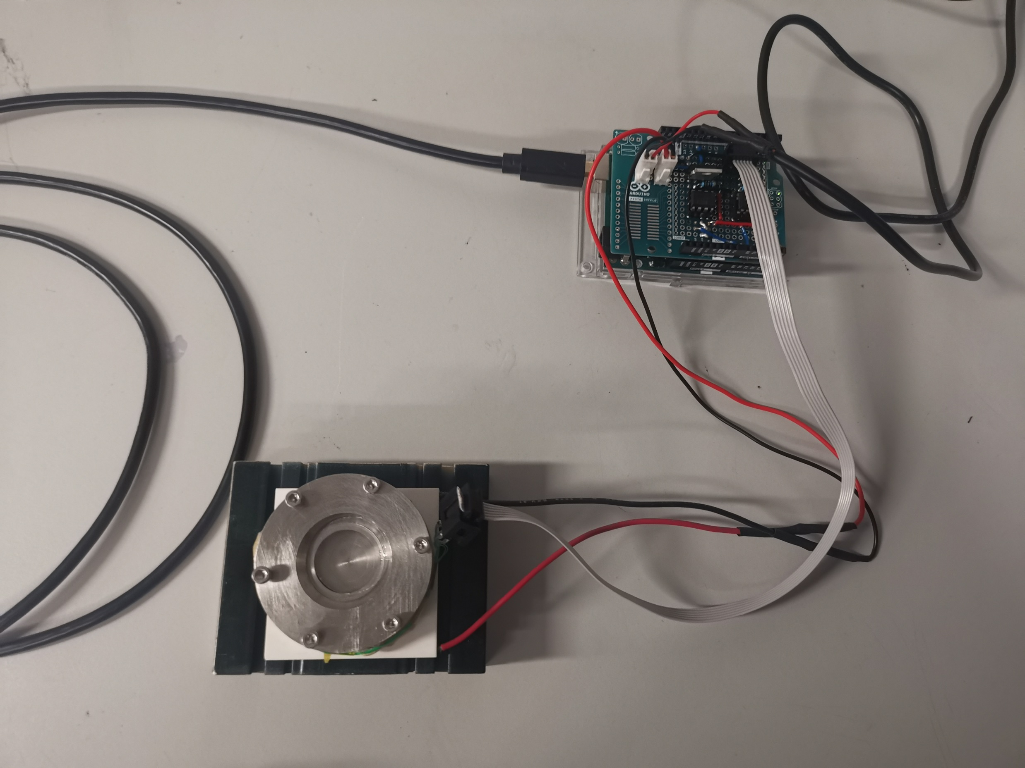
Prototype and Setup
Notes:
For visualization, here is the pictures for the setup

Slide 9
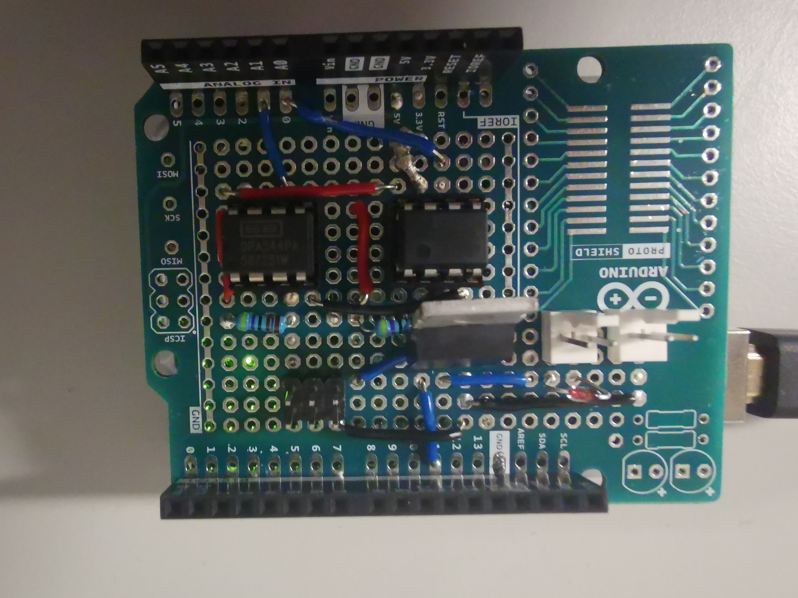
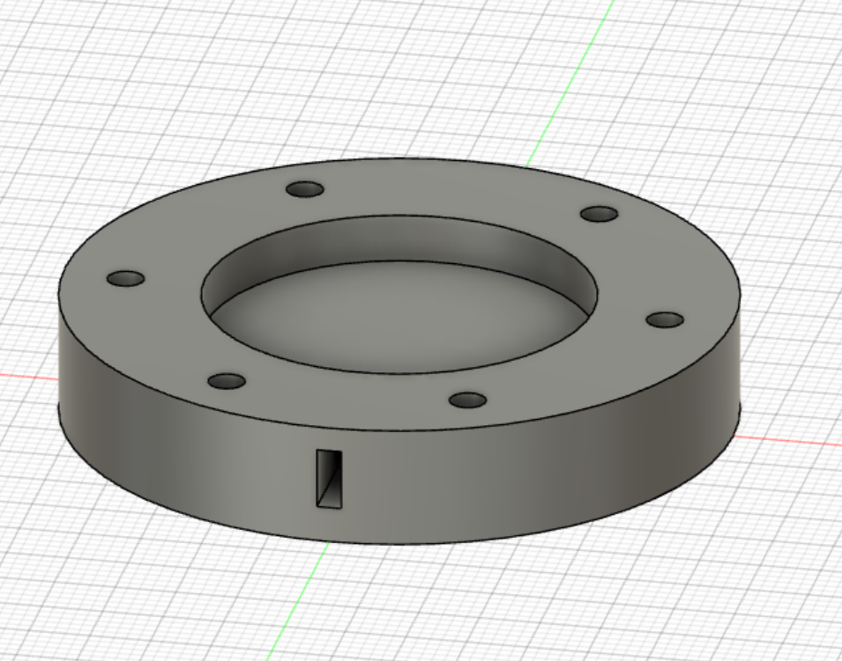
Prototype and Setup
Peltier plate
Power adapter
Sensor connector
Notes:
sensor location and inner sample space which can be sealed
Prototype board picture, connectors for sensor, heating plate and power adapter

Slide 10
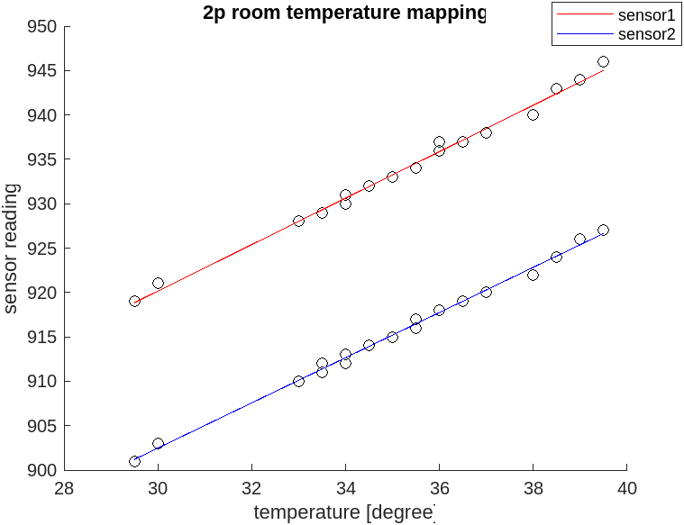

Temperature Mapping
Notes:
Here comes to the result, shown both sensor has good linearity across trials in a same day. Worth to note this mapping used all the data from the cooling process, as the heating data is much scattered and hard to map with the liquid temperature measured by the thermometer.

Slide 11
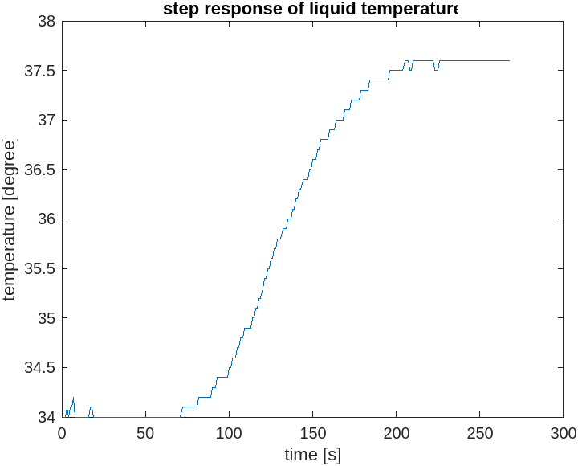
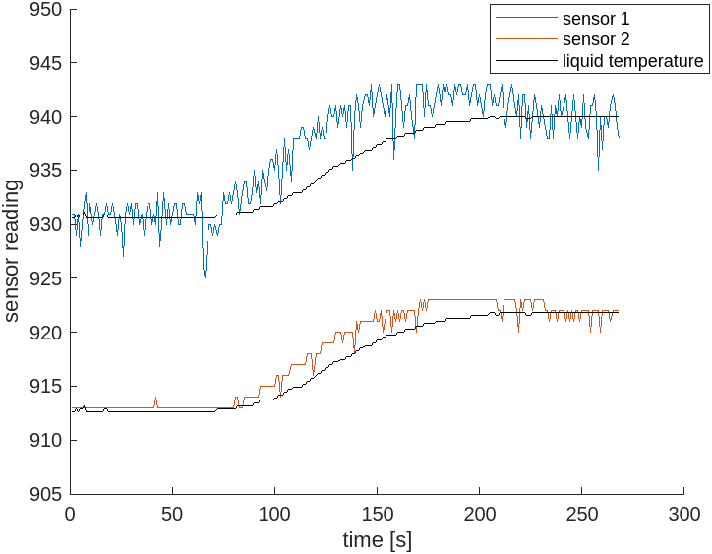
Temperature Mapping
Notes:
Here is a step response graph, the sensor2 was chose for control as it got a more stable reading in heating, which suggested the connection and location , and the setpoint was switched from 915 to 925, which equivalent to 33 steps to 37.5 Degree Celsius. The graph on the right side shows that the sensor2 raw reading has a good match in shape while as sensor 1 has a quite fluctuated readings through the process.

Slide 12
Temperature Control Performance
Notes:
After all the mapping test, in the best setpoint range which stabilize the liquid temperature within the optimal temperature range of brain. Within a 15 mins recording after settling, all the 5 setpoints has deviation less than 0.5 degree C, which is a promising result for the control performance, and also indicated that the system has avoided accumulating heat in time.

Slide 13
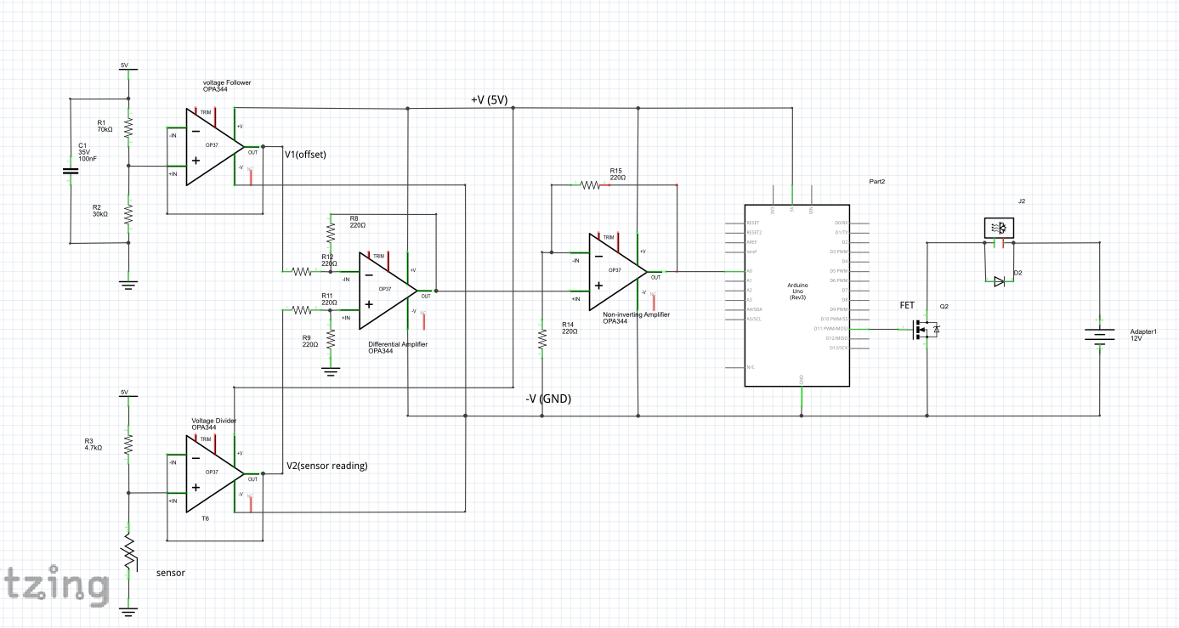
Resolution Improvement
Non-inverting amplifier – amplifying the signal
Voltage follower –offset voltage
Differential amplifier - subtract the offset
Notes:
The modified circuit removes the offset from the reading, and with an amplifier, the signal then takes use of the most ADC bits
Voltage reference band gap reference, recalibrate!
Capacitor (decoupling capacitor) between the +ve and –ve supply of each op amp ic, for a stable signal and not affect with each other

Slide 14
Resolution Improvement
Notes:
Demonstration here the step response after amplification, it could provide upto a 13 fold increase of the signal, which improve the resolution of the temperature mapping

Slide 15
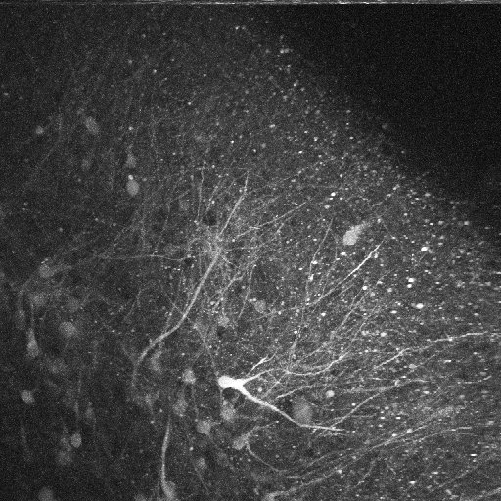
Organoid Calcium Dynamics
Imaging plan
- new organoid slices in the temperature control chamber
- record under temperature control, around and within the optimal temperature range, repeat for each site
Notes:
As no obvious signal in the old organoids, and due to the schedule of the new organoid,
This is an upcoming imaging plan, focus on the variation in firing rate

Slide 16
Conclusion
Temperature Control System
Linearity in Direct Mapping - from analog pin sensor reading signal to the actual liquid temperature
Precise Control – setpoint interval of 0.5 °C, and less than ±0.3 °C error bar
High Temperature Reading Resolution Design – subtract the offset and amplify the signal, however, still need to work on unwanted fluctuation/noises
Regular re-mapping is required because of the weak mechanical connection and external environment
Calcium Dynamics
Expecting signal in new organoid slices, representing the early developmental dynamics
Expecting variation in firing rate and the signal intensity under temperature regulation
Notes:
Linear relationship direct mapping of sensor reading after ADC to the actual temperature
Achieve a precise control
use Computational method and signal processing for signal sterbilisation

Slide 17
Discussion
Demonstrate the potential and pros of brain organoid model for neuroscience study
Determine the developmental dynamics and maturation (i.e. synchronized oscillatory network [2]) in the samples
Then, the significant of temperature regulation during imaging on the calcium dynamics
Evidence with in vivo temperature manipulation [3], at certain region in the brain
Notes:
In order to demonstrate the potential of using brain organoids to supplement the animal models, for disease study and other neuroscience research,
A recent paper tried to insert a probe in vivo, which with temperature control to change striatal tissue temperature, a nonmonotonic effect on baseline of firing rate, complex spatiotemporal profile

Slide 18
Acknowledgements
I am grateful to all of those with whom I have had the pleasure to work during this project.
My supervisors in the lab, Prof. Schulz, Nawal and Elena for the professional guidance on the project and technical support in the lab
Electronics lab technicians Paschal and Tariq, for advice on the system design and grant for electronic materials in this project
Mechanical lab technicians, John and Hamidreza for advice on chamber design and the manufacturing work of the chamber
And my teammates, Dilara and Julia, for their excellent work on growing our own organoids in the lab and manage all the works accompanied with organoid culture.

Slide 19
Reference
ripotent stem cells in vitro’, Development, 142(18), pp. 3178–3187. Available at: https://doi.org/10.1242/dev.123851.
Lancaster, M.A. et al. (2013) ‘Cerebral organoids model human brain development and microcephaly’, Nature, 501(7467), pp. 373–379. Available at: https://doi.org/10.1038/nature12517.
Monteiro, T. et al. (2023) ‘Using temperature to analyze the neural basis of a time-based decision’, Nature Neuroscience, 26(8), pp. 1407–1416. Available at: https://doi.org/10.1038/s41593-023-01378-5.

Slide 20
THANK YOU

