Slide 1

Post-processing Imaging for 3D Model in Discrete Element Method
Rasterization
Spatial Interpolation
Nanjing University
WEI Huajing
14/06/2020

Slide 2
Content
Background
Algorithm
Aim

Slide 3
Content
Background
Algorithm
Aim

Slide 4
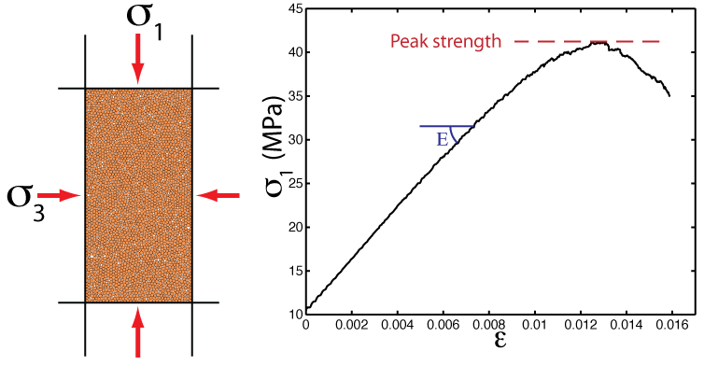
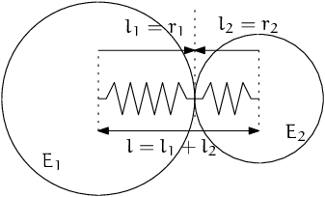
Background
DEM: Discrete Element Model
Micro-granular system for macroscopic object
Based on Newtonian mechanics
Masses of computation

Slide 5
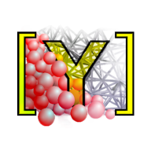
Software
YADE: Yet Another Dynamic Engine
Performed on Linux
Open Source
Python Command Line

Slide 6
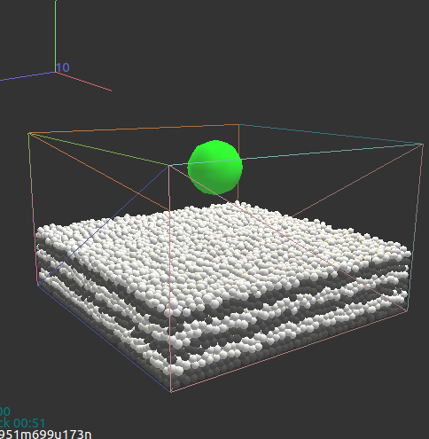
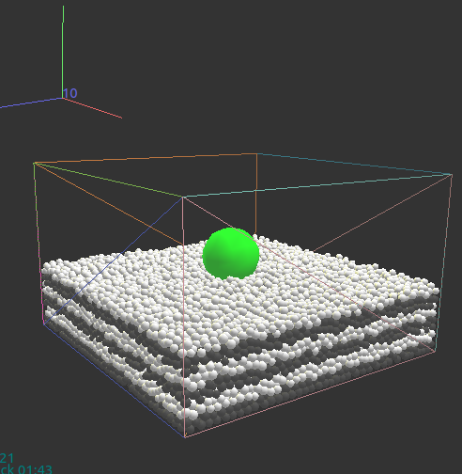
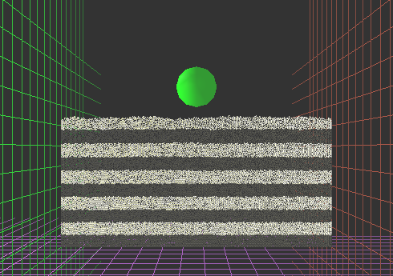
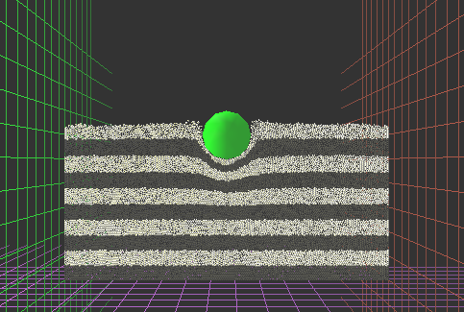
Scenario
Process of aerolite collision

Slide 7
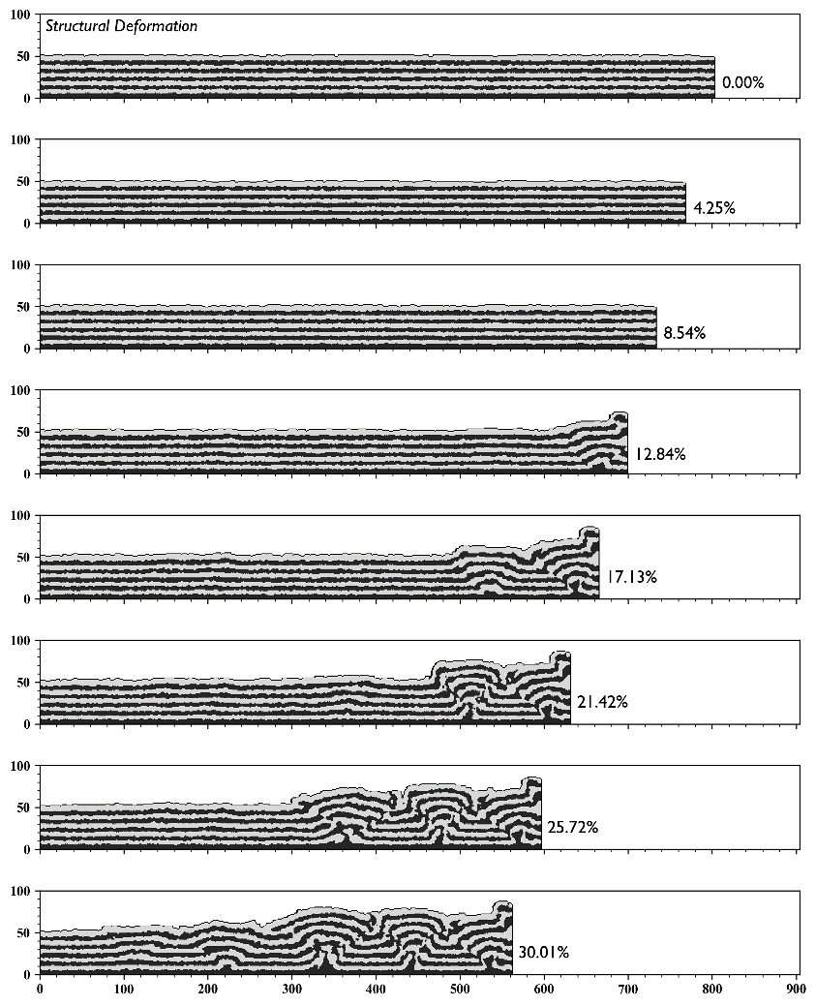
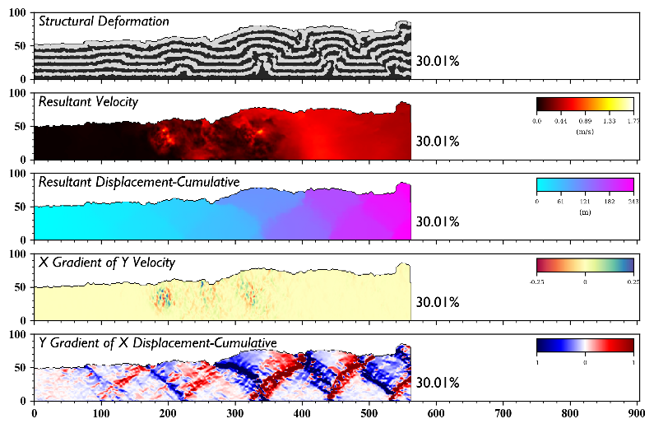
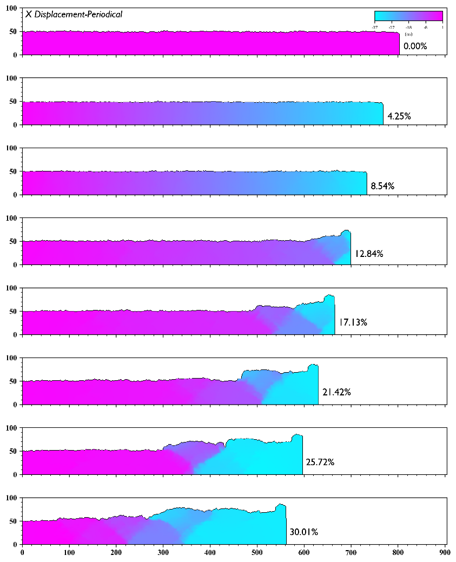
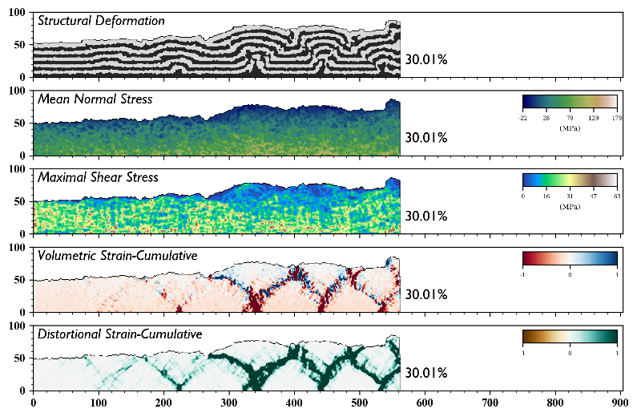
Imaging Effect

Slide 8
Content
Background
Algorithm
Aim

Slide 9

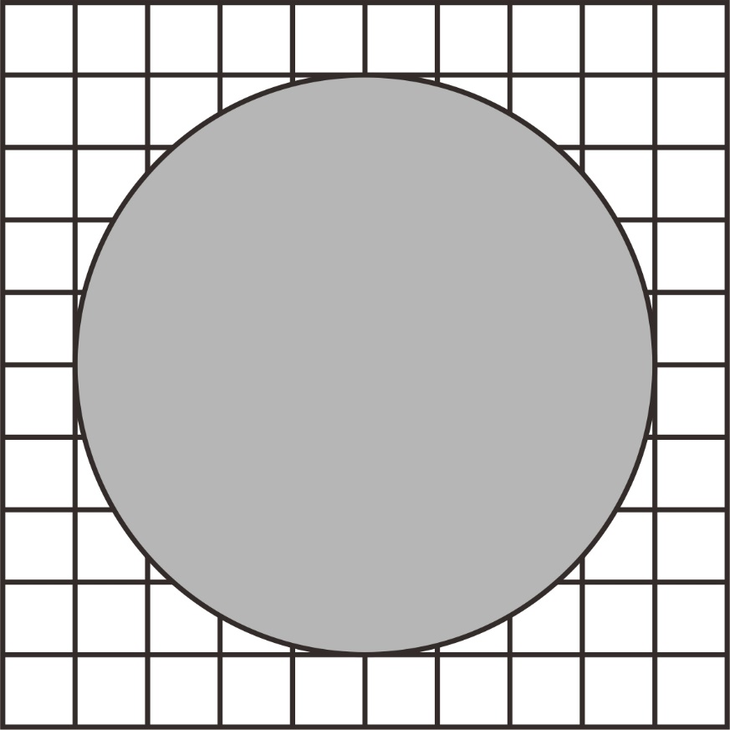
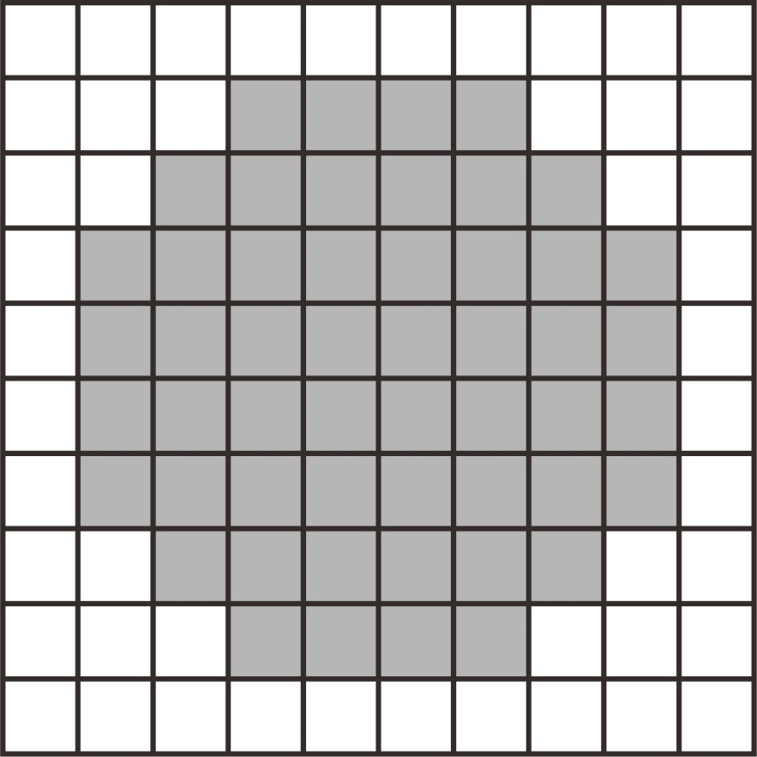


Rasterization
GitHub: https://github.com/jerryweihuajing/Post-Processing

Slide 10
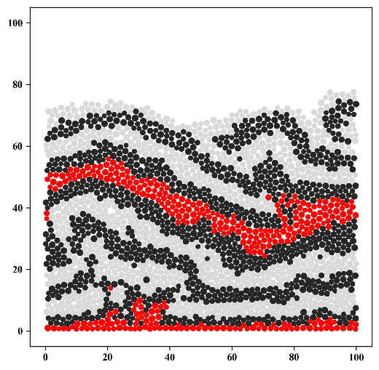
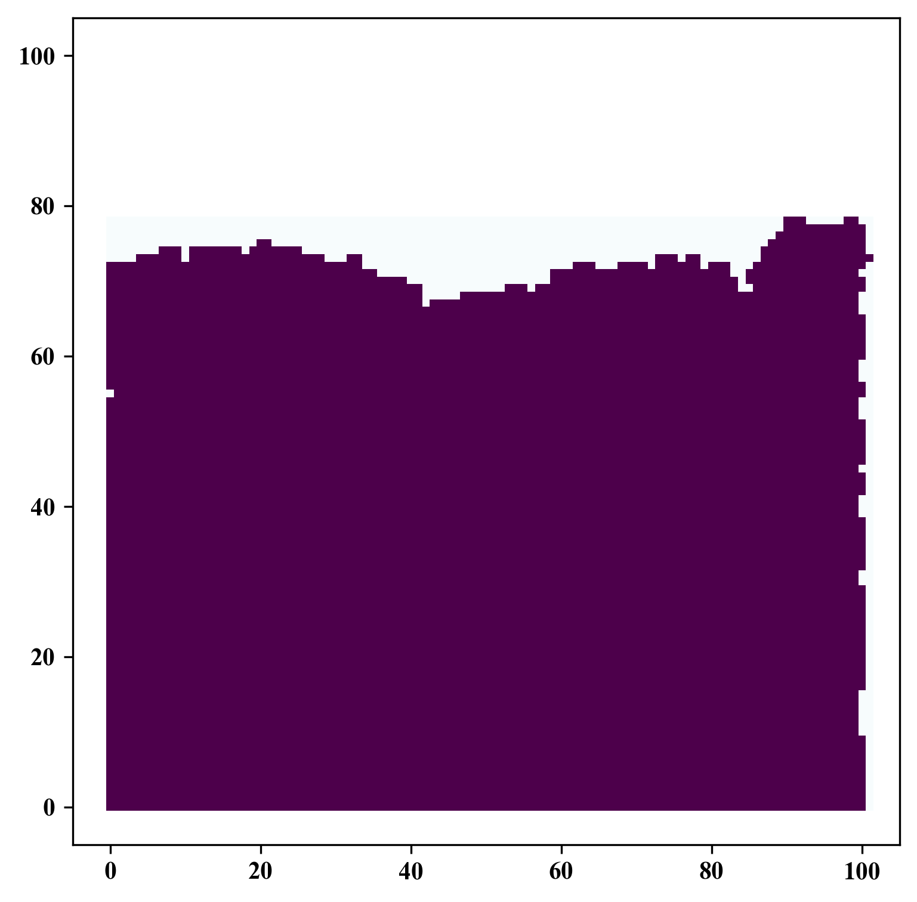
Rasterization
GitHub: https://github.com/jerryweihuajing/Post-Processing

Slide 11
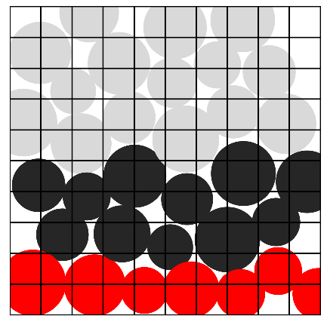
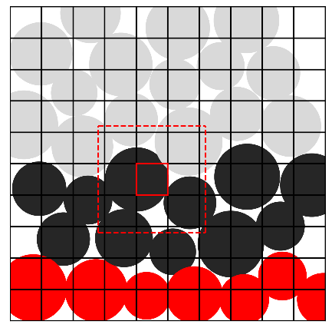
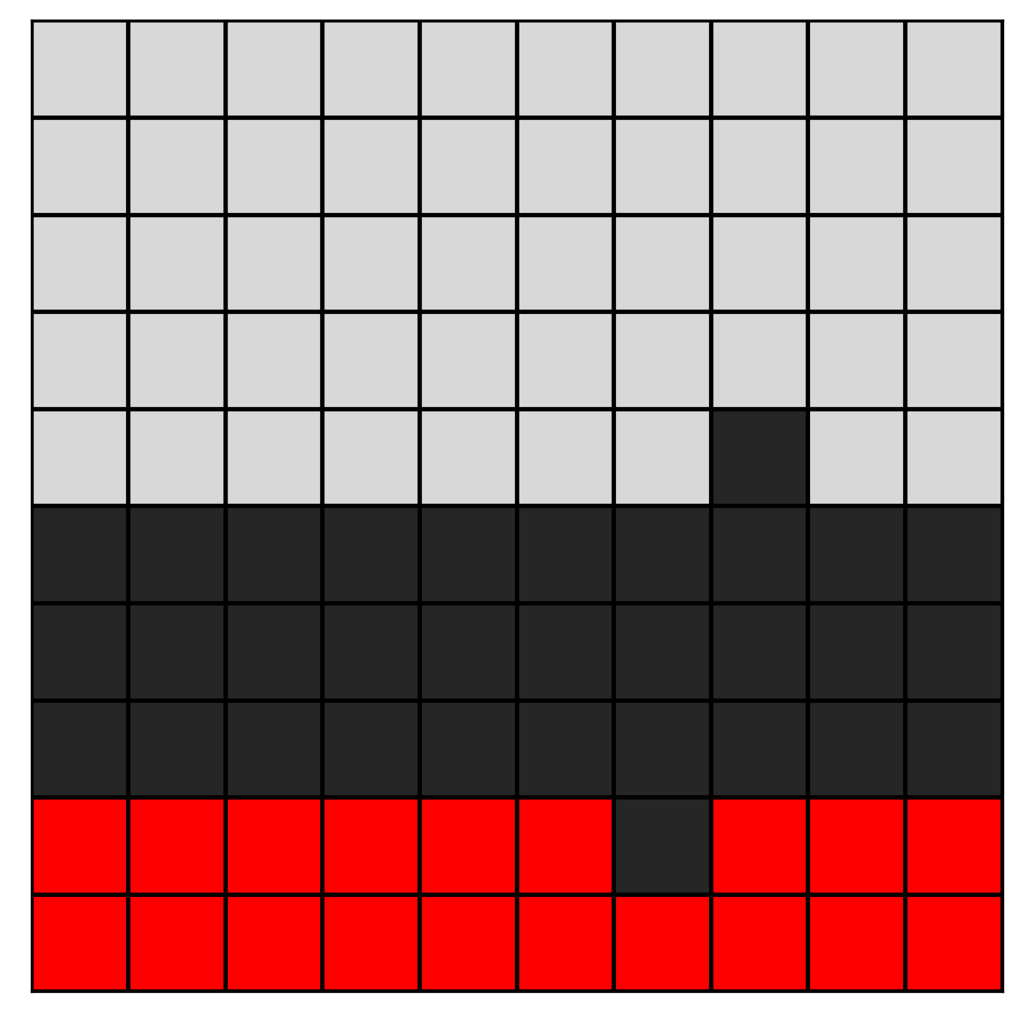
Rasterization
GitHub: https://github.com/jerryweihuajing/Post-Processing

Slide 12

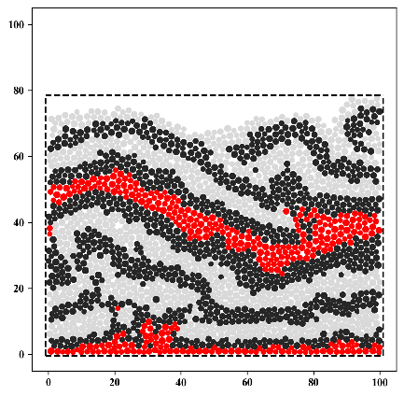
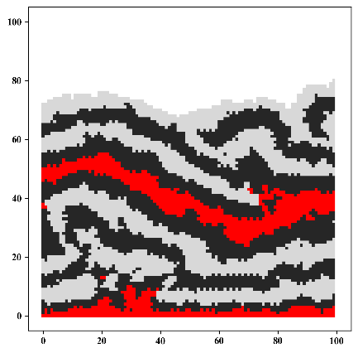
Rasterization
GitHub: https://github.com/jerryweihuajing/Post-Processing

Slide 13
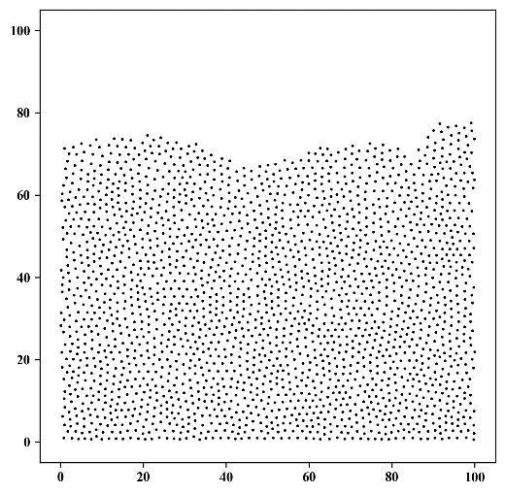
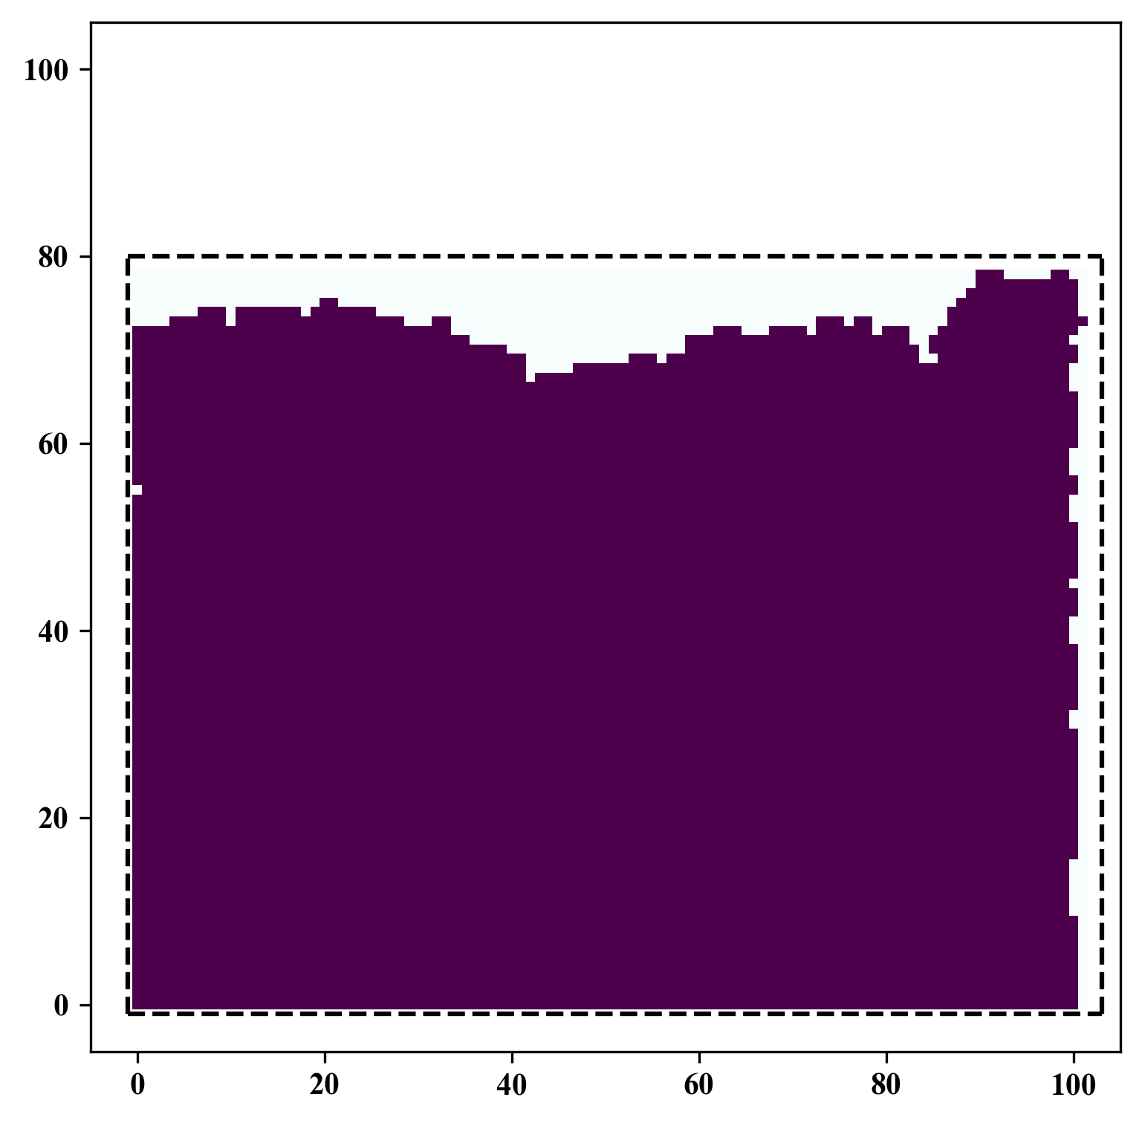
Spatial Interpolation
GitHub: https://github.com/jerryweihuajing/Post-Processing

Slide 14
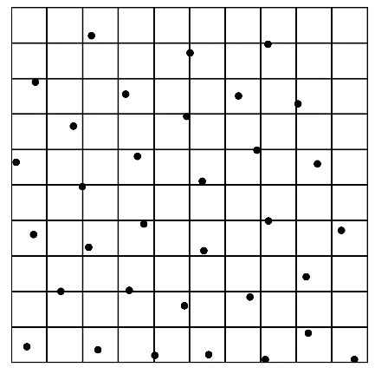
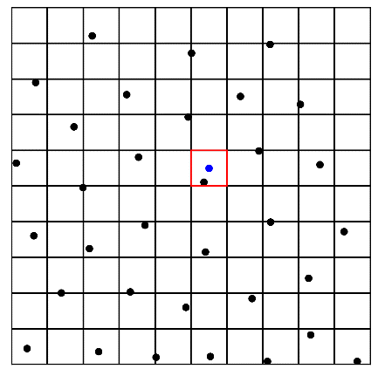
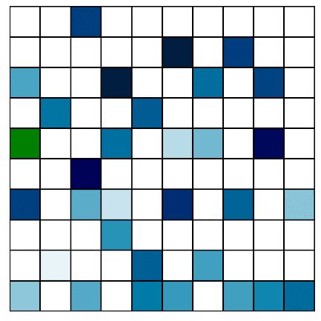
Spatial Interpolation
GitHub: https://github.com/jerryweihuajing/Post-Processing

Slide 15
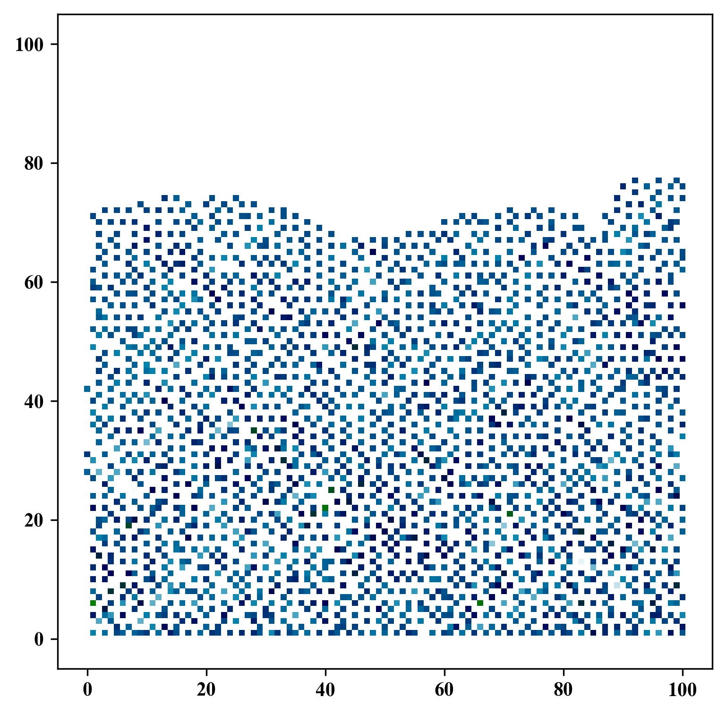
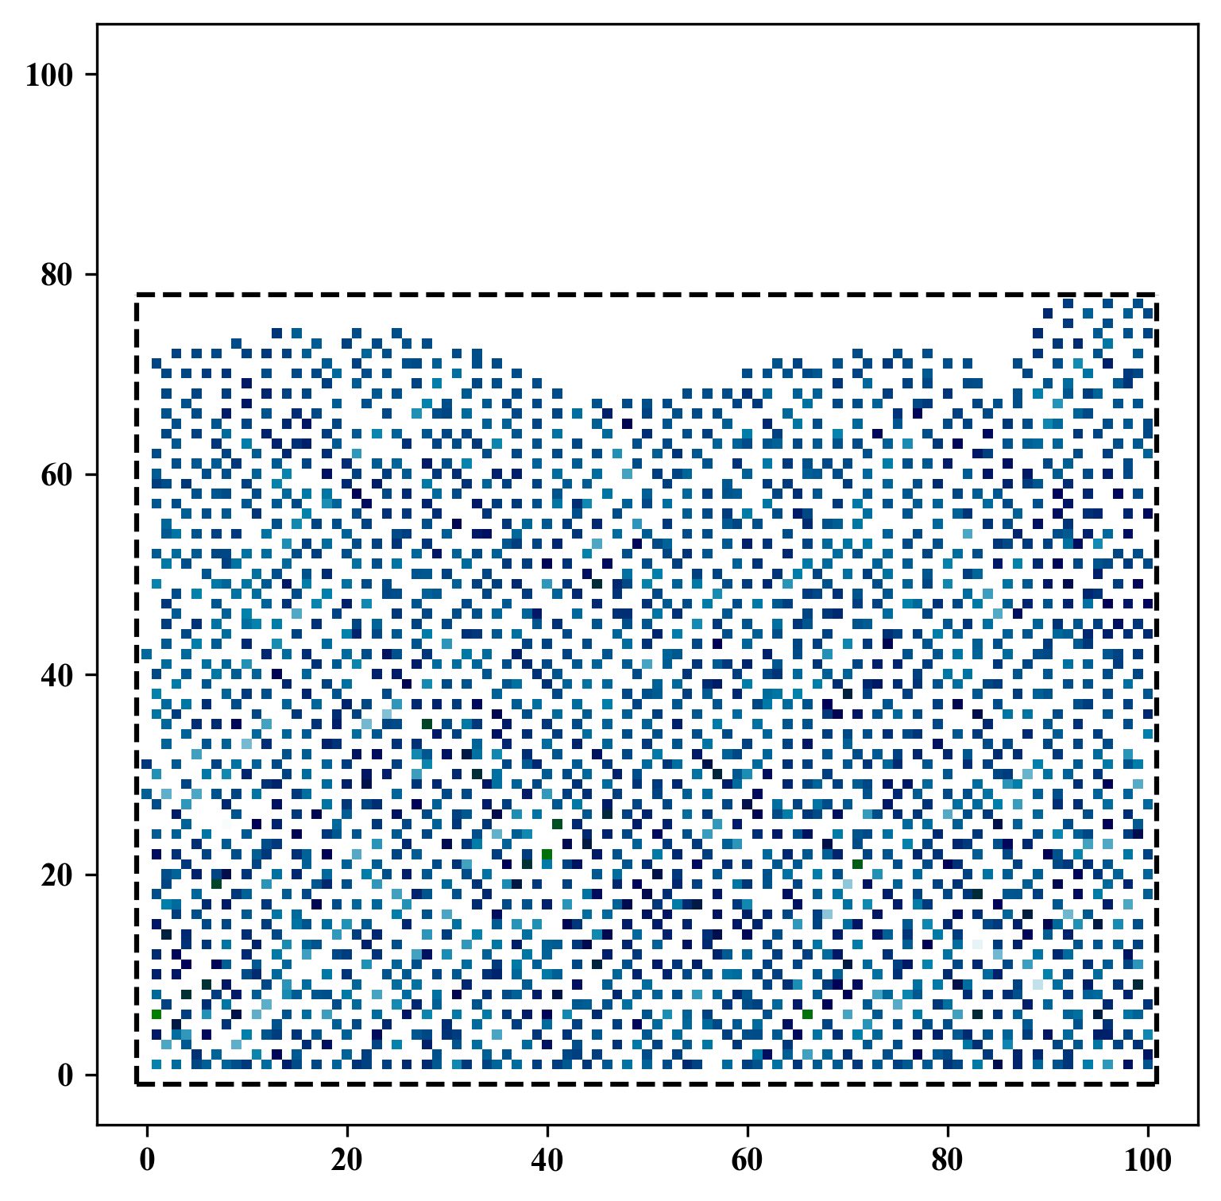
Spatial Interpolation
GitHub: https://github.com/jerryweihuajing/Post-Processing

Slide 16
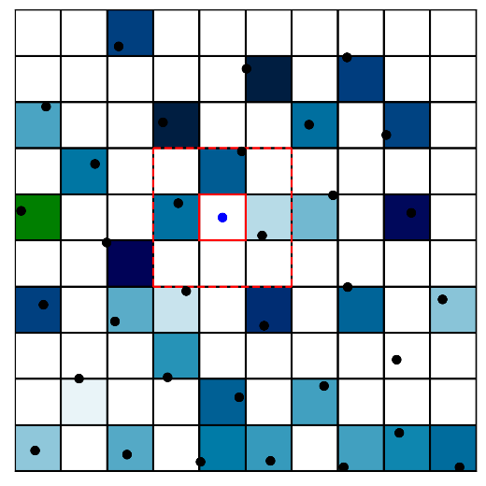
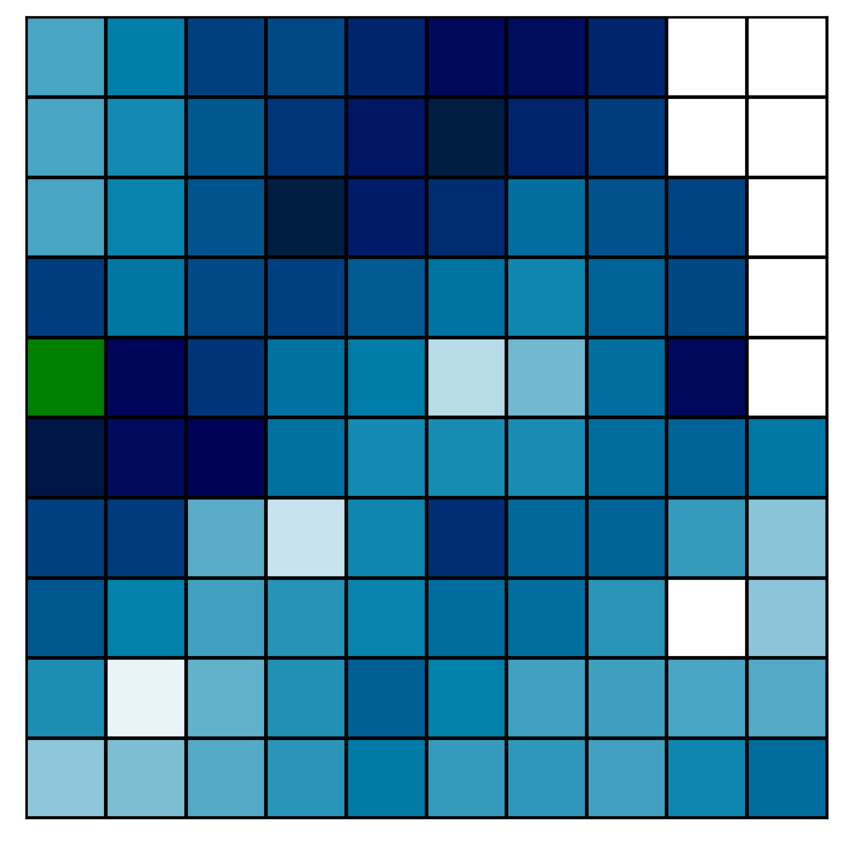
Spatial Interpolation
GitHub: https://github.com/jerryweihuajing/Post-Processing

Slide 17
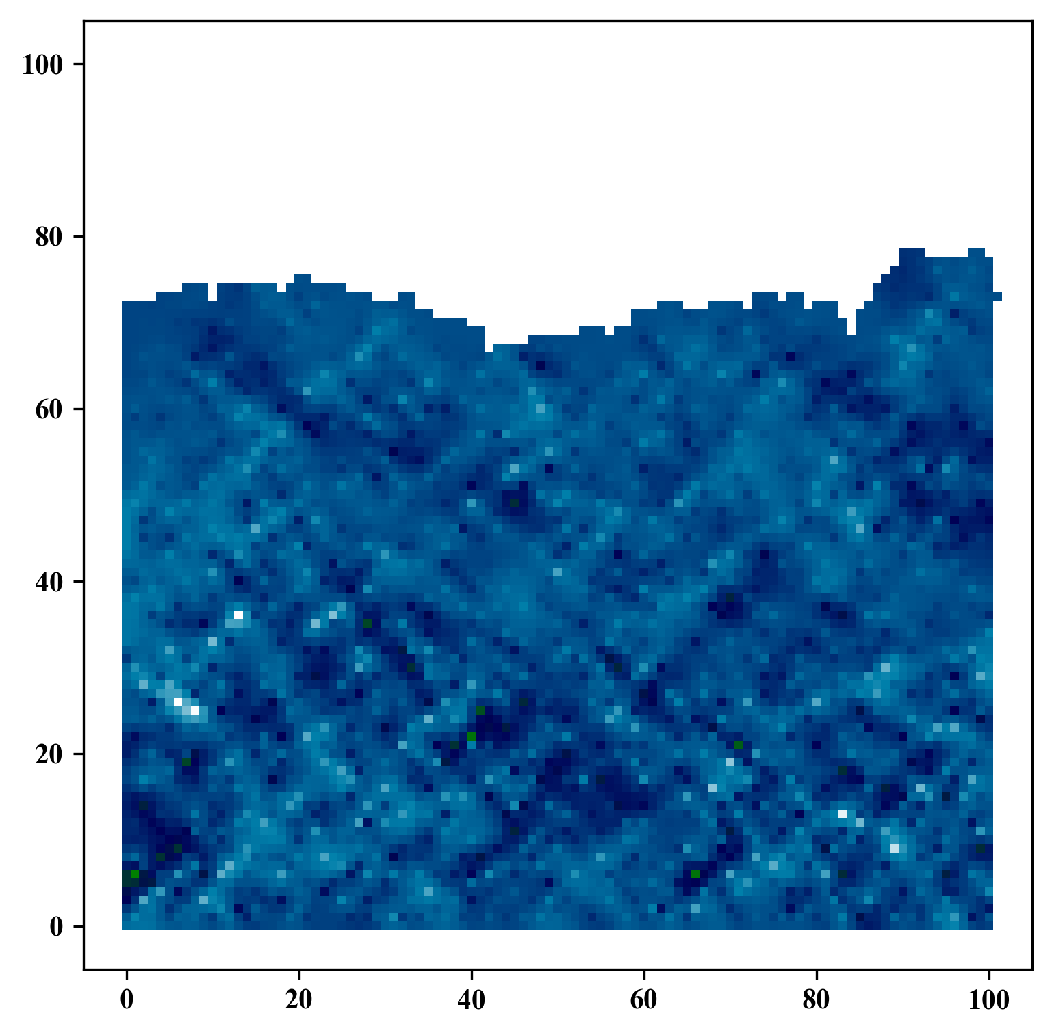
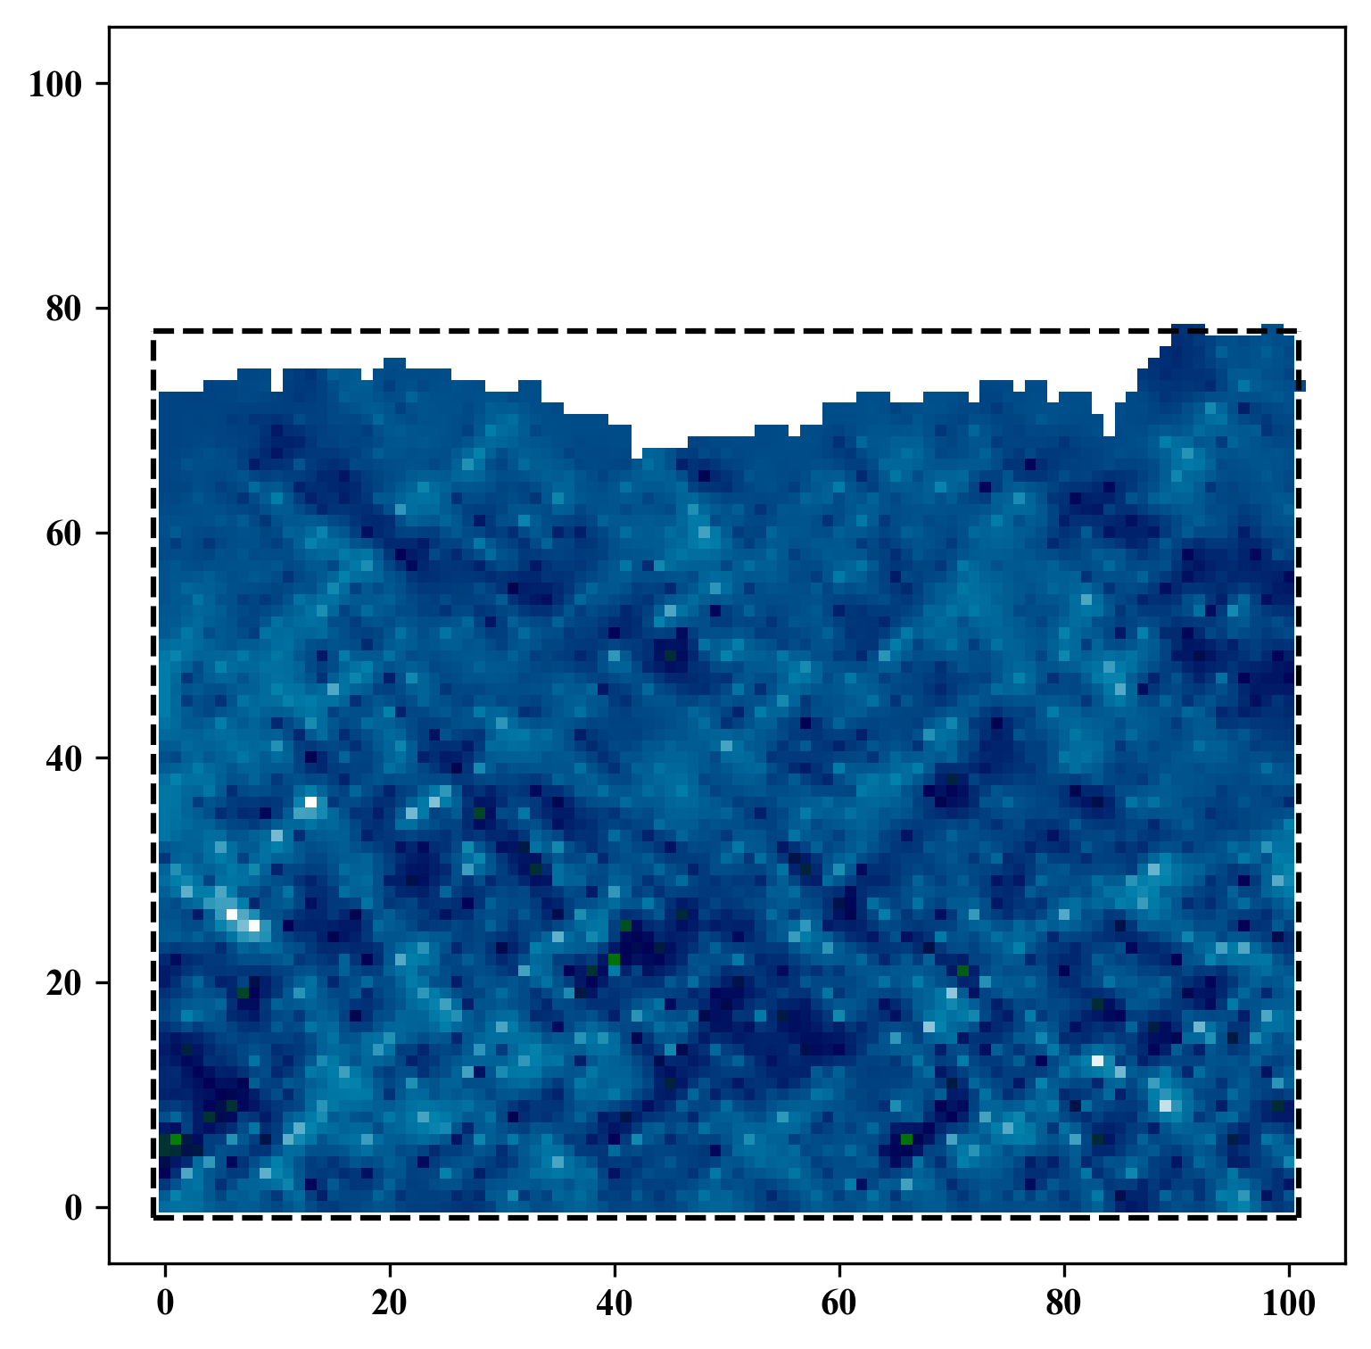
Spatial Interpolation
GitHub: https://github.com/jerryweihuajing/Post-Processing

Slide 18
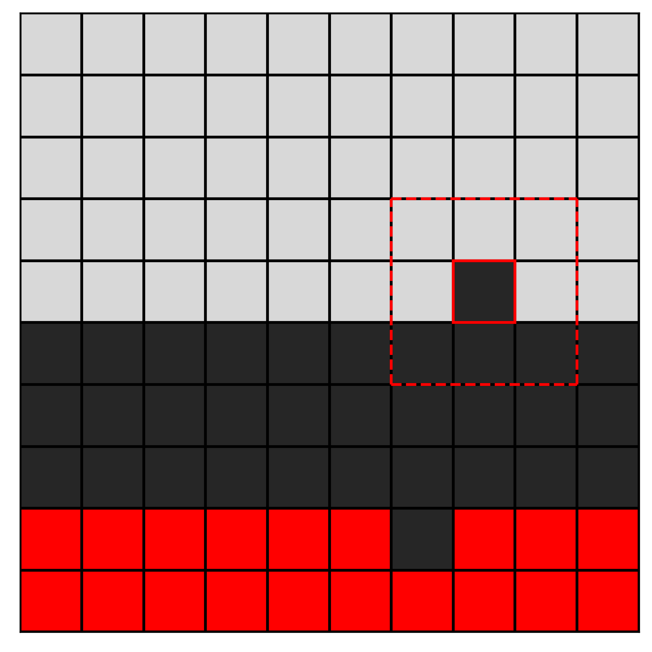
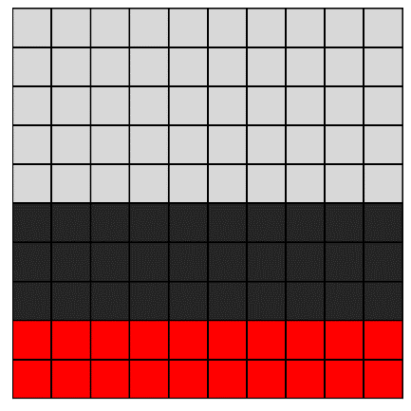
Gaussian Filtering
GitHub: https://github.com/jerryweihuajing/Post-Processing

Slide 19

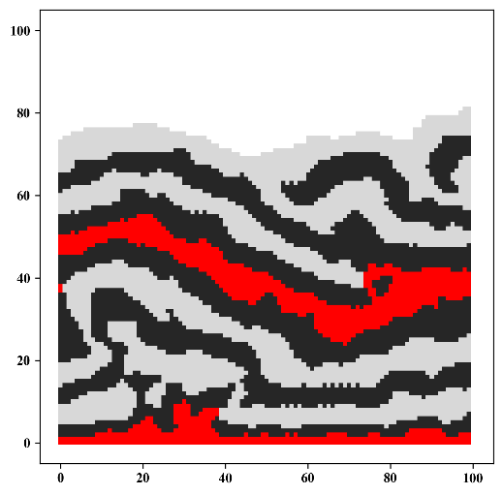
Gaussian Filtering
GitHub: https://github.com/jerryweihuajing/Post-Processing

Slide 20
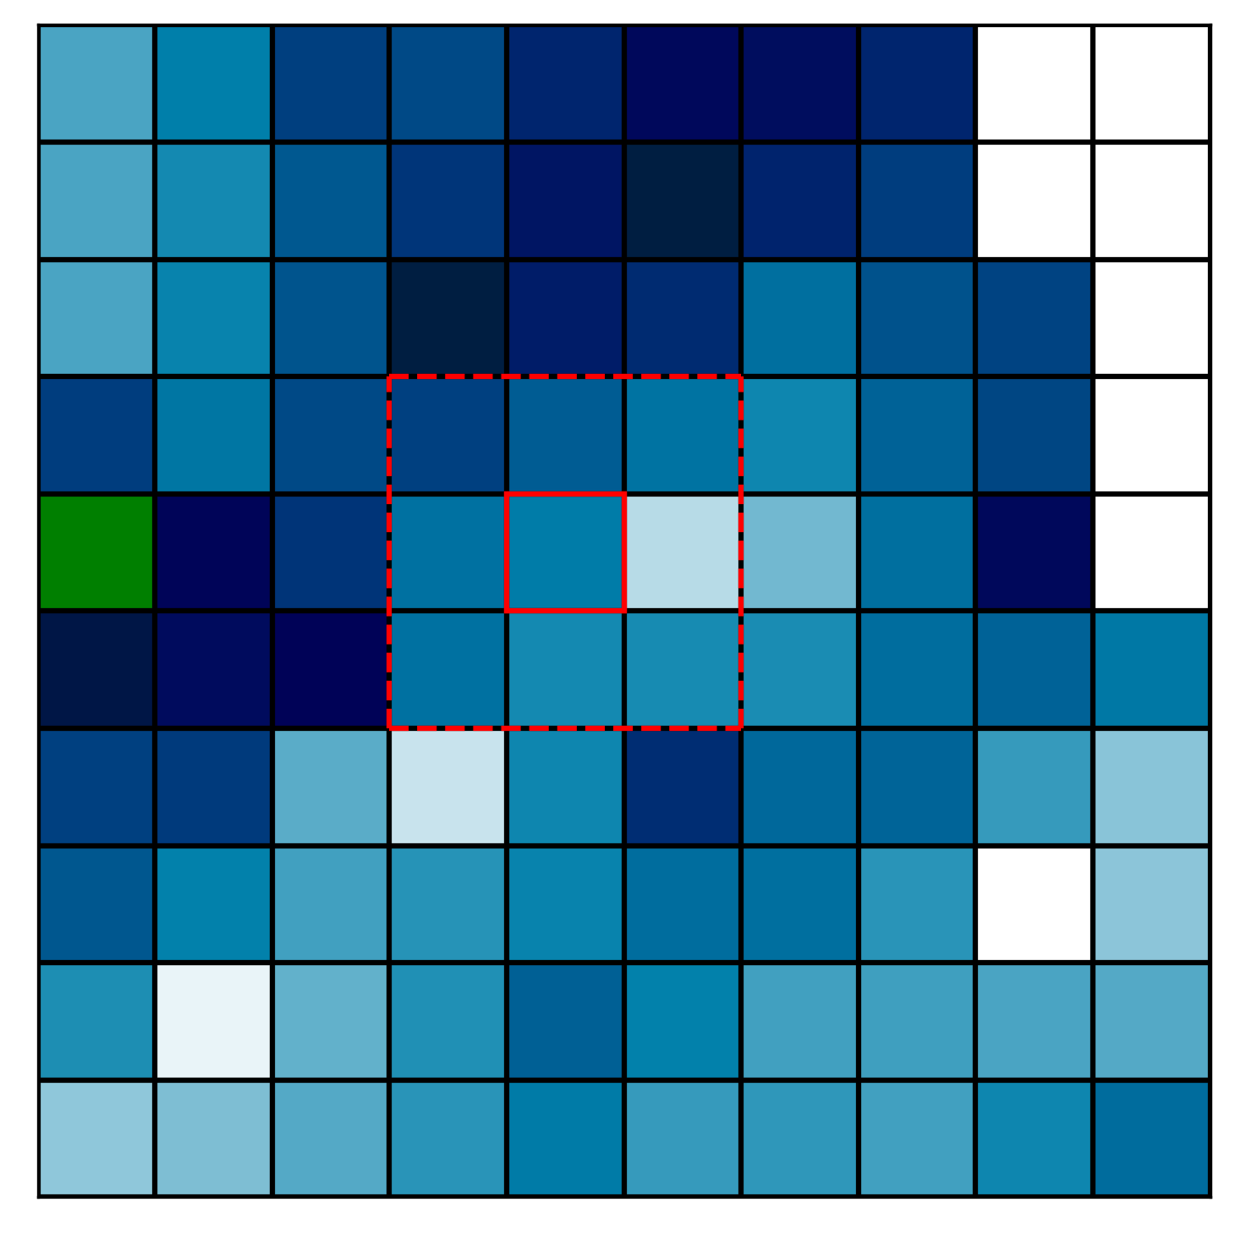
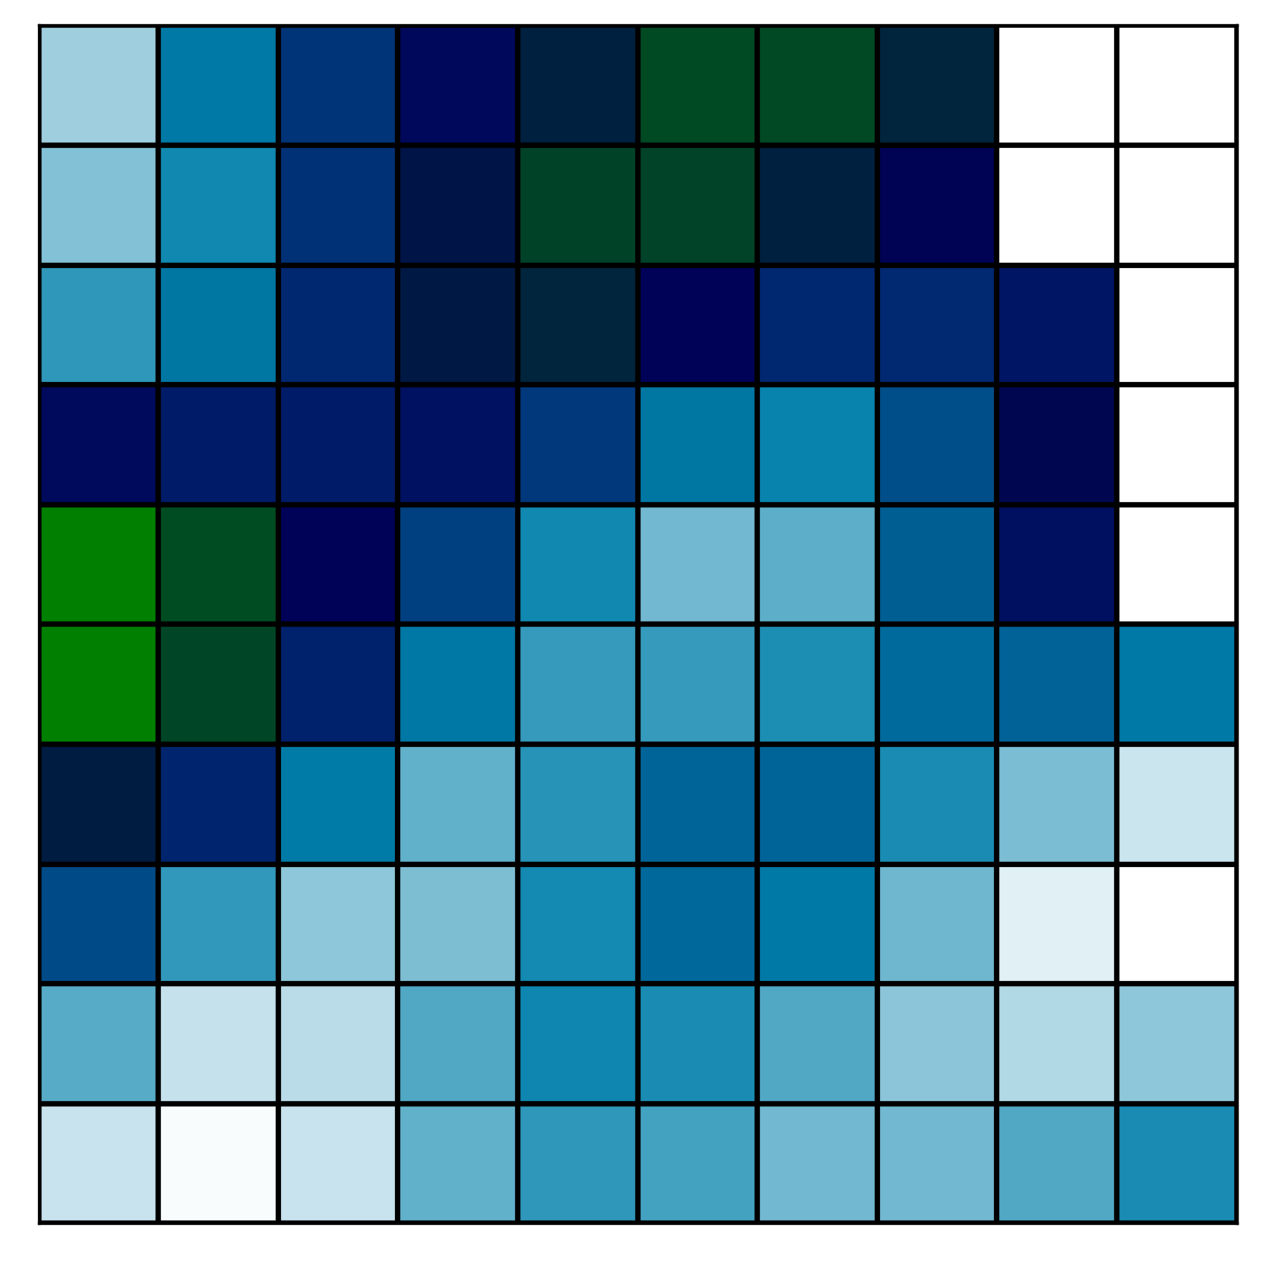
Gaussian Filtering
GitHub: https://github.com/jerryweihuajing/Post-Processing

Slide 21
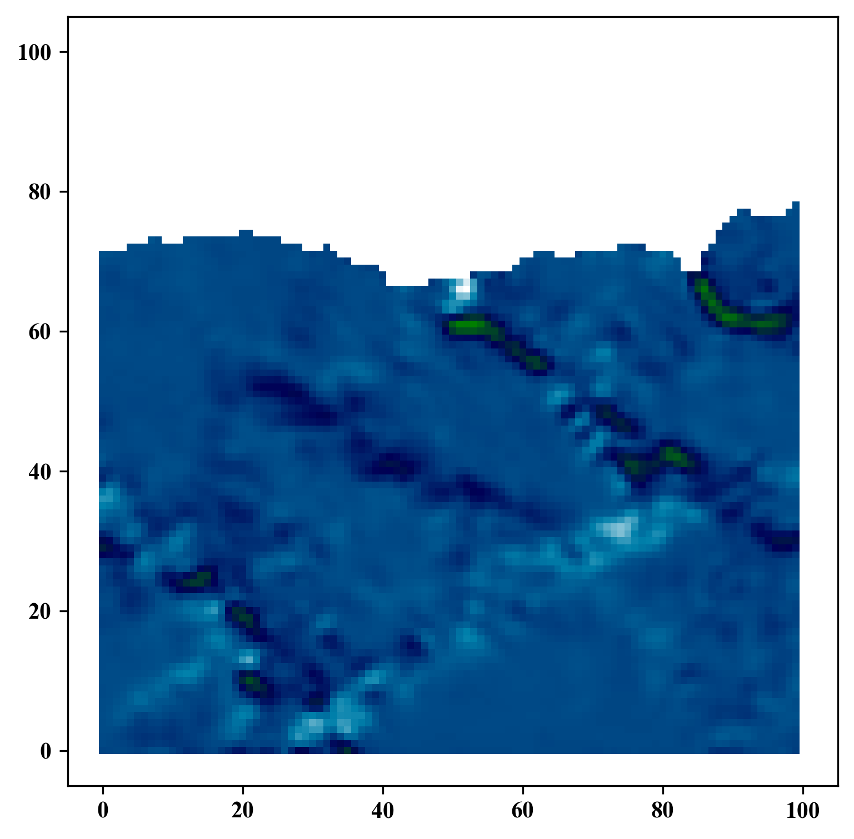
Gaussian Filtering
GitHub: https://github.com/jerryweihuajing/Post-Processing

Slide 22
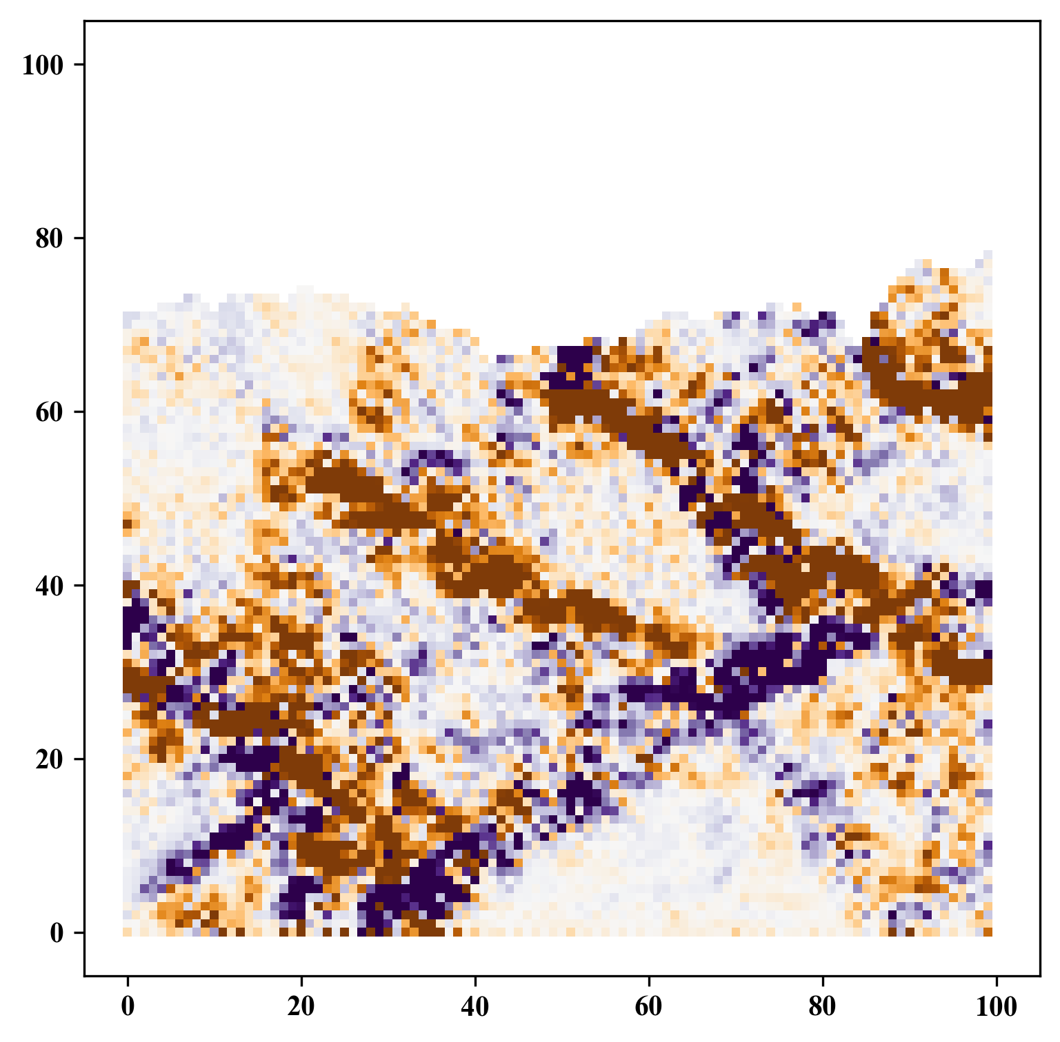
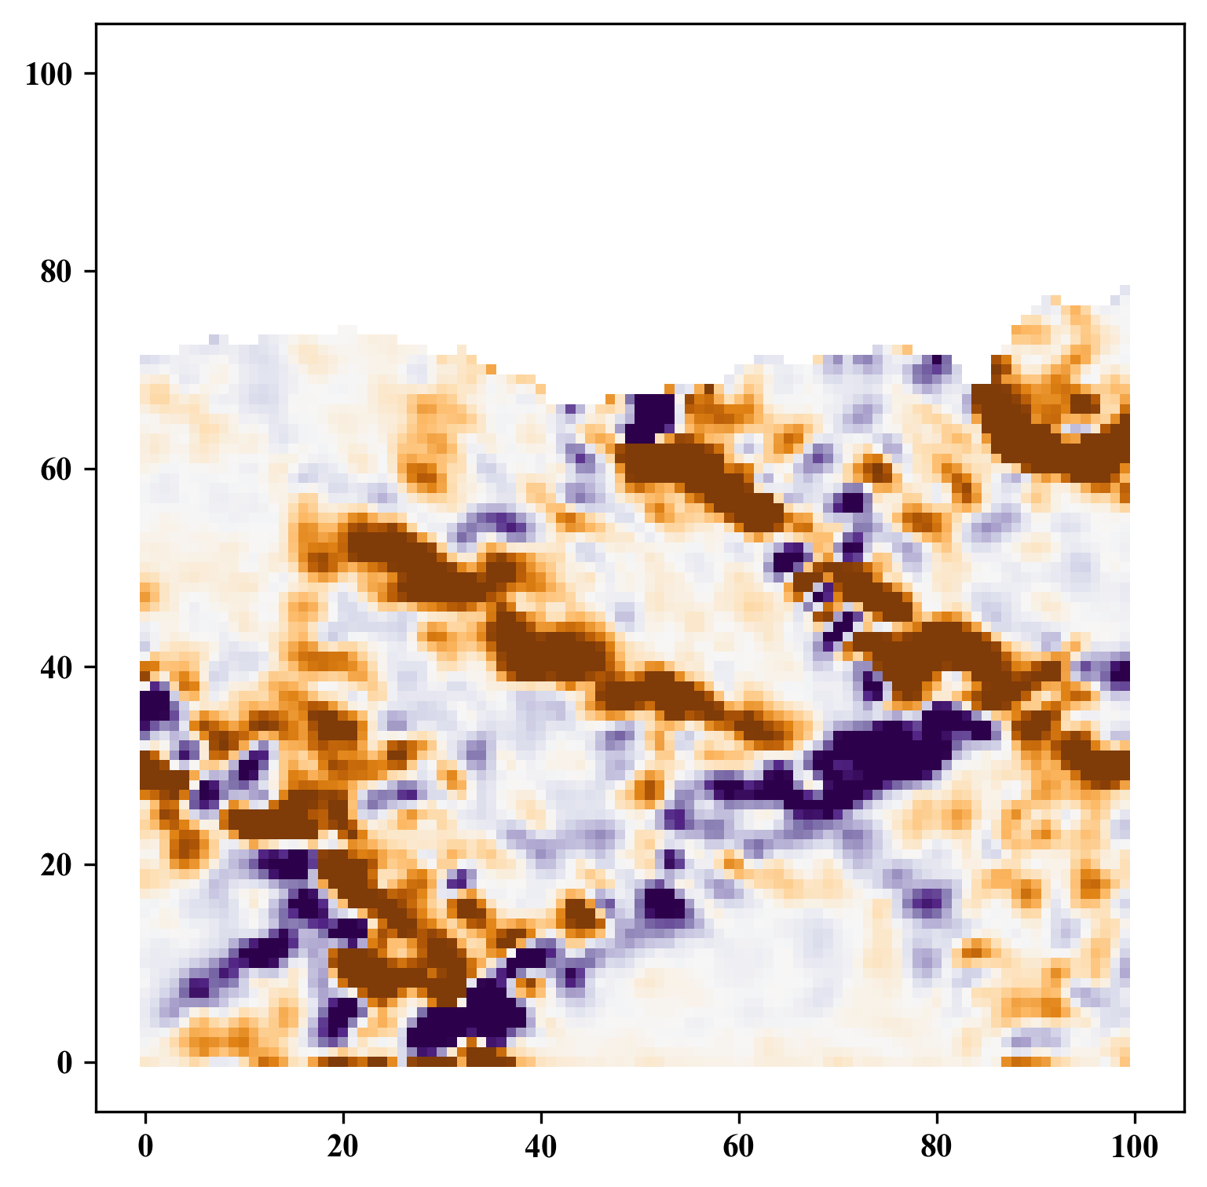
Gaussian Filtering
GitHub: https://github.com/jerryweihuajing/Post-Processing

Slide 23
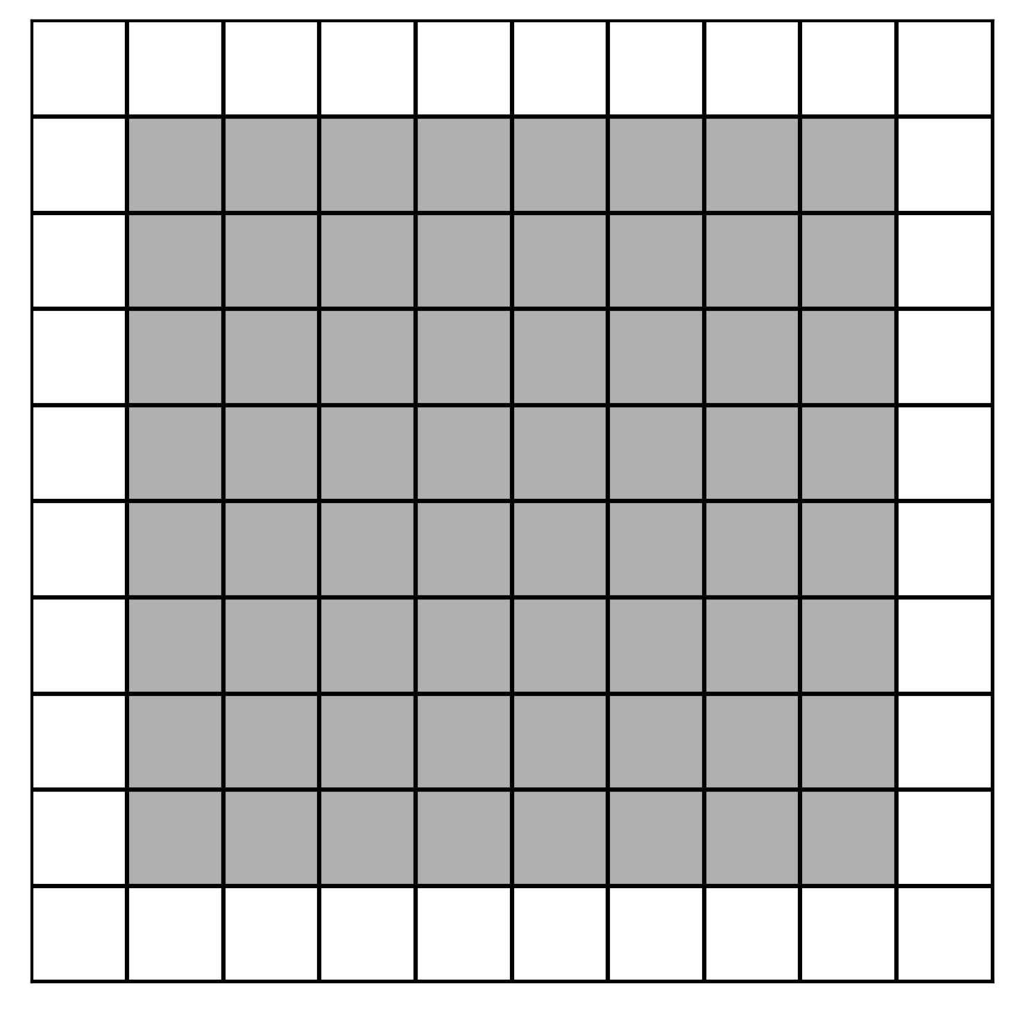
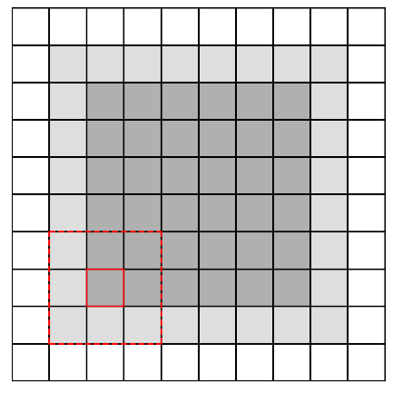
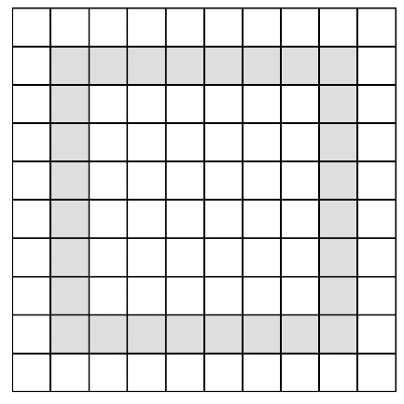
Boundary Extraction
GitHub: https://github.com/jerryweihuajing/Post-Processing

Slide 24
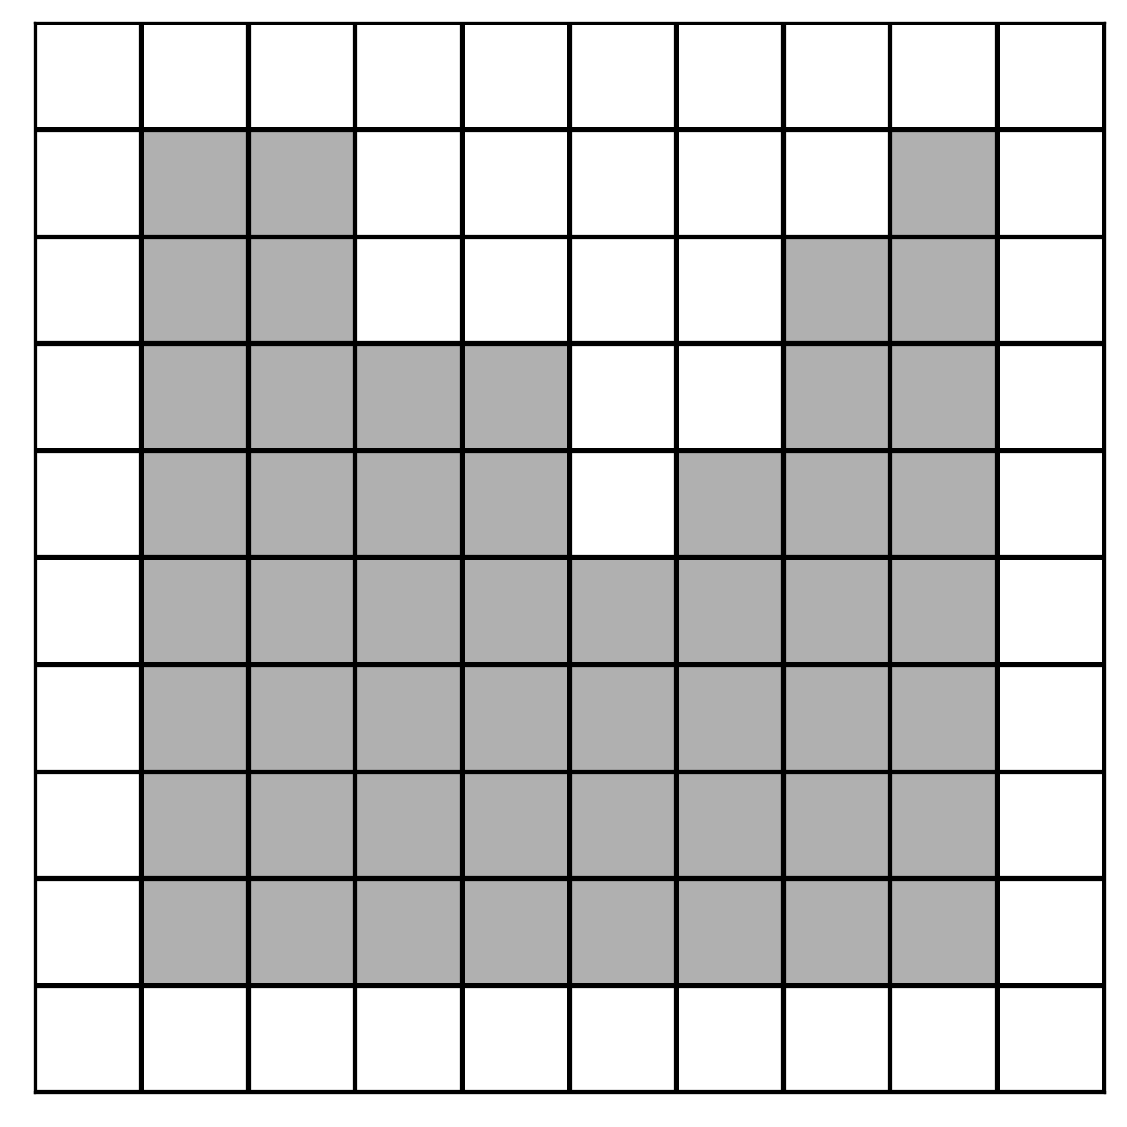
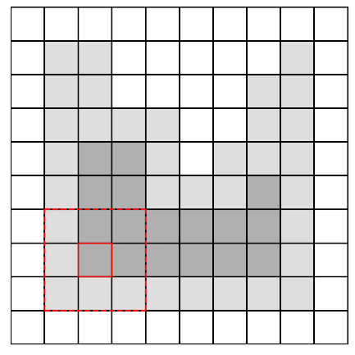
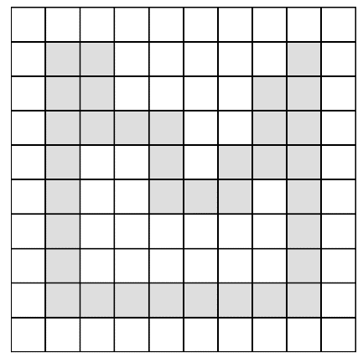
Boundary Extraction
GitHub: https://github.com/jerryweihuajing/Post-Processing

Slide 25
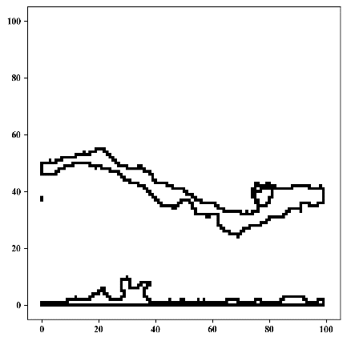
Boundary Extraction
GitHub: https://github.com/jerryweihuajing/Post-Processing

Slide 26
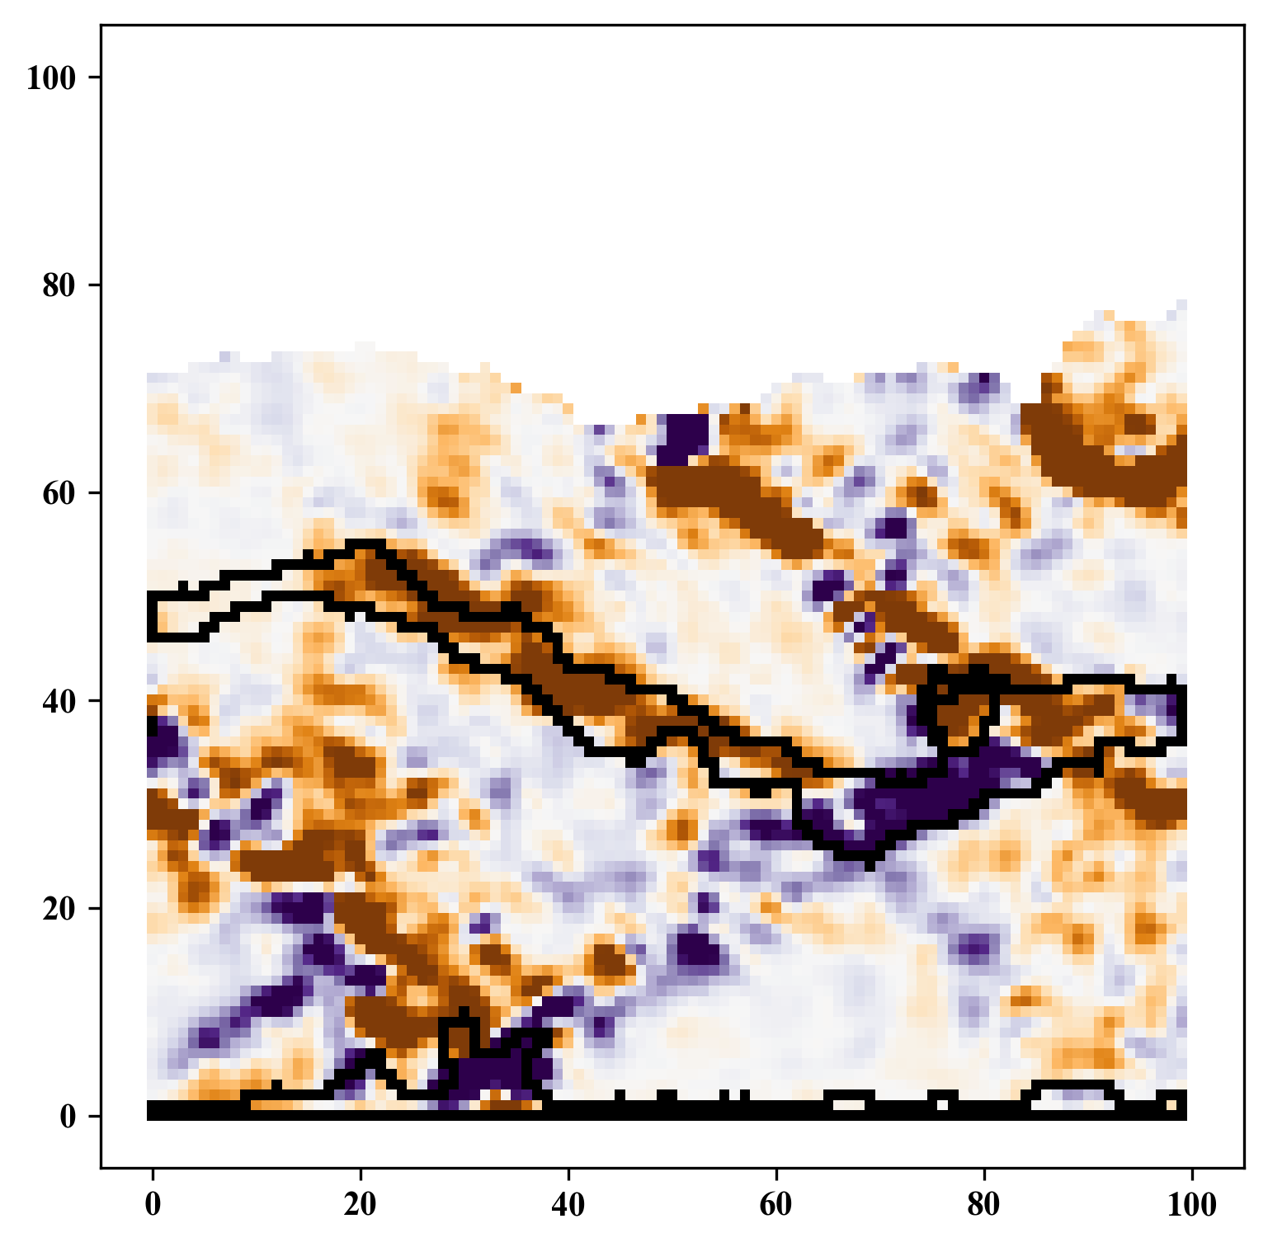
Boundary Extraction
GitHub: https://github.com/jerryweihuajing/Post-Processing

Slide 27
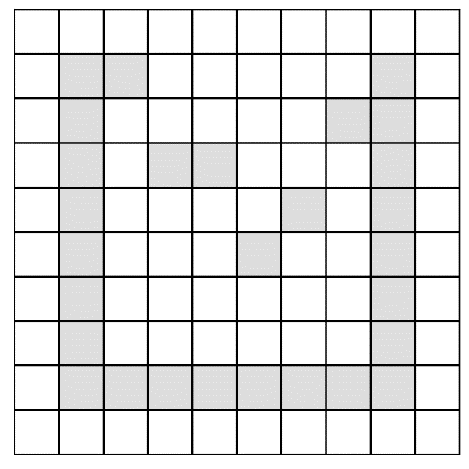
Outline Calculation
GitHub: https://github.com/jerryweihuajing/Post-Processing

Slide 28
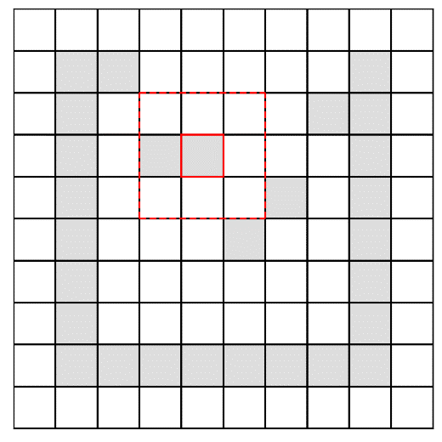
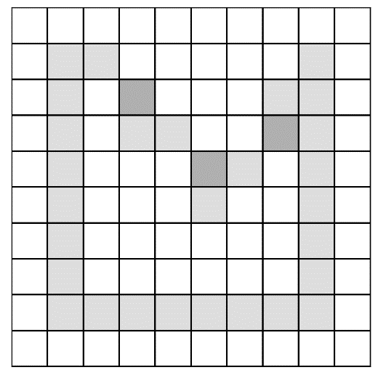
Outline Calculation
GitHub: https://github.com/jerryweihuajing/Post-Processing

Slide 29



Outline Calculation
GitHub: https://github.com/jerryweihuajing/Post-Processing

Slide 30

Outline Calculation
GitHub: https://github.com/jerryweihuajing/Post-Processing

Slide 31
Content
Background
Algorithm
Aim

Slide 32
Aim
Viewing Transformation
(Circle) Rasterization
Spatial Interpolation
Z-Buffering

Slide 33
Acknowledgement
THANKS

