Slide 1

Post-processing Imaging for 3D Model in Discrete Element Method
Rasterization
Spatial Interpolation
Nanjing University
WEI Huajing
14/06/2020

Slide 2
Content
Background
Algorithm
Aim

Slide 3
Content
Background
Algorithm
Aim

Slide 4
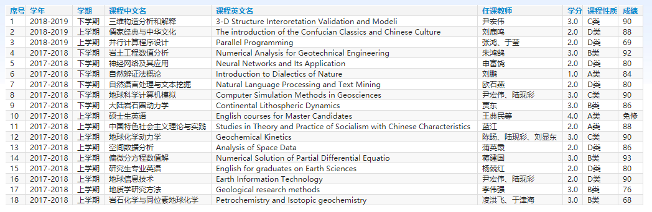
Curriculum
18 courses for 45 credits

Slide 5
Workload
Python Code for Post-processing algorithm: 56172 lines
2D Compression Structural Experiment: 53 sets
Structural Deformation and Feature Map Figures: 5724 pieces

Slide 6
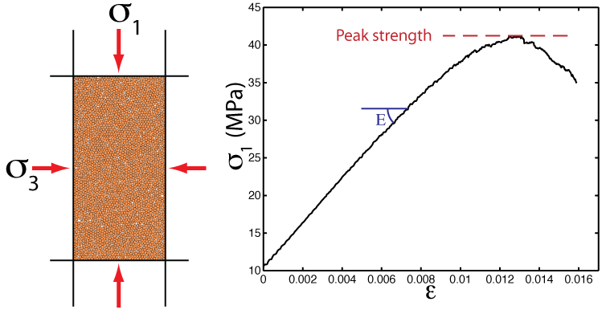
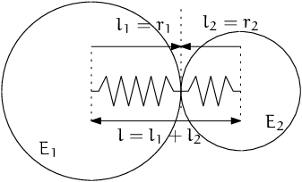
Background
DEM: Discrete Element Model
Micro-granular system for macroscopic object
Based on Newtonian mechanics
Masses of computation

Slide 7
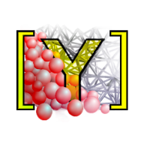
Software
YADE: Yet Another Dynamic Engine
Performed on Linux
Open Source
Python Command Line

Slide 8
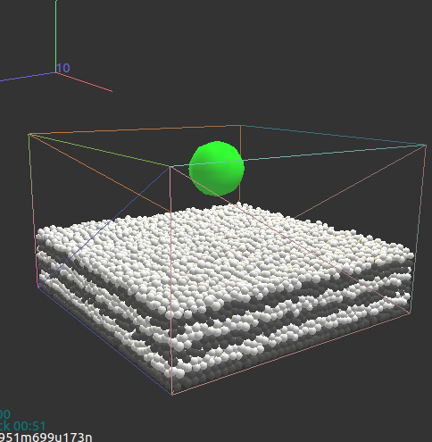
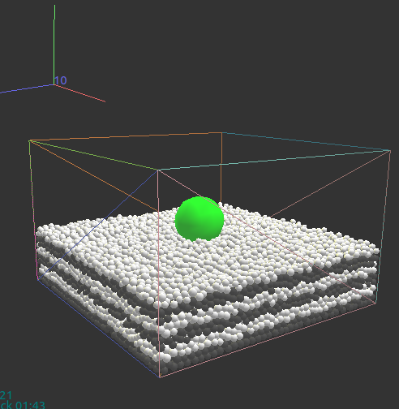
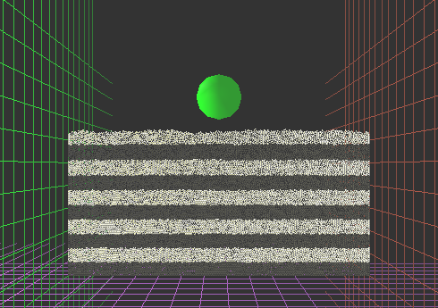
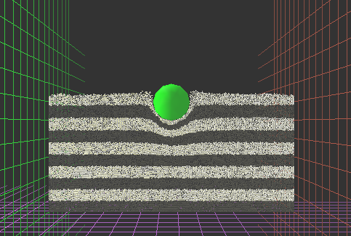
Scenario
Process of aerolite collision

Slide 9
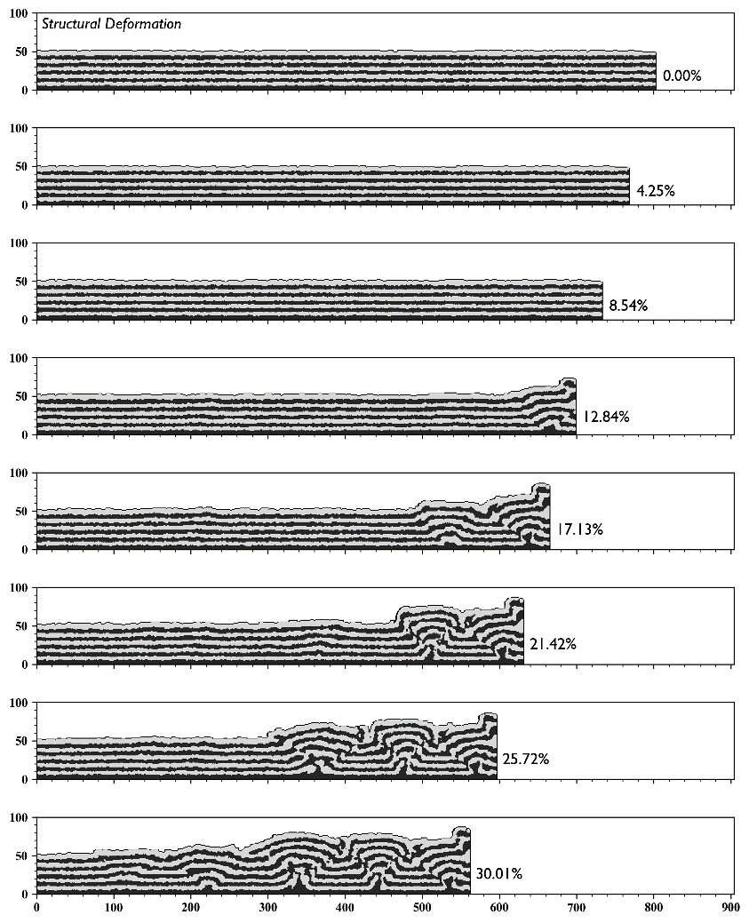
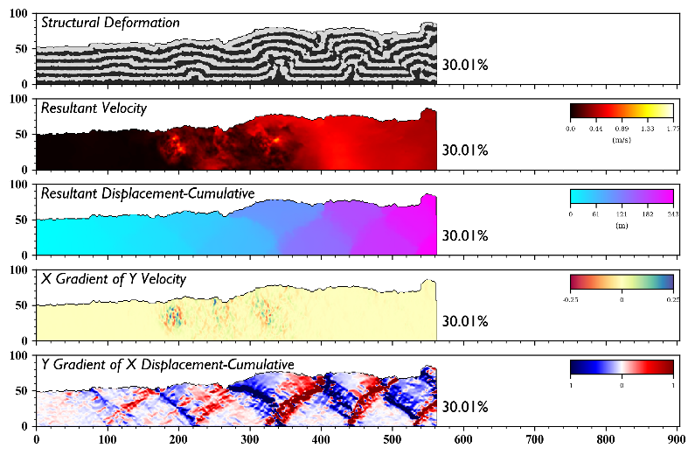
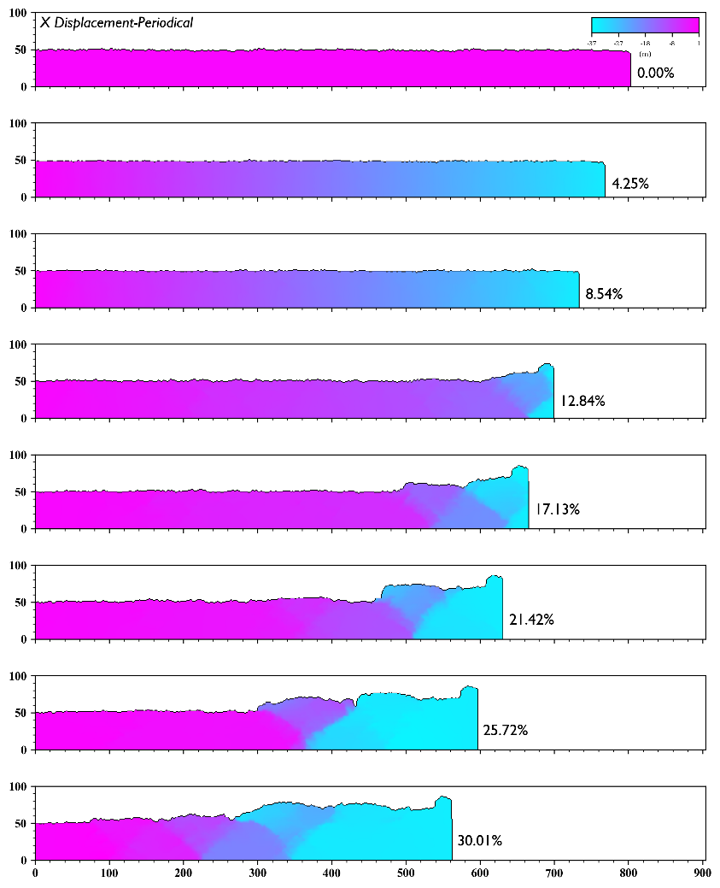
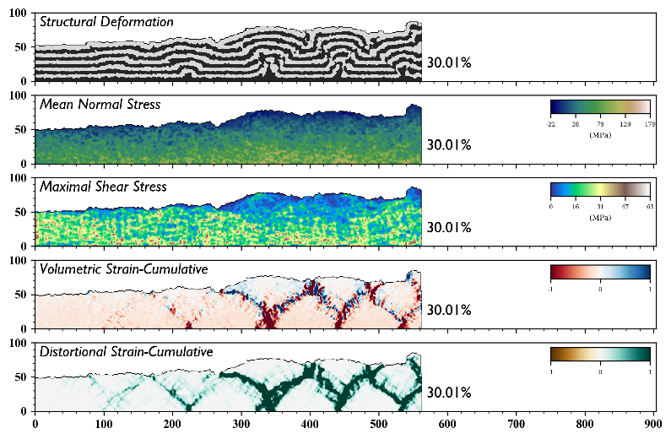
Imaging Effect

Slide 10
Content
Background
Algorithm
Aim

Slide 11

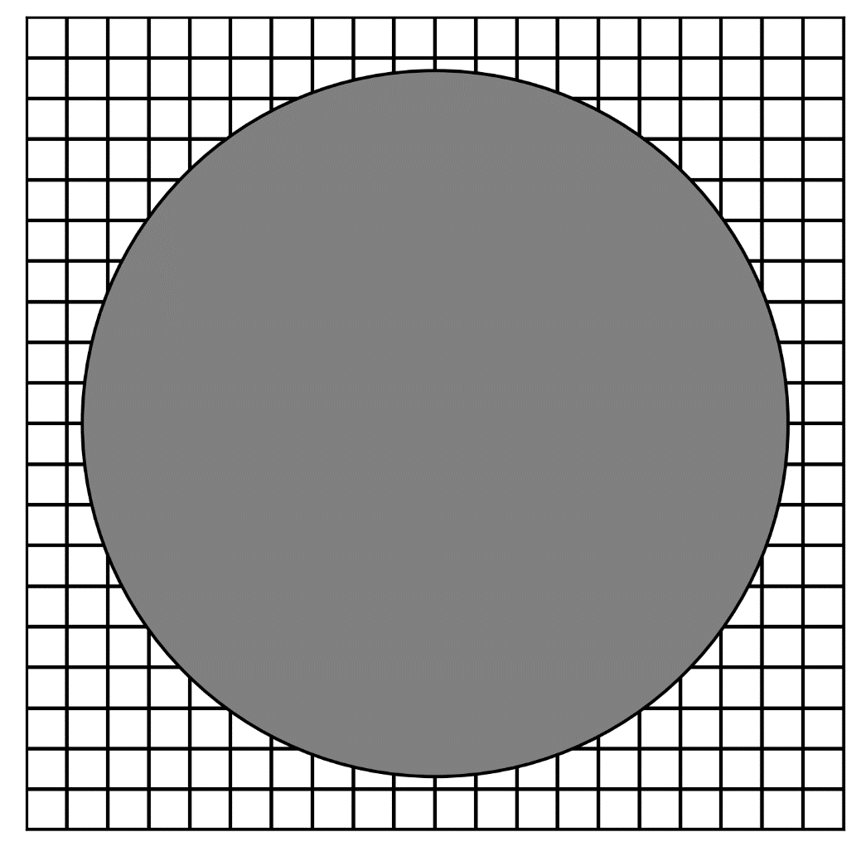
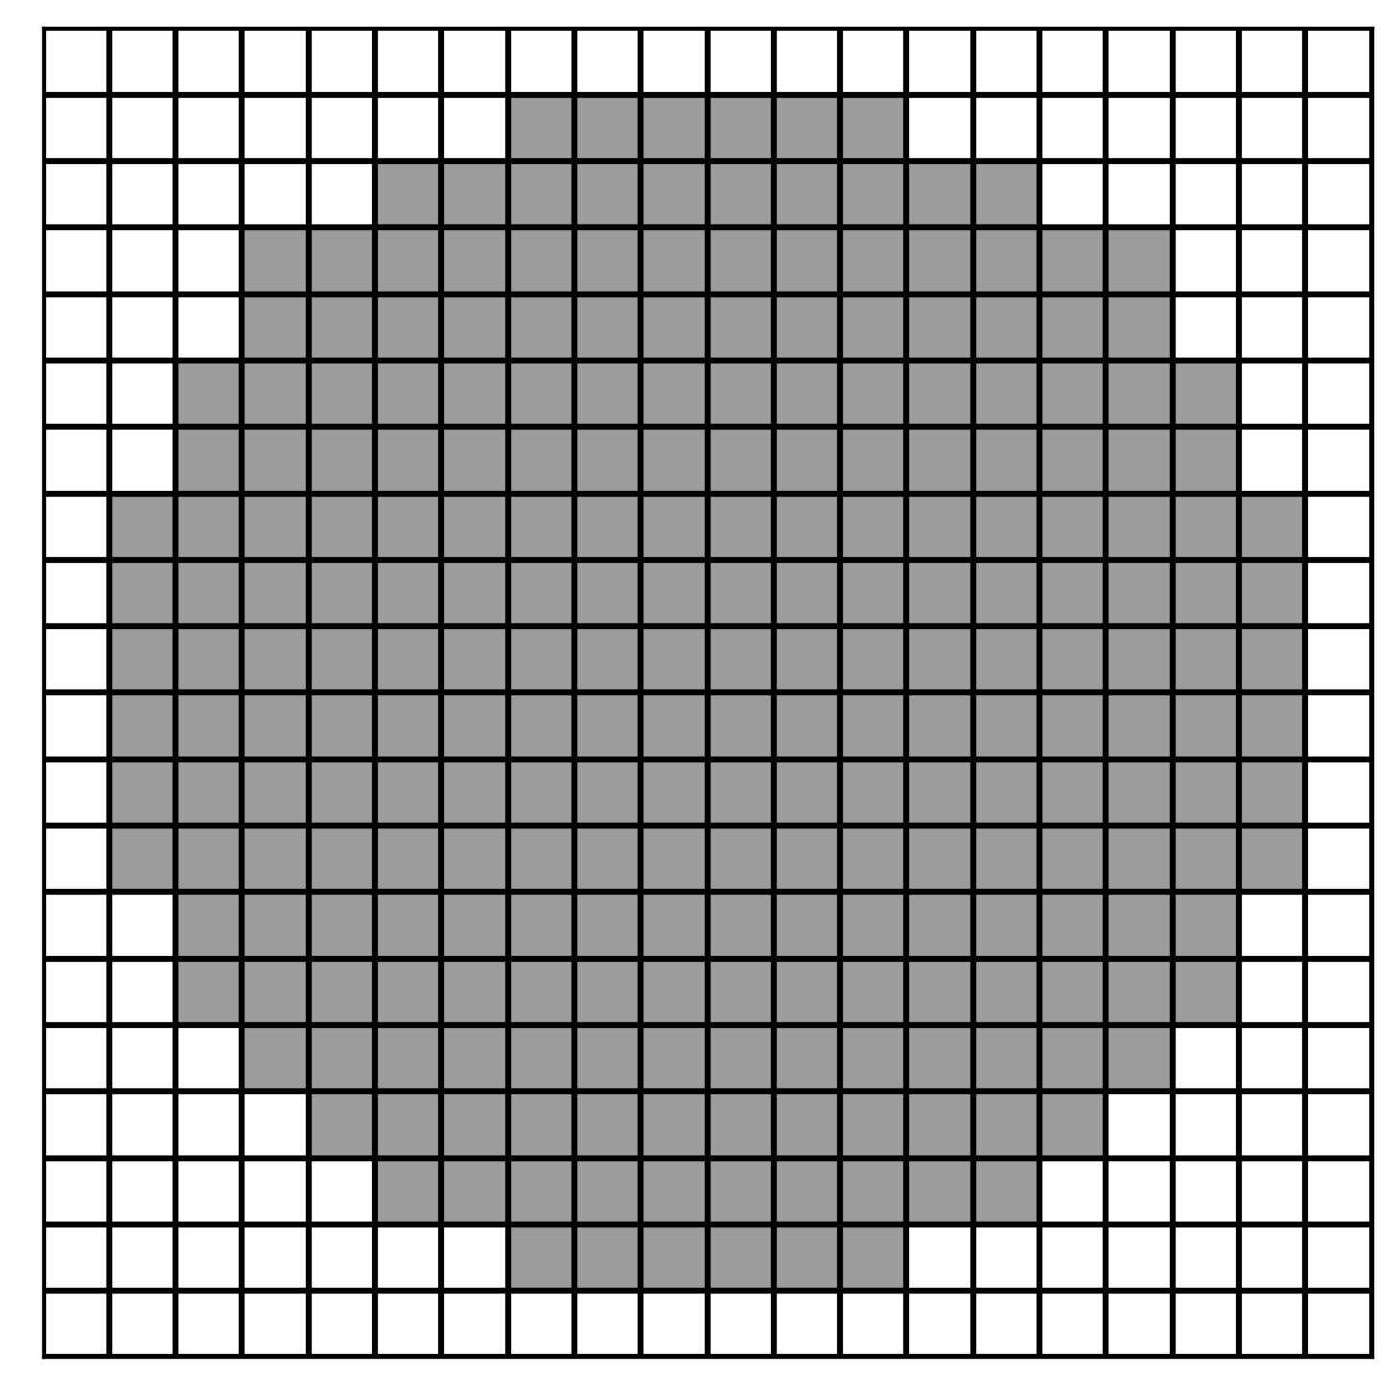


Rasterization
GitHub: https://github.com/jerryweihuajing/Post-Processing

Slide 12
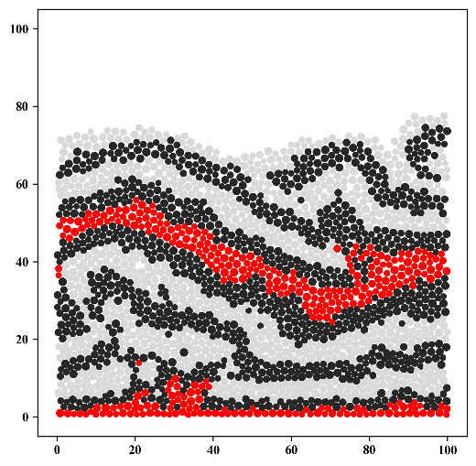
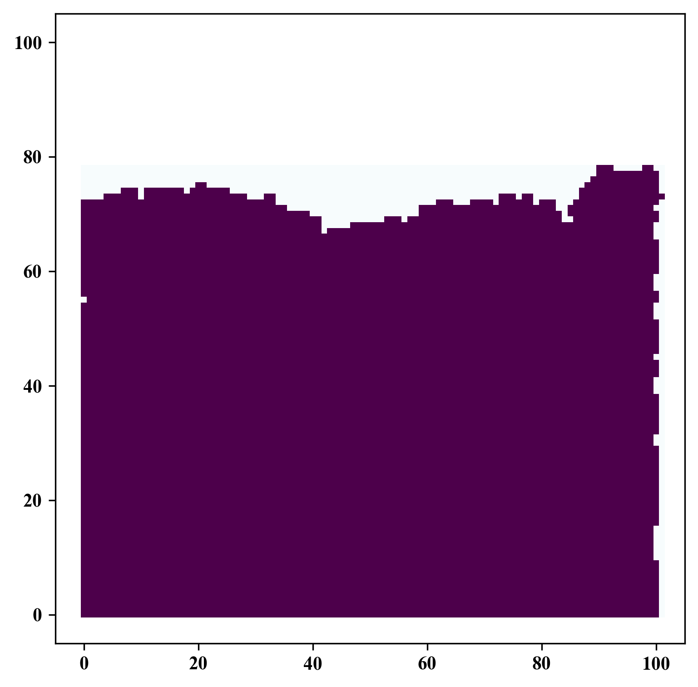
Rasterization
GitHub: https://github.com/jerryweihuajing/Post-Processing

Slide 13
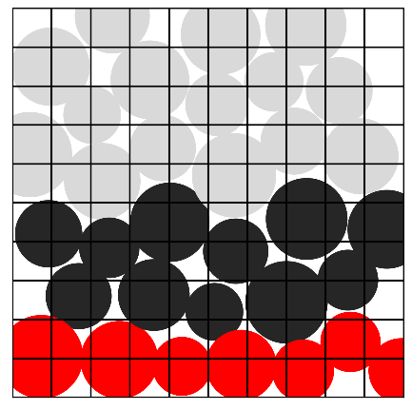
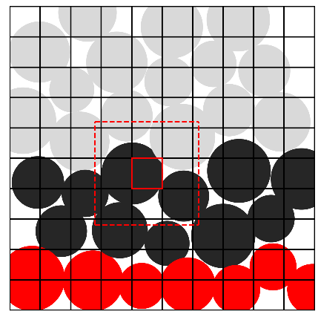
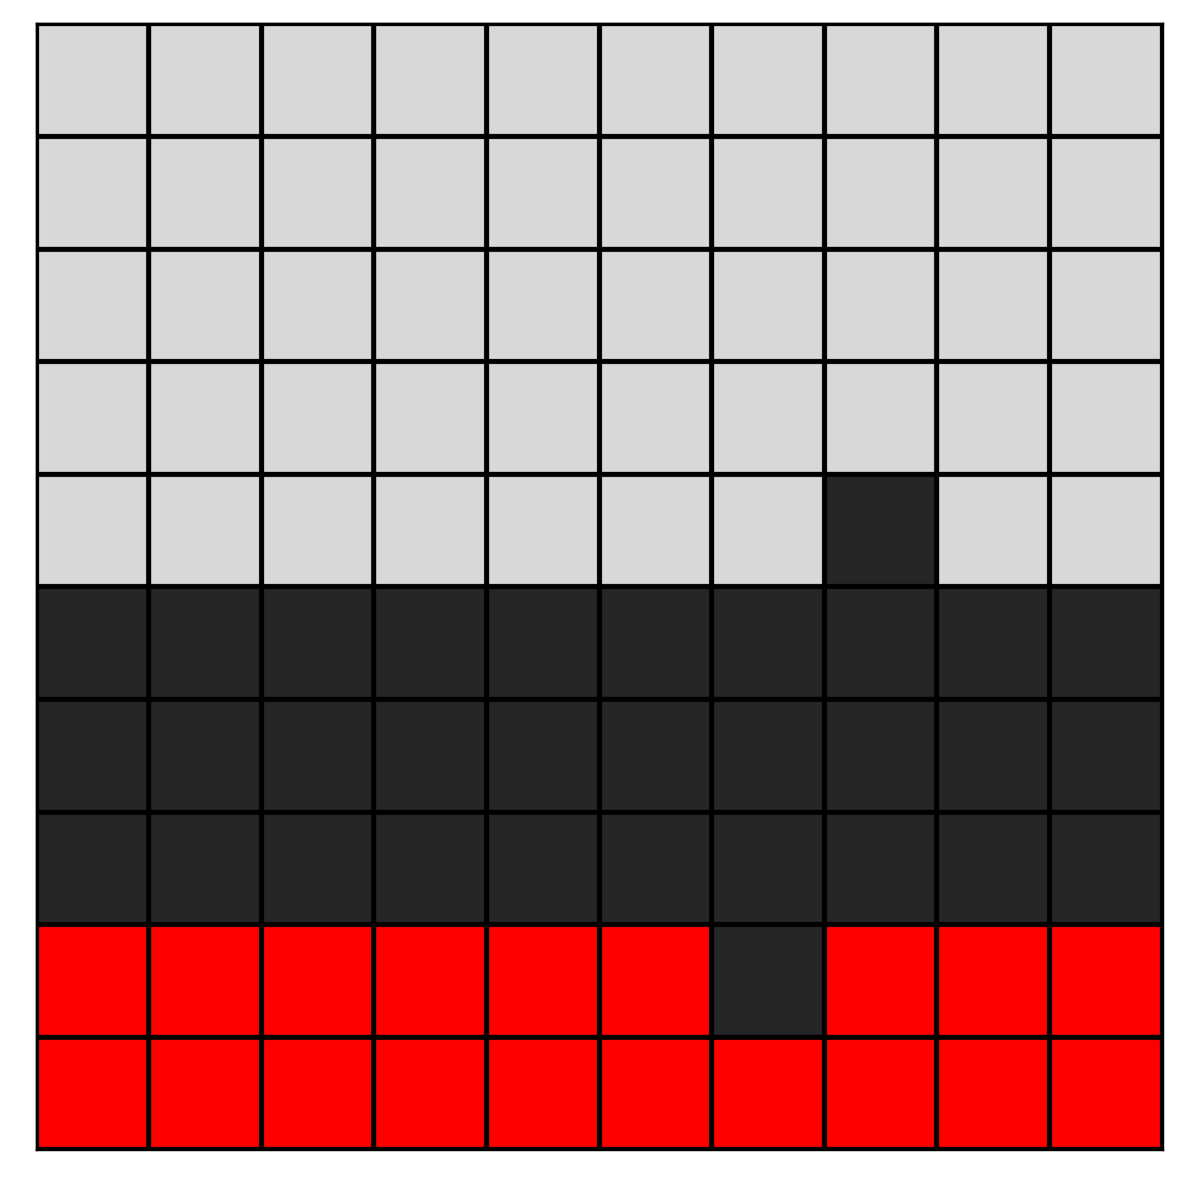
Rasterization
GitHub: https://github.com/jerryweihuajing/Post-Processing

Slide 14

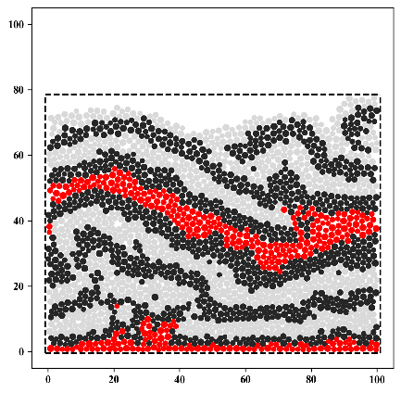
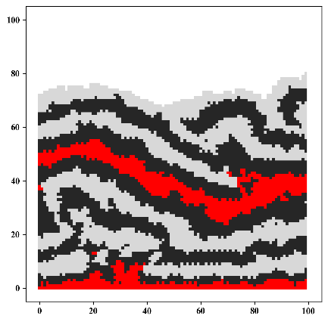
Rasterization
GitHub: https://github.com/jerryweihuajing/Post-Processing

Slide 15
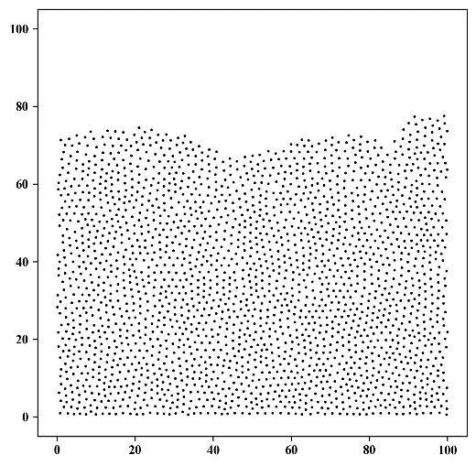
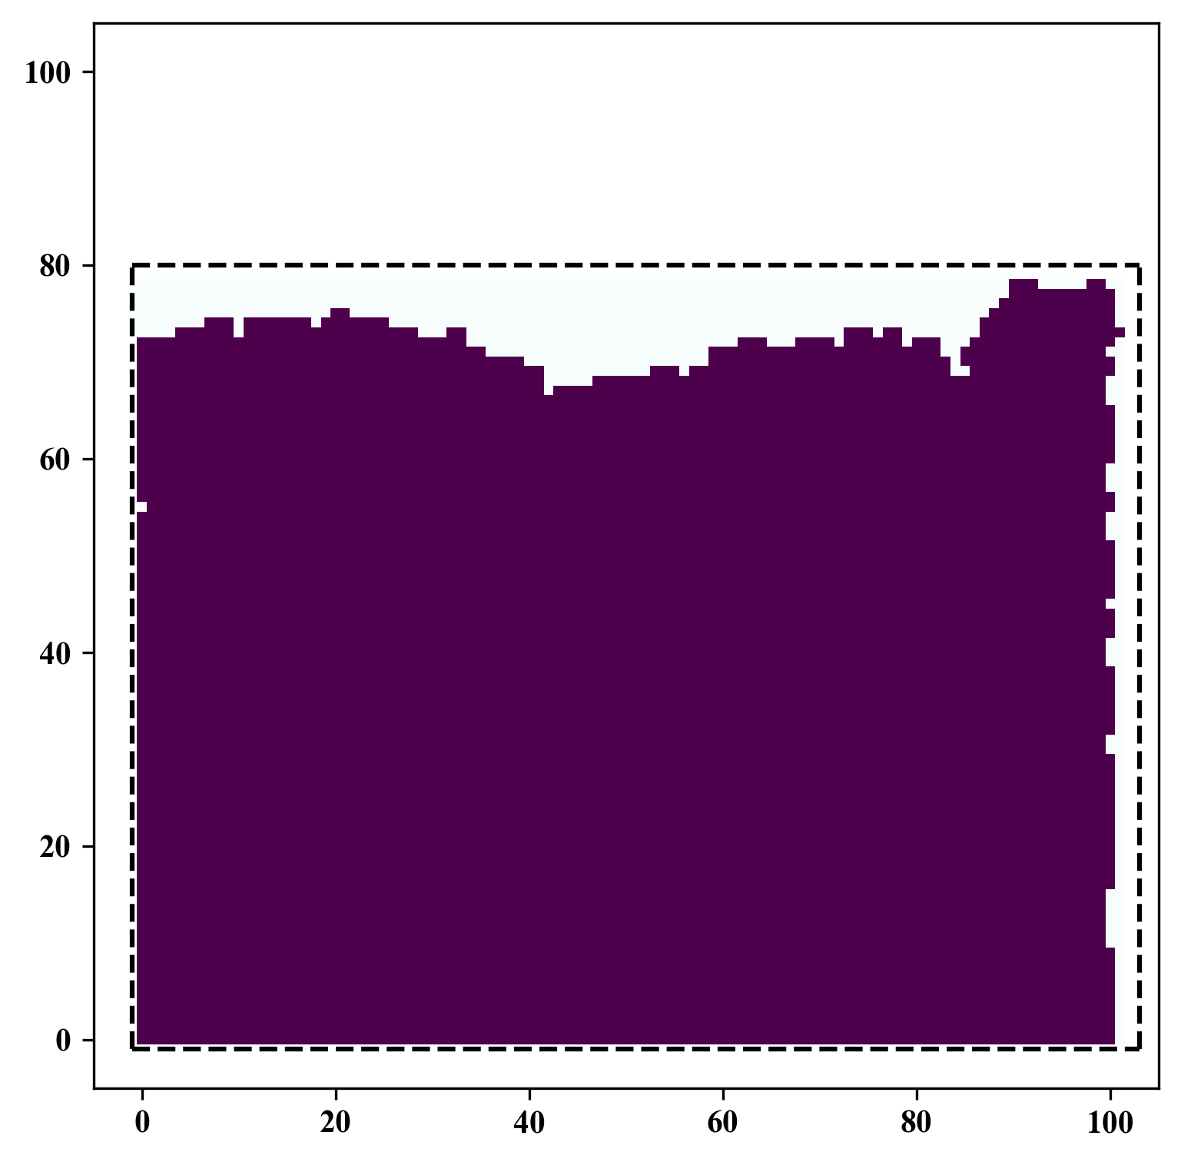
Spatial Interpolation
GitHub: https://github.com/jerryweihuajing/Post-Processing

Slide 16
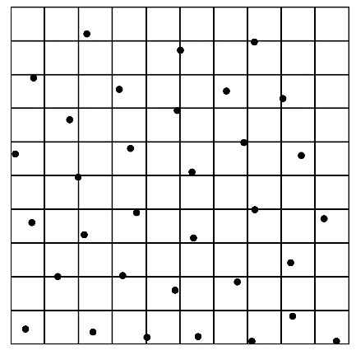
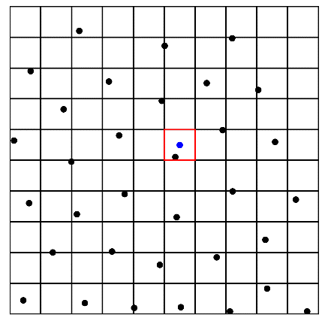
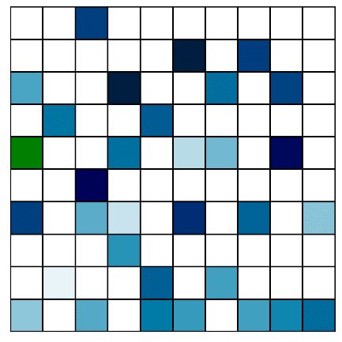
Spatial Interpolation
GitHub: https://github.com/jerryweihuajing/Post-Processing

Slide 17
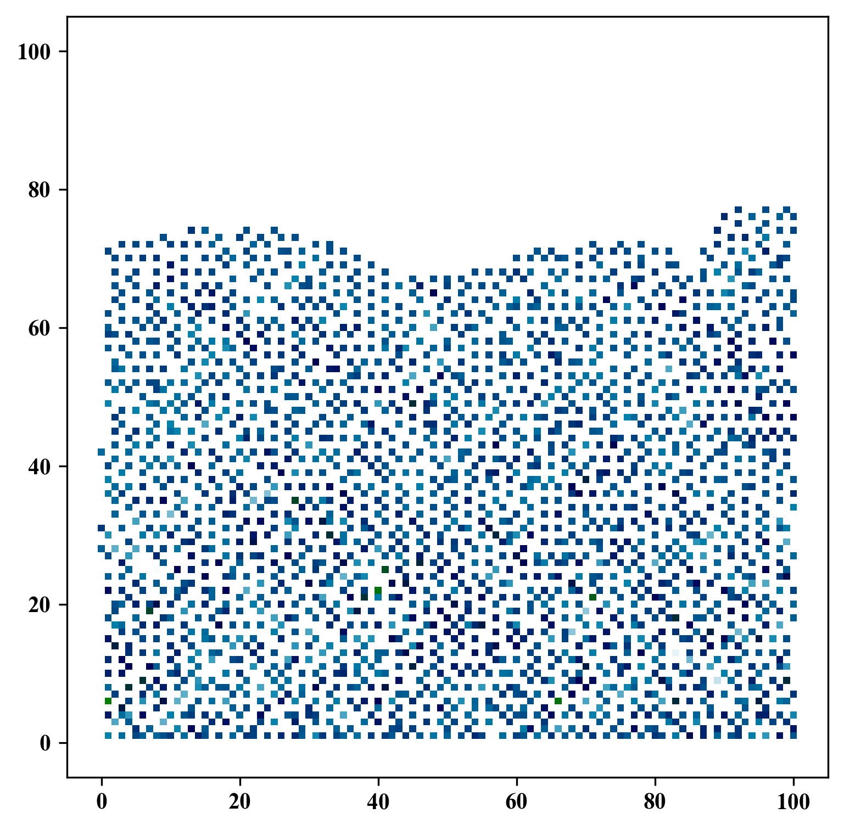
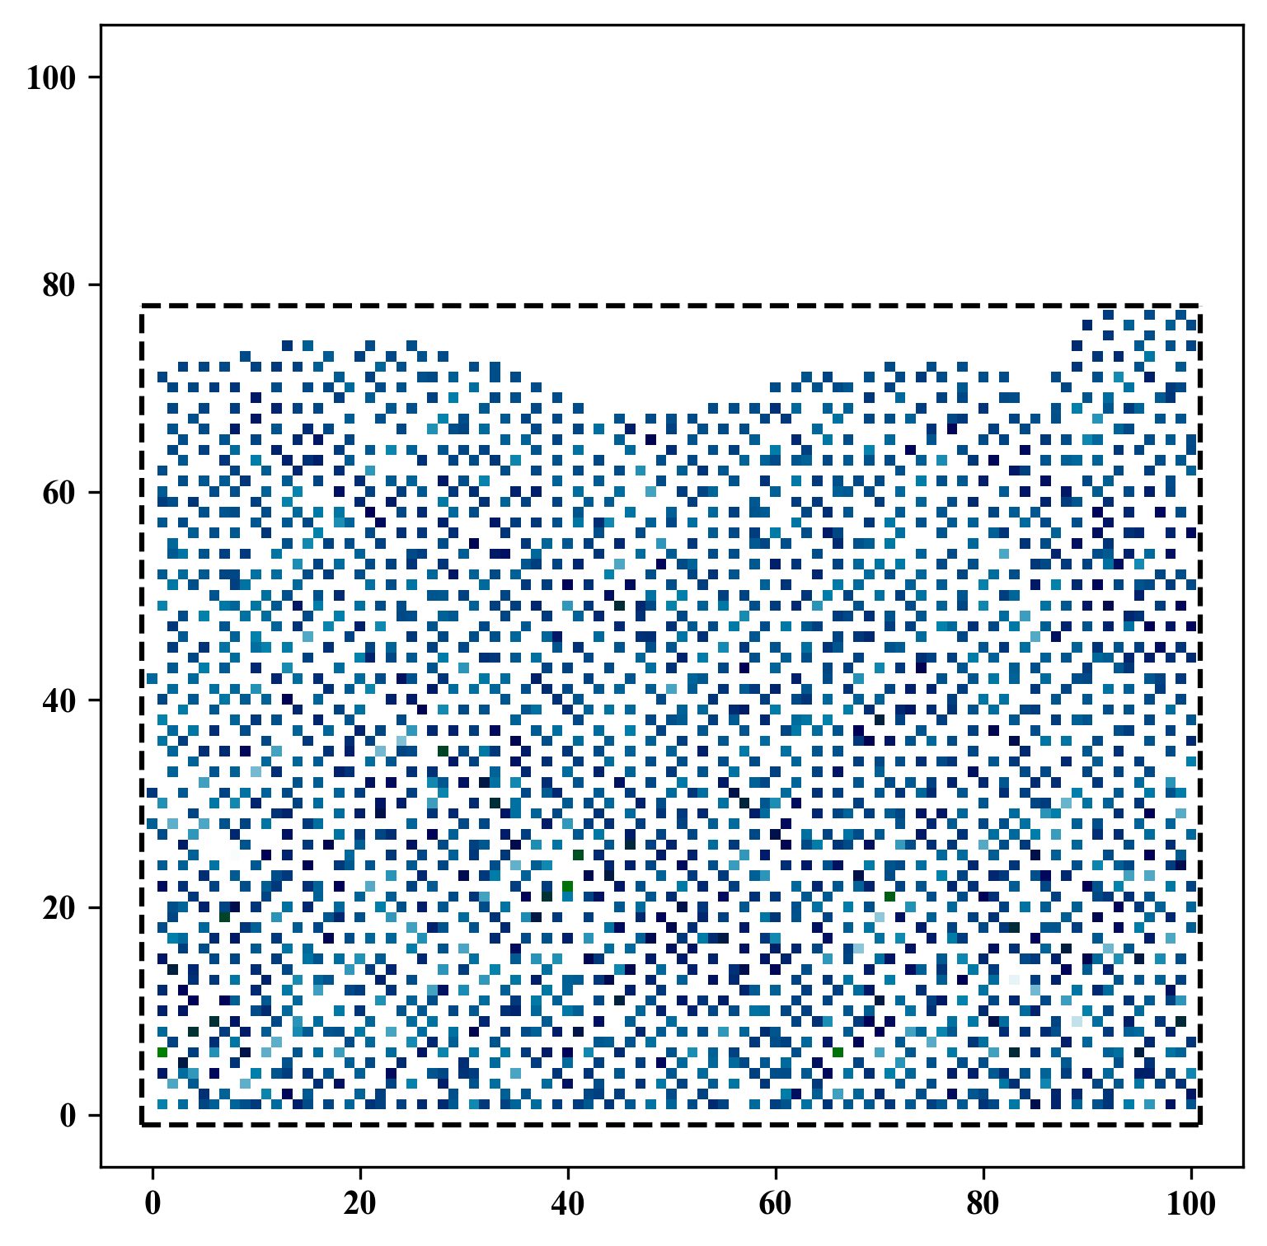
Spatial Interpolation
GitHub: https://github.com/jerryweihuajing/Post-Processing

Slide 18
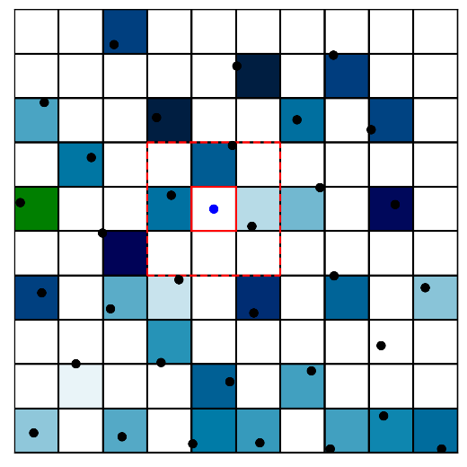
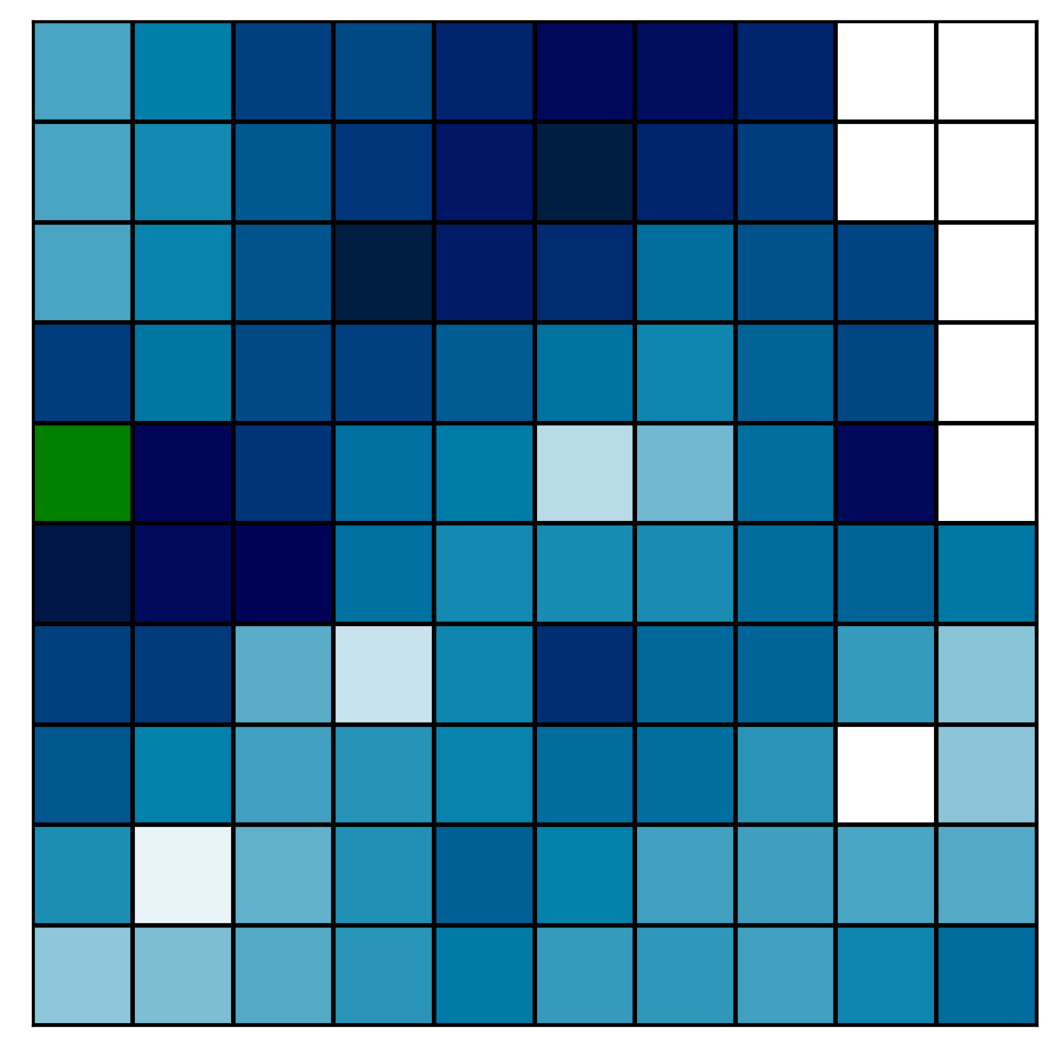
Spatial Interpolation
GitHub: https://github.com/jerryweihuajing/Post-Processing

Slide 19
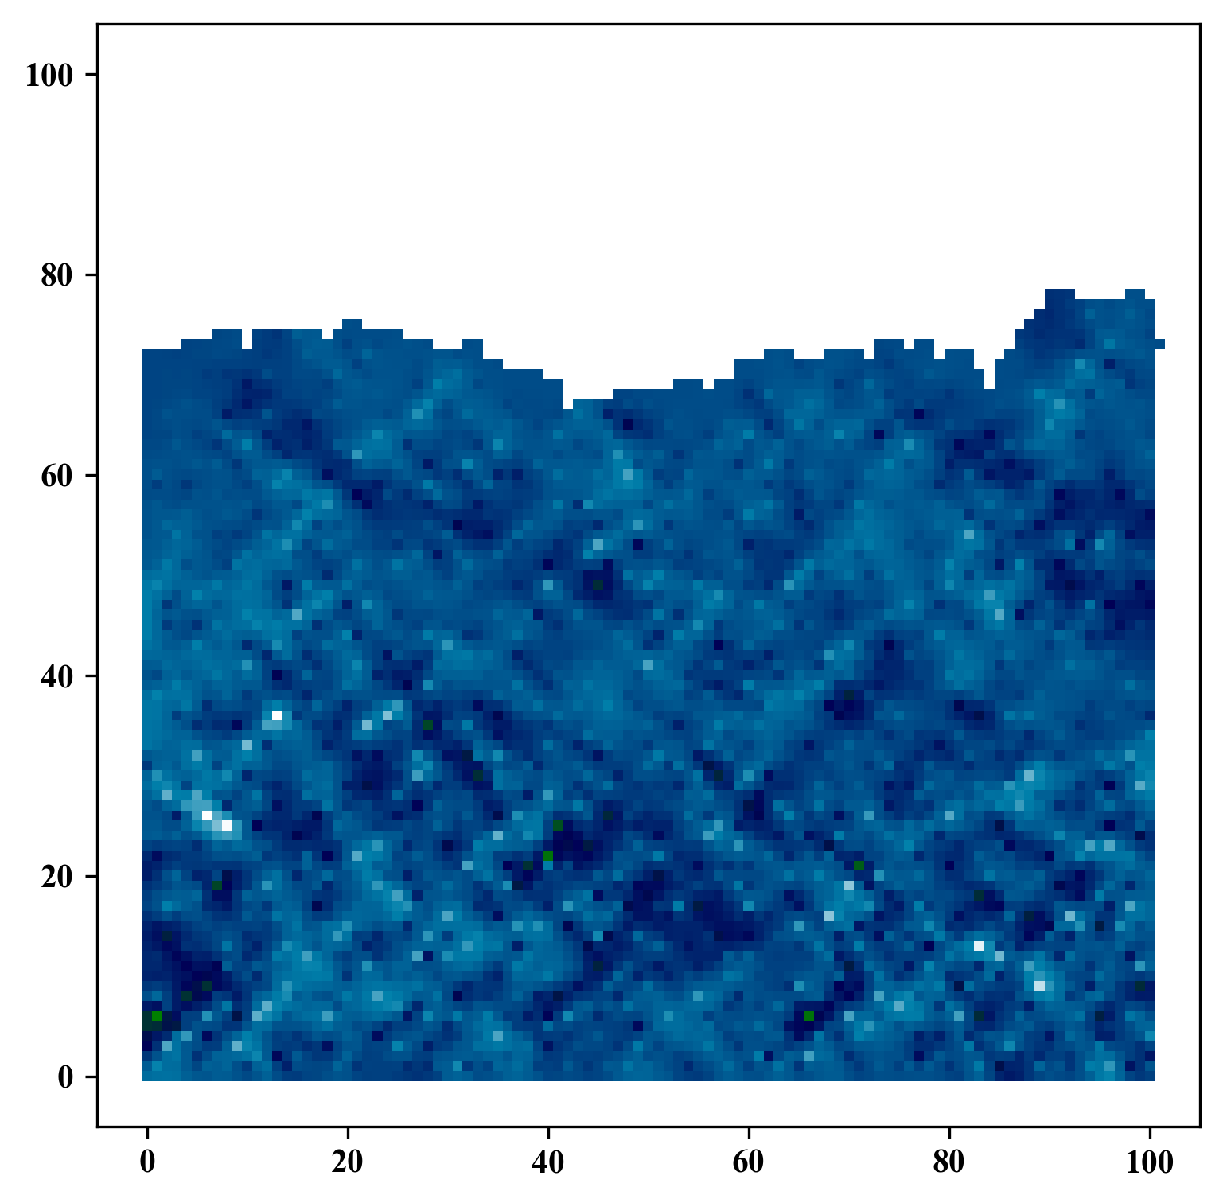
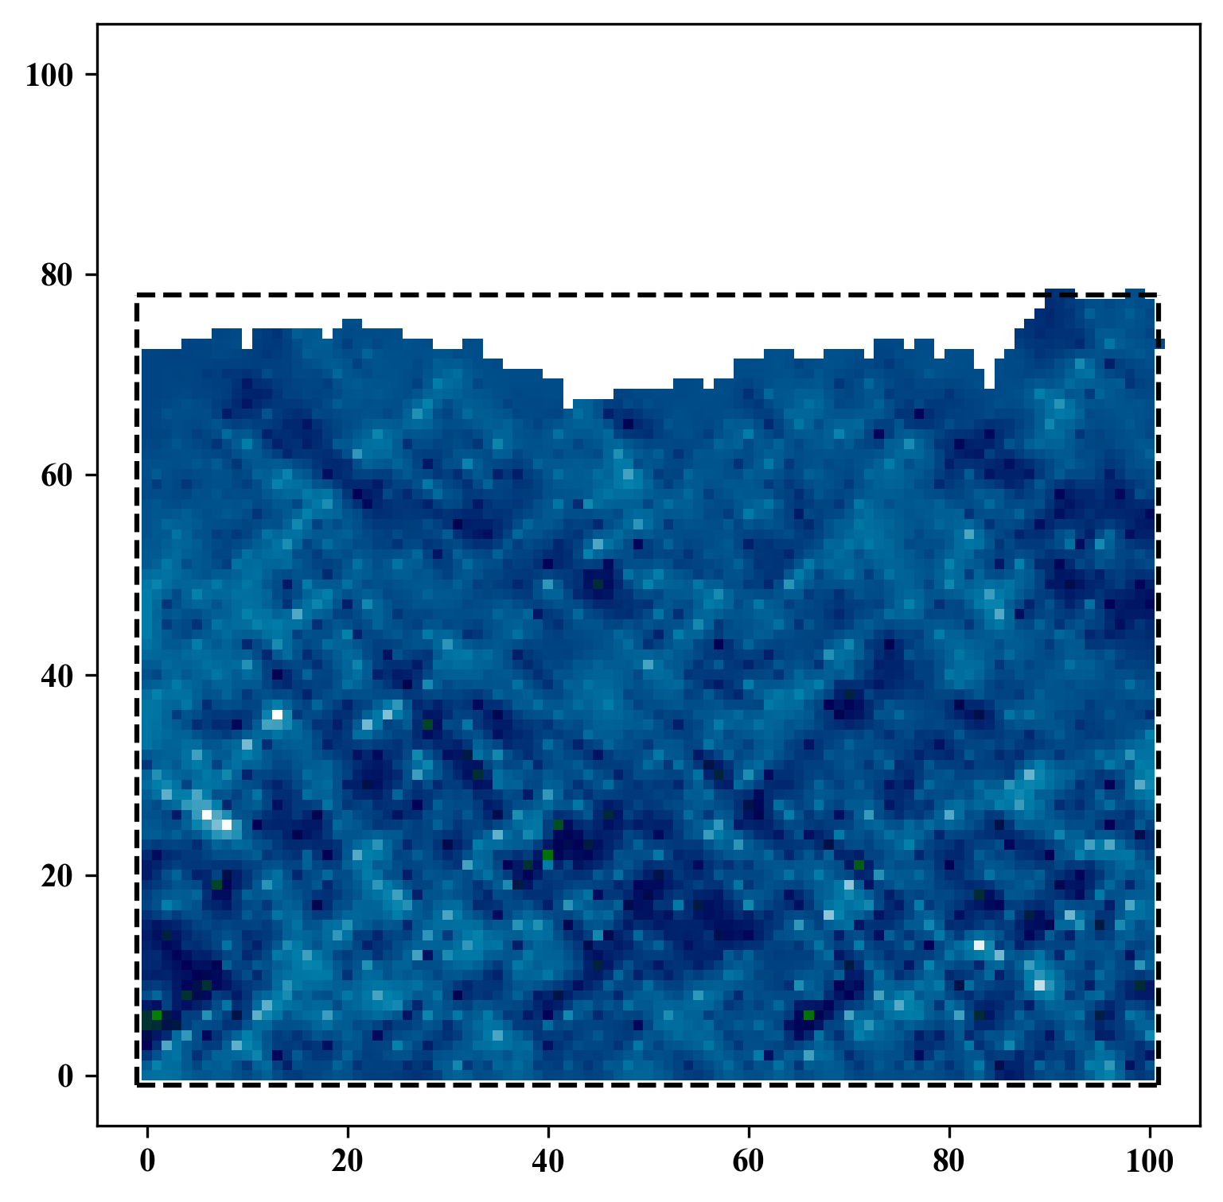
Spatial Interpolation
GitHub: https://github.com/jerryweihuajing/Post-Processing

Slide 20
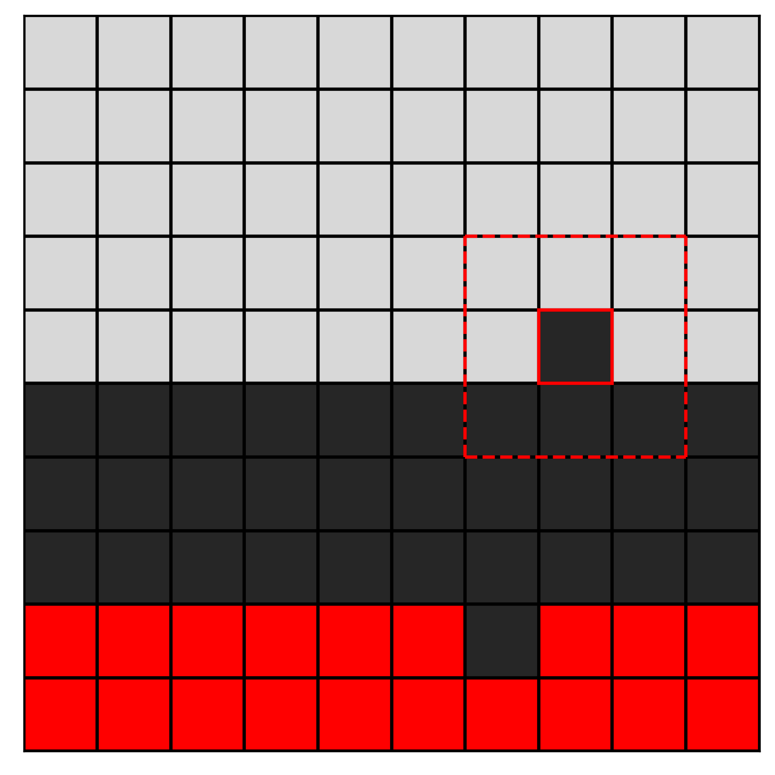
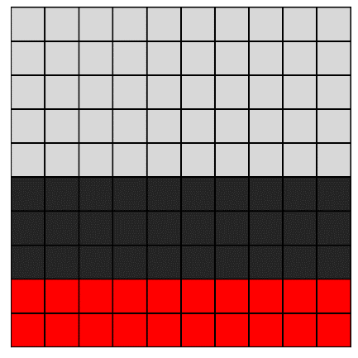
Gaussian Filtering
GitHub: https://github.com/jerryweihuajing/Post-Processing

Slide 21

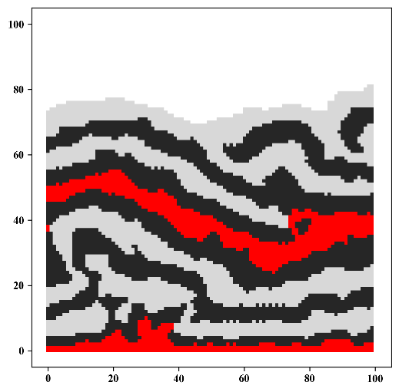
Gaussian Filtering
GitHub: https://github.com/jerryweihuajing/Post-Processing

Slide 22
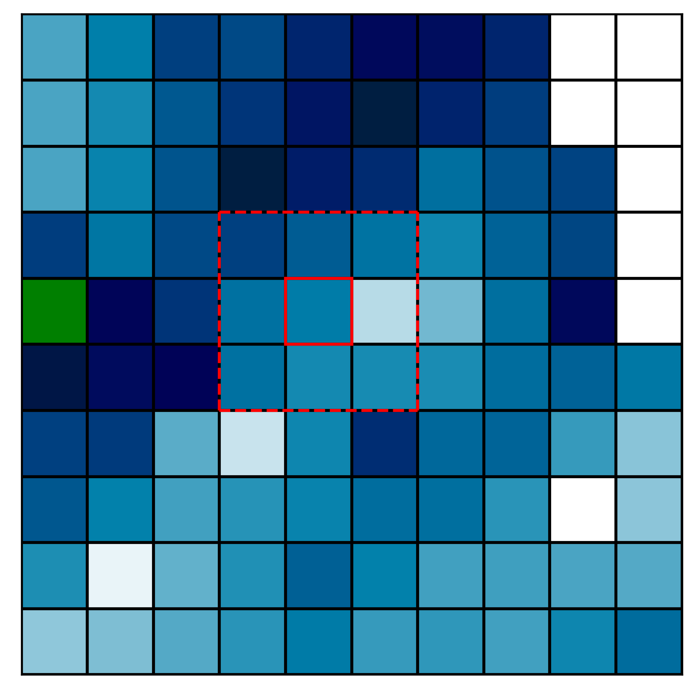
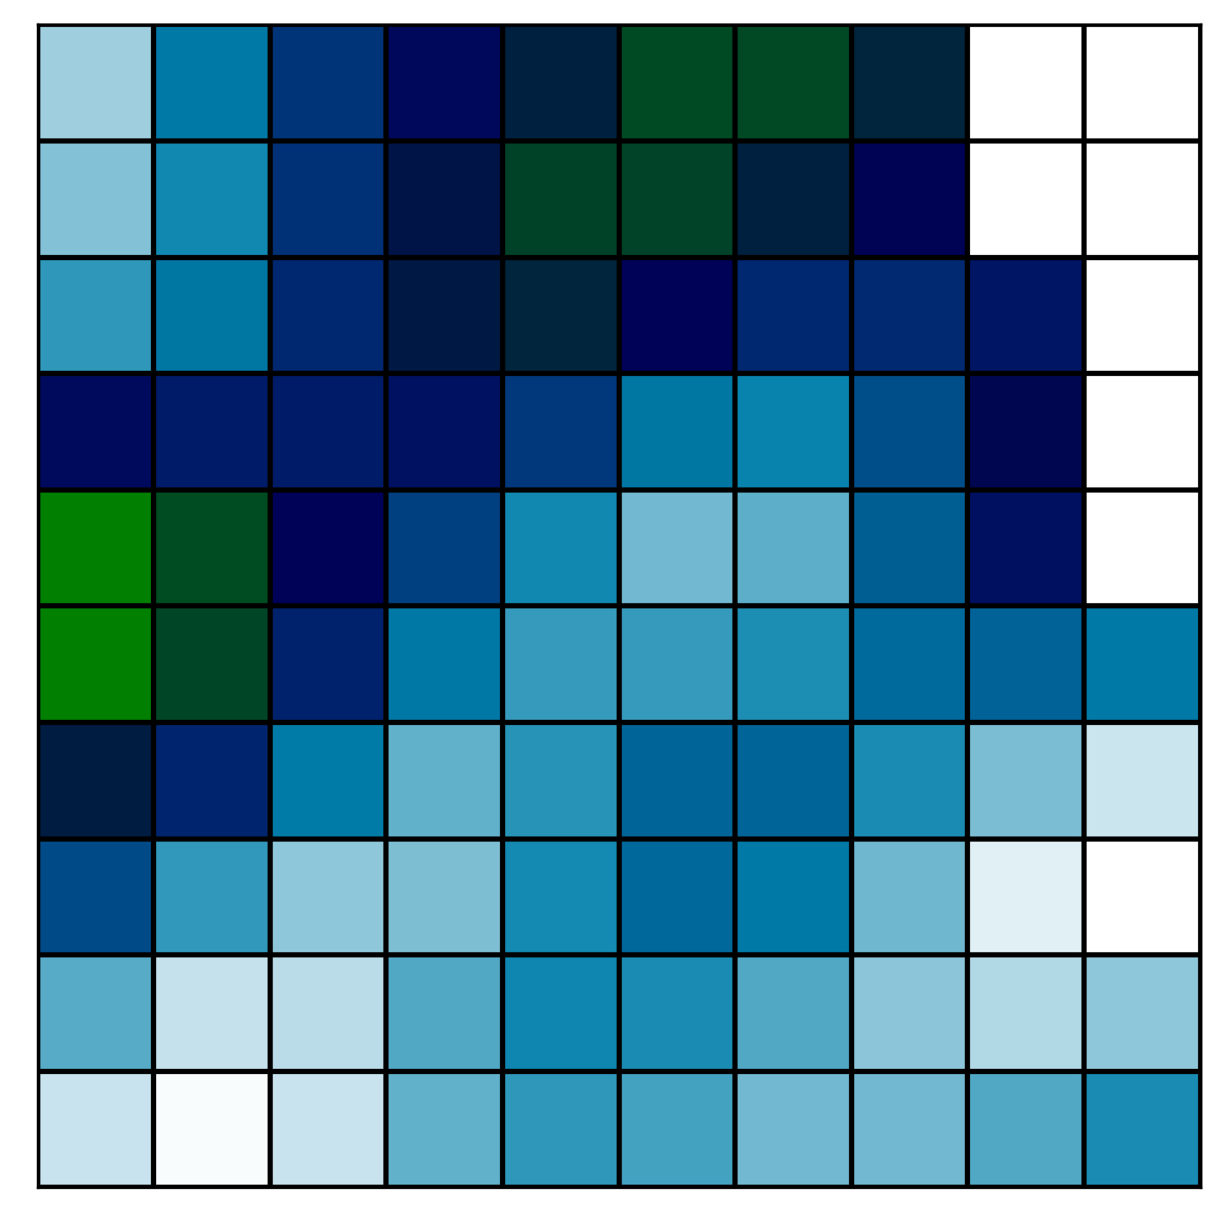
Gaussian Filtering
GitHub: https://github.com/jerryweihuajing/Post-Processing

Slide 23
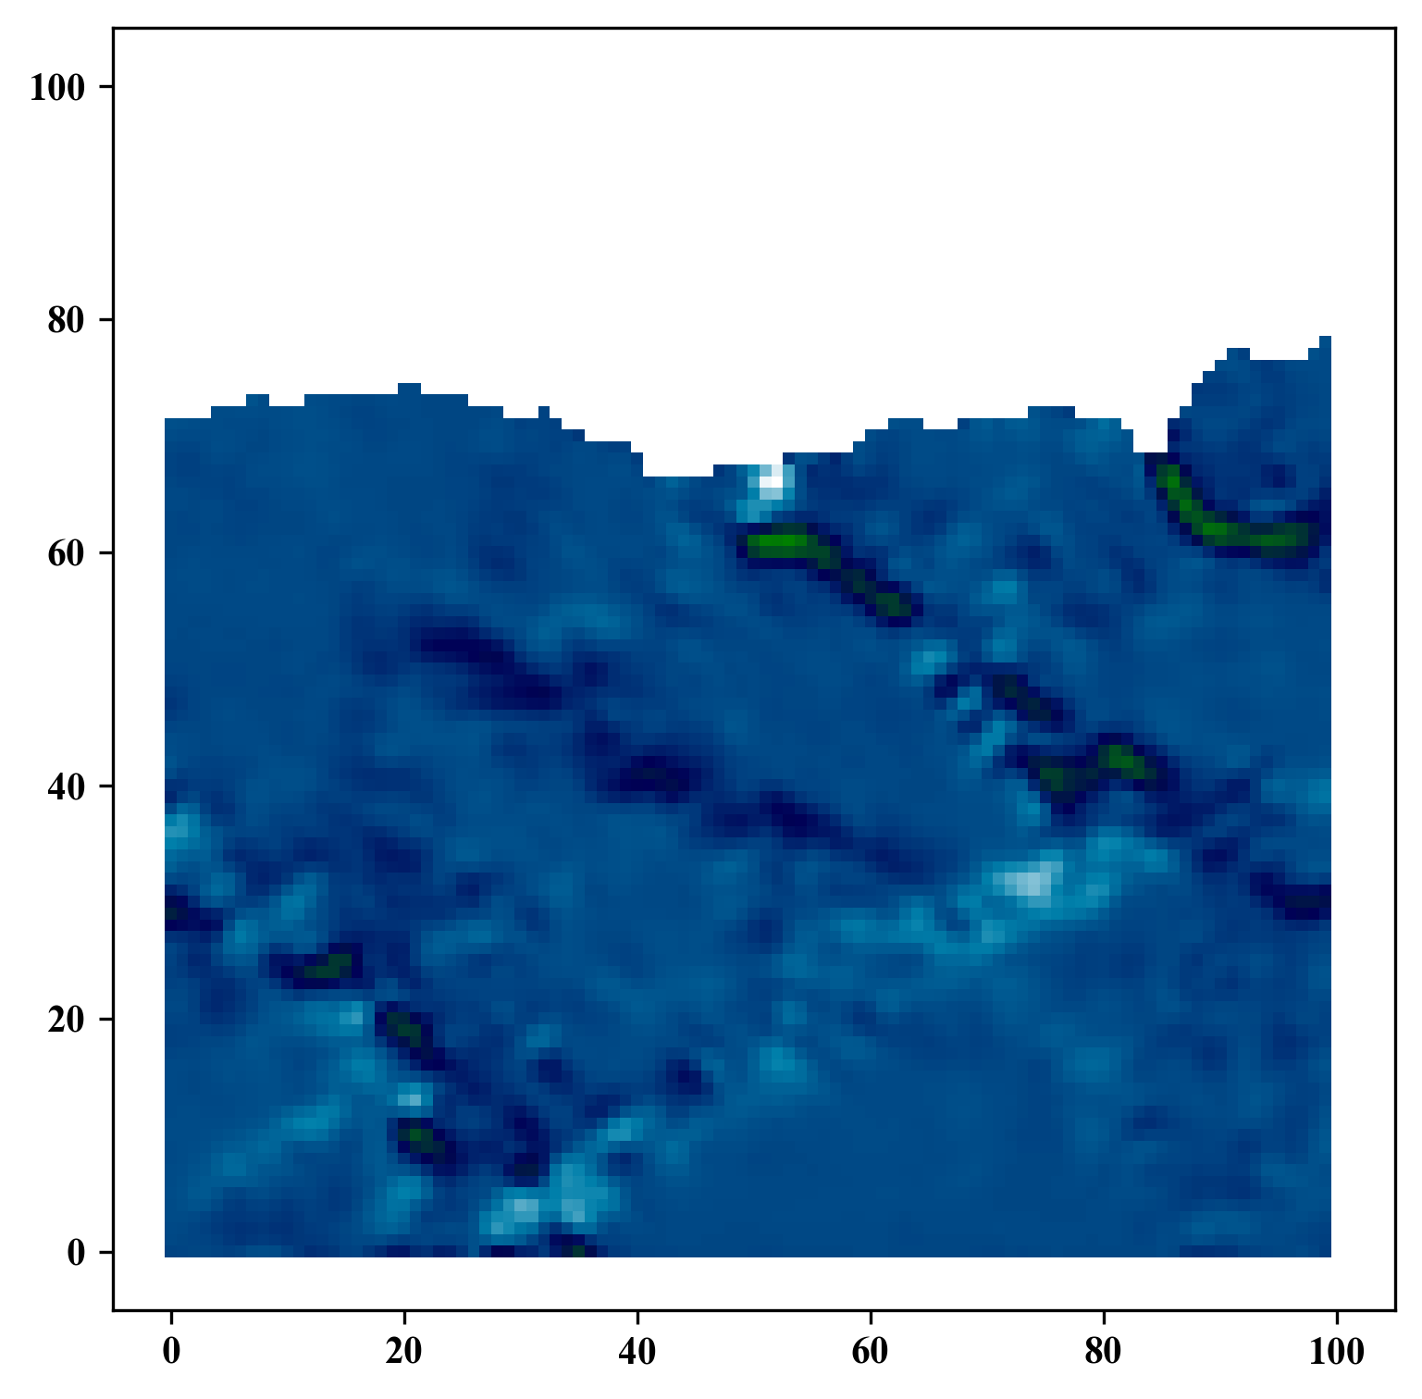
Gaussian Filtering
GitHub: https://github.com/jerryweihuajing/Post-Processing

Slide 24
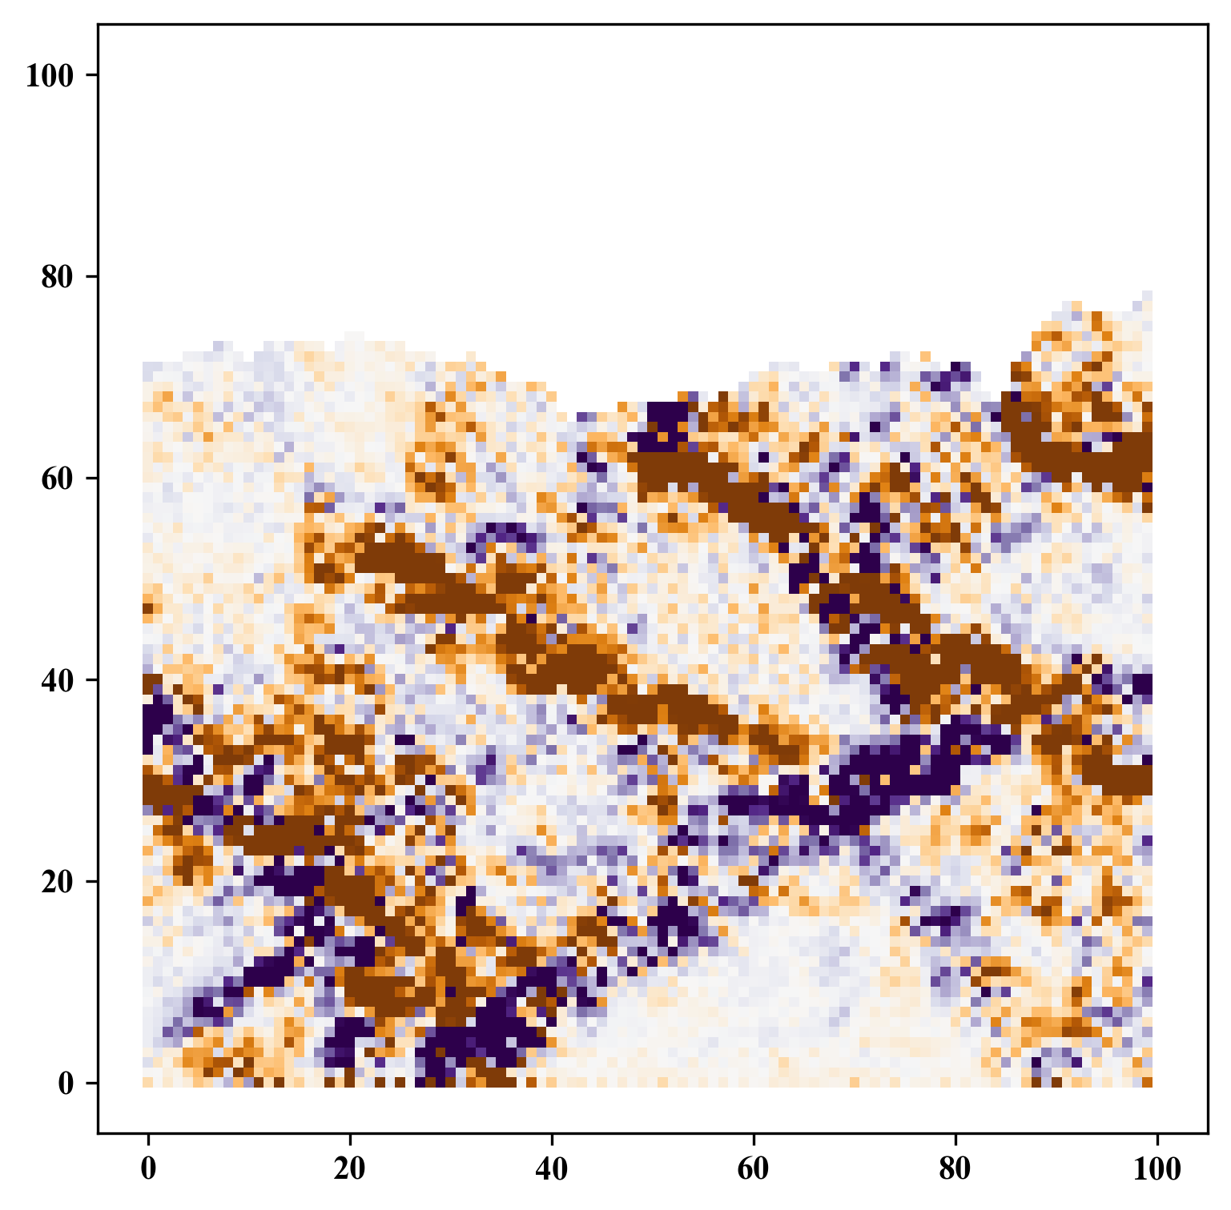
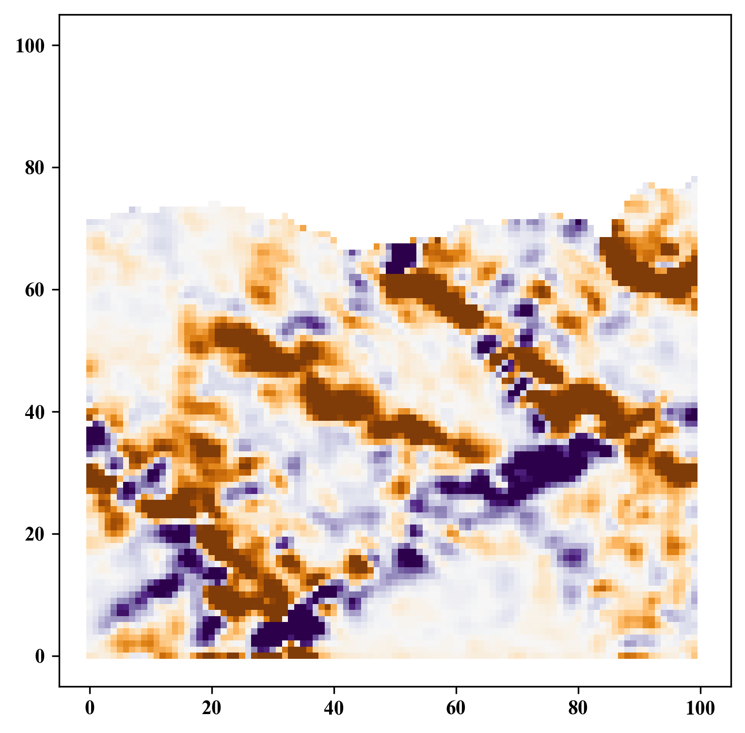
Gaussian Filtering
GitHub: https://github.com/jerryweihuajing/Post-Processing

Slide 25
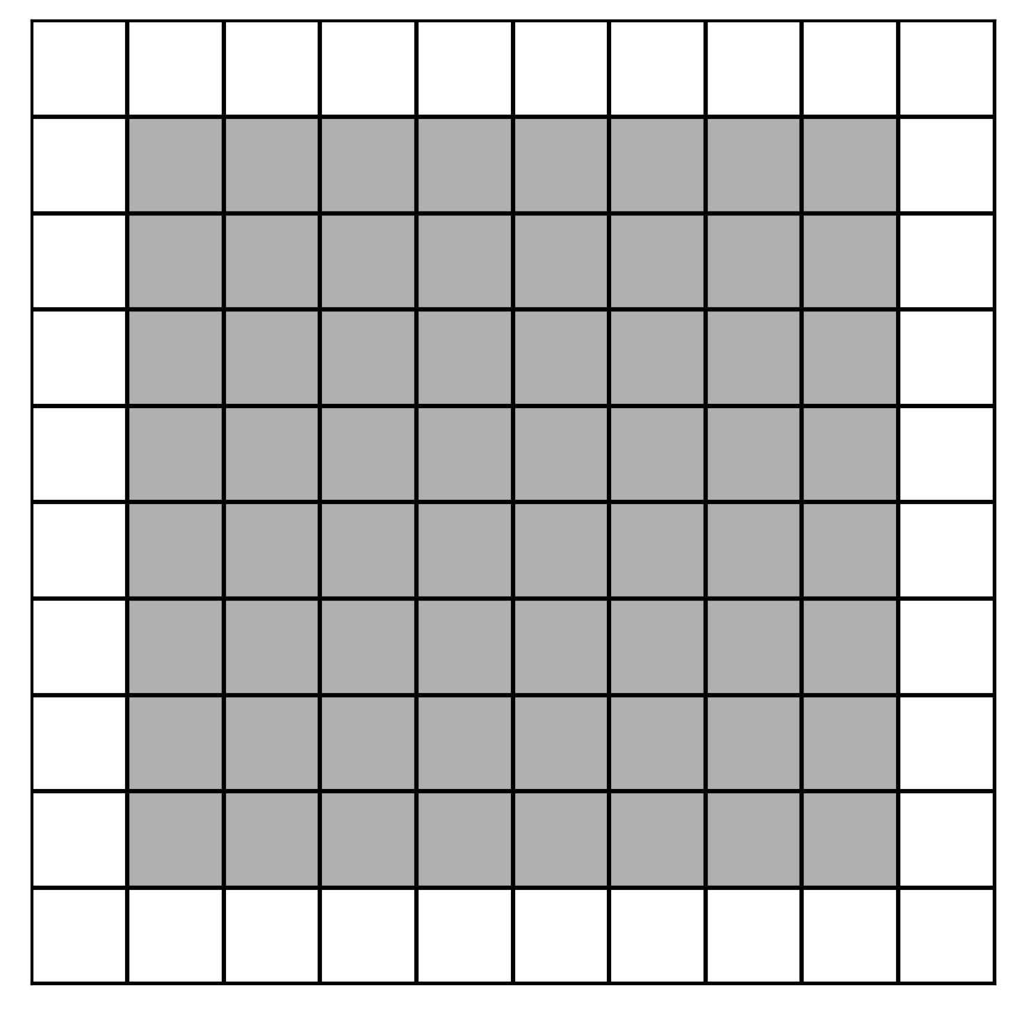
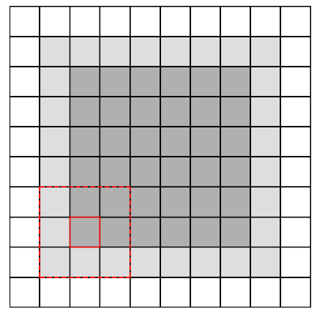
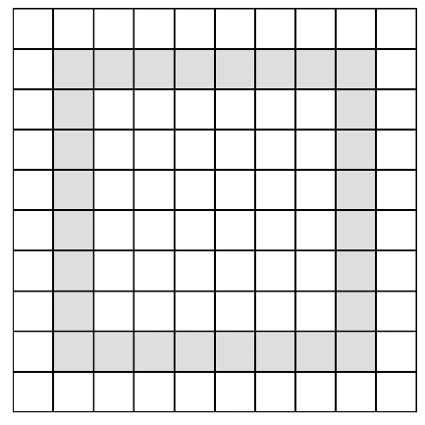
Boundary Extraction
GitHub: https://github.com/jerryweihuajing/Post-Processing

Slide 26
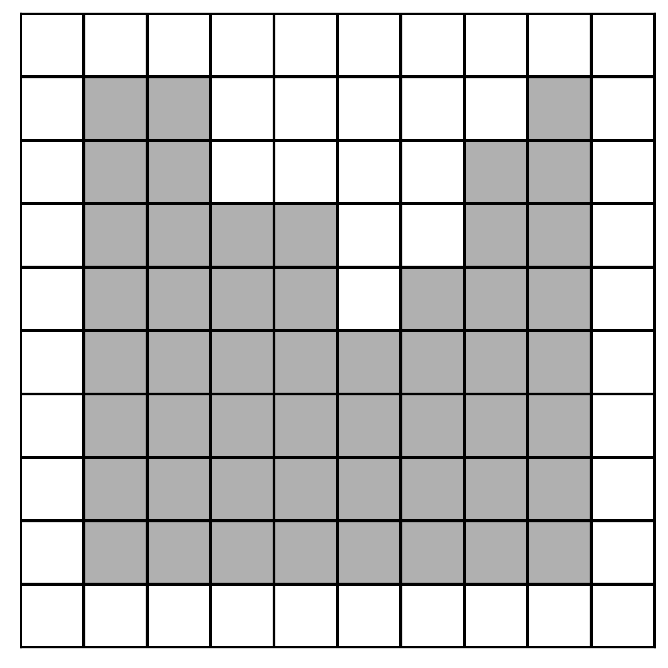
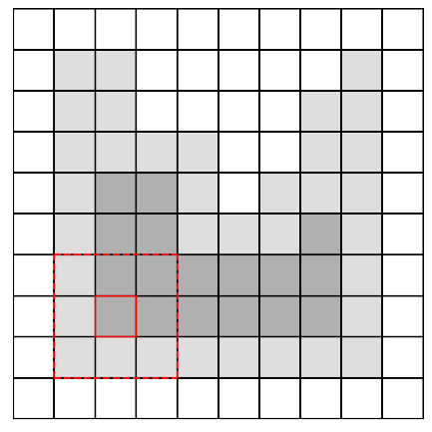
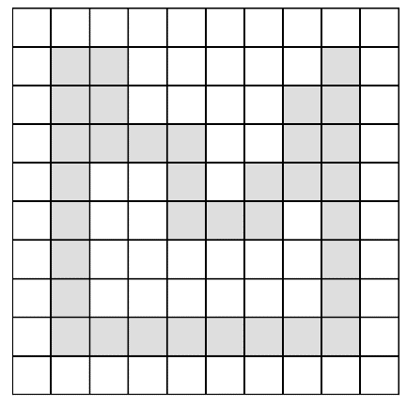
Boundary Extraction
GitHub: https://github.com/jerryweihuajing/Post-Processing

Slide 27
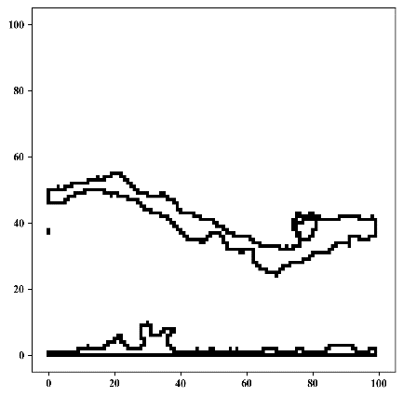
Boundary Extraction
GitHub: https://github.com/jerryweihuajing/Post-Processing

Slide 28
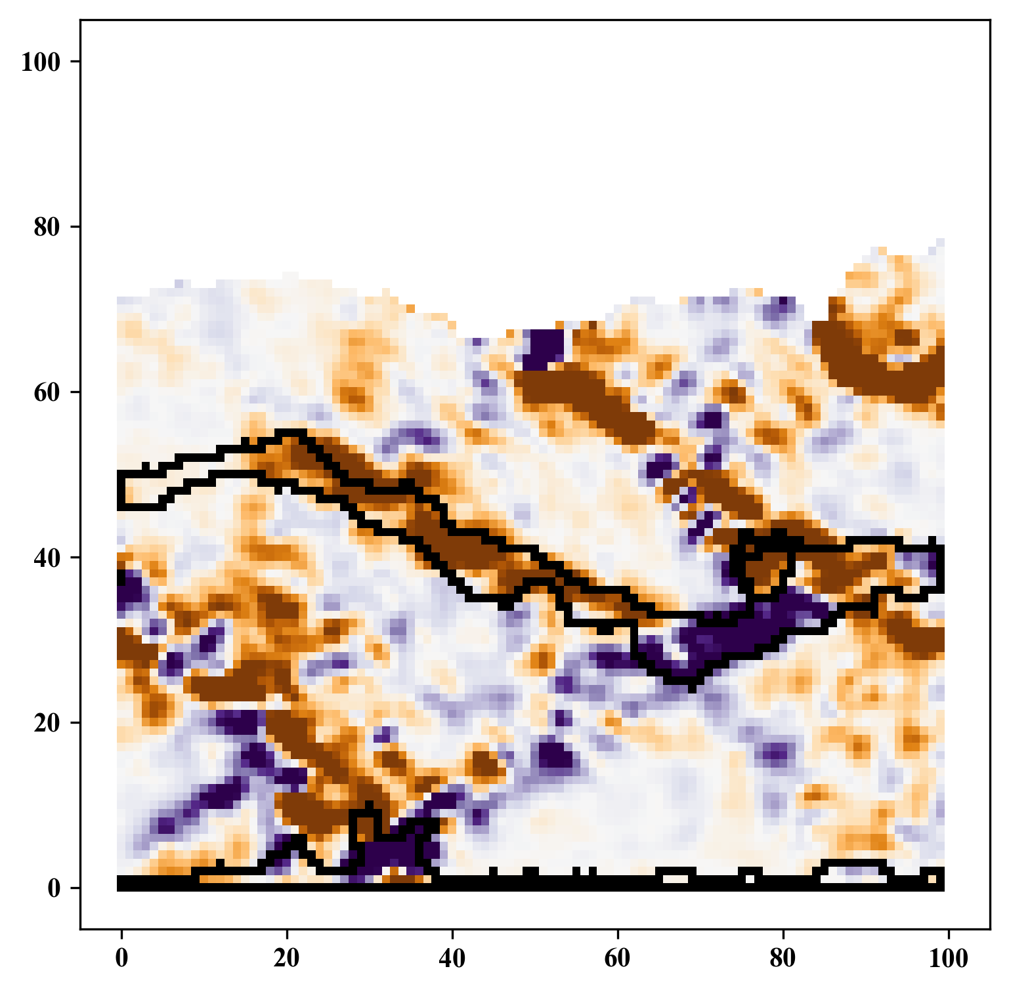
Boundary Extraction
GitHub: https://github.com/jerryweihuajing/Post-Processing

Slide 29
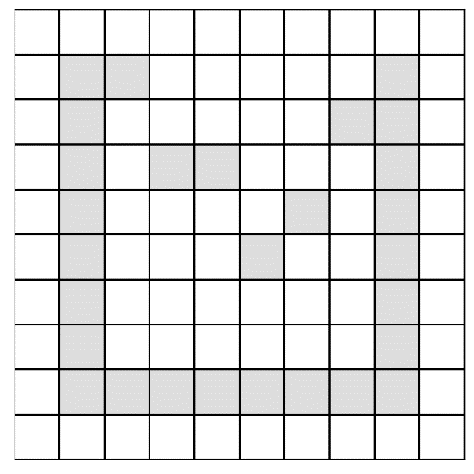
Outline Calculation
GitHub: https://github.com/jerryweihuajing/Post-Processing

Slide 30
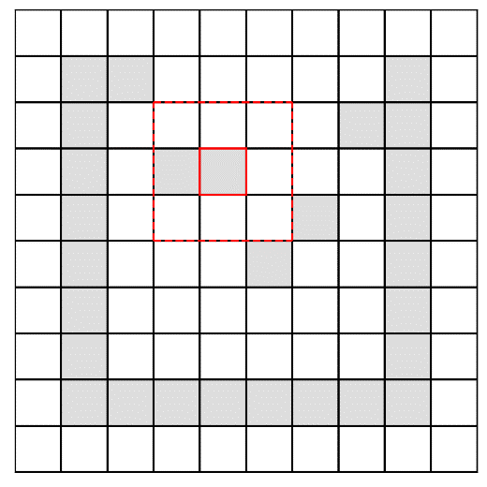

Outline Calculation
GitHub: https://github.com/jerryweihuajing/Post-Processing

Slide 31



Outline Calculation
GitHub: https://github.com/jerryweihuajing/Post-Processing

Slide 32

Outline Calculation
GitHub: https://github.com/jerryweihuajing/Post-Processing

Slide 33
Content
Background
Algorithm
Aim

Slide 34
Acknowledgement
THANKS

