Slide 1
Git, Github, Bluemix
Jerry

Slide 2
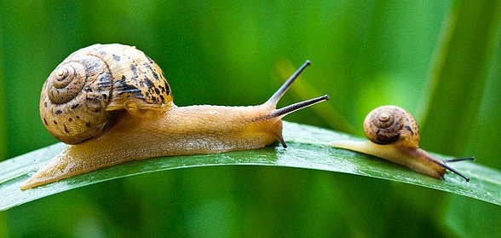
軟體 動物 ? Mollusca

Slide 3
軟體(Software) 不等於 軟體(Mollusca)

Slide 4
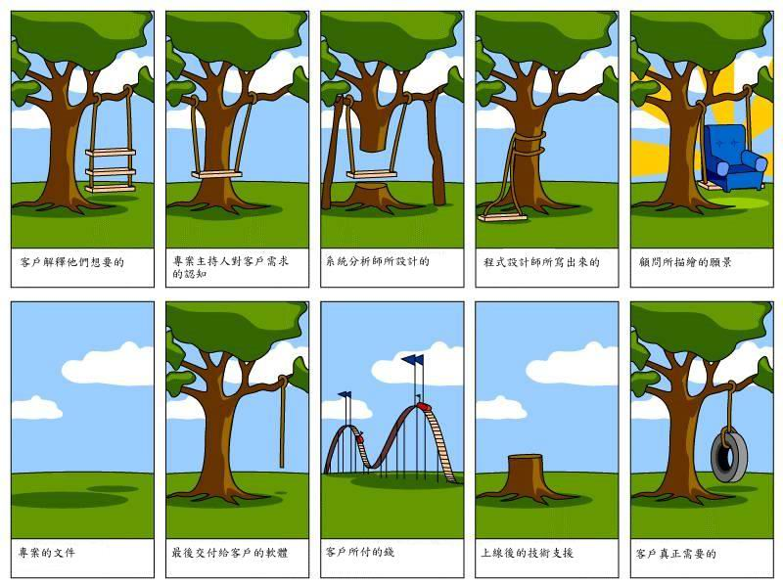

Slide 5
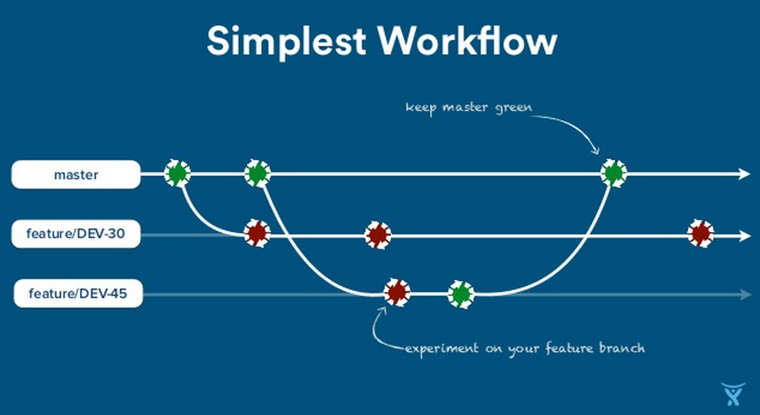

Slide 6
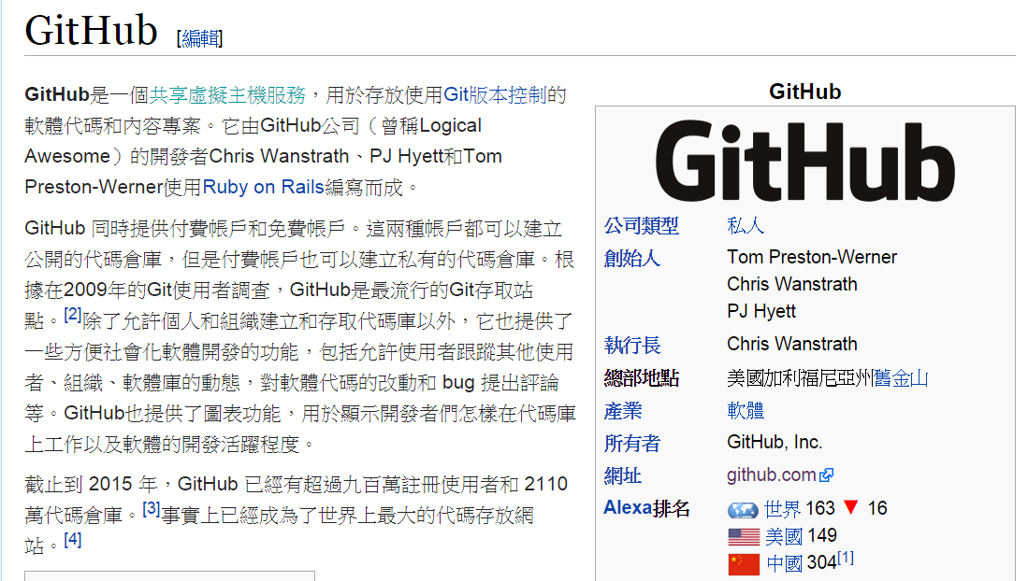
GitHub

Slide 7
Set up
git config --global user.name "jerry" git config --global user.email "jerry@mail.ntust.edu.tw"

Slide 8
Empty repository

Slide 9
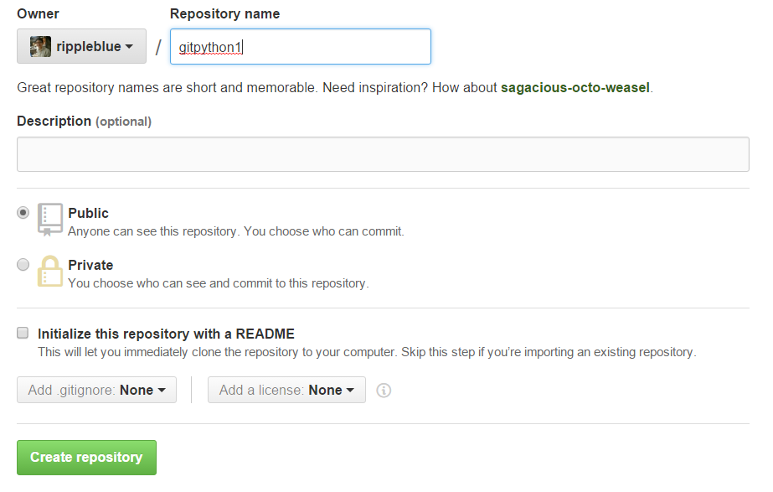
Empty repository

Slide 10
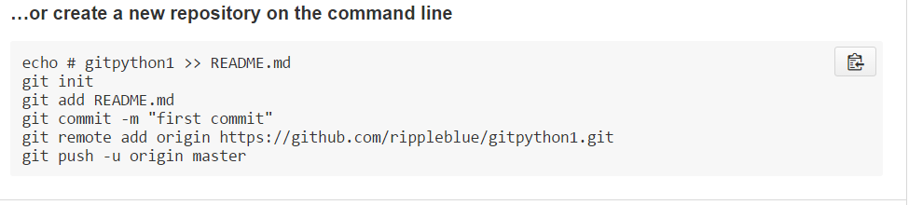
自行進資料夾新增檔案(windows)
空的必須加

Slide 11
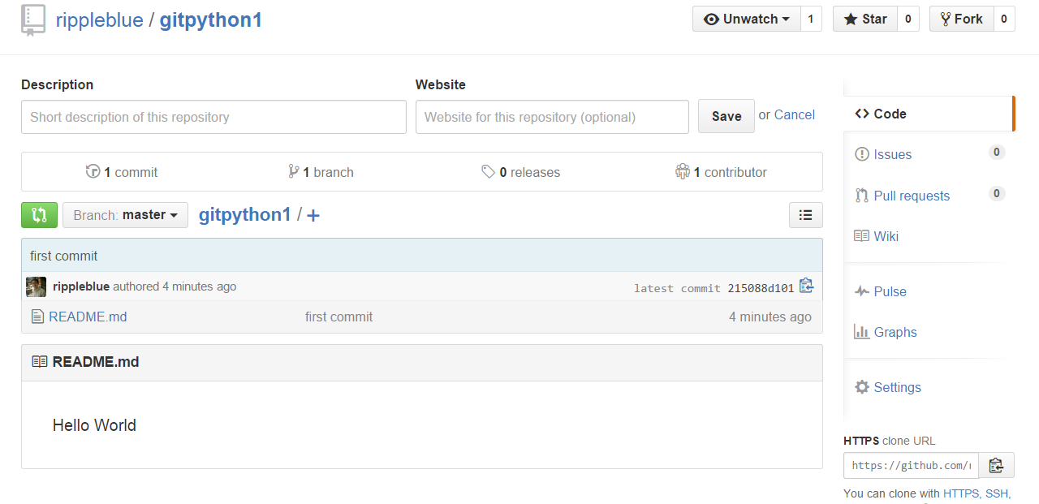
成功畫面

Slide 12
Non-empty Repository (第一天結束)

Slide 13
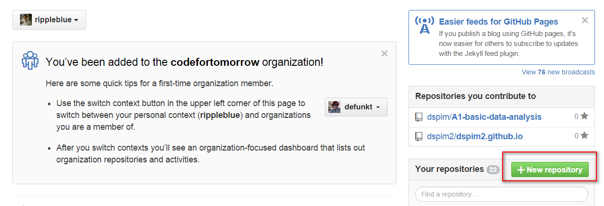

Slide 14
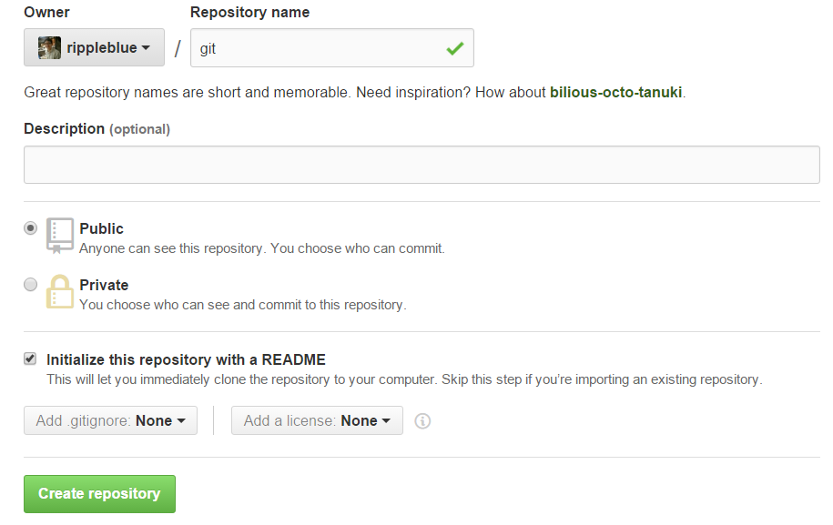

Slide 15
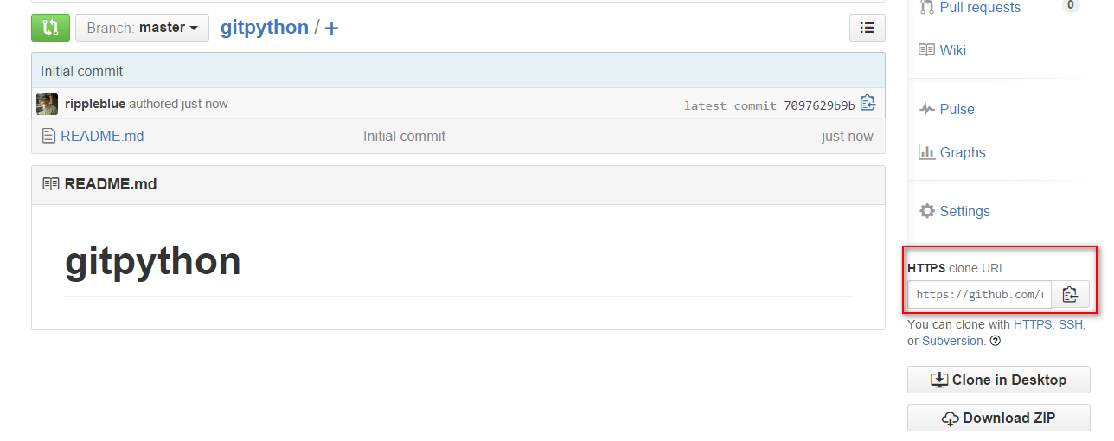

Slide 16
Non-empty Repository
git clone https://github.com/rippleblue/pythontest2.git
cd gitpyton
自行新增檔案至資料夾
git add .
git commit –m “11.txt”
git push origin master
git log

Slide 17
Non-empty Repository
再新增檔案至資料夾
git add .
git commit –m “new commit”
git push

Slide 18


新檔案上傳
再新增檔案至資料夾
git add .
git commit –m “new commit”
git push

Slide 19
Delete Files

Slide 20
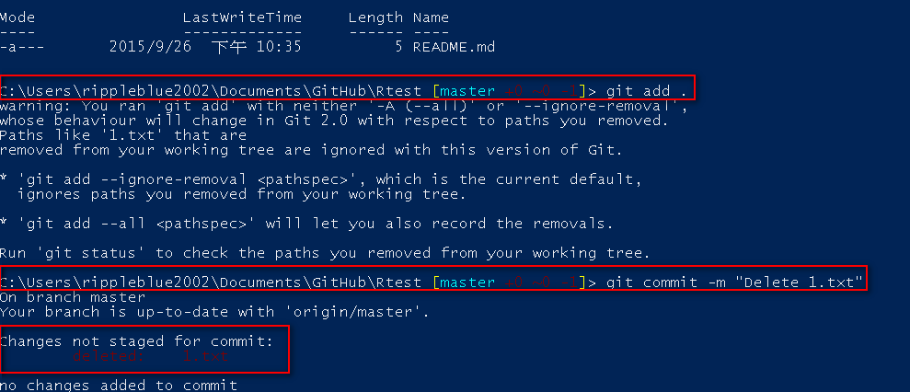
Error ?

Slide 21
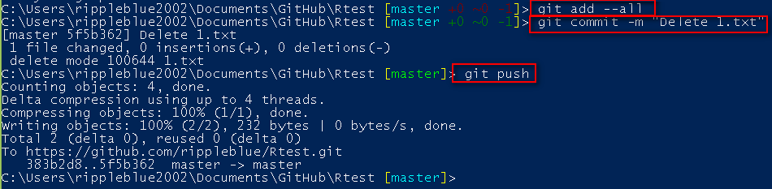
Delete files

Slide 22
repository merge

Slide 23
新增github 與 工作目錄
gitpython_empty
照舊再做一次

Slide 24
git remote add origin https://github.com/rippleblue/gitpython_empty.git
git add .
git branch new1
git branch
git checkout new1

Slide 25
新增任檔案
git add .
git commit –m “new1 branch”
git push
git push origin new1

Slide 26
git checkout master
git merge new1
git push

Slide 27
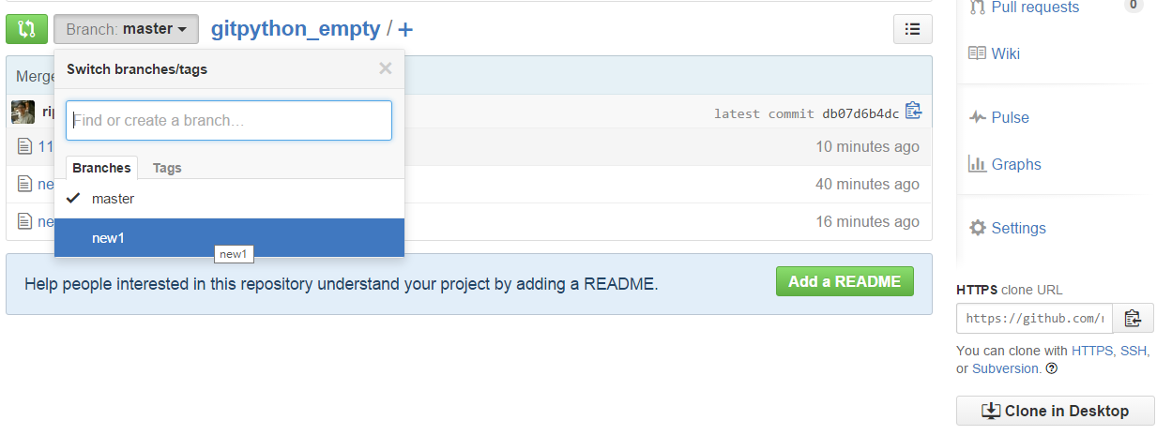
Github

Slide 28
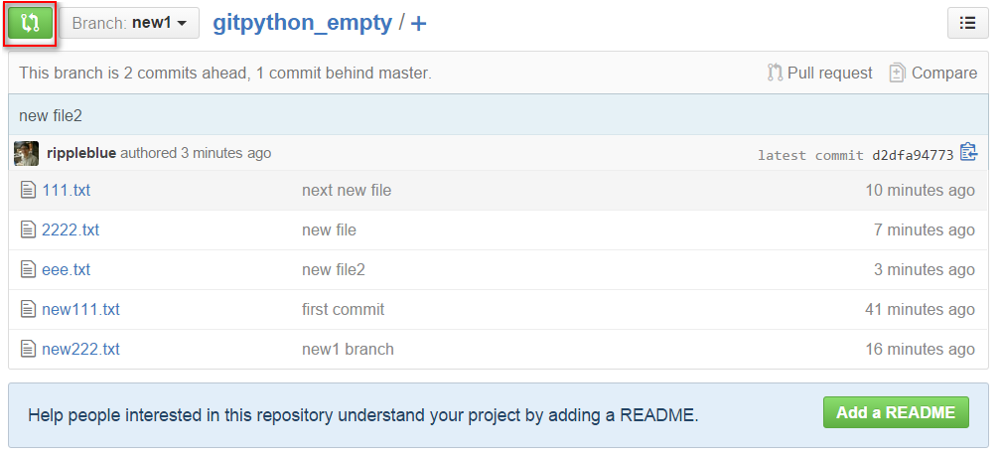

Slide 29
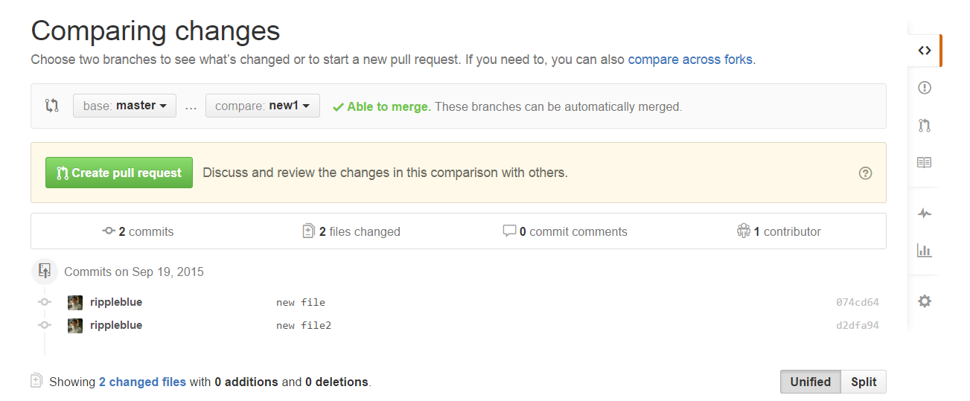

Slide 30
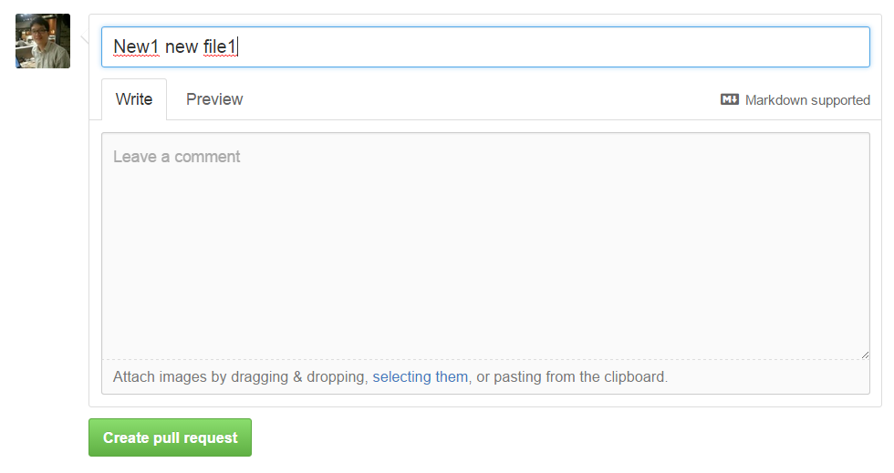

Slide 31
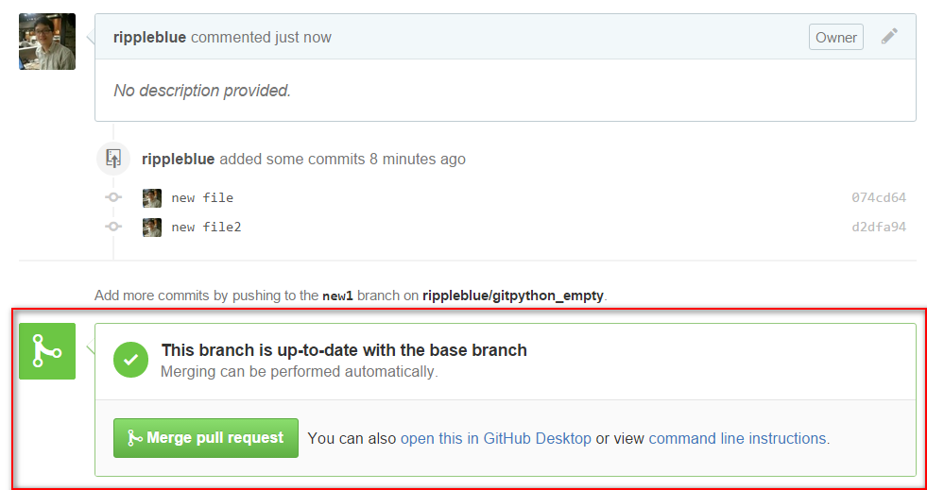

Slide 32
Branch

Slide 33
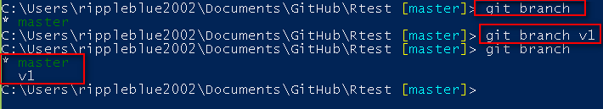

Create and delete branches
Create
Delete
git branch -D new-branch # 強制刪除 new-branch

Slide 34
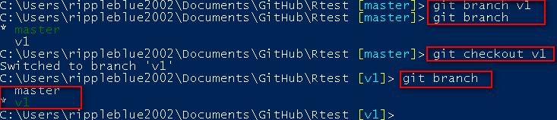
Switching branches

Slide 35
exercise

Slide 36
Exercise
Try to create non-empty and Empty repository
Try to commit to repository
Try to push files to repository
Try to delete files from repository
How to upload your files to teacher repository ?

Slide 37
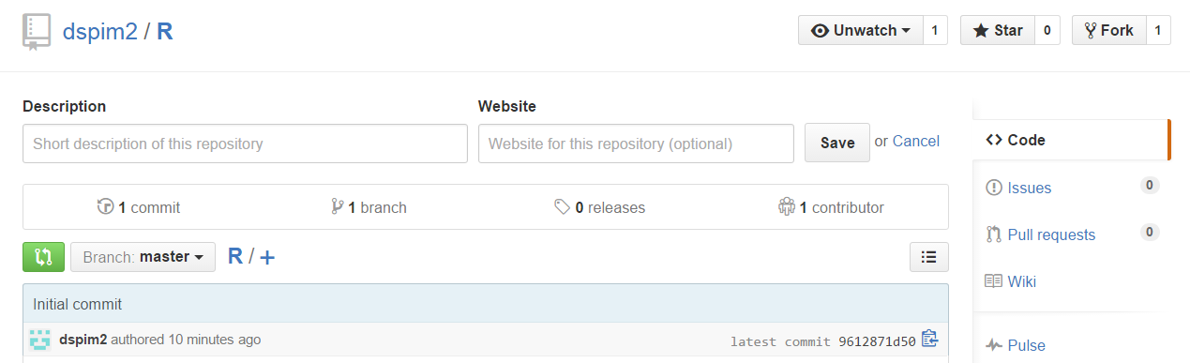
How to upload your files to teacher repository ?
提交檔案到老師的Repository

Slide 38
先Fork到本機
git clone https://github.com/rippleblue/R.git
新增檔案
Git add .
Git commit –m “something new”
Git push

Slide 39
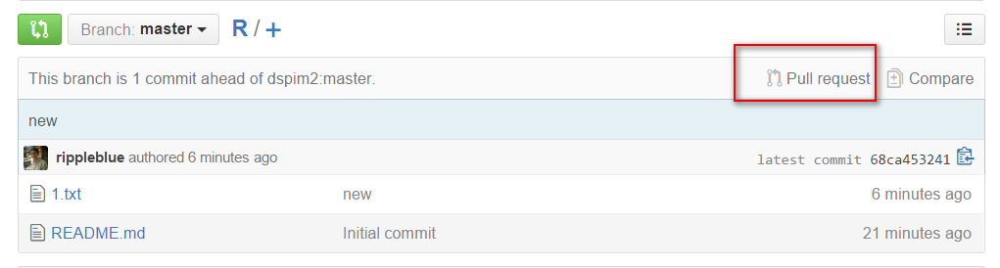
Create pull request

Slide 40
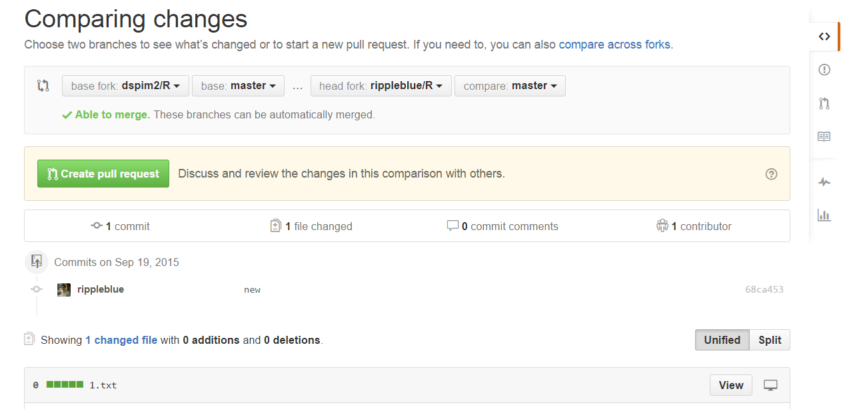

Slide 41
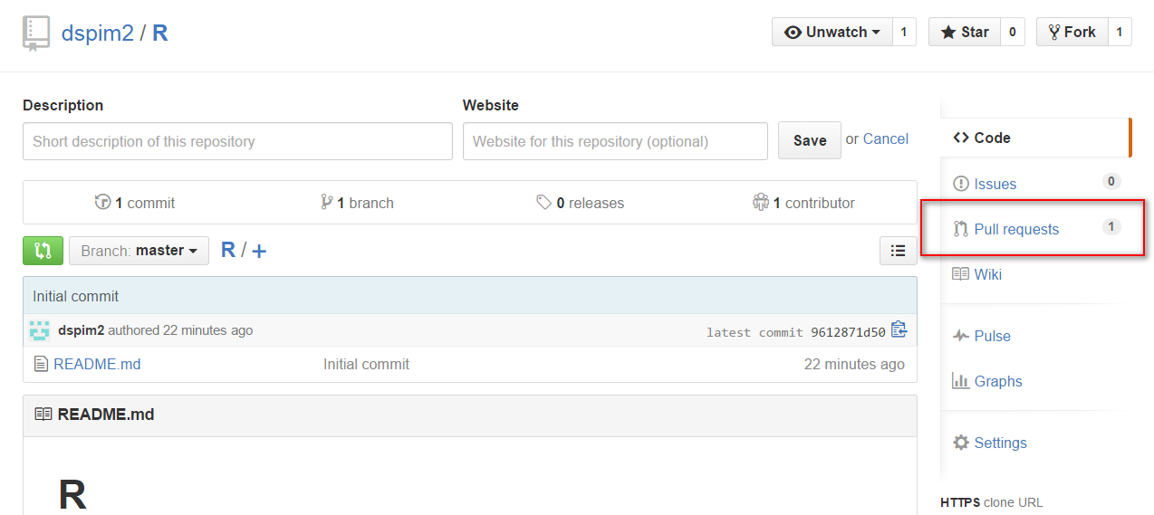
收到Pull requests的Repository

Slide 42
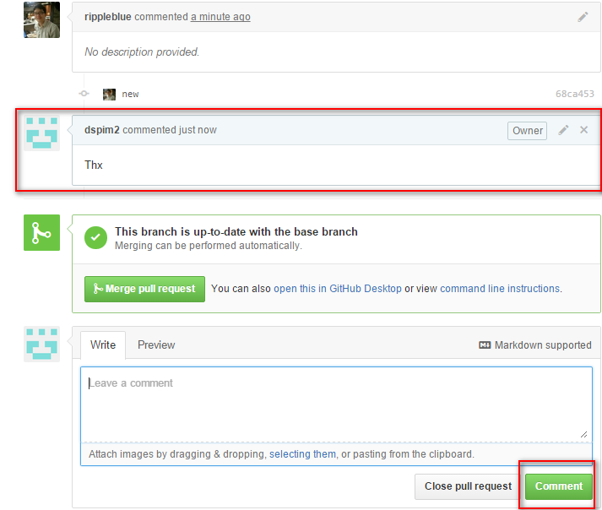

Slide 43
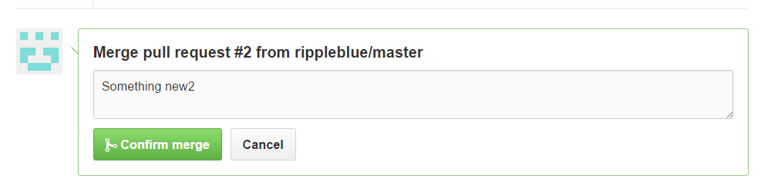

Slide 44
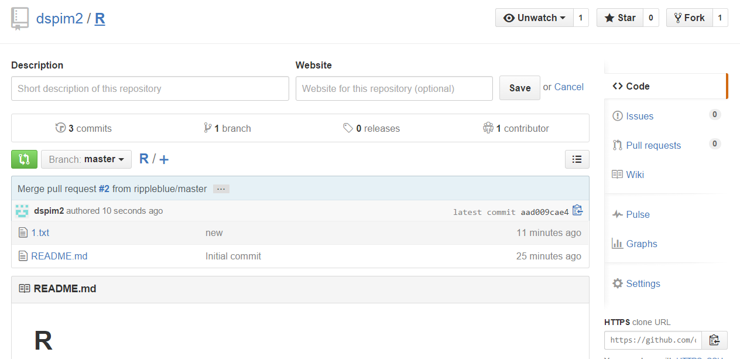

Slide 45
進階Git

Slide 46
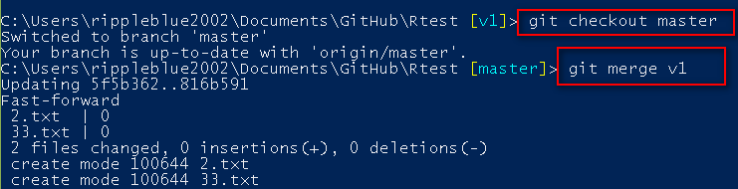
Git reset 還原
檔案經過Branch上傳
將v1進行Merge

Slide 47
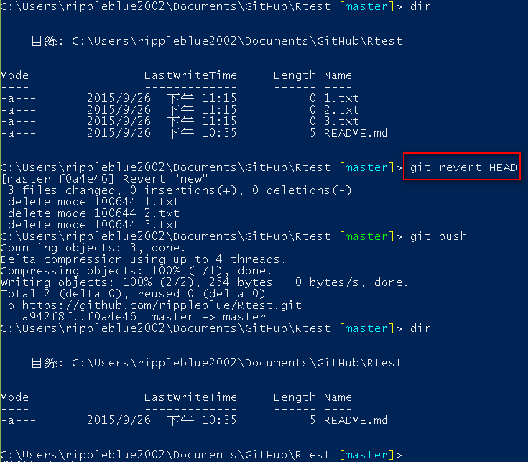

Slide 48
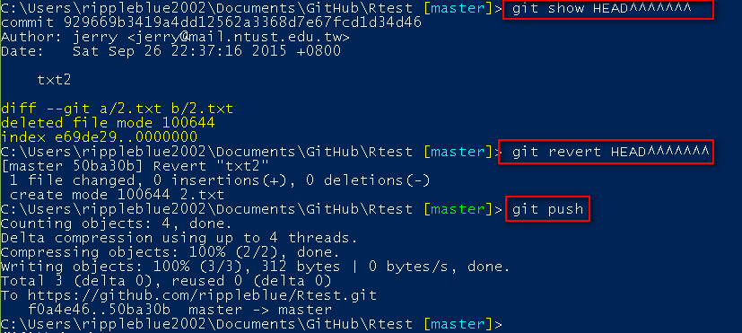
git show HEAD^ (前一版本)
git show HEAD^^ (前前一版本)
git show HEAD~4 (前前前前一版本)

Slide 49
git show filename #檢查狀態
git diff filename #列出差異
git stash #放入暫存區

