Slide 1
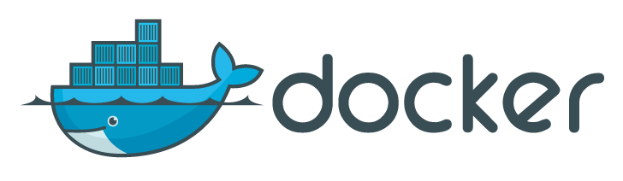
Docker
Jerry

Slide 2
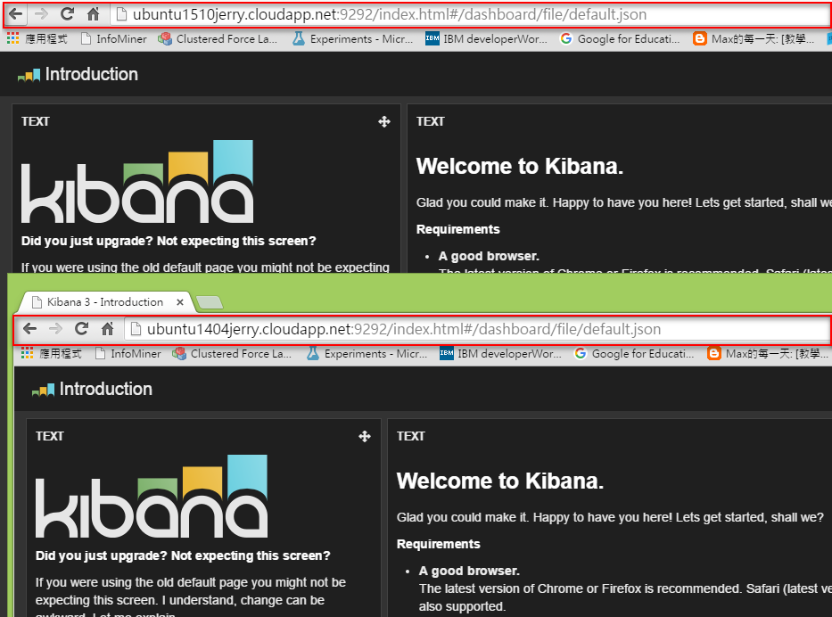

Slide 3
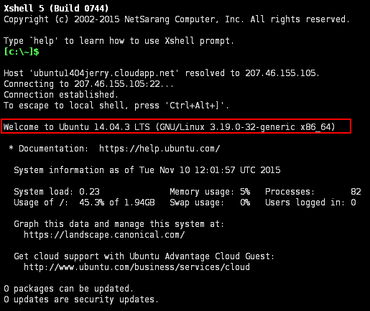
Ubuntu 14.04

Slide 4
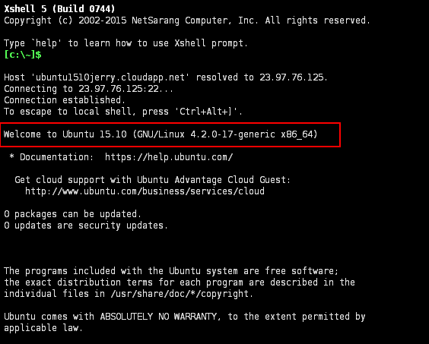
Ubuntu 15.10

Slide 5
Command-line
sudo apt-get update
sudo apt-get install docker.io
sudo docker pull pblittle/docker-logstash
sudo docker run -d \
-p 9292:9292 \
-p 9200:9200 \
pblittle/docker-logstash

Slide 6
Reference
http://ubuntu1510jerry.cloudapp.net:9292/
http://ubuntu1404jerry.cloudapp.net:9292

Slide 7
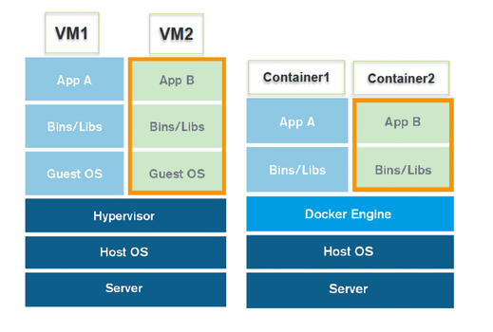
Vmware, Virtualbox
Docker

Slide 8
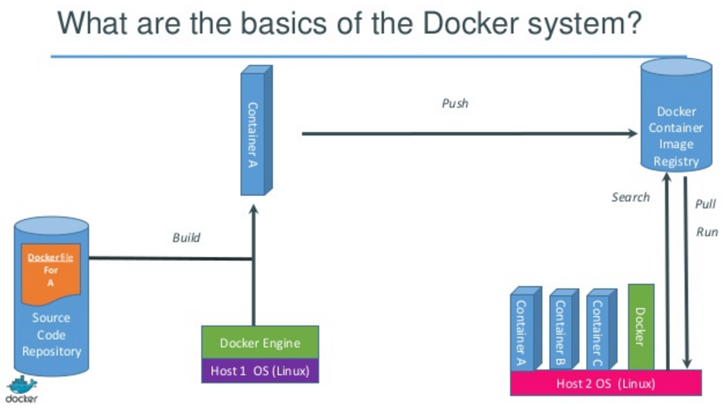

Slide 9
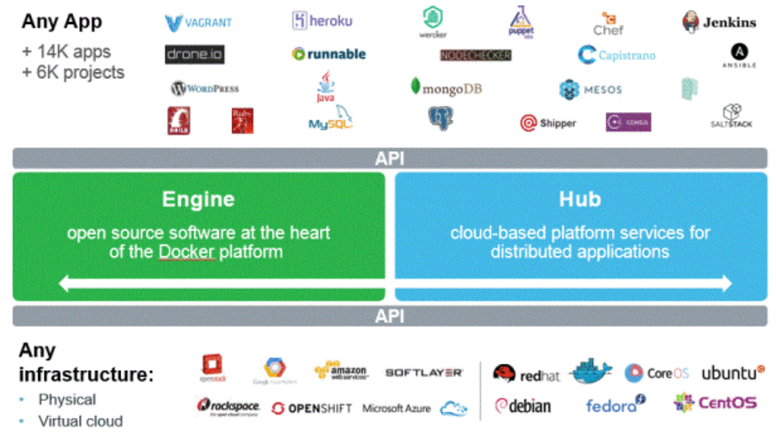

Slide 10
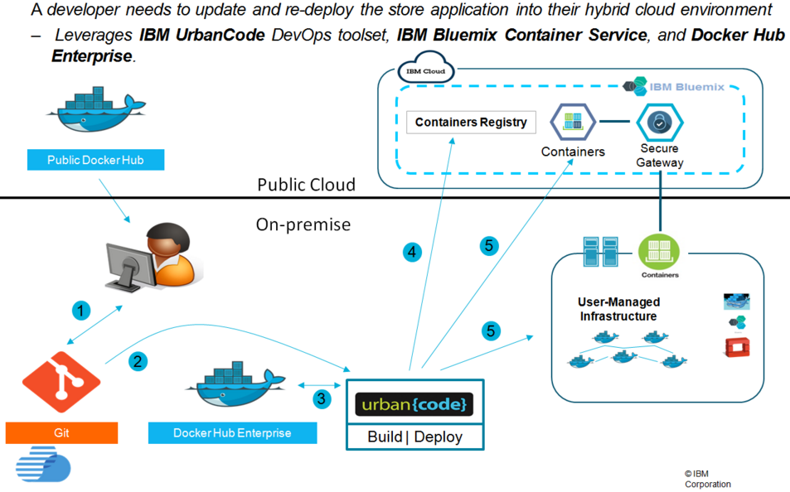
Application

Slide 11
Docker Tutorial

Slide 12
Getting Started (ubuntu 14.10 64bit)
sudo apt-get update
sudo apt-get -y install docker.io
sudo docker info
sudo docker login

Slide 13
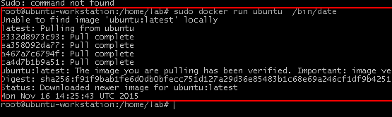
Get started ubuntu container with date
sudo docker search ubuntu
sudo docker run ubuntu /bin/date

Slide 14
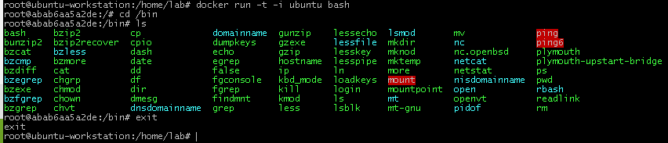
Interactive command line with container
docker run -t -i ubuntu bash
exit
Container ID

Slide 15
Container List
docker ps --help
docker ps -a -q

Slide 16
Shut down Container
docker ps # list
docker start abab6aa5a2de
docker stop abab6aa5a2de
docker rm abab6aa5a2de
docker ps -a

Slide 17
Management Docker Image
docker images

Slide 18
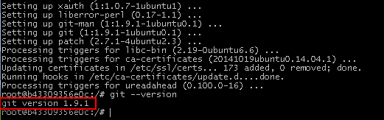
docker pull
# Update Container
docker run -t -i ubuntu bash
git --version
apt-get update
apt-get -y install git
git --version

Slide 19

docker pull
docker commit -m=" Add Git " -a="jerry" b43309356e0c jerryspark/ubuntu:ubuntuwithgit
docker images | grep ubuntuwithgit
docker push jerryspark/ubuntu
Container ID

Slide 20
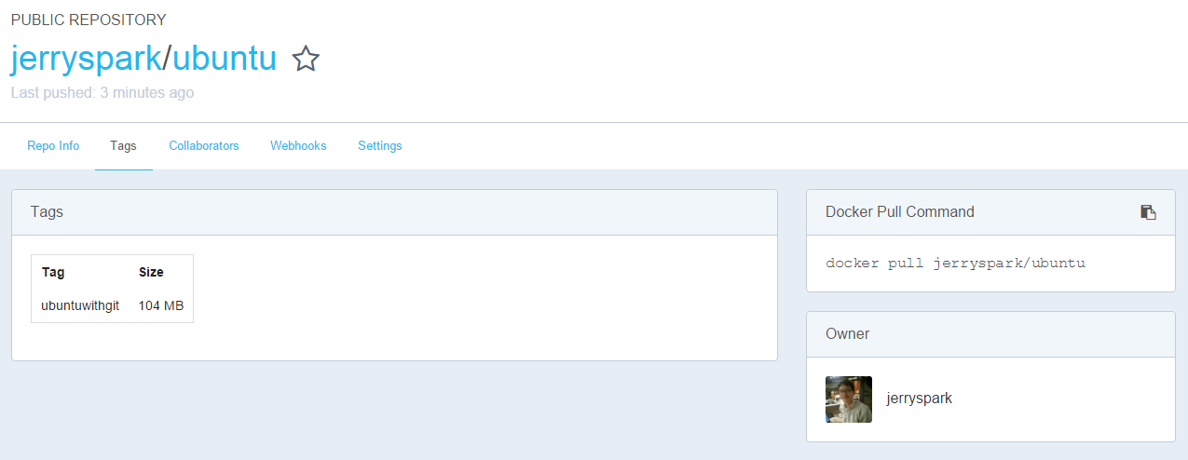
docker pull

Slide 21
Docker File

