Slide 1
Docker
Jerry

Slide 2
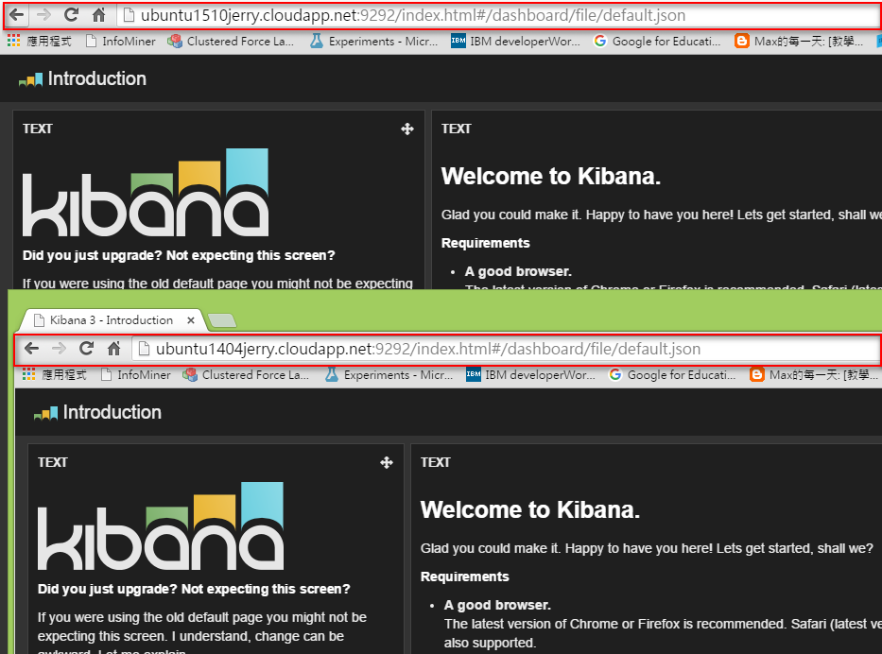

Slide 3
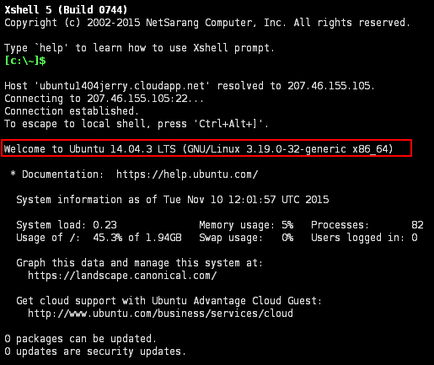
Ubuntu 14.04

Slide 4
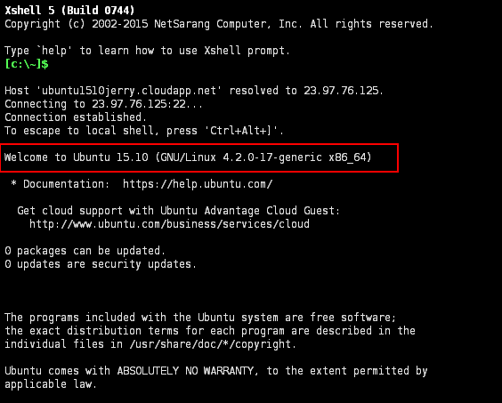
Ubuntu 15.10

Slide 5
Command-line
sudo apt-get update
sudo apt-get install docker.io
sudo docker pull pblittle/docker-logstash
sudo docker run -d \
-p 9292:9292 \
-p 9200:9200 \
pblittle/docker-logstash

Slide 6
Reference
http://ubuntu1510jerry.cloudapp.net:9292/
http://ubuntu1404jerry.cloudapp.net:9292

Slide 7
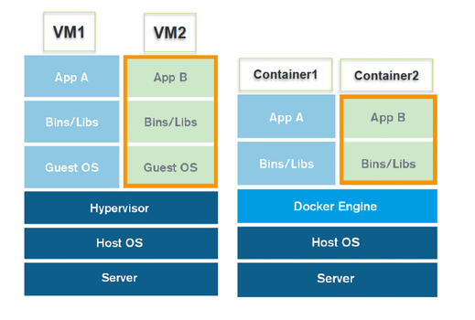
Vmware, Virtualbox
Docker

Slide 8
Getting Started (ubuntu 14.10 64bit)
sudo apt-get update
sudo apt-get -y install docker.io
sudo docker info
sudo docker login

Slide 9
sudo search ubuntu
# Get started ubuntu container with date
sudo run ubuntu /bin/date

