Slide 1


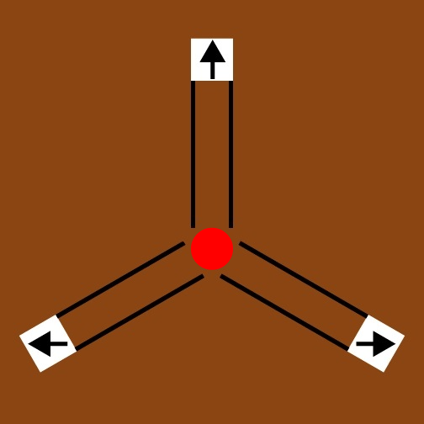
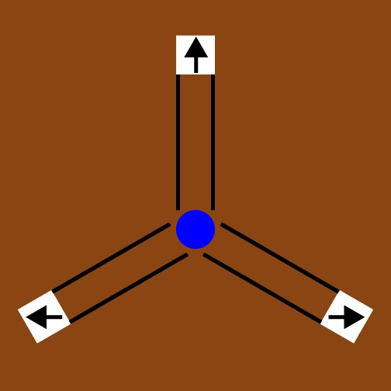
Assessing Human Performance in
Recognition of Spatial and Temporal Patterns
Jerry Zhang^{1,2}, Lukas Vogelsang², Shlomit Ben-Ami², Sharon Gilad-Gutnik², Pawan Sinha²
Los Gatos High School, 20 High School Ct. Los Gatos, CA¹, Sinha Lab, Department of Brain and Cognitive Sciences, MIT, 43 Vassar St, Cambridge, MA²
Introduction
Results/Analysis
Discussion/
Conclusion
Children with autism spectrum disorder (ASD) exhibit a wide variety of behavioral symptoms, including impaired communication skills and inclination towards repetitive actions.
Children with ASD live in a seemingly magical world, where events occur without a cause.
The Predictive Impairment in Autism (PIA) hypothesis presents the idea that an inability to predict may tie the varying symptoms together.
PIA posits that there may be inaccuracies with prediction of patterns in spatial and temporal conditions.
Without being able to predict movements based on past actions, patients have difficulty interacting with dynamic objects and theory of mind.
This project tests the PIA hypothesis.
An experiment was created with two parts. Both parts include a blue ball and a red ball that move and require the use of the past to determine future actions. The actions of the balls change after 50 rounds, requiring subjects to change their ideas of how the balls move.
The first, spatial part tests predictive abilities based on where the ball will move to, either up, left, or right with the probabilities set prior to the experiment.
The second, temporal part tests predictive abilities based on when the ball will move, with the actual times determined by a Gaussian curve with a set mean and standard deviation.
Although we were unable to find ASD patients to run the experiment, we collected and analyzed baseline data to get an insight into how children without ASD predict patterns in time and space.
From the limited pilot data collected, a few interesting lessons were learned.
In the spatial part, the overall graph demonstrates that the actual keypresses aligned greatly with the given probabilities, demonstrating that pattern recognition is generally accurate with the current configuration.
When separating the keypresses by color, there appears to be an influence by one ball on the other; for example in the first set of 50, the blue appeared 80% of the time on the top while the red ball only appeared 12.5% of the time there. However, 20% of the keypresses on red balls guessed that it would go to the top. This influence can be seen across the graph.
In the temporal condition, it appears as if subjects were able to differentiate between the two balls more when the differences were the largest and the smallest (sets 1 and 2). Further data collection and analysis will need to be completed to determine why this is not the case on the middle ones (sets 3 and 4).
In sets 1 and 2, there are visibly two peaks with a large spread, with each of the peaks near where the true mean was. Similarly to the spatial condition, there appears to be influence by one ball on the other.
In addition to these graphs, we ran t-tests on the temporal data to determine that people easily detect when the time changes on one ball but not the other, with this consistently switching from blue to red to blue between the 3 changes.
Through these we learned that human prediction and pattern recognition is generally strong but may get a little bit mixed between two almost simultaneous actions.
In the future we hope to be able to run this experiment on ASD patients and compare the results to be able to test the PIA hypothesis in more depth.
Trials | Blue | Red
1-50 | .800 .100 .100 | .125 .750 .125
51-100 | .150 .150 .700 | .850 .075 .075
101-150 | .200 .600 .200 | .175 .175 .650
151-200 | .183 .483 .333 | .183 .333 .483
Trials | Blue | Red
1-50 | 500 | 1500
51-100 | 833 | 1166
101-150 | 1166 | 500
151-200 | 1500 | 833
Spatial
Methods
Temporal
References
Experiment written using JavaScript, published online.
Three parts: Practice, Spatial, and Temporal. Subjects are told which part they are in prior to starting.
Practice mode is designed to train subjects on the game mechanics, including which keys to press and how the ball will move.
Spatial mode tests subjects’ abilities to predict which direction the ball will move, with 200 trials total. The probabilities change every 50 (25 per color). The probabilities (in order from left to right) are listed in the Spatial chart above.
Temporal mode tests subjects’ abilities to predict what time the ball will move, with the direction fixed. There are 200 trials, with the means, standard deviations (1/10 of the mean), and allowed prediction difference (1/3 of the mean) changing every 50 (25 per color). The means are listed in the Temporal chart.
Through statistical analysis, including t-tests and ANOVA tests, of key presses, time pressed, and scores for each of the tests, I am looking to see whether there is a pattern of prediction that relates to behavior.
Sinha P, et al. Autism as a disorder of prediction. Proc. Natl Acad. Sci. USA. 2014, 111, 15220–15225.
Acknowledgements
I’d like to thank the team at the Sinha Lab this summer for providing a great environment to work and develop this project.

