Slide 1


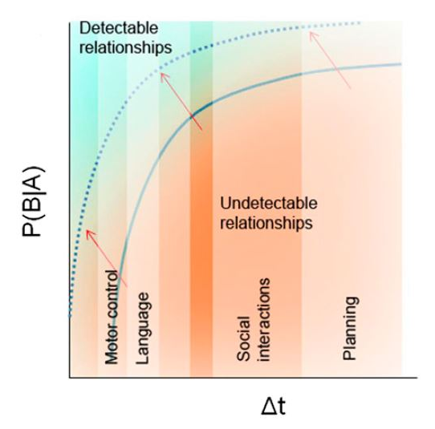
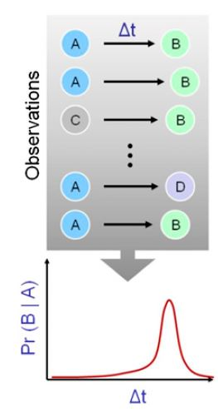
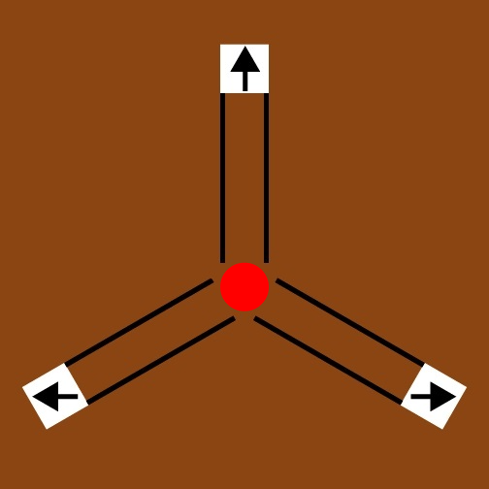
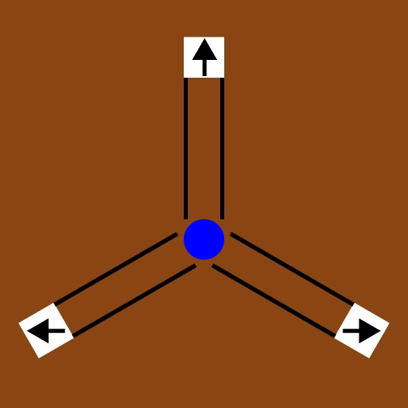
Assessing Human Performance in
Recognition of Spatial and Temporal Patterns
Jerry Zhang^{1,2}, Lukas Vogelsang², Sharon Gilad-Gutnick², Shlomit Ben-Ami², Pawan Sinha²
Los Gatos High School, 20 High School Ct. Los Gatos, CA¹, Sinha Lab, Department of Brain and Cognitive Sciences, MIT, 43 Vassar St, Cambridge, MA²
Introduction
Results/Analysis - Spatial
Results/Analysis - Temporal
People with autism spectrum disorder (ASD) exhibit a wide variety of behavioral symptoms, including impaired communication skills and inclination towards repetitive actions.
Children with ASD live in a seemingly magical world, where events occur without a cause.
The Predictive Impairment in Autism (PIA) hypothesis presents the idea that an inability to predict may tie the varying symptoms of autism together.¹
PIA posits that autism may be associated with inaccuracies in predicting patterns in spatial and temporal conditions.
Specifically, people with ASD may detect fewer relationships over time in various aspects of life, including motor control and language.
For example, without being able to predict movements based on past actions, patients have difficulty interacting with dynamic objects.
This project was created to test the PIA hypothesis.
An experiment was created with two parts: spatial and temporal. Both parts require the use of past events to determine future outcomes.
As of now, this project is a pilot to test performance of neurotypical individuals and will later be expanded to test on ASD subjects.
Prior to running the experiment on ASD patients, we tested the viability of the experiment on neurotypical individuals.
From the limited pilot data of 8 samples collected, a few interesting lessons were learned.
In the temporal condition, subjects were able to differentiate between the two balls more when the differences were the largest and the smallest (sets 1 and 2).
Further data collection and analysis will need to be completed to assess sets 3 and 4.
In sets 1 and 2, there are two visible peaks with a large spread, with each of the peaks near where the true mean was. Similarly to the spatial condition, there appears to be an influence by one ball on the other.
We ran t-tests to determine that people easily detect when the time changes on one ball but not the other, with this consistently switching from blue to red to blue between the 3 changes.
P. Sinha et al. (2014)
In the spatial condition, actual keypresses aligned well with the given probabilities, demonstrating that pattern recognition is generally accurate with the current configuration.
When separating the keypresses by color, there appears to be an influence by one ball on the other.
In the first set of 50 trials, the blue ball appeared 80% of the time on the top while the red ball only appeared 12.5% of the time there.
However, 20% of the keypresses on red balls guessed that it would go to the top.
Methods
Conclusion/Future Directions
Our pilot study showed that human prediction and pattern recognition is generally strong but may get a little bit mixed between two almost simultaneous actions.
In the future we hope to be able to run this experiment on ASD subjects and compare the results to be able to test the PIA hypothesis.
Experiment written using JavaScript, published online.
Two conditions: Spatial and then Temporal
Spatial: tests subjects’ abilities to predict which direction the ball will move, with 200 trials total.
Probabilities change every 50 trials(25 per color) and the directions are randomized based on given probability distributions.
Temporal: tests subjects’ abilities to predict what time the ball will move, with the direction fixed. There are 200 trials, with the means, standard deviations (1/10 of the mean), and allowed prediction difference (1/3 of the mean) changing every 50 trials (25 per color).
Times are based on a Gaussian distribution given mean and standard deviation.
Through statistical analysis, including t-tests and ANOVA tests, of key presses, time pressed, and scores for each of the tests, patterns of prediction that relate to behavior were assessed.
References/Acknowledgements
I’d like to thank the team at the Sinha Lab this summer for providing a great environment to work and develop this project.
¹ Sinha P, et al. Autism as a disorder of prediction. Proc. Natl Acad. Sci. USA. 2014, 111, 15220–15225.

