Slide 1
Daisy Hackathon 2020
Bobaholics: Jerry He, Kailin Hong, Trudie Cheung

Slide 2
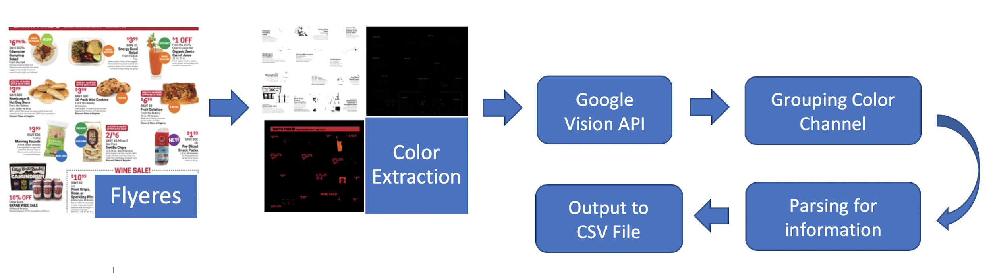
Solution Overview

Slide 3
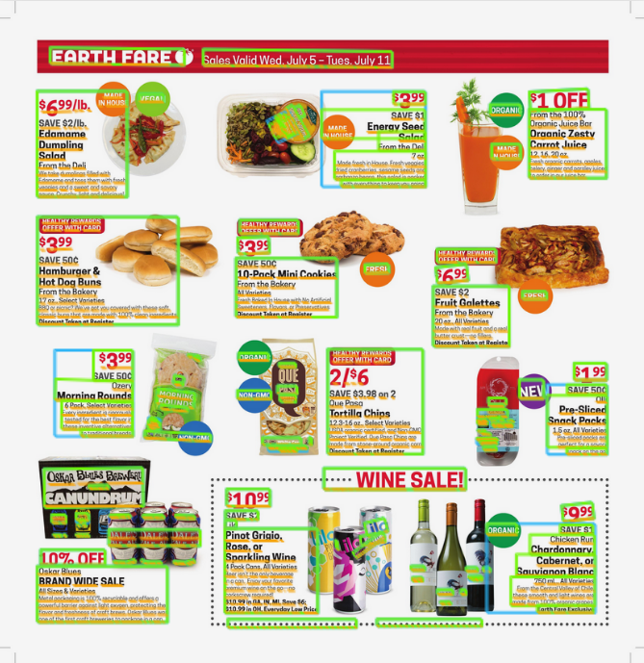
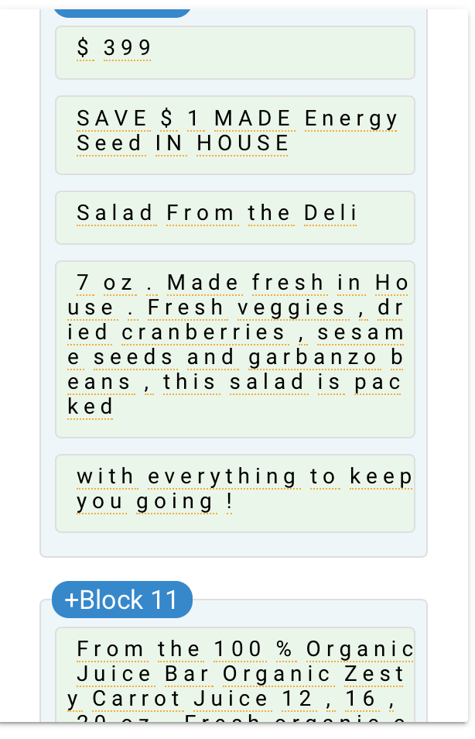
Challenge 1: Text Recognition
Optical Character Recognition (OCR) to detect text in images
→ Google Vision API

Slide 4
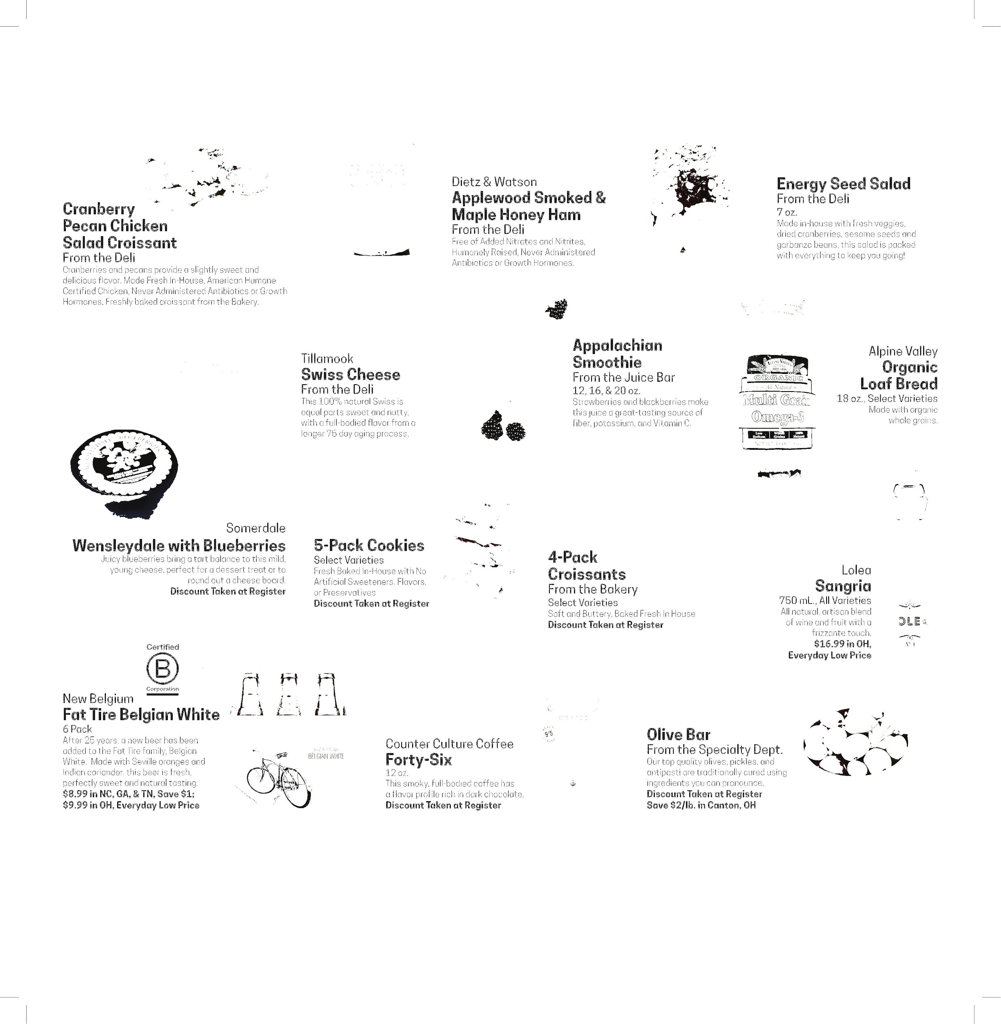
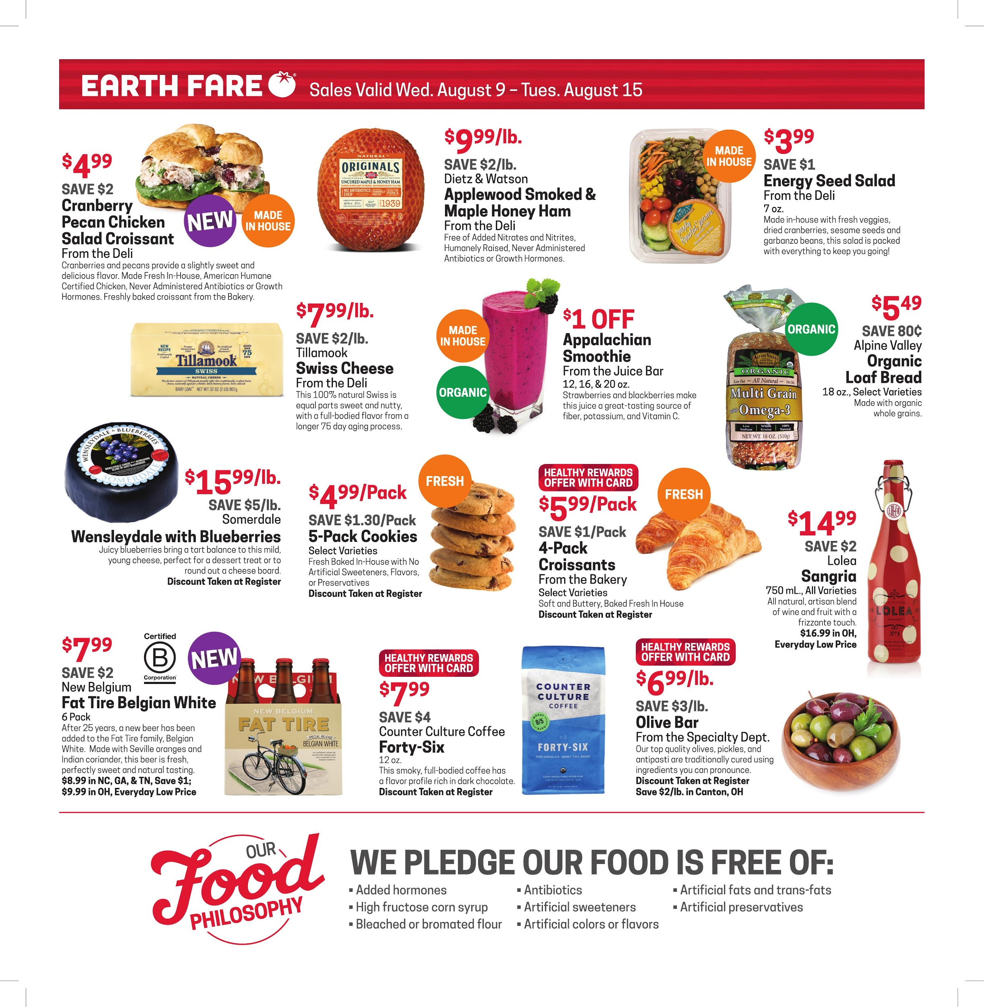
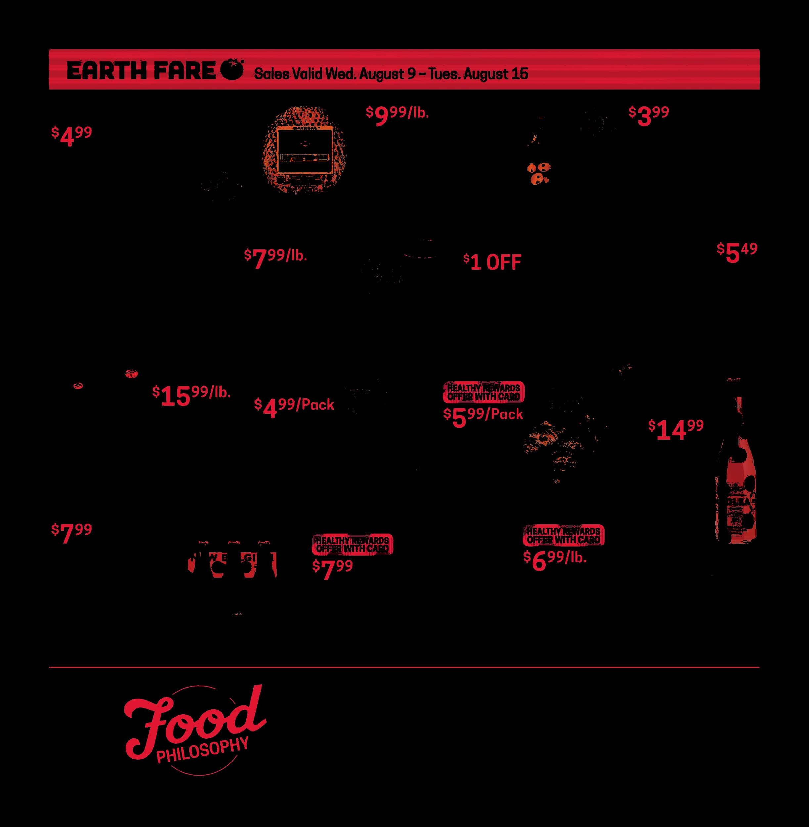
Challenge 2: Image Segmentation
Initial Approach → Cropping images based on contours
Revised Approach → Fuzzy segmentation based on text colours, dealing with borders
Patterns in colour and categorization of the information the text gave us

Slide 5
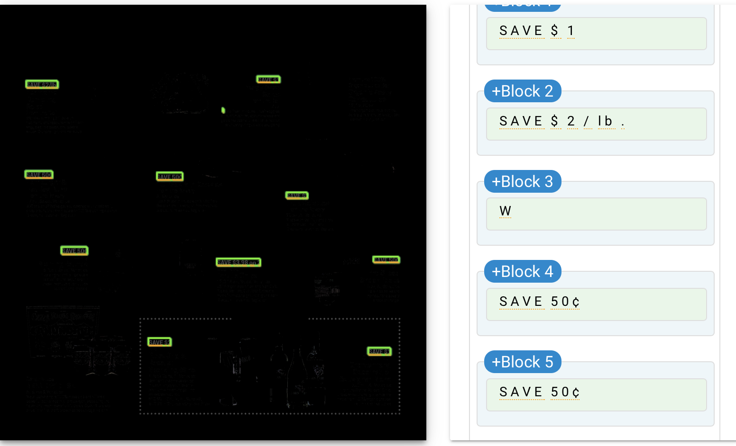
Challenge 3: Parsing
Grouping different colored information based on location
Classification of strings/text blocks into the type of information
Identify patterns in strings (with classification)
Output to CSV
CSV
Output

Slide 6
Next Steps
Generalized parsing
More sophisticated image segmentation (edge detection, create bounding boxes, etc)
Font Classifier

