Slide 1


CV32E40P* Verification Schedule Status Functional RTL Freeze Readiness Review
Mike Thompson
www.openhwgroup.org
© OpenHW Group
November 30, 2020
1

Slide 2
Administravia
Attendance is now being tracked for all OpenHW Task Group meetings:
This meeting qualifies as an OpenHW Group Task Group meeting.
Eligibility to vote in each committee depends on meeting attendance, as described in the OpenHW bylaws.
OpenHW projects working towards formal Project Launch:
CVA6: Jérôme Quevremont, Florian Zaruba
FORCE-RISCV: Jingliang (Leo) Wang
CV32E40P_V2: Arjan Bink, Davide Schiavone, John Martin
Multiple software projects: Jeremy Bennett

Slide 3
Recommendation from Last Week...
CV32E40P is ready for “Functional RTL Freeze”.
Still a few loose end to clean off:
Mostly checklist items.
Need to create GitHub tags, run regressions and publish results.
Can we get this done in time for a formal review on 2020-12-01?
Keep in mind that American Thanksgiving is this weekend and the SiLabs team have earned a break!
Mike should not lead this review.

Slide 4
This is the CV32E40P Functional RTL Freeze Readiness Review
We are not declaring Functional RTL Freeze today.
We are presenting the path to Functional RTL Freeze:
Who does what.
How is it recorded.
Functional RTL Freeze is achieved when cv32e40p GitHub issue #595 is closed by Arjan Bink.
This issue is gated by the closure of issues that track the completion of the milestone checklists.
In theory, a formal meeting is not required to declare achievement of the milestone.

Slide 5
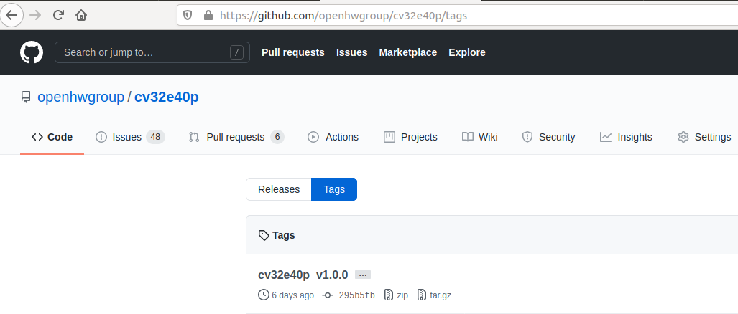
What, exactly, are we “Freezing”?
Two things – both “frozen” by creating GitHub Tags:
The RTL in cv32e40p.
The User Manual in core-v-docs.

Slide 6
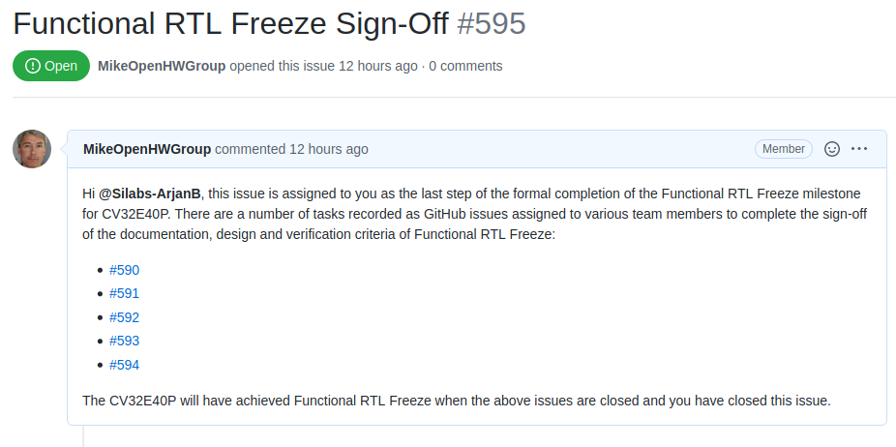
Sign-Off
We are done when all these issues are closed.

Slide 7
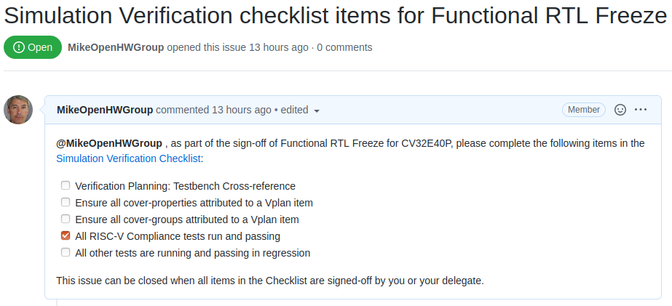
Sign-Off – Individual Checklists
Checklist done when all these boxes
are checked and issue is closed.

Slide 8
Checklists
Have been translated from Spreadsheets to Markdown tables in core-v-docs:
https://github.com/openhwgroup/core-v-docs/tree/master/program/milestones/CV32E40P/RTL_Freeze_v1.0.0
One Markdown table per Spreadsheet tab:
Documentation
Design
Simulation Verification
Formal Verification

Slide 9
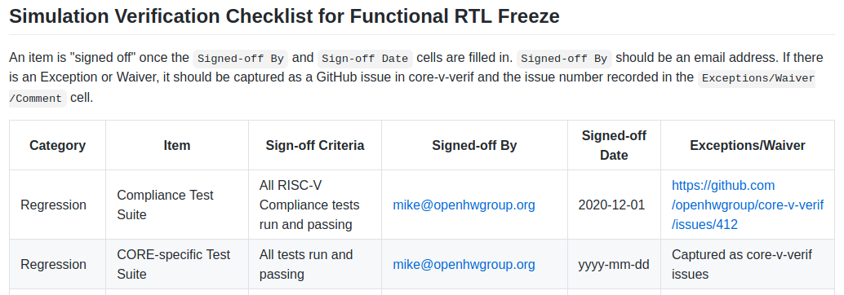
Closing off Checklist Items
Fill out the Checklist as per the instructions:
Indicate an item is complete by updating Signed-off By and Signed-off Date.
All waivers must be captured as a GitHub issue.
All waivers must be closed (indicating acceptance) by either Davide or Arjan.

Slide 10
Closing off Checklist Items
Fill out the Checklist as per the instructions:
Indicate an item is complete by updating Signed-off By and Signed-off Date.
All waivers must be captured as a GitHub issue.
All waivers must be closed (indicating acceptance) by either Davide or Arjan.

Slide 11

We are almost there...
At this point its mostly “just accounting”.
Nevertheless, its important:
Provides a corporate history that is (hopefully) easy to track and reference in the future.
Minimizes chances of items slipping through the cracks.
Demonstrates to the Membership that we take this seriously.
Provides a solid example to the open-source community.

Slide 12
Thank You

