Slide 1


OpenHW Group Standardized Tracer Interface for CORE-V-VERIF
Mike Thompson
mike@openhwgroup.org
© OpenHW Group
December 16, 2020

Slide 2
CORE-V-VERIF Today
DUT
memory
DUT: CORE-V RTL
(cv32e40p)
Tracer
Compare
RISC-V.hex
GCC/
LLVM/ ASM
Step
Ref
memory
SystemVerilog module
Synch
RISC-V.elf
Imperas Reference
(OVP model of cv32e40p)
RISC-V.S /
RISC-V.c
Single UVM Environment
Tracer, Sync and Step are tightly couple to micro-architecture of the cv32e40p.
Brittle: a small change to the RTL can break it.
Very sensitive to machine state transitions (e.g. machine mode to debug mode).
© OpenHW Group
Source: adopted from Imperas

Slide 3
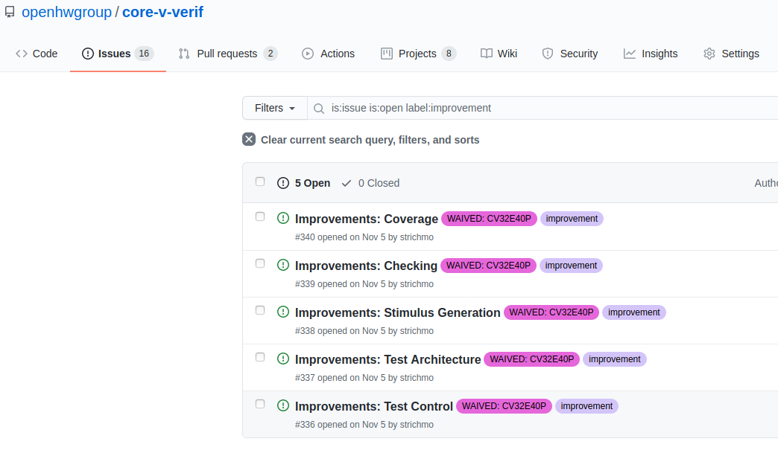
Great Minds Think Alike...
Steve created a set of “Improvements” issues in core-v-verif in early November.
Simon and Lee proposed a standard Tracer/Introspector in early December.
Jean-Roch implemented RVFI on the CVA6 this week.

Slide 4
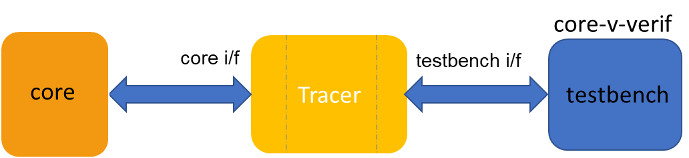
Imperas Proposal
CV32E40P_V2
1) A STANDARD WAY OF CONNECTING
THE TESTBENCH TO THE TRACER
2) A COMMON DEFINITION OF CAPABILITIES TRACER MUST PROVIDE
3) Each core will need to provide functionality from itself up into its tracer up to the testbench
CV32A6
CV64A6
CV32E2
Future CORE-V
… … ...
Proposal #1: define a common interface to the testbench that all CORE-V cores support.
Source: adopted from Imperas

Slide 5
How Would We Use It?
Option 1: Dump Tracer output to files for post-processing.
Option 2: Step-and-Compare as with CORE-V-VERIF and CV32E40P.
Option 3: Transaction scoreboarding.
Option 4: Formal verification.
Option 5: Trace capability in silicon.
Proposal #2: Testbench I/F should support all five options.

Slide 6
Implementation
Several team members (myself, Arjan Bink (SiLabs), Lee Moore (Imperas)) have independently investigated the RISC-V Formal Interface (RVFI):
Developed by Claire Wolf as a “framework for formal verification of RISC-V processors.”
At first glance it seems to fit our needs.
Lee Moore has started a discussion paper:
Need to find a way for broader participation.
Jean-Roch Coulon (Thales) has a pull-request add RVFI to CVA6.

Slide 7
We need to define our Requirements
Unambiguous signal of instruction retirement by the core:
PC updated
CSRs updated
Machine state (privilege level) updated
Visibility of the actual Instruction
Instruction Meta-data as per RVFI?
Do we want an “Integer Register Read/Write” interface such as specified in the RVFI, or access to the actual Register File?
Other open questions:
Memory Access
Out-of-order execution
Fused instructions

Slide 8
Next Steps
Document Requirements.
Document Interface Semantics:
Maybe start with the RVFI for the core’s interface.
RM interface must support the Requirements, but could have a different interface.
Use CVA6 and a development branch of cv32e40p/core-v-verif to validate implementation.

Slide 9
Thank You!
© OpenHW Group

