Slide 1


CV32E40P* Verification Schedule Status Sprint #6
Mike Thompson
www.openhwgroup.org
© OpenHW Group
October 26, 2020
1

Slide 2
Administravia
Attendance is now being tracked for all OpenHW Task Group meetings:
This meeting qualifies as an OpenHW Group Task Group meeting.
Eligibility to vote in each committee depends on meeting attendance, as described in the OpenHW bylaws.
CVA6 and FORCE-RISCV projects working towards formal Project Launch:
Reach out to Jérôme Quevremont (CVA6) or Jingliang (Leo) Wang (FORCE) to get involved.
“RTL Freeze” for CV32E40P:
If you haven’t already, please review the Checklist at: https://github.com/openhwgroup/core-v-docs/blob/master/program/milestones/Functional_RTL_Freeze_Criteria.xlsx

Slide 3
Pushing Toward “Functional RTL Freeze”
Recall from last week that this final sprint is “completion driven”, not “task driven”.
A major part of that is completing all items on the Checklist.
Jingliang (Leo) Wang of Futurewei has agreed to oversee the process of completing the Checklist:
Recall that Leo serves as co-chair of the Verification Task Group, along side Steve Richmond.
Each item in the Checklist will be assigned an owner.
Other Tracking Methods:
Completeness of Verification Plans (on core-v-verif)
GitHub Issues (Documentation, Design and Verification)
Coverage Reports (a static report is available on-line)

Slide 4
Verification Plans
Current status of simulation Vplans is provided at https://github.com/openhwgroup/core-v-docs/tree/master/verif/CV32E40P/SimulationVerificationPlan
Current “holes” in the simulation Vplans:
CSRs: I believe this is complete, ready to check-in collated all CSRs features.
OBI: Vplan ready for review
Sleep Unit and Pipelines are not started(!)
Formal Vplans updated.

Slide 5
Issues
CORE-V-DOCS:
10 open issues (-3 from last week)
6 related to PULP ISA and therefore not gating CV32E40P
2 Vplan and 6 User Manual
CV32E40P:
50 open issues (-4 from last week. Note: not all RTL)
19 are already waived for CV32E40P
CORE-V-VERIF:
19 open issues (same as last week)
6 are “tasks”
3 are “waived”
At what point do we block
pull-requests for cv32e40p?

Slide 6
Trending Issues
CV32E40P:
Three of the five new issues from Axiomise are now resolved.
Two illegal instruction issues (#548 and #549) :
Tracer, S&C or RTL issues.
Expected to be resolved by pull-requests cv32e40p #557 and core-v-verif #305 (now merged in).
Issue #537: remove apu_master_*_o from the top-level port map.
This is gated by core-v-docs issue #48 (which Mike just re-opened).
Recommend we waive both of these if not resolved before 2020-11-02.
CORE-V-VERIF:
#308: Mike broke Compliance
Old issue - #53: what do to about the FPNEW?
Issues from last week that are expected to be resolved by pull-requests cv32e40p #557 and core-v-verif #305:
Issues related to injection of random stalls on memory interfaces.
HPM counters (issue #239)
CORE-V-DOCS:
Issue #48: spec’ing the APU interface.

Slide 7
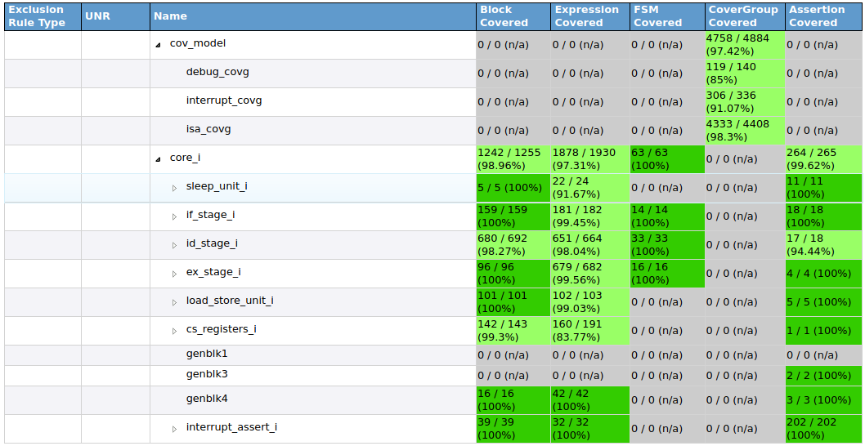
Coverage Data from 2020-10-23
A Coverage Report, generated on 2020-10-23, is available at https://mikeopenhwgroup.github.io/core-v-docs/.

Slide 8
RTL Freeze Checklist Review

Slide 9
Thank You

Slide 10
Background Info
(mostly slides from previous week)

Slide 11
Block Missing Coverage
core_i.id_stage_i.decode_i
482, 485: illegal instruction: p.elw
2307: uret
2336: illegal instruction (default clause of OPCODE_SYSTEM)
2380: Reading floating point CSRs (FFLAGS, FRM, FCSR)
2391: Writes to CSRs, MVENDORID, MARCHID, MIMPID, MHARTID
2464: Writes to any H/W Performance Monitor CSR
2546: User-mode CSR status: USTATUS, UEPC, UTVEC, UCAUSE
Covered in next
Pull-Request

Slide 12
Block Missing Coverage
core_i.id_stage_i.controller_i
377: Stall on FIRST_FETCH (id_ready_i == 0)
653: EBREAK instruction in single step and ebreak_force_debug_mode is off
643: id_ready_i == 0 during single step
1022: Ebreak instruction during single step mode
1032: Ecall during single step mode
1062: csr_status_i during single step mode
1155: debug_req_entry_q during DBG_TAKEN_ID step
1174: single step during DBG_TAKEN_IF
1209: single_step during trigger match, debug entry, other conditions

Slide 13
Block Missing Coverage
core_i.cs_registers_i.genblk2
1017: mcause write
core_i.cs_registers_i.g_mphmcounter[3].g_implemented
1523: write to upper 32 bits of mhpmcounter

Slide 14
Expression Missing Coverage
core_i.id_stage_i.decoder_i
2464: Illegal instruction for HPM CSR counter writes
core_i.id_stage_i.controller_i
1021: debug single step with debug_mode
1031: debug_single_step with debug mode
1061: debug_single_step with debug mode

Slide 15
Assertion Missing Coverage
u_debug_assert
a_ebreak_during_debug_mode
a_ebreak_debug_mode

Slide 16
Covergroup Missing Coverage
ISA coverage
Loads using x0 as rs1
Stores using x0 as rs1
jalr with a zero offset
lui with imm == 0
csr* -> Missing multiple writes to read-only registers

Slide 17
Covergroup Missing Coverage
ISA coverage
c.lui with zero and negative immediate
c.addi16sp with imm == 0 or negative
c.addi4spn with uimm8 == 0
c.slli with shamt5 == 0
c.srai with shamt5 == 0

Slide 18
Covergroup Missing Coverage
Interrupt handler entry/exit
jalr, sb, c.jal, c.ebreak, dret, ebreak, ecall, jalr
Debug
External debug request crossed with states
No trigger match without enable
Write to DCSR, DPC, DSCRATCH0, DSCRATCH1 in non-debug mode
Trigger register access cross coverage

Slide 19
Fin

