Slide 1


CV32E40P* Verification Schedule Status Sprint #6
Mike Thompson
www.openhwgroup.org
© OpenHW Group
November 02, 2020
1

Slide 2
Administravia
Attendance is now being tracked for all OpenHW Task Group meetings:
This meeting qualifies as an OpenHW Group Task Group meeting.
Eligibility to vote in each committee depends on meeting attendance, as described in the OpenHW bylaws.
CVA6 and FORCE-RISCV projects working towards formal Project Launch:
Reach out to Jérôme Quevremont (CVA6) or Jingliang (Leo) Wang (FORCE) to get involved.
“RTL Freeze” for CV32E40P:
If you haven’t already, please review the Checklist at: https://github.com/openhwgroup/core-v-docs/blob/master/program/milestones/Functional_RTL_Freeze_Criteria.xlsx

Slide 3
Pushing Toward “Functional RTL Freeze”
Recall from last week that this final sprint is “completion driven”, not “task driven”.
A major part of that is completing all items on the Checklist.
Jingliang (Leo) Wang of Futurewei has agreed to oversee the process of completing the Checklist:
Recall that Leo serves as co-chair of the Verification Task Group, along side Steve Richmond.
Each item in the Checklist will be assigned an owner.
Other Tracking Methods:
Completeness of Verification Plans (on core-v-verif)
GitHub Issues (Documentation, Design and Verification)
Coverage Reports (a static report is available on-line)

Slide 4
Verification Plans
Current status of simulation Vplans is provided at https://github.com/openhwgroup/core-v-docs/tree/master/verif/CV32E40P/SimulationVerificationPlan
Current “holes” in the simulation Vplans:
Simulation Vplans:
Need to start cross-referencing Vplan items with specific coverage.
OBI: Vplan ready for review
Sleep Unit and Pipelines are not started(!)
Formal Vplans up to date.

Slide 5



Issues
CORE-V-DOCS: 10 open issues (flat over last week)
2 Vplan issues:
#128 is part of debug Vplan review
#16 relates to Sleep Vplan
2 User Manual:
#40 is labeled “Enhancement”, does this gate RTL Freeze?
#78 appears stale
6 related to PULP or FP ISA and therefore not gating CV32E40P
CORE-V-VERIF: 12 open issues (-5 from last week)
3 are related to injection of random stalls on memory
2 are “tasks”
3 are “waived”
CV32E40P: 11 un-waived and open issues
2 are resolved
4 are verification issues
4 are of Type “Task” or “Enhancement”
Note: waiving of RTL issues is done either explicitly or implicitly:
Explicitly waived issues filter: -label:waived:cv32e40p
Implicitly waived issues filter: -label:param:pulp_xpulp -label:param:fpu

Slide 6
Trending Issues (1 of 2)
CV32E40P:
Issue #537: remove apu_master_*_o from the top-level port map.
Done! (This is a good thing).
Need to update the UM (see core-v-docs issue #48).
Issue #563 (and associated Pull-Request #564):
Adding debug status pins for external Debug Module
Design largely done – impact to verification is expected to be “days not weeks”.
CORE-V-VERIF:
Issues related to Debug verification (see next slide).
HPM counters (issue #239)
CORE-V-DOCS:
Issue #48: spec’ing the APU interface.

Slide 7
Trending Issues (2 of 2)
Certain conditions cause a mismatch between RTL and RM which results in step-and-compare errors:
Any debug request that is not aligned with exception-entry:
e.g. Illegal instruction coincident with assertion of debug_req_i
We are confident that these are all false negatives and there is no associated RTL bug.
We churned on this for a week with limited progress. To get past this we are doing the following:
Øystein will audit the Debug DV plan to identify any coverage holes (estimates ~ 1 working week to complete):
First priority will be to fill these holes.
Second priority is to cross reference the DV plan with the actual coverage.
Steve has implemented an extension to riscv-dv to improve control over riscv-dv injection of ebreaks and drets to the test program:
The goal is to avoid the scenario that triggers the false negatives.
This update is already on the master branch and there are no failures with this signature. No impact on coverage.
If necessary, a set of one or more directed tests will be generated to hit the coincident debug-request and exception-entry scenario. These may need to be run with the ISS disabled.
Lee and Greg are investigating whether a more general solution is practical – this work will not gate RTL Freeze.

Slide 8
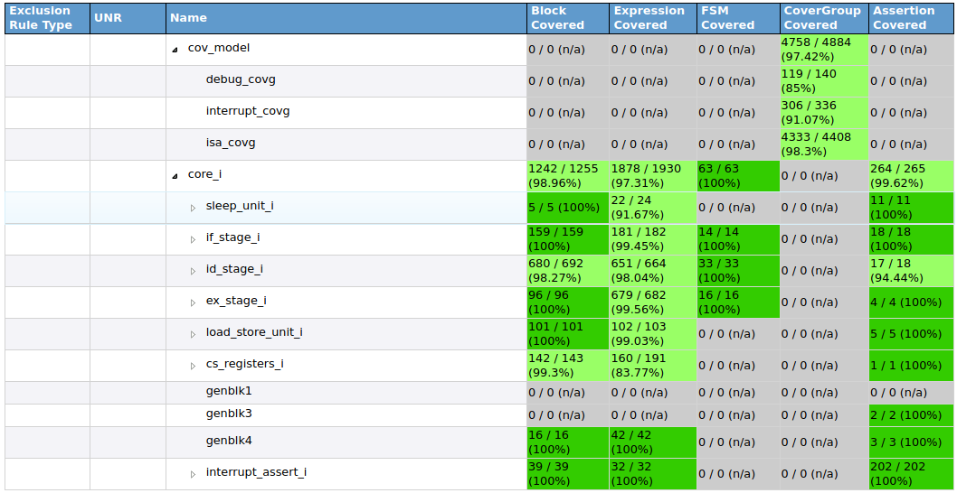
Coverage Data from 2020-10-23
Link to the latest coverage is here: https://github.com/openhwgroup/core-v-verif/blob/master/README.md

Slide 9
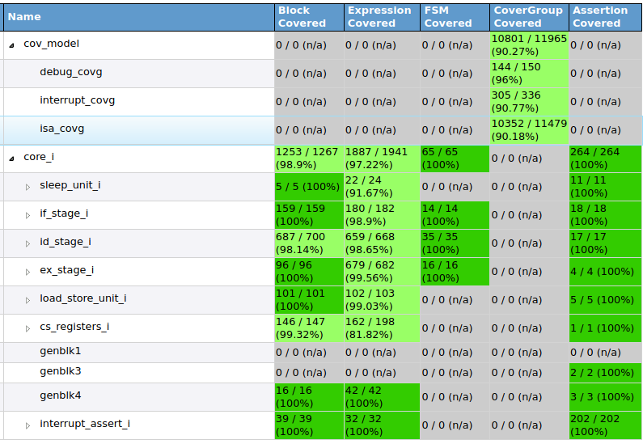
Coverage Data from 2020-11-03
Debug Fcov up by > 10%.
Interrupt Fcov flat over
previous week.
ISA Fcov down due
to new Cross: - all instr
followed by every other.
Assertion coverage now 100%.
Code coverage flat
over previous week.

Slide 10
Block Uncovered
cs_registers_i
Write to mcause
controller_i
Single step an ebreak instruction in debug mode
Single step an ebreak instruction when not in ebreak mode
Single step an ebreak instruction when not in ebreak when flushing pipe
Single-step a CSR status register
WFI/NOP when flushing
© OpenHW Group
May 2020
<number>

Slide 11
Expression Uncovered
sleep_unit_i
fetch_enable_i: Needs testbench fix (strichmo)
prefetch_controller_i:
“Defensive programming of misaligned branch”
Comments indicate this may not occur
May need exaggerated stalls
© OpenHW Group
May 2020
<number>

Slide 12
Expression Uncovered
controller_i:
Stall on FIRST_FETCH (exaggerated stalls)
Interrupt on FIRST_FETCH
Ecall in single-step
Ebreak in single-step
mret in debug mode
alu_i:
Add-round expression
mult_i
Short_round expression
© OpenHW Group
May 2020
<number>

Slide 13
Expression Uncovered
cs_registers_i
Writes to non-existent MHPMEVENT* registers
© OpenHW Group
May 2020
<number>

Slide 14
CoverGroup Uncovered
ISA
Note: Some discrepancies between Metrics/Xcelium
Shift values == 0
Some CSR instruction type (set,clear,write,imm) crossed with all CSRs
Loads using zero as source register
ISA Cross
85%, no refinement yet
© OpenHW Group
May 2020
<number>

Slide 15
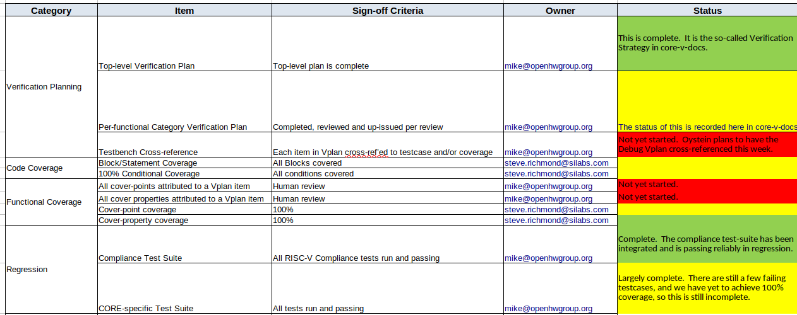
Simulation Verification Checklist

Slide 16
Formal Verification Checklist
OneSpin is working on annotation/cross-reference of formal Vplans:
Expect to commit the updates this week.
All assertions are holding with reachable witness.
There is a disclaimer on M-ext: achieving partial proofs instead of exhaustive proofs.

Slide 17
Thank You

