Slide 1


CV32E40P* Verification Schedule Status Sprint #6
Mike Thompson
www.openhwgroup.org
© OpenHW Group
November 16, 2020
1

Slide 2
Administravia
Attendance is now being tracked for all OpenHW Task Group meetings:
This meeting qualifies as an OpenHW Group Task Group meeting.
Eligibility to vote in each committee depends on meeting attendance, as described in the OpenHW bylaws.
CVA6 and FORCE-RISCV projects working towards formal Project Launch:
Reach out to Jérôme Quevremont (CVA6) or Jingliang (Leo) Wang (FORCE) to get involved.
“RTL Freeze” for CV32E40P:
If you haven’t already, please review the Checklist at: https://github.com/openhwgroup/core-v-docs/blob/master/program/milestones/Functional_RTL_Freeze_Criteria.xlsx

Slide 3
Pushing Toward “Functional RTL Freeze”
Recall from last week that this final sprint is “completion driven”, not “task driven”.
A major part of that is completing all items on the Checklist.
Jingliang (Leo) Wang of Futurewei has agreed to oversee the process of completing the Checklist:
Recall that Leo serves as co-chair of the Verification Task Group, along side Steve Richmond.
Each item in the Checklist will be assigned an owner.
Other Tracking Methods:
Completeness of Verification Plans (on core-v-verif)
GitHub Issues (Documentation, Design and Verification)
Coverage Reports (a static report is available on-line)

Slide 4
Verification Plans
Current status of simulation and Formal Vplans is provided at https://github.com/openhwgroup/core-v-docs/tree/master/verif/CV32E40P/
Current “holes” in the simulation Vplans:
Simulation Vplans:
Cross-referencing of Vplan items with specific coverage is ~75% complete.
OBI: Vplan reviewed and a set of assertions to cover it has been written (not yet integrated into environment).
Sleep Unit and Pipelines Vplans are not started(!)
Formal Vplans up to date.

Slide 5
Issues
CORE-V-DOCS:
1 Vplan issues:
#16 relates to Sleep Vplan
1 User Manual (new in the past week):
#261 “Add description about Core Versions and RTL Freeze”
Is #259 an issue for the ISA?
Others are related to PULP or FP ISA or the FPGA project and therefore not gating CV32E40P.
CORE-V-VERIF:
1 related to debug (see next slide)
2 have known resolution, just need the time to do it!
1 is a “task”
10 are “waived” (5 of these are labeled as “improvement” for future core-v-verif projects.
CV32E40P:
Mike is recommending that #270 (common manifest) should gate RTL Freeze.

Slide 6
Trending Issues
CV32E40P:
None!
CORE-V-DOCS:
None!
CORE-V-VERIF:
#331: “Step and compare fails if debug_req_i is asserted at the same time as a trigger match”
Øystein reports that test that found this issue is now passing
Do we know that debug_req_i and trigger match are still coincident in the test?

Slide 7
MetricsCI Regression Failures
debug_test_boot_set:
Testcase fails because “DUT WRAPPER virtual peripheral signaled exit_value=1”
This test seems like an orphan… is it related to issue #331?
debug_test_trigger:
Is this test sensitive to the GCC version in the toolchain?

Slide 8
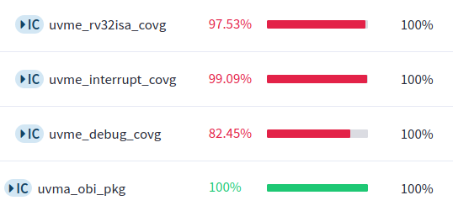
MetricsCI Functional Coverage Summary
Single run of regression “cv32_full_coverage_no_pulp “ run on RTL hash ‘’9d22d0f”:

Slide 9
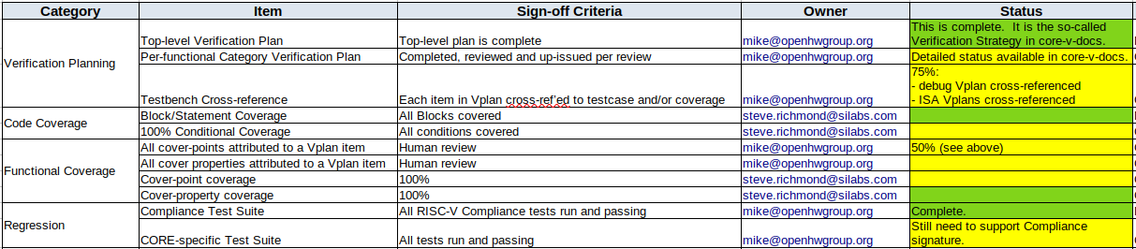
Simulation Verification Checklist

Slide 10
Thank You

